Slide 1
A VISUAL GUIDE
Crystal Graph Neural Networks
Predicting elastic moduli directly from crystal structure — a from-scratch reproduction of PINK
CIF
Crystal graph
CGCNN
K and G
κₗ
→
→
→
→
Aizaz Khalid · reproduction of PINK (J. Mater. Inf. 2025, 5, 12)

Slide 2
01 · MOTIVATION
Why predict elastic moduli?
The bottleneck
Why they matter here
Elastic moduli come from DFT calculations costing hours to days of compute per material.
Only ~11,000 of the Materials Project's ~150,000 entries have them.
Screening a large candidate space by DFT is simply not affordable.
PINK screens for materials with ultralow lattice thermal conductivity κₗ.
Its physics stage needs bulk modulus K and shear modulus G as inputs.
A network that predicts K and G in milliseconds turns an impossible screen into a routine one.
A CIF says where the atoms are. It does not say how stiff the crystal is — that is what we are learning.

Slide 3
02 · THE PIPELINE
Where this work fits in PINK
CIF
CGCNN
Slack model
κₗ
→
→
→
crystal structure
predicts K and G
physics, not learned
lattice thermal conductivity
The elastic moduli are the ONLY learned quantity. Everything downstream is physics.
This project implements the first arrow — CIF → (K, G) — including the network itself, written from scratch rather than forked. It produces the (K, G) table the κₗ stage consumes.
Scope: the machine-learning half of PINK, reproduced independently.

Slide 4
03 · REPRESENTATION
A crystal becomes a graph
A neural network cannot read a .cif file. So we translate:
Nodes = atoms
Edges = bonds
Edge features
Each atom carries a fixed 92-dimensional vector of element properties: group, period, electronegativity, covalent radius, valence electrons.
The 12 nearest neighbours within 8 Å. The search respects periodic boundaries, so atoms at a cell face see their periodic images.
Each bond length is expanded onto 41 Gaussian basis functions rather than fed in as one raw number.
Why this representation generalises
The graph stores only distances between atoms, never absolute positions — so it is invariant to translation, rotation and the choice of unit cell. The same crystal written two different ways produces the same graph.

Slide 5
04 · EDGE FEATURES
Why bond lengths are expanded
eₖ(d) = exp( −(d − μₖ)² / σ² ) μₖ = 0, 0.2, … 8 Å σ = 0.2 Å
The problem with a raw number
What the expansion buys
A single scalar distance forces the network to learn a sharply non-linear response to it from scratch — a hard thing to fit and slow to converge.
A bond at 2.31 Å strongly activates the basis functions centred near 2.3 and barely touches the one at 5.0. The distance dependence becomes a smooth, nearly linear read-out — far easier to learn.
This is a radial basis expansion — the same trick used throughout atomistic machine learning.

Slide 6
05 · THE NETWORK
Gated graph convolution
Message passing updates each atom's vector using its neighbours. For atom i with neighbours j:
zᵢⱼ = vᵢ ⊕ vⱼ ⊕ eᵢⱼ
vᵢ ← vᵢ + Σⱼ σ(zᵢⱼ W_f + b_f) ⊙ g(zᵢⱼ W_s + b_s)
The gate σ(·)
Shared weights
The residual vᵢ +
Decides, per bond, how much that neighbour contributes. A weak long bond can be ignored without being discarded.
The same linear layer processes every edge. That is what makes this a convolution, and why it generalises across crystal sizes.
Gradients flow straight through the stack, so early layers are not washed out by later ones.
Three convolution layers, so every atom sees its environment out to roughly three bond hops.

Slide 7
06 · POOLING & TARGET
Two decisions that matter more than they look
Mean-pool, never sum
Train on log₁₀(modulus)
v_c = (1/N) Σᵢ vᵢ
moduli span 1 – 575 GPa
A modulus is an INTENSIVE property. Doubling the unit cell must not double the prediction — but a sum would make the output scale with however many atoms the CIF author happened to write down.
Under a plain MSE on raw values, a 40 GPa error on a stiff crystal produces 100× more gradient than the same RELATIVE error on a soft one — so the model would learn to care only about hard materials.
Exactly the wrong bias for this project
PINK screens for ULTRALOW thermal conductivity — the soft, compliant end of the range. Taking the logarithm converts “within a factor of x” into “within a fixed distance”, so soft and stiff crystals carry equal weight.
Normalisation statistics come from the training split only — using all the data would leak the test set.

Slide 8
07 · THE DATA
What to train on
1,213 CIFs
10,987 matbench crystals
Materials Project structures, and NO labels at all. These are the PREDICTION set.
DFT-computed K and G — the same benchmark the paper trained on. This is the TRAINING set.
Only 278 of the 1,213 appear in matbench — so it is tempting to label those and train on them.
The structures were never the limit — the LABELS were
Intersecting an unlabelled collection with a labelled benchmark discards 97% of the labels that exist. Invert the roles: train on all 10,987 matbench crystals, and treat the 1,213 CIFs purely as a prediction set. That is 40× more data — and it is what the paper does.
When labels are the scarce resource, never let an unlabelled collection define your training set.

Slide 9
08 · ENSEMBLING
Three models, averaged
Two networks trained on the same data from different random initialisations land in different minima. They AGREE about the signal and DISAGREE about their own noise — so averaging keeps the first and partially cancels the second.
Average in log space
Members share one split
Free uncertainty
Members predicting 10 and 1000 GPa average to 100 GPa in log space but 505 GPa linearly. 100 is the defensible answer.
--seed varies initialisation; --split-seed is PINNED. Otherwise the ensemble is scored partly on data some members trained on.
The spread between members is a per-crystal confidence estimate — where they disagree, the ensemble is guessing.
The code refuses to combine members whose test splits disagree, rather than trusting the caller to have got it right.

Slide 10
09 · RESULTS
Model performance
Model
MAE log₁₀(GPa)
R²
MAE (GPa)
Rel. error
Bulk, single model
0.0696
0.882
11.54
17.4%
Bulk, 3-model ensemble
0.0630
0.901
10.20
15.6%
Shear, single model
0.0836
0.889
7.71
21.2%
Shear, 3-model ensemble
0.0781
0.899
7.27
19.7%
Measured on 1,648 held-out crystals. All models share one train/validation/test split, so every row is directly comparable.
No overfitting
Ensembling gain
Train 0.032 vs test 0.063 — ordinary generalisation error, not recall.
9% of the bulk error removed by averaging three initialisations.

Slide 11
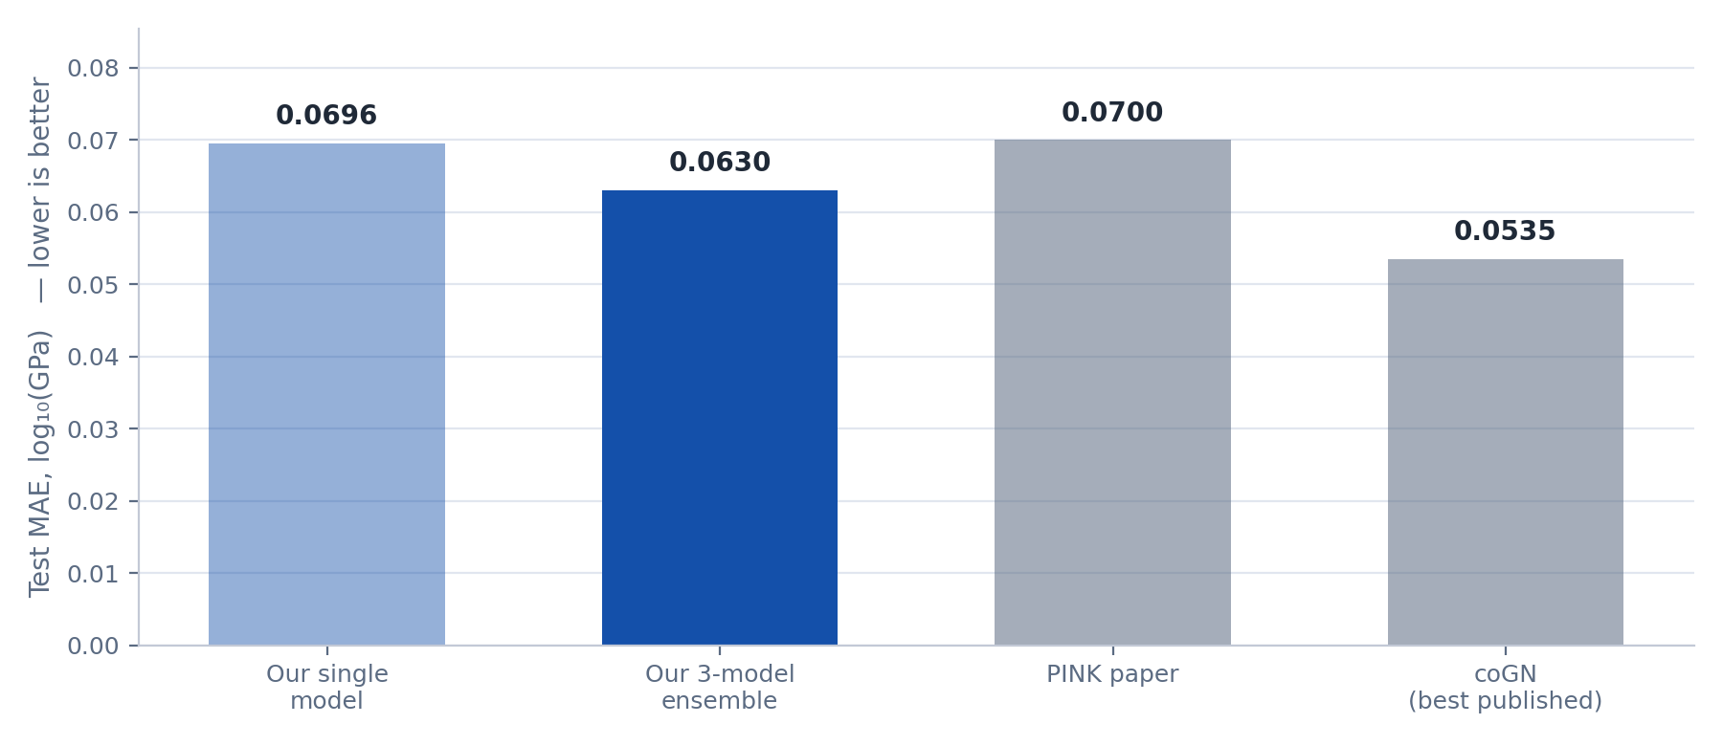
10 · RESULTS
How we compare to the literature
Reading this
Our bulk ensemble slightly BEATS the paper it reproduces.
It sits between PINK and coGN — the best result ever published on this benchmark, with any architecture.
Same architecture, same data as the paper. The gains come from ensembling and the cosine schedule.
Reproduction target met: 0.0630 against the paper's ≈0.070.

Slide 12
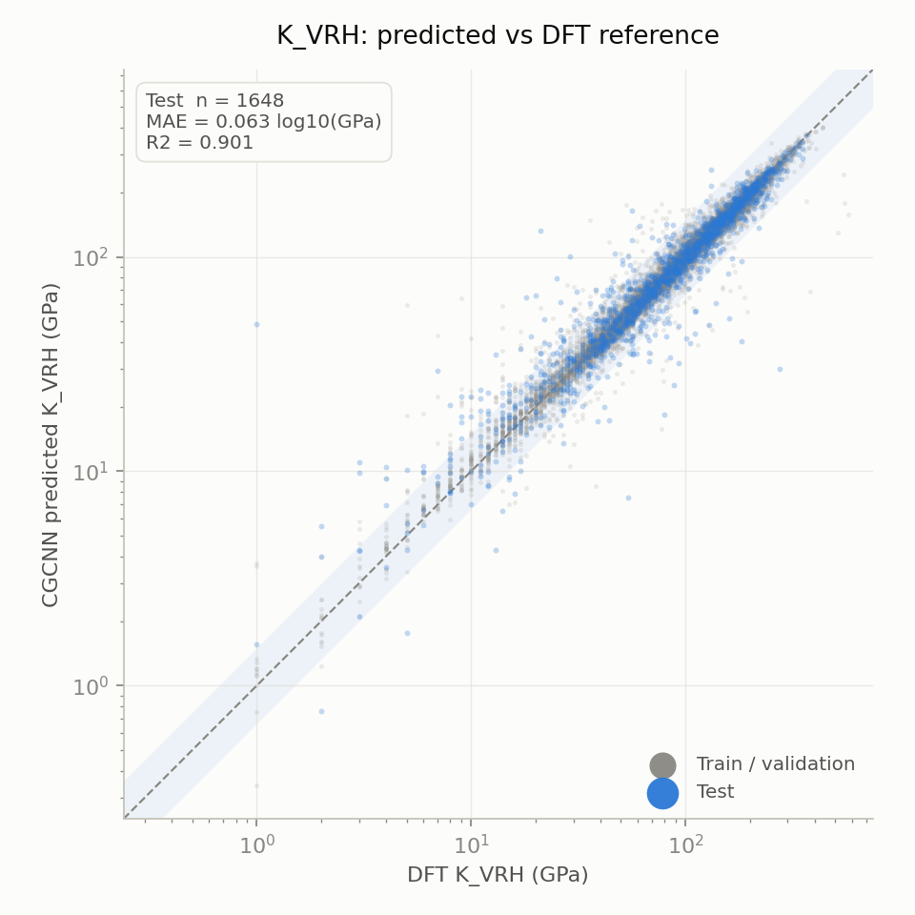
11 · RESULTS
Predicted vs DFT — bulk modulus
How to read a parity plot
Every point is one crystal: DFT value on x, our prediction on y. A perfect model puts every point on the diagonal.
Points ABOVE the line are over-predictions; BELOW are under-predictions.
The shaded band marks “within a factor of 1.5” — a useful screening tolerance, where getting the RANKING right matters more than the absolute value.
Blue = the 1,648 held-out test crystals. Grey = the training cloud, shown for context only.
R² = 0.901 — the model explains 90% of the variance.

Slide 13
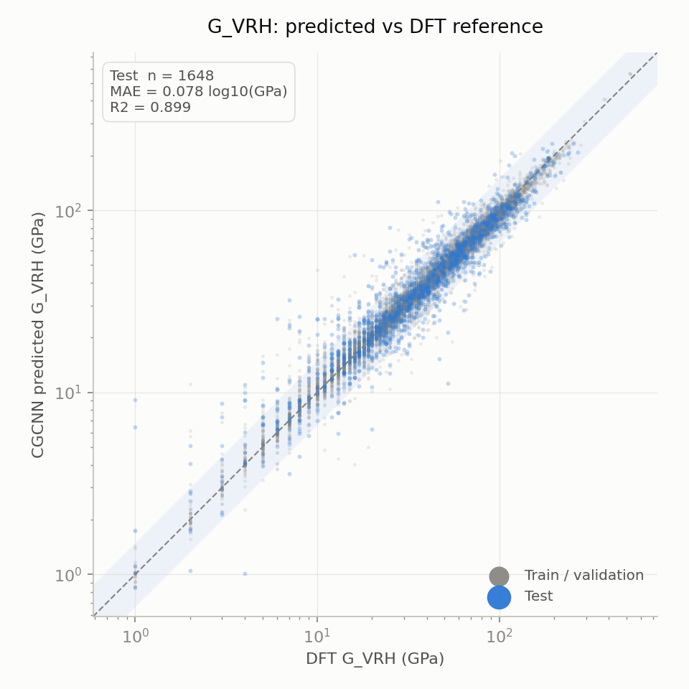
12 · RESULTS
Predicted vs DFT — shear modulus
Shear is the harder target
MAE 0.0781 against 0.0630 for bulk — consistently worse, and for a physical reason.
Bulk modulus resists uniform compression, which is dominated by average bond stiffness — close to what a graph network reads off directly.
Shear modulus resists shape change, which depends on bond DIRECTIONALITY and on anisotropy the representation captures less directly.
The same ordering appears in the paper and across the matbench leaderboard — it is a property of the task, not of our implementation.

Slide 14
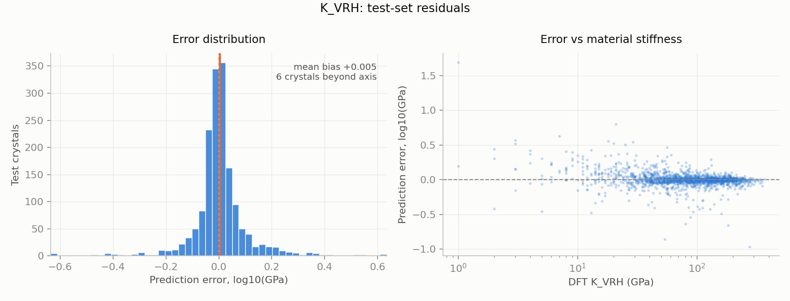
13 · RESULTS
Where the errors live
Left: unbiased
Right: the honest weakness
The error distribution is centred on zero — the model does not systematically over- or under-predict.
Errors fan out below ~30 GPa. The model is least reliable on soft materials — precisely the ultralow-κ regime PINK targets.

Slide 15
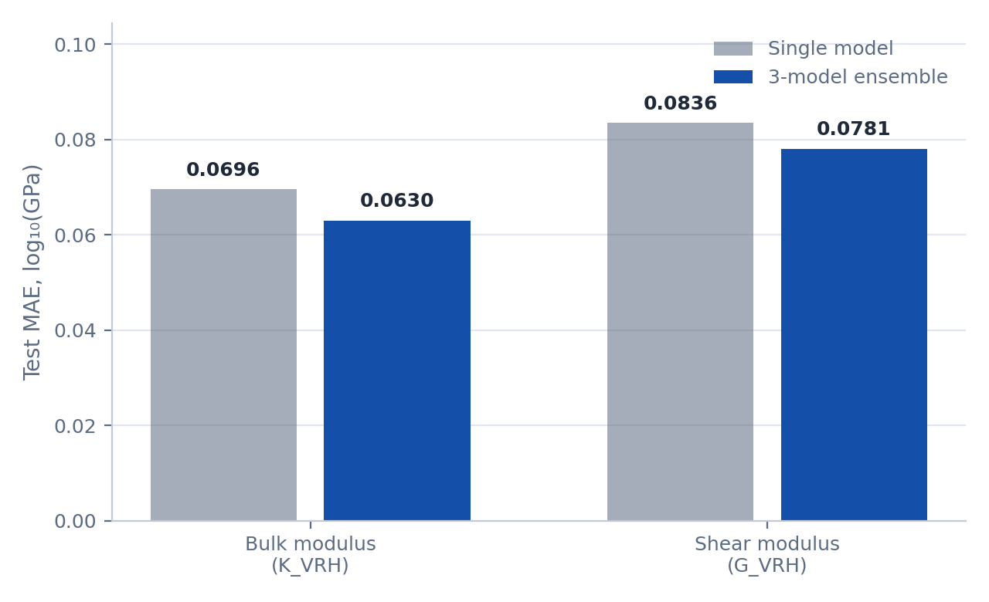
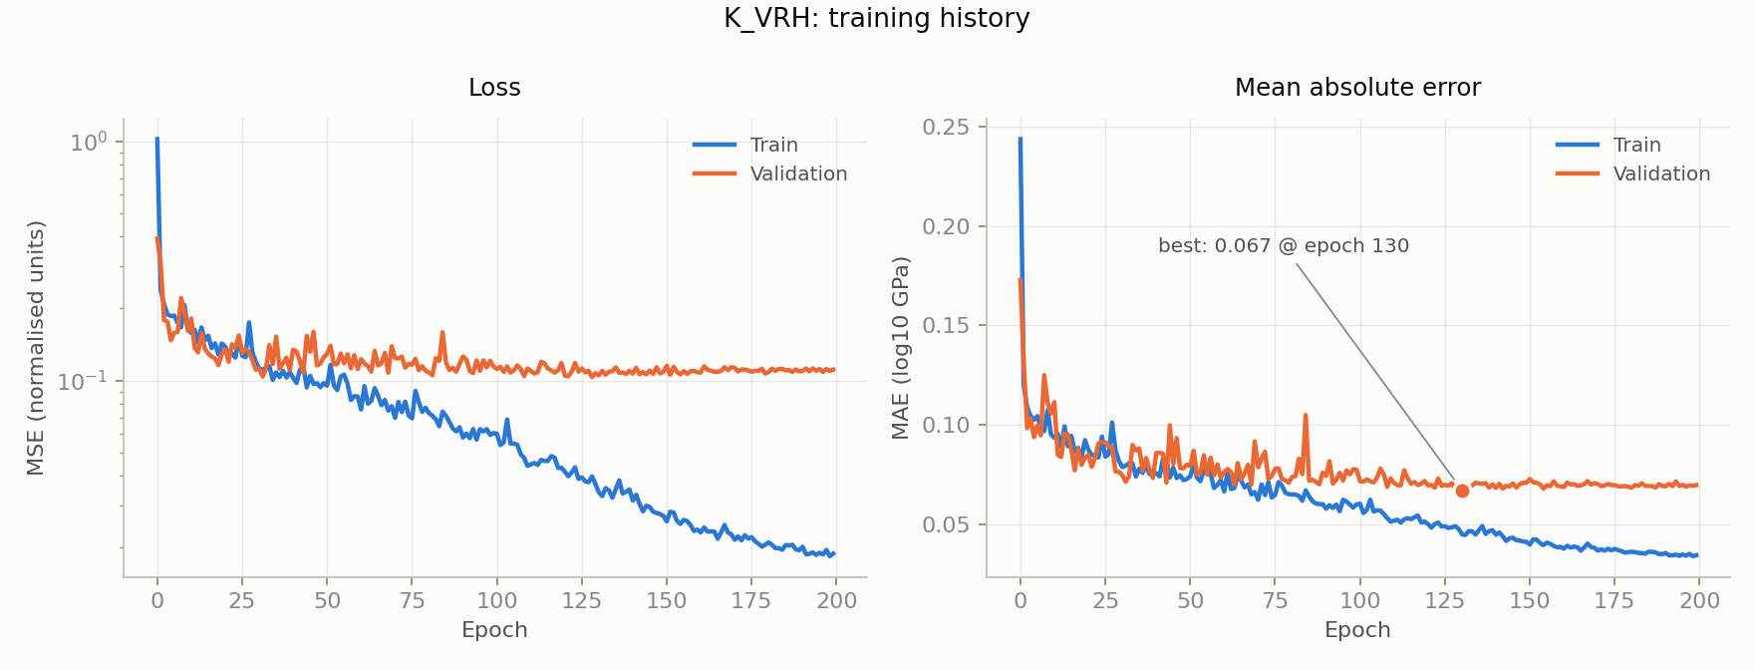
14 · RESULTS
Ensembling, and how it trains
Averaging three initialisations
Training curves
Consistent gains on both targets — about 9–10% of the error, in line with the 10–15% typically expected.
Cosine annealing over 200 epochs. Train and validation stay close together throughout — no divergence, so no overfitting.

Slide 16
15 · HONESTY
How low can the error go?
Because the model is trained on log₁₀, MAE converts to a MULTIPLICATIVE error of 10^MAE − 1.
MAE 0.0630 → within a factor of 1.156 → 15.6% typical error
A ~2% relative error is NOT reachable on this task — by anyone
2% would need MAE = 0.0086, about six times better than the best result ever published on this benchmark with any architecture.
The blocker is not model capacity — it is LABEL NOISE. The targets are DFT-computed elastic moduli, and DFT elastic constants themselves disagree with experiment by roughly 5–15%.
A model cannot be more accurate than the labels it is fitted to. A model reporting 2% here would be revealing a leak, not an achievement.
Realistic floor for this architecture: ≈0.06 log₁₀, about 15%. We are at 0.0630.

Slide 17
16 · CONTRIBUTION
What we did differently from the paper
Written from scratch
1
Graph construction, convolution, pooling and training loop are our own implementation — not a fork. No pre-trained weights are ever loaded.
Ensembles, not single models
2
Three initialisations per target, averaged in log space. Worth ~9–10% of the error, and it supplies a per-crystal uncertainty the paper has no equivalent of.
Adam with cosine annealing
3
Rather than the original CGCNN's SGD with step decay. On a fixed epoch budget a scheduled decay beats a reactive one.
Provenance on every prediction
4
Each row records whether the model was trained on that crystal. Without it, accuracy claims on a screening set cannot be interpreted — part of the apparent accuracy may be recall.
A documented error floor
5
We state what accuracy is achievable and why, and report both the multiplicative and range-normalised errors rather than whichever flatters more.
Deliberately identical: the architecture, the training data, the log target, the split ratio. In a reproduction, differences should be few and intentional.

Slide 18
17 · DELIVERABLE
What this produces
results/pink_moduli_predictions.csv
Bulk and shear modulus for all 1,213 crystals — with Pugh ratio, DFT reference where one exists, per-crystal ensemble uncertainty, and a provenance tag. This is the input the κₗ stage consumes.
935
278
42
crystals genuinely unseen
in matbench, so tagged as recall
in the held-out test split
A built-in correctness check
On the 42 test-provenance crystals the error is 0.062 — matching the benchmark test error. Had the provenance mapping been wrong, we would have seen the much lower training-set error instead.
Next: feed these moduli into the Slack model, and propagate the uncertainties through to κₗ — something the original pipeline cannot do.

Slide 19
18 · REPRODUCIBILITY
Run it yourself
conda env create -f environment.yml && conda activate pink-cgcnn
./run_pipeline.sh --predict # ~2 min, no training
./run_pipeline.sh # retrain: ~45 min GPU
Checkpoints committed
~45 min on a GPU
Numbers never hand-copied
All six models (~380 KB each) are in the repository, so every figure and number regenerates in two minutes without training.
Colab notebook included. On the 2016 laptop this was developed on, the same work takes about nine hours.
This deck, RESULTS.md and the metrics table are all generated from the same CSV the pipeline writes.
Full write-up in docs/method.pdf · github.com/ikhalid-dev/cgcnn-project
Reproduction target met: bulk MAE 0.0630 vs the paper's ≈0.070, on the paper's own benchmark.

