Slide 1
Walchand college of engineering, Sangli
Project in C Graphics
“Sharp Shooter”

Slide 2

Group member’s:-
Hrushikesh S. Gadakh(2013BIT218)
Vitthal V. Sarode (2013BIT217)
Sachin P. Gaikwad (2013BIT214)

Slide 3
Front End:
C(Graphics):-
Suitable for objects in game.
Easier to handle.
code becomes compressed and easy to learn for beginners.
Sufficient UI can be provided without having knowledge of oo features.

Slide 4
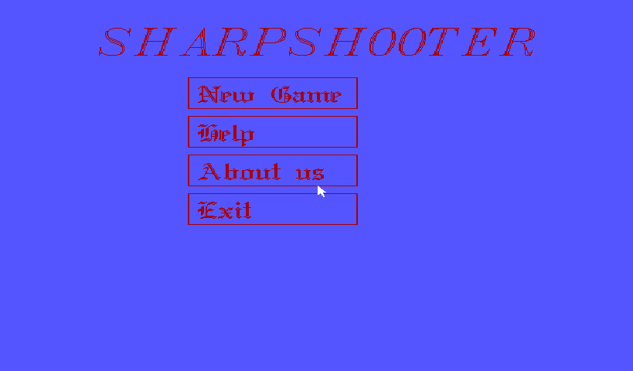
Snapshot

Slide 5
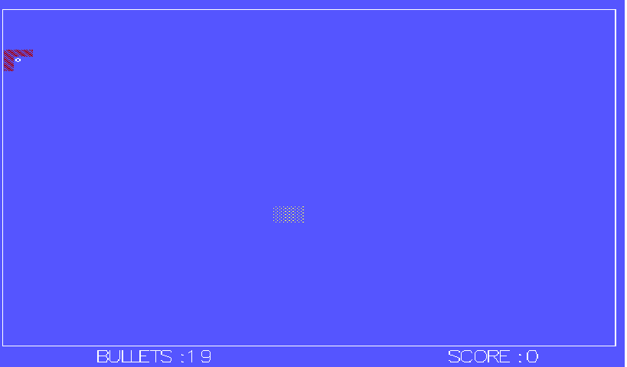

Slide 6
Rules for game:-
One gun will be provided with certain no. of bullets.
A target will blink and move over the screen.
The shooter have to shoot the target correctly.
For each bullet the score will incremented in the multiple of 5.

Slide 7
What we have done
We have cleared our ideas about the required GUI and set a step towards actual code.
We have created the front end of the GUI and the objects such as gun and the target is done.
We have implemented three levels of the game.
Each of the level will be more difficult than previous one.
The bullet in each level is decreased and score to utilize is increased.
At the time of hit the sound will be produce.

Slide 8


