Slide 1
HR ANALYSIS
Project: To Find Attrition on the basis of different criteria

Slide 2
Task Performed
Import Data
Transform the Data (Null values, Duplicate values)
Draw the Chart
Making the Interactive Dashboard

Slide 3
Key performance indicators (KPI)
Overall Emp = Total No. of employees in the company
Attrition = Total No. of employees who had left the company
Attrition Rate = Total Attrition/Total employees
Average Age = Average age of the employees in the company
Average Salary = Average age of the employees in the company
Years at Company = How many years employee will work

Slide 4
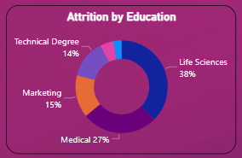
Attrition by Education
Represents the educational background of those employees who had left the job
Emp. from life science background are maximum who had left the job
Emp. from Technical Degree are minimum who had left the job

Slide 5
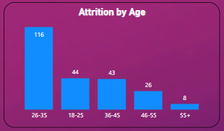
Attrition by age
Represents the age slab of those employees who left the company
Emp. from age slab 26-35 are maximum are in maximum no. i.e. 116
Emp. from age above 55 are minimum no. i.e. 8

Slide 6
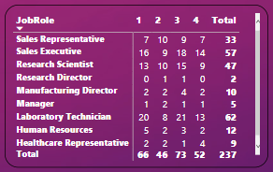
Satisfaction rating
Represents the score given by those emp. who left the company from different department

Slide 7
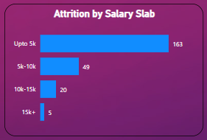
Attrition by salary slab
Represents that how many emp left the company on the basis of different salary slab
As you can see maximum emp who had left the job are came from up to 5k slab which less than average salary of company i.e. 163
minimum emp who had left the job are came from above 15k slab i.e. 5

Slide 8
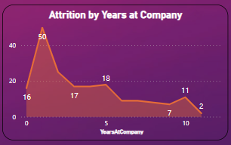
Attrition by years at company
Represents emp spend how many years at company
As you can see maximum emp. left the company are within 1st or 2nd year at company
As emp. Spend more years at company then there chances of left the company is decreased

Slide 9
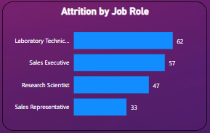
Attrition by job role
Represents no. of employees by different job role who had left the job
As you can see that emp. from Lab Tech. role are in highest no. to left the job
Company to pay attention to lab department and provide incentive and other benefits to stop them to leave the company

Slide 10
Steps
Talk to emp. of particular department and take feedback at regular interval of time
Improves the hiring process
Improves the employees experience

Slide 11
Project Learning
Create interactive dashboard to track and analyze online sales data.
Customization by using Filters and Slicers
Create connection, join tables
Use different types of charts like Bar chart, Pie chart, Donut chart

Slide 12


