Slide 1
RETAIL ANALYSIS
Project: E Commerce company working on optimizing the app

Slide 2
Strategy
3 tables
Login logs table Users Behaviour
Sale Order Marketing Efficiency
Sales Order Item Product Performance

Slide 3
Team Members
Deepak Kumar
Satyam Kumar
Dileep Kumar Verma
Suraj Kumar
Khushbu Kumari

Slide 4
Daily logins
Insights
On Every Sunday, no. of users login declines
Increase in no. of users in 2022 as compared to 2021

Slide 5
Conversion Rate
Insights
Conversion Rate = Daily Orders Placed/Daily Login Count
Conversion Rate of 2021=2.13%
Conversion Rate of 2022=1.92%
Login increased in 2022 but no. of orders has decreased
Users not satisfied with products

Slide 6
KPI
Retention rate = 33.19%
Churn Rate = 66.80%
Conversion Rate of 2022=1.92%
80% Revenue = 4% Users
Active Users = 15%

Slide 7
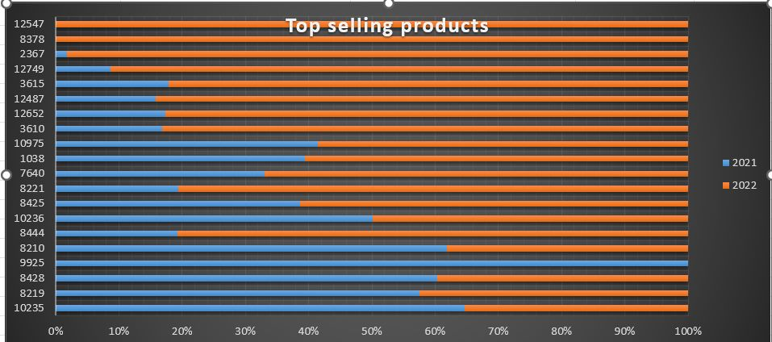
Top Selling Products
Insights
10235 was top selling product 2021 but could not perform well 2022
Newly launched product 12547 was top selling product in 2022
Under performing products of 2021 performed well in 2022
Top performer in 2021 couldn’t perform well in 2022
Productid (9925) is discontinued

Slide 8
Login Frequency & No. of Orders
Insights
Login frequency & Order placed both decline on every Sunday
In 2022 Login frequency increased as well as no. of order placed increased
No. of Order is directly proportional to Login frequency

Slide 9
Order Trend
Insights
No. of Order placed decline on every Sunday
From 2nd and 3rd week no. of order placed in 2022 is greater than 2021

Slide 10
Challenges/Learning
Difficult to draw the chart from the give table but overcome that problem after trying different charts
Learn how to work in a team
Draw the insights from the data
understanding kpi’s

Slide 11


