Slide 1
PS 26083
Extreme Heatwave Early Warning &
Human Thermal Stress Index
Team TechForge · Ministry of Earth Sciences (MoES) / NCMRWF · Theme: Disaster Management
Traditional heat warnings tell us how hot it will be.
We translate that into what the weather will do to human health.

Slide 2
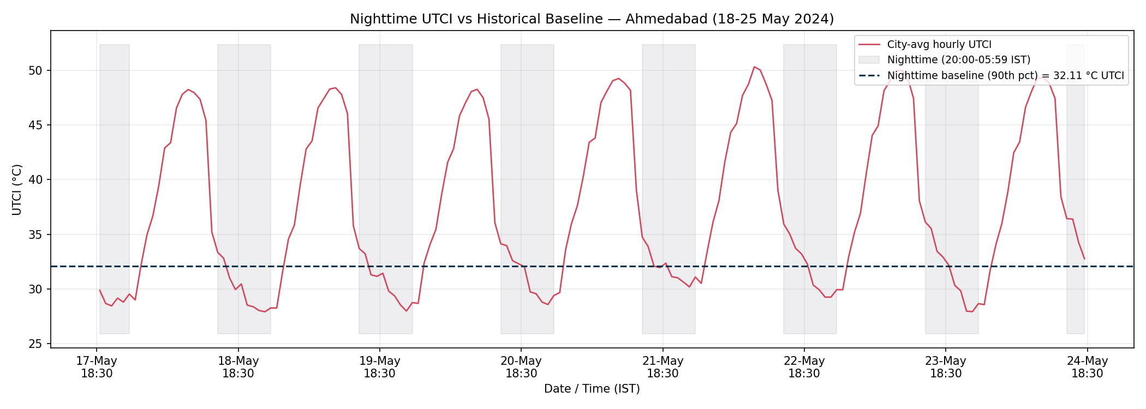
What Existing Heat Warnings Miss
🟢 DEMONSTRATED
Dry-bulb temperature only
40°C at 20% humidity feels nothing like 40°C at 70% humidity — the latter compounds toward fatal.
No humidity, wind, or radiation
These physically change how much heat the human body actually absorbs and can shed.
No nighttime accounting
Bodies need cool nights to recover. Persistent hot nights across a heatwave are invisible to daily alerts.
Real example: nighttime UTCI staying above the historical baseline
for 8 straight nights during May 2024 — invisible to daily alerts.
No cumulative burden
A single hot day is treated the same as day 5 of an unbroken heatwave — health risk is not the same.
City-wide, not hyper-local
One alert for the whole city hides which specific wards are most exposed and least equipped to cope.

Slide 3
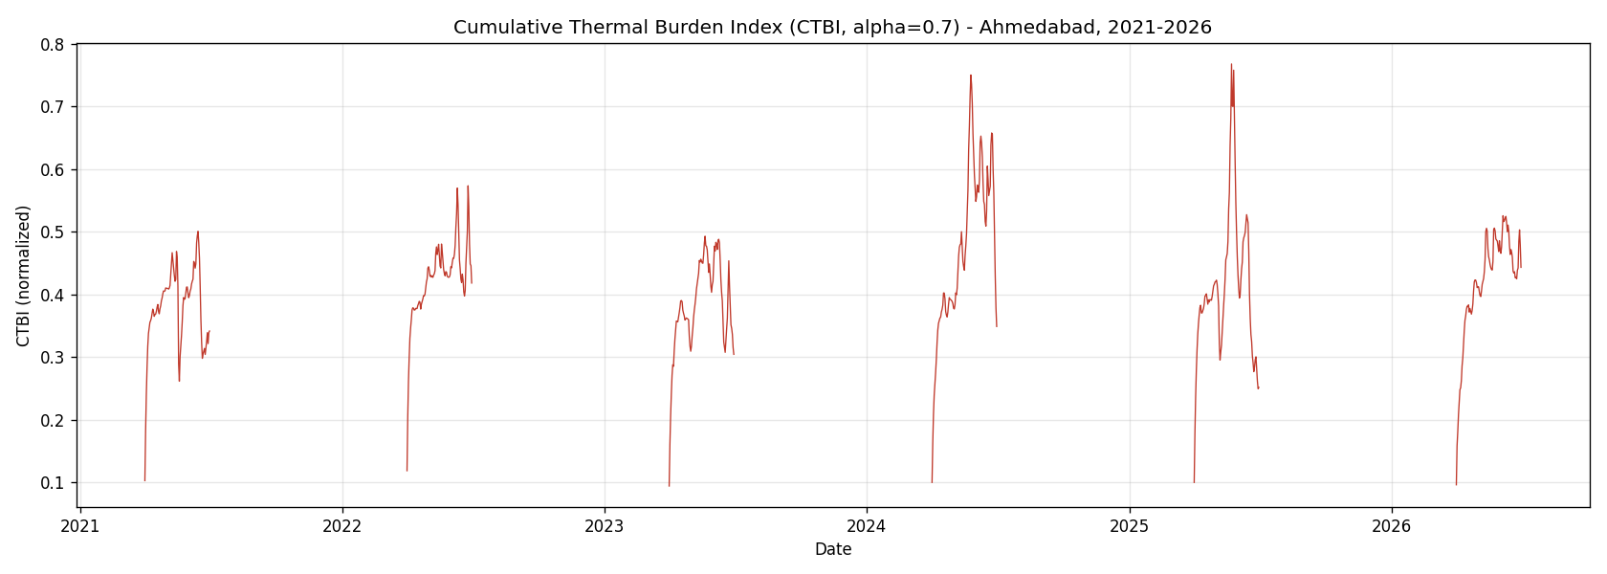
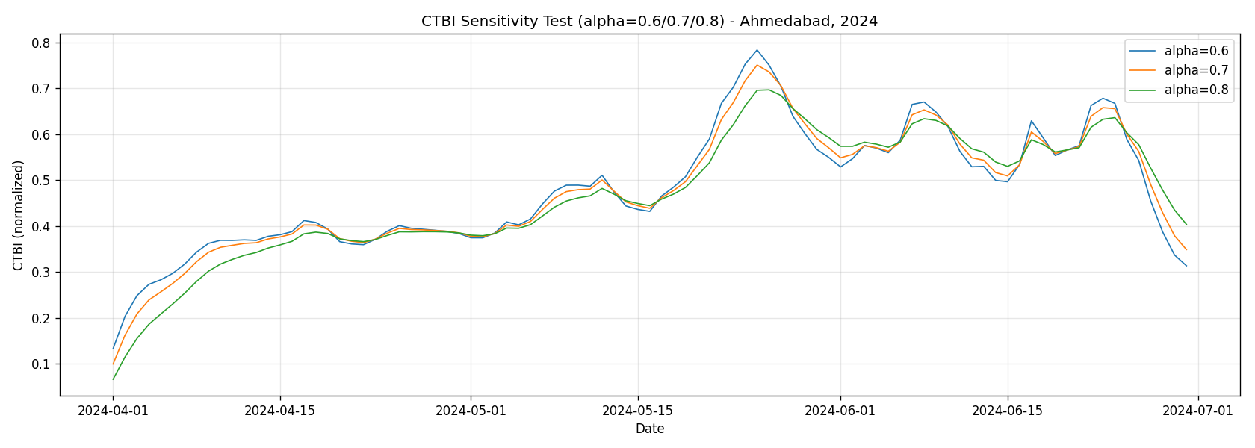
Core Innovation — NCTL + CTBI
🟢 DEMONSTRATED
NCTL — Nighttime Cumulative Thermal Load
Sum of nighttime UTCI above the local historical 90th-percentile baseline — degree-hours of unrecovered heat, every night.
CTBI — Cumulative Thermal Burden Index
CTBI(t) = α·CTBI(t−1) + β·DayStress_norm(t) + γ·NCTL_norm(t) — multi-day heat memory, not a single-day snapshot.
"They operationalize persistent nighttime thermal load and cumulative thermal burden — moving from prediction to intervention priority."

Slide 4
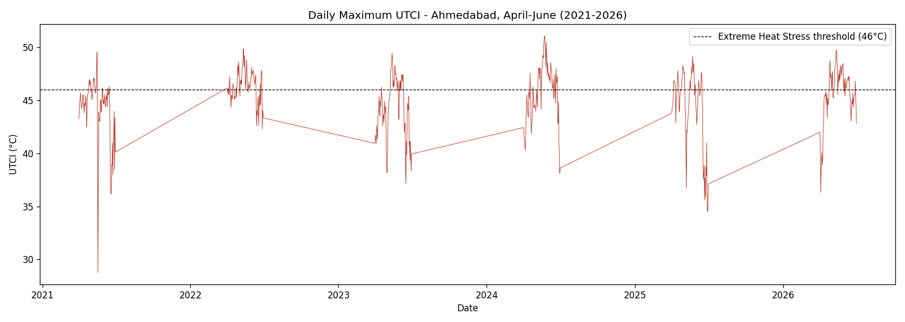
Methodology — Weather to Priority
🟢 DEMONSTRATED
ERA5
(Copernicus)
→
RH + MRT
estimation
→
UTCI
(pythermalcomfort)
→
DayStress +
NCTL
→
CTBI
(multi-day)
→
Ward spatial
join (48)
→
Vulnerability +
response capacity
→
Priority +
Actions
Tech stack
Python · xarray, pandas, GeoPandas · pythermalcomfort (UTCI) · Streamlit + Plotly · Google Earth Engine (WorldPop, Sentinel-2) · GitHub
Critical path (never cut)
ERA5 → UTCI → NCTL → CTBI → Spatial → Priority → Action → Dashboard. Everything else is enhancement.

Slide 5
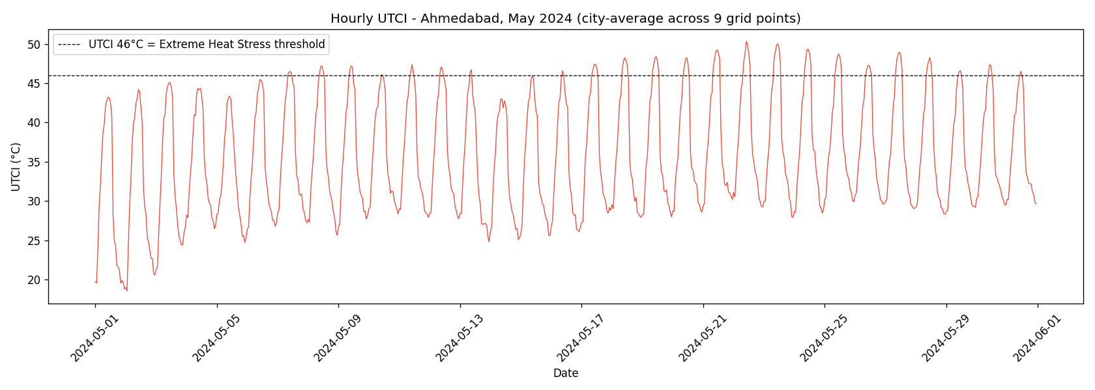
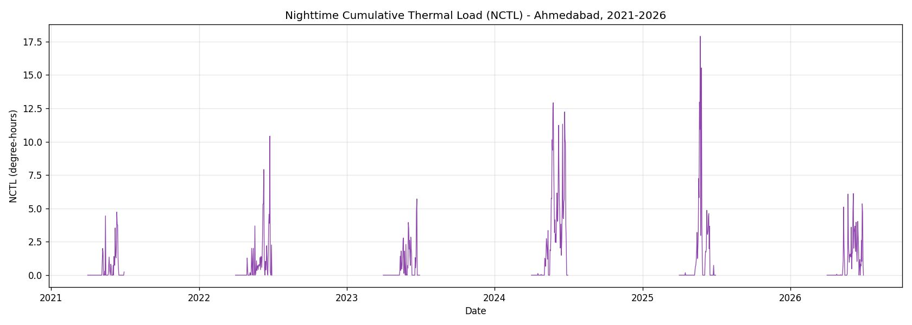
🔥 Real Proof of Work
🟢 DEMONSTRATED
Real ERA5 data → real UTCI → real NCTL → real CTBI. Six full heatwave seasons, 2021–2026.
Independent sanity check (Khushi, Day 3): CTBI rises to peak and declines after in all 6 seasons; season's max NCTL correlates with peak CTBI at r = 0.944.

Slide 6
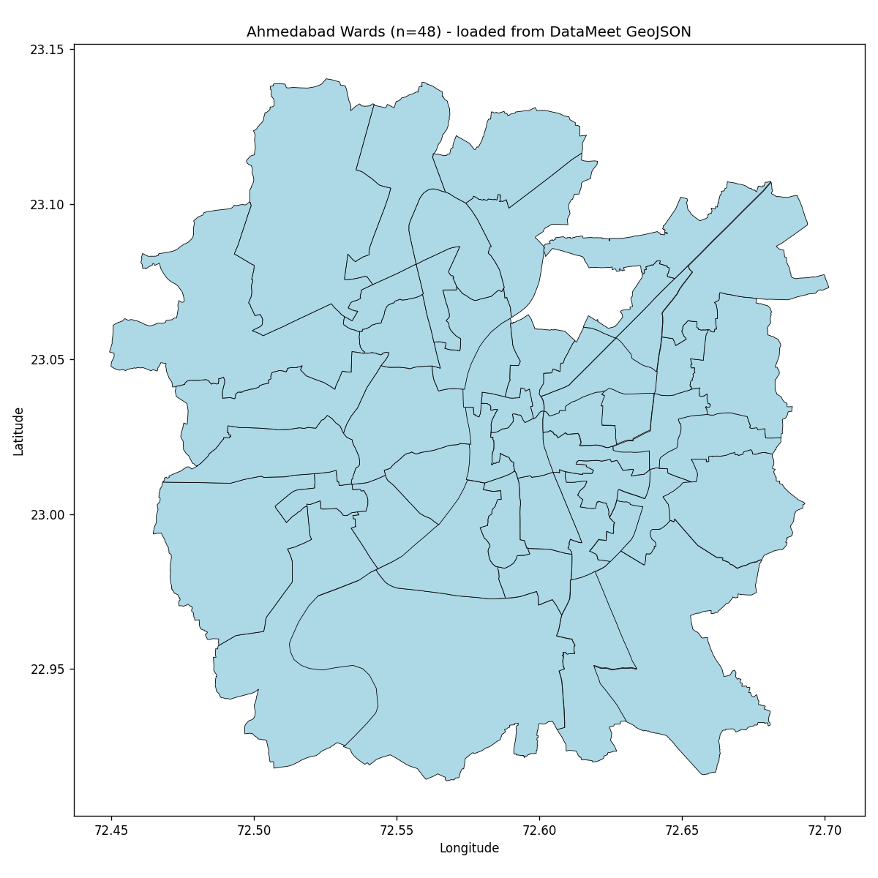
Ward-Level Intelligence
🟢 DEMONSTRATED
48 real AMC ward boundaries (post-2021 delimitation), loaded via GeoPandas.
ERA5 grid points spatially joined to ward centroids (nearest-grid-point method — documented, not exact interpolation).
Vulnerability: WorldPop 100m population density + Sentinel-2 NDVI, aggregated per ward — chosen after 2011 Census ward boundaries were found incompatible with current wards (no official crosswalk exists).
Sanity-checked: total estimated population 60.9 lakh vs Ahmedabad's actual ~63–65 lakh.

Slide 7
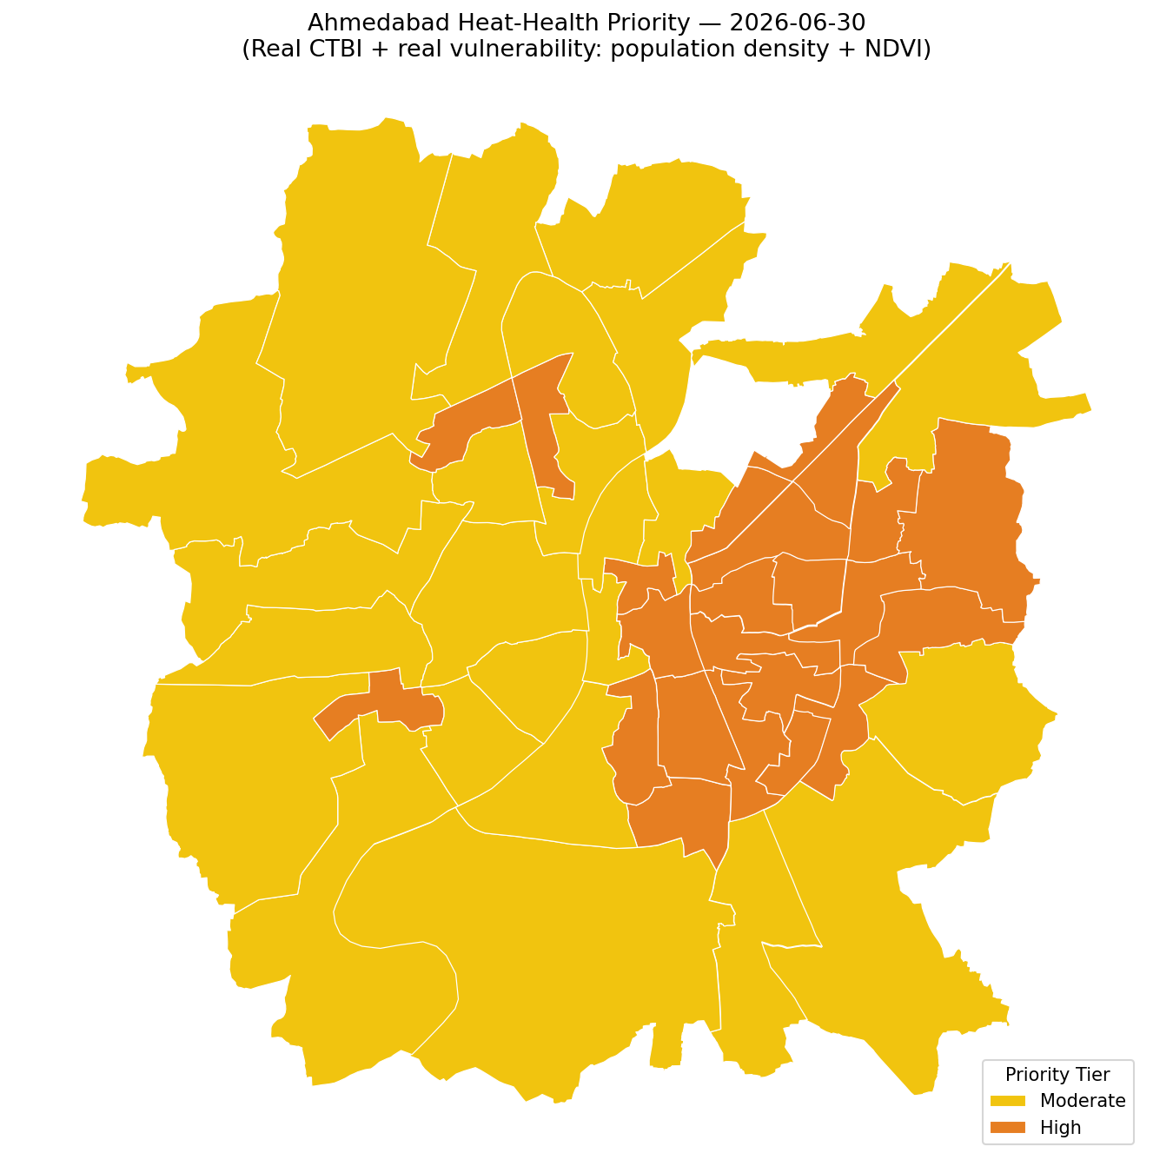
Heat-Health Priority — Transparent Rubric
🟡 PROTOTYPE
High thermal burden + High vulnerability + Low response capacity = CRITICAL
Rule-based, not machine-learned — every threshold is documented in the Decision Log, not invented live.
Currently: 23 High-priority wards, 25 Moderate — a real, spatially-varying split from real CTBI + real vulnerability (population density, green cover).
Honest cap: CRITICAL is never shown yet. Response capacity (healthcare access) isn't built — the rubric shows "HIGH (partial — response capacity pending)" rather than fabricate the third factor.
Q&A-ready answer: "We use an interpretable rule-based proxy because ward-level mortality/hospitalization labels aren't publicly available. We did not fabricate training labels."

Slide 8
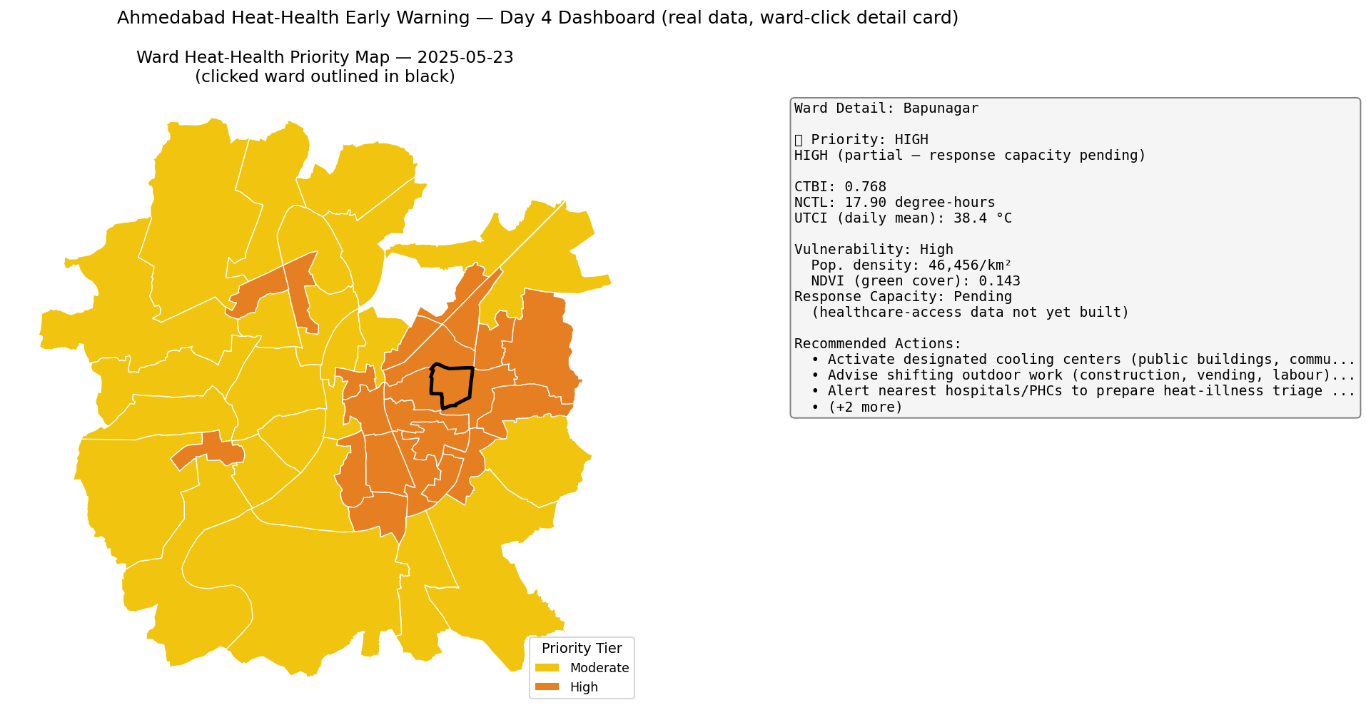
Dashboard — Working Prototype
🟡 PROTOTYPE

Slide 9
Predict → Explain → Prioritize → Act
Predict
Explain
Prioritize
Act
UTCI / NCTL / CTBI
from real ERA5 data
→
Which ward, why —
CTBI + vulnerability drivers
→
Rule-based priority
(Low/Moderate/High)
→
HAP-grounded action
recommendations
🟢 DEMONSTRATED
🟢 DEMONSTRATED
🟡 PROTOTYPE
🟡 PROTOTYPE
🔵 FUTURE — Phase 2
Historical health outcomes (hospitalization/mortality) + this same feature set → XGBoost/baseline models → SHAP explainability → calibrated 3–5 day health-impact warning. Requires institutional data we cannot honestly manufacture today.

Slide 10
Impact, Validation & Scale
Who uses this
What we can confidently claim
Municipal corporations (AMC and beyond) · Disaster management authorities · NCMRWF / IMD forecasting integration · Public health departments
"An operational prototype that transforms hourly meteorological data into human thermal stress, quantifies persistent nighttime thermal load, accumulates that burden over multiple days, and maps it spatially for heat-health prioritization."
Validation plan (once real labels exist)
AUROC, F1, Recall, and calibration curves against real hospitalization/mortality records — not claimed today, planned for Phase 2 once institutional data access is granted.
What we do not claim
✗ Mortality prediction with X% accuracy
✗ Clinically validated recovery index
✗ Ward-level ERA5 (it's ~25km, spatially joined honestly)
✗ "Scientifically correct" α = 0.7 (chosen, sensitivity-tested)
✗ Real SHAP (none run — future work only)
Scale path
One city (Ahmedabad, prototype) → other Heat Action Plan cities with similar data availability → national NCMRWF-integrated network.

