Slide 1
PROJECT 2 PROPOSAL
PantryPlate
Multi-constraint recipe recommendation balancing
taste, pantry, nutrition, and dietary restrictions
A study of how recommendations evolve as users tune the relative importance of competing objectives.
Recommender Systems · Project 2 Proposal · 3 June 2026

Slide 2
THE PROBLEM
2 / 20
“What should I cook tonight?”
Harder than existing recommenders treat it as.
Real cooks juggle four constraints simultaneously:
Pantry
Nutrition
Diet
Taste
What's on hand and available
Calorie and macro alignment
Vegetarian, gluten-free, allergens
What they'd actually enjoy
GAP
Existing recommenders (Spoonacular, MyFitnessPal, Eat This Much) optimize for one constraint at a time. None model the trade-off explicitly.
Problem and significance

Slide 3
OUR CONTRIBUTION
3 / 20
The trade-off as our research object
We make multi-constraint balancing the unit of study, not a side-effect.
We build a recommender that explicitly models the joint trade-off between four objectives, and study how recommendations evolve as users tune the relative weights.
HEADLINE HYPOTHESIS
Balanced multi-objective ranking produces qualitatively better recommendations than single-objective optimization on a composite usefulness metric.
The slider between objectives isn't a UI feature — it's the empirical finding.
Significance and X-factor framing

Slide 4
DATASET
4 / 20
Food.com via Kaggle
Real user-recipe interactions at scale. No scraping required.
Recipes
Total reviews
All users
231,637
1.13M
226,570
PUBLISHED PRE-SPLIT · TRAIN / VALIDATION / TEST (MAJUMDER ET AL. 2019)
TRAIN
VALIDATION
TEST
698,901
7,023
10,393
interactions
held-out positives
held-out positives
24,961 active users
1 per user
1 per user, novel recipes
For model fitting
For hyperparameter tuning
For final evaluation
Time range 2000–2018 · 88.6% of ratings are 4+ stars · 100% nutrition coverage · 8,023 canonical ingredients
Dataset: Majumder et al., EMNLP 2019 · kaggle.com/datasets/shuyangli94/food-com-recipes-and-user-interactions
Dataset overview

Slide 5
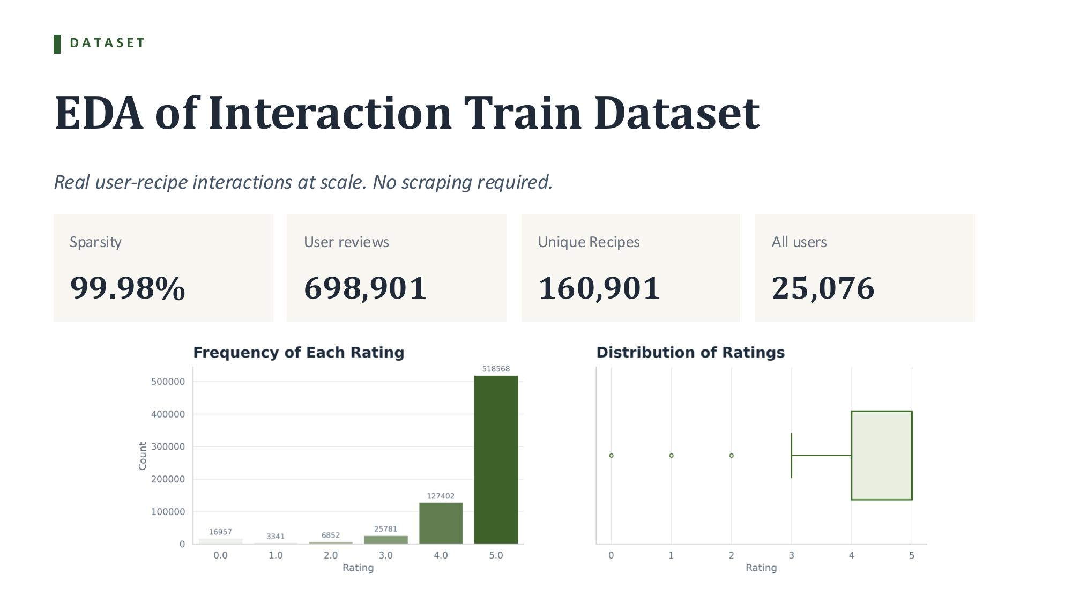
5 / 20

Slide 6
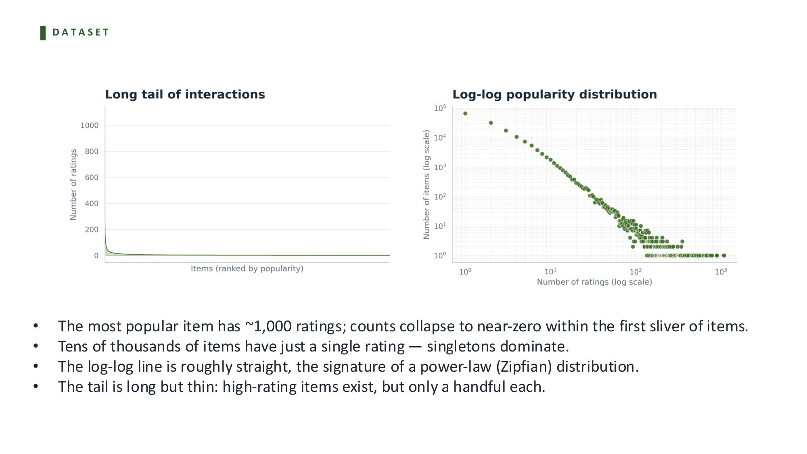
6 / 20

Slide 7
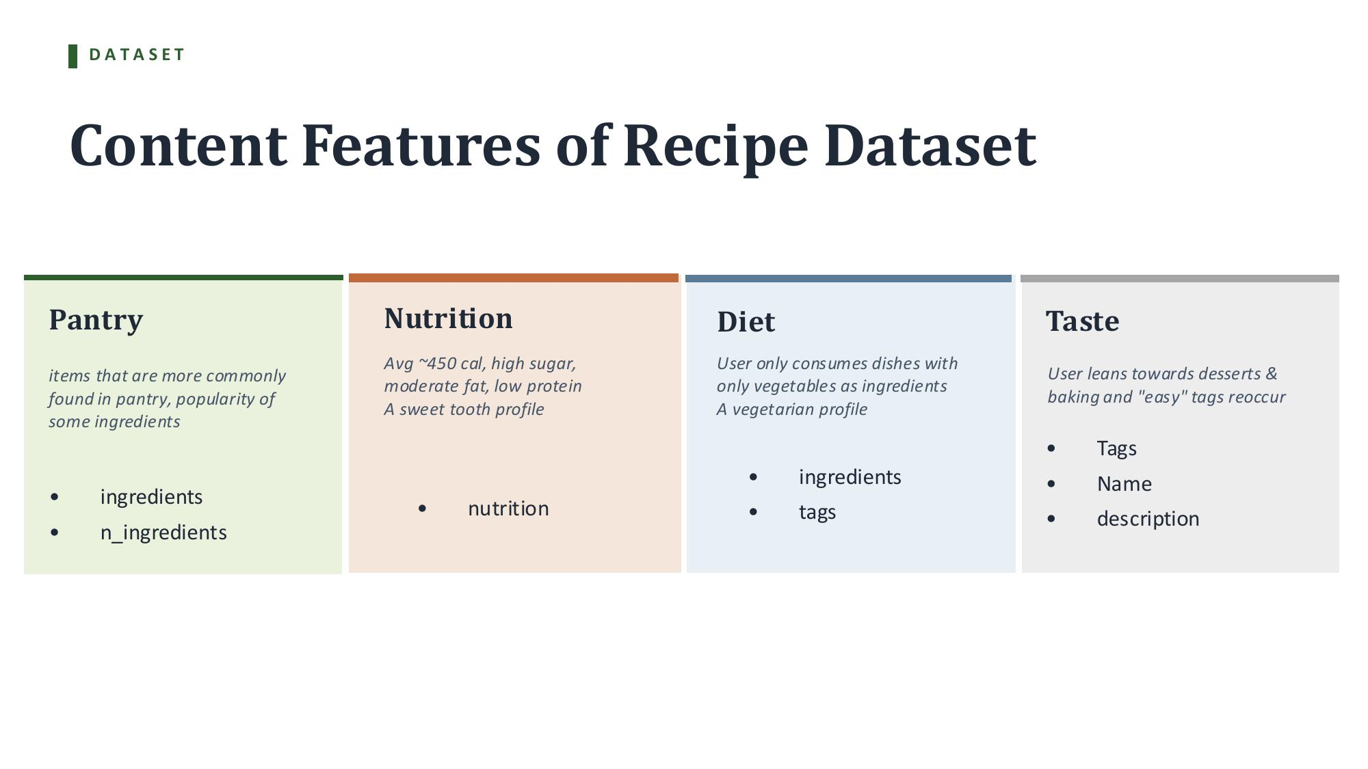
7 / 20

Slide 8
ARCHITECTURE
8 / 20
Two-stage pipeline
Recsys learning in Stage 1; constraint reasoning in Stage 2.
USER CONTEXT
Rating history · pantry · macro targets · dietary restrictions · α-weights
↓
STAGE 1 · CANDIDATE GENERATION (REAL RECSYS)
MF, EASE, BPR, content TF-IDF, Sentence-BERT, hybrid, two-tower neural, sequential — learns taste from observed ratings. Returns top-200 candidates.
↓
STAGE 2 · MULTI-CONSTRAINT RERANKING (X-FACTOR)
Scores each candidate on taste × pantry × nutrition × diet. Combines via α-weighting. Returns top-10.
↓
Top-10 recommendations
Recsys is the project. Constraints are how we extend it.

Slide 9
STAGE 1 MODELS
9 / 20
Two complementary paradigms
Real recipe apps face two scenarios. Each needs a different family of models.
COLLABORATIVE FILTERING
CONTENT-BASED
Learns from rating co-occurrence — who rated what, finds taste-similar users.
Learns from recipe content directly — ingredients, tags, nutrition, name, description.
ANSWERS
ANSWERS
“What do users like me like?”
“Who'd like this new recipe?”
→ Wins on WARM-ITEM recommendation
→ Wins on COLD-ITEM recommendation
FAILS WHEN
FAILS WHEN
The recipe has no rater history — zero signal to extrapolate from.
Content is generic; doesn't capture nuanced user-specific taste.
HYBRID — BEST OF BOTH Combines CF taste signal with content features. The only family that handles both warm and cold scenarios.
Recommendation paradigms · Stage 1 implementations via Cornac (Salah et al. 2020)

Slide 10
STAGE 2 RERANKER
10 / 20
The four constraint scores
Where the X-factor lives.
s_taste
— predicted relevance from Stage 1 (continuous, [0,1])
s_pantry
— non-staple ingredient overlap, soft ranking signal (continuous, [0,1])
s_nutrition
— Gaussian proximity to macro targets (continuous, [0,1])
s_diet
— hard filter: 1 if all restrictions met, 0 otherwise
final(u, r) = s_diet × (αt · s_taste + αp · s_pantry + αn · s_nutrition)
Only s_diet is a hard filter; the other three are continuous ranking signals — weighted, never excluding. For dietary restrictions without tag coverage (keto, paleo, whole30, lactose-free, halal, low-sugar), s_diet is derived from macros plus an ingredient blocklist.
RESEARCH OBJECT
The (αt, αp, αn) simplex. Where on this surface do recommendations land, and what does the optimal balance look like?
Algorithms — Stage 2 reranker

Slide 11
X-FACTOR
11 / 20
The α-sweep study
The trade-off curve is the headline empirical result.
We sweep α across the simplex and measure how each metric shifts.
HYPOTHESIS 1 single-objective optimization produces worse Useful Recall@K than balanced ranking
HYPOTHESIS 2 optimal α-weighting differs by user type — fitness-focused users weight nutrition higher; budget cooks weight pantry higher
HYPOTHESIS 3 as constraints tighten, learned taste signal remains material — distinguishing this from pure filtering
HEADLINE PLOT Useful Recall@K vs α-position. Inflection point visible. Per-persona overlays.
Runs on both evaluation tracks — warm-item LOO and cold-item — so we can study how the trade-off shifts across scenarios.
X-factor — what we'll learn that's new

Slide 12
EVALUATION · WHAT WE MEASURE
12 / 20
Three categories of metric
Each plays a distinct role. Together they evaluate the full system.
Predictive
Mechanical
Joint (signature)
"did the model guess right?"
"does output have desired properties?"
"both at once"
Recall@5, @10
NDCG@10
MRR
Pantry Hit Rate@K
Nutrition Adherence@K
Diet Compliance@K
Useful Recall@K
Multi-Constraint Score
α-sweep curves
Bootstrap 95% CIs on all means. Wilcoxon signed-rank for model-vs-model comparisons.
Evaluation — metrics overview

Slide 13
EVALUATION · GROUND TRUTH
13 / 20
What “ground truth” actually means here
There is no canonical “correct top-10.” So what do we compare against?
We use prediction reframing: the model is given a user's past ratings and asked to predict their future ones.
PREDICTIVE METRICS
MECHANICAL METRICS
Ground truth = the recipe a user actually rated next in held-out data. We grade the model on whether that recipe appears in its top-K recommendations from the rest of the catalog.
No ground-truth labels needed. Computed deterministically: does this recipe fit the user's pantry? Does it hit the macro targets? Yes / no, by simple comparison.
The “user's real next behavior” is the only ground truth we can defend. The constraint side doesn't need ground truth — it's checked mechanically.
Evaluation — what counts as truth

Slide 14
EVALUATION · PROTOCOL
14 / 20
The leave-one-out protocol, step by step
For each user with sufficient interactions.
1
Sort the user's ratings by date. Most recent first.
2
Hold out the user's most recent positive rating. Definition of "positive": 4 stars or higher.
3
Train the model on all earlier ratings. The model never sees the held-out item.
4
Ask the model for a top-10 recommendation list. From the full catalog, excluding already-rated items.
5
Check whether the held-out recipe is in that top-10. If yes, it's a hit for that user.
6
Aggregate across all users. Mean across users gives Recall@10, NDCG@10, MRR.
Track A cohort: 24,961 active users from the authors' pre-split train, with ~658K training interactions after holding out the most-recent positive per user (~24,382 held-out positives). Track B uses the authors' pre-split test directly (10,393 cold-item held-outs). See next slide for the dual-track design.
Evaluation — protocol

Slide 15
EVALUATION · DUAL-TRACK DESIGN
15 / 20
Two evaluation regimes, same architecture
Real recipe apps face both scenarios — we evaluate on both.
TRACK A · WARM-ITEM (standard CF)
TRACK B · COLD-ITEM (content-aware)
TEST SET
~24K positives, time-based LOO on train
TEST SET
10,393 positives, authors' test split
SIGNAL
Items have median 20 raters in train
SIGNAL
Items have 0 raters in train (cold by design)
QUESTION
What's the next item from the known library?
QUESTION
What novel recipe, before anyone has rated it?
MODELS
All 8 Stage 1 models compete
MODELS
Content-aware only: TF-IDF, BERT, hybrid, 2-tower
FLOOR
Popularity Recall@10 ≈ 3.0%
FLOOR
0.0% — popularity has no signal for unseen
ANALOGY
“Trending recipes among users like me”
ANALOGY
“Surface new recipes before they go viral”
WHY BOTH Different models win different regimes. CF-only dominates warm; content-aware dominates cold. Only the hybrid handles both — the architectural payoff. The Stage 2 reranker and α-sweep run on both tracks.
Recipe apps need both. PantryPlate evaluates on both.
Evaluation — dual-track design

Slide 16
EVALUATION · USEFUL RECALL@K
16 / 20
The signature metric in plain language
What makes Useful Recall@K specific to PantryPlate.
Standard Recall@K asks one question:
Did the model rank a known future positive interaction in the top-K?
Useful Recall@K asks two:
1. Did the model rank a known future positive interaction in the top-K?
2. AND does that recommendation satisfy all of the user's constraints?
For a recommendation to count as useful, the held-out recipe must appear in the top-K AND satisfy:
• Pantry: user is missing ≤ 3 non-staple ingredients (we assume universal staples — salt, oil, flour, eggs — are always available; EDA showed even with staples assumed, ~25% of recipes meet this threshold — discriminative and intuitive)
• Nutrition: within ±20% of the user's macro targets
• Diet: all dietary restrictions respected
This is where model performance and constraint awareness combine into a single number. We report Recall@K and Useful Recall@K side by side — the gap between them is the project's contribution.
Evaluation — signature metric

Slide 17
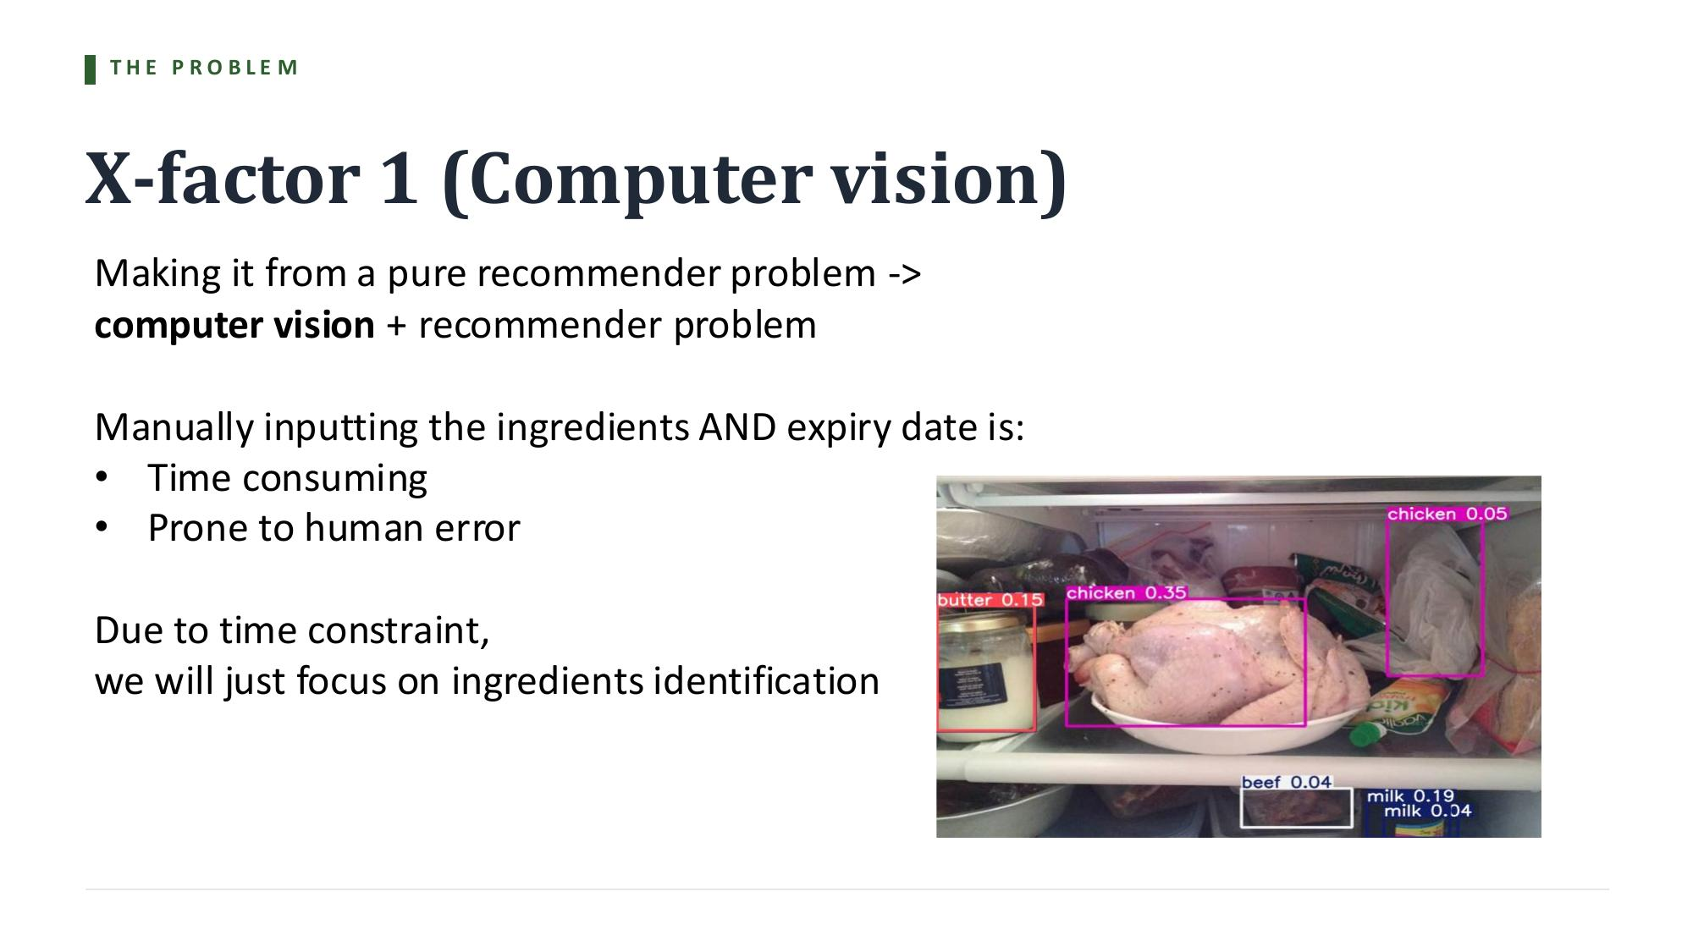
REACH GOAL 1
17 / 20
Vision-based ingredient input
A stretch goal — only pursued if the recsys is on track at the Week 4 progress gate.

Slide 18
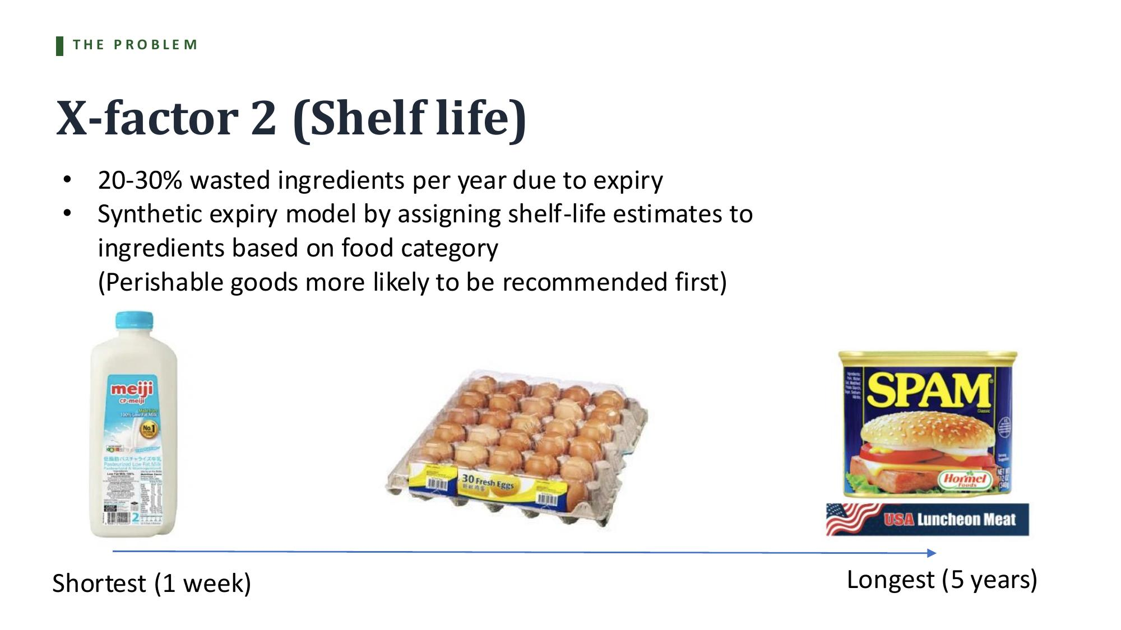
REACH GOAL 2
18 / 20
Shelf-life prioritization
A stretch goal — would extend the reranker with a 5th constraint (s_shelf) if pursued.

Slide 19
REACH GOAL ROADMAP
19 / 20
How PantryPlate evolves from baseline to stretch
The recsys core stays constant; reach goals extend inputs and outputs.
The original problem
+ Reach Goal 1 (CV)
Real-use case (both reach goals)
Computer vision
Computer vision
↓
↓
Recommender
Recommender
Recommender
↓
↓
↓
Evaluation on held-out set
Evaluation on held-out set
Shelf-life prioritization
Reach goal roadmap

Slide 20
TIMELINE
20 / 20
Six-week schedule
From May 13 to presentation on June 24.
W1
May 13–19
Data pipeline · sanity checks · EDA · feasibility analysis · popularity baseline ✓
W2
May 20–26
Eval harness · MF · EASE · BPR · content TF-IDF · Sentence-BERT
W3
May 27–Jun 2
Hybrid + two-tower neural · results table
Proposal due Jun 3
W4
Jun 3–9
Stage 2 reranker · personas (25–35-item pantries) · Reach Goal decision gate
W5
Jun 10–16
α-sweep experiments · ablations · Reach Goal integration (if go)
W6
Jun 17–23
Analysis · slides · demo polish · physical prop
Present Jun 24
Milestones

