Slide 1
Detecting Financial Fraud via Graph Neural Networks: A Multi-Dataset, Graph-Based Learning Approach
Haoyuan Chen, Izaak King, Bryan Gelnett

Slide 2
Outline
01
02
03
04
05
06
07
Introduction
Existing Literature
Dataset Overview
Methodology
Experimental Setup
Modeling Results
Discussion
And Future Work

Slide 3


01
Introduction

Slide 4
Motivation - Financial Fraud Detection
Financial Impact
Billions are lost annually to financial fraud
Class Imbalance
Extreme class imbalance (Illicit << Licit)
Evolving Challenges
Fraud activities are constantly growing more coordinated and complex
Traditional Methods Struggle
Traditional methods tend to struggle with this problem, treating transactions independently
Notes:
Fraud is a massive real-world problem across banking, crypto, payments
The key challenge isn’t just prediction—it’s rare event detection due to class imbalance
Fraud activities act in complex, coordinated patterns, not isolated events
But most ML models ignore this—they look at each transaction alone
That’s the core limitation we’re addressing

Slide 5


Why Graph Neural Networks
Network Phenomenon
Fraud is fundamentally a network phenomenon. Transactions typically have relationships and correlations (same user, device, etc.).
Limit of Tabular Data
Tabular features alone cannot capture relational context, missing deep connections between entities.
Solution: Introduce Edges and Graph Structure
Notes:
In reality, transactions are connected
Fraud often shows up as groups or chains of activity
Graphs let us model this naturally
GNNs aggregate information from neighbors → capture hidden structure
This is the key idea behind our approach

Slide 6

02
Existing Literature

Slide 7
Existing Literature
Traditional Fraud Detection
- Andrea Dal Pozzolo et al. highlight class imbalance challenges
- Common use of Logistic Regression, Random Forest, MLP
- Transactions are treated as independent samples
Graph Neural Networks (GNNs)
- Thomas Kipf & Max Welling — GCN
- Petar Veličković et al. — GAT
- William Hamilton et al. — GraphSAGE
- Models capture relational structure in graphs
Gap in Existing Work
- Focus on single datasets
- Limited direct comparison between classical ML models and GNNs
- Unclear when graph structure provides benefits
Notes:
Fraud detection has been studied extensively using standard ML
Work by Pozzolo highlights how severe class imbalance makes this problem difficult
These models treat each transaction independently
More recent work introduces graph-based learning
Kipf & Welling → GCN (neighborhood aggregation)
Veličković → GAT (attention over neighbors) niebors assigned wieghts
Hamilton → GraphSAGE (scalable, inductive learning) - focuses on fixed number of nieghbors then genralizes to unseen nodes. Aggregates nodes.
These methods show strong results, especially in financial networks
But prior work is often limited to one dataset
And lacks consistent comparison to classical models
So it’s still unclear when GNNs actually add benefit

Slide 8
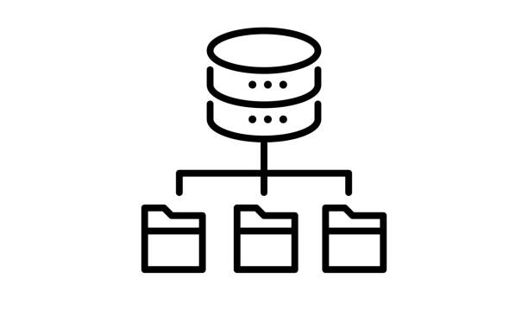
03
Dataset Overview

Slide 9
Dataset Selection
PaySim (Mobile Money Simulation)
- Synthetic mobile money transaction dataset
- Tabular structure
- Simulates real-world financial transfer behavior
- Includes normal and fraudulent transaction labels
Elliptic Dataset
- Real-world Bitcoin transaction dataset
- Natural graph structure
- Nodes represent individual transactions
- Contains licit, illicit and unknown transactions
- Large-scale financial network data (~200k transactions)
IEEE-CIS Dataset
- Real-world credit card fraud dataset (Featured in Kaggle Competition)
- Tabular structure
- Includes rich categorical and behavioral features
- Highly imbalance fraud labels
Notes:
Paysim
PaySim is a simulated dataset, not real financial data
It mimics mobile money systems like digital wallets
It is commonly used in academic fraud detection work
Because it is synthetic, patterns are partially controlled
This makes it useful for testing model robustness
Again, we will later explain how we model it structurally
Elliptic
This is a real blockchain-based dataset
Each data point corresponds to a Bitcoin transaction
It includes labels indicating whether a transaction is illicit or not
It is widely used in financial fraud research
Key point: it reflects real-world financial behavior at scale
We will later explain how we model it as a graph
IEEE-CIS
This is a widely used industry dataset
Each row is a transaction with many engineered features
It does not come with any explicit relational structure
It is extremely imbalanced, which makes fraud detection hard
It serves as a strong real-world tabular benchmark
Later, we show how we extend it into a graph setting

Slide 10

04
Methodology
Notes:
Lets move on to Methodology

Slide 11
Problem Formulation
Problem Formulation
- Fraud detection as node classification
- Each transaction is a node
- Goal: predict fraud vs non-fraud
Graph Representation
- Transactions represented as node classification
- Nodes contain transaction features
- Edges encode relationships between transactions
Objective
- Learn representations that capture both features and relationships
Notes:
We formulate fraud detection as a node classification problem on a graph
Each transaction is represented as a node
The model’s task is to predict whether each node corresponds to a fraudulent or legitimate transaction
Instead of treating transactions independently like in traditional ML, we embed them in a graph structure
Nodes carry feature information describing the transaction
The key idea is that edges allow us to model dependencies between transactions
The goal is to learn representations that combine:
the intrinsic features of each transaction
and the structural relationships captured by the graph
This formulation enables Graph Neural Networks to leverage both sources of information simultaneously

Slide 12
Graph Construction
PaySim (Mobile Money Simulation)
- Constructed Graph
- Edges based on:
- Sender to Receiver links
- Temporal proximity
Elliptic Dataset
- Native Bitcoin transaction graph
- Edges based on:
- Actual fund transfers
IEEE-CIS Dataset
- Constructed Graph
- Edges based on:
- Shared card information
- Device fingerprint
- Email/identity overlap
Notes:
Speaker notes
This slide explains how we construct graphs for each dataset
For Elliptic, the graph is already given
it represents real Bitcoin transaction flows
so edges correspond to actual transfers between transactions
For IEEE-CIS, there is no inherent graph structure
so we construct edges using shared identity signals
including card details, device information, and email or identity overlaps
this introduces some noise but captures potential relational structure
For PaySim, we build a synthetic transaction graph
edges are formed based on sender–receiver relationships
and also temporal proximity between transactions (We connect transactions that occur close in time, fraud happens in bursts)
reflecting typical mobile money behavior patterns
The key takeaway is that each dataset provides a different level of structural richness
This variation is important for evaluating how robust graph-based models are across different settings

Slide 13
Baseline Models
analytics
Logistic Regression
psychology
MLP (Multi-Layer Perceptron)
account_tree
Random Forest (XGBoost)
Notes:
Logistic Regression: Linear decision boundary, trained with weighted BCE loss to handle class imbalance.
MLP: Multi-layer perceptron with batch normalization and dropout (0.3) to capture non-linear relationships in tabular features.
Random Forest (XGBoost): Histogram-based ensemble method robust to unscaled features and imbalanced data.
We start with three standard tabular baselines: a linear model, a neural network, and a tree-based ensemble. While these achieve strong AUC-ROC scores, their fraud-class F1 scores plateau around 0.39–0.49 across datasets. More importantly, they exhibit a precision-recall tradeoff: high recall but low precision (many false alarms) or vice versa. This ceiling suggests that tabular features are insufficient. Fraud is fundamentally a network phenomenon—it involves relationships, temporal sequences, and graph patterns that tabular models cannot exploit. This motivates our move to Graph Neural Networks, which embed nodes in their transactional context.

Slide 14
Graph Neural Network Architectures
• Core idea - Each node learns from its neighbors iteratively
• At each layer, node i receives aggregated information from k-hop neighbors
• Outputs logits that are used for training and inference
GCN
Uniform, normalized averaging
Stable, efficient baseline
Works well when neighbors are the same class
Treats all neighbors equally
GraphSAGE
Learnable aggregation on sampled neighbors
Inductive - works on unseen nodes
Flexible aggregator (mean, pooling, etc)
GAT
Learns attention weights per edge
Uses Multi-head attention
Identifies most informative neighbors
Highest computational overhead
Notes:
2-layer GNN stack:
Layer 1:
F features →H hidden dimensions
Layer 2:
H hidden → 1 logit per node
Training: logit-based loss (BCEWithLogitsLoss / Focal Loss) + class weighting
Inference: sigmoid + tuned threshold
Comparison knob: all three models differ only in how neighborhoods are aggregated
GCN - think of it as averaging your neighbors' signals with a fixed recipe
GraphSAGE - I pick K random neighbors, aggregate them flexibly, combine with myself
GAT - I learn to pay more attention to neighbors that matter most

Slide 15
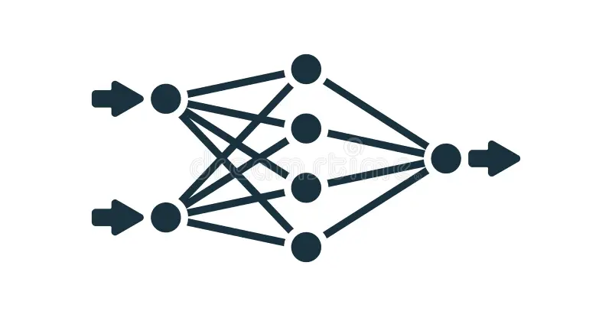
05
Experimental Setup

Slide 16
Data Splitting and Preprocessing
Data Splitting
- PaySim and Elliptic: 60/20/20 split
- IEE-CIS: Train/Test sets given from competition
- 20% split for validation
- Stratified sampling preserves fraud ratio
Preprocessing
- Missing values imputed with 0
- Features standardized (centered and scaled)
- Transactions with missing or unknown labels dropped
Notes:
For consistency, we apply standardized splitting strategies
Elliptic and PaySim are split into training, validation, and test sets using a 60/20/20 ratio
IEEE-CIS provides a predefined split from the competition, so we further separate a 20% validation set from training data
We ensure stratified sampling so the severe fraud imbalance is preserved in all splits
In preprocessing, missing feature values are replaced with zeros
We also standardize all features to stabilize training across models
We remove any transactions with missing or unknown identifiers

Slide 17
Evaluation Metrics
Datasets are Extremely imbalanced
A model can achieve “good” performance by always predicting non-fraud
Instead, we focus on metrics that reflect fraud class performance
Metrics include F1-Score, Precision, Recall and ROC (for fraud class)
Notes:
Since fraud detection is highly imbalanced, accuracy is not meaningful
A model can achieve high accuracy by always predicting non-fraud
Instead, we focus on metrics that reflect minority class performance
F1-score is our primary metric because it balances precision and recall
Precision and recall are also reported individually for interpretability
AUC-ROC measures overall separability between classes
Together, these metrics provide a complete evaluation of both classification and ranking quality

Slide 18
Training and Hyperparameter Tuning
Training Strategies
-Full-batch training (Models trained on entire graph)
- Mini-batch training (Use of imbalanced sampler functions to handle class imbalance)
- Hyperparameters optimized via Grid Search across configurations
- Model selection based on maximizing validation fraud F1-Score
Key Model Settings
- GNN Architecture: Standard 2-layer models
- Hidden Units: Explored configurations with 64, 128 and 256 hidden channels
- Regularization: Applied Dropout (0.3, 0.5) and weight decay to prevent overfitting
Loss Functions
-Full-batch: weighted with BCE Loss, with pos_weight tuned to address imbalance
- Mini-batch: Focal Loss tuned to focus on hard-to-classify examples
Decision Threshold
- Dynamically tuned on the validation set to optimize F1-score for the fraud class
- Not fixed at 0.5, optimized for each model and dataset
Notes:
For Elliptic and PaySim, we use full-batch training for stable optimization.
For IEEE-CIS, we use mini-batch training with NeighborLoader due to scale.
We also use ImbalancedSampler to address class imbalance in batches.
Hyperparameters are tuned via grid search, selecting models based on validation F1-score.
All GNNs use a 2-layer GraphSAGE architecture.
We test hidden sizes of 64, 128, and 256.
Dropout and weight decay are used for regularization.
Full-batch: weighted BCE loss to handle class imbalance.
Mini-batch: Focal Loss to focus on hard fraud examples.
Threshold is tuned per dataset and model on validation data.
We do not use the default 0.5 cutoff due to class imbalance.

Slide 19
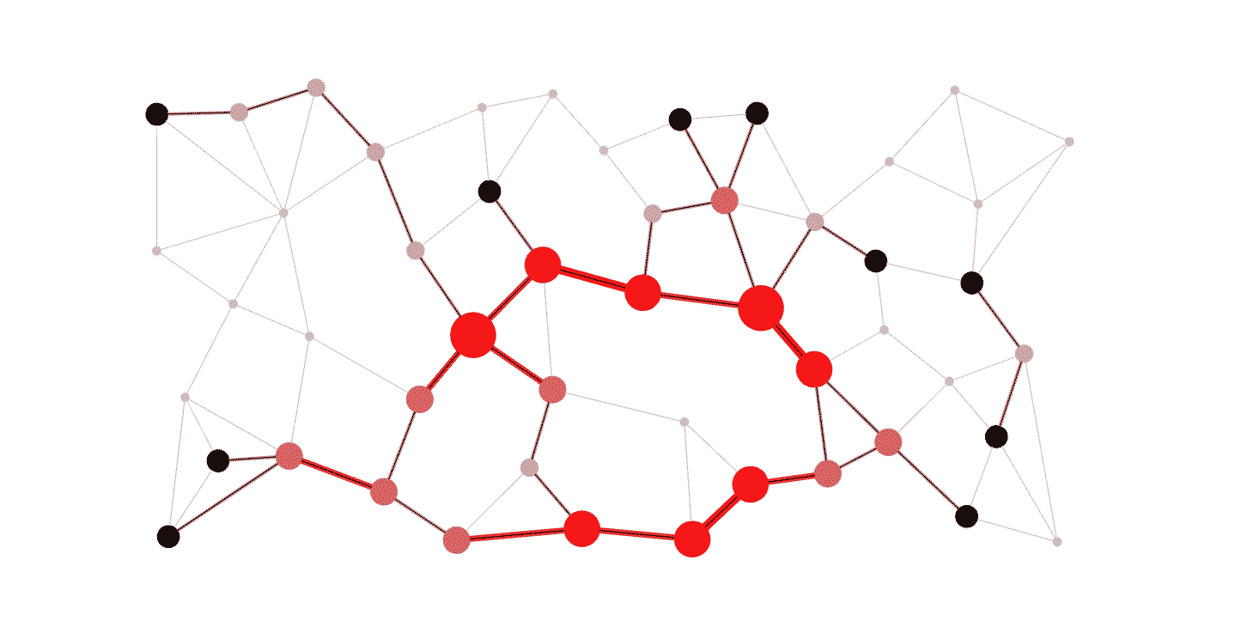
06
Modeling Results

Slide 20
PaySim Dataset - Baseline
Model | AUC-ROC (Fraud) | F1 (Fraud) | Precision (Fraud) | Recall (Fraud)
Logistic Regression | 0.888662 | 0.521754 | 0.982445 | 0.355195
MLP | 0.872917 | 0.609788 | 0.996269 | 0.439351
Random Forest | 0.994344 | 0.392666 | 0.252629 | 0.881053
Notes:
Baselines perform surprisingly strong overall
Random Forest:
Near-perfect AUC → excellent ranking
But weaker F1 due to imbalance between precision and recall
MLP:
Best F1 (~0.61) → strongest overall baseline
Logistic Regression:
Very high precision
But low recall → misses many fraud cases

Slide 21
PaySim - GNNs
Model | AUC-ROC (Fraud) | F1 (Fraud) | Precision (Fraud) | Recall (Fraud)
PaySim Mini-batch (GCN) | 0.9266 | 0.1244 | 0.0703 | 0.5380
PaySim Full-batch (GCN) | 0.9151 | 0.3357 | 0.4781 | 0.2587
PaySim Mini-batch (GAT) | 0.9044 | 0.0329 | 0.0168 | 0.7182
PaySim Full-batch (GAT) | 0.8986 | 0.2674 | 0.3778 | 0.2069
PaySim Mini-batch (graphSAGE) | 0.9833 | 0.0507 | 0.0261 | 0.8764
PaySim Full-batch (graphSAGE) | 0.9698 | 0.5118 | 0.7013 | 0.4029
Notes:
GNN performance is mixed on this dataset
Full-batch GraphSAGE:
Best GNN (F1 ~0.51)
Close to baselines, but not clearly better
Mini-batch models:
Very high recall
But extremely low precision → hurts F1
Takeaway:
Graph structure here is not very informative

Slide 22
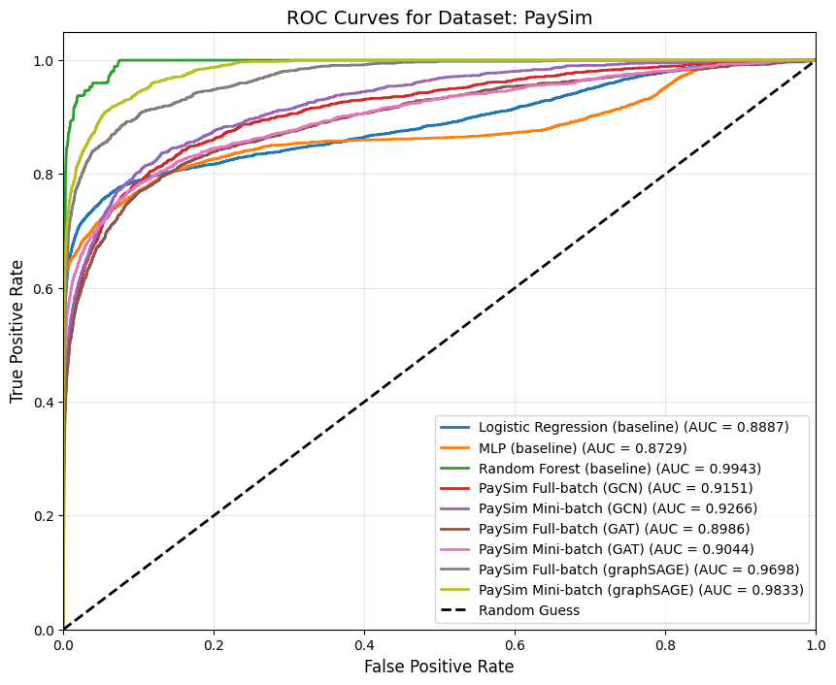
PaySim - ROC Curves
Notes:
Random Forest dominates → best ranking performance
GraphSAGE (mini-batch):
Very strong AUC
Key insight:
High AUC doesn’t necessarily translate to strong fraud classification
Overall: GNNs are competitive, but no clear advantage

Slide 23
Elliptic Dataset - Baseline
Model | AUC-ROC (Fraud) | F1 (Fraud) | Precision (Fraud) | Recall (Fraud)
Logistic Regression | 0.840864 | 0.299204 | 0.204669 | 0.556025
MLP | 0.838084 | 0.431635 | 0.589744 | 0.340381
Random Forest | 0.823252 | 0.493583 | 0.462963 | 0.528541
Notes:
Baselines are much weaker here
Best F1 ≈ 0.49 (Random Forest)
Logistic Regression:
Low precision, limited usefulness
MLP:
Slight improvement, but still constrained
Takeaway:
Tabular models struggle without relational structure

Slide 24
Elliptic Dataset - GNNs
Model | AUC-ROC (Fraud) | F1 (Fraud) | Precision (Fraud) | Recall (Fraud)
Elliptic Mini-batch (GCN) | 0.9697 | 0.6247 | 0.4707 | 0.9285
Elliptic Full-batch (GCN) | 0.9712 | 0.8383 | 0.8653 | 0.8130
Elliptic Mini-batch (GAT) | 0.9552 | 0.4228 | 0.2696 | 0.9791
Elliptic Full-batch (GAT) | 0.9726 | 0.8083 | 0.8216 | 0.7954
Elliptic Mini-batch (graphSAGE) | 0.9812 | 0.6322 | 0.4741 | 0.9483
Elliptic Full-batch (graphSAGE) | 0.9797 | 0.8743 | 0.9188 | 0.8339
Notes:
Huge improvement across all models
GraphSAGE (full-batch):
Best overall (F1 ~0.87)
Strong precision and recall balance
GCN and GAT:
Also perform very well (~0.80+ F1)
Mini-batch:
Higher recall, lower precision
Takeaway:
Graph structure is extremely informative

Slide 25
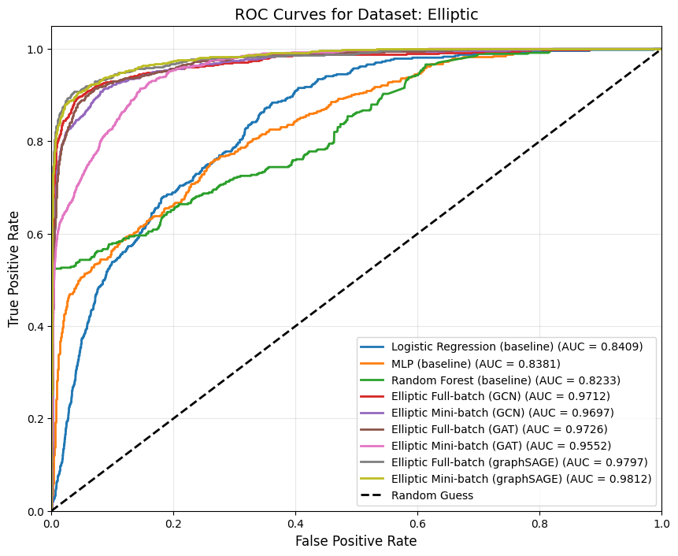
Elliptic Dataset - ROC Curves
Notes:
GNN curves clearly dominate baselines
AUC ~0.97–0.98 → excellent separability
Baselines significantly lower
Interpretation:
Strong relational signal drives performance
This is the clearest validation of GNNs

Slide 26
IEEE-CIS Dataset - Baseline
Model | AUC (Fraud) | F1 (Fraud) | Precision (Fraud) | Recall (Fraud)
Logistic Regression | 0.803648 | 0.274809 | 0.221024 | 0.363189
MLP | 0.843439 | 0.395109 | 0.414193 | 0.377707
Random Forest | 0.816087 | 0.413681 | 0.459046 | 0.376476
Notes:
Moderate baseline performance
Random Forest:
Best F1 (~0.41)
MLP:
Close behind
Logistic Regression:
Weakest
Takeaway:
Some predictive signal exists, but limited

Slide 27
IEEE-CIS Dataset - GNNs
Model | AUC-ROC (Fraud) | F1 (Fraud) | Precision (Fraud) | Recall (Fraud)
IEEE-CIS Mini-batch (GCN) | 0.7653 | 0.0677 | 0.0350 | 0.9998
IEEE-CIS Full-batch (GCN) | 0.8434 | 0.3451 | 0.2716 | 0.4733
IEEE-CIS Mini-batch (GAT) | 0.6306 | 0.0718 | 0.0375 | 0.8662
IEEE-CIS Full-batch (GAT) | 0.8649 | 0.4356 | 0.4613 | 0.4125
IEEE-CIS Mini-batch (graphSAGE) | 0.8992 | 0.1911 | 0.1075 | 0.8626
IEEE-CIS Full-batch (graphSAGE) | 0.9146 | 0.5571 | 0.7104 | 0.4583
Notes:
GraphSAGE (full-batch):
Best overall (F1 ~0.56)
Clear improvement over baselines
GAT:
Moderate gains
GCN:
Less stable
Mini-batch:
Very high recall
But low precision → tradeoff
Takeaway:
Graph helps, but gains are more modest

Slide 28
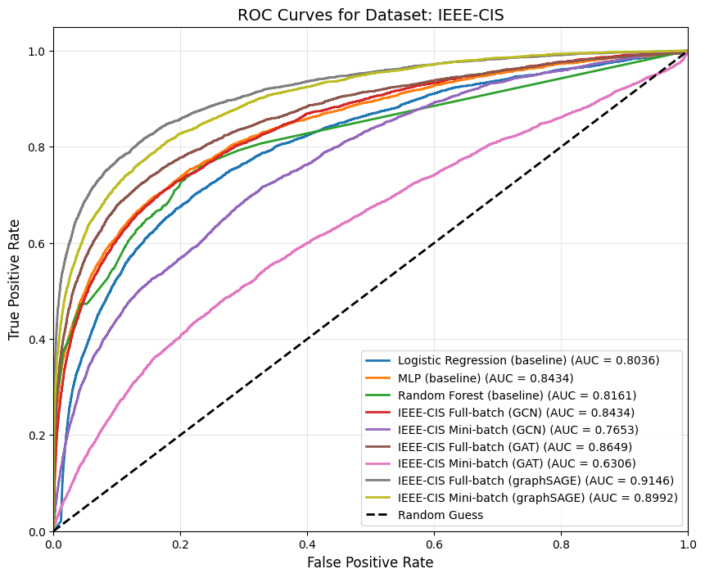
IEEE-CIS Dataset - ROC Curves
Notes:
GraphSAGE achieves highest AUC → best ranking
GNNs outperform baselines overall
Gap smaller than Elliptic
Mini-batch:
More variability due to sampling
Interpretation:
Graph signal exists, but is weaker and noisier

Slide 29
Key Results
Overall Performance
- GNNs outperform classical models across most metrics in Elliptic and IEEE-CIS datasets
- Strongest gains in F1-Score
Best Performing Model
- GraphSAGE (Full-batch) overall best and most stable
- Highest performance on Elliptic and strong generalization across datasets
Dataset-Level Trends
- PaySim: Mixed results, baselines remain competitive
- Elliptic: Largest improvements from graph structure
- IEE-CIS: Moderate gains, sensitive to graph construction
Mini-batch vs Full-batch
-Mini-batch improves scalability but reduces stability
- Often increases recall at the cost of precision
- Limited neighborhood information
- Full-batch training produces more consistent results
Notes:
Across Elliptic and IEEE-CIS, GNNs consistently outperform classical models in key fraud metrics mainly f1
GraphSAGE trained with the full dataset stands out as the most consistent and best performing model due to its robustness against the imbalanced data and noisy graphs
Dataset behavior is very different across the board:
Elliptic → strongest and most consistent gains due to real transaction graph
IEEE-CIS → moderate improvements, but depends heavily on how the graph is built
PaySim → weaker gains, classical models still competitive
Main takeaway: → GNNs are effective, but only when the underlying graph structure is meaningful
Mini-batch makes the training more efficient, but the imbalanced sampling methods we used cause each update to only see partial views of the graph, and the model becomes more sensitive to local patterns of fraud, predicting fraud more aggressively leading to higher recall and lower precision
Mini-batch training is mainly used for scalability on large graphs like IEEE-CIS
Instead of processing the full graph, it samples subgraphs during training
This makes training much more efficient, but it also means:
Each update sees only a partial view of the graph
Some important neighborhood relationships are missing or underrepresented
As a result, message passing becomes noisier and less globally consistent
This affects classification behavior:
The model becomes more sensitive to local patterns of fraud
It tends to predict fraud more aggressively
This explains the observed trade-off:
Higher recall (catches more fraud cases)
Lower precision (more false positives)

Slide 30

07
Discussion

Slide 31
Impact of Dataset Structure
Key Insight: Dataset Structure Determines GNN Effectiveness
PaySim
- Simulated transactions
- Temporal and sender-receiver links
- Limited relational signal
- Baselines remain competitive
Elliptic
- Native transaction graph (Bitcoin flow)
– Clear relational dependencies
- Largest gains from GNNs
- GraphSAGE best overall performance
IEEE-CIS
- Heuristic graph construction
- Shared identifiers (card, device, email)
- Noisy relationships
- Moderate GNN improvements
Notes:
Elliptic gives the strongest performance boost because it is a true transaction graph
Edges reflect actual Bitcoin fund transfers, so message passing is meaningful
This is why we see the highest AUC-PR and F1 improvements here
IEEE-CIS is more challenging because the graph is constructed, not natural
Edges rely on shared identifiers like cards, devices, and emails
This introduces noise and weaker structural signal, so gains are smaller and less stable
PaySim is fully synthetic, so even though we build a graph, it lacks real-world relational complexity
As a result, classical models like Random Forest and MLP remain strong baselines
Overall takeaway: → GNN performance is not just model-dependent → It is highly dependent on how meaningful the graph structure is

Slide 32
Limitations
Graph Construction Assumptions
- IEEE-CIS and PaySim require heuristic edge creation
- May introduce noisy or artificial relationships
Dataset Heterogeneity
- Elliptic: real data
- IEEE-CIS: real data, required graph conversion
- PaySim: synthetic, required graph conversion
- Limits direct compatibility
Computational Constraints
- Limited hyperparameter search space due to training cost, time
- Constrained GNN depth and tuning
Class Imbalance
- Extreme skew in all datasets
- Precision-recall trade-offs in mini-batch training
Model Sensitivity
- GAT / GCN more unstable under sampling
- GraphSAGE more robust
Notes:
First limitation is graph construction quality
For IEEE-CIS and PaySim, edges are based on heuristics like shared IDs or time windows
These may not reflect real financial relationships → can introduce noise
Second is dataset inconsistency
Elliptic is a true graph, while others require transformation
This makes comparisons not perfectly uniform across datasets
Third is computational limits
GNNs are expensive, especially full-batch training on Elliptic
So hyperparameter tuning was restricted to a practical range
Fourth is extreme class imbalance
All datasets are heavily skewed toward non-fraud
This leads to precision vs recall trade-offs, especially in mini-batch setups
Finally, model stability differences
GCN and GAT are more sensitive to sampling noise
GraphSAGE is more stable due to inductive neighborhood sampling
Overall takeaway: → Results are strong, but depend on data quality, graph design, and compute limits

Slide 33
Future Work
Graph Construction
- Learn edges automatically instead of heuristic rules
- Improve noisy graph generation (IEEE-CIS, PaySim)
Temporal Modeling
- Capture evolving fraud patterns over time
- Use dynamic /temporal GNNs
Scalability
- Improve efficiency for large financial graphs
- Reduce full-batch training cost
Imbalance Handling
- Better cost-sensitive and adaptive threshold methods
Notes:
First improvement area is graph construction
Instead of manually defining edges, future work should learn relationships directly from data
Second is temporal modeling
Fraud evolves over time, but current models treat graphs as static
Temporal GNNs could better capture this behavior
Third is scalability
Full-batch training is computationally expensive, especially for large graphs like Elliptic
More efficient training methods are needed
Final area is class imbalance
Even with weighting and threshold tuning, extreme imbalance remains a challenge
More adaptive strategies could further improve fraud recall without sacrificing precision

Slide 34
Thank You
Questions?
Notes:
GraphSAGE performs better mainly because it’s more robust to noisy graphs
Our datasets—especially IEEE-CIS and PaySim—have heuristically constructed edges, so not all connections are meaningful
Unlike GCN, GraphSAGE doesn’t over-smooth node features
And unlike GAT, it doesn’t rely on learning attention weights, which can be unstable with noisy data
It also works better with mini-batch sampling, which we use for large graphs
AUC-ROC is useful bc it measures overall ranking performance, when the decision threshold is tuned separately. It does a good job at measuring how well the model separates fraud vs non-fraud across all thresholds, which is useful in our project with huge class imbalance, so a single threshold isnt reliable.

