Slide 1
Building an Information Retrieval System using University Data - M2
PRI 2023/24
GONÇALO ALMEIDA
ŽAN ŽLENDER
ILINA KIROVSKA

Slide 2
Milestone 1 recap
Main idea is to build a search engine where students can get as much information about universities and various aspects related to them.
Main data sources: QS WorldUniversity Rankings Kaggle dataset, Wikipedia page for each university and its city
The result of the Milestone 1 is a single JSON document containing a collection of 529 university documents

Slide 3
Document schema
2024_rank
2023_rank
institution_name
country_code,
country, size
focus
age
status
academic_reputation_score
academic_reputation_rank
employer_reputation_score
employer_reputation_rank
faculty_student_score
faculty_student_rank
age
status
academic_reputation_score
academic_reputation_rank
employer_reputation_score
employer_reputation_rank
faculty_student_score
faculty_student_rank
citations_per_faculty_score
citations_per_faculty_rank
international_students_score
international_students_rank
institution_name__wrong
wikidata
foundation_year
overall_score
international_research_network_score
international_research_network_rank
employment_outcomes_score
employment_outcomes_rank
wikipedia_text
city_name
city_wikipedia_text
coordinates

Slide 4
Milestone 2
Create Solr schemas
Index documents
Query Information Needs
Retrieve the top 30 results
Evaluate results

Slide 5
Schema design
Version 1: basic schema with no boosts and minimal use of filter
ASCII FoldingFilter
Lower Case Filter

Slide 6
Field | Indexed | Field type
 |  | Version 1 | Version2
2024_rank | true | text | int
2023_rank | true | text | float
institution_name_-_wrong | false | text | text
institution_name | true | text | text
country_code | true | text | text
country | true | text | text
size | true | text | text
focus | true | text | text
age | true | text | text
status | true | text | text
academic_reputation_score | true | text | float
academic_reputation_rank | true | text | text
employer_reputation_score | true | text | float
employer_reputation_rank | true | text | text
faculty_student_score | true | text | float
faculty_student_rank | true | text | text
Field | Indexed | Field type
 |  | Version 1 | Version2
citations_per_faculty_score | true | text | float
citations_per_faculty_rank | true | text | text
international_students_score | true | text | float
international_students_rank | true | text | text
international_research _network_score | true | text | float
international_research _network_rank | true | text | text
employment_outcomes_score | true | text | float
employment_outcomes_rank | true | text | text
overall_score | true | text | float
wikidata | false | text | text
wikipedia_text | true | text | wikipediaText
city_wikipedia_text | true | text | wikipediaText
foundation_date | true | text | date
coordinates | true | coordinates | coordinates

Slide 7
Schema design
Version 2:
ASCII Folding Filter
Lower Case Filter
Classic Filter - strips periods from acronyms and "’s" from possessives
English Minimal Stem Filter - stems plural Englishwords to their singular form
Porter Stem Filter - applies the Porter Stemming Algorithm

Slide 8
Information need 1
Description: Looking for universities that are top-ranked in computer science and are located in cities that have rich cultural heritage
Query 1: wikipedia_text:"computer science" city_wikipedia_text:heritage 2024_rank:[1 TO 100]
Query 2:wikipedia_text:"computer science"^3 AND city_wikipedia_text:heritage^2 AND 2024_rank:[* TO 200]^4
User priorities: high ranking universities in the field of computer science where the city the university is located in also has a rich heritage
Query | P@10 | AvP | R@10 | F@10
Query 1 | 0.4 | 0.42 | 0.29 | 0.42
Query 2 | 1.0 | 1.0 | 0.34 | 0.67

Slide 9
Information need 2
Description: Looking for universities located in the United Kingdom that have courses in biology and are ranked in the top 150
Query 1: country: “United Kingdom“ country_code: UK wikipedia_text: biology 2024_rank:[1 TO 150]
Query 2:country: "United Kingdom"^2 country_code: UK wikipedia_text:biology^2 2024_rank:[1 TO 150]^3
User priorities: universities that have a rank of 150 or higher, giving those in the UK with courses in biology a lower priority
Query | P@10 | AvP | R@10 | F@10
Query 1 | 0.4 | 0.65 | 0.57 | 0.57
Query 2 | 0.9 | 0.9 | 0.64 | 0.78

Slide 10
Information need 3
Description: Looking for universities in Germany that have a dental medicine faculty/dentistry and a large number of students
Query 1: country: Germany country_code: DE size: large wikipedia_text: "dental medicine“
Query 2: country: Germany^2 country_code: DE size: large wikipedia_text: dent*^2
User priorities: universities located in Germany offering courses in dental medicine, giving those having a large number of students a lower priority
Query | P@10 | AvP | R@10 | F@10
Query 1 | 0.7 | 0.8 | 0.58 | 0.64
Query 2 | 1.0 | 1.0 | 0.56 | 0.71

Slide 11
Information need 4
Description: Looking for universities that have a faculty of engineering or a faculty of science and are located in a city with a Mediterranean climate
Query 1: wikipedia_text: “faculty of science” wikipedia_text: “faculty of engineering” city_wikipedia_text: “Mediterranean climate”
Query 2: wikipedia_text: “faculty of science”^2 wikipedia_text: “faculty of engineering”^2 city_wikipedia_text: “Mediterranean climate”
User priorities: universities offering courses in science and engineering, giving those in a city with a Mediterranean climate a lower priority than those with the wanted courses.
Query | P@10 | AvP | R@10 | F@10
Query 1 | 0.6 | 0.79 | 0.27 | 0.38
Query 2 | 1.0 | 0.89 | 0.43 | 0.61

Slide 12
Information need 5
Description: Looking for top-ranked universities in the north of Europe with a focus on the Computer Science field
Query 1: wikipedia_test: “Computer Science” city_wikipedia_text: “north Europe” 2024_rank:[1 TO 150]
Query 2: wikipedia_test: “Comput* Science”^4 2024_rank:[1 TO 150] fq: !geofilt sfield=coordinates pt=61.069625,4.867638 d=1430868.94
User priorities: top universities located in the north of Europe that have interest on the Computer Science field
Query | P@10 | AvP | R@10 | F@10
Query 1 | 0.3 | 0.37 | 0.5 | 0.38
Query 2 | 1.0 | 1.0 | 0.33 | 0.5

Slide 13
Information need 5
Description: Looking for top-ranked universities in the north of Europe with a focus on the Computer Science field
Query 1: wikipedia_test: “Computer Science” city_wikipedia_text: “north Europe” 2024_rank:[1 TO 150]
Query 2: wikipedia_test: “Comput* Science”^4 2024_rank:[1 TO 150] fq: !geofilt sfield=coordinates pt=61.069625,4.867638 d=1430868.94
User priorities: top universities located in the north of Europe that have interest on the Computer Science field
Query | P@10 | AvP | R@10 | F@10
Query 1 | 0.3 | 0.37 | 0.5 | 0.38
Query 2 | 1.0 | 1.0 | 0.33 | 0.5

Slide 14
Evaluation discussion
For any information retrieval system the relevance of the top results is of primary importance.
This can be checked by calculating P@10.
The previous results where P@10 = 1.0 for almost every boosted query lead to the conclusion that we have built a quite successful search engine.
Additionally, the difference between Mean Average Precision for Version 1 and Version 2 of the search engine is another indicator that by using Solr filters and boosters the performance of the search engine has improved.
Metric | Version 1 | Version 2
MAP | 0.62 | 0.96

Slide 15
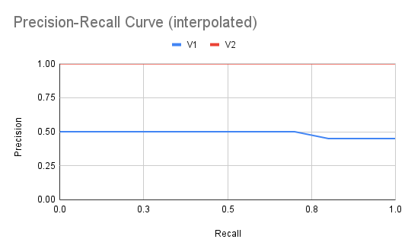
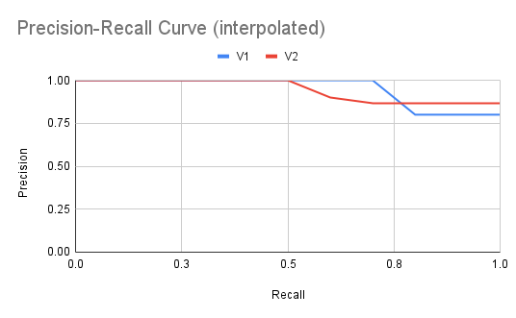
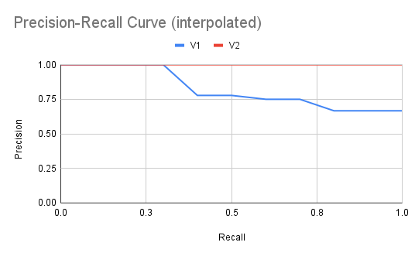
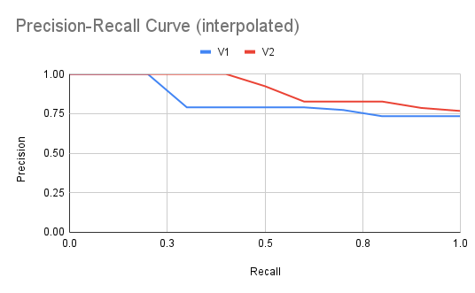
Information need 1
Information need 2
Information need 3
Information need 4

Slide 16
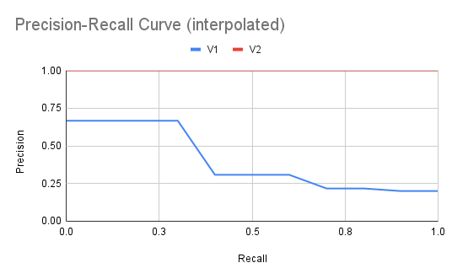
Information need 5

Slide 17
Conclusion
Good understanding of Solr and it's indexing and querying capabilities
Boosting queries gives much better results
Proven that the current iimplementation of the university search engine works

Slide 18
Future work
In the future we will try to further improve the performance of the search engine using different methods, one of them being Natural Language Processing. Additionally we will focus on creating a user interface for the project.

