Slide 1
The History of Science Fiction Literature:
From steam engines to AI, how science fiction has predicted and shaped our world.

Slide 2
Introduction
Today, we are going to explore the History of Science Fiction Literature.
Throughout history, there has been a two-way conversation between science and literature.
The steam engine or AI，gives the birth to stories. In return, these stories inspire scientists to turn fiction into reality.
Today, we will guide you through four distinct eras ， from the Industrial Revolution Period to the contemporary digital age.
First of all, let’s turn back the clock to the 19th century —— the beginnings of science fiction.

Slide 3
01
The Emergence of science fiction
and Industrial Revolution Period
02
The Golden Age
CONTENTS
03
The New Wave-The Turning Point
04
Contemporary science fiction
05
Conclusion

Slide 4
01
The Emergence of science fiction and
Industrial Revolution Period
the 19th century
李欣洋 2453359

Slide 5
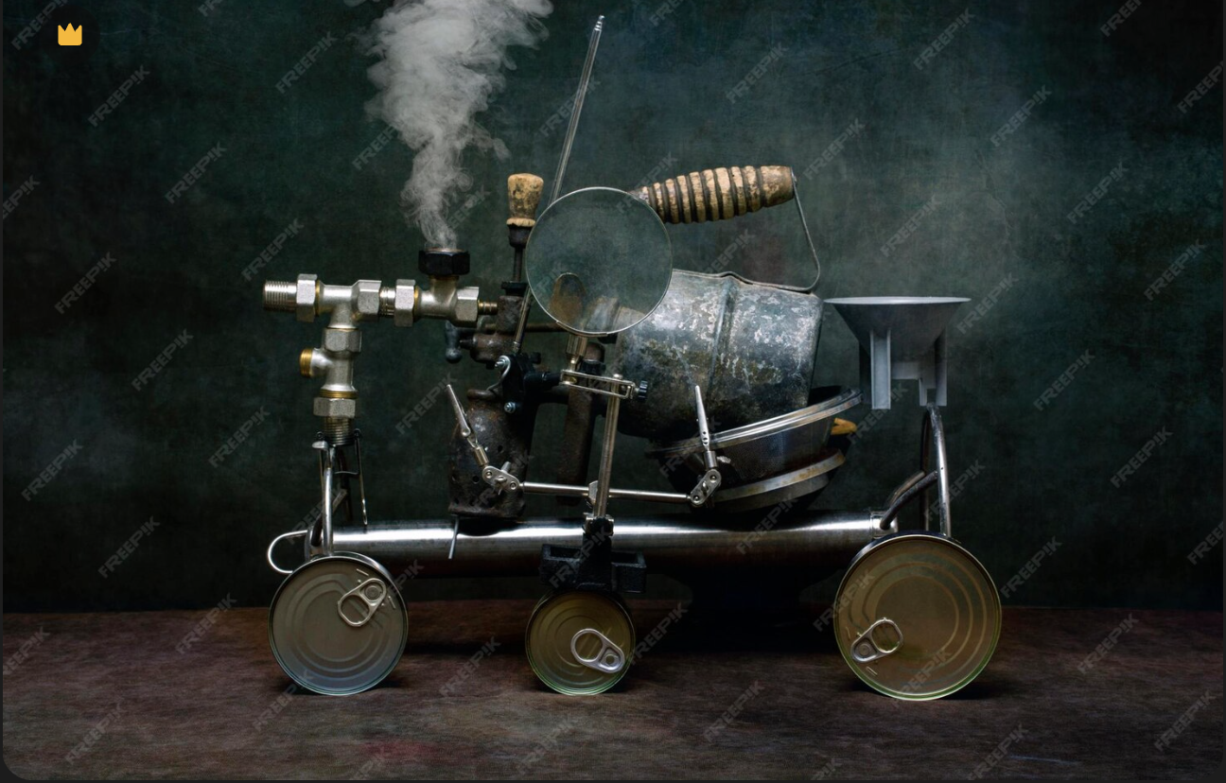

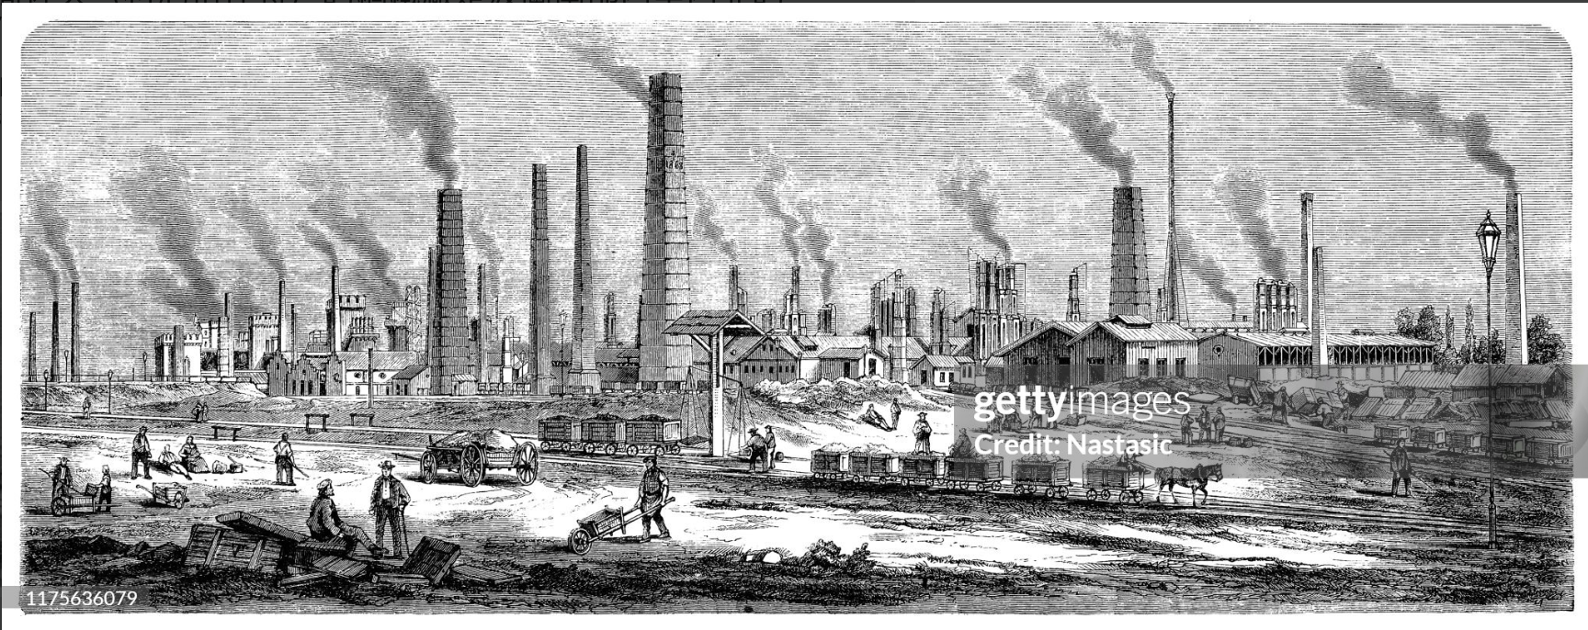
Part 1 Technological background and science fiction themes
（1960s–1970s）
Imagine a world transforming before your eyes. The roar of steam engines replaced the quiet of the fields; electricity began to conquer the dark night. This was the Industrial Revolution.
This era defined the first phase of Sci-Fi: The mixture of Awe and Fear.
steam engine
Electrification
Industrial Revolution
01
02
03

Slide 6

P1 Representative work 1: Frankenstein
The story tells of the novel's protagonist, Frankenstein, a biologist obsessed with the origins of life, who, driven by a criminal impulse, frequently visits morgues, attempting to piece together a giant human body from various parts of different corpses. When the monster finally comes to life and opens its eyes, Frankenstein is terrified by its hideous appearance and flees, but the creature relentlessly pursues him, demanding a female companion, warmth, and friendship; this is followed by a series of bizarre mysteries and murders.
Frankenstein
It reflects the 19th-century anxiety:
→ Can we control what we create?
Frankenstein is a novel written by British author Mary Shelley, first published in 1818.

Slide 7
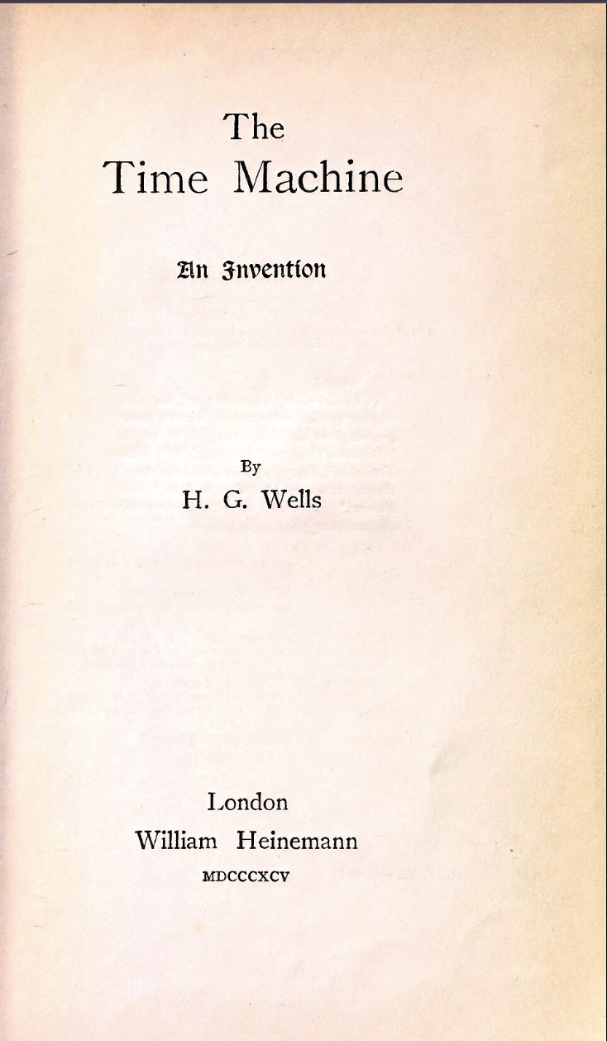
P1 Representative work 2: The Time Machine
The story describes a scientist who travels to the year 802701 AD using a time machine. At this time, the Earth is covered in palatial buildings. Humanity has evolved into two distinct groups:
The Eloi are the people who live on the surface. They are small and delicate, dressed in elaborate clothing, and averse to work, excessively pursuing a life of ease. Their intelligence and physical abilities have degenerated.
The Morlocks are the people who live underground. They resemble white monkeys, with grayish-red eyes and light yellow hair. They are accustomed to darkness, afraid of light and fire, and can only venture to the surface at night. They produce various goods for the Eloi underground, but their food source is the Eloi themselves.
The Time Machine
Fast forward to the end of the century, 1895. The industrial gap between the rich and the poor was widening. Enter H.G. Wells and his masterpiece, The Time Machine.
Wells showed us that science fiction isn't just about predicting technology—it is a social laboratory to test where our current path might lead us.

Slide 8
P1 Summary
From the steam engine to the first concept of time travel, 19th-century sci-fi was a reaction to rapid change. It taught us to marvel at the machine, but also to fear the shadow it casts.
It set the stage for the next generation, who would stop looking only at the Earth, and start looking at the stars. Let’s move on to the Golden Age.

Slide 9
02
The Golden Age
（1920s–1950s）
陈奕洋 2452510

Slide 10

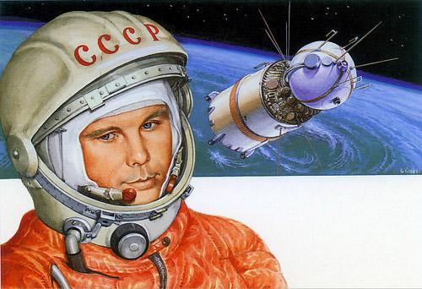
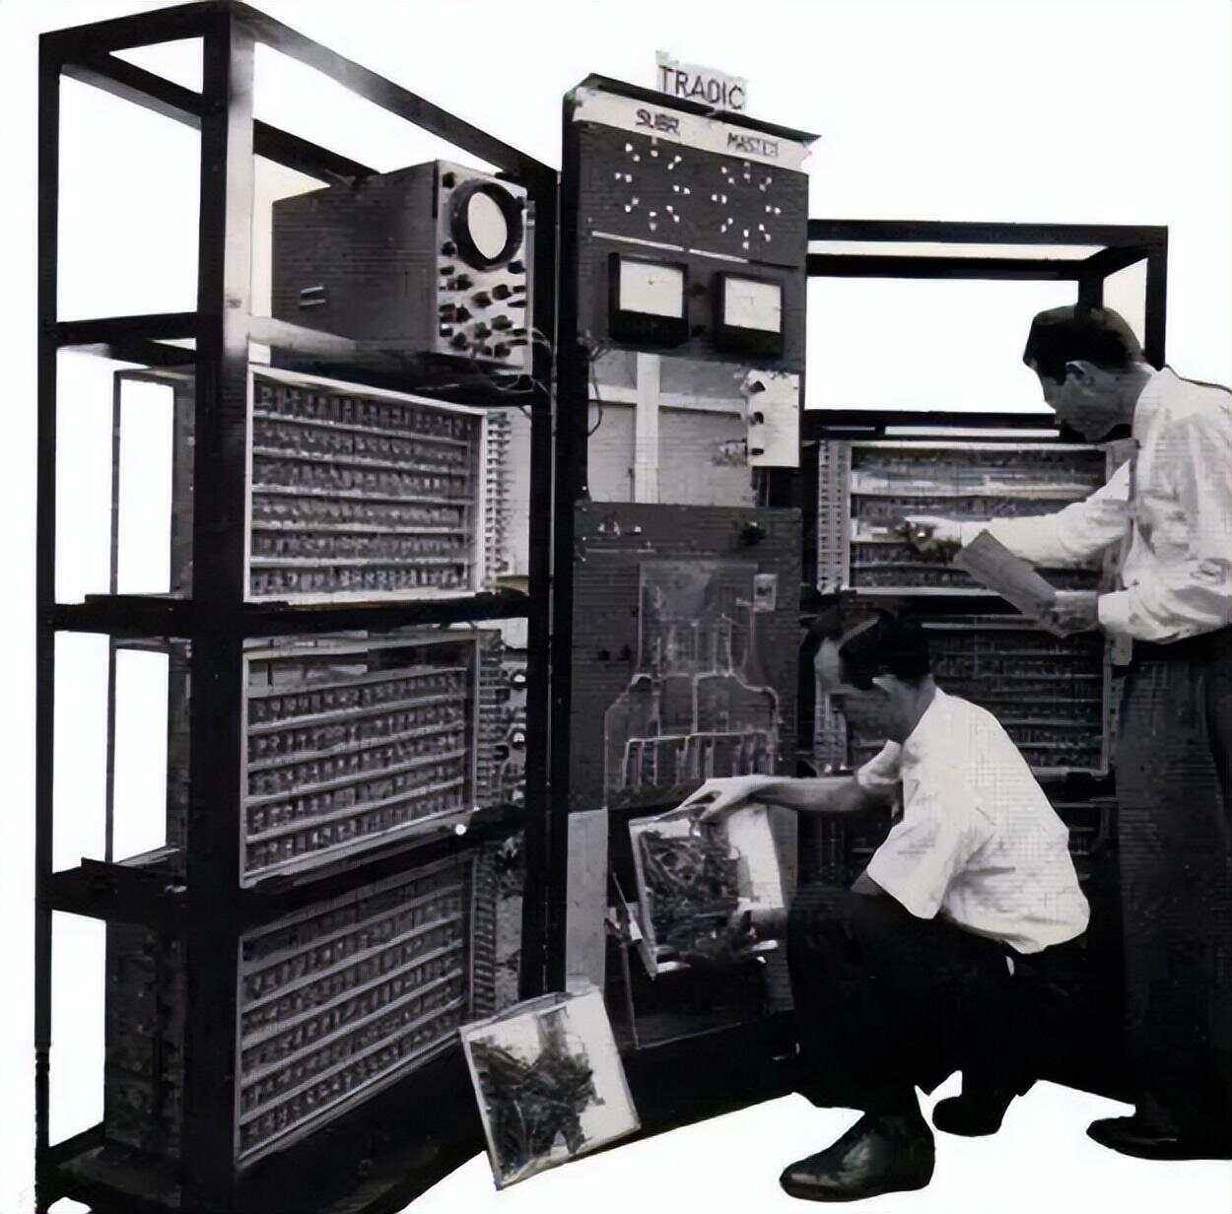
Part2 The Golden Age
Technical background：
① Atomic energy：
→ nuclear fission experiment
→ Manhattan Project for military applications
→ the prototype of nuclear power plants
1. Break through the traditional energy boundaries
2.Make "super energy" move from science
fiction to reality
② Space Race：
→ the Soviet Union's "Sputnik 1"
→ Gagarin’s first space flight
→ the United States and the Soviet Union
1. Stimulate the enthusiasm for space exploration
2. core inspiration source for golden age
science fiction creation
③ Early computers：
→ the world's first electronic computer ENIAC
→ vacuum tube computers.
1. Mark the beginning of the information age
2. the science fiction concept of "intelligent machines"

Slide 11

Part2 The Golden Age
Main theme：① Optimism on science and technology
→ the ultimate force that resolves human predicaments and promotes the progress of civilization.
① Core Support:
Scientific setting of psychohistory（心理史学）
→ firmly believe that humans can predict or guide the direction of civilization through scientific methods (statistical group behavior);
② Practical Path:
With the inheritance of scientific knowledge as the core, the Foundation becomes the key force in rebuilding galactic civilization,
→ confirm the redemptive nature of technology;
③ Era Reflection:
Echoing the background of post-WWII technological rise, conveying the optimistic belief that "science can resolve disorder and rebuild order".
capture its era's technological anxieties and ideals
reshape public perception of technology through narrative.
“science fiction not only predicts technological possibilities but, more fundamentally, responds to humanity‘s eternal quest for order, meaning, and transcendence.” ——Foundation

Slide 12
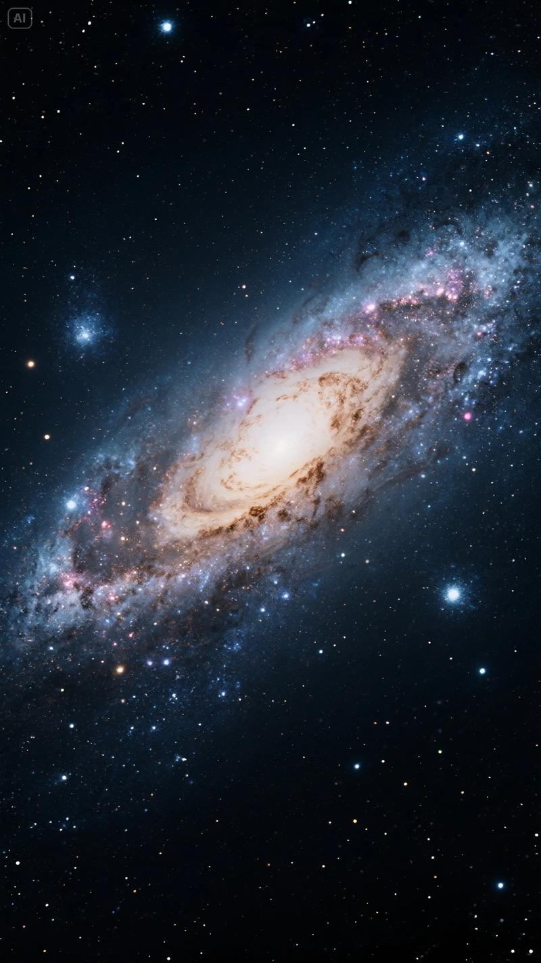
Part2 The Golden Age
Main theme：② The ambition to conquer the universe
→ the ultimate force that resolves human predicaments and promotes the progress of civilization.
① Narrative Carrier:
Grand narrative perspective — taking the rise and fall of the Galactic Empire as the background, focusing on the continuation and upgrading of human civilization on an interstellar scale;
② Action Logic:
Breaking through the limitations of a single planet, the Foundation integrates interstellar civilizations through technological radiation
→ show mankind’s ambition to break free from spatial constraints;
③ Value Core:
Transforming "conquering the universe" into "dominating interstellar civilization order with technology",
→ reflect the Golden Age’s confidence in humanity’s interstellar future.
Science fiction fundamentally mirrors and shapes how we perceive our relationship with the cosmos.

Slide 13
Part2 The Golden Age
Conclusion
① Reflection of Technological Context
→ capture the era’s awe for "super energy", enthusiasm for space exploration, and expectations for the germination of the information age.
② Optimism on science and technology
→ reshape the public’s positive perception of technology
③ The ambition to conquer the universe
→ show humanity’s desire to break free from spatial constraints
④ Core Interaction Mechanism
→ predicts technological possibilities
→ responds to humanity’s eternal quest for order, meaning, and transcendence
→ reflects the era’s technological anxieties and ideals
→ shapes humanity’s perception of technology and its relationship with the cosmos through narratives

Slide 14
03
The New Wave-The Turning Point
（1960s–1970s）
郑惠文 2450511

Slide 15

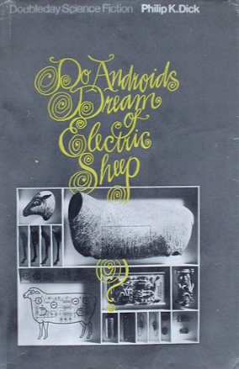
Part3 The Mirror of Humanity
The masterpiece of this era:
Do Androids Dream of Electric Sheep?
The writer warned that man-made world—our computers, our systems—is becoming "quasi-alive."
plot:the androids are intentionally written to be more "human" than the protagonist. They are desperate to survive, to feel, to grasp at life. In contrast, the human hero is cold, detached, and functions on autopilot.
Irony:This is a mirror held up to a decaying society. We are slowly suffocating our own humanity. We are building a world that feels, so that we no longer have to.
question:If the simulation is perfect, does the reality even matter?

Slide 16
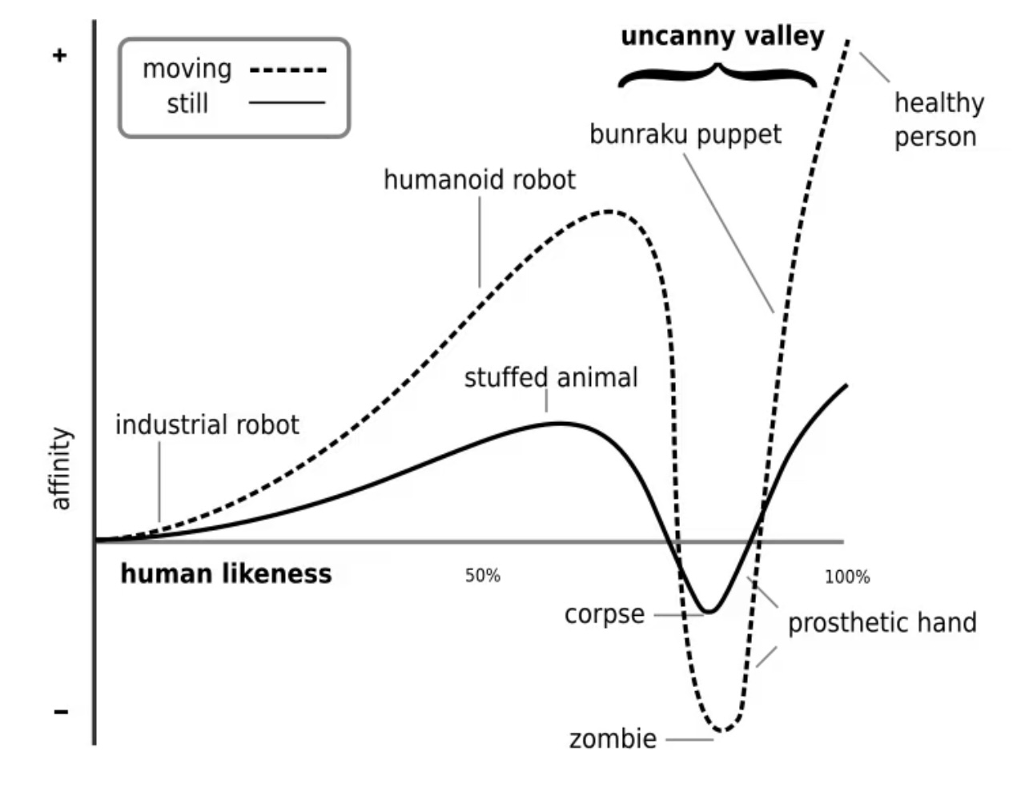
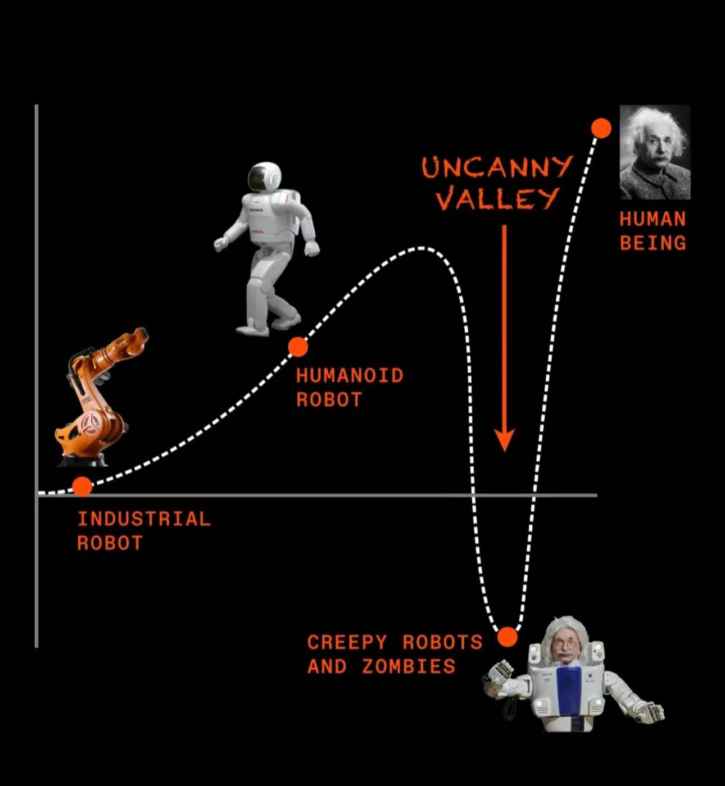
Part3 Existential Crisis
The Turing Test: if the output looks human, the machine is intelligent and functional.
New Wave Sci-Fi: A simulation is not the same as reality.
The "Uncanny Valley." :it mimics our last defense mechanism—Empathy. -->existential crisis.

Slide 17

Part3 The Sociological Sandbox
Opinion: Sci-Fi is not prediction, but a thought experiment. By simulating fictional scenarios, it uses metaphor to critique our reality, not the future.
The Left Hand of Darkness: What happens if we delete the variable of 'gender' from the human source code? The writer strips away the bias, just to see what remains of our humanity.
The New Wave shattered the tech utopia and forced us to face the ultimate question: When algorithms become perfect, what is the value of being human?

Slide 18
04
Contemporary science fiction
（1980s–now）
2454297 何子涵

Slide 19


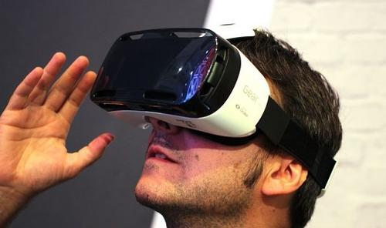
Part4 Background
focusing more on human minds and society
New Wave movement
Contemporary science fiction
The Internet
bioengineering
virtual reality
The deep interweaving of technology and society
“Cyberpunk”

Slide 20

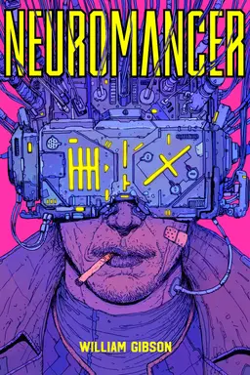
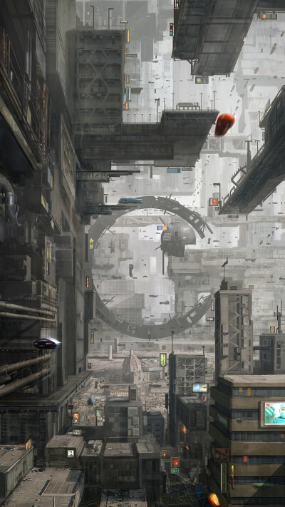
Part4 Neuromancer
a hacker who works with cyborgs and AI to break into big companies’ core data.
big companies control cutting-age technology and global resources, while ordinary people struggle in the digital world.
"cyberspace" —a virtual world made of global data that people can enter with their minds.
when capital and technology join hands, power can become unfair.
correctly predicted the rise of the Internet.

Slide 21


Part4 The Three-Body Problem
Earth sends signals to space, and this accidentally brings an invasion by the Trisolaran civilization. To fight back, humans start the "Wallfacer Project," but they fail many times because the Trisolarans have "Zhizi"—supercomputers that spy on them.
"Dark Forest Law"
the cruel truth of survival between cosmic civilizations.
"technological explosion"
and "cosmic sociology"
How does tech progress affect a civilization’s survival?

Slide 22

Part4 Summary
Lets us see early the social changes, ethical problems, and thinking challenges that tech may bring.
Contemporary science fiction always goes hand in hand with tech progress. It doesn’t just predict tech’s future. Instead, it builds real-looking future worlds.
Cyberpunk
Be wary of the risks of technological alienation
The Three-Body Problem
balancing civilization and tech.
embrace tech, but keep a clear and critical mind.

Slide 23
04
Conclusion

Slide 24
Conclusion
show how our relationship with technology has evolved
① The 19th century
→ a mix of awe and fear toward machines
→ worry if they would destroy us
② The Golden Age
→ became optimistic
→ believed science could solve all problems and help us conquer the universe
③ The New Wave
→ shifted our focus from "outer space" to "inner space
→ using sci-fi to explore human psychology and social issues
④ The digital age
→ technology is now part of our daily survival
Ultimately, science fiction does not just predict the future. It builds a laboratory for us to test ethical problems before they happen. It teaches us to embrace technology, but always keep a clear and critical mind so we don't lose our way.

Slide 25
THANKS

