Slide 1
关于某项技术的研究与实现
XX学院论文汇报
毕业答辩模板
学号： 12345678
答 辩 人： 山丘
指导老师： 山丘

Slide 2
01
The Emergence and Industrial Revolution Period
02
研究方法与目标思路
CONTENTS
03
案例分析与实践难点
04
研究成果与应用前景

Slide 3
01
The Emergence and Industrial Revolution Period
李欣洋 2453359

Slide 4
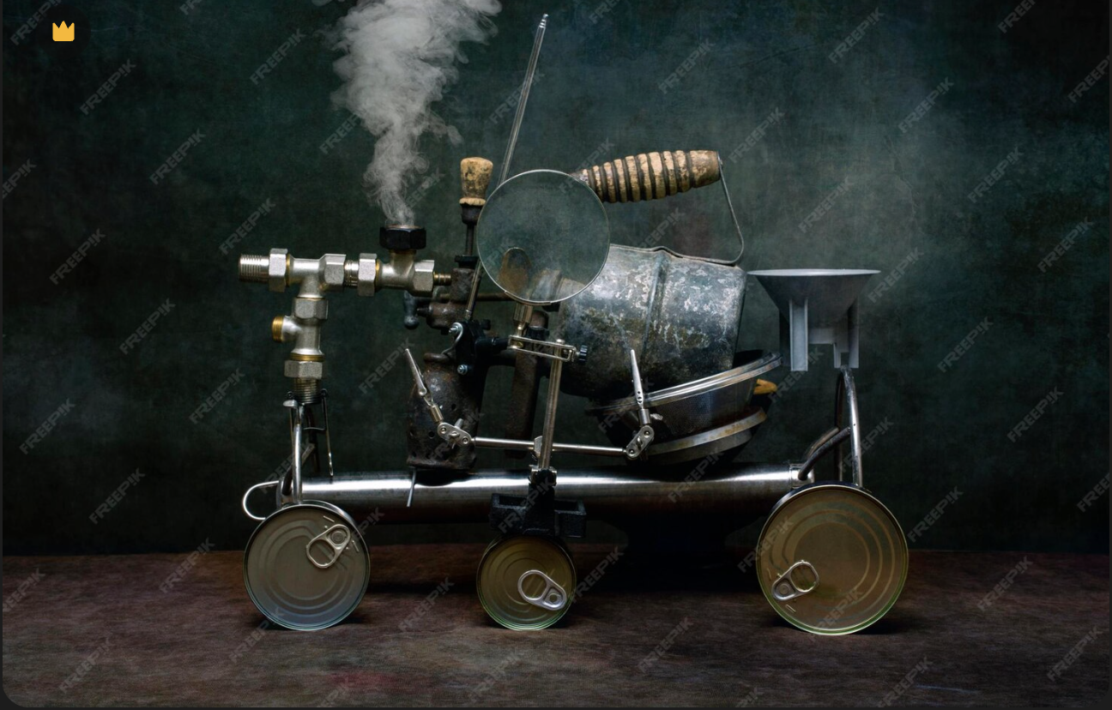

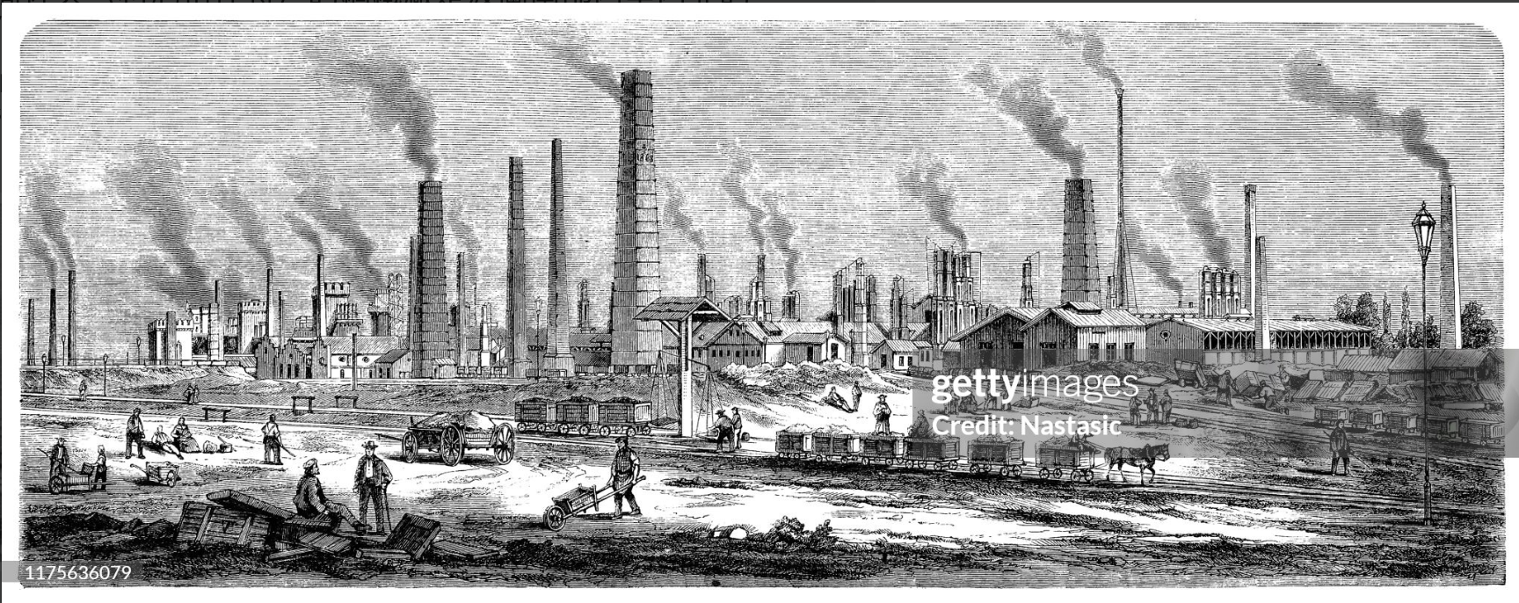
Technological background and science fiction themes
Imagine a world transforming before your eyes. The roar of steam engines replaced the quiet of the fields; electricity began to conquer the dark night. This was the Industrial Revolution.
This era defined the first phase of Sci-Fi: The mixture of Awe and Fear.
steam engine
Electrification
Industrial Revolution
01
02
03
04

Slide 5
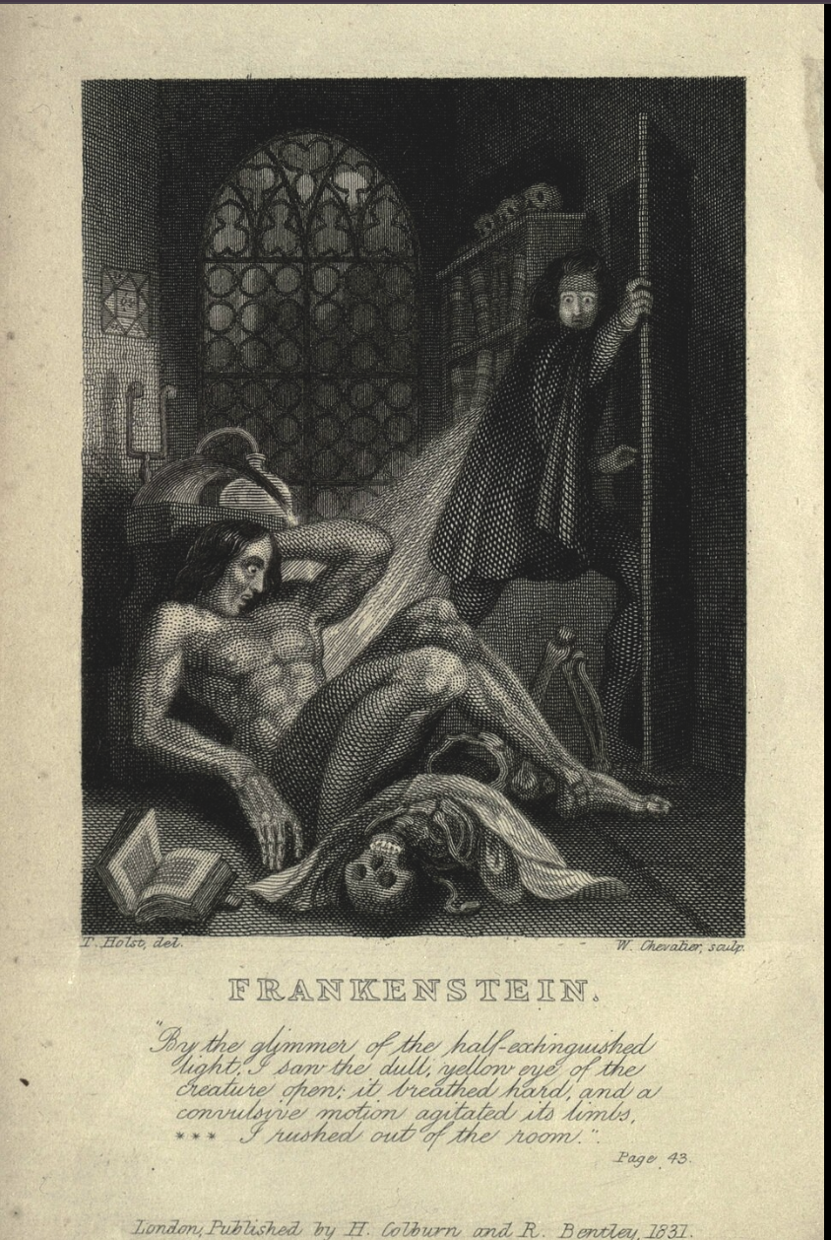
Representative work 1: Frankenstein
The story tells of the novel's protagonist, Frankenstein, a biologist obsessed with the origins of life, who, driven by a criminal impulse, frequently visits morgues, attempting to piece together a giant human body from various parts of different corpses. When the monster finally comes to life and opens its eyes, Frankenstein is terrified by its hideous appearance and flees, but the creature relentlessly pursues him, demanding a female companion, warmth, and friendship; this is followed by a series of bizarre mysteries and murders.
Frankenstein
It reflects the 19th-century anxiety: Can we control what we create?
Frankenstein is a novel written by British author Mary Shelley, first published in 1818.

Slide 6
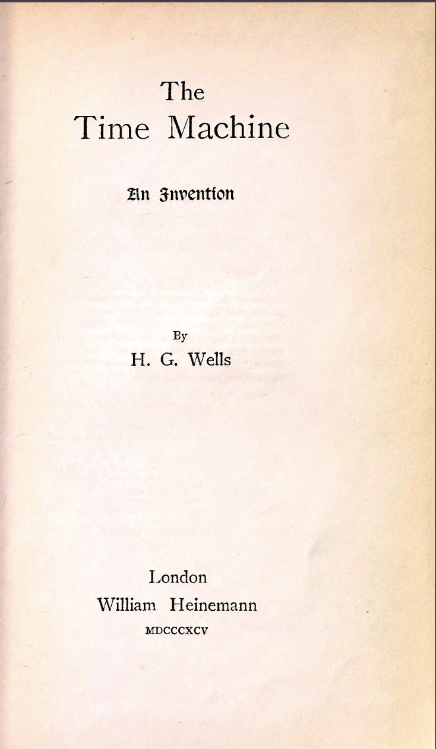
Representative work 2: The Time Machine
The story describes a scientist who travels to the year 802701 AD using a time machine. At this time, the Earth is covered in palatial buildings. Humanity has evolved into two distinct groups:
The Eloi are the people who live on the surface. They are small and delicate, dressed in elaborate clothing, and averse to work, excessively pursuing a life of ease. Their intelligence and physical abilities have degenerated.
The Morlocks are the people who live underground. They resemble white monkeys, with grayish-red eyes and light yellow hair. They are accustomed to darkness, afraid of light and fire, and can only venture to the surface at night. They produce various goods for the Eloi underground, but their food source is the Eloi themselves.
The Time Machine
Fast forward to the end of the century, 1895. The industrial gap between the rich and the poor was widening. Enter H.G. Wells and his masterpiece, The Time Machine.
Wells showed us that science fiction isn't just about predicting technology—it is a social laboratory to test where our current path might lead us.

Slide 7
Summary
From the steam engine to the first concept of time travel, 19th-century sci-fi was a reaction to rapid change. It taught us to marvel at the machine, but also to fear the shadow it casts.
It set the stage for the next generation, who would stop looking only at the Earth, and start looking at the stars. Let’s move on to the Golden Age.

