Slide 1
Kaggle - Two Sigma Connect: Rental Listing Inquiries
-Keshav Malpani

Slide 2
Overview:
To determine on what criteria the interest level showed by the tenants depends
The outcome is what would be a “good listing” that would get the maximum interest
Performed exploratory data analysis
Performed data cleaning, preprocessing and generated new features
Use the different ML algorithms to generate accuracy and log loss
Compared the log loss score and selected the best approach
Tools and Libraries used: Python, Scikit Learn, Numpy, Pandas, NLTK, Matplotlib, Plotly, Gpxpy

Slide 3
Data Cleaning and Preprocessing:
Data cleaning
Removed usernames, URL, HTML tags, hashtags, punctuation, stop words and special characters
Stemming
Slang Conversion
Tokenization
Tf-Idf Vectorization
Label Encoding using Preprocessing
Training and Testing
K – Fold Cross Validation (k = 10/100)
Stratified K – Fold Cross Validation (k = 10/100)

Slide 4
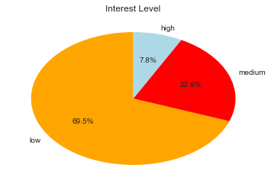
Disparity in the data:
The data given is highly skewed
Use stratified k-fold approach for taking equal portions of data of each class
Make the class names into labels for easier processing –
1 - high , 2 - medium, 3 - low
Having unbalanced data might cause performance variation and results tend to go towards the label with more training examples

Slide 5
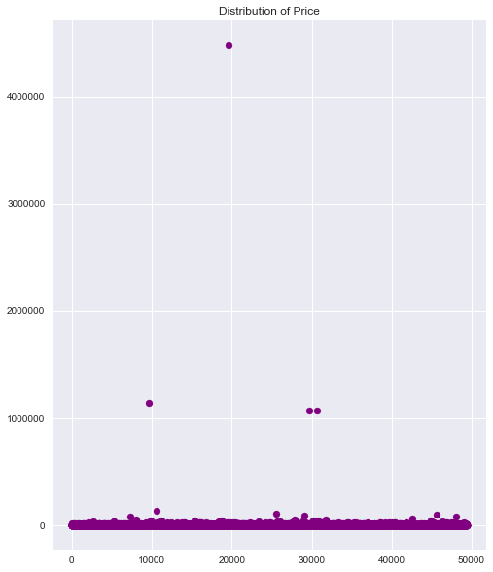
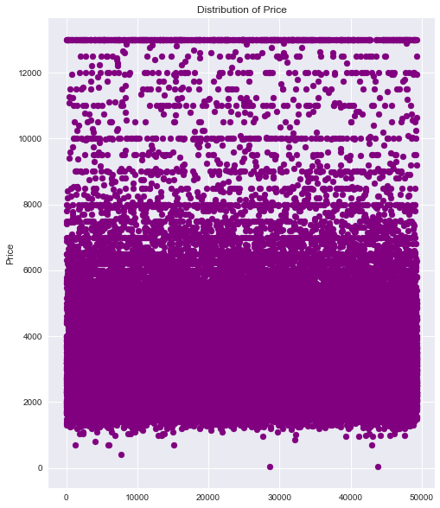
Removing outliers based on price:

Slide 6
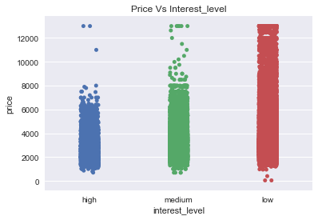
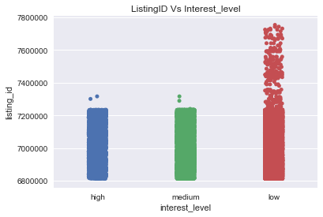
Price vs Interest: Listing ID vs Interest:

Slide 7
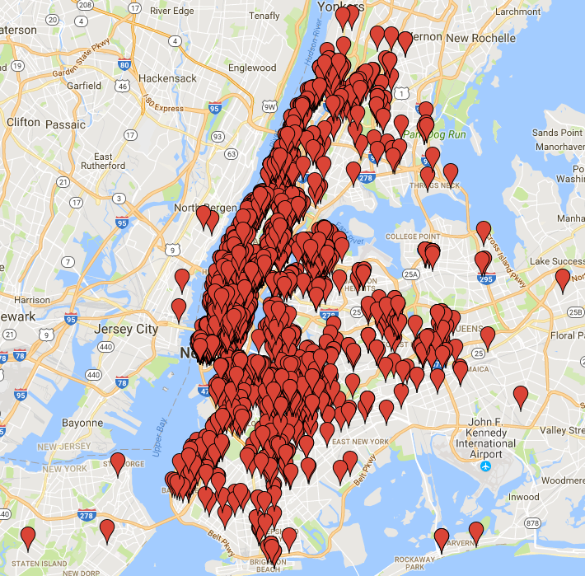
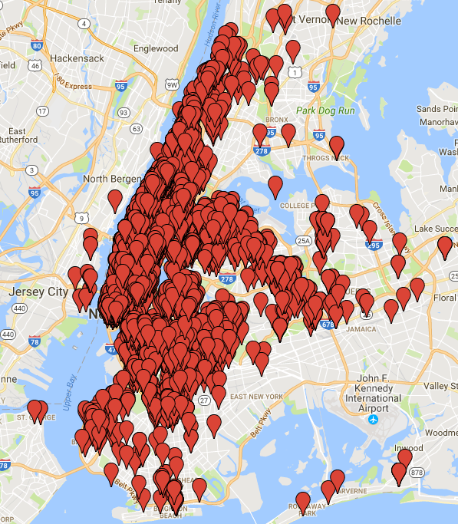
Interest Level based on Latitude and Longitude: High: Medium:

Slide 8
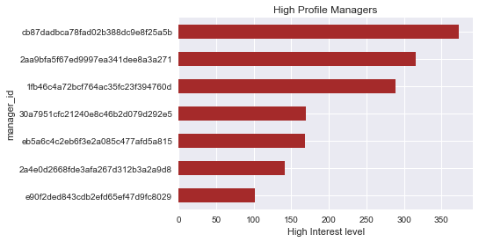
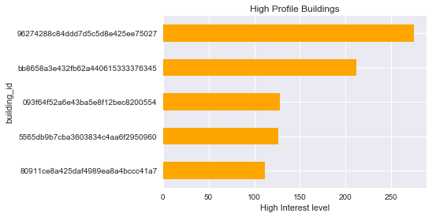
Repeated Managers and Buildings in the data:

Slide 9
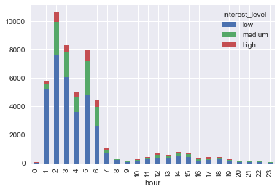
Time of the Day vs Interest Level:

Slide 10
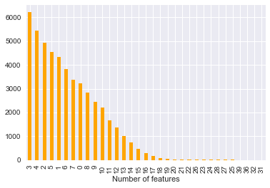
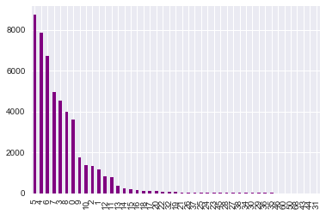
Interest based on features and photos: No. of Features: No. of Photos:

Slide 11
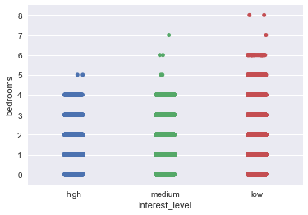
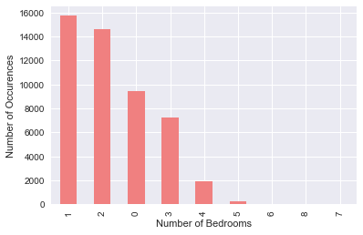
Analysis on the number of bedrooms:

Slide 12
Classifiers used and Results:
Classifier | Accuracy | Log Loss
Random Forests Classifier (n = 100) | 78.90% | 0.61
Extra Trees Classifier (n = 100) | 75.96% | 1.1
AdaBoost Classifier | 76.59% | 0.92
Logistic Regression | 72.32% | 0.69
Soft Voting Classifier (RF, ET, AdaB & LR) | 79.02% | 0.62
XGBoost Classifier | 81.20% | 0.57

Slide 13
Thank you. Any Questions?

