Slide 1
Developing and Optimizing Data Structures for a Dynamic Inventory Management System in Python
Term Project, Deliverable 4: Final Presentation
Rahul Solanki
MSCS-532-B01: Algorithms and Data Structures
School of Computer and Information Sciences, University of the Cumberlands | Dr. Michael Solomon
August 2, 2026
https://github.com/iknalos/MSCS-532-Project-Deliverable-4
Notes:
Good afternoon. This presentation summarizes my term project: designing, implementing, and optimizing the data structures behind a dynamic inventory management system in Python. The project ran in three phases: a design phase that chose one structure per query pattern, a proof-of-concept phase that implemented everything from first principles with a full test suite, and an optimization phase that removed the measured bottlenecks and quantified the result. Over the next fifteen minutes I will walk through the application and its requirements, the design rationale, the proof of concept, the optimization work including two instructive failures, and the measured results. The one-line thesis, which every result will illustrate: asymptotic analysis chooses the structure, but in an interpreted language, measurement gets the final vote.

Slide 2
The Problem: Dynamic Inventory
E-commerce inventory changes continuously
Every sale and delivery moves a quantity
Prices move with promotions; products come and go
Four latency-sensitive query patterns
Exact SKU lookup
Low-stock alerts: the k scarcest products
Price-band queries for merchandising
Category listing
No single structure serves all four efficiently
Rahul Solanki | MSCS-532-B01 | Dynamic Inventory Management
2
Notes:
Inventory sits on the critical path of a commerce operation. The workload is highly dynamic: every sale decrements stock, every delivery increments it, and prices change constantly. On top of that mutation stream, the business asks four very different questions: find this SKU now, what is about to run out, what do we sell between ten and twenty-five dollars, and what is in this category. Two workload properties matter as much as the queries themselves. The traffic is skewed: a small fraction of products receives most of the lookups, roughly the familiar eighty-twenty pattern of retail demand. And the operations on the sales path, quantity updates and low-stock checks, are latency-sensitive, because they run inside request handlers. Each question favors a different data structure, and no single structure serves all four, which is exactly what makes this a good case study in data structure composition rather than data structure selection.

Slide 3
Design: One Structure per Query Pattern
Hash table → SKU lookup, O(1) expected
Binary min-heap (keyed on quantity) → low-stock, O(log n)
Skip list (keyed on price, SKU) → range queries, O(log n + m)
Hash table of category → SKU set → listing, O(1) membership
InventorySystem facade keeps all indexes consistent
Validate first, then mutate every affected index
Rahul Solanki | MSCS-532-B01 | Dynamic Inventory Management
3
Notes:
The design maps each query pattern to the structure whose guarantees fit it. A hash table gives constant expected time SKU lookup. A binary min-heap keyed on quantity keeps the scarcest product at the root. A skip list, Pugh's randomized ordered structure, serves price ranges in expected log n plus output time without any rebalancing code. Keys are price-SKU pairs so equal prices stay totally ordered. A facade class composes the indexes and keeps them consistent: every mutation validates its input first, then updates the hash table, heap, and skip list together, so a failed operation can never leave the indexes disagreeing. Alternatives were weighed and rejected explicitly: a balanced search tree offers worst-case bounds but at much higher implementation risk than a skip list; cuckoo hashing gives worst-case constant lookup but pays with eviction cascades on insertion, wrong for a mutation-heavy index; and Fibonacci heaps improve exactly the operation we care about, decrease-key, but their constant factors are famously poor. Those rejections were bets on constant factors, and the measurement phase will show how decisive constant factors turn out to be.

Slide 4
Phase 2: Proof of Concept
Every structure implemented from first principles
No external dependencies in the core
All operations functional end to end
add / get / update quantity / update price / remove
low_stock(k), price ranges, categories
65-test contract suite + guided demo script
Same assertions later validate the optimized code
Known bottlenecks documented, deliberately deferred
Rahul Solanki | MSCS-532-B01 | Dynamic Inventory Management
4
Notes:
Phase 2 delivered a correct, fully tested proof of concept. Each structure is its own module, implemented from scratch, with no third-party dependencies, so what we measure later is my code and not library internals. Every operation works end to end: adding and removing products, updating quantities and prices with the changes visible through every index, low-stock alerts, price ranges, and category listing, all exercised by a guided demo script. The tests are organized as contract classes, meaning the identical assertions can run against any implementation of the same interface. That decision pays off in phase three, because it proves the optimized system is observably equivalent to the baseline. Known inefficiencies, like the heap's linear-time update by SKU, were documented in the code as deliberate deferrals, which turned phase three from a search for problems into the execution of a plan.

Slide 5
Testing: Contracts Make Optimization Safe
65 tests, written once against each interface
Unit: ordering, resizing, tombstones, duplicates
Integration: updates visible through every index
Edge cases: empty, zero qty, equal prices, bad input
Randomized workloads vs reference models
Same suite binds to baseline AND optimized code
Full suite runs in < 0.1 s → ran after every change
Rahul Solanki | MSCS-532-B01 | Dynamic Inventory Management
5
Notes:
Before optimizing anything, the safety net. The suite has sixty-five cases, but the important property is how they are written: as contract classes against each interface, bound to concrete implementations in one line each. Unit tests cover ordering, resizing, and tombstones; integration tests confirm that an update is visible through every index; edge cases cover empty structures, zero quantities, equal prices, and invalid input; and randomized workloads are checked against reference models built on Python's own primitives, so thousands of random operations must match a known-good oracle exactly. Stress cases go after the failure modes unit tests miss, like twenty-five hundred delete-and-reinsert cycles that exercise tombstone reuse. Because the whole suite runs in under a tenth of a second, it ran after every optimization step, and it caught regressions twice before any benchmark number was trusted. Every speedup you are about to see comes with this guarantee of unchanged behavior.

Slide 6
Measured Bottlenecks in the Baseline
Heap update-by-SKU: O(n) linear scan
Every quantity change scans the heap array
Low-stock query: sorts all n entries for top k
Build: n individual inserts, O(n log n)
Interpreter overhead on every skip-list pointer hop
Per-node objects inflate memory
Rahul Solanki | MSCS-532-B01 | Dynamic Inventory Management
6
Notes:
Profiling the proof of concept confirmed the bottlenecks the design predicted. The dominant one is the heap: changing a product's quantity means finding it, and a binary heap only supports that by scanning the array, which is linear time per update. On the sales hot path, that is the worst possible place for a linear term. The low-stock query sorted all n entries to return ten, an n-log-n cost for a constant-size answer. Building the system used n independent inserts instead of one bulk pass. And two costs are specific to Python rather than to the algorithms: every skip-list pointer hop is an interpreted operation with real per-step cost, and per-node objects carry attribute dictionaries that inflate memory. Notice the split: the first three are asymptotic problems, the last two are constant-factor problems. The optimizations divide the same way.

Slide 7
Phase 3: Optimizations
Indexed heap: position map → O(log n) updates
Floyd's heapify: O(n) bulk build
Top-k via frontier walk: O(k log k), not a full sort
Open-addressing hash table
Perturbed probing, load cap 2/3, tombstones, flat arrays
Skip list → sorted array + C-level bisect
Deliberate read/write trade-off for read-heavy workloads
bulk_load, __slots__, scan-resistant LRU cache
Rahul Solanki | MSCS-532-B01 | Dynamic Inventory Management
7
Notes:
Phase 3 made four structural changes. The heap gained a position map from SKU to array index, maintained during sifts, making updates logarithmic; bulk construction uses Floyd's linear-time heapify; and top-k walks the heap as an implicit tree with a small frontier, touching on the order of k nodes instead of sorting all n. The hash table moved to open addressing with CPython-style perturbed probing, a two-thirds load cap, and tombstone deletion, with keys and values in flat parallel arrays for memory contiguity; tombstones are compacted away at resize, so endless delete-and-reinsert churn cannot degrade the probe chains. The skip list was replaced by a sorted array driven by the C-implemented bisect module, an explicit trade-off: writes now pay linear-time shifts, but each shift is a single memmove in C while every skip-list hop is interpreted, so reads win big and the write penalty stays affordable for read-heavy retail traffic. Finally, system-level work: one-pass bulk load, slots on hot classes to cut per-object memory, and a four-thousand-entry LRU cache exploiting the eighty-twenty lookup skew.

Slide 8
Two Instructive Failures
Generator-based probing made lookups SLOWER
One Python frame per probe step > entire chaining cost
Fix: inline the probe loop
Range queries polluted the LRU cache
Cold scan keys evicted the hot working set
Fix: scans bypass the cache (scan-resistant policy)
Lesson: in interpreted code, constant factors are design
Rahul Solanki | MSCS-532-B01 | Dynamic Inventory Management
8
Notes:
Two failures along the way are worth a slide because they generalize. First, my initial open-addressing table generated probe indices with a Python generator, which reads beautifully. But resuming a generator costs a frame switch on every probe step, and that per-step overhead exceeded the entire cost of the chaining baseline it was supposed to beat: the optimized table measured slower until I inlined the probe loop, at which point the win appeared. The algorithm was never wrong; the constant factor was. Second, my first cache design routed range-query results through the LRU cache. Range queries touch many keys exactly once, so each scan evicted the hot working set and the cache stopped helping the lookups it existed for, classic cache pollution. Scan-type queries now bypass the cache entirely, the same reason database buffer pools use scan-resistant replacement policies. The shared lesson, and the sorted-array decision is a third instance of it: in an interpreted language, constant factors are part of the design space, not an afterthought.

Slide 9
Results: Speedup vs Baseline (100k products)
Operation | Gain | What changed
Quantity updates | 2,750x | O(n) scan removed
Low-stock queries | 3,403x | Full sort removed
Bulk load | 2.4x | Floyd's heapify
Skewed lookups | 1.4x | Open addressing + cache
Price-range queries | 1.6x | Sorted array + C bisect
Peak memory | 69 → 58 MiB | Flat arrays + __slots__
Correctness | 65/65 | Same contract, both builds
Rahul Solanki | MSCS-532-B01 | Dynamic Inventory Management
9
Notes:
Here are the headline numbers at one hundred thousand products, and they split exactly along the asymptotic versus constant-factor line. Where an order of growth was removed, the gains are enormous and grow with n: quantity updates and low-stock queries are thousands of times faster, and those ratios have no ceiling, because the baseline pays a linear or n-log-n term the optimized version simply does not have. Where the change was constant-factor, gains are steady and bounded: bulk load, lookups, and range queries improve by tens of percent to a couple of times, at every size. Peak memory dropped by about seventeen percent, from sixty-nine to fifty-eight mebibytes, which is the flat arrays and slots records replacing per-node objects. And critically, the identical sixty-five-test contract passes on both implementations, so every one of these speedups comes with unchanged observable behavior. In practical terms, the two sales-path operations moved from milliseconds toward microseconds, the difference between an index that can sit inside a request handler and one that needs batching.

Slide 10
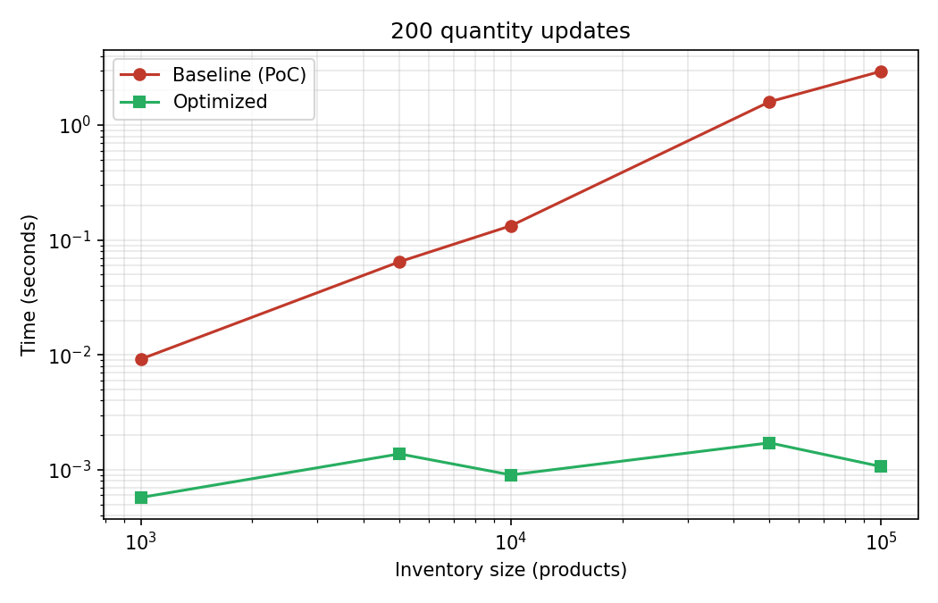
Asymptotics Dominate at Scale
Log-log: diverging curves = an O(n) term removed
Baseline update cost grows linearly with n
Indexed heap stays near-flat
Rahul Solanki | MSCS-532-B01 | Dynamic Inventory Management
10
Notes:
This log-log plot shows the cost of two hundred quantity updates as catalog size grows from one thousand to one hundred thousand products. Both axes are logarithmic, so a polynomial cost is a straight line and its slope is the exponent. The baseline curve climbs steadily because each update scans the heap array to find the product before sifting it; the optimized curve stays nearly flat because the position map answers the same question in constant time and the sift is logarithmic. Diverging lines on a log-log plot are the visual signature of an order-of-growth difference, not a tuning difference: no amount of micro-optimization moves a curve's slope, only removing the linear term does.

Slide 11
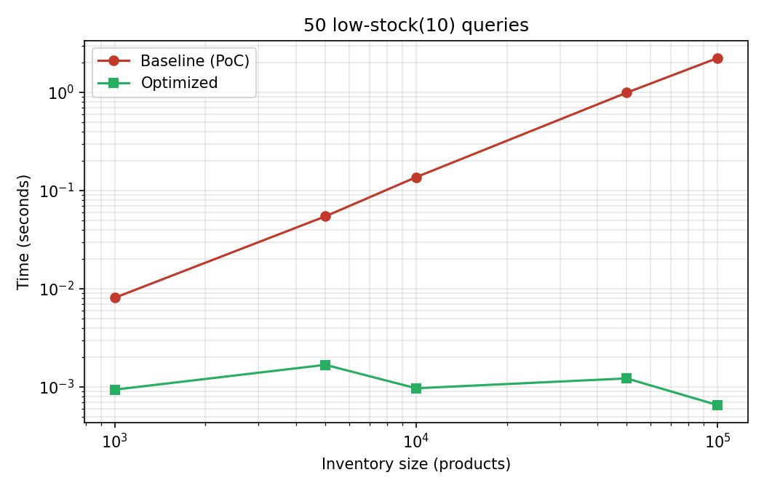
Same Story for Low-Stock Alerts
Baseline: sort all n per query, O(n log n)
Optimized: O(k log k) frontier walk
3,403x at n = 100,000
Rahul Solanki | MSCS-532-B01 | Dynamic Inventory Management
11
Notes:
The low-stock query shows the same divergence, and it is worth seeing twice because the mechanism is different. The baseline sorts the entire heap array on every query, an n-log-n cost paid to return ten items. The optimized version exploits the heap property itself: the smallest element is at the root, and the next candidates are always children of what has been taken, so a small frontier walk touches on the order of k nodes no matter how large the catalog grows. At one hundred thousand products that is a factor of several thousand, and unlike a constant-factor win, it keeps growing with the catalog.

Slide 12
Limitations and Future Work
Sorted-array writes are O(n)
B-tree / LSM-style index if price churn dominates
Cache helps only skewed traffic
Single-process, in-memory; synthetic workloads
Future work follows from each limitation
Persistence (write-ahead logging), concurrency
Production traces; C extensions for hot loops
Rahul Solanki | MSCS-532-B01 | Dynamic Inventory Management
12
Notes:
Honest limitations. The sorted price index pays linear-time writes, which is the right trade only while reads dominate; a B-tree or LSM-style structure is the escape hatch if price churn ever grows to dominate the workload. The cache only helps skewed traffic; under uniformly random lookups it would be roughly neutral. The system is single-process and in-memory, and the benchmarks run on synthetic catalogs with an assumed skew, not production traces; those assumptions are stated rather than hidden, and they bound what the numbers can claim. Future work follows directly from each limitation: durability through write-ahead logging, concurrency with finer-grained structures, validation on production traces, and C extensions for the remaining hot loops if constant factors must shrink further. A more research-flavored direction: characterizing the crossover point where pointer-based ordered structures overtake contiguous ones for a given interpreter and read-write mix, turning the trade-off made here into a predictive model.

Slide 13
Conclusion
Theory chooses the structure; measurement validates it
Asymptotic fixes: gains that grow with n
Constant-factor fixes: steady, workload-dependent gains
Contract tests made optimization safe
Code, tests, benchmarks: https://github.com/iknalos/MSCS-532-Project-Deliverable-4
Questions?
Rahul Solanki | MSCS-532-B01 | Dynamic Inventory Management
13
Notes:
To conclude: the project delivered a principled design, a correct and fully tested proof of concept, and an optimization pass that improved every measured operation and reduced memory while an identical test contract guaranteed unchanged behavior. The central lesson is the interplay between theory and measurement. Asymptotic analysis chose the structures and predicted where they would fail, and both predictions held. But measurement got the final vote three times: a generator erased an algorithmic win until it was inlined, a cache was destroyed by scans until they bypassed it, and a textbook-inferior sorted array beat a skip list because its inner loop runs in C. Theory chooses the structure; measurement validates the choice; and the test contract is what lets you act on the measurements safely. All code, tests, benchmarks, and this presentation are on GitHub at the link shown. Thank you, and I am happy to take questions.

