Slide 1
















$$aY∈RB\left(T\right)$$
$$Y∈MR\left(T\right)⊆ \\ RB(T)∩LB(T)$$
$$aY$$
$$a∈Weiner(Y)$$
$$Y$$
$$d$$
$$c$$
$$d$$
$$b∉Goto(aY)$$
$$b∈Goto(Y)$$
$$aYb$$
$$a∉Weiner(Yb)$$
$$c$$
$$Yb$$
$$aYb∈MAW\left(T\right) \\ ⊆AW(T)$$
$$Yb∈LB\left(T\right)$$

Slide 2




$$aY∈RB\left(T\right)$$
$$Y∈MR\left(T\right)⊆ \\ RB(T)∩LB(T)$$
$$aY$$
$$a∈Weiner(Y)$$
$$Y$$
$$d$$
$$c$$
$$d$$
$$b∈Goto(aY)$$
$$b∈Goto(Y)$$
$$aYb$$
$$a∈Weiner(Yb)$$
$$c$$
$$Yb$$
$$aYb∈MUS\left(T\right) \\ ⊆W(T)$$
$$Yb∈LB\left(T\right)$$
a leaf $l$ with $weight\left(l\right)=1$

Slide 3


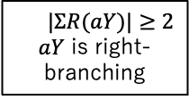


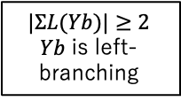
$$aY$$
$$a∈Weiner(Y)$$
$$Y$$
$$Y∈MR\left(T\right)⊆ \\ RB(T)∩LB(T)$$
$$|ΣR(aY)|≥2$$ $aY$ is right-branching
$$d$$
$$c$$
$$d$$
$$b∈Goto(aY)$$
$$b∈Goto(Y)$$
$$aYb$$
$$a∈Weiner(Yb)$$
$$c$$
$$Yb$$
$$|ΣL(Yb)|≥2$$
$Yb$ is left- branching
$$aYb∈{MF}_{=k}\left(T\right) \\ ⊆W(T)$$
subtree with $weight\left(l\right)=k$

Slide 4


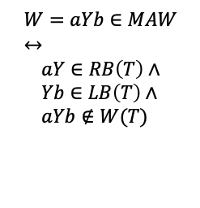










$$W=aYb∈MAW \\ ↔$$
$$aY∈RB\left(T\right)∧ \\ Yb∈LB\left(T\right)∧ \\ aYb∉W(T)$$
$$aY∈RB\left(T\right)$$
$$a$$
$$Y∈MR(T)⊆RB(T)∩LB(T)$$
$$b$$
$$c$$
$$a$$
$$aYb∈MAW(T)$$
$$b$$
$$Yb∈LB\left(T\right)∧$$
$$a$$
$$b$$
$$aYb∉W(T)$$

