Slide 1
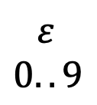




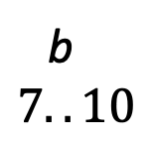

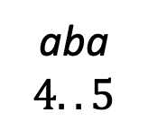


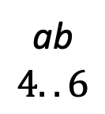

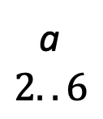

𝑆 = 𝑎 𝑎 𝑏 𝑎 𝑎 𝑏 𝑎 𝑏 𝑏 $
1 2 3 4 5 6 7 8 9 $10$
Idx
$$SA$$
$$LCP$$
$$BWT$$
$$ISA$$
Sorted suffixes
$$Σ=\left\{a,b\right\} (\$< a<b)$$
1 2 3 4 5 6 7 8 9 $10$
$$ε$$
$$0..9$$
$$1$$
$$2$$
$$3$$
$$4$$
$$5$$
$$6$$
$$7$$
$$8$$
$$9$$
$$10$$
$$10$$
$$1$$
$$4$$
$$2$$
$$5$$
$$7$$
$$9$$
$$3$$
$$6$$
$$8$$
$$0$$
$$0$$
$$4$$
$$1$$
$$3$$
$$2$$
$$0$$
$$1$$
$$2$$
$$1$$
$$b$$
$$\$$$
$$b$$
$$a$$
$$a$$
$$b$$
$$b$$
$$a$$
$$a$$
$$a$$
$$2$$
$$4$$
$$8$$
$$3$$
$$5$$
$$9$$
$$6$$
$$10$$
$$7$$
$$1$$
$
aabaababb$
aababb$
abaababb$
ababb$
abb$
b$
baababb$
babb$
bb$
a
$$2..6$$
aba
$$4..5$$
ab
$$4..6$$
b
$$7..10$$

Slide 2
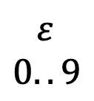




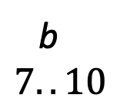


Idx
$$SA$$
$$LCP$$
$$BWT$$
$$ISA$$
Sorted suffixes
$$S=aabaababb\$$$
1 2 3 4 5 6 7 8 9 $10$
1 2 3 4 5 6 7 8 9 $10$
$$1$$
$$2$$
$$3$$
$$4$$
$$5$$
$$6$$
$$7$$
$$8$$
$$9$$
$$10$$
$$10$$
$$1$$
$$4$$
$$2$$
$$5$$
$$7$$
$$9$$
$$3$$
$$6$$
$$8$$
$$0$$
$$0$$
$$4$$
$$1$$
$$3$$
$$2$$
$$0$$
$$1$$
$$2$$
$$1$$
$$b$$
$$\$$$
$$b$$
$$a$$
$$a$$
$$b$$
$$b$$
$$a$$
$$a$$
$$a$$
$$2$$
$$4$$
$$8$$
$$3$$
$$5$$
$$9$$
$$6$$
$$10$$
$$7$$
$$1$$
$
aabaababb$
aababb$
abaababb$
ababb$
abb$
b$
baababb$
babb$
bb$
a
$$2..6$$
aba
$$4..5$$
ab
$$4..6$$
$$ε$$
$$0..9$$
b
$$7..10$$

Slide 3

1
$
$$ε$$
a
b
2
b
aba
b
6
a
a
5
a
a
$
b$
3
b$
ababb$
b
b$
4

Slide 4

1
$
a
b
$$ε$$
b
2
b
6
aba
a
a
5
a
$
b$
a
b$
3⁽¹⁾
3⁽²⁾
3⁽³⁾
ababb$
b
b$
4⁽⁶⁾
4⁽²⁾
4⁽⁴⁾
4⁽⁵⁾
4⁽⁴⁾
4⁽¹⁾

Slide 5


1
1
$
a
b
$
a
b
$$ε$$
$$ε$$
b
b
2
b
2
b
aba
6
aba
6
a
a
a
5
a
5
a
a
$
b$
a
a
$
b$
b$
3
b$
3⁽¹⁾
3⁽²⁾
3⁽³⁾
ababb$
b
b$
ababb$
b
b$
4⁽⁶⁾
4⁽²⁾
4⁽⁴⁾
4⁽⁵⁾
4⁽⁴⁾
4
4⁽¹⁾

Slide 6















$$α$$
$$root$$
$$q=suf(p)$$
$$p= parent(u)$$
$$suf$$
$$g_{1}$$
$$γ$$
$$γ$$
$$⋯$$
arc $f$
$$g_{k}$$
$$v$$
$$u$$
d
$$C(v)$$
$$C(u)$$

Slide 7












$$root$$
$$root$$
$$offset$$
$$slink$$
$${u′=v}_{0}$$
$$u={av}_{0}$$
$$⋮$$
$$v_{i}$$
$$arc f$$
$$v_{i+1}$$
$$⋮$$
$$v=v_{k}$$
$$w$$

Slide 8




















(a) Starting with an explicit node $u$
(b) Ending at node $v$
$$root$$
$$root$$
$$root$$
$$root$$
$$offset$$
$$offset$$
$$slink$$
$${u′=v}_{0}$$
$$slink$$
$$u^{′}=v_{0}$$
$$u={av}_{0}$$
$$⋮$$
$$u={av}_{0}$$
$$b_{0}$$
$$b_{0}$$
$$⋮$$
$$v_{i}$$
$$v_{i}$$
$$b_{i}$$
$$b_{i}$$
$${arc g}_{i}$$
$$arc f$$
$$v_{i+1}$$
$$arc f$$
$$v_{i+1}$$
$$b_{i+1}$$
$$b_{i+1}$$
$$⋮$$
$$⋮$$
$$v=v_{k}$$
$$slink$$
$$v=v_{k}$$
$$w$$
$$w=av_{k}$$

Slide 9





















$$root$$
$$a$$
$$root$$
$$root$$
$$a$$
$$root$$
$$v_{0}$$
$$v_{0}$$
$$u$$
$$u$$
$$v_{i}$$
$$v_{i}$$
$${arc g}_{i}$$
$${arc g}_{i}$$
$$arc f$$
$$v_{i+1}$$
$$arc f$$
$$v_{i+1}$$
$$v=v_{k}$$
$$v=v_{k}$$
$$av$$
$$av$$

Slide 10
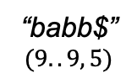

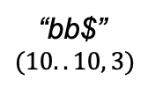
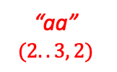

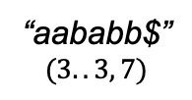
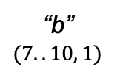

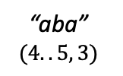
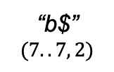
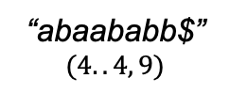
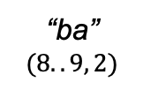
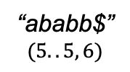
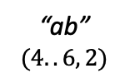

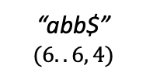
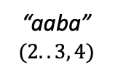

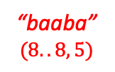

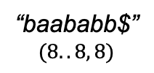
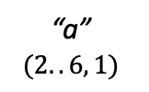


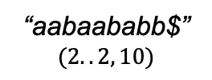
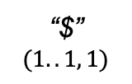
$ε$ $$(1..10, 0)$$
“a” $$(2..6, 1)$$
“aa” $$(2..3, 2)$$
“aaba” $$(2..3, 4)$$
“aabaababb$”
$$(2..2, 10)$$
marker factor type (object of the suffix tree)
$$a$$
$$a$$
$$a$$
$$(\#)$$
“ab” $$(4..6, 2)$$
“aba” $$(4..5, 3)$$
maximal repeat (branching node)
“$”
$$(1..1, 1)$$
$$b$$
“aababb$”
$$(3..3, 7)$$
non-maximal repeat (branching node)
$$b$$
$$b$$
“b$”
$$(7..7, 2)$$
“abaababb$”
$$(4..4, 9)$$
“abb$” $$(6..6, 4)$$
“ababb$”
$$(5..5, 6)$$
non-repeat (leaf)
“ba”
$$(8..9, 2)$$
$$a$$
“baababb$”
$$(8..8, 8)$$
non-right-branching (virtual node)
“b” $$(7..10, 1)$$
“baaba” $$(8..8, 5)$$
tree edge (goto link)
“bb$”
$$(10..10, 3)$$
“babb$”
$$(9..9, 5)$$
Weiner edge (reverse suffix link)

Slide 11
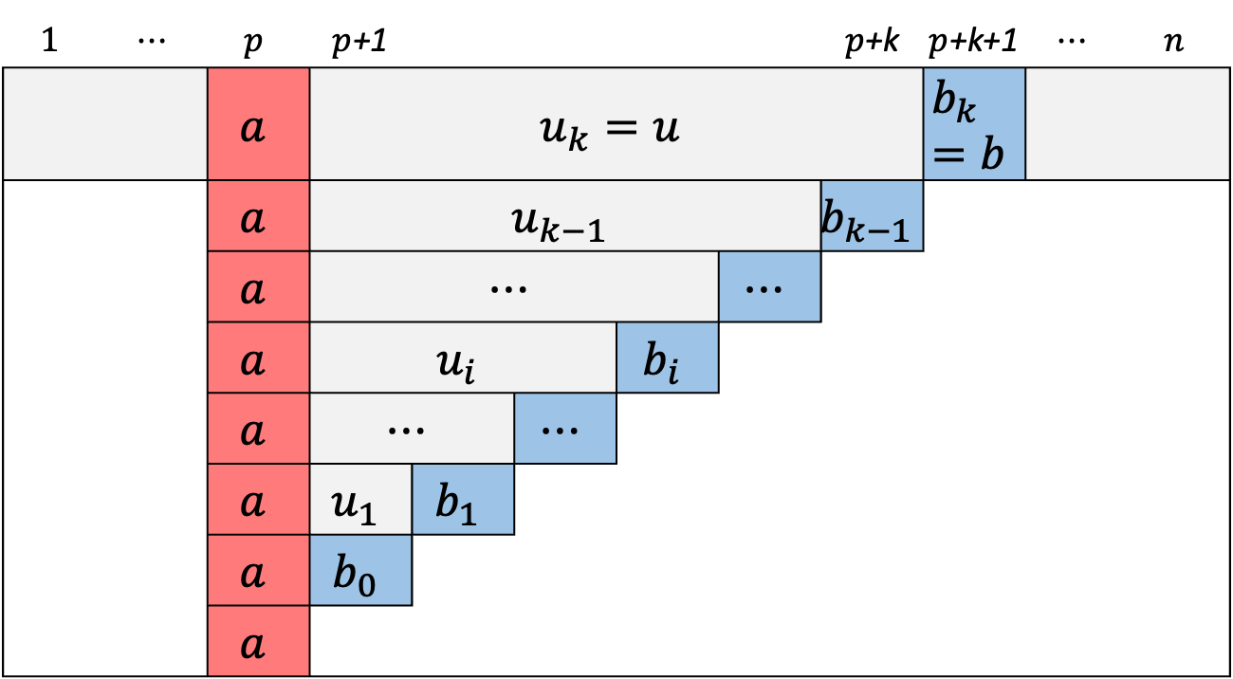
$$1$$ | $$⋯$$ | $$p$$ | $p$+1 |  |  |  |  | $p$+k | $p$+k+1 | $$⋯$$ | $$n$$
 |  | $$a$$ | $$u_{k}=u$$ |  |  |  |  |  | $$b_{k}=b$$
 |  | $$a$$ | $$u_{k−1}$$ |  |  |  |  | $$b_{k−1}$$
 |  | $$a$$ | $$⋯$$ |  |  |  | $$⋯$$
 |  | $$a$$ | $$u_{i}$$ |  |  | $$b_{i}$$
 |  | $$a$$ | $$⋯$$ |  | $$⋯$$
 |  | $$a$$ | $$u_{1}$$ | $$b_{1}$$
 |  | $$a$$ | $$b_{0}$$
 |  | $$a$$

Slide 12
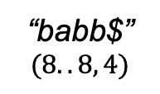

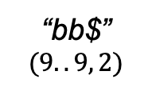
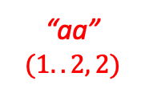
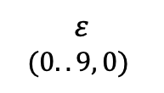
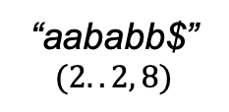
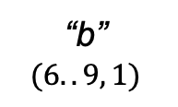

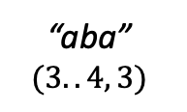
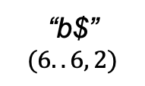
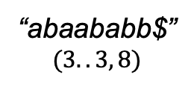
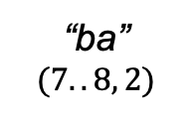
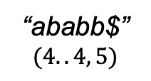
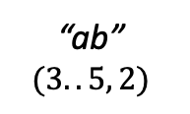

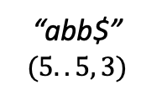
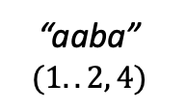

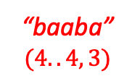

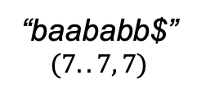
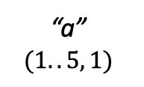


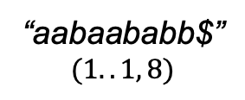
$ε$ $$(0..9, 0)$$
“a” $$(1..5, 1)$$
“aa” $$(1..2, 2)$$
“aaba” $$(1..2, 4)$$
“aabaababb$”
$$(1..1, 8)$$
Legend factor type (object of the suffix tree)
$$a$$
$$a$$
$$a$$
$$(\#)$$
“ab” $$(3..5, 2)$$
“aba” $$(3..4, 3)$$
$$b$$
maximal repeat (branching node)
“aababb$”
$$(2..2, 8)$$
$$b$$
non-maximal repeat (branching node)
“abaababb$”
$$(3..3, 8)$$
$$b$$
“b$”
$$(6..6, 2)$$
“abb$” $$(5..5, 3)$$
$$a$$
non-repeat (leaf)
“ababb$”
$$(4..4, 5)$$
“ba”
$$(7..8, 2)$$
“baababb$”
$$(7..7, 7)$$
non-right-branching (virtual node)
“baaba” $$(4..4, 3)$$
“b” $$(6..9, 1)$$
tree edge (goto link)
“bb$”
$$(9..9, 2)$$
“babb$”
$$(8..8, 4)$$
Weiner edge (reverse suffix link)

Slide 13
1
$
a
b
3
b
aba
14
a
$
b$
12
a
6
b$
ababb$
b
b$
2

Slide 14


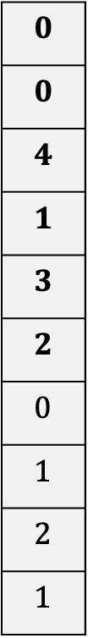
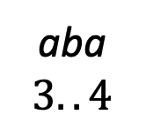

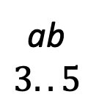
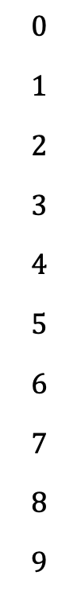
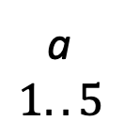
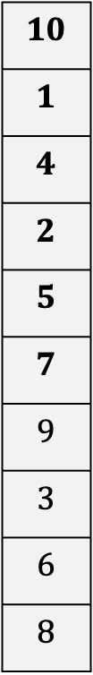

$$T=aabaababb\$ , Σ=\left\{a,b\right\} (\$< a<b)$$
1 2 3 4 5 6 7 8 9 $10$
Index
$$SA$$
$$LCP$$
Sorted suffixes
$$0$$
$$1$$
$$2$$
$$3$$
$$4$$
$$5$$
$$6$$
$$7$$
$$8$$
$$9$$
$$10$$
$$1$$
$$4$$
$$2$$
$$5$$
$$7$$
$$9$$
$$3$$
$$6$$
$$8$$
$$0$$
$$0$$
$$4$$
$$1$$
$$3$$
$$2$$
$$0$$
$$1$$
$$2$$
$$1$$
$
aabaababb$
aababb$
abaababb$
ababb$
abb$
b$
baababb$
babb$
bb$
ab
$$3..5$$
aba
$$3..4$$
a
$$1..5$$
$$ε$$
$$0..9$$

Slide 15

























$ε$ $$(0..9, 0)$$
“a” $$(1..5, 1)$$
“aaba” $$(1..2, 4)$$
“aabaababb$”
$$(1..1, 8)$$
$$a$$
$$a$$
$$a$$
$$(\#)$$
“ab” $$(3..5, 2)$$
“aba” $$(3..4, 3)$$
$$b$$
“aababb$”
$$(2..2, 8)$$
$$b$$
$$b$$
“abaababb$”
$$(3..3, 8)$$
“b$”
$$(6..6, 2)$$
“abb$” $$(5..5, 3)$$
$$a$$
“ababb$”
$$(4..4, 5)$$
“ba”
$$(7..8, 2)$$
“baababb$”
$$(7..7, 7)$$
“b” $$(6..9, 1)$$
“baaba” $$(4..4, 3)$$
maximal repeat (branching)
non-maximal repeat (branching)
“bb$”
$$(9..9, 2)$$
“babb$”
$$(8..8, 4)$$
non-repeat (leaf)
tree edge
Weiner edge (suffix link)

Slide 16


















$ε$ $$(0..9, 0)$$
“a” $$(1..5, 1)$$
“aaba” $$(1..2, 4)$$
“aabaababb”
$$(0..0, 8)$$
$$a$$
$$a$$
$$a$$
$$(\#)$$
“ab” $$(3..5, 2)$$
“aba” $$(3..4, 3)$$
“aababb”
$$(1..1, 8)$$
$$b$$
$$b$$
“abaababb”
$$(3..3, 8)$$
“abb” $$(5..5, 3)$$
$$a$$
“b” $$(6..9, 1)$$
“ba”
$$(7..8, 2)$$
“ababb”
$$(4..4, 5)$$
“baababb”
$$(7..7, 7)$$
$$b$$
non-maximal repeat
maximal repeat
“bb”
$$(9..9, 2)$$
“babb”
$$(8..8, 4)$$
tree edge
Weiner edge (suffix link)

Slide 17










$$T=aabaababb , Σ=\{a,b\}$$
Index
$$SA$$
$$LCP$$
Sorted suffixes
$$0$$
$$1$$
$$2$$
$$3$$
$$4$$
$$5$$
$$6$$
$$7$$
$$8$$
$$0$$
$$3$$
$$1$$
$$4$$
$$6$$
$$8$$
$$2$$
$$5$$
$$7$$
$$0$$
$$4$$
$$1$$
$$3$$
$$2$$
$$0$$
$$1$$
$$2$$
$$1$$
aabaababb
aababb
abaababb
ababb
abb
b
baababb
babb
bb
ab
$$[2, 4]$$
aba
$$[2, 3]$$
a
$$[0, 4]$$
$$ε$$
$$[0, 8]$$

Slide 18



$$T=aabaababb , Σ=\{a,b\}$$
index
$$0$$ | $$1$$ | $$2$$ | $$3$$ | $$4$$ | $$5$$ | $$6$$ | $$7$$ | $$8$$
$$SA(T)$$
$$0$$ | $$3$$ | $$1$$ | $$4$$ | $$6$$ | $$8$$ | $$2$$ | $$5$$ | $$7$$
$$LCP(T)$$
$$0$$ | $$4$$ | $$1$$ | $$3$$ | $$2$$ | $$0$$ | $$1$$ | $$2$$ | $$1$$

Slide 19










$$T=aabaababb , Σ=\{a,b\}$$
index
$$SA(T)$$
$$LCP(T)$$
$$0$$
$$1$$
$$2$$
$$3$$
$$4$$
$$5$$
$$6$$
$$7$$
$$8$$
$$0$$
$$3$$
$$1$$
$$4$$
$$6$$
$$8$$
$$2$$
$$5$$
$$7$$
$$0$$
$$4$$
$$1$$
$$3$$
$$2$$
$$0$$
$$1$$
$$2$$
$$1$$
$$aabaababb$$
$$aababb$$
$$abaababb$$
$$ababb$$
$$abb$$
$$b$$
$$baababb$$
$$babb$$
$$bb$$
$$“aaba”$$
$$[0, 1]$$
$$“ab”$$
$$[0, 3]$$
$$“a”$$
$$[0, 4]$$
$$“ ”$$
$$[0, 8]$$

Slide 20


























$$T=(\#)aabaababb(\$) , Σ=\{a,b\}$$
$$“ ”$$
$$“a”$$
$$“aaba”$$
$$(\left[0, 8\right], 0)$$
$$(\left[0, 4\right], 1)$$
$$(\left[0, 1\right], 4)$$
$$“aabaababb”$$
$$a$$
$$a$$
$$a$$
$$(\#)$$
$$“ab ”$$
$$(\left[2, 4\right], 2)$$
$$“aba ”$$
$$“aababb”$$
$$b$$
$$b$$
$$“abaababb”$$
$$“aba”$$
$$“ b”$$
$$a$$
$$“ababb”$$
$$(\left[5, 8\right], 1)$$
$$“ba”$$
$$“baababb ”$$
$$b$$
$$“babb ”$$
$$“bb ”$$

