Slide 1

Your Partner For Digital Growth
November 2024

Slide 2

Table of Contents
Overview
Our Values
Industries
Historical Milestones
Our Services
Project Management
Software Development
Business Analysis & Solution Architecture
Testing & Quality Assurance
Operation Support
Working Models
Turn-Key Solutions
Managed Services
Consultancy
Outsourcing Services
About iKnow - Technology Stack
What We Deliver?
What We Deliver Rather Than Code?
Knowledge Transfer
iKnow’s Expertise
Some of Our Clients
Contact Us

Slide 3
Overview
With the vision of becoming a global player, iKnow provides consultancy services on all IT activities such as turnkey software solutions, complex system integration, process control consultancy, agile transformation, SDLC, Project & Portfolio Management, Test management, software architecture.
With its quality assurance and support services, iKnow offers the most suitable solution for your organization in line with your demands.
It also uses all the tools of new technology while creating projects that increase revenue, add prestige to your company, increase the satisfaction of your customers, create savings and minimize risks.
iKnow adopts four working models. These are;
KPI Based Managed Services (Managed Services)
Project Based Turnkey Services
Consulting Services
Outsourcing Services
iKnow is one of the leading providers in the industry to which it contributes with its experienced staff, the employment it creates, its competence in every field of IT and its solution-oriented approach.

Slide 4
Our Values
Our values are what make us unique, drive our company culture, and govern everything we do.
Every iKnow employee learns our values from their first day. We operate through these values that are at the centre of our culture of successful outcomes and focus on delivery.
What does iKnow mean to our people?
Client-Centricity
We put our clients at the centre of everything we do. We care about your business, and we commit ourselves to solving your problems through innovative technology solutions. This is a central tenet of a customer-centric company.
People First
At iKnow, we place a premium on the well-being of
our team. We hire highly skilled, hard-working individuals who share our values and ethos, and we treat them with the respect they deserve.
Innovation-Driven
At iKnow, we focus on creating and implementing cutting-edge technology solutions.
We help our clients gain a competitive edge through innovative, value-adding technology.
Honesty & Transparency
We believe in straightforward, no-nonsense communication. We prioritize honesty in all our interactions and transparency in all our processes.
Predictability
We understand the importance of predictability in quality, scale, and cost. We commit to consistent high standards in all our projects and processes.
Outcome Oriented
Our focus is always on delivering the highest possible standards. We are driven by outcomes and motivated by success.
Going One Beyond
We are not content with the status quo. We push the boundaries of what’s possible to deliver the best possible results for our clients and our company.

Slide 5






Industries
Since iKnow was founded in 2017, we have helped clients across a wide range of industries to gain a competitive advantage through digital transformation.
We help our clients to navigate the ever-evolving digital landscape and partner with them to streamline their processes, improve their customer experience and mitigate cyber security concerns by building new innovative solutions as well as updating legacy infrastructure with new technologies.
Financial Services
As a trusted partner of finance companies including banks, insurers and investors, we provide bespoke software development, maintenance, and consulting solutions to enable business growth across the financial services sector.
Retail and E-Commerce
From inventory control systems to customer portals and e-commerce apps, we have helped many organisations to create business efficiencies whilst also improving customer experience.
Healthcare
We empower medical professionals, in both the public and private sectors, to transform the delivery of healthcare and ensure the best patient outcomes.
Large Enterprises
As experts in digital transformation, we provide consultation services for large multinational businesses and build bespoke software solutions that help improve your business’ resilience in an always competitive marketplace.
SME’s
At iKnow, we’ve worked with start-ups and SMEs from the early stages of concept validation and MVP creation, through to the development of a scalable architecture for further project improvement.
Government and Public Sector
We have extensive experience working with Government and Public Sector organisations to improve the way the general public accesses its services. This includes creating seamless user experiences and updating outdated legacy systems to the latest technologies.

Slide 6
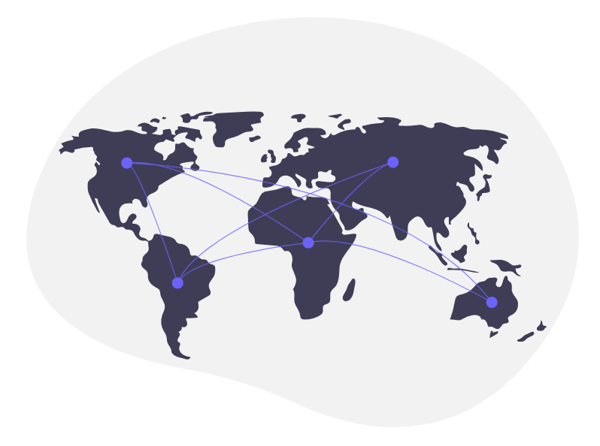
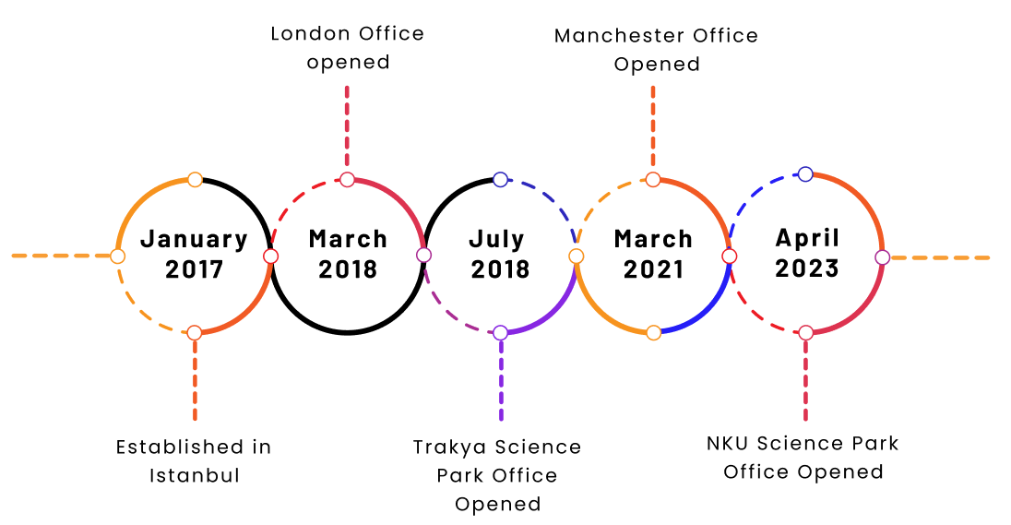
Historical Milestones

Slide 7
Our Services
Project Management
Software Development
Business Analysis & Solution Architecture
Testing and Quality Assurance
Operational Support

Slide 8
Our Services - Project Management
iKnow provides end to end project management services to plan, develop and deploy Software Projects with a successful delivery.
iKnow gives support to choose and apply proper project management methodologies for the customer projects. iKnow, with its experienced team which has deep knowledge of project management, provides support for initial project steps, project stages and customer working models.
Supporting to E2E Processes:
Project coordination
Project information workflow
Preparing and implementing the project plan
Project execution and control
Project closure
iKnow always aims to complete the projects in a perfect and efficient way by considering quality, timing, performance and cost elements.

Slide 9

Our Services - Software Development
iKnow Software Development team, specialized in up-to-date programming languages, provides efficient customization of the software applications with quality, rapid and agile approach. iKnow serves the most appropriate solution in terms of time and cost by providing right resources and efficient planning of software development processes. Our software development approach is not to produce workaround solutions, but to produce appropriate and permanent solutions by anticipating possible performance and security problems that may arise afterwards. We provide end to end solutions for multi-domain applications by following Agile and Waterfall development methodologies.
iKnow Development team has strong expertise on Java and .Net programming languages.

Slide 10
Our Services - Business Analysis & Solution Architecture
iKnow provides the right communication between customers, stakeholders and business units by gathering customer requirements according to their needs and requests, and also by following the detailed analysis process with our experienced team which has deep knowledge of Business analysis and Solution Architecture.
Our target is to deliver rapid and high-quality projects with our experienced Business Analysis and Solution Architecture Team. iKnow manages the following processes very carefully: defining requirements, determining customer needs, pre-analysis, preparing analysis documents and providing best architectural solution which is inline with company roadmap. iKnow also aims to complete the Analysis & Architecture phase in the best way possible by adapting the correct and complete analysis principle.

Slide 11
Our Service - Testing & Quality Assurance
iKnow provides testing services by its experienced team with using up-to-date technology and methods.
iKnow aims to complete the projects with the highest performance and lowest error margin. As Testing and Quality Assurance is one of the most important part of the software development process, iKnow assists quality assurance Processes end to end, through its careful and responsible team.
iKnow provides system, integration, performance and automation testing services to its clients. Our major test responsibilities are as below:
Specifying activity-based test roles and responsibilities
Preparation of the test plan according to the relevant test methodologies
Designing Test Cases and Scenarios
Defect Tracking

Slide 12
Our Service - Operation Support
iKnow provides support to the companies for improving their existing technologies and operational activities with the most up-to-date information technology infrastructure. We support companies to increase their operational quality by maximizing service, system and accessibility criteria. iKnow provide support for Service Desk, Level1 and Level2 operational activities in many IT domains. In addition to operational support activities, iKnow provides end to end functional and technical trainings for their clients. Our experienced Training team transfers the solution efficiently to the client team through extensive training materials and training classes.

Slide 13
Working Models
Turn-Key Solutions
Managed Services
Consultancy
Outsourcing Services

Slide 14
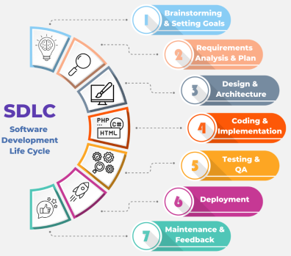
Working Models - Turn Key Solutions
iKnow, taking the end-to-end responsibility of the overall delivery, provides the entire solution of a turn-key project based on the customer requirements. iKnow provides turn-key solutions covering entire SDLC processes from analysis, design, development and testing to operation phases.
iKnow closely follows the up-to-date technologies and ensures that delivered solutions are easily integrated with the existing systems and solutions of the customers. iKnow ensures continuous and efficient operation of information technology infrastructures by providing turn-key solutions.

Slide 15
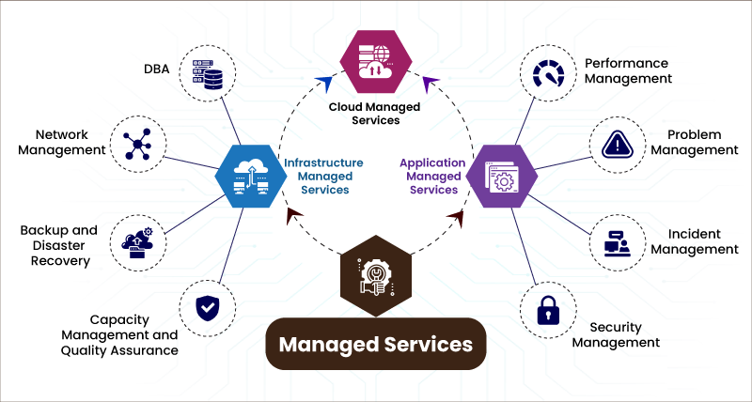
Working Models - Managed Services
iKnow provides managed services by proactively managing It functions on behalf of our customers. As Managed Service Provider, iKnow ensures that required IT functions and services are delivered efficiently within the customer operations.
iKnow aims to create quality work by providing cost saving managed services and gives 7/24/365 support to complete all processes successfully with our experienced team.

Slide 16
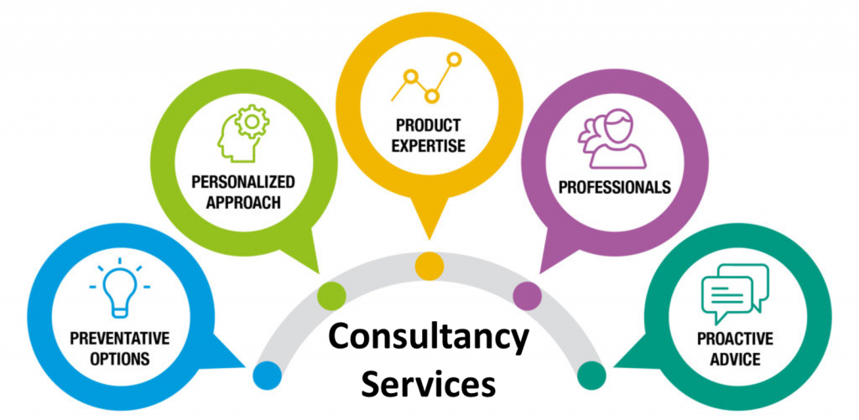
Working Models - Consultancy
iKnow provides consultancy services to increase the quality of service by using the latest technologies in favor of our customers. Our vision is to serve advantages of information technologies to the customers as a benefit.
We provide consultancy services in all areas of information technologies such as management, methodology, application, software, testing and operational support services. iKnow supports its clients with expertise in every aspect of the software, from choice of technology to enterprise architecture for testing services, integration and training.

Slide 17
Working Models - Outsourcing Services
iKnow provides wide range of Outsourcing Services, with its prior aim of creating “Customer Satisfaction”. It is crucial for us to increase Customer productivity and operational quality by offering “Correct” Resources to our customers.
We aim to add a value to our Customers with our outsourcing services. iKnow offers outsourcing services for Project Management, Business Analysis, Software Development, Operation Support and Testing. With the help of these services, it’s possible to monitor and reduce the employee cost, to get faster and higher quality results by enabling customers to concentrate only on the production area effectively. By using our experience in the areas of Project Management, Agile (Scrum), Software Development, Analysis, Testing and operations; our aim is to understand customer needs and to give support with our team of experts. We provide the following services to our customers with our expert team which has global project experience in all areas;
Long Term Onsite Outsourcing
Project Based Outsourcing
Project Based Product Development Outsourcing

Slide 18
About iKnow - Tech Stack
iKnow is a software and solution development company delivering high quality and cost-effective custom applications to its clients.
The company has been founded by many experts who have been in the Telecom sector more than twenty years.
Here is our tech stack:
Programming Languages High-Level Languages: Python, Java, C#, JavaScript, Ruby, PHP Scripting Languages: Bash, Perl Mobile Development Mobile Platforms: iOS, Android Mobile Development Frameworks: Swift (iOS), Kotlin (Android), Flutter, React Native DevOps and CI/CD Continuous Integration/Continuous Deployment: Jenkins, GitLab CI, GitHub Actions Containerization: Docker, Kubernetes, OpenShift Monitoring and Logging: Prometheus, Grafana, ELK Stack | Web Development Frontend Frameworks and Libraries: React, Angular, Vue.js Backend Frameworks: Node.js, Django, Flask, Ruby on Rails, Spring Boot, ASP.NET CSS Frameworks: Bootstrap Databases Relational Databases: MySQL, PostgreSQL, Oracle Database, Microsoft SQL Server NoSQL Databases: MongoDB, Cassandra, Redis In-Memory Databases: Redis, Memcached AI Frameworks and Libraries TensorFlow, PyTorch, Scikit-learn, Hugging Face Trans. Pretrained Local Models: LLaM, Mistral ,Phi, Qwen, Deepseek Pretrained API models: OpenAI, IBM Watson

Slide 19
About iKnow - Tech Stack
In addition to our Software development capabilities, iKnow is also very experienced in providing tailor made integrated systems, solutions and services in Telecommunication, Banking, Insurance and Health care markets and we have extensive experience in many technologies.
Here is our tech stack (cont.):
Cloud Platforms Major Cloud Providers: Amazon Web Services (AWS), Microsoft Azure, Google Cloud Platform (GCP) Other Cloud Services: IBM Cloud, Oracle Cloud Version Control Systems Distributed Version Control: Git Centralized Version Control: SVN Testing and Quality Assurance Unit Testing Frameworks: JUnit (Java), NUnit (.NET), pytest (Python), Mocha (JavaScript) Integration Testing: Selenium Performance Testing: Jmeter | Data Science and Machine Learning Data Processing: Pandas (Python), Apache Spark Machine Learning Frameworks: PyTorch Project Management and Collaboration Project Management Tools: JIRA, Trello, Azure DevOps Collaboration Tools: Slack, Microsoft Teams, Confluence API and Microservices API Development and Documentation: Swagger, Postman, OpenAPI Microservices Frameworks: Spring Cloud

Slide 20
What We Deliver?
Software and Documentation
System Integration
(Installation of Software, Integration, Integration Test, Performance test, Monitoring, etc.)
List of our deliverables:
Component | Description
UI/UX Design | Figma and CSS files of the UI/UX design.
Backend Code | The core backend codebase, likely including service logic, data access layers, and business rules implemented in Java or .Net.
Configuration Files | Files such as application.properties, application-test.properties, and application-local.properties for different environment configurations.
XML Configurations | Various XML files for specific service configurations.
Setup Documentation | Detailed setup instructions for the web server, VM, file server, Java, .Net and MongoDB.
API Endpoints | List of API endpoints exposed by the backend service, possibly described in the documentation or through a tool like Swagger.
Test Suites | Unit tests, integration tests, or end-to-end tests that ensure the quality and functionality of the application.
Database Schema | SQL scripts or database schema definitions required for setting up the necessary database(s) for the application.
Frontend Code | The core frontend codebase, including components, screens, and navigation logic implemented in React Native.
Frontend Configuration Files | Configuration files specific to the React Native environment, such as .babelrc, metro.config.js, or react-native.config.js.
Navigation Setup | Implementation of navigation logic, potentially using libraries like React Navigation, for handling screen transitions and deep linking.
State Management | Implementation of state management, possibly using Redux, MobX, or React's built-in Context API, to manage application state.
API Integration | Code for interacting with backend APIs, handling data fetching, and managing network requests and responses within the frontend.

Slide 21
What We Deliver Rather Than Code?
The below table identifies the documents to be delivered;
Document Title | Description
SRS document | Solution/System Requirements Specifications document
SAS document | System Architecture Specifications Document
HLD | Detailed High Level Design Specifications Document
IFS-OFFLINE IFS-ONLINE | Interface Specification for all offline (file based) and online (WSIL based) external interfaces.
IG | Installation Guide
OCG | Operations and Configuration Guide

Slide 22
Knowledge Transfer
If iKnow awarded to a project to ensure the seamless transfer of critical project knowledge from the development team to the operations, support, and end-user teams, enabling effective management and future development of the project these steps will be followed:
Documentation:
Comprehensive documentation of system architecture, codebase, configurations, and workflows, detailed technical guides, user manuals, and FAQs will be prepared.
Training Sessions:
Interactive sessions for stakeholders, including developers, IT support, and end-users and hands-on training with live system demonstrations and Q&A will be held.
Knowledge Repositories:
Centralized knowledge base or wiki for easy access to project documentation and resources and version-controlled repositories to manage updates and changes will be created.
Shadowing and Pairing:
Structured periods where incoming team members shadow experienced team members and pair programming or paired troubleshooting for hands-on learning will be organised.
Feedback Loops:
Regular feedback sessions to identify knowledge gaps will be held.
Handover Process:
To ensure all knowledge is transferred, clear handover procedures, including checklists and sign-offs will be organised. Transition of responsibility with a support plan for post-handover assistance will be planned.

Slide 23
iKnow’s Expertise
Head Count Roles Experience Specialities
8 | Project Managers, Team Leads | +15 Years | Project management, leadership, technical expertise, communication, problem-solving, risk management, architecture design, team coordination, strategic planning, stakeholder engagement, and decision-making.
14 | Designers, Analyists, Solution Architects | +10 Years | Technical expertise, communication, problem-solving, risk management, architecture design, team coordination, strategic planning, stakeholder engagement, and decision-making.
52 | Software Developers | 2-10 Years | Java, .Net, React, RESTful APIs, microservices, database management, front-end/back-end integration, problem-solving, code optimization, DevOps.
11 | Software Testers | 2-10 Years | Test automation, manual testing, QA strategy, bug tracking, test planning, risk analysis, performance testing, regression testing, and continuous improvement.

Slide 24












Some of Our Clients

Slide 25
Contact Us
Tel 1: +44 7551 00 49 72
Tel 2: +44 7464 17 89 61
Tel 3: +90 542 561 58 38
E-mail: info@iknowtechnology.uk
Web: https://iknowtechnology.uk
Offices:
Darussafaka Mah. Kilim Sok. Maslak, Sariyer, Istanbul, Turkey
Trakya University, 1. Murat, Trakya Science Park, Edirne, Turkey
NKU Science Park, Silahtaraga Mah, Corlu, Tekirdag, Turkey
17 Green Lanes, London, England, N16 9BS, United Kingdom
Core, Brown St, Manchester, M2 1DH, United Kingdom

Slide 26
THANK YOU

