Slide 1
VoIP Penetration Testing:
Lessons Learned, Tools and Techniques
Jason Ostrom
Sr. Security Consultant
John Kindervag, CISSP, QSA
Sr. Security Architect

Slide 2
Why?
Low Awareness as to Security Threats to VoIP
Publicly Accessible IP Phones
  Waiting Areas
  Conference Rooms
  Hotel Rooms
How easily can an Attacker Gain Privileged Access?

Slide 3
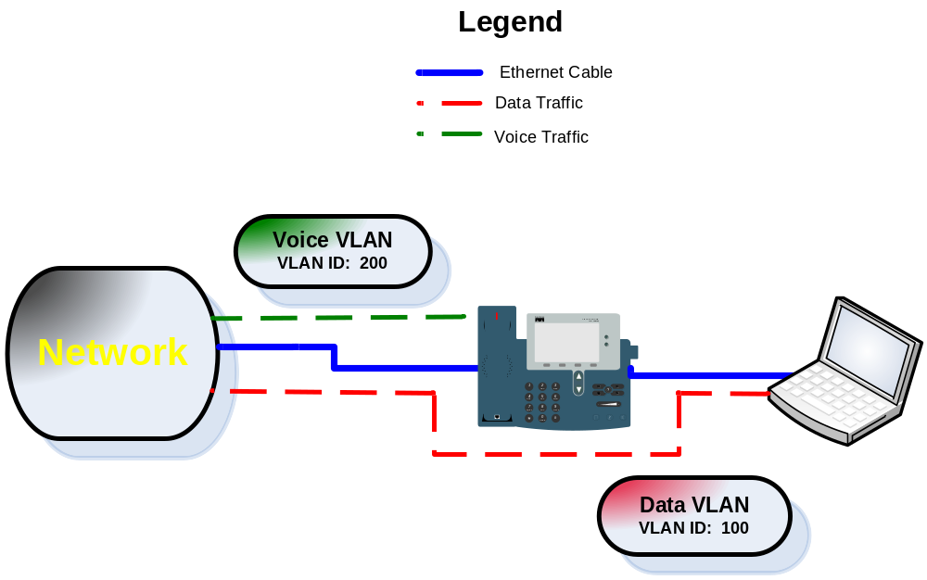
Voice VLAN

Slide 4
Live Demonstration

Slide 5
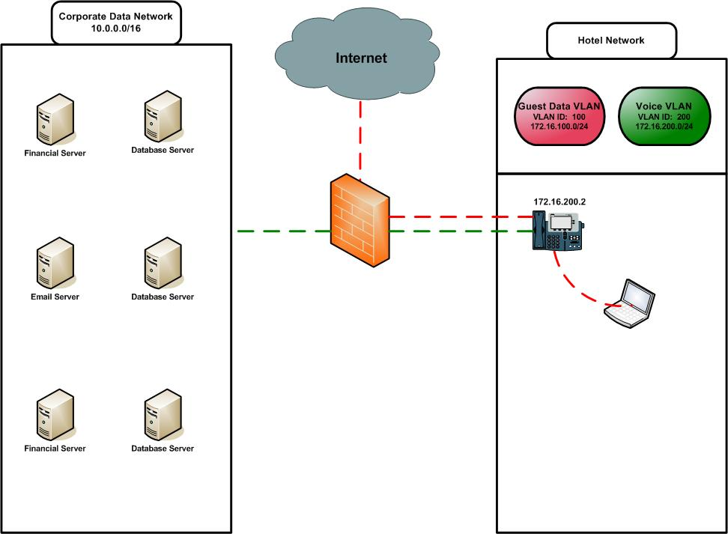
Customer VoIP Network

Slide 6
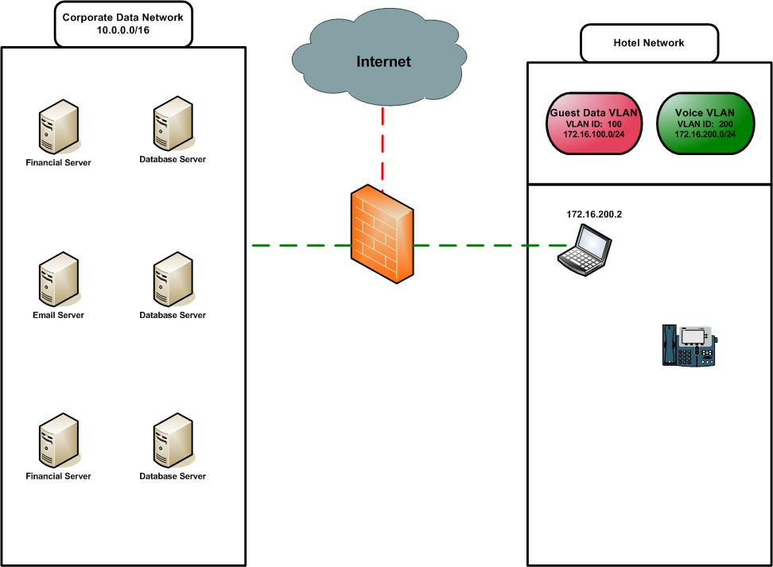
How this happens

Slide 7
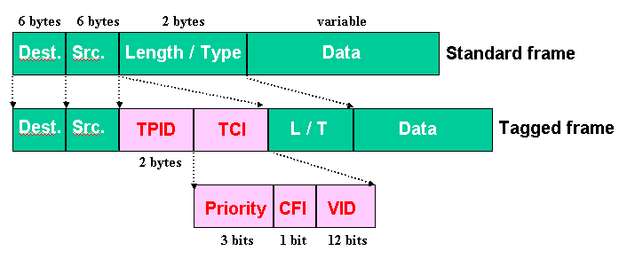
Create a new VLAN Interface on the PC

Slide 8
VoIP Hopper:
Jumping from one VLAN to the Next!
A look at automating the collection of small information tokens and VLAN Hopping that can allow exploitation of VoIP Networks.

Slide 9
VoIP Hopper Information
Project Download – http://voiphopper.sourceforge.net
Security Focus Article
http://www.securityfocus.com/infocus/1892

Slide 10

Q&A

Slide 11
Contact Information
Jason Ostrom, CCIE Security #15239, QSA
Sr. Security Consultant
jostrom@vigilar.com
John Kindervag, CISSP, QSA
Sr. Security Architect
jkindervag@vigilar.com
If you would like a copy of this presentation please contact:
marketing@vigilar.com

