Slide 1
Are You a Credit Card Holder?
FDA Homework 2 by 張財實

Slide 2
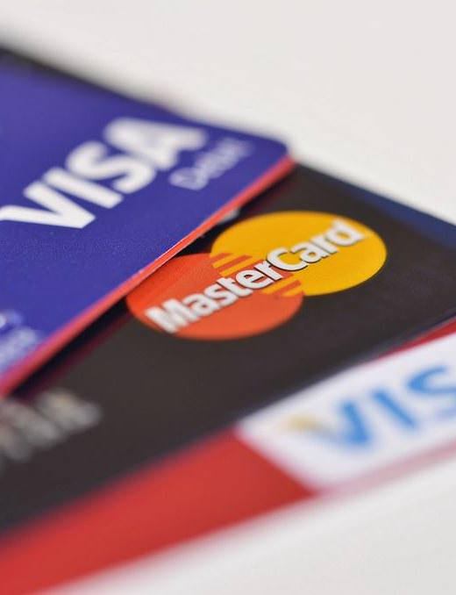
Procedure
Create Rules
Generate Data
Split Data
Use Skilearn Decision Tree
Compare
Review

Slide 3

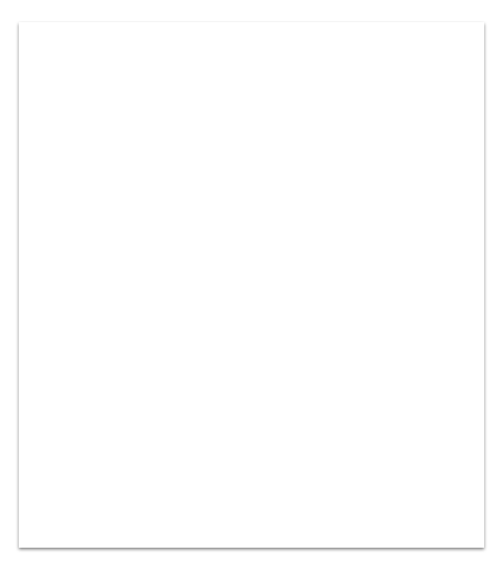
Data Generation
Create my Own Rules
Define Attributes and Features
Generate Random Data
Create Function
Data Output

Slide 4
Data Features
Online Shopping Experience
Income
Expense
Age
Sex
Why?

Slide 5
Generate Random Data
Generate Random Values For Each Features
Income - normal(35000, 15000)
Expense - normal(30000, 17500)
Age - uniform(16,80)
Sex - uniform(Female, Male)
Online Shopping Experience - uniform(0,5)

Slide 6
Create Function
X --->---[Func]--->--- Y
^(Rules)
X: Data Y: y/n a card holder

Slide 7
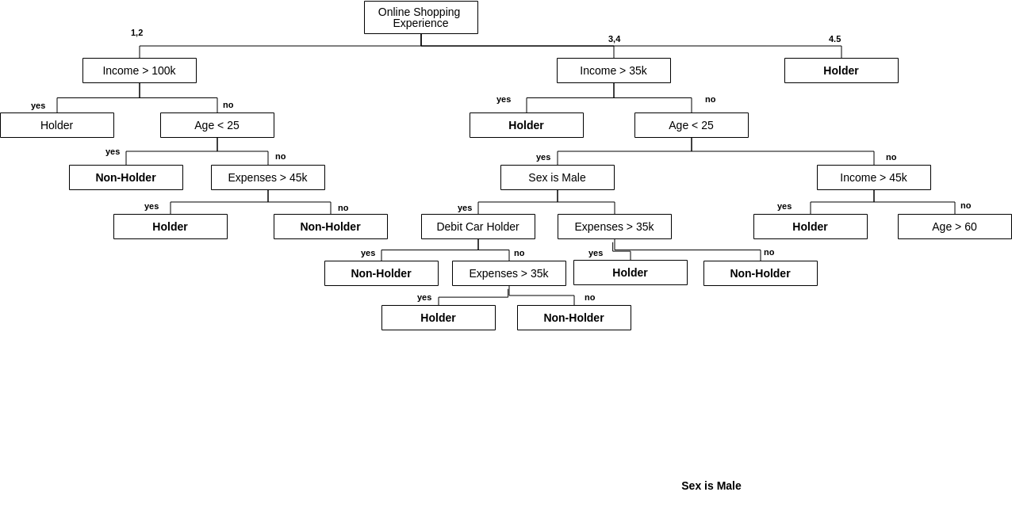
My Tree and Rules

Slide 8
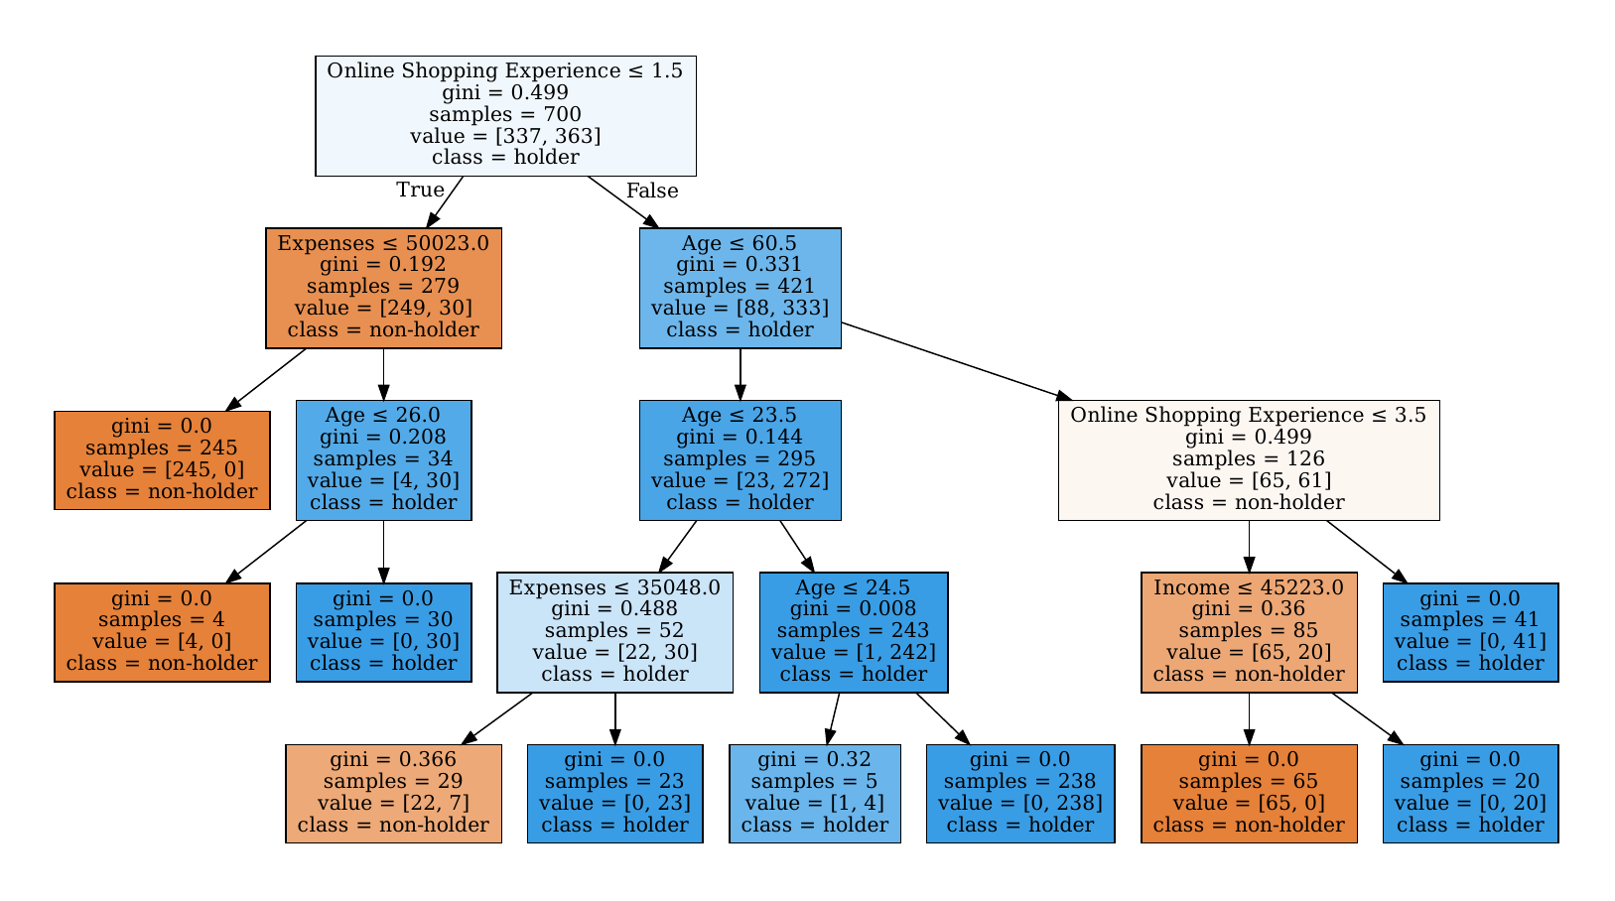
Sklearn Decision Tree

Slide 9
Comparison
How Different
Accuracy:
0.98
How different
Debit card user and Sex is not relevant to my right data.
Level conditions place in different ways
Condition break points are slightly shifted
Income conditions are different
How Similar
The result are well predicted

Slide 10
Review
The decision tree is almost the same as my right data without using sex and debit card attribute.
The income value is shifted a lot.
Decision tree is so accurate.

Slide 11
Which tree will I prefer?
Decision Tree From Sklearn
Life Experience
Decision Tree has Gini

