Slide 1
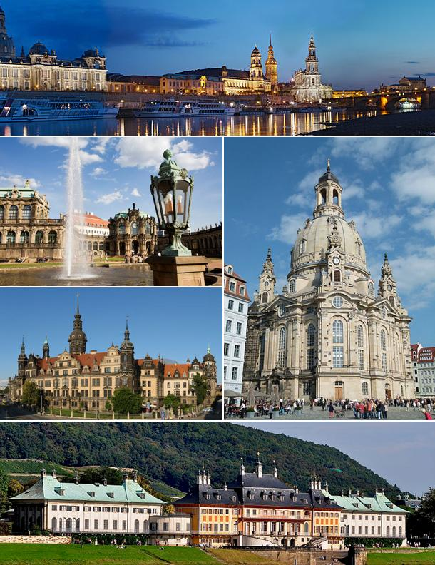
Dresden

Slide 2
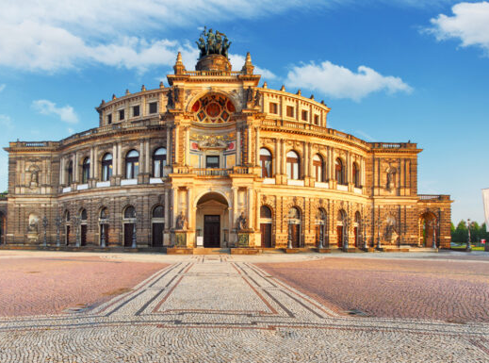
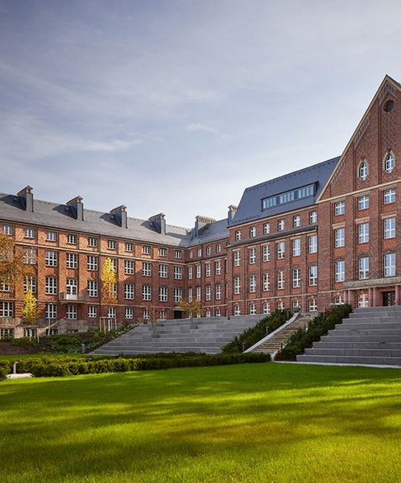
Hauptifnormation

Slide 3
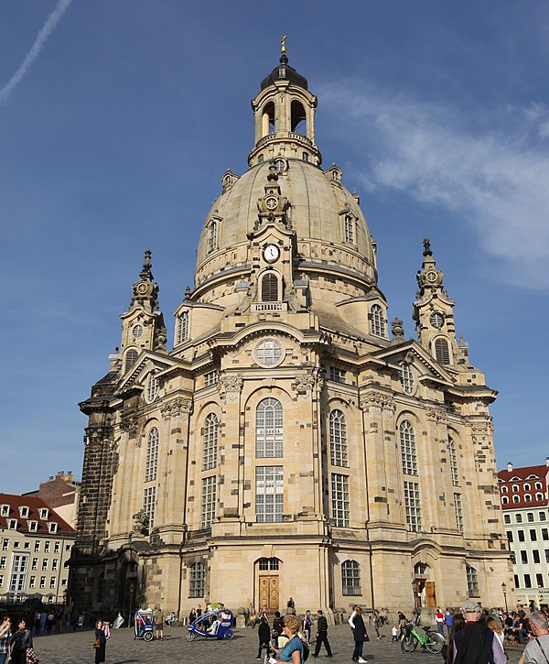
Die Frauenkirche
Notes:
Consider talking about:
Early history
Early-modern age
Second World War
Post-war
Post-reunification

Slide 4
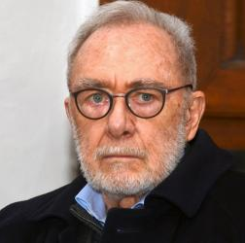
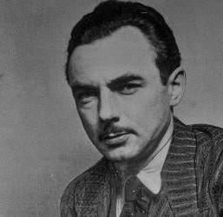
Weltberühmte Personen von Dresden

