Slide 1


Movie Rating Prediction App
Machine Learning Project
Komal Gupta

Slide 2
Introduction to Movie Rating Prediction
Objective of the Model
To predict movie ratings based on key features like genre , num of votes and release year. This model helps users make informed decisions about what movies to watch based on predicted enjoyment levels.
Data Analysis and Model Building
We analyzed key movie features (genre, numVotes) using Pandas, NumPy, Seaborn, and Matplotlib to uncover trends and visualize relationships. For prediction, we built and optimized models like linear regression and decision trees to deliver accurate movie rating predictions.
Overview of Streamlit
Streamlit is an open-source app framework designed for creating interactive web applications in data science. It enables the rapid deployment of predictive models with minimal code, making it ideal for this movie rating prediction app.

Slide 3
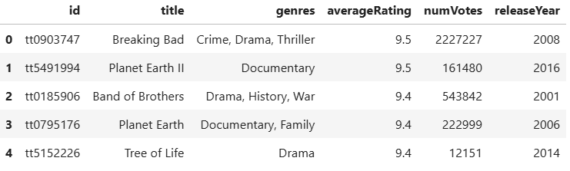
Introduction TO DATASET
Dataset Overview
This dataset comprises IMDb's Top 1000 TV series, providing valuable data for exploring trends and factors that influence viewer ratings and popularity.
Size: 1000 rows and 6 columns.
Source: Kaggle.
Key Columns:
ID: Unique identifier for each series.
Title: Name of the TV series.
Genres: Genre(s) such as Drama, Comedy, Thriller.
Average Rating: IMDb user rating.
Num Votes: Number of user votes.
Release Year: Year the series first aired.
This dataset offers insights into genre trends, audience engagement, and factors that may contribute to high ratings.

Slide 4
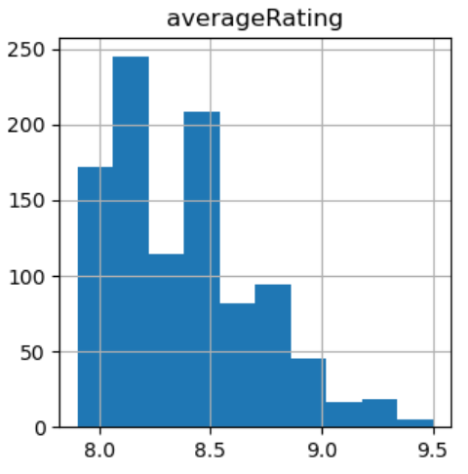
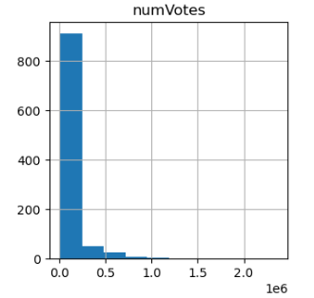
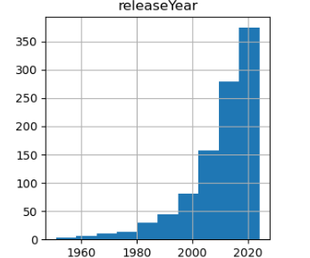
INSIGHTS FROM DATA
Data Overview
No Null Values: The dataset is clean and complete, with no missing values.
No Duplicate Values: No duplicate entries were found, ensuring data integrity.
Outliers Present: Outliers were identified and handled using Winsorization (capping method) to maintain data accuracy.
Histogram 1: Average Rating
Most movies have an average rating between 8.0 and 8.5.
Histogram 2: Number of Votes
The majority of movies have a low number of votes, mostly below 500,000.
Histogram 3: Release Year
A clear trend of increasing movie releases is visible from the 1990s onwards.

Slide 5
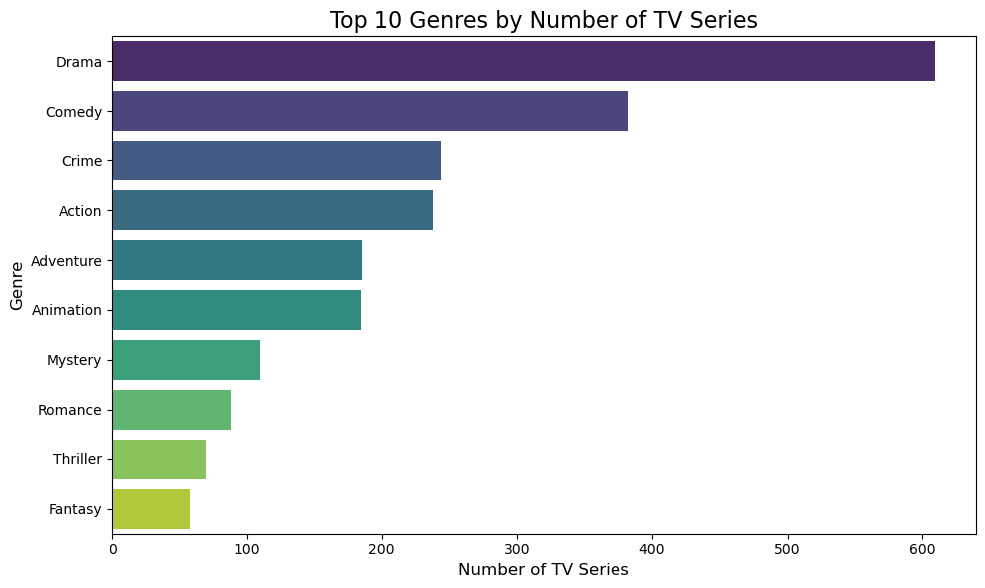
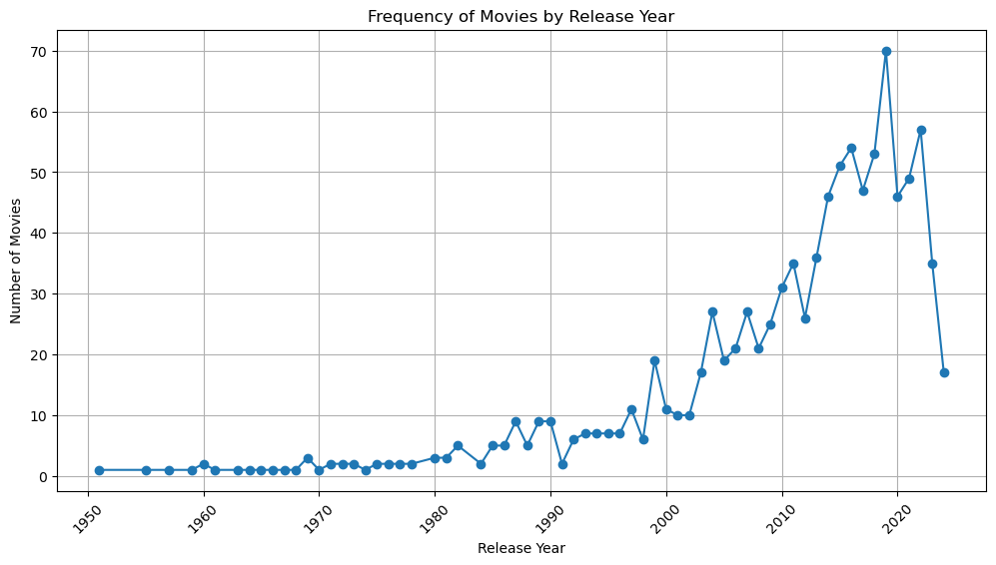
EXPLORATORY DATA ANALYSIS (EDA)
The chart shows the top 10 TV genres by popularity. Drama is the most popular with over 600 series, followed by Comedy. Genres like Crime, Action, and Adventure are also well-represented.
The film industry has experienced remarkable growth over the past decades, peaking in the late 20th and early 21st centuries. While recent years have seen a slight slowdown, the industry continues to thrive.

Slide 6
Feature Engineering: Enhancing Data for Better Insights
1.Feature Dropping:
ID and Title: These columns were dropped as they provide unique identifiers and don't contribute to predictive modeling.
2.Feature Creation:
Number of Genres: A new feature, num_genres, was created to capture the number of genres associated with each movie. This can potentially influence factors like audience appeal or critical reception.
3.Feature Scaling:
Min-Max Scaling: This technique was applied to numerical features to ensure they are on a similar scale.
4.Feature Encoding:
Multi-Label Binarizer: This technique was used to encode the genres column, which likely contained multiple genres for each movie. Each genre was converted into a binary feature, indicating its presence or absence.

Slide 7
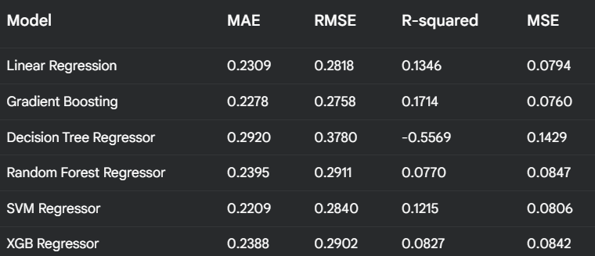
Model BUILDING , Selection and Training
Data Splitting: The dataset was divided into training (80%) and testing (20%) sets.
Model Training: Multiple regression models (Linear Regression, Random Forest, Gradient Boosting, SVR, XGBoost) were trained on the training data.
Model Selection: The best-performing model was selected based on Root Mean Squared Error (RMSE).
MODEL COMPARISON :

Slide 8
LIMITATIONS AND CHALLENGES
Data Issues:
Small Dataset: We didn't have a lot of data to train our model. This can make it harder for the model to learn patterns.
Limited Features: We didn't have many different types of information about the movies, which limited our ability to make accurate predictions.
Genre Complexity: Predicting multiple genres for a movie is challenging, as different genres can be related in complex ways.
Model Limitations:
Overfitting: Our model might have learned the training data too well, making it less accurate on new, unseen data.
Bias: The model might be biased towards certain types of movies, especially those that are highly rated.

Slide 9
DEPLOYMENT
To make the model accessible to a wider audience, we deployed it using Streamlit. This web-based application allows users to input movie details and receive predicted ratings.
Key Steps in the Deployment Process:
Model Serialization: The trained model was saved as a pickle file for future use.
Streamlit App Development: A Python script was created using Streamlit to build the web application.
User Interface Design: A simple and intuitive interface was designed to allow users to input movie details.
Model Integration: The saved model was loaded into the Streamlit app to make predictions.
Deployment: The app was deployed to a platform (Streamlit Cloud), making it accessible to users.
APP LINK

Slide 10
FUTURE WORK & CONCLUSION
FUTURE WORK:
1.Collect more data to improve model performance, such as detailed user reviews, critic ratings, or series runtime.
2.Incorporate additional features like director, cast, budget, or country to uncover deeper insights.
3.Experiment with ensemble techniques like bagging, boosting, and stacking to improve model accuracy.
4.Improve the user interface to provide a more engaging and informative experience.
CONCLUSION:
Our findings reveal significant trends in TV series ratings, including the impact of genres and voting patterns. The machine learning models we developed can serve as a foundation for further improving audience engagement and content strategies in the entertainment industry.

Slide 11
REFERENCE AND RESOURCES
DATASET - IMDb Top 1000 TV Series dataset from Kaggle.
Libraries and Tools Used –
Python libraries: Pandas, NumPy, Matplotlib, Seaborn, scikit-learn.
IDE: Jupyter Notebook or VS Code.
Deployment Tools: Streamlit.
PROJECT LINKS –
GIT HUB REPOSITORY: GIT LINK
DEPLOYED APP: APP LINK

Slide 12
“Thank you for your time and attention!”
KOMAL GUPTA
Email: komalg.connect@gmail.com
LINKEDIN: To Connect CLICK HERE

