Slide 1
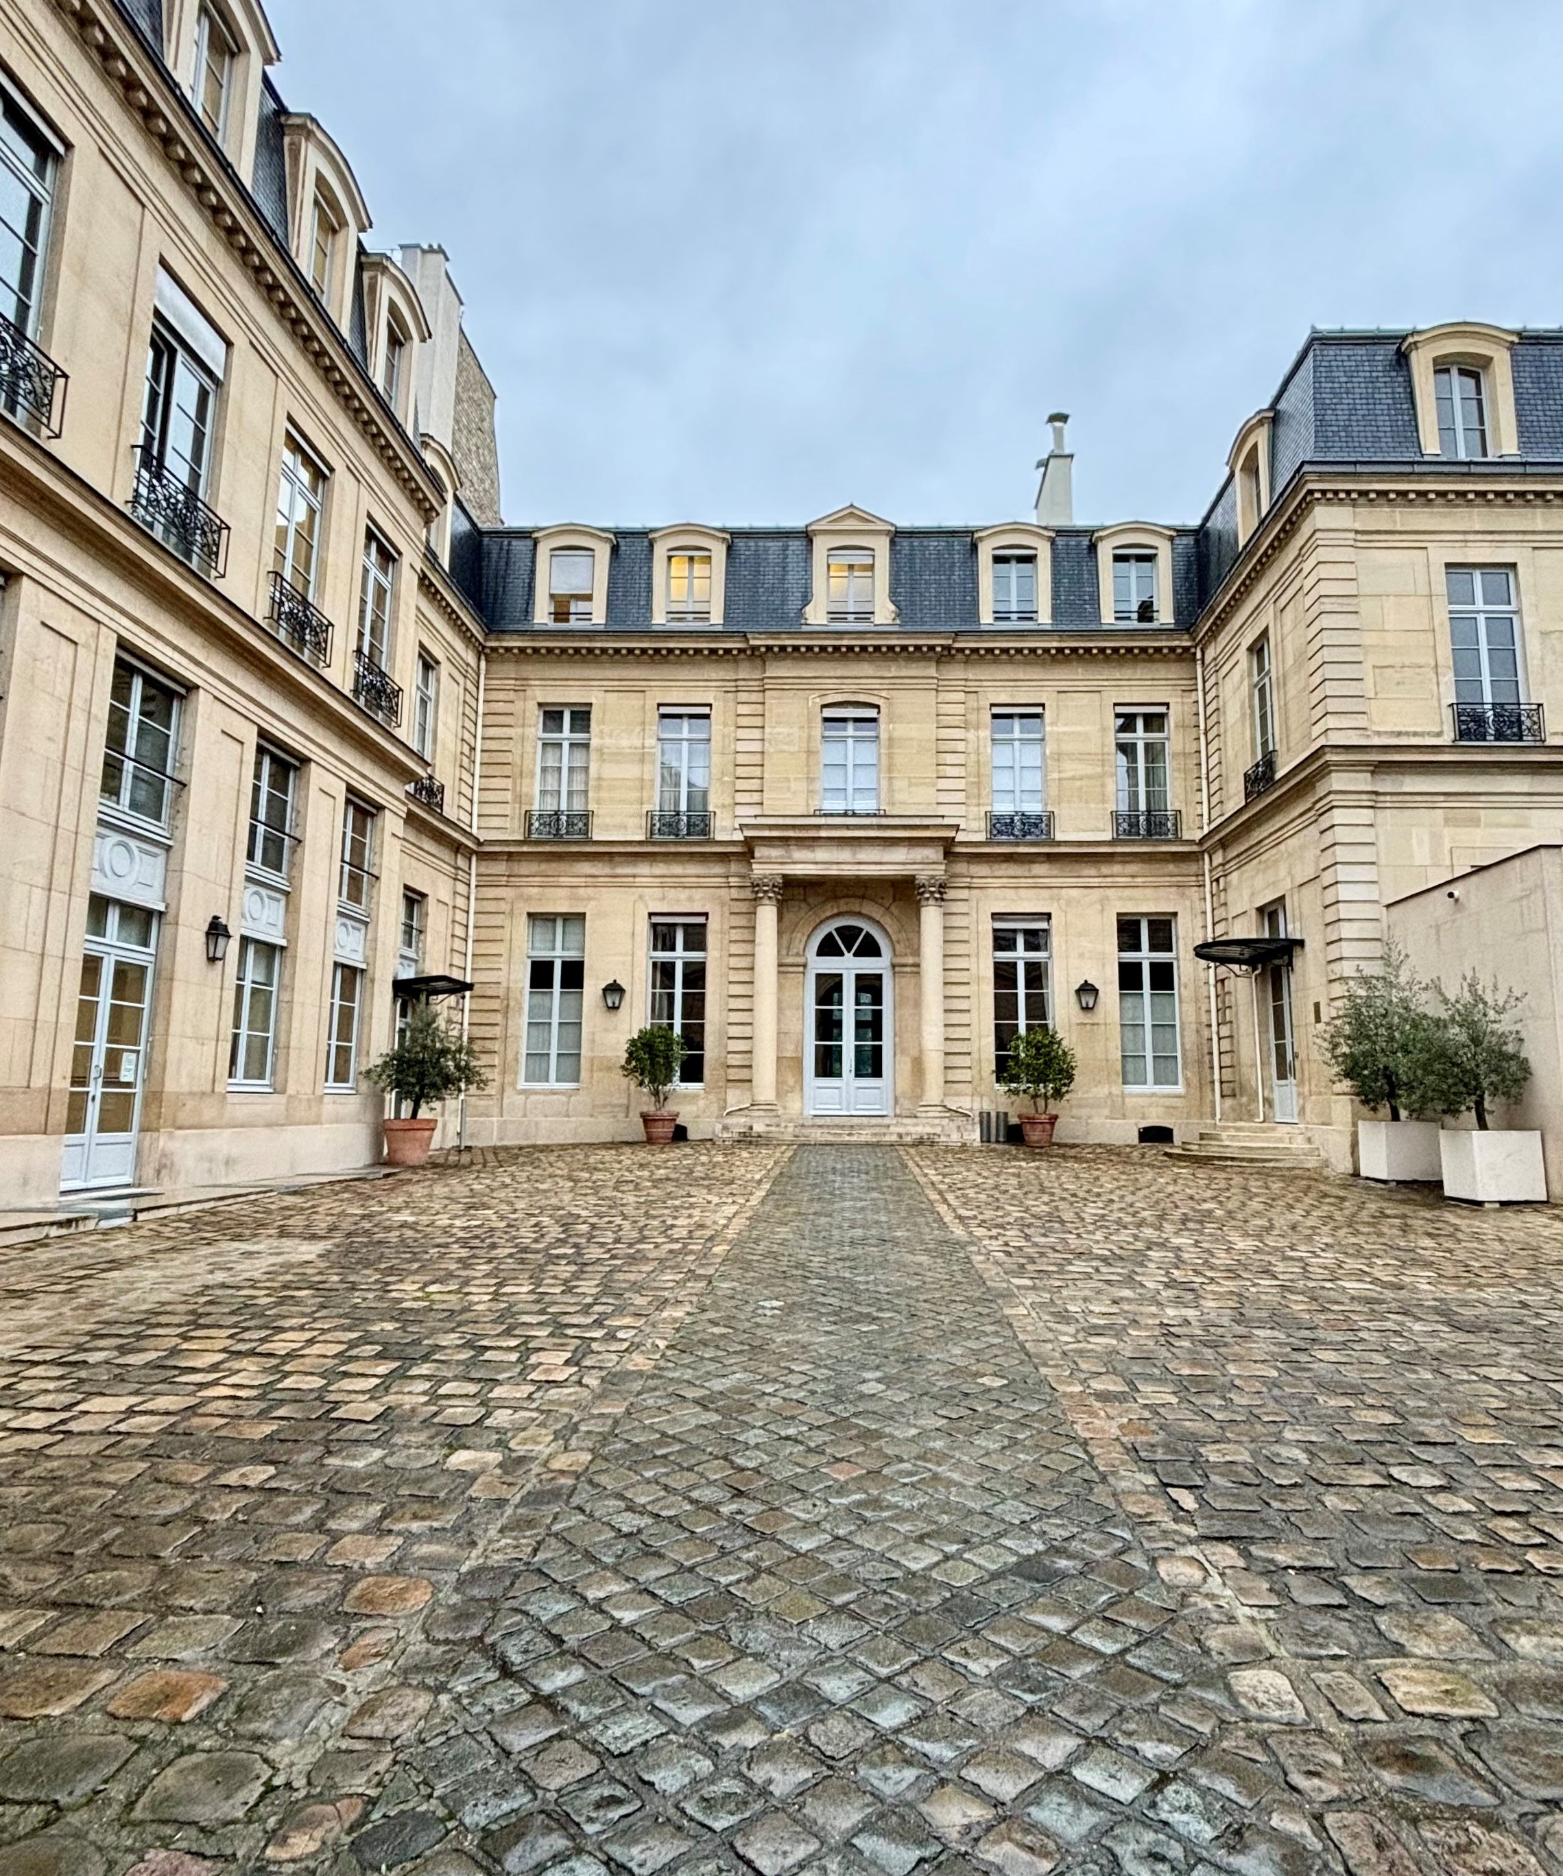
HOSPITALITY COLLECTION
Hotel portfolio
system
A company story with room
for each property.
Independent concept / fictional property
Notes:
Independent concept created with AI assistance. Original layout and native editable text. This is a two-slide design study, not commissioned hospitality work. No actual hotel results, affiliations or operating claims. Photo is mood imagery only.
{
"file": "cover-tall.jpg",
"description": "Courtyard entrance of Hôtel de Besenval, Paris; architectural mood reference",
"author": "John Jason Junior",
"license": "CC0 1.0 Universal",
"license_url": "https://creativecommons.org/publicdomain/zero/1.0/",
"source_page": "https://commons.wikimedia.org/wiki/File:H%C3%B4tel_de_Besenval_Paris_courtyard_main_entrance_residence_and_small_courtyard_%282%29.jpg",
"original_url": "https://upload.wikimedia.org/wikipedia/commons/6/62/H%C3%B4tel_de_Besenval_Paris_courtyard_main_entrance_residence_and_small_courtyard_%282%29.jpg",
"dimensions": "2279 x 3941",
"use": "Slide 1, cover crop. Historic residence photo, not a claim about a commercial hotel."
}

Slide 2
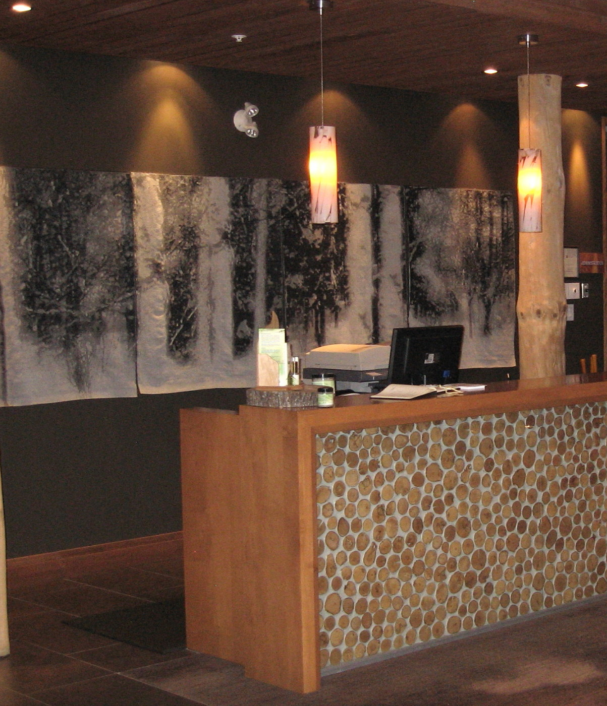
PROPERTY OVERVIEW
Arden House
An imagined urban retreat
Warm interiors and a quiet courtyard.
Concept narrative only.
LOCATION
[City, country]
ROOMS
[Confirmed key count]
SPACES
[Owner-approved facilities]
OPENING
[Confirmed date or status]
Independent concept / fictional property: Arden House
Notes:
Independent concept created with AI assistance. Arden House is a fictional property for this study. All bracketed facts require owner confirmation. The photo is mood imagery, not a photograph of Arden House. No hotel, guest, financial, performance or paid-client claims. Native editable text; raster photograph.
{
"file": "property.jpg",
"description": "Lobby of Hôtel-Musée Premières Nations, Quebec; interior mood reference",
"author": "Stevemphoto1",
"license": "Public domain, self-released worldwide",
"source_page": "https://commons.wikimedia.org/wiki/File:Hotel_lobby.jpg",
"original_url": "https://upload.wikimedia.org/wikipedia/commons/3/33/Hotel_lobby.jpg",
"dimensions": "2074 x 1556",
"use": "Slide 2, cropped toward empty left side. Not Arden House."
}

