Slide 1
11. December 2023
by Andrii Stoliarov & Igor Korobov
PROJECT: IMAGE RECOGNITION
Course: Python Foundation

Slide 2
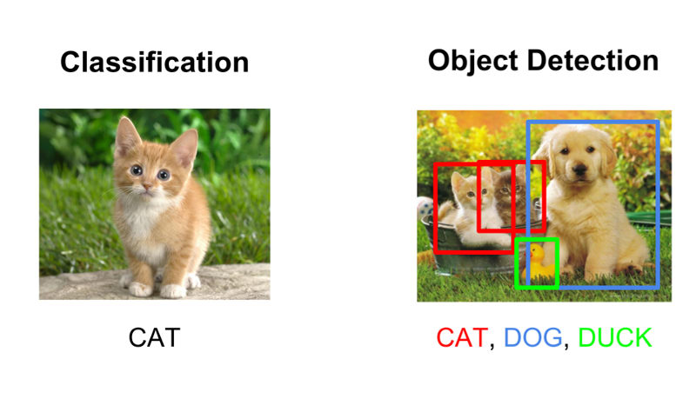
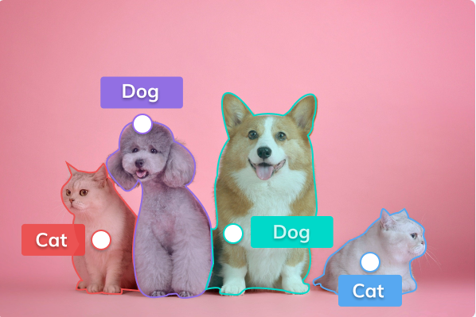
What is image recognition?
a computer vision technology that enables machines to interpret and understand visual information from images or videos.
Classification
Object Detection
Image Segmentation
Classification: Categorizing images into predefined classes or labels, enabling the system to recognize and assign appropriate tags to the content.
Object Detection: Identifying and locating specific objects or patterns within an image, allowing for precise localization.
Image Segmentation: Dividing an image into distinct regions or segments, facilitating a more detailed understanding of the visual content and enabling fine-grained analysis.

Slide 3






Computer vision / AI-Models
the integration of AI techniques with visual processing to enable machines to interpret and understand the visual world
TensorFlow: An open-source machine learning framework that includes modules for building and deploying computer vision models.
Keras: A high-level neural networks API that can run on top of TensorFlow, Theano, or Microsoft Cognitive Toolkit, simplifying the process of building and training deep learning models.
PyTorch: Another deep learning library that provides tools for building and training computer vision models, known for its flexibility and dynamic computation graph.
Microsoft Azure Computer Vision API: A cloud-based service that enables developers to integrate pre-trained computer vision models for tasks like image classification, object detection, and OCR (Optical Character Recognition).
Amazon Rekognition: A cloud service from Amazon Web Services (AWS) that provides powerful image and video analysis capabilities, including object and scene detection.
Google Cloud Vision API: A cloud-based service by Google that allows developers to integrate vision capabilities such as label detection, facial recognition, and text extraction into their applications.

Slide 4



A typical workflow for deep learning projects
Create model
Test model
collection of images
associated categories
Learning algorithm
Present test data
Real-world use
Feedback
Build from scratch
Pretrained model
Present new data
Check accuracy
Prepare data
Train model
Deployment
A typical deep learning workflow for image recognition:
prepare-training-data
Prepare Training Data: Start with a collection of images and compile them into their associated categories. This could also include any preprocessing steps to make the images more consistent for a more accurate model.
create-deep-learning-model
Create a Deep Learning Model: While you can build a deep learning model from scratch, it may be best to start with a pretrained model that you can use as a starting point for your application. (Learn more about pretrained models).
train-the-model
Train the Model: Model training involves presenting the test data to the model. The model then iterates over the data multiple times and automatically learns the most important features relevant to the images. As the training continues, more sophisticated features will be learned by the model, until the model can accurately decipher between the classes of images in the training set.
test-data
Test Data: Test on new data that the model hasn’t seen before to see what the model believes the image to be. If results are not what you are expecting, iterate on these four steps until the accuracy is more acceptable.

Slide 5
What our code consists of and how it works
Flask
Data preparation
Image classification in TensorFlow
Multi-model classification
Loads the web page we created
Specify the selected model in the dictionary
Receives data in the required format
It is possible to specify several models in the dictionaries
Analyses the incoming file
Specify the expected size of the image by the model
The model classifies input data
All necessary steps will be performed for each model
Initialises the classification process
Convert the original picture into the format for the model
Returns possible classes and their probabilities
We will get a list with results for each model
Refreshes the page with the result
Convert the original picture into the format for Flask
3 most likely classes and their probabilities are saved
All results will also be displayed on the page

Slide 6

Frameworks: Flask
Frameworks simplify web application development by providing pre-built structures and functionalities
Web application with a user interface.
Flexibility
Minimalism
Ease of Learning
Integration with External Libraries
RESTful API Development

Slide 7


Frameworks: TensorFlow and Keras
Supports JavaScript
A core platform and library
High-level API
Runs on top of TensorFlow, Theano etc.
Machine learning platform
Deep learning library
Actively developed by contributors
Good documentation
Actively developed by contributors
Good documentation
Open-source
Open-source
Keras
Easy model building
Easy model building
Pre-trained models
Easy to use
Easy to use
Best performance in class
Data parallelism
Sometimes slower than pure backend
Performance
Performance

Slide 8
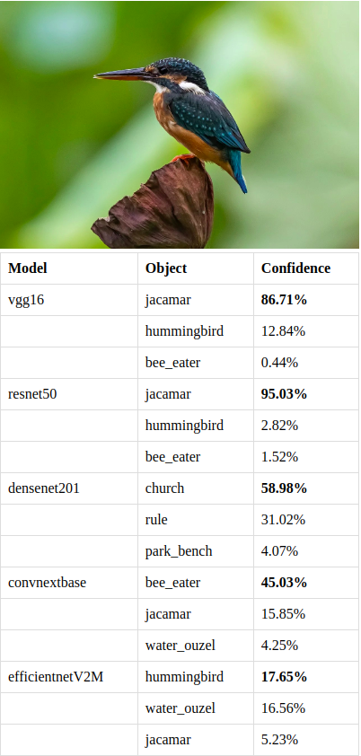
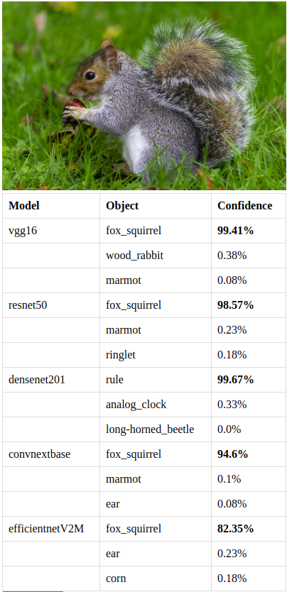
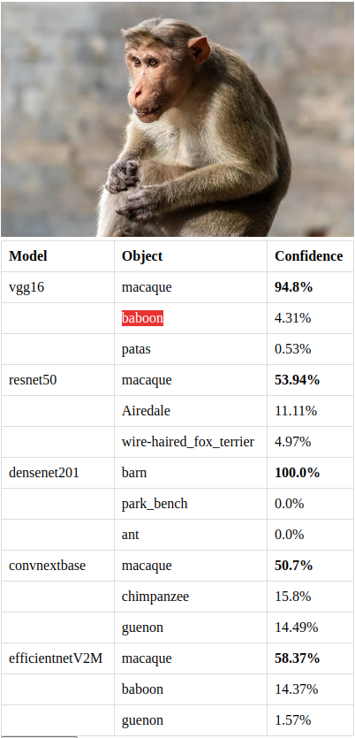
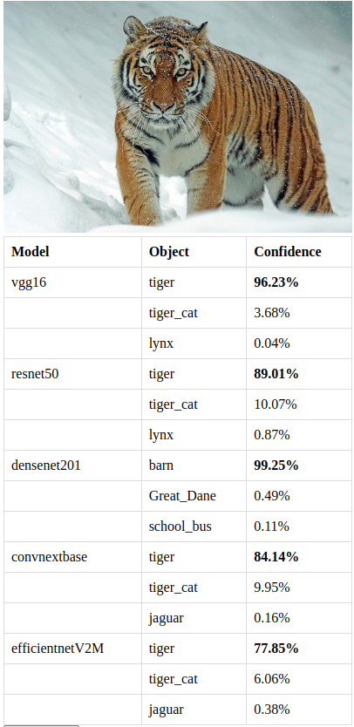
Results & Confidence (%)

Slide 9
Conclusion
The way to perfection
# file extension checker
# error handler
# several pages on website
# model fallibility
# advanced model preparation
# teaching-up the model

Slide 10

Thank you for your attention!
No questions??

