Slide 1
11. December 2023
by Andrii Stoliarov & Igor Korobov
PROJECT: IMAGE RECOGNITION
Course: Python Foundation

Slide 2
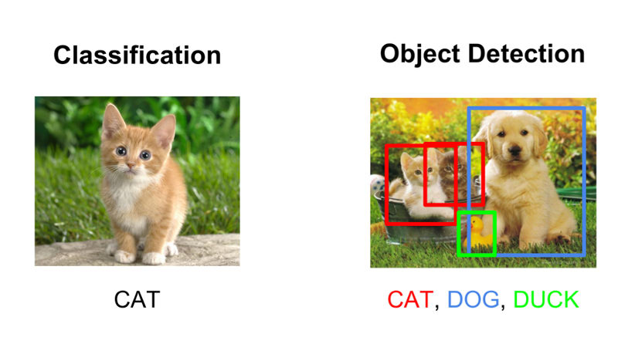
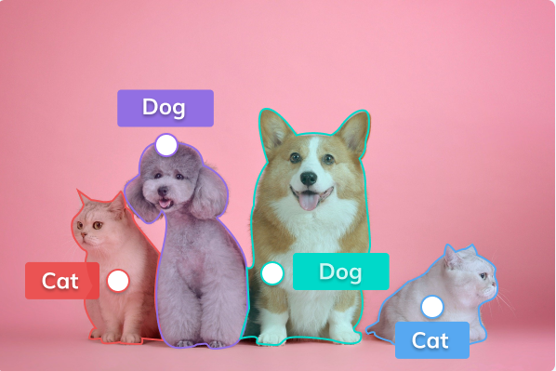
What is image recognition?
a computer vision technology that enables machines to interpret and understand visual information from images or videos.
Classification
Object Detection
Image Segmentation

Slide 3






Computer vision / AI-Models
the integration of AI techniques with visual processing to enable machines to interpret and understand the visual world

Slide 4



A typical workflow for deep learning projects
Create model
Test model
collection of images
associated categories
Learning algorithm
Present test data
Real-world use
Feedback
Build from scratch
Pretrained model
Present new data
Check accuracy
Prepare data
Train model
Deployment

Slide 5
What our code consists of and how it works
Flask
Data preparation
Image classification in TensorFlow
Multi-model classification
Loads the web page we created
Specify the selected model in the dictionary
Receives data in the required format
It is possible to specify several models in the dictionaries
Analyses the incoming file
Specify the expected size of the image by the model
The model classifies input data
All necessary steps will be performed for each model
Initialises the classification process
Convert the original picture into the format for the model
Returns possible classes and their probabilities
We will get a list with results for each model
Refreshes the page with the result
Convert the original picture into the format for Flask
3 most likely classes and their probabilities are saved
All results will also be displayed on the page

Slide 6

Frameworks: Flask
Web application with a user interface
Flexibility
Minimalism
Ease of Learning
Integration with External Libraries
RESTful API Development
Frameworks simplify web application development by providing pre-built structures and functionalities

Slide 7


Frameworks: TensorFlow and Keras
Supports JavaScript
A core platform and library
High-level API
Runs on top of TensorFlow, Theano etc.
Machine learning platform
Deep learning library
Actively developed by contributors
Good documentation
Actively developed by contributors
Good documentation
Open-source
Open-source
Keras
Easy model building
Easy model building
Pre-trained models
Easy to use
Easy to use
Best performance in class
Data parallelism
Sometimes slower than pure backend
Performance
Performance

Slide 8
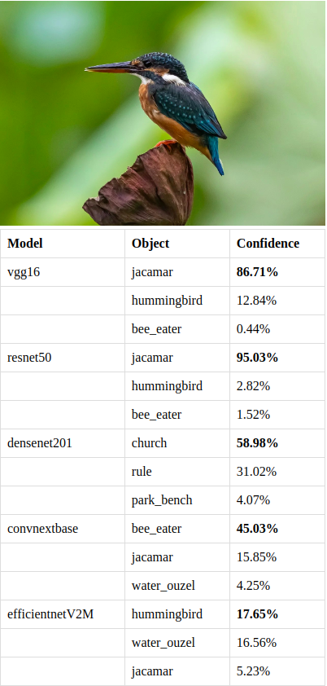
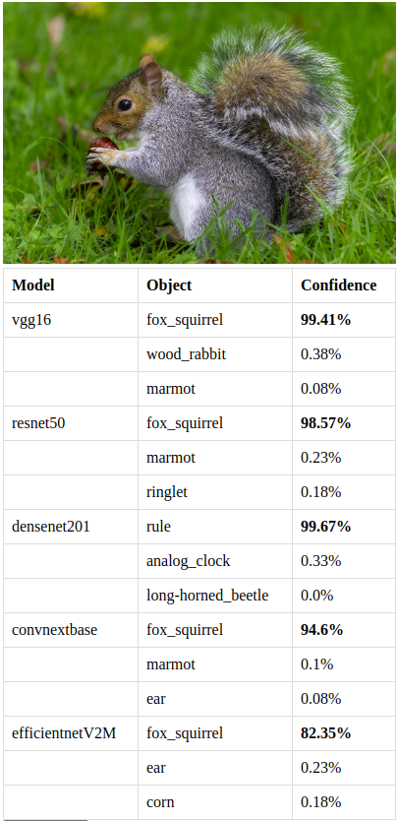
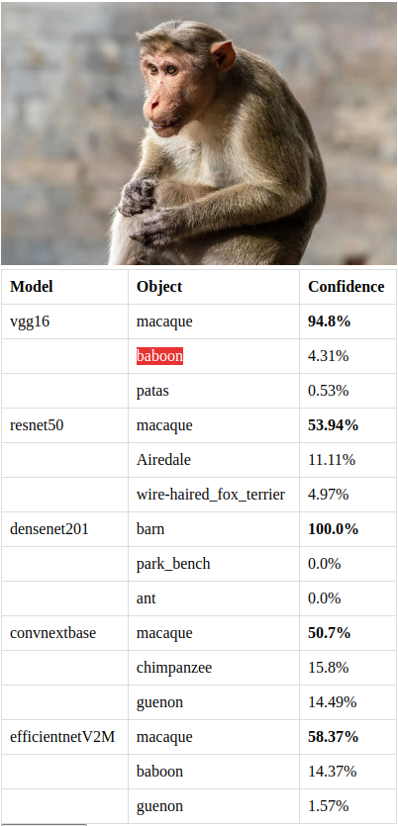
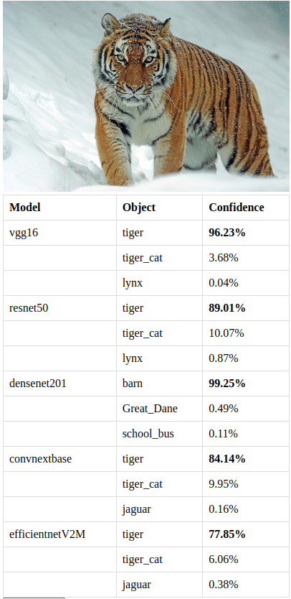
Results & Confidence (%)

Slide 9
Conclusion
The way to perfection
# file extension checker
# error handler
# several pages on website
# model fallibility
# advanced model preparation
# teaching-up the model

Slide 10

Thank you for your attention!
No questions??

