Slide 1
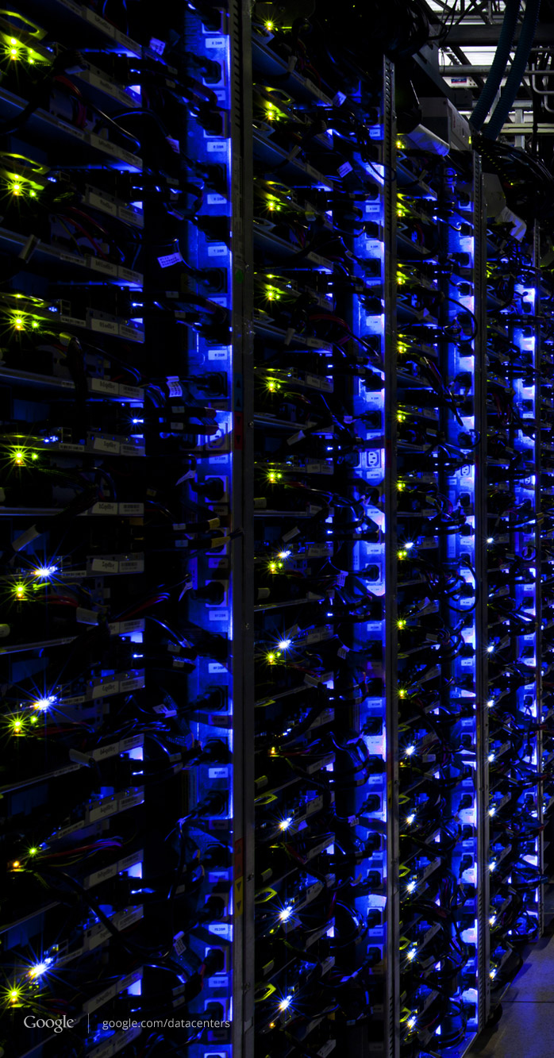
Software Defined Networking
Notes:
Software-defined networking (SDN) is a newly emerging computer networking architecture. Its main distinguishing factor is the separation of the data plane from the control plane in routers and switches. In other words, the control is decoupled from hardware and implemented in software.

Slide 2
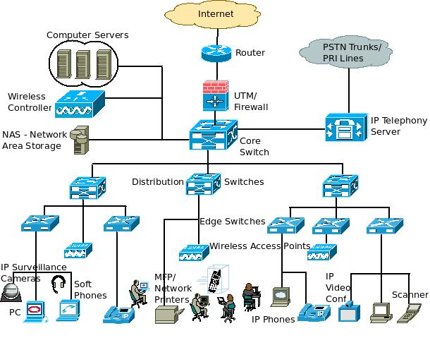
Limitations of Current Networks
Switches
Notes:
Software-defined networking (SDN) is an architecture that aims to make networks agile and flexible. The goal of SDN is to improve network control by enabling enterprises and service providers to respond quickly to changing business requirements.
Software-defined networking (SDN) technology is an approach to network management that enables dynamic, programmatically efficient network configuration in order to improve network performance and monitoring making it more like cloud computing than traditional network management.
Why The Business Needs SDN. Software-defined networking provides network programmability, which helps contain operational costs and enables business growth. Ultimately, programmability of the network will be critical for business growth.

Slide 3
Limitations of Current Networks
Enterprise networks are difficult to manage
“New control requirements have arisen”:
Greater scale
Migration of Virtual Machine System (VMS)
How to easily configure huge networks?
Notes:
Validate responsiveness as demand varies according to user needs
Firewalls and load balancers
Eliminate vulnerability and exposure between users and applications
ON VMS Virtual machines allow you to run an operating system in an app window on your desktop that behaves like a full, separate computer.
An internal virtual network consists of one system using virtual machines or zones that are configured over at least one pseudo-network interface. These containers can communicate with each other as though on the same local network, providing a virtual network on a single host.
Live migration refers to the process of moving a running virtual machine or application between different physical machines without disconnecting the client or application. Memory, storage, and network connectivity of the virtual machine are transferred from the original guest machine to the destination.

Slide 4
















Limitations of Current Networks
Old ways to configure a network
App
App
App
Operating
System
Specialized Packet Forwarding Hardware
App
App
App
Operating
System
App
App
App
Specialized Packet Forwarding Hardware
Operating
System
App
App
App
Specialized Packet Forwarding Hardware
Operating
System
Specialized Packet Forwarding Hardware
App
App
App
Operating
System
Specialized Packet Forwarding Hardware
Notes:
The bigger promise of software defined networking (SDN) is that it will centralize and simplify control of enterprise network management. ... One of the primary advantages of software defined networking is that it creates a framework to support more data-intensive applications like big data and virtualization.
SDN simplifies networking for both data center and WAN deployments by moving to software many network functions that have traditionally resided in hardware, making them programmable and automatable. Additionally, SDN segregates network functions into the Control Plane and Data Plane.

Slide 5

Limitations of Current Networks
Feature
Feature
Many complex functions baked into infrastructure
OSPF, BGP, multicast, differentiated services, Traffic Engineering, NAT, firewalls, …
Million of lines of source code
Operating
System
Specialized Packet Forwarding Hardware
Billions of gates
Cannot dynamically change according to network conditions

Slide 6
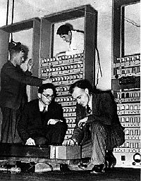
Limitations of Current Networks
No control plane abstraction for the whole network!
It’s like old times – when there was no OS…
Wilkes with the EDSAC, 1949
Notes:
Packages travel inside the network…
Switches pass them along…
But the decisions are made individually by the switches.. such as where to pass them
Nobody is dynamically controlling the network flow

Slide 7
Idea: An OS for Networks
Closed
App
App
App
Operating
System
Specialized Packet Forwarding Hardware
App
App
App
Operating
System
App
App
App
Specialized Packet Forwarding Hardware
Operating
System
App
App
App
Specialized Packet Forwarding Hardware
Operating
System
Specialized Packet Forwarding Hardware
App
App
App
Operating
System
Specialized Packet Forwarding Hardware
Notes:
The main difference between network operating system (NOS) and distributed operating system is that a network operating system provides network related functionalities while a distributed operating system connects multiple independent computers via a network to perform tasks similar to a single computer.
A network operating system (NOS) is a computer operating system (OS) that is designed primarily to support workstations, personal computers and, in some instances, older terminals that are connected on a local area network (LAN).

Slide 8















Idea: An OS for Networks
Control Programs
Network Operating System
App
App
App
Operating
System
Specialized Packet Forwarding Hardware
App
App
App
Operating
System
App
App
App
Specialized Packet Forwarding Hardware
Operating
System
App
App
App
Specialized Packet Forwarding Hardware
Operating
System
Specialized Packet Forwarding Hardware
App
App
App
Operating
System
Specialized Packet Forwarding Hardware
Notes:
How do we redefine the architecture to open up networking infrastructure and the industry!
By bring to the networking industry what we did to the computing world

Slide 9
Idea: An OS for Networks
Control Programs
Network Operating System
Simple Packet Forwarding Hardware
Simple Packet Forwarding Hardware
Simple Packet Forwarding Hardware
Simple Packet Forwarding Hardware
Simple Packet Forwarding Hardware
Notes:
The key is to have a standardized control interface that speaks directly to hardware
A whole network is like a big machine

Slide 10
Idea: An OS for Networks
“NOX: Towards an Operating System for Networks”
Software-Defined Networking (SDN)
Control Programs
Global Network View
Network Operating System
Control via forwarding
interface
Protocols
Protocols
The Future of Networking, and the Past of Protocols, Scott Shenker, with Martin Casado, Teemu Koponen, Nick McKeown
Notes:
NOX is an open source development platform for C++-based software-defined networking (SDN) control applications. POX, a variant for Python development. NOX is a piece of the software-defined networking (SDN) ecosystem. Specifically, it's a platform for building network control applications.
A remote controller has control of a switch’s forwarding decisions

Slide 11
Software Defined Networking
No longer designing distributed control protocols
Much easier to write, verify, maintain, …
An interface for programming
NOS serves as fundamental control block
With a global view of network
Notes:
The scope, the design goal
No need for distance-vector routing if you have a global view – compute dijkstra directly

Slide 12
Software Defined Networking
Examples
Ethane: network-wide access-control
Power Management
Notes:
What is Ethane? Ethane is a new architecture for enterprise networks which provides a powerful yet simple management model and strong security guarantees. Ethane allows network managers to define a single, network-wide, fine-grain policy, and then enforces it at every switch.
Check network flow, scan…
Reduce the speed of the links that are not well utilized, or turn them off together

Slide 13
Software Defined Networking
Questions:
How to obtain global information?
What are the configurations?
How to implement?
How is the scalability?
How does it really work?

Slide 14
OpenFlow
“OpenFlow: Enabling Innovation in Campus Networks”
Like hardware drivers
– interface between switches and Network OS
Notes:
The Open Networking Foundation (ONF) is a user-driven non-profit organization focused on promoting the adoption of software-defined networking (SDN) through open standards development. ... Its flagship contribution has been OpenFlow, widely considered the first SDN standard.
ONF defines OpenFlow as the first standard communications interface defined between the control and forwarding layers of an SDN architecture. OpenFlow allows direct access to and manipulation of the forwarding plane of network devices such as switches and routers, both physical and virtual (hypervisor-based).

Slide 15
OpenFlow
Control Path (Software)
Data Path (Hardware)
Notes:
The OpenFlow Switch data flow consists of a Flow Table. The control path consists of a controller which programs the flow entry in the flow table. SDN OpenFlow is based on an Ethernet switch, with an internal flow-table, and a standardized interface to add and remove flow entries. An OpenFlow controllable datapath, allowing switch and controller vendors to work independently to create interoperable SDN products.

Slide 16
OpenFlow
OpenFlow Controller
OpenFlow Protocol (SSL/TCP)
Control Path
OpenFlow
Data Path (Hardware)
Notes:
Leverages hardware inside most switches today (ACL tables)
An OpenFlow controller is an application that manages flow control in a software-defined networking (SDN) environment. ... Because the network control plane is implemented in software, rather than the firmware of hardware devices, network traffic can be managed more dynamically and at a much more granular level.

Slide 17


OpenFlow Switching
Controller
OpenFlow Client
PC
Software
Layer
OpenFlow Table
MAC
src
MAC
dst
IP
Src
IP
Dst
TCP
sport
TCP
dport
Action
Hardware
Layer
*
*
*
5.6.7.8
*
*
port 1
port 1
port 2
port 3
port 4
5.6.7.8
1.2.3.4
17
Notes:
An OpenFlow switch is a software program or hardware device that forwards packets in a software-defined networking (SDN) environment. OpenFlow switches are either based on the OpenFlow protocol or compatible with it.

Slide 18
OpenFlow Table Entry
Rule
Action
Stats
Packet + byte counters
Forward packet to port(s)
Encapsulate and forward to controller
Drop packet
Send to normal processing pipeline
…
Switch
Port
MAC
src
MAC
dst
Eth
type
VLAN
ID
IP
Src
IP
Dst
IP
Prot
TCP
sport
TCP
dport
+ mask
Notes:
The earliest prototype… just to get an idea

Slide 19
OpenFlow Examples
Switching
Switch
Port
MAC
src
MAC
dst
Eth
type
VLAN
ID
IP
Src
IP
Dst
IP
Prot
TCP
sport
TCP
dport
Action
*
*
00:1f:..
*
*
*
*
*
*
*
port6
Routing
Switch
Port
MAC
src
MAC
dst
Eth
type
VLAN
ID
IP
Src
IP
Dst
IP
Prot
TCP
sport
TCP
dport
Action
*
*
*
*
*
*
5.6.7.8
*
*
*
port6
Firewall
Switch
Port
MAC
src
MAC
dst
Eth
type
VLAN
ID
IP
Src
IP
Dst
IP
Prot
TCP
sport
TCP
dport
Action
*
*
*
*
*
*
*
*
*
22
drop
OpenFlow/SDN tutorial, Srini Seetharaman, Deutsche Telekom, Silicon Valley Innovation Center

Slide 20



OpenFlow Usage
Controller
Alice’s code:
Simple learning switch
Per Flow switching
Network access control/firewall
Static “VLANs”
Her own new routing protocol: unicast, multicast, multipath
Home network manager
Packet processor (in controller)
IPvAlice
Alice’s Rule
Alice’s code
OpenFlow Switch
PC
Decision?
OpenFlow
Protocol
Alice’s Rule
Alice’s Rule
OpenFlow Switch
OpenFlow Switch
OpenFlow/SDN tutorial, Srini Seetharaman, Deutsche Telekom, Silicon Valley Innovation Center
Notes:
Table entries can be updated

Slide 21

OpenFlow
Standard way to control flow-tables in commercial switches and routers
Just need to update firmware
Essential to the implementation of SDN
Notes:
SDN provides separation between the control plane (controller) and data plane (switch) functions of networks using a protocol that modifies forwarding tables in network switches. ... The OpenFlow protocol defines the interface between an OpenFlow Controller and an OpenFlow switch.

Slide 22

Centralized/Distributed Control
“Onix: A Distributed Control Platform for Large-scale Production Networks”
Centralized Control
Distributed Control
Controller
Controller
OpenFlow
Switch
OpenFlow
Switch
Controller
OpenFlow
Switch
OpenFlow
Switch
OpenFlow
Switch
OpenFlow
Switch
Notes:
As the control platform, Onix is responsible for giving the control logic programmatic access to the net- work (both reading and writing network state). ... These are the four basic components of an SDN- based network.
Partition, aggregation, consistency, durability
Asynchronous but eventually consistent

Slide 23
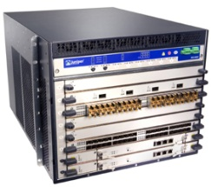
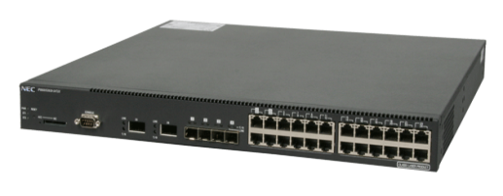
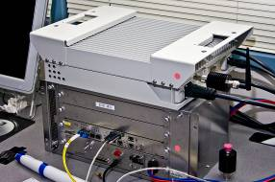
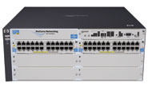
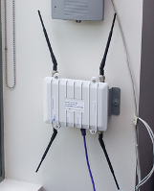

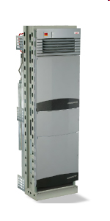

Current status of SDN
Hardware support
Juniper MX-series
NEC IP8800
WiMax (NEC)
HP Procurve 5400
Netgear 7324
PC Engines
Pronto 3240/3290
Ciena Coredirector
More coming soon...
Notes:
Not only switches but other network components

Slide 24
Current status of SDN
Industry support
Google built hardware and software based on the OpenFlow protocol
VMware purchased Nicira for $1.26 billion in 2012
IBM, HP, NEC, Cisco and Juniper also are offering SDNs that may incorporate OpenFlow, but also have other elements that are specific to that vendor and their gear.
http://gigaom.com/2012/03/19/are-vendors-closing-openflow/
http://gigaom.com/2012/12/17/2012-the-year-software-defined-networking-sold-out/
http://www.extremetech.com/internet/140459-networking-is-getting-better-and-thats-partly-thanks-to-google
Notes:
Nicira offers a way to build scale out virtualized networks and uses OpenFlow, but only as a small aspect of its controller product.
100+ institutions around the world are using openflow

Slide 25
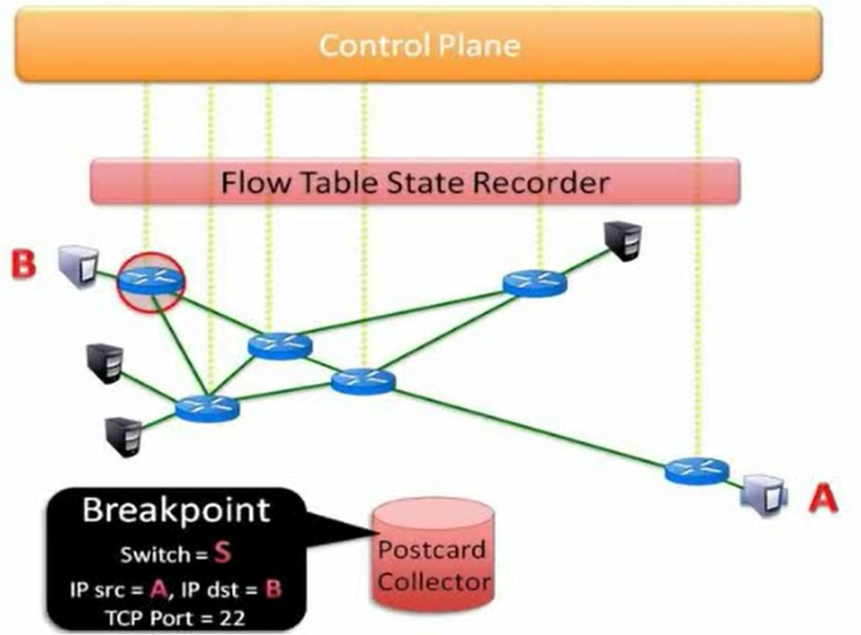
Future Focuses of SDN
New policies for security
Programmable WLANs
The placement of controllers (amount; location; centralized/distributed)
Debugger for SDN
* All references are listed in the last slide.
Notes:
Transparently changing host IP to avoid attack – sdn provides a namespace interface (a strong mapping mechanism)
2. access point (AP) association decisions are not made by the infrastructure, but by clients. Have no control to that part… state changes.. Virtual AP for management
4. Breakpoints and packet backtraces

