Slide 1
The Combinatorial Multigrid Solver
Yiannis Koutis, Gary Miller
Carnegie Mellon University
TexPoint fonts used in EMF.
Read the TexPoint manual before you delete this box.: AAAA

Slide 2
Where I am coming from
Theoretical Computer Science Community
Studies asymptotic complexity of problems
Prefers broad complexity statements over specialized, conditional or experimental results
Likes graph theory
Any planar SPD system can be solved directly
in time O(n^{1.5}) [LRT]

Slide 3
CMG: A linear system solver
What kind of linear systems?
Graph Laplacians
Symmetric
Negative off-diagonals
Zero row sums
An AMG-like goal: A two-level method with provable properties for an arbitrary weighted sparse Laplacian.

Slide 4
Laplacians in efficient algebraic reductions
Gremban
Flip
off-diagonal
signs
Spielman, Daitch
Laplacian
+
Diagonal
SPD*
negative
off-diagonals
Laplacian
FED’s of
scalar elliptic PDEs
Reitzinger
Boman, Hendrickson, Vavasis
Avron, Chen,Shklarski, Toledo

Slide 5


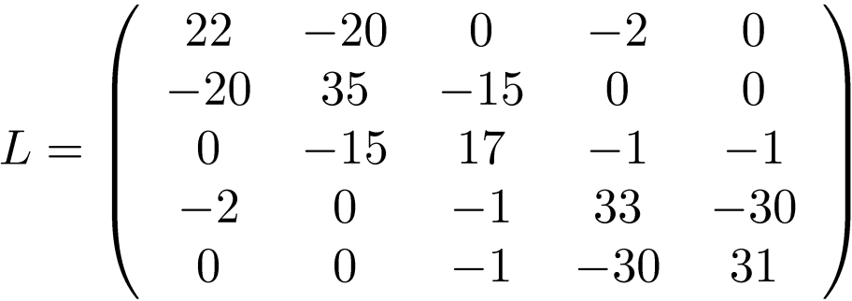





Laplacians of weighted graphs
Random Walk Matrix:
Electrical network, Ohm’s law:
30
2
1
1
20
15

Slide 6
Outline
Preconditioners in computer science
Combinatorial Subgraph preconditioners
Combinatorial Steiner preconditioners
The Combinatorial Multigrid Solver

Slide 7
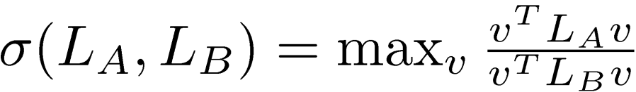
Graph preconditioning
The support number
The condition number
The preconditioner of a graph A must be a graph B
[Vaidya 93]
A GMG-like goal: Graph B must preserve the combinatorial geometry of A

Slide 8

Graph preconditioning
The quadratic form:
Measure of similarity of the energy profile of the two networks
If then
Splitting Lemma, Locality of Support
30
2
1
1
20
15

Slide 9
Outline
Preconditioners in Computer Science
Combinatorial Subgraph preconditioners
Combinatorial Steiner preconditioners
The Combinatorial Multigrid Solver

Slide 10
Solving linear systems on Laplacians Subgraph Preconditioners
Find an easily invertible preconditioner for a Laplacian
Approximate a given graph with a simpler graph
B = Maximum Spanning Tree + a few edges
Solve B with partial elimination and recursion
Maximum Spanning Tree
[Vaidya 93]
30
2
1
1
20
15

Slide 11


Solving linear systems on Laplacians Subgraph Preconditioners
Replace MST with Low Stretch Trees [EEST05]
Quite more complicated than MST
Better ways to add edges to the tree
Sparsification of dense graphs [ST04]
Use planar multi-way separators [KM07]
Also parallel
Laplacians in
Planar Laplacians in

Slide 12
Outline
Preconditioners in Computer Science
Combinatorial Subgraph preconditioners
Combinatorial Steiner preconditioners
The Combinatorial Multigrid Solver

Slide 13
Steiner Preconditioners
Spanning tree
Laplacians have same sizes
Steiner Tree [GrM97]
Laplacians have different sizes
b
j
a
i
f
g
d
h
c
a
b
e
h
i
j
g
e
f
c
d

Slide 14

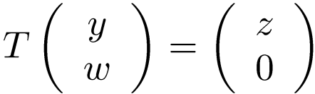

Steiner Preconditioners
Does it make sense?
Usual preconditioners involve the solution of
Steiner preconditioners
This is the linear operator
The effective preconditioner
Steiner Tree
Laplacians have different sizes
f
g
a
b
e
h
i
j
c
d

Slide 15
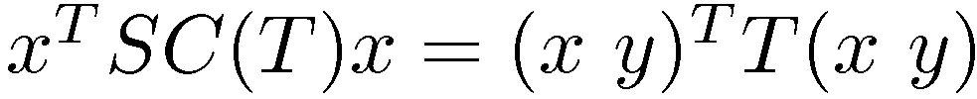
Steiner Preconditioners Support analysis
View the graph as an electric circuit. Set the voltages on the leaves and let the internal voltages float. If y are the internal voltages:
y minimizes ( x y)^{T} T ( x y)
f
g
a
b
e
h
i
j
c
d

Slide 16

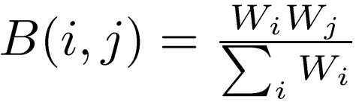
Steiner Preconditioners Support analysis for the star
Precondition any graph with one Steiner node
This gives
How about the other direction?
The effective preconditioner
W_{n}
W₁
W_{i}
W_{j}
i
j
1
i
j
n

Slide 17
Steiner Preconditioners Support analysis for the star
Precondition any graph with one Steiner node
Bounding
W_{n}
W₁
W_{i}
W_{j}
i
j
1
i
j
n
constant
Cheeger

Slide 18

Steiner Preconditioners Support analysis for the star
Precondition any graph with one Steiner node
Graph must be an expander (i.e. has no sparse cuts)
Weights in star should not be much larger than weights in A
If the weight W_{n} in the star can be arbitrarily large
W_{n}
W₁
W_{i}
W_{j}
n
1
i
j
n

Slide 19

Steiner Preconditioners Support graphs
Find a number of m vertex-disjoint clusters
Assign a Steiner star to each cluster
Create a Quotient graph Q on the Steiner nodes
Need bounded
_{C}
W_{i}
W_{i}
i
j
_{C}

Slide 20
Steiner Preconditioners Requirements for clustering
Necessary and sufficient requirements for a clustering
Each cluster must be an expander
Precondition property: a constant fraction of the weight for each vertex must be within its assigned cluster
One exceptional heaviest vertex per cluster
_{C}
W_{i}
i
j
_{C}

Slide 21
Outline
Preconditioners in Computer Science
Combinatorial Subgraph preconditioners
Combinatorial Steiner preconditioners
The Combinatorial Multigrid Solver

Slide 22


Steiner Preconditioners An algebraic view
Vertex-Cluster incidence matrix R
R(i,j)=1 if vertex i is in cluster j, 0 otherwise
Quotient graph
Known as Galerkin condition in multigrid
We solve the system
From this we have

Slide 23

Steiner Preconditioners The multigrid connection
The basic AMG ingredients
Smoother S,
nxm Projection operator P
Galerkin condition constructs Q from P and A
Two-level method is described by error-reduction operator
Convergence proofs are based on assumptions for the angle between the low frequencies of S and Range(P)

Slide 24






Steiner Preconditioners The multigrid connection
Closed form for the Schur complement of the Steiner graph
The normalized Laplacian
The normalized Schur complement
We know
The two matrices are spectrally close
Low frequency of close to
Easy to derive exact bounds

Slide 25
The Combinatorial Multigrid Solver
Two-level proofs follow
Theory of Support Trees gives insights and proofs for the full multilevel behavior
3D convergence properties better than 2D
two-level method derived via a preconditioning technique
involving extra dimensions

Slide 26

Experiments with CMG vs Subgraph Preconditioners
Systems with 25 million variables in <2 minutes
Steiner preconditioner construction at least 4-5 times faster relative to subgraph preconditioner construction [sequential only]
Steiner preconditioner gives much faster iteration
Speed of convergence measured by residual error at iteration k

Slide 27
Thank you!

Slide 28
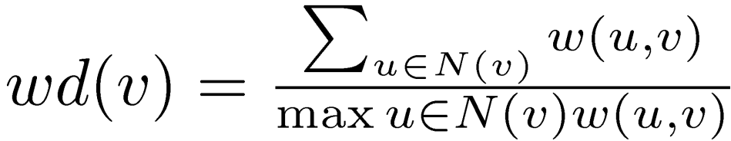
Decomposition into isolated expanders
The exceptional vertex greatly simplifies computation
Effective Degree of a Vertex
3
20
1
17

Slide 29




Decompositions in constant maximum effective degree graphs
The algorithm
Form a graph F by picking the heaviest incident edge for v2 V
F is a forest of trees with no singletons vertices
For each vertex with wd(v)>T cut the edge out in F
Split remaining F into constant size clusters
Each constant size cluster has:
constant conductance
At most one exceptional vertex without the precondition
With the remaining edges from G the conductance at least 1/T

Slide 30


Construction of the Steiner preconditioner illustration by a small example
Preconditioner preserves sparse cuts, aggregates expanders
30
4
2
1
1
22
35
17
33
31
20
15

