Slide 1
Algebraic and combinatorial tools for optimal multilevel algorithms
Yiannis Koutis
Carnegie Mellon University

Slide 2
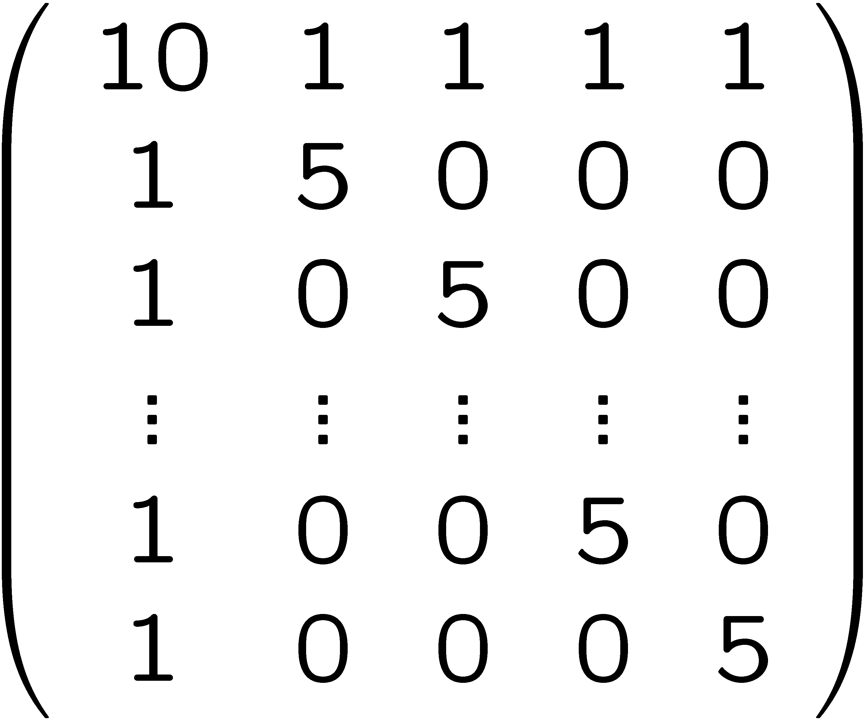
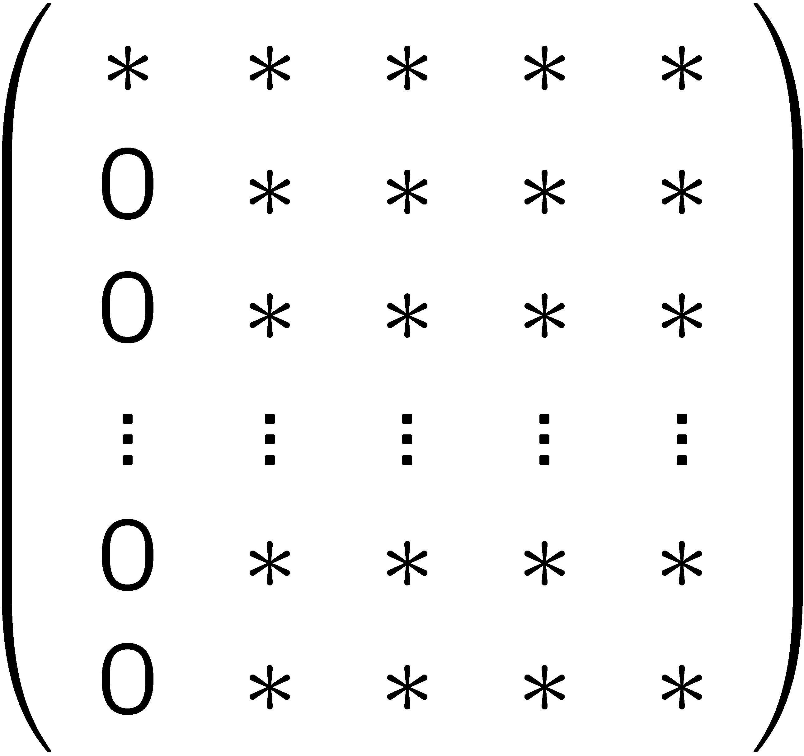
Spectral graph theory
Combinatorial scientific computing
Start with a system Ax =b
The problem of fill

Slide 3
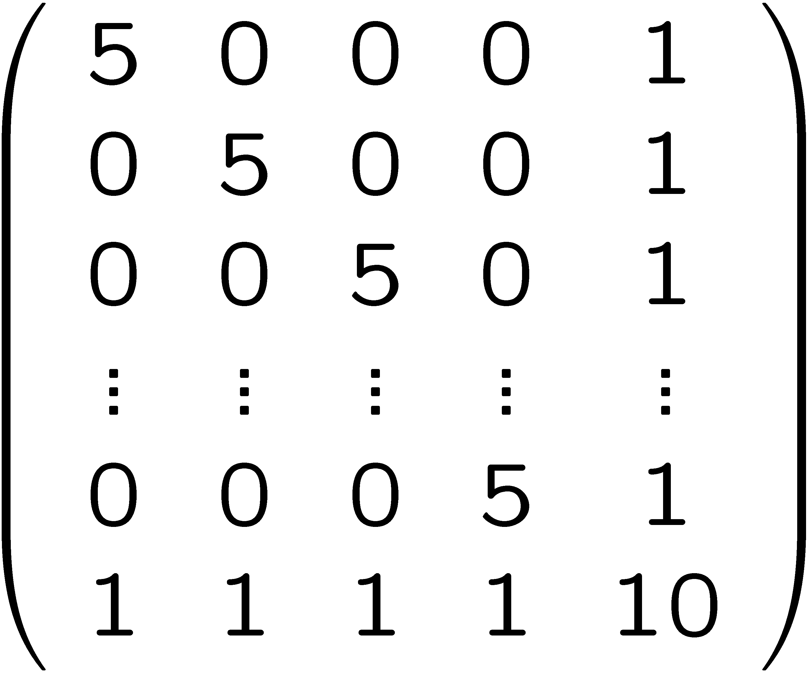
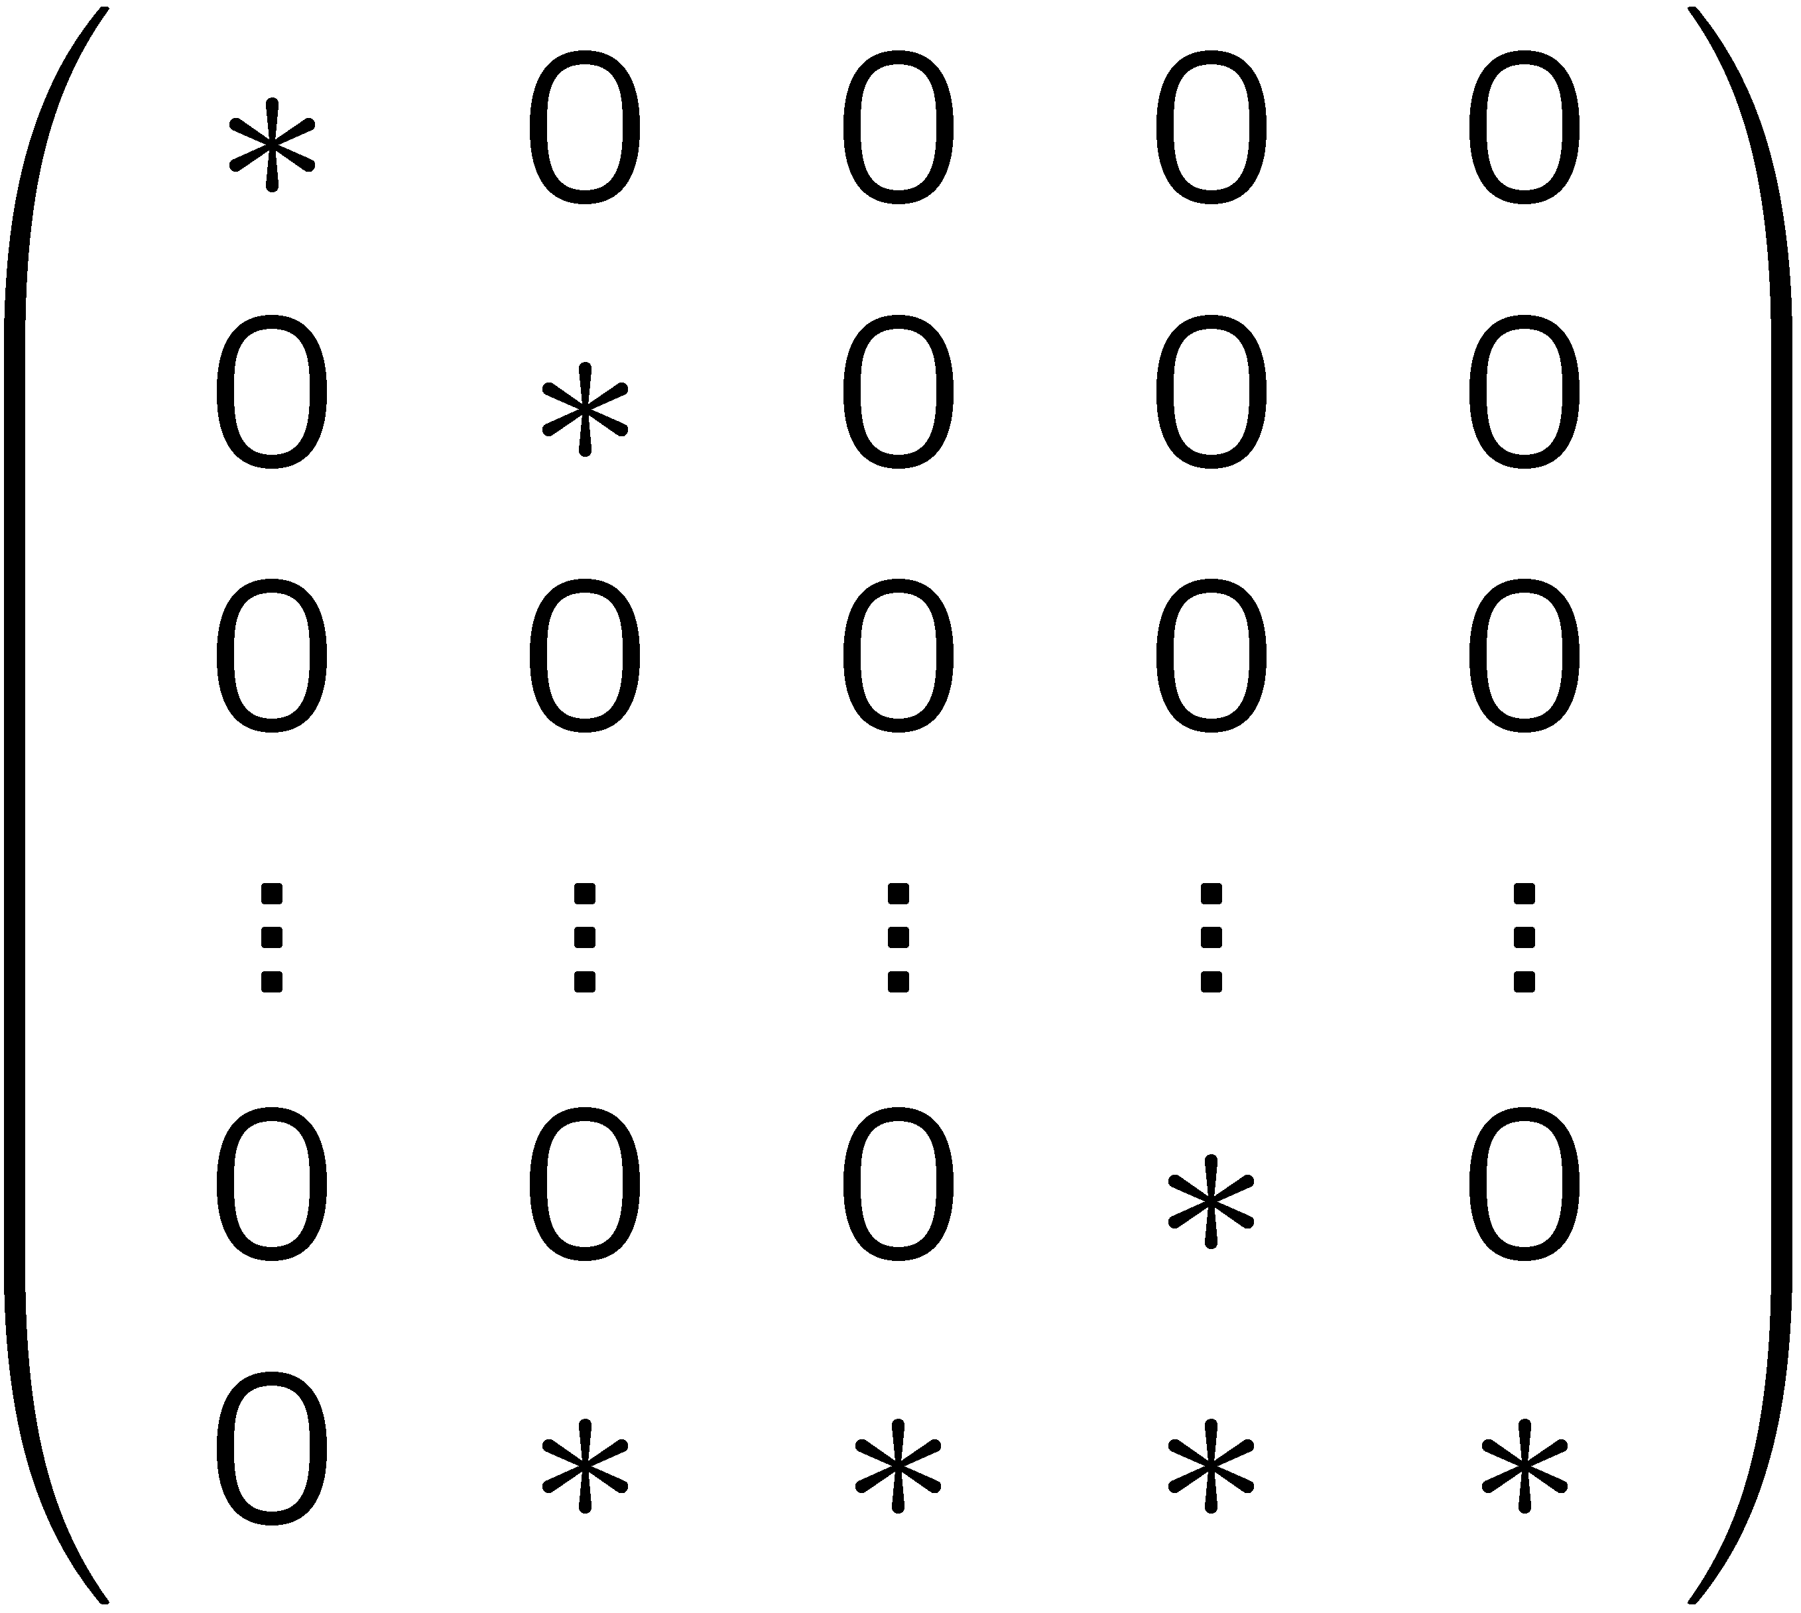
Combinatorial linear algebra and scientific computing
Start with a system Ax =b

Slide 4
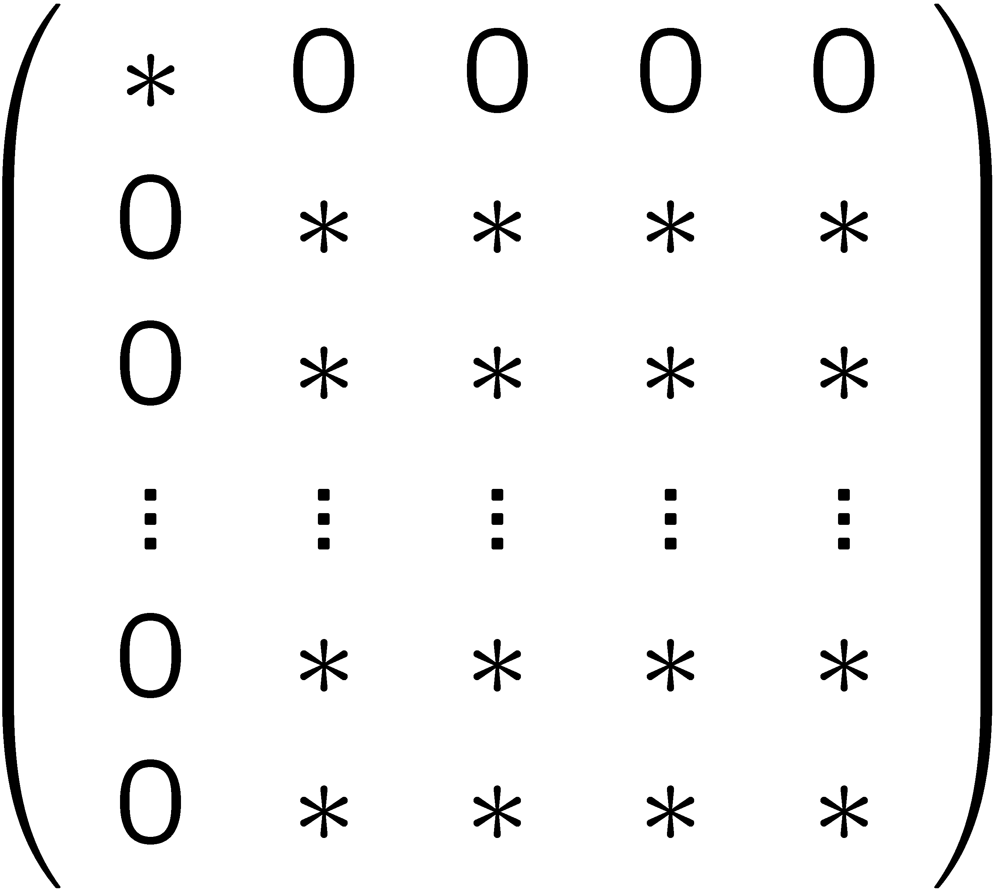
Combinatorial linear algebra and scientific computing
Start with a system Ax =b
Complete Mess!
1

Slide 5
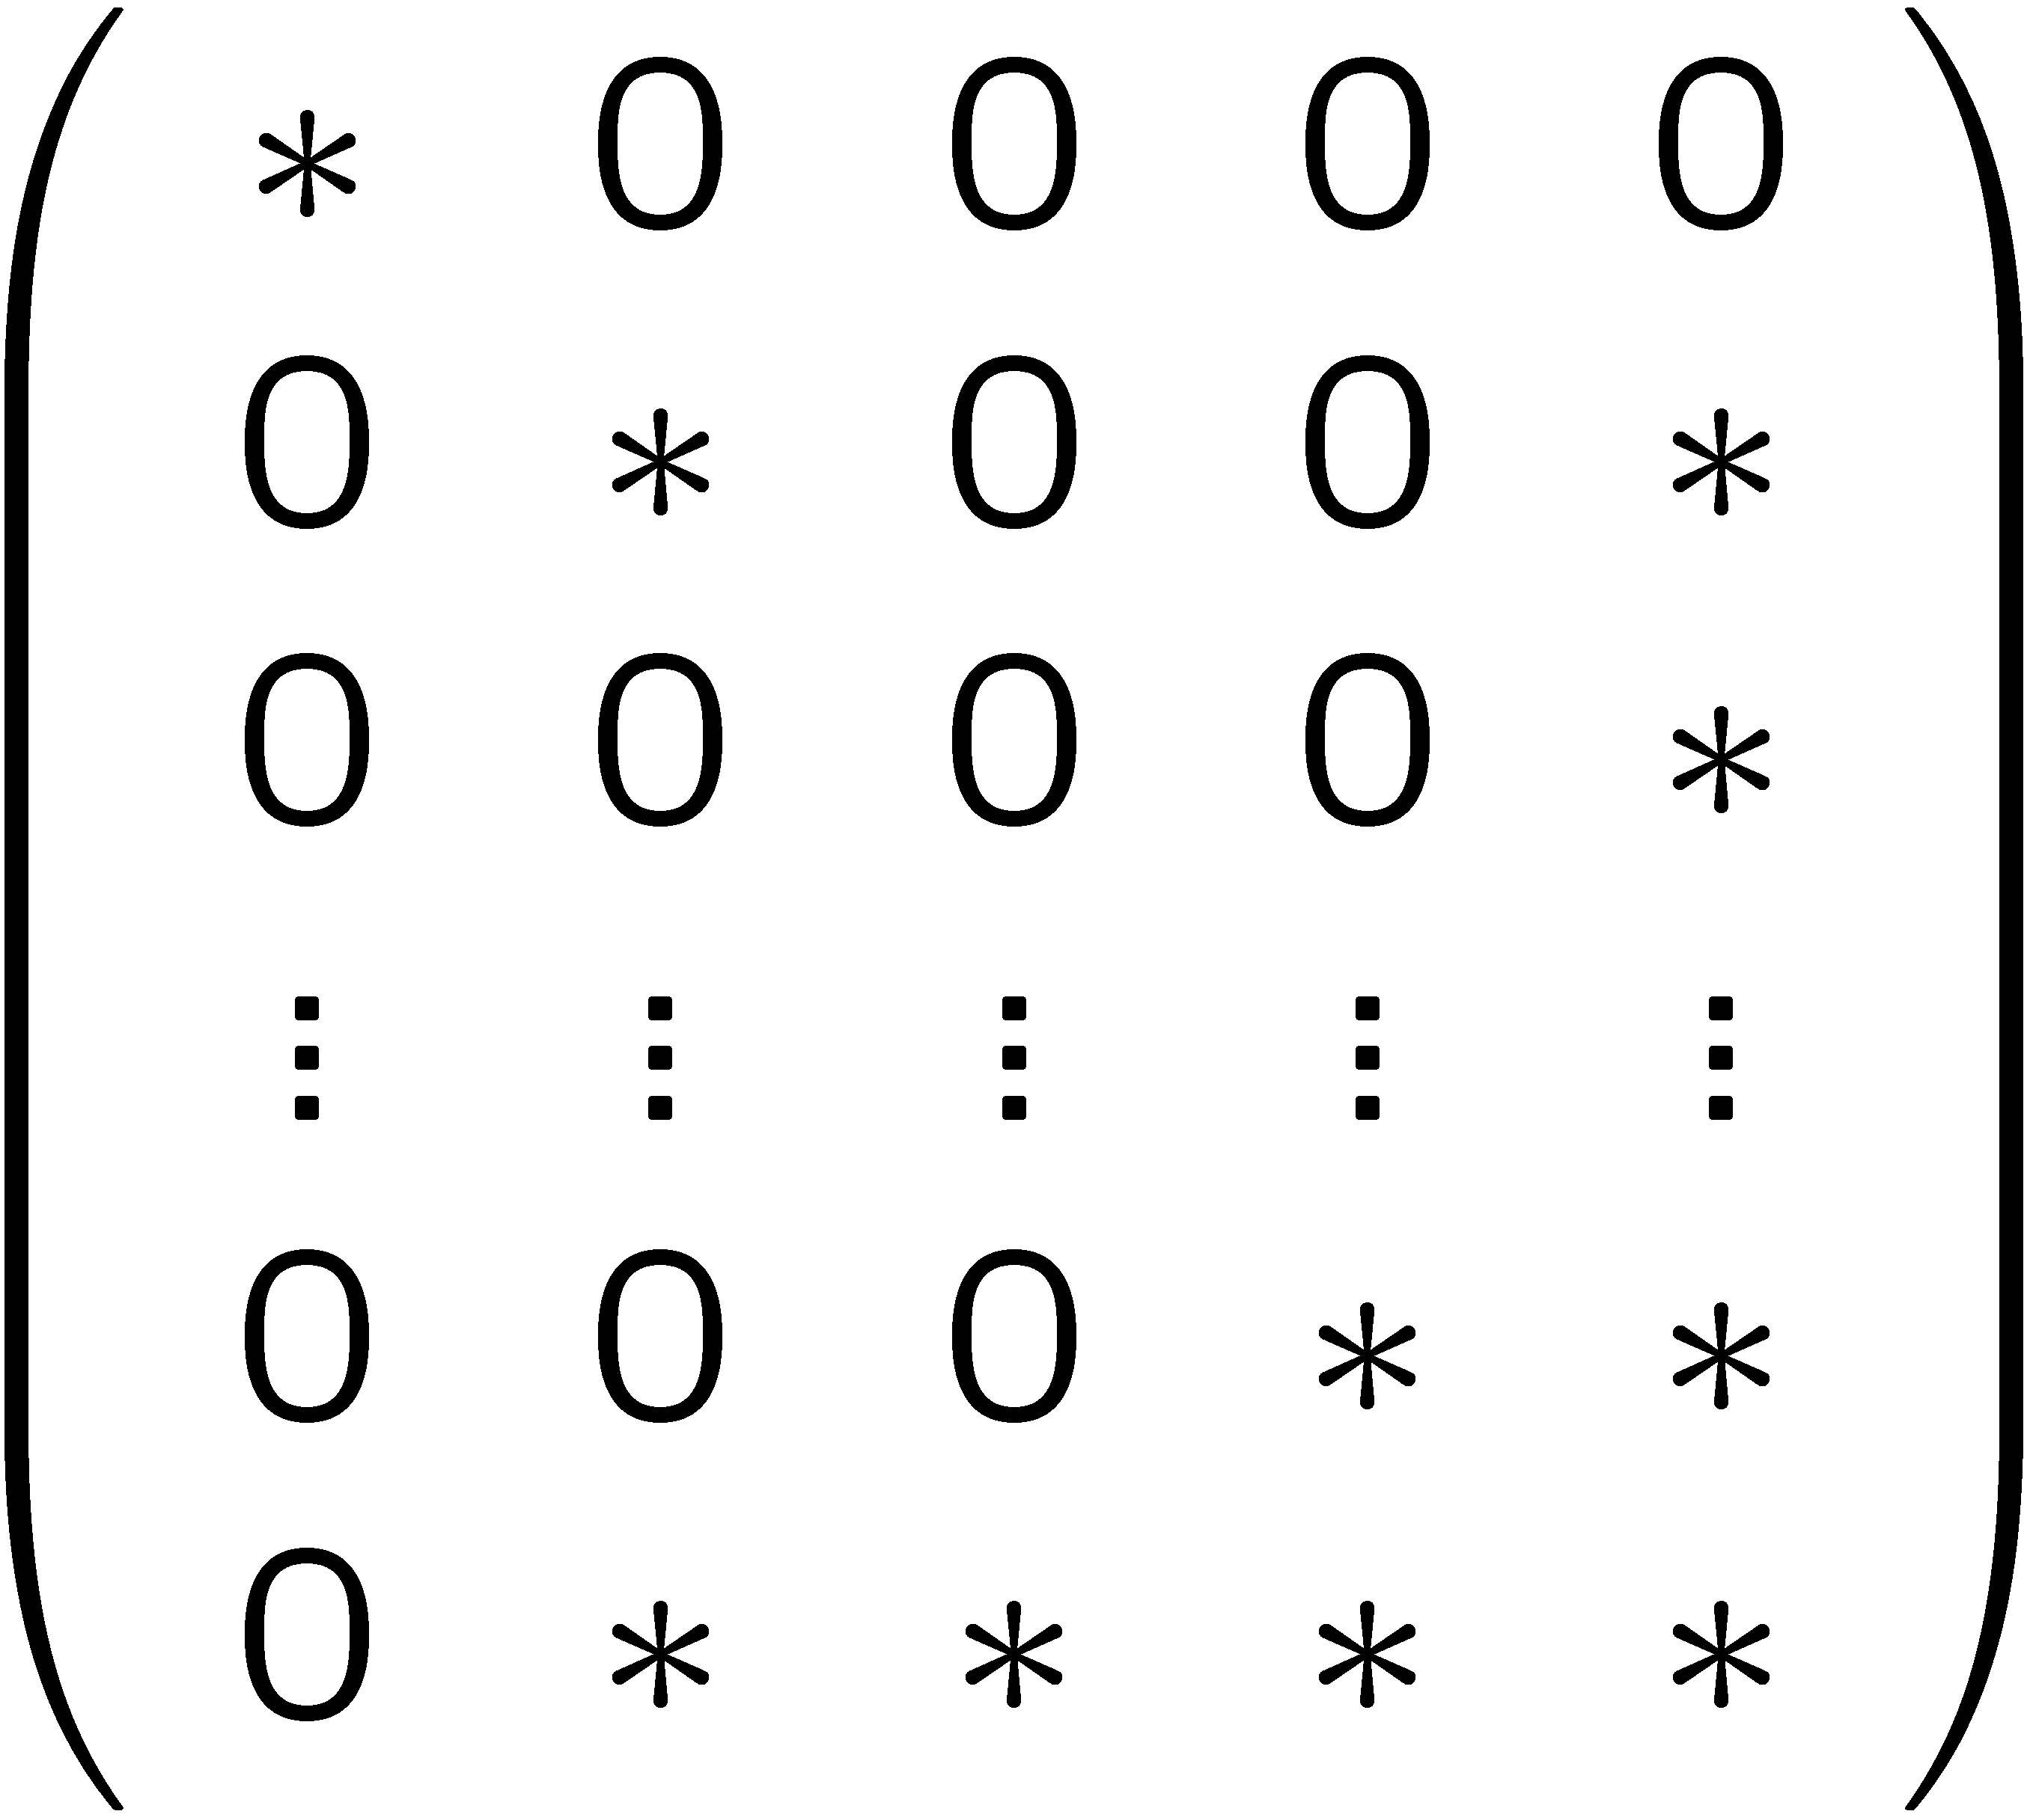
Combinatorial linear algebra and scientific computing
Start with a system Ax =b
1

Slide 6
Combinatorial linear algebra and scientific computing
Matrices viewed as graphs [direct methods]:
Planar positive definite matrices in O(n^{1.5}) time
[George], [Lipton, Rose,Tarjan]
Graphs viewed as matrices [iterative methods]:
Approximate sparsest cut in O(m polylog(n)) time [Spielman,Teng]
Find eigenvector of the Laplacian of the graph
A wonderful theory of graph approximations where
combinatorics and algebra work in synergy

Slide 7
contributions
Linear work parallel algorithms for
Combinatorial problems:
Multi-way planar edge partitioning
Multi-way planar vertex partitioning
Algebraic problems:
Solving systems with planar Laplacians
Solving systems with a priori known structural properties

Slide 8
contributions
Theory for
Perturbations of graph eigenvectors
Structure of eigenvectors with respect to edge cuts
Applications to
Classical algebraic multigrid algorithms
Graph-theoretic approach to design and analysis

Slide 9
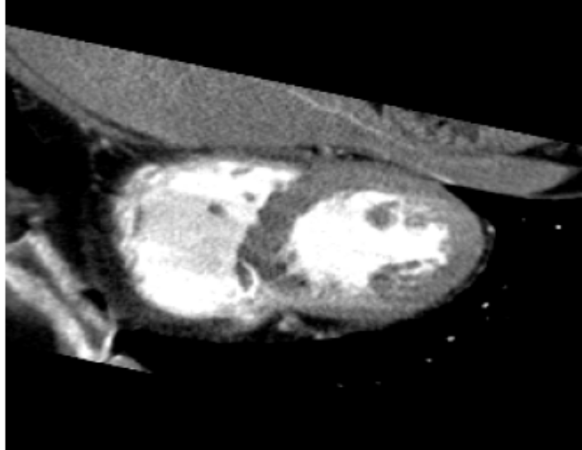
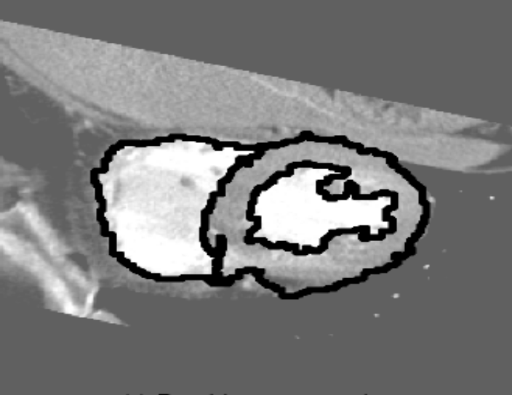
why planar systems?
Leo Grady@ Siemens
images are formulated as rectangular grids [up to 1 billion nodes]
million of images must be processed every day (mammograms, OCT retinal)
weights vary by a factor of 10⁶
PDEs discretized with finite elements [Boman,Hendrickson,Vavasis 05]

Slide 10
why laplacians?
adjacency: A(i,j) = w_{i,j}
degree sequence: D(i,i) = Σ_{j} w_{i,j}
Laplacian: L = D-A
Normalized: N = D^{-1/2} L D^{-1/2}
Random walk matrix: I-0.5D⁻¹L
cut structure of the graph [Cheeger], Euclidean commute time
spectral properties of the Laplacian
capture
combinatorial properties of the graph

Slide 11
Outline
planar multi-way edge partitioning
planar multi-way vertex partitioning
solving linear systems: introduction
solving planar Laplacians
a bit of perturbation theory

Slide 12
planar multi-way edge partitioning
Partitioning the edges into disjoint clusters with small boundaries
n/k^{1/2} edges delimiting
pieces of size O(k)

Slide 13
planar multi-way edge partitioning is it possible for any planar graph?
planar separator theorem:
every planar graph can be split
roughly in half by removing n^{1/2} vertices.
+ recursive bisection
+ a few bells and whistles
= O(n/k^{1/2}) edges that delimit pieces of size O(k)
In O(nlog n) time: recursively apply planar separator [Fre87]
In our work: O(kn) time using a localized approach

Slide 14
a quick time outline of multi-way edge partitioning in linear time
triangulate graph
form k-neighborhood of every face
partial layer
2nd layer

Slide 15
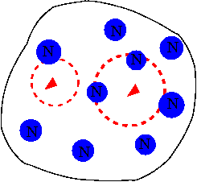
multi-way edge partitioning in linear time the set of independent k-neighborhoods
a set of independent k-neighborhoods
[no blue neighborhoods intersect]
the set is maximal
[Every red neighborhood
intersects a blue neighborhood]

Slide 16
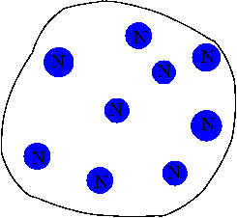
multi-way edge partitioning in linear time decomposition into Voronoi regions
every exterior face is assigned to “closest” blue neighborhood

Slide 17
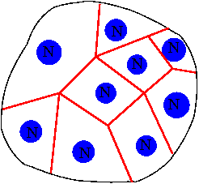
multi-way vertex partitioning in linear time decomposition into Voronoi regions
every exterior face is assigned to “closest” blue neighborhood
n/k connected
Voronoi regions:
faces in Voronoi graph

Slide 18
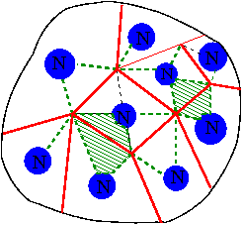
multi-way edge partitioning in linear time decomposition into Voronoi-Pair regions
paths from center faces of neighborhoods to surrounding Voronoi nodes
graph decomposed into constant size Voronoi-Pairs that are easy to deal with
how many paths did we add?
O(n/k)
still too many?

Slide 19
multi-way edge partitioning in linear time covering each long path with cores
we are done!!
total boundary = cores + exposed part = O(k^{1/2})
n/k paths * k^{1/2} boundary = O(n/k^{1/2}) edges
N
v

Slide 20
Outline
planar multi-way edge partitioning
planar multi-way vertex partitioning
solving linear systems: introduction
solving planar Laplacians
a bit of perturbation theory

Slide 21
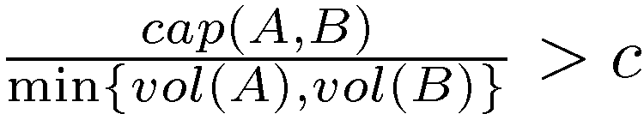
multi-way vertex partitioning in linear time into expander graphs
there are planar expanders
A
B
1
2
4
2^{n}

Slide 22
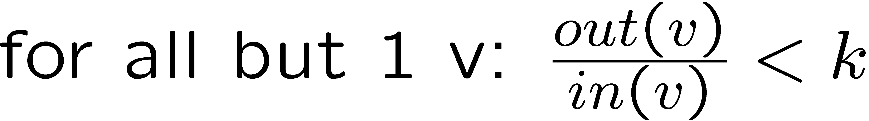
multi-way vertex partitioning in linear time into “isolated” expander graphs
Requirements:
a set of m disjoint clusters of vertices V_{i}
each subgraph on V_{i} is an expander
each expander is “isolated” from its exterior
n/m is constant

Slide 23
planar multi-way vertex partitioning local sparsification
Maximum Weight
Spanning
Tree
Factory
local sparse component:
component size k
each vertex keeps 1/k of its incident weight
MST

Slide 24
planar multi-way vertex partitioning global sparsification
Maximum Weight
Spanning
Tree
Factory
global sparse graph:
each vertex keeps 1/k of its incident weight
total number of edges n-1 + O(n/k^{1/2})
MST

Slide 25
planar multi-way vertex partitioning the numerical insight
Greedy contraction strategy for no fill:
Greedily eliminate degree 1 vertices
Greedily replace a vertex of degree 2 by an edge between its neighbors
How far do we get?
If the graph has n-1+t edges
greedy contraction gives a graph with 4t vertices

Slide 26
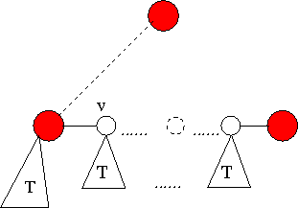
planar multi-way vertex partitioning decomposing the global sparse graph
we are done!!
n-1 + O(n/k^{1/2}) edges
greedy contraction stops in O(n/k^{1/2}) block vertices
vertex disjoint trees: use parallel tree contraction [Miller, Reif]
lightest edge

Slide 27
Outline
planar multi-way edge partitioning
planar multi-way vertex partitioning
solving linear systems: introduction
solving planar Laplacians
a bit of perturbation theory

Slide 28
solving Laplacian systems multilevel algorithms
Hard goals yield hard rules
Hard goal: linear time algorithm
Hard rule: we cannot afford fill

Slide 29
solving Laplacian systems hierarchies of graphs
approximation measure
not too many levels
good approximation between levels
Solving requirement:
reduction / approximation^{1/2} < ½
Solving complexity:
O(reduction*graph size)
size reduction

Slide 30
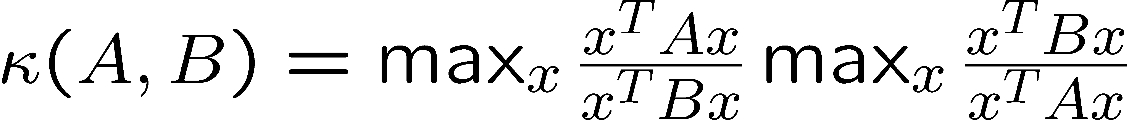
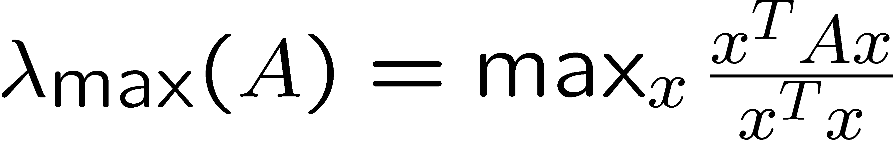
the approximation measure algebraically natural
condition number
eigenvalue characterization
Rayleigh Quotient

Slide 31
the approximation measure
“naturally” natural
graph
x^{T} A x =
electrical network
energy consumption with vector of voltages x
c
r=1/c
κ(A,B) compares the “energy” consumption of the two networks

Slide 32
the approximation measure combinatorially natural
Multicommodity flows:
For every edge (u,v) of A:
send w(u,v) units of flow between u and v in B
A solution is characterized by:
congestion: the maximum congestion over edges in B
dilation: “weighted” diameter of paths in solution
κ(A,B) < congestion*dilation

Slide 33
Outline
planar multi-way edge partitioning
planar multi-way vertex partitioning
solving linear systems: introduction
solving planar Laplacians
a bit of perturbation theory

Slide 34
solving requirement and complexity the guiding goal
Solving requirement:
size reduction /condition number^{1/2} < ½
Solving complexity:
O(size reduction*graph size)

Slide 35
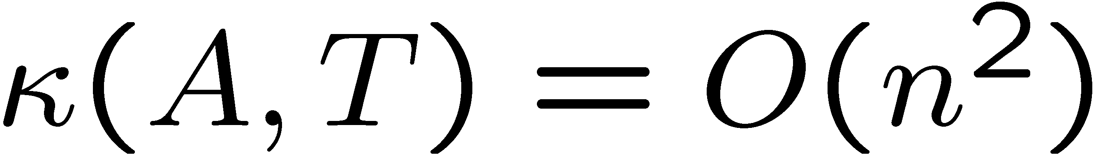
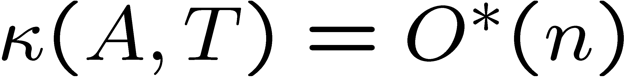
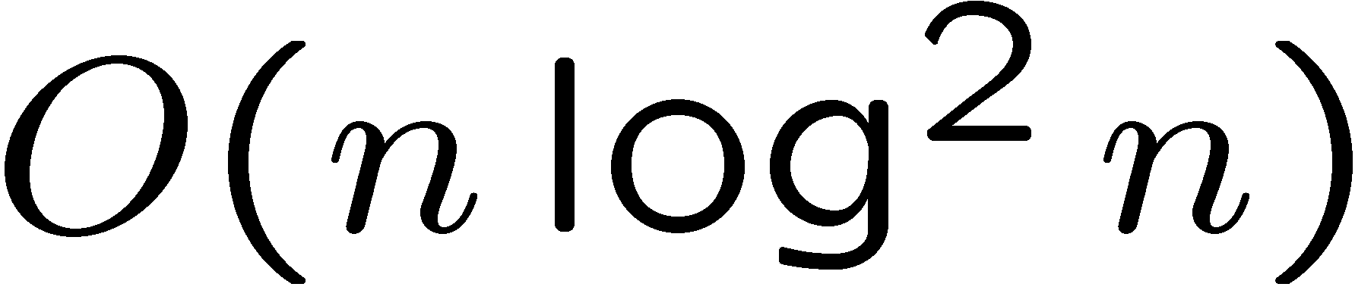
evolution of graph approximations aka graph preconditioners
[Vaidya] : MST with
[MMPRW 03]: tree T with:
impractical algorithm for finding tree
[EEST 04-05]: tree T with:
T can be constructed in time
extra Steiner nodes logarithmic diameter
subtree, O(m) in general case

Slide 36
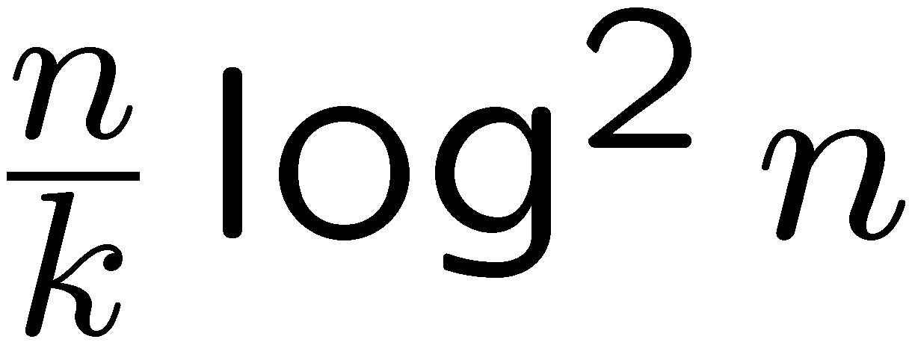
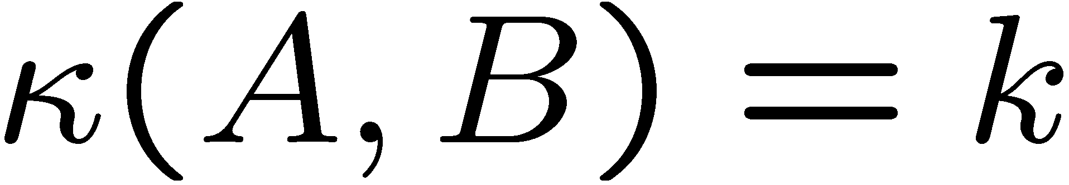
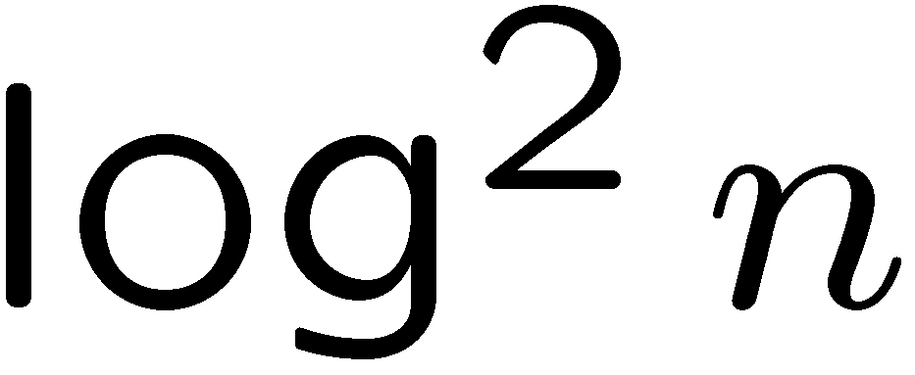
evolution of preconditioning the recent history
question:
Can we augment T to get a smaller size reduction?
[ST 04] B = T + edges
approximation quality:
solving requirement with size reduction:

Slide 37
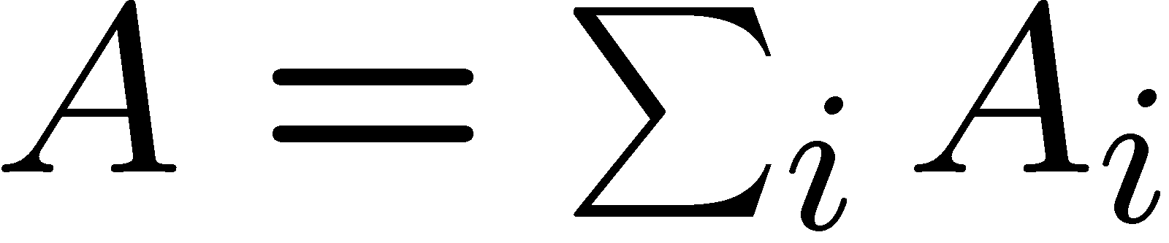
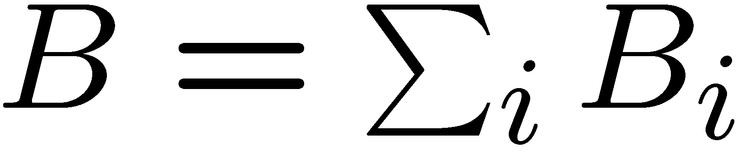
the key in the analysis of preconditioners aka the Splitting Lemma
a reduction to simpler graphs
assume and
then
A_{i}: edges
B_{i} : paths
Goal : trees with low average stretch

Slide 38
the key in the analysis of preconditioners aka the Splitting Lemma
Monolithic preconditioners:
construct tree, add edges back
Ω(nlog n)
no obvious way to parallelize
motivated by the analysis “easiness”

Slide 39
the key in the construction of preconditioners aka the Splitting Lemma
Miniature Preconditioners!

Slide 40
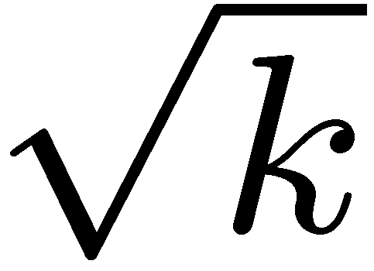
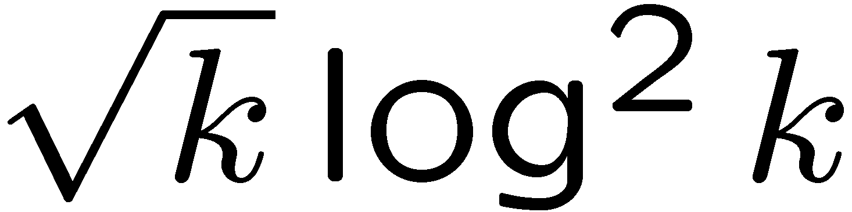
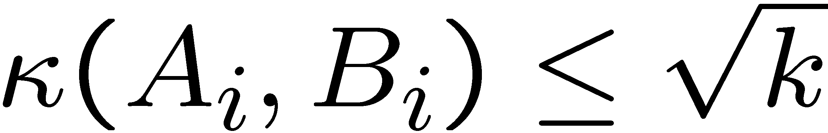
optimal planar preconditioners
Spielman & Teng
Preconditioner Factory
local mini preconditioner:
component size k
boundary size
approximate each A_{i} with
B_{i} = T_{i} + edges
approximation quality
S&T

Slide 41
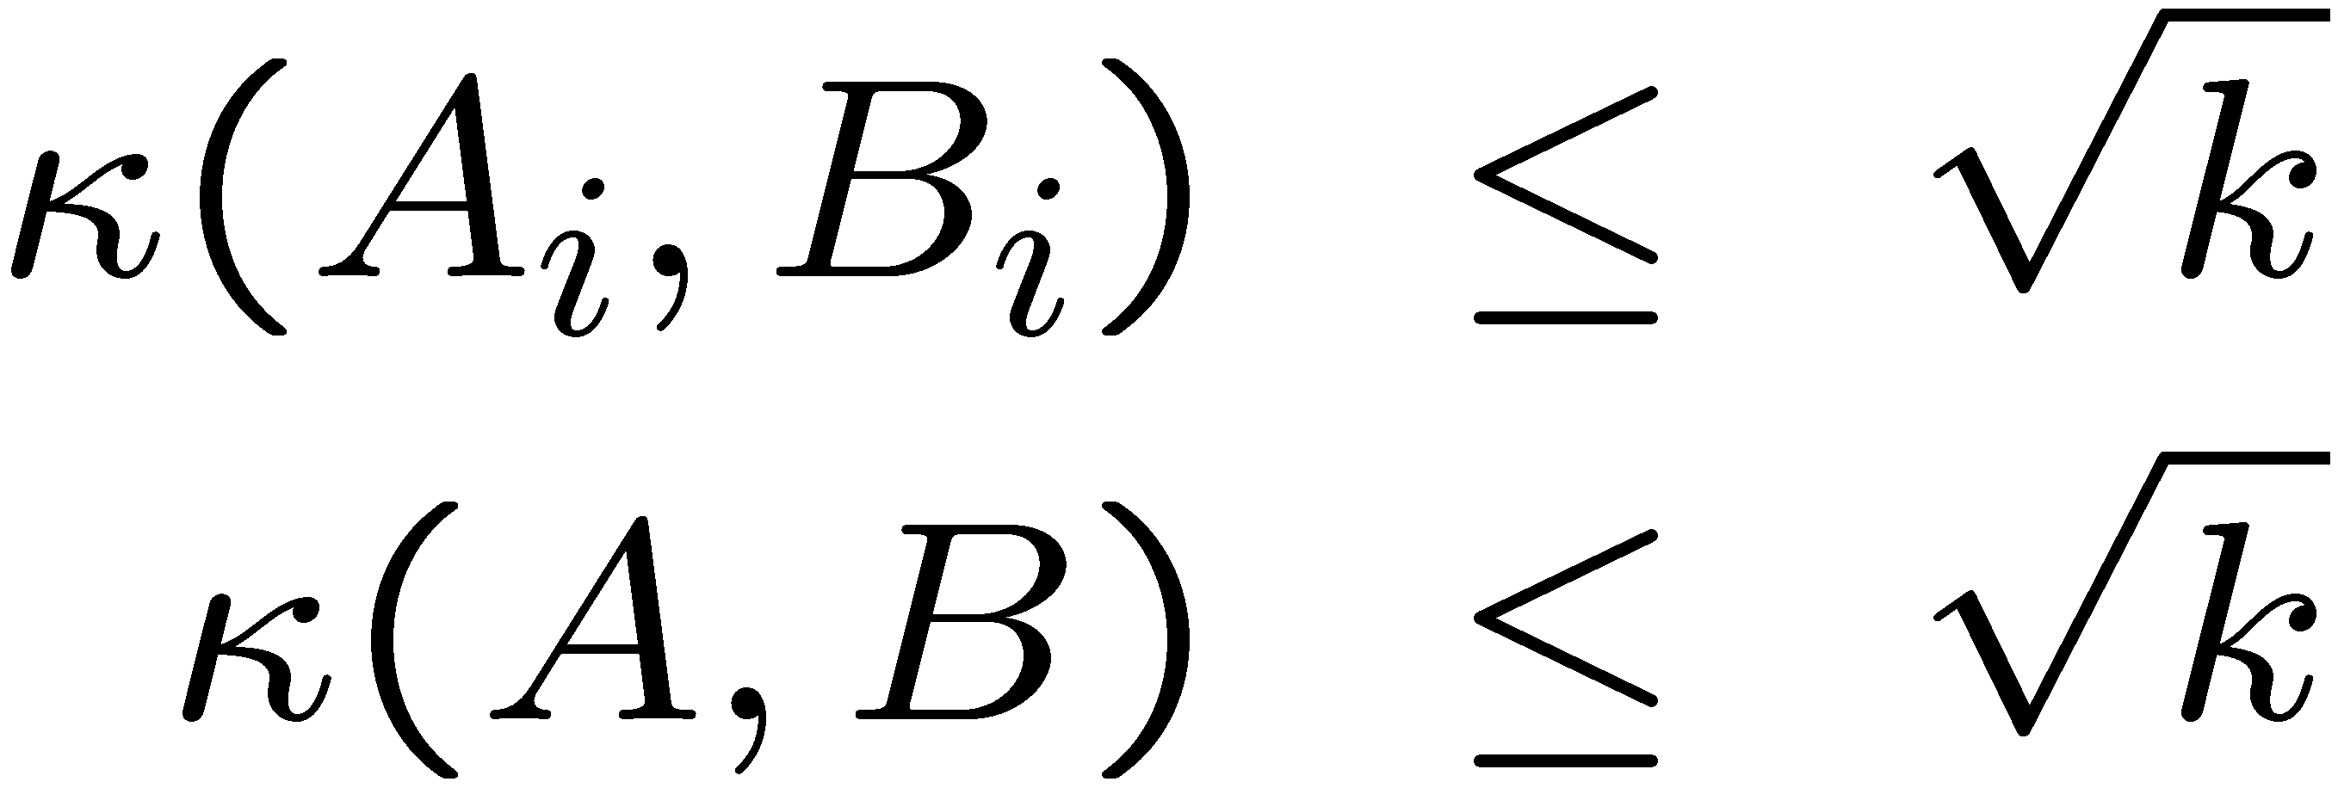
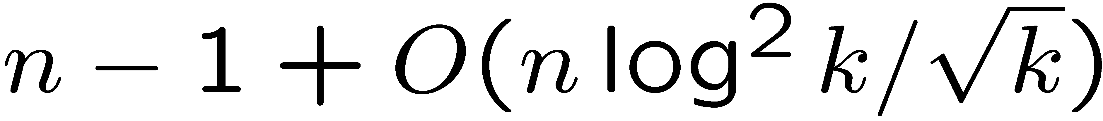
optimal planar preconditioners
we are done!!
Spielman & Teng
Preconditioner Factory
global preconditioner:
approximation quality
total number of edges
S&T
size reduction /condition number^{1/2} < 1/k^{1/2}

Slide 42
hey... great algorithm!
(you ‘re just another theorist.... this will never be practical!)
Usually applications need to solve several systems with a given Laplacian. Hierarchies are constructed once.
Theorems need to be pessimistic because they have to deal with rare instances. Now we can measure the actual quality and optimize the solver.
Spend O(k²) time on each miniature preconditioner. Gremban & MMRPW factory is back in business.
The algorithm is parallel and work-efficient.

Slide 43
Outline
planar multi-way edge partitioning
planar multi-way vertex partitioning
solving linear systems: introduction
solving planar Laplacians
a bit of perturbation theory

Slide 44
spectral perturbation theory for Laplacians
grid graph: A
split faces arbitrarily: B
what is the relationship of the eigenvalues and eigenvectors of A and B?
embed B into A:
κ(A,B) < congestion*dilation< 4

Slide 45
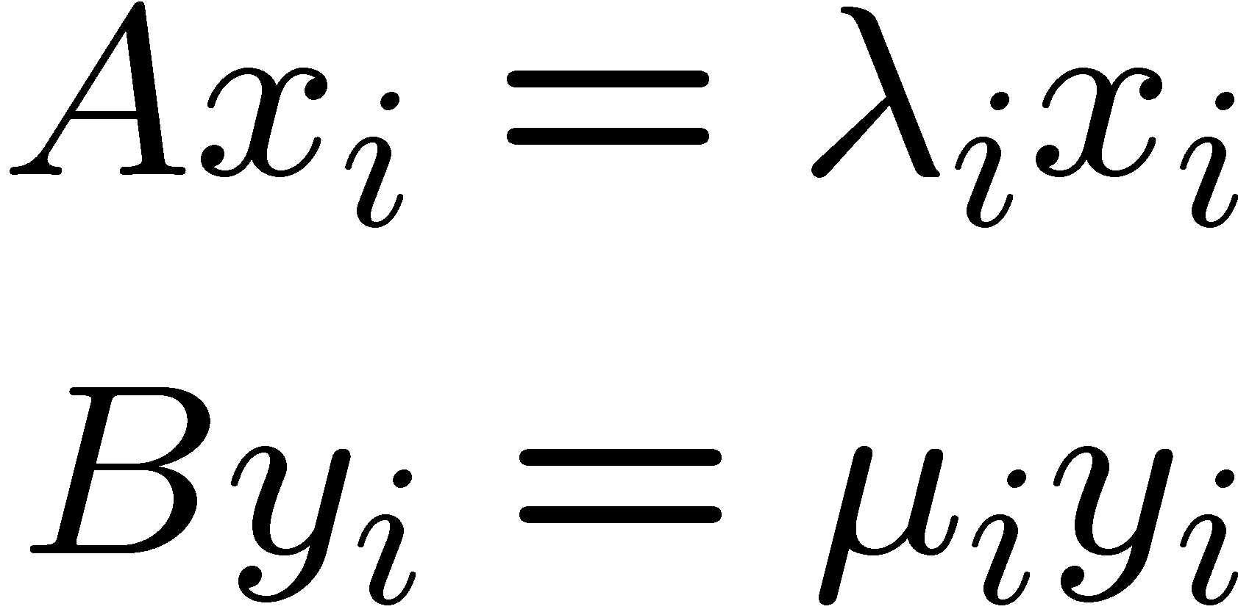
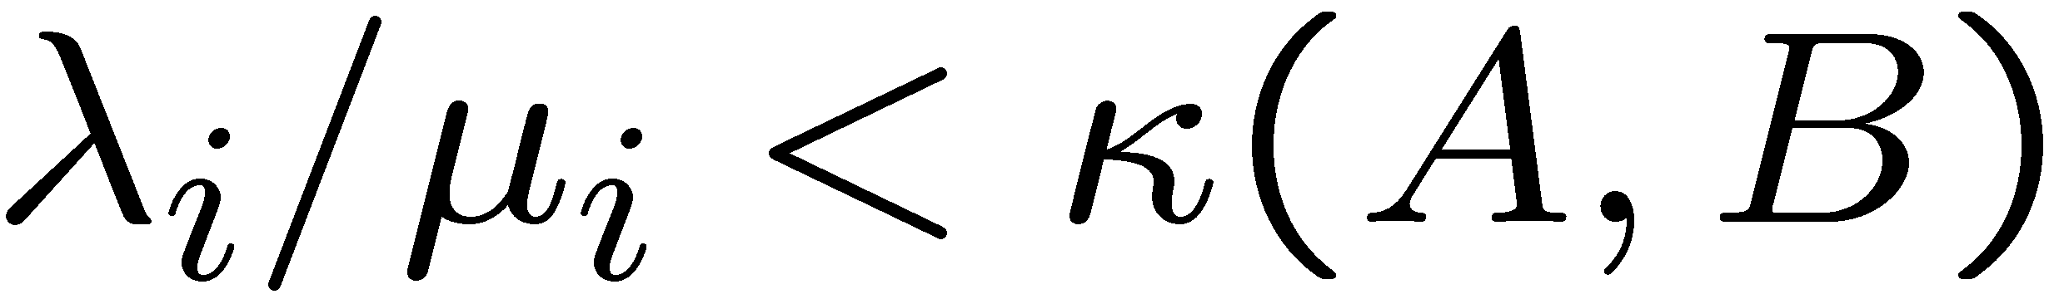
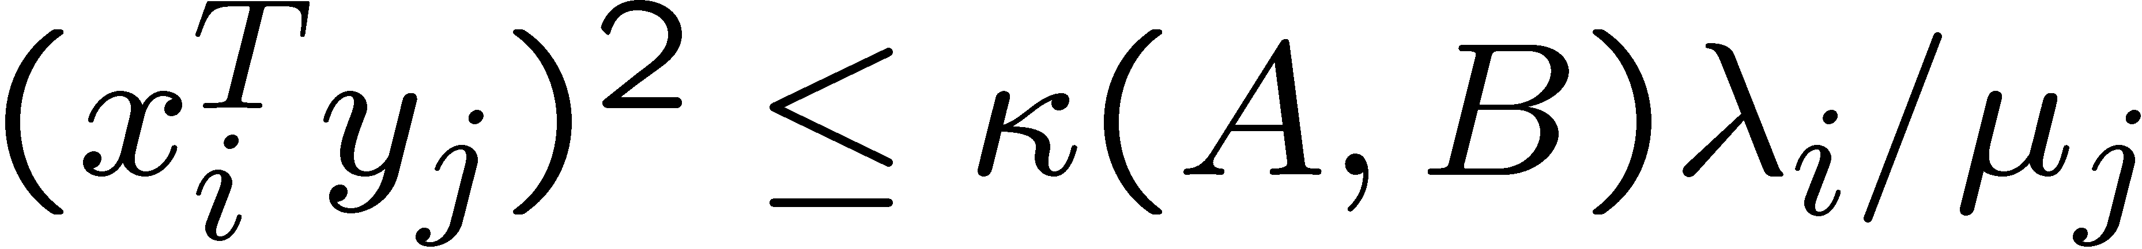
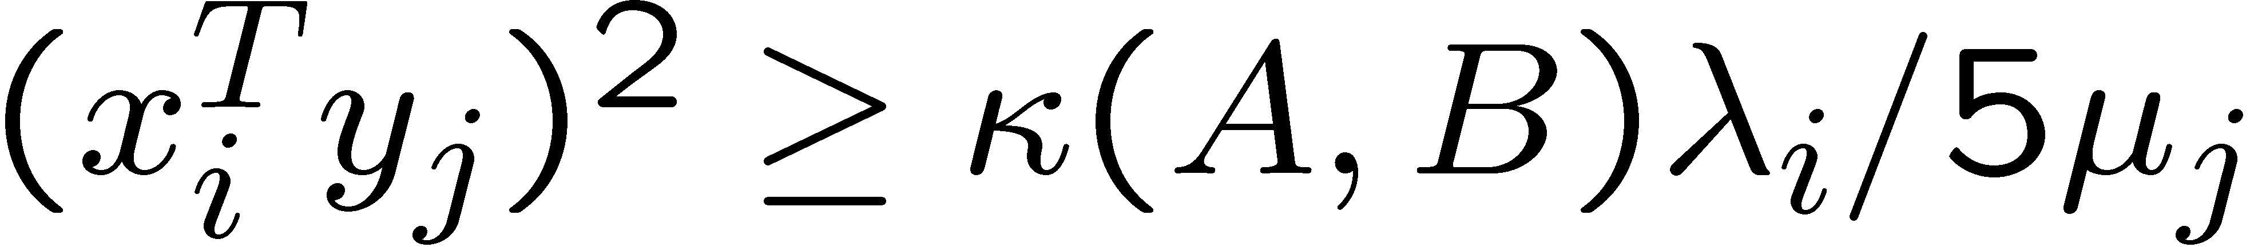
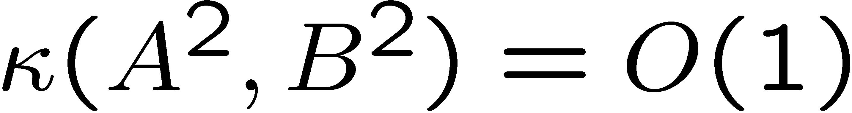
spectral perturbation theory for Laplacians
eigenvalue decomposition of A and B
eigenvalue theorem
eigenvector theorem
there are graphs with
there are graphs with
can you always find a preconditioner B with
combinatorial approach for Algebraic MultiGrid Algorithms (AMG)

Slide 46
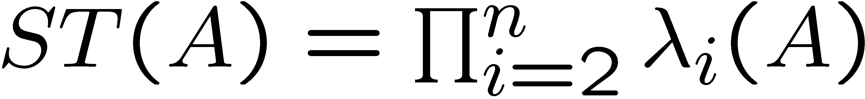
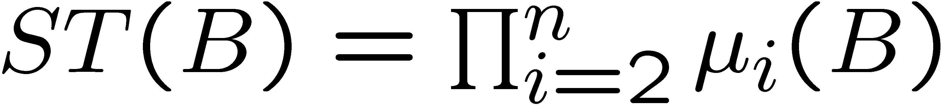
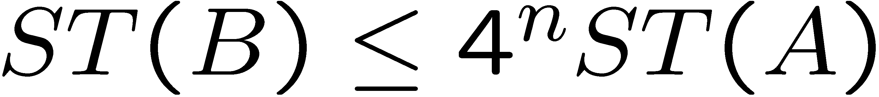
sleek proofs via spectral graph theory
grid graph: A how many spanning trees ?
split faces arbitrarily: B how many more ?
By the eigenvalue perturbation:

Slide 47
Outline
we are done!!
planar multi-way edge partitioning
planar multi-way vertex partitioning
solving linear systems: introduction
solving planar Laplacians
a bit of perturbation theory

Slide 48
Thanks!

