Slide 1
Regularized linear regression with formation signals

Slide 2
Idea
Only use only features from formation
Can regularized linear regression with multiple features give a better result (lower error) than a single feature?

Slide 3
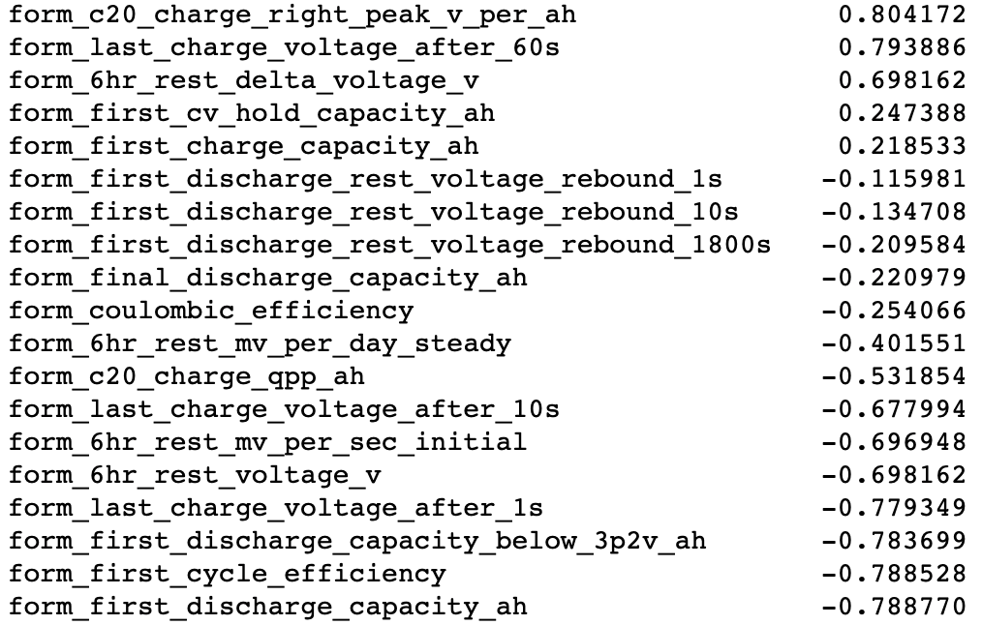
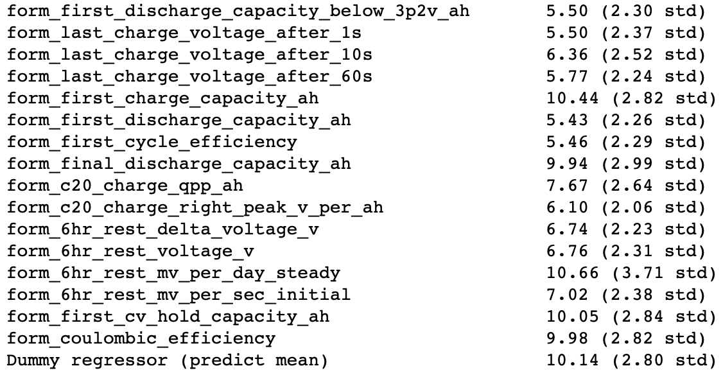
Some baselines
Correlation with cycle life
Baseline 1- (or 0-) feature linear regressions

Slide 4
Manual grid search

Slide 5
Manual grid search – restricting to “high correlation” features (abs(corr) > 0.6)

Slide 6
Manual grid search – restricting to “very high correlation” features (abs(corr) > 0.78)

Slide 7
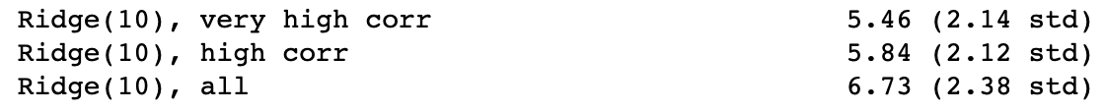
Scores from “best” regularized models

Slide 8
Further possibilities
Methods suggested here for understanding output of linear regression: https://scikit-learn.org/stable/auto_examples/inspection/plot_linear_model_coefficient_interpretation.html
Transform features and output with log

