Slide 1
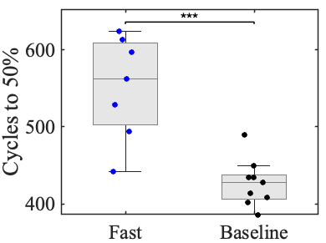
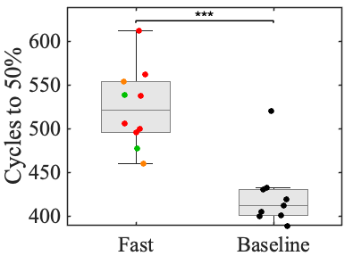
Fast formation
Baseline formation
Fast formation
Baseline formation

