Slide 1
CSU Classroom clicker
Immanuel George, George gerguis, dan grinblat, david jones

Slide 2
Clicker app overview
Application that encourages student participation
Two modes
Quiz
Live
Facilitates lectures
Can provide means for teachers to assess participation/comprehension

Slide 3








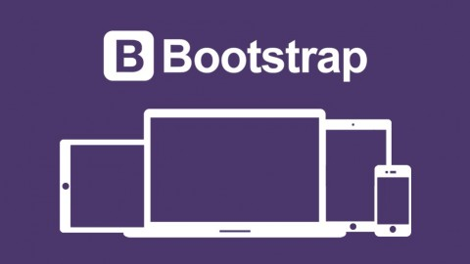


Technology used

Slide 4
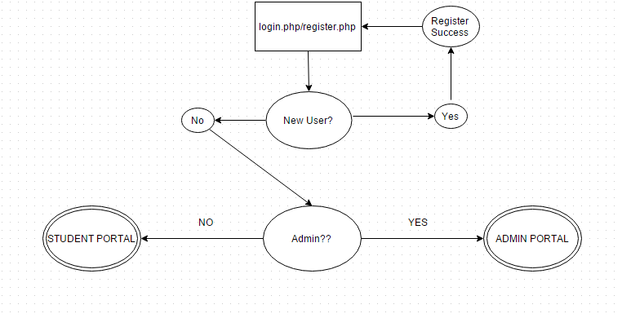
Flow chart

Slide 5
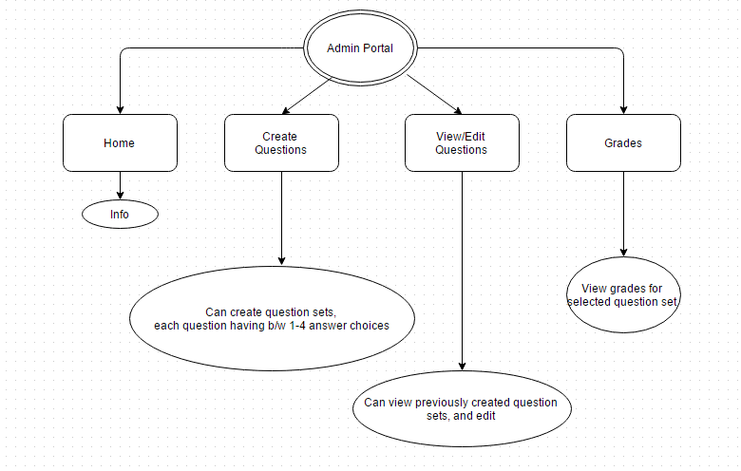
Admin portal

Slide 6
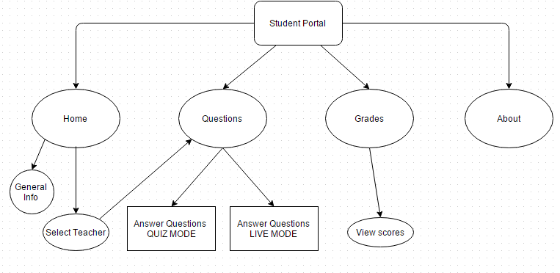
Student portal

Slide 7
Quiz vs. live modes
QUIZ MODE- Gets all questions from database and allows user to answer all questions at once.
Live mode- uses websockets to update student one question at a time. with a optional time limiter (in seconds) per question to keep all students on track.

Slide 8
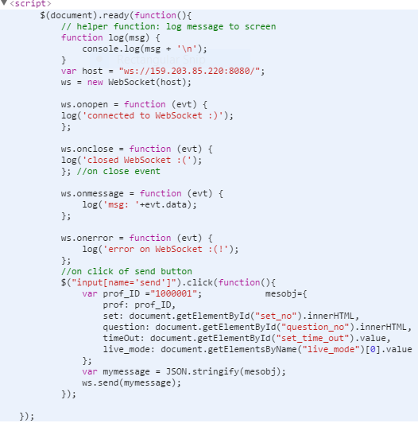
Live mode admin side technical details
When Professor in questions.php clicks live Mode
websocket sends a json object with professor id,
Set number, question number, set time out, live mode

Slide 9
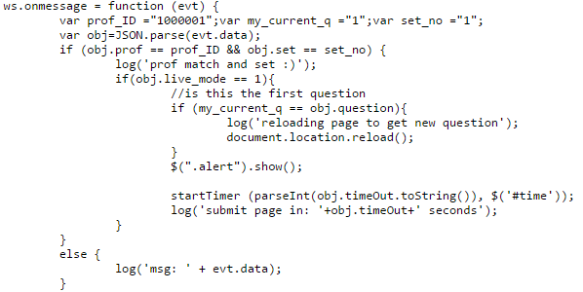
Live mode student side technical details
After Student selects his/her professor and set number they then navigate to student_questions.php websocket will
receive json object and will try to match prof_ID and Set & question number

Slide 10
Final Android Code
Overwrote back button functionality
Webpage optimization for 7” tablet
Removed toolbar

Slide 11
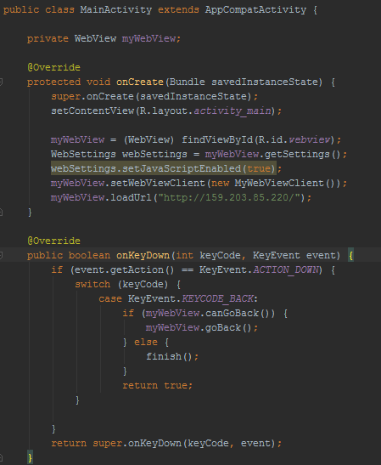

Slide 12
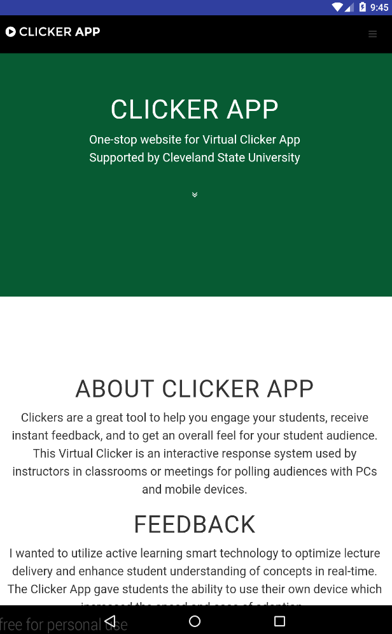
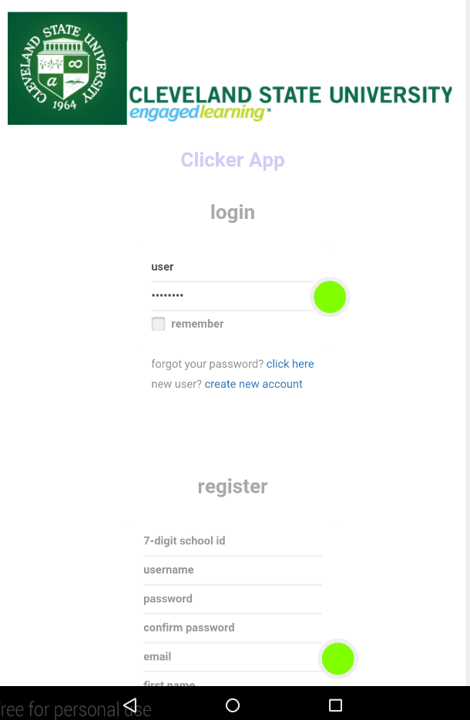

Slide 13
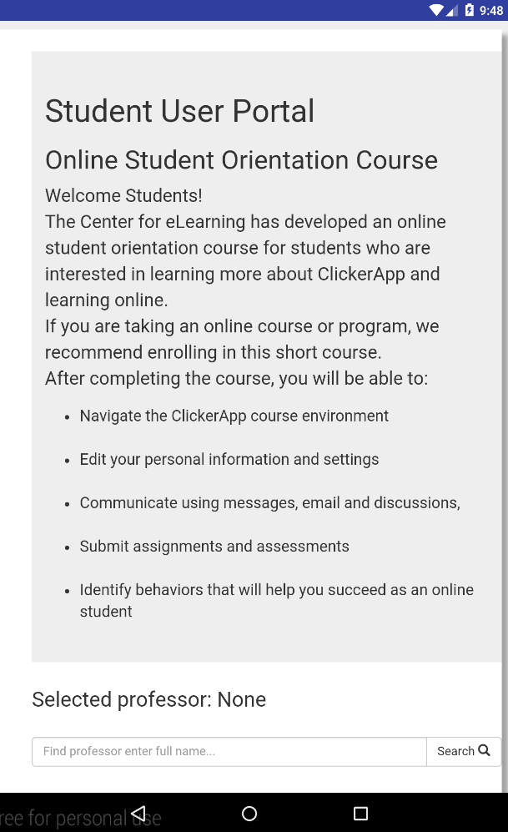
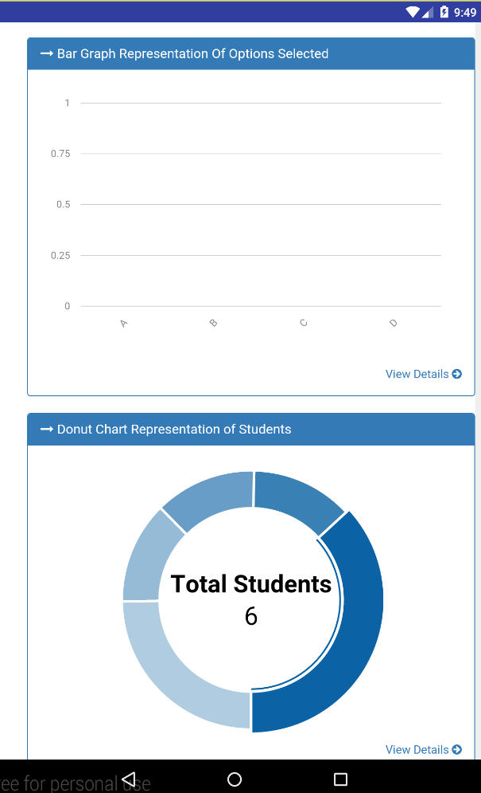

Slide 14
Live demo
Volunteers?? Any??

