Slide 1
JSON Schema for HTTP API-s
@ikr
JSZurich + Webtuesday lightning talk
14.01.2014

Slide 2
Premise
“The secret to building large apps is NEVER build large apps. Break up your applications into small pieces. Then, assemble those testable, bite-sized pieces into your big application.”
–Justin Meyer

Slide 3
Component
Not component
Unit of software deployment
A separate active process
Programming language namespace or class
File
In-process linked library: jar, dll, composer- or npm package

Slide 4
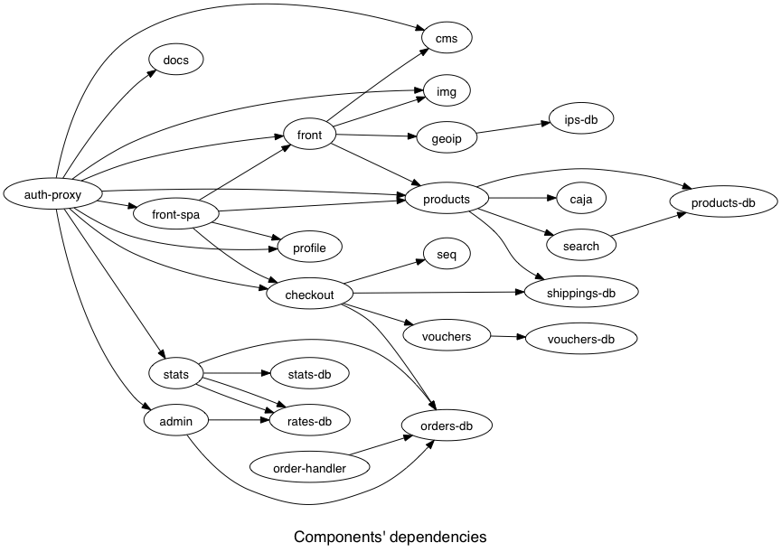
Components as if you mean it

Slide 5
Benefits
HTTP
Super-low coupling
Understandability of parts
Small and fast test suites
Accessibility: just curl and jsontool
Scalability
Mostly stateless
Value-based and data-oriented
Composability via pipes and filters
Whole new feature in a few lines of bash

Slide 6
Drawbacks: some questions become harder to answer
I'm GET-ting a list of entities. What properties do they have?
I need to change that entity's structure. What's affected?

Slide 7
JSON Schema to the rescue
Describes the JSON format of your resources/entities in JSON
IETF draft

Slide 8
"currency": {
"type": {
"enum": [
"CHF", "EUR",
"GBP", "RUB", "USD"
]
}
}
"cost": {
"type": "object",
"properties": {
"currency": {"$ref": "#currency"},
"amount": {
"type": "string",
"pattern": "^[0-9]+\\.[0-9]{2}$"
}
},
"required": ["currency", "amount"]
}

Slide 9
"destination": {
"type": "object",
"oneOf": [
{"$ref": "#destinationCity"},
{"$ref": "#destinationRegion"},
{"$ref": "#destinationHotel"}
]
},
"periodOfStay": {
"type": "object",
"properties": {
"checkInDate": {
"type": "string", "format": "date"
},
"checkOutDate": {
"type": "string", "format": "date"
}
},
"required": ["checkInDate", "checkOutDate"]
},

Slide 10
Exposing via HTTP
Schema has a URL
Format declaration in header
Link: <http://example.com/my-hyper-schema#>; rel="describedBy"
JSON Hyper-Schema
JSON+HAL

Slide 11
Automatic verification
Verifying middleare for requests and responses
In development mode only
Profit!

