Slide 1

Help for pet owners during the coronavirus pandemic

Slide 2


Brand Guidelines
Baloo 2
Baloo 2 medium
Baloo 2 semibold
Baloo 2 extrabold
#438945 Logo and primary buttons
Rgba 247, 244, 233, 0.391 Background
rgb 245, 245, 245 Whitesmoke cards
#f7f4e9 Light secondary buttons

Slide 3

What is Petocracy?
People lacking resources during Covid to take care of their pet either due to loss of employment or can’t pay bills, etc...
Volunteers pick up the slack by registering to donate to help those registered pets or volunteer for requested services such as walking dog, etc...

Slide 4
Project Demo

Slide 5

Petocracy Contributors
SKOTU
Super Koders of the Universe
EXPRESS aka The Refactorer, alias Ashley
SQL aka Sir Schema, alias John
ELEMENT aka Ms. DOM, alias Ikra
Ashley | Ikra | John
Sequelize | HTML5 | Sequelize
Javascript | CSS | Javascript/Jquery
API & HTML Routes | Javascript | Cloudinary & Passport

Slide 6
Challenges and Success
Challenges
Svg icons
Heroku and Github/Gitbash
Cascade
Sending data to the back side in app.get call to app.route
Local storage
Successes
Incorporated more than 1 new technology
Ability to pass information between api calls to filter data

Slide 7

Future Enhancements
Upload Volunteer pictures
Finish securing credit card info/connecting to credit card processing
Allow for multiple services and/or pets to be entered per registered user
Add testimonials and/or comments from site users
Once pet has been fully sponsored, their info would transfer to the successful stories page

Slide 8
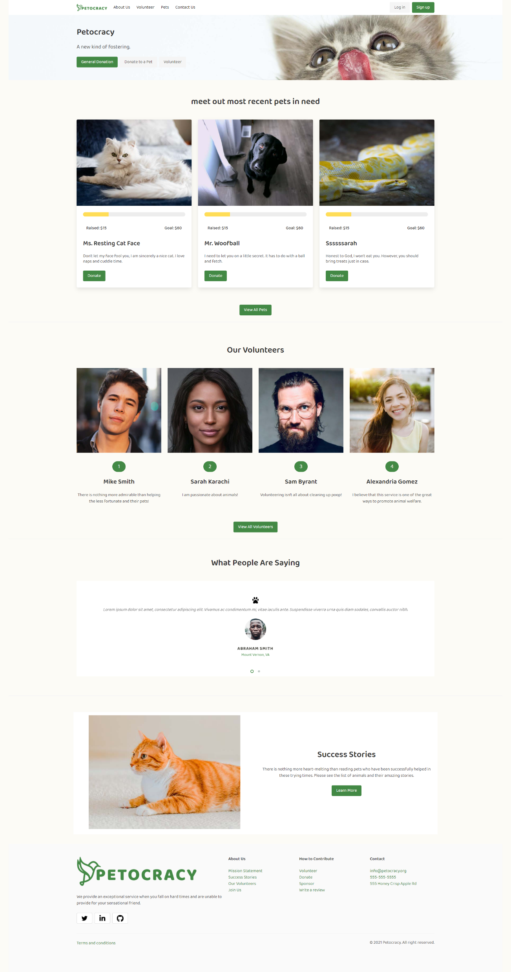
Deployment Links
Repo Link
https://github.com/stithac/group1_project2
Deployed Link
https://immense-coast-50151.herokuapp.com

Slide 9
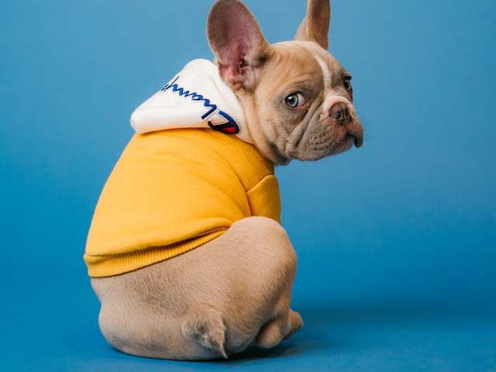
Questions?

Slide 10
Title
subtitle

Slide 11
text

