Slide 1
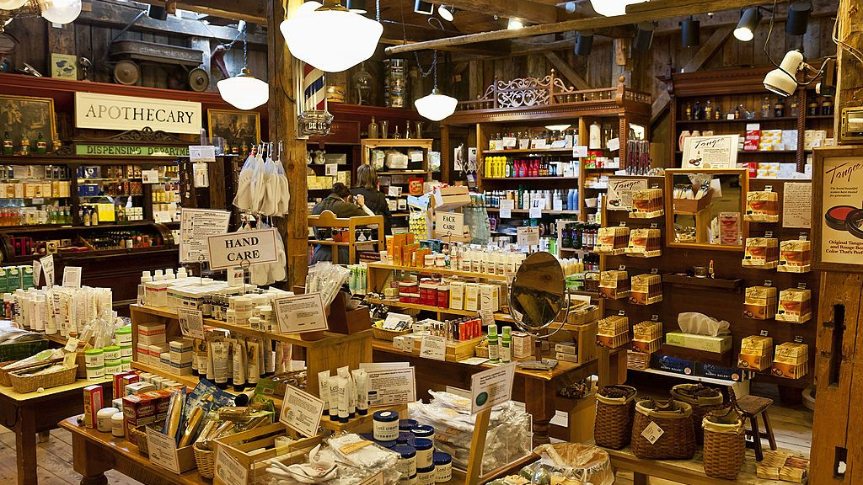
Multi Mart Loyalty Card Expansion
Group- 07

Slide 2

Table of contents:
01
02
03
Introduction
Visualization Insights : Revenue
Pre-processing & Cleaning
04
05
06
Conclusion
Recommendations
Visualization Insights : Loyalty Card

Slide 3
Introduction
The primary objective of the visualization project for Multi Mart Retail store is to provide a comprehensive and visually intuitive view of the sales happened in the store and revenue generated from sales from the year 2019 to 2023.
This comprehensive analysis aims to shed light on the store's sales performance and revenue generation.
With a focus on customer behavior and preferences, our goal is to guide the store in making informed decisions about the potential expansion of its Loyalty Card program to new regions.
Our dataset includes key metrics such as customer, purchase history, revenue, products, and more, providing a holistic understanding of Multi Mart's retail landscape.
Through comprehensive visualizations, the store aims to empower its teams to make informed choices and optimize strategies for sustained success.
01
02
03

Slide 4
Pre-Processing & Cleaning
Acquired
Cleaned
Transformed
Final validation
Imported datset
Sanity Check
Dupicate & missing data validation
Excluding junk data
Creating new columns
Preparing data for BI
Final sanity checks
Importing data to Tableau
1
2
3
4

Slide 5



Visualization Insights : Revenue
Active Customers
The store is currently interacting with a vibrant community of 5,013 customers.
Revenue (Last Quarter)
5,013
Product Categories
The store yielded a robust revenue of 5.91 million in the last quarter.
The store features a diverse range of 2,552 distinct product categories.
$5.91M
2,552

Slide 6
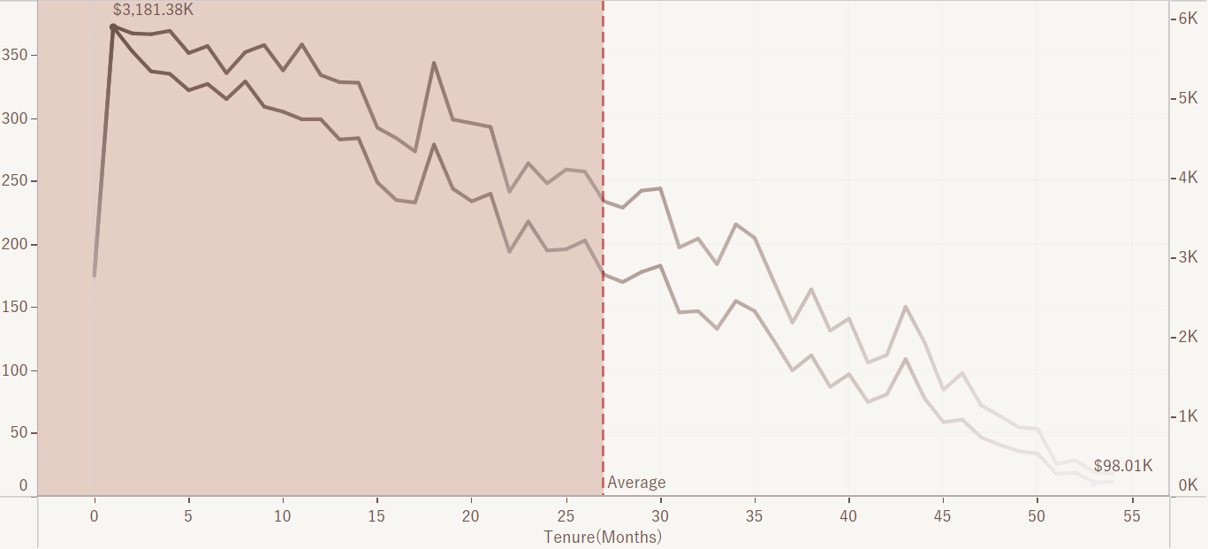
Purchase-Revenue Analysis
Line chart illustrates total purchases and revenue trends over customer tenure, with an average line.
372 customers made 5913 purchases, contributing $3181.38k.
In contrast, 11 loyal customers with a 55-month association made 304 purchases, generating $98.01k.

Slide 7
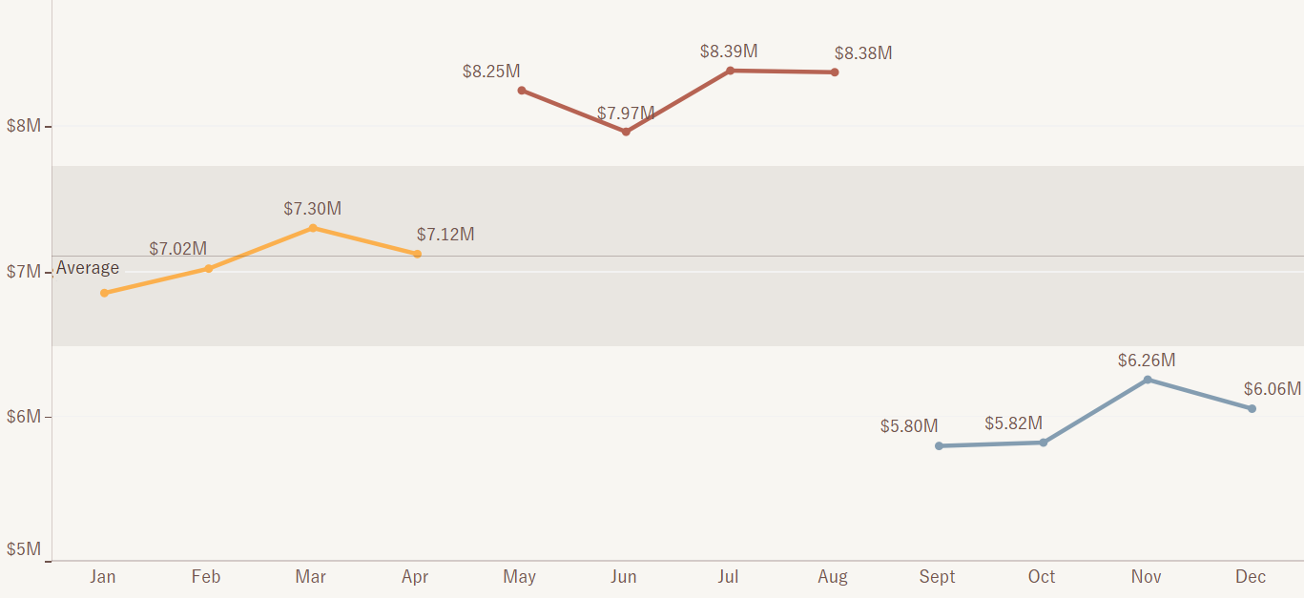
Clustered Monthly Revenue
The clustered line chart displays monthly store revenue with an average band.
Peak revenue ranging from $8.25M to $8.39M, is observed from May to August.
In contrast, lowest revenue is seen to be between $5.8M to $6.26M, occurring from September to December.

Slide 8
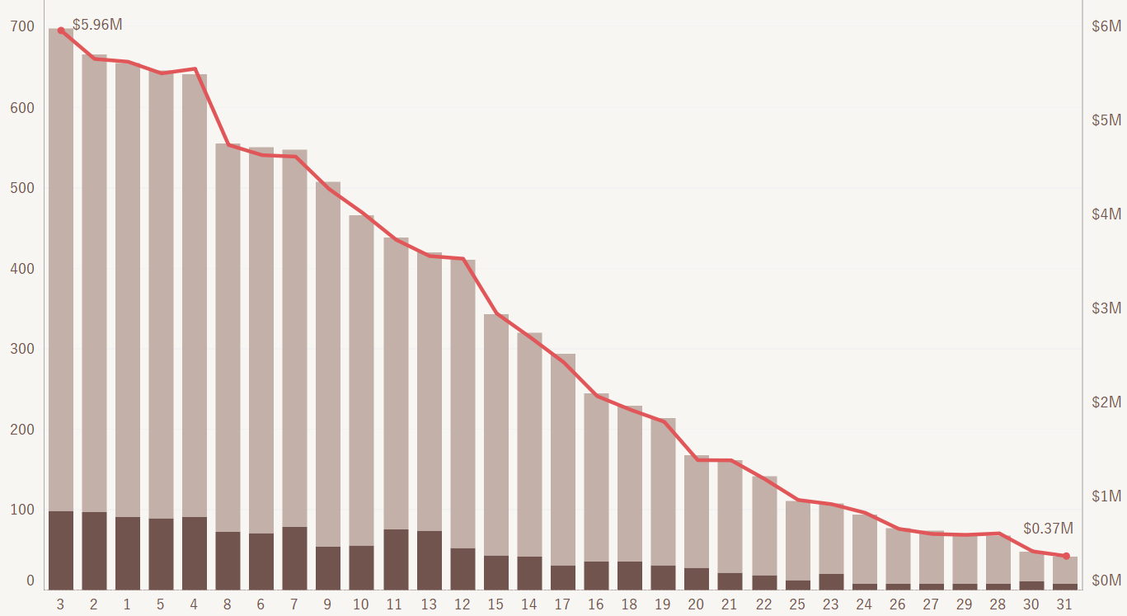
Customer Frequency & Revenue
This graph provides insights into the distribution of customer frequency and the corresponding revenue generated, categorized by Loyalty card membership.
It reveals that a significant number of customers visit the store infrequently yet contribute significantly to the revenue. Notably, the highest revenue generated by a segment of customers reaches 5.96 million.
Another key observation is that only 15% of the customers hold a Loyalty card, indicating an opportunity for the store to increase Loyalty card adoption.

Slide 9
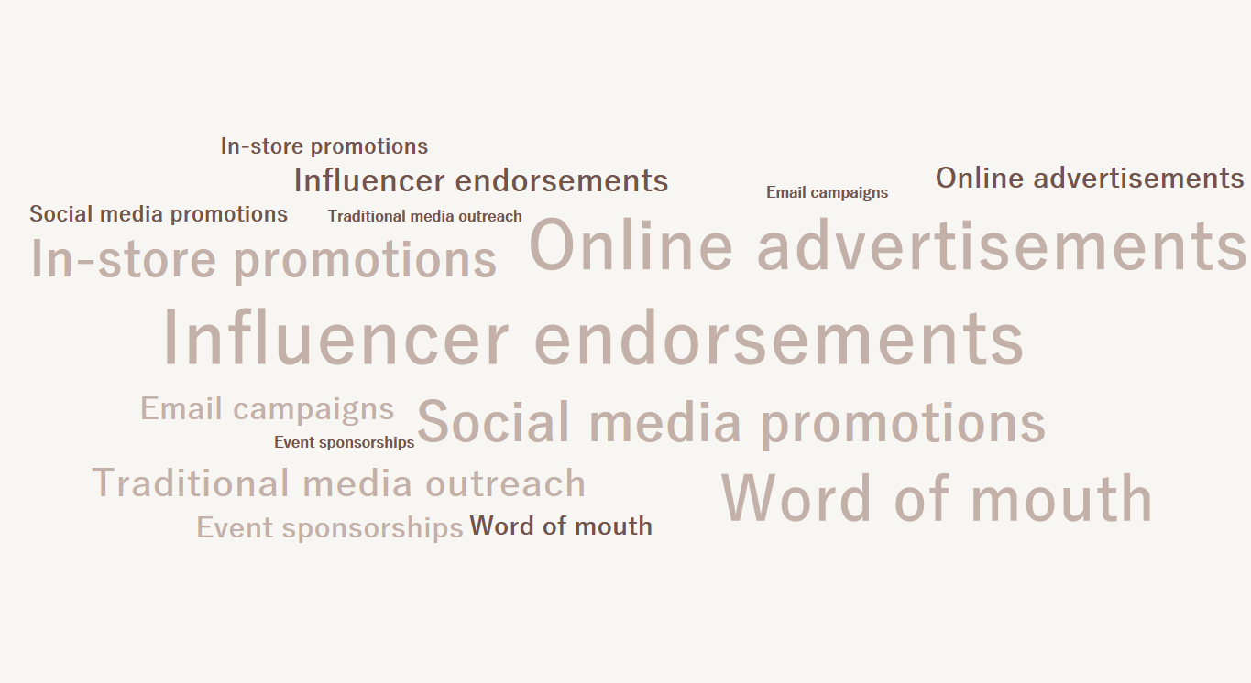
Referral Impact: Revenue & Loyalty Card
This graph delivers valuable insights into the revenue generated from various referral sources, distinguished by Loyalty card membership.
The chart highlights that Influencer endorsements, online advertisements, and Social media promotions are the predominant referral sources contributing to the store's major revenue share.
However, the data indicates a lower percentage of customers holding Loyalty cards within these influential referral sources.

Slide 10


Visualization Insights : Loyalty Card
Active Customers
5,013
The store is currently interacting with a vibrant community of 5,013 customers.
741
Loyalty Card Memberships
The store currently holds a total of 741 customers possessing their loyalty card.
4.51
Avg. Feedback Score
The store gains a feedback score of 4.51 on an average.

Slide 11

Campaign Response Across Loyalty Card Membership
The table represents customer response to the loyalty card campaign.
A huge number of customers do not hold a loyalty card with the store.
Predominantly, customers ignore the campaign, with a minority opening emails and even fewer making purchases.
A vast majority of 74.01% customers ignore the campaign, while a mere 5.89% deem it successful.

Slide 12
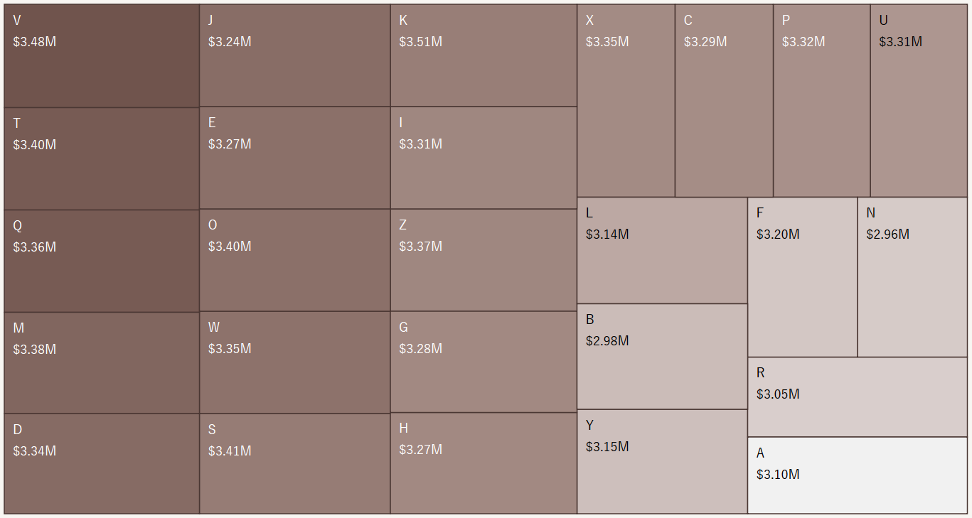
Revenue Across Product Categories
This graph unveils crucial insights into the revenue generated across different product categories, categorized by Loyalty card membership.
Notably, products D, V, and Q emerge as the top contributors to revenue without the Loyalty card, while products M, H, and S dominate revenue generation with Loyalty card memberships.

Slide 13
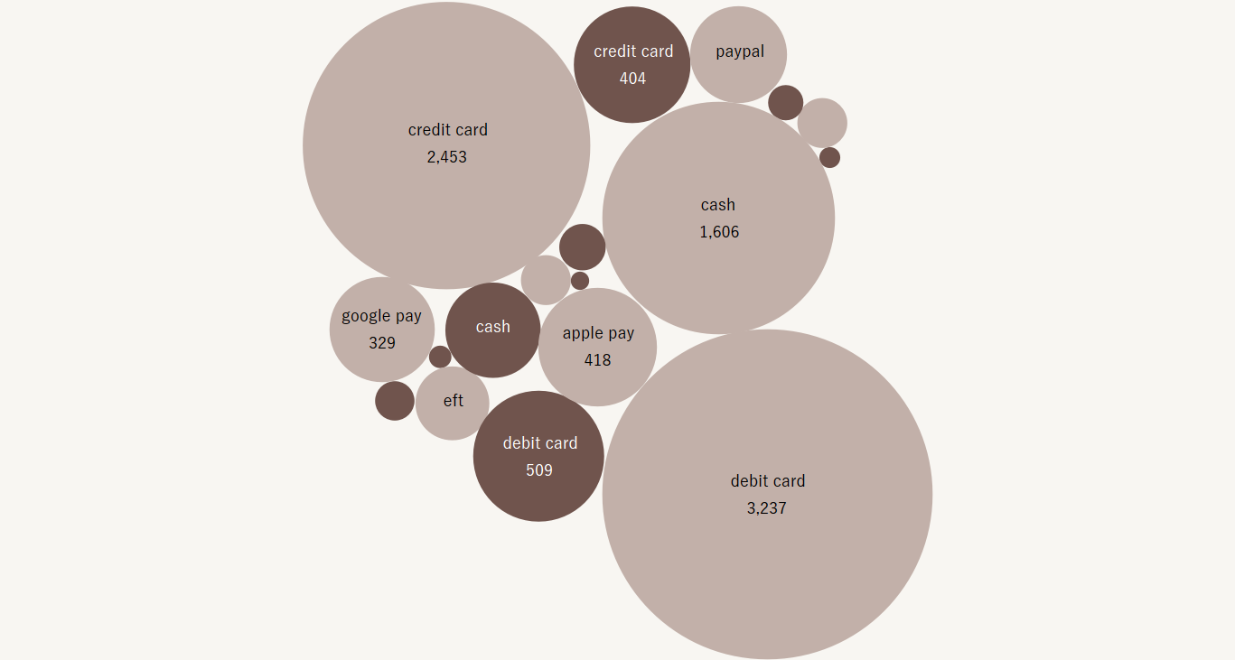
Customer Distribution by Payment Method
This graph presents a comprehensive view of customer preferences regarding different payment methods, segmented by Loyalty card membership.
The analysis reveals that a significant majority of customers opt for debit and credit cards as their preferred payment methods.
Notably, a substantial number of these customers do not hold Loyalty cards, indicating an opportunity for the store to promote Loyalty cards strategically.

Slide 14
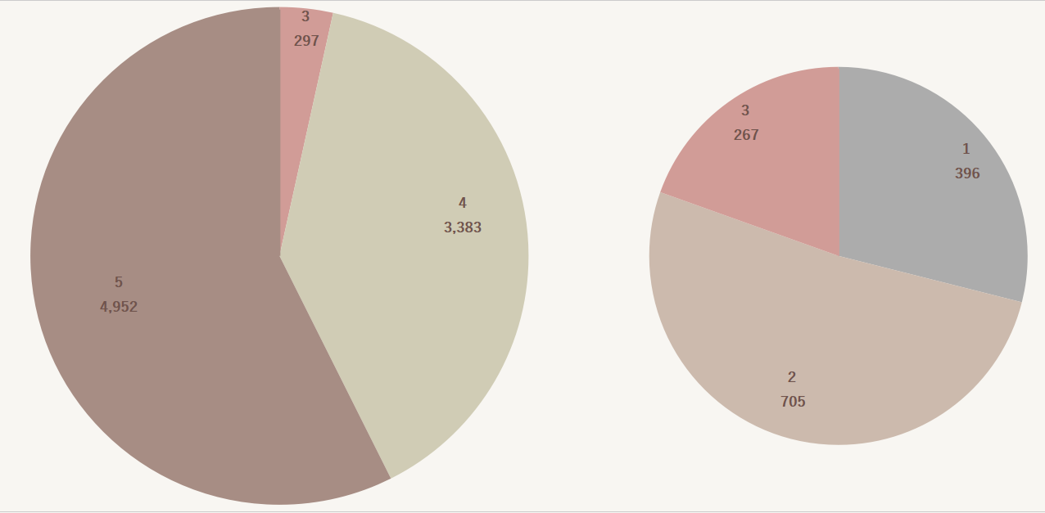
Feedback Score Distribution Across Loyalty
The pie charts illustrates customer distribution based on loyalty card status and feedback scores.
Customers with loyalty cards predominantly provide lower scores (1-3).
While those without cards tend to give higher scores (3-5).

Slide 15
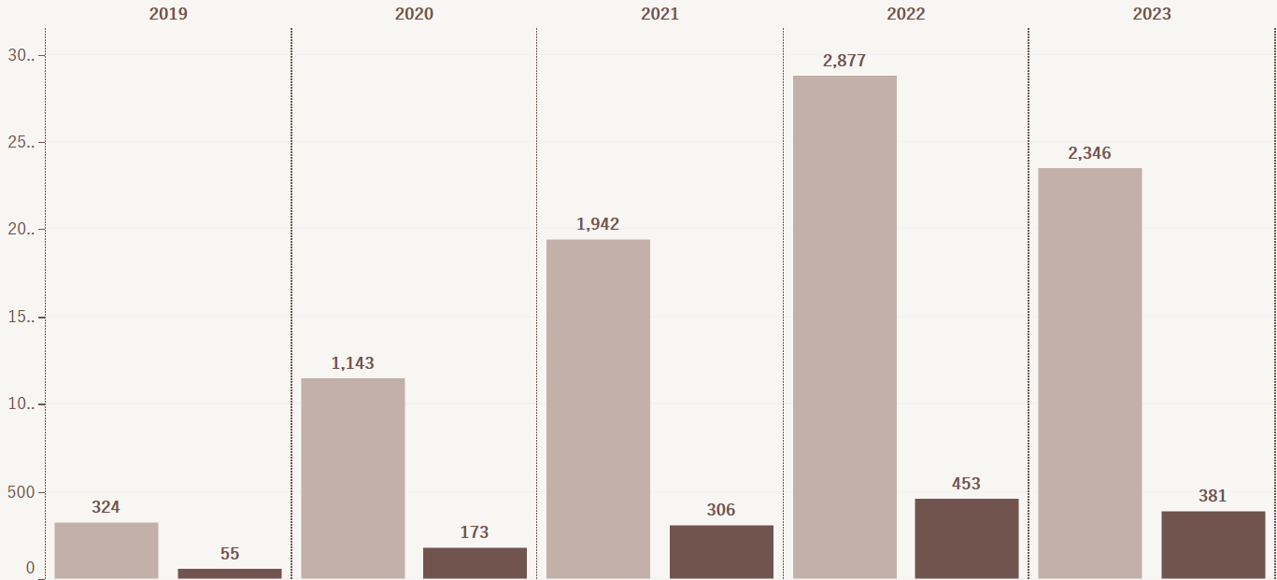
Churn Analysis by Loyalty Status
The grouped bar chart displays annual customer churn.
Highest churn is observed in the year 2022, with 2877 customers leaving the store.
The overall, churn ratio surpasses that of retained customers for the store over time.

Slide 16
Conclusion
The analysis underscores the impact of infrequent yet high-revenue-generating customers, with the top segment contributing up to 5.96 million.
Influencer endorsements, online advertisements, and Social media promotions emerge as key drivers of substantial revenue for the store.
Debit and credit card are the highest mose of payment in majority of the customers.
Customers with shorter revenue duration make numerous purchases, generating the highest revenue.
Peak revenue, $8.39M, occurs mid-year, dipping in the last quarter.
Highest feedback scores are from non-loyalty card holders, while cardholders provide poorer feedback.

Slide 17






Recommendations
Multi Mart should promote the Loyalty card more extensively to target less frequent customers, potentially leading to increased purchases and revenue.
Store should offer compelling discounts in the last quarter to increase the number of purchases and revenue during this time for the store to generate revenue in above the average range.
Store should promote Loyalty cards through Influencer and Online advertisement so that the Loyalty card members would also increase along with the revenue.
Store should establish partnerships with local banks to offer an additional card that integrates with the store's Loyalty membership. This collaboration will encourage more customers using debit cards to join the Loyalty program.
Multi Mart store should provide offers to the customers based on tenure, such that if a customer is spending more than 2 years with the store will get additional points on the Loyalty.
Improve loyalty card benefits to uplift customer feedback, especially for cardholders who currently provide lower scores, while maintaining the positive feedback from non-cardholders.

Slide 18
Thank You
Group- 07

