Slide 1
Related work in Stock Prediction

Slide 2
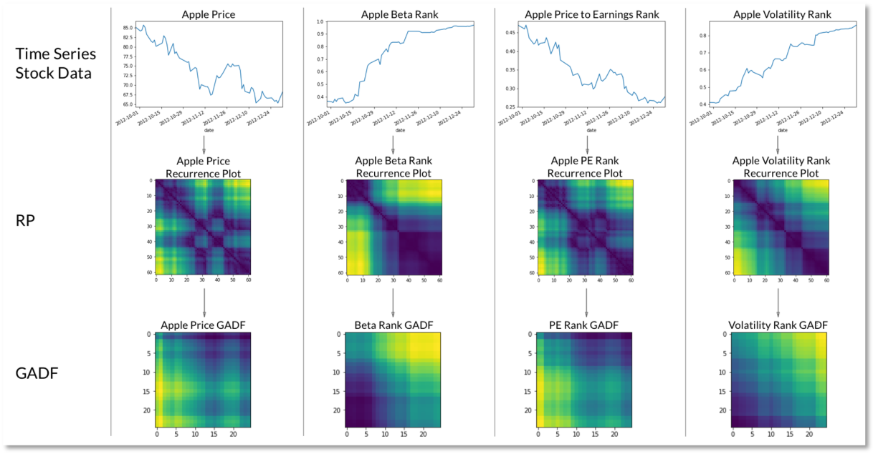
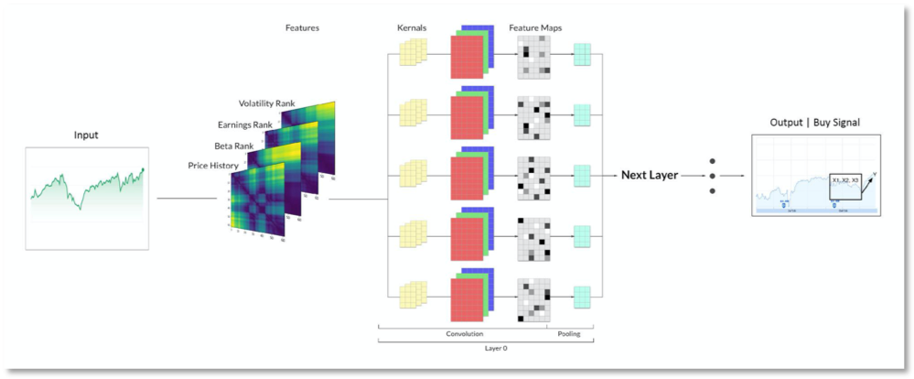
CNN followed by Transformers [Lucene Research]
LSTM are non-parallelizable and unable to decide which information to save or discard when the input stream grew larger
Use CNN and CapsNet to detect certain snippets of pattern formations such as a sudden spike or drop in a feature value
Sequence the identified patterns through a transformer to measure how the sequence of these patterns can be used to reliably forecast an outcome.
Details in this link. This link contains blogpost on CapsNet.

