Slide 1
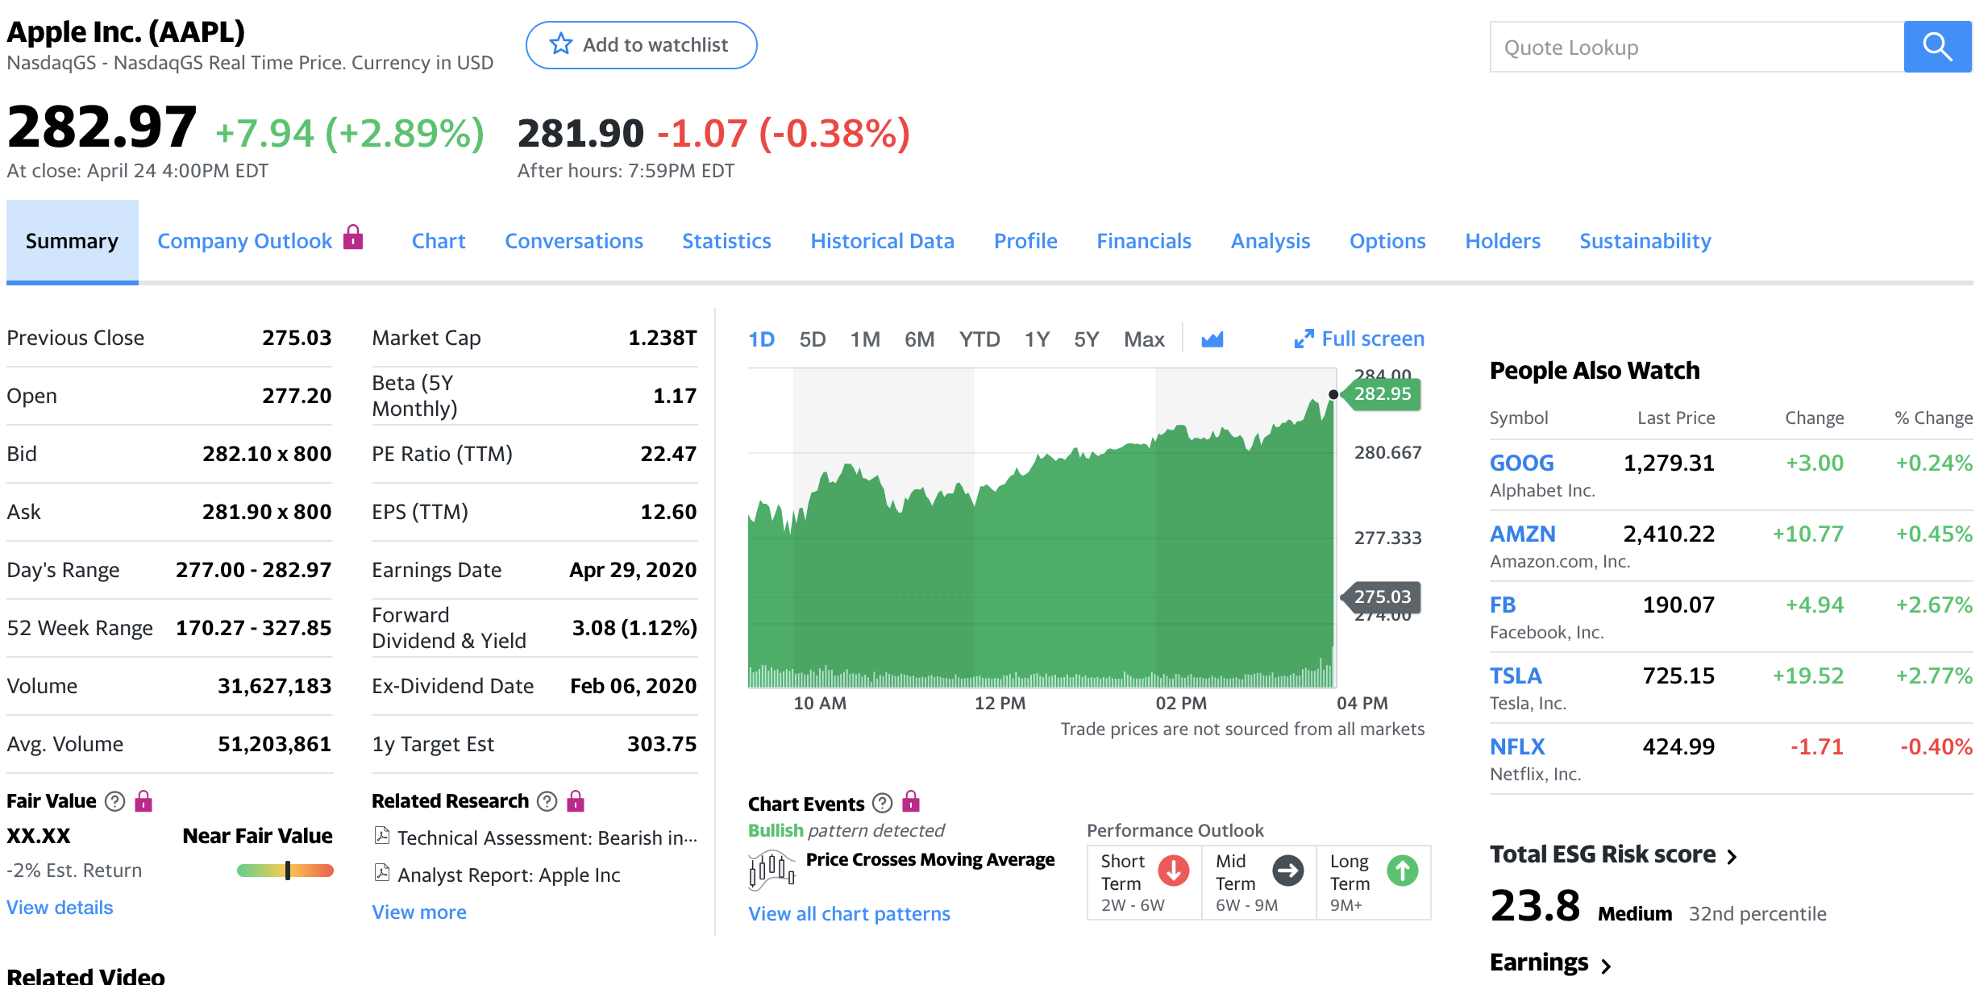
dayHigh
previousClose
regularMarketOpen
ask
dayLow & dayHigh
volume

