Slide 1
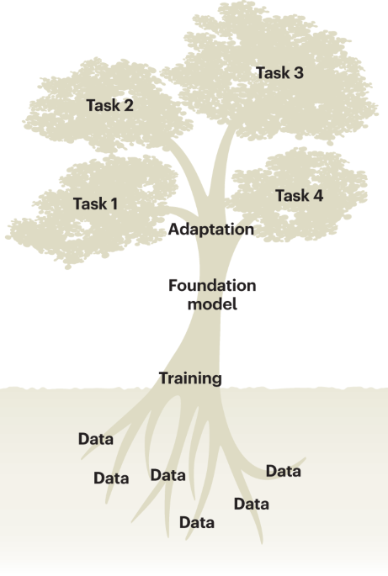
Fine-Tuning Genomic Foundation Models
Ikram Ullah, Staff Scientist
Image taken from – Tang, Lin. "Large models for genomics." Nature Methods 20.12 (2023): 1868-1868.

Slide 2
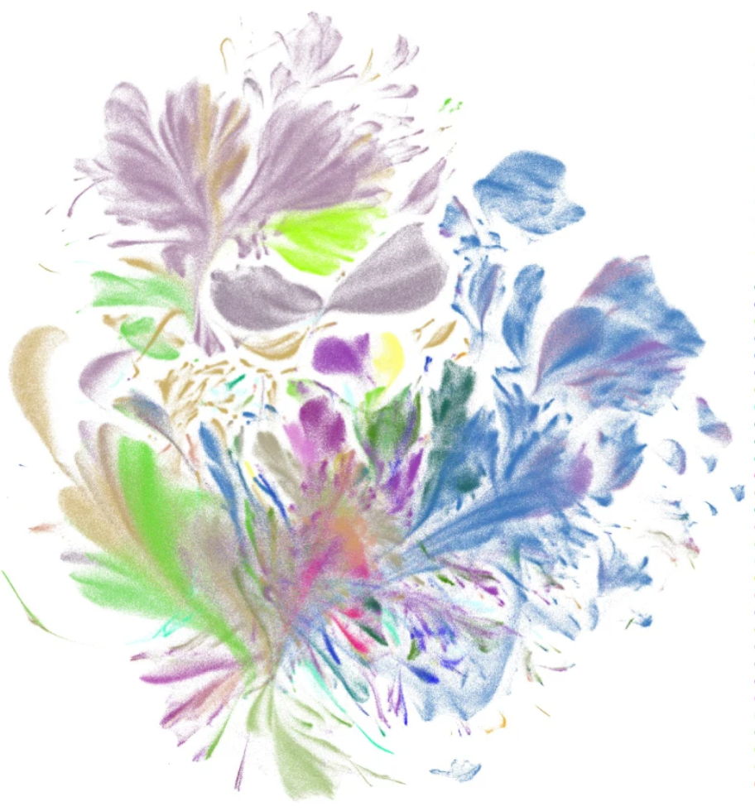
Agenda
Why Fine-Tuning? The Transfer Learning Paradigm
Overview of Fine-Tuning Pipeline
Full Fine-Tuning vs. Parameter-Efficient Fine-Tuning (PEFT)
LoRA: Low-Rank Adaptation
Practical Lab (Transcription Factor Binding Prediction)
Introduction to Pre-Training & Fine-Tuning
UMAP visualization of the pretrained scGPT cell embeddings (emb; a random 10% subset), colored by major cell types
Cui, Haotian, et al. "scGPT: toward building a foundation model for single-cell multi-omics using generative AI." Nature Methods 21.8 (2024): 1470-1480.

Slide 3
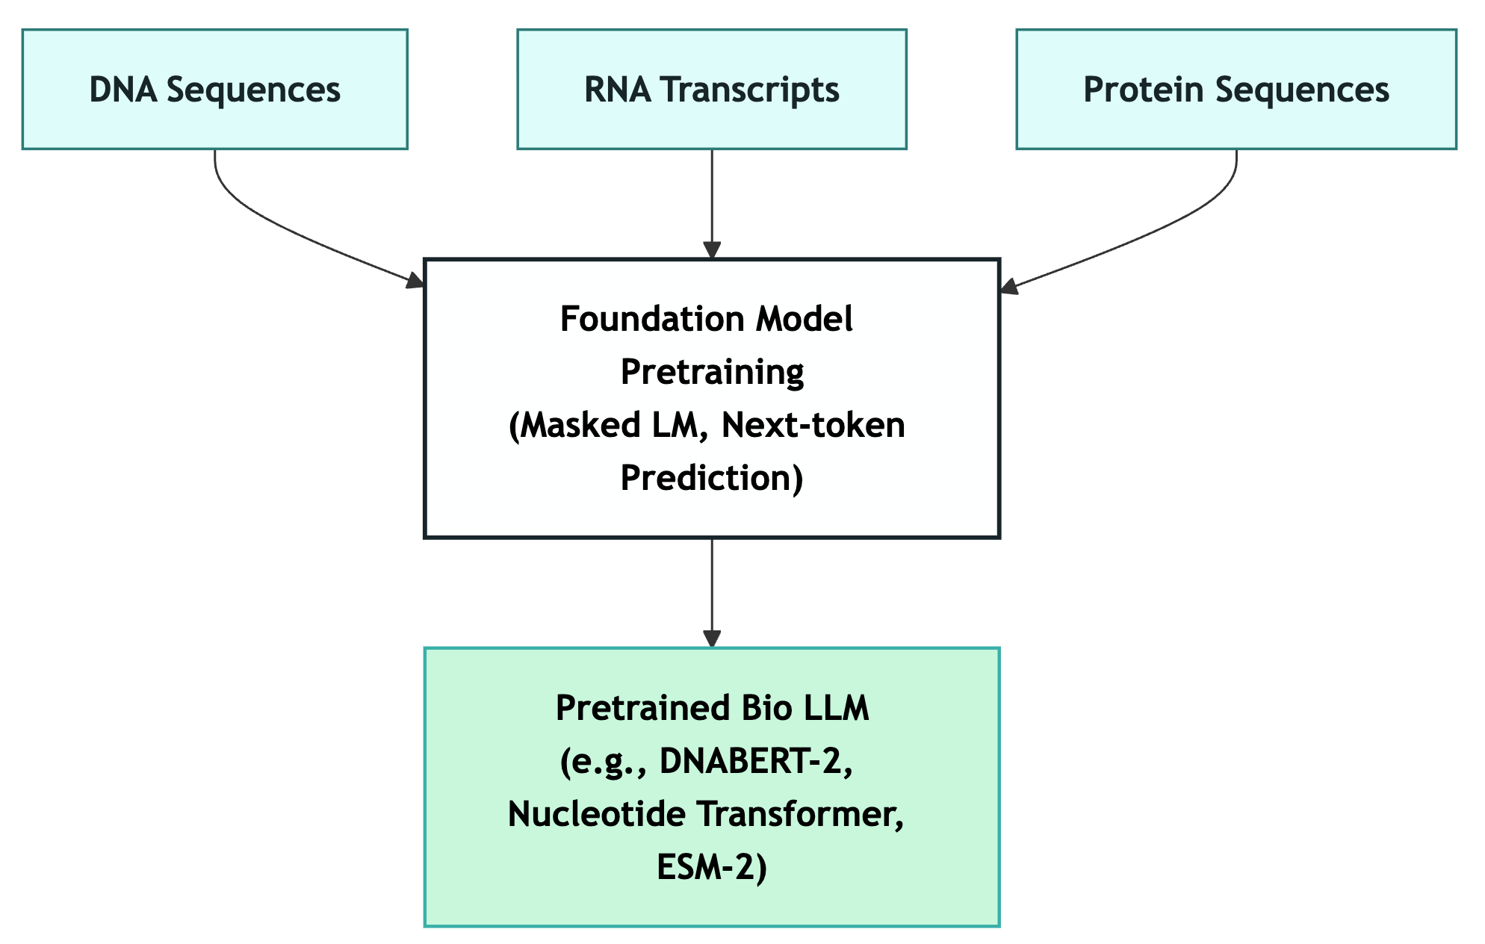
What is Pre-training?
Building General Knowledge
  Training on massive unlabeled genomic data to learn patterns
Key Points:
  Huge datasets (billions of sequences)
  Self-supervised learning
  General patterns learned
  Compute-intensive (days/weeks on GPUs)
  Foundation model as output
Example
  DNABERT trained on Human DNA
  Captures motifs, regulatory syntax, dependencies between different regions

Slide 4
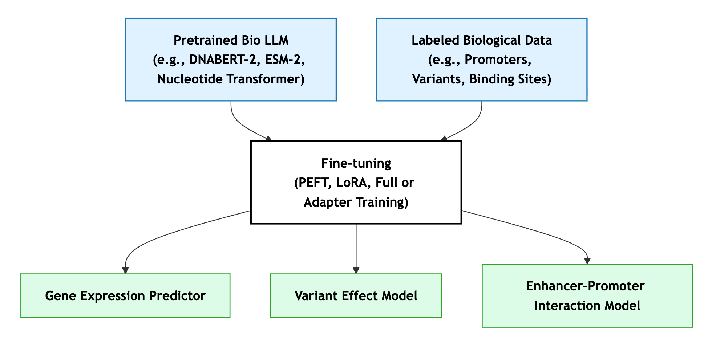
What is Fine-tuning?
Specialization for Your Task
  Adapt a pre-trained model to specific tasks using labeled data.
Key Points:
  Small datasets (thousands of sequences)
  Labeled data required
  Adapts knowledge to your problem
  Fast & cheap (hours on single GPU)
  Task-specific output
Example:
  Use pathogenic variants to identify disease mutations
  Understanding gene regulation
  Synthetic element design

Slide 5
Pre-training vs Fine-tuning
Aspect | Pre-training | Fine-tuning
Data Size | Billions of sequence tokens (e.g., genomes, proteomes) | Thousands to millions of labeled samples
Data Type | Unlabeled biological sequences (self-supervised tasks) | Labeled data for specific tasks (e.g., promoters, variants, binding sites)
Objective | Learn general biological representations | Adapt representations to a specific prediction task
Time | Weeks to months | Hours to days
Compute & GPUs | Multi-GPU or TPU clusters (e.g., 64–256 GPUs) | Single or few GPUs (e.g., LoRA on RTX 3090)
Cost Estimate | $50k–$500k+ | $10–$1k
Result | Foundation (base) model | Task-adapted (specialized) model
Pretraining builds “biological intelligence,” fine-tuning channels it for specific task

Slide 6
Fine-Tuning: The Transfer Learning Paradigm
Data Efficiency:
Learn More from Less
Requires only a small labeled dataset to specialize for a new biological task.
Compute & Time Efficiency: Faster by Design
Enables rapid iteration and experimentation across many tasks.
Performance Boost: Smarter Starting Point
Achieves strong accuracy and generalization with minimal additional training.
Sustainability & Reusability: Train Once, Use Many Times
Reuses existing foundation models instead of retraining from scratch.

Slide 7
Full Fine-Tuning vs. Parameter-Efficient Fine-Tuning
Finetuning full model can be very heavy and complex
  Let’s take examle of DNABERT-2 model (117 Million parameters)
Aspect | Full Fine-Tuning | Parameter-Efficient Fine-Tuning (PEFT)
Parameters Updated | All model 117M parameters | Only a small subset (e.g., LoRA or adapter weights)
GPU Memory Requirement | Very high (≈30 GB or more) | Low (≈4× less)
Training Speed | Slow — hours to days | Fast — minutes to a few hours
Risk of Catastrophic Forgetting | High — overwrites pre-trained knowledge | Low — base model remains frozen
Flexibility / Adaptability | Full flexibility — can adapt all layers | Moderate — only modifies low-rank or adapter components
Best Suited For | Large institutions or foundational model creators | Research labs and applied task fine-tuning

Slide 8
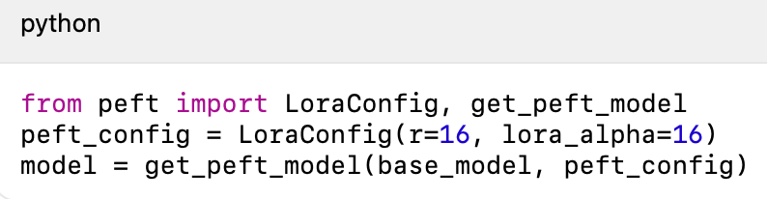
LoRA: From Full Fine-Tuning → Smart Parameter Updates
Full fine-tuning updates every parameter, demanding huge GPU memory and long training.
LoRA offers a smarter alternative — train only a few thousand parameters while keeping most knowledge intact.
How LoRA works
  Freeze the pre-trained model
  Insert small trainable matrices A and B
  Update only 1–3 % of parameters
Outcome
  100× fewer trainable parameters
  4× less GPU memory
  Modular adapters per task

Slide 9
Quantization + LoRA → QLoRA
Even LoRA models can be large → compress the frozen base further.
Quantization:
  ~50% memory reduction when moving from fp16 → 8-bit
  ~75% reduction from fp16 → 4-bit
  Accuracy largely maintained if quantization is applied correctly
QLoRA = Quantization + LoRA:
  Quantize the frozen base → smaller memory footprint
  Keep LoRA adapters in higher precision for stability
  Enables fine-tuning billion-parameter models on consumer GPUs
LoRA shrinks what you train; quantization shrinks what you load
Together, they achieve up to 4×–8× memory savings with relatively smaller in accuracy loss.

Slide 10

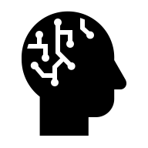



Overview of Fine-Tuning Pipeline
Prepare Dataset
Load Model
Configure Training
Run Training
Evaluate

Slide 11
Prepare Dataset
Get the data
  Collect raw biological sequences (e.g., DNA, RNA, or protein) along with task-specific labels such as binding sites, promoters, or variant effects.
Tokenize data
  Convert sequences into numerical tokens (e.g., k-mers, BPE, character tokens) so the model can understand and process them efficiently.
Split into Train, Validation and Test set
  Divide the dataset to train the model, tune its parameters, and fairly evaluate its performance on unseen examples.
Configure Data Collation
  Define how batches are formed during training—padding, truncation, and alignment—to ensure consistent sequence lengths and efficient GPU use.

Slide 12
Load Model
Load pre-trained model
  Usually hosted on model hubs (e.g., Hugging Face Hub, GitHub, or lab repositories)
  Can also be stored locally or on HPC
Attach PEFT adapters (e.g., LoRA)
Model organization
  Architecture – the model’s structure (e.g., transformer layers, attention heads).
  Weights / Parameters: Numerical values that capture learned biological relationships.
  Tokenizer / Vocabulary: The mapping between biological symbols (A, T, C, G, amino acids) and numerical tokens
  Configuration File: Metadata such as model size, layer count, and training setup.

Slide 13
Configure Training
Why configuration matters
  Same model + Same data + Different configuration = Totally different outcomes
The Restaurant Analogy
  Same ingredients but a change in recipe may drastically change food experience
Bad Configuration
  Training: Crashes after 2 days
  Memory: OOM errors
  Accuracy: 52% (coin flip!)
  Cost: $500 wasted
  You: "Deep learning is broken!”
Good Configuration
  Training: 2 hours done
  Memory: 60% utilized
  Accuracy: 89% (paper-worthy!)
  Cost: $5 total
  You: "I'm publishing this!"

Slide 14
Key Training Hyperparameters
Parameter | Description | Typical Value / Range
Learning Rate | Most critical parameter: too high → divergence; too low → no learning. | 1e-5 to 1e-4 (for fine-tuning)
Batch Size | Balances memory usage vs gradient quality. | 8–32 (use gradient accumulation if limited)
Number of Epochs | Number of full passes through the data. | Use early stopping rather than fixed count
Warmup Steps | Gradual lr increase at start to prevent instability. | 5–10% of total steps
Optimizer | Update rule; affects convergence speed and stability. | AdamW (β1=0.9, β2=0.999, ε=1e-8)
Dropout Rate | Randomly zeros activations to regularize; applied to embeddings/attention/MLP. | 0.0–0.2 (often 0.1 in pretrained configs)

Slide 16
Questions & Comments

