Slide 1

Centralized College Database
Saikrishna B A

Slide 2
Introduction to PL/SQL
PL/SQL was developed by Oracle Corporation in the early ’90s to enhance the capabilities of SQL. It is a database-oriented programming language that is a powerful extension of SQL with procedural capabilities. The key strength of PL/SQL is its tight integration with the Oracle database.

Slide 3
Some of its procedural capabilities include
♣ Variable Definition and Assignment
♣ Conditional Processing
♣ Loop Constructs
♣ Error Handling
♣ Unique Capabilities of Subprograms
So in this report of ours which is concerning the Centralised College Database, we have endeavored to use certain features of Advance SQL such as procedures, Case, If-Else statement, While loops, Cursor, and Trigger.

Slide 4
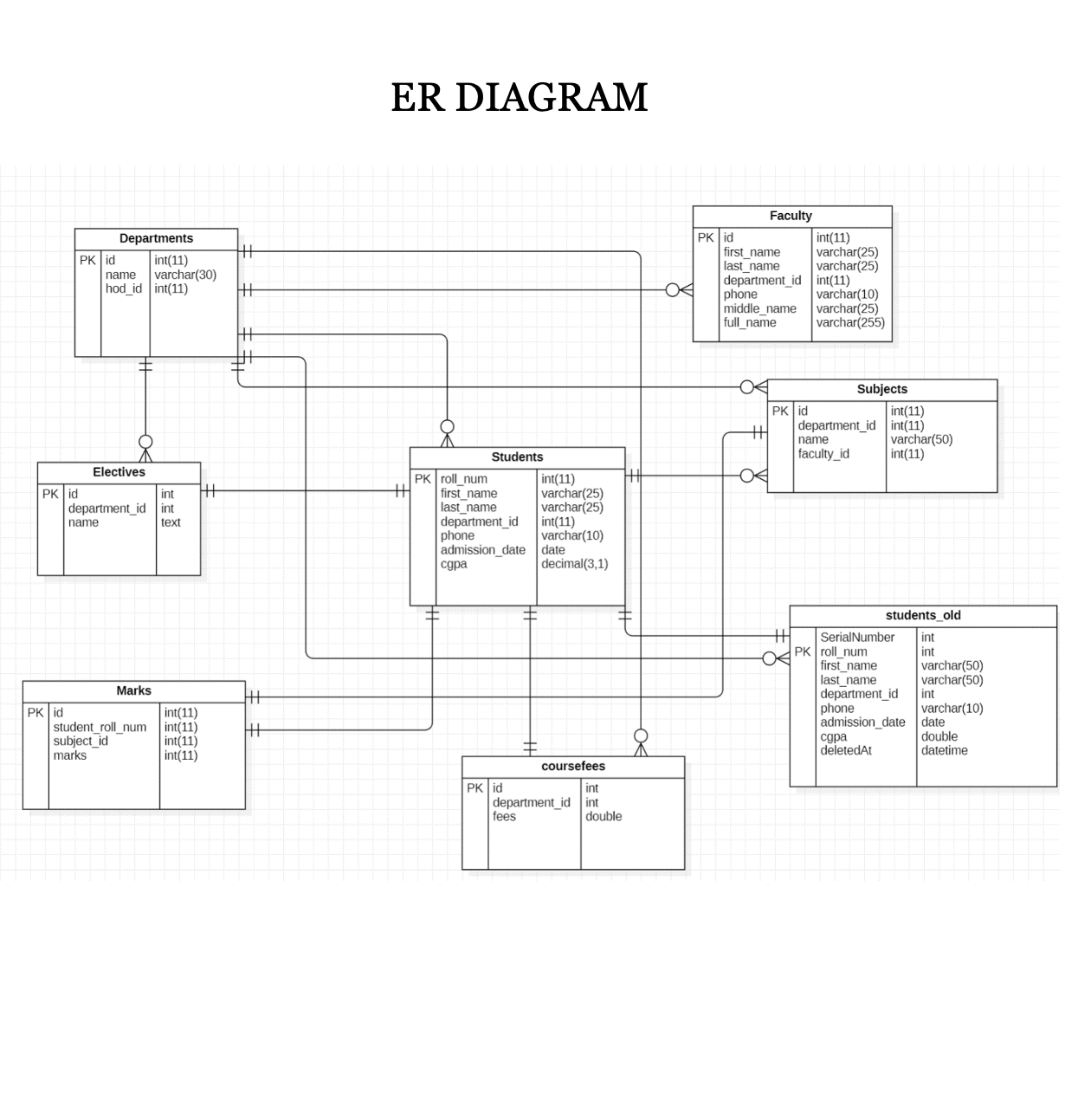

Slide 5
Procedures :
CURSORS
A cursor is a pointer to this context area. It contains all information needed for processing the statement. In PL/SQL, the context area is controlled by Cursor.
A cursor contains information on a select statement and the rows of data accessed by it.
A cursor is used to refer to a program to fetch and process the rows returned by the SQL statement, one at a time.
There are two types of cursors: Implicit Cursors & Explicit Cursors

Slide 6
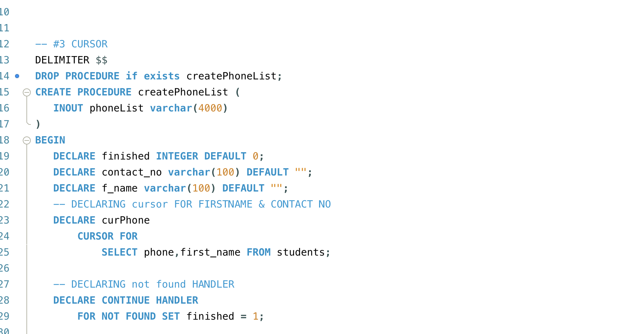
Cursor Example

Slide 7
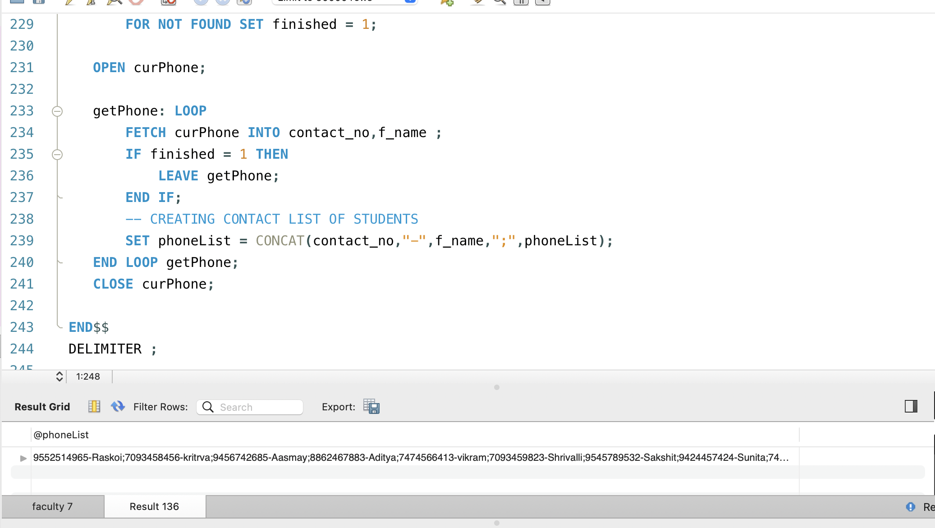

Slide 8
Triggers
The triggers play an important role while validating the SQL and PLSQL queries on an automatic basis depending on some conditions.
It executes or fired like a definite event every time.
A trigger can be defined as automatic code execution on an event of a database.
A trigger is a PL/SQL block structure or a subprogram that is fired or executed when a DML statement like Insert, Delete, Update is executed on a database table.
A trigger is triggered automatically at predefined timing and even when an associated DML statement is executed.
Triggers are physically stored in a database.

Slide 9
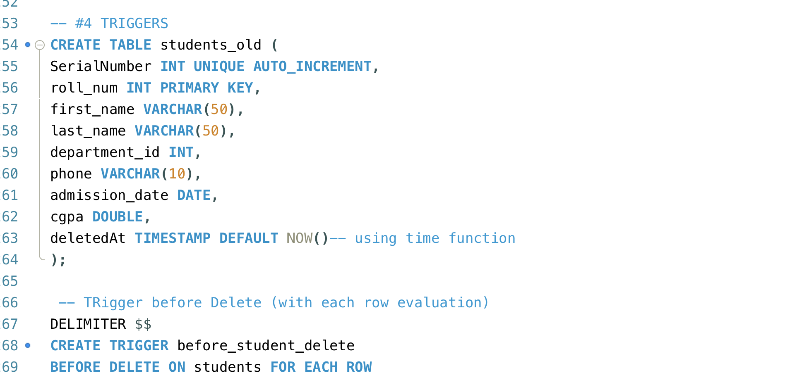

Slide 10
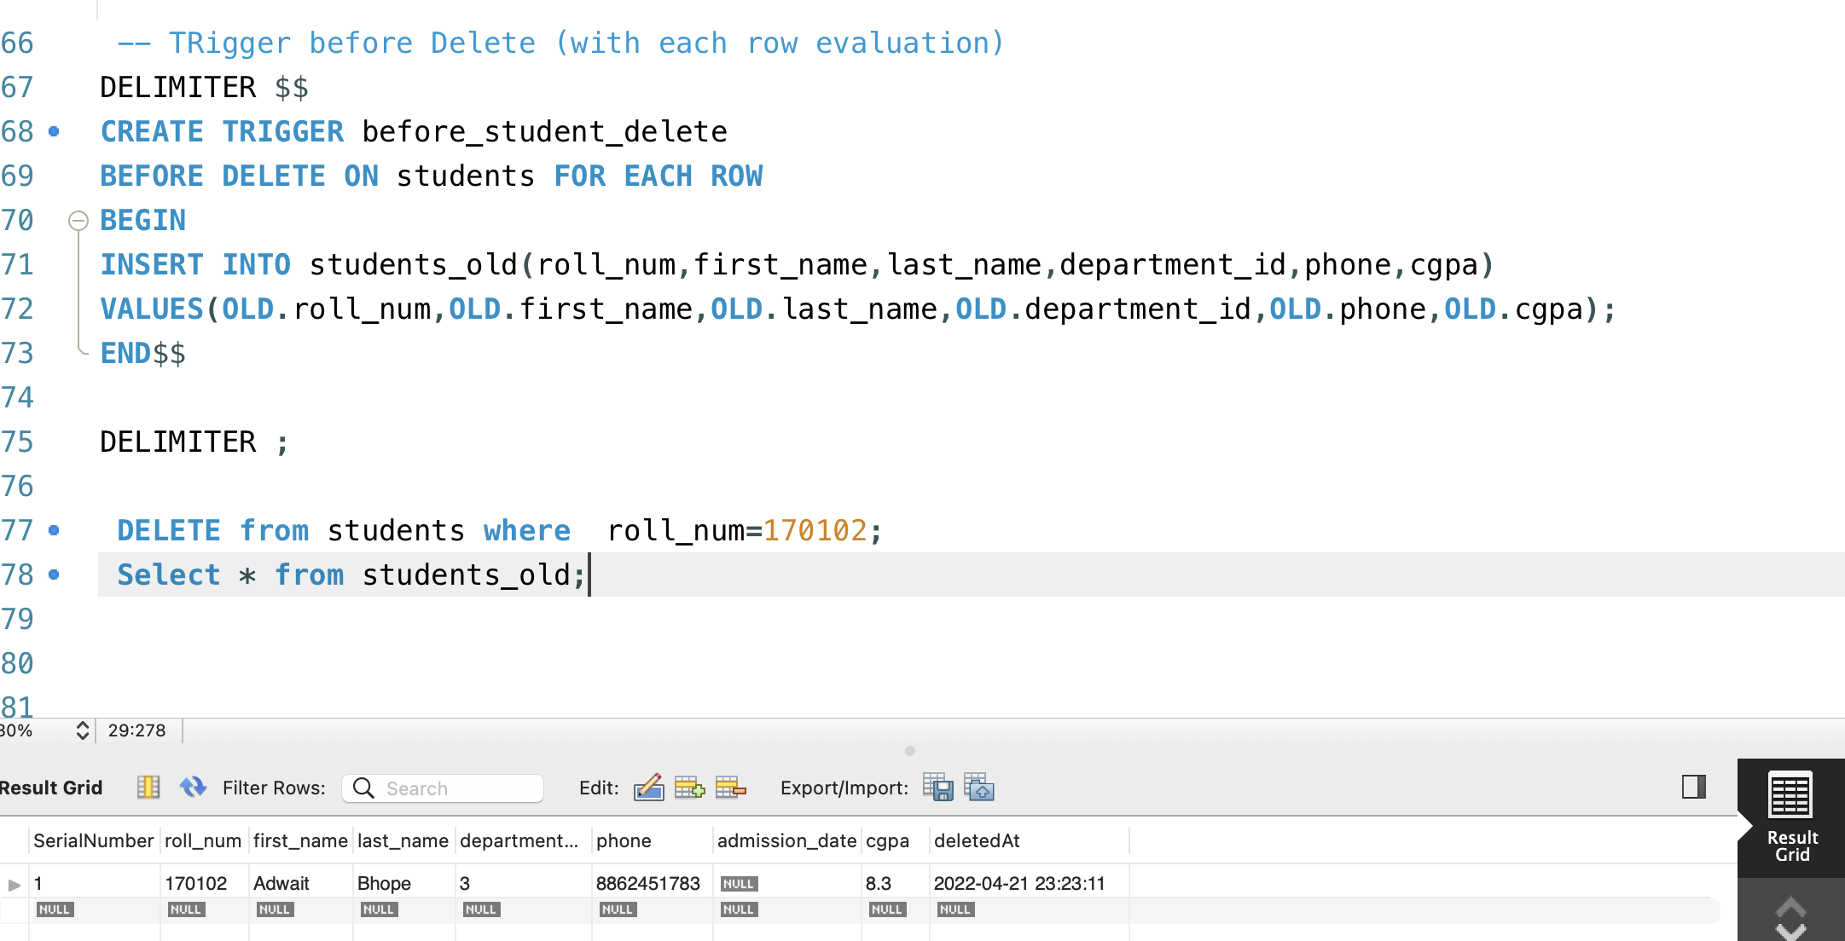

Slide 11
While Loop
The WHILE loop statement continues to execute the statements between the LOOP and END LOOP as long as the condition in the WHILE clause evaluates to TRUE.
PL/SQL evaluates the condition in the WHILE clause before each loop iteration. If the condition is TRUE, then the loop body executes. In case it is FALSE or NULL, the loop terminates.
If the condition is FALSE before entering the loop, the WHILE loop does not execute at all. This behaviour is different from the LOOP statement whose loop body always executes once.

Slide 12
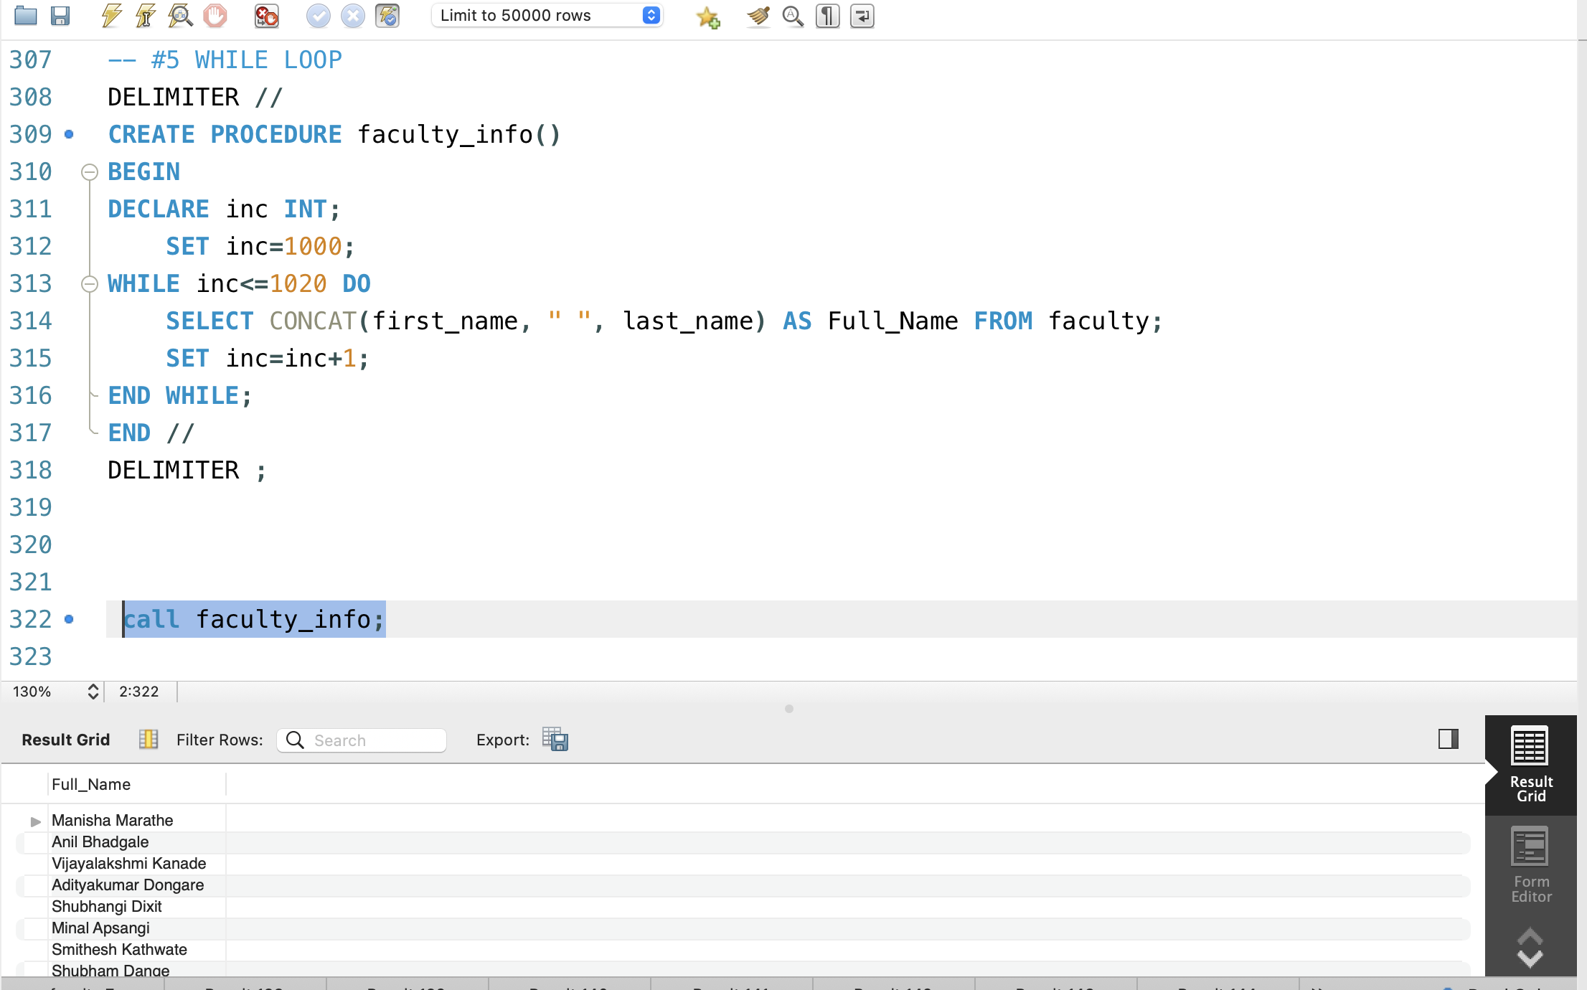

Slide 13
IF-ELSE CONDITION
In PL/SQL, the IF-THEN-ELSE statement is used to execute code when a condition is TRUE or execute a different code if the condition evaluates to FALSE.

Slide 14
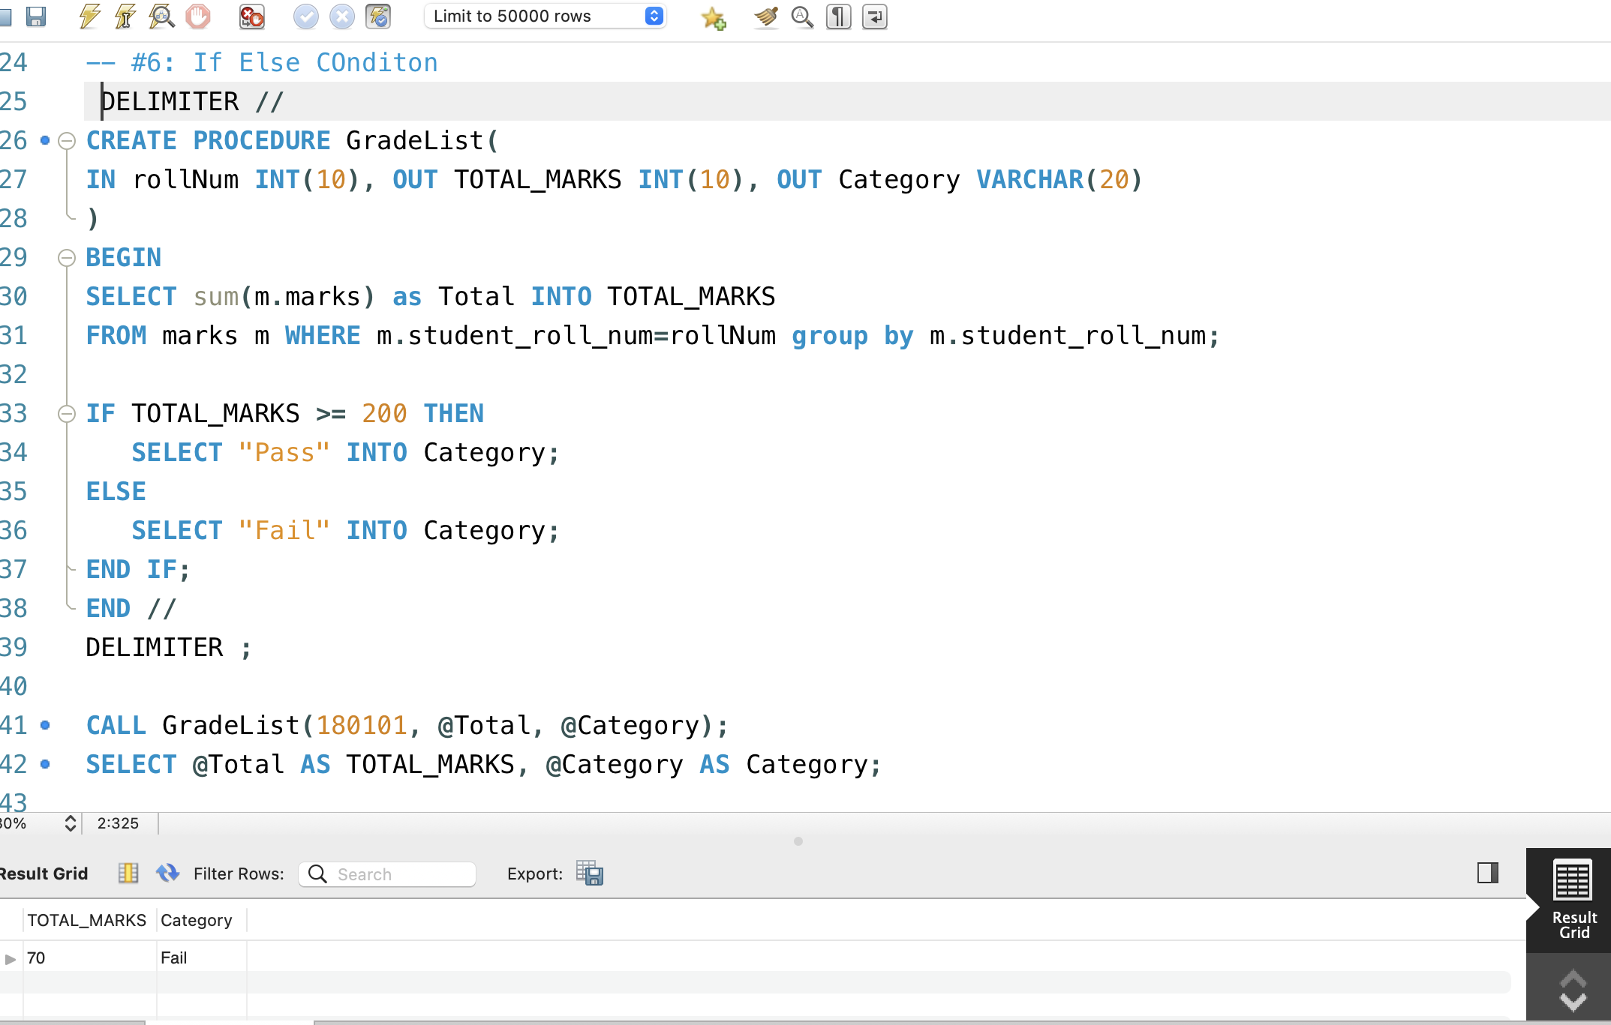

Slide 15
Case Statement
1. The CASE statement is a compact way to evaluate a single condition and choose between many alternative actions.
2. This statement is very useful when we have multiple conditions as well as the expected input is also multiple and changeable according to the situation.
3. It makes sense to use CASE when there are three or more alternatives to choose from.

Slide 16
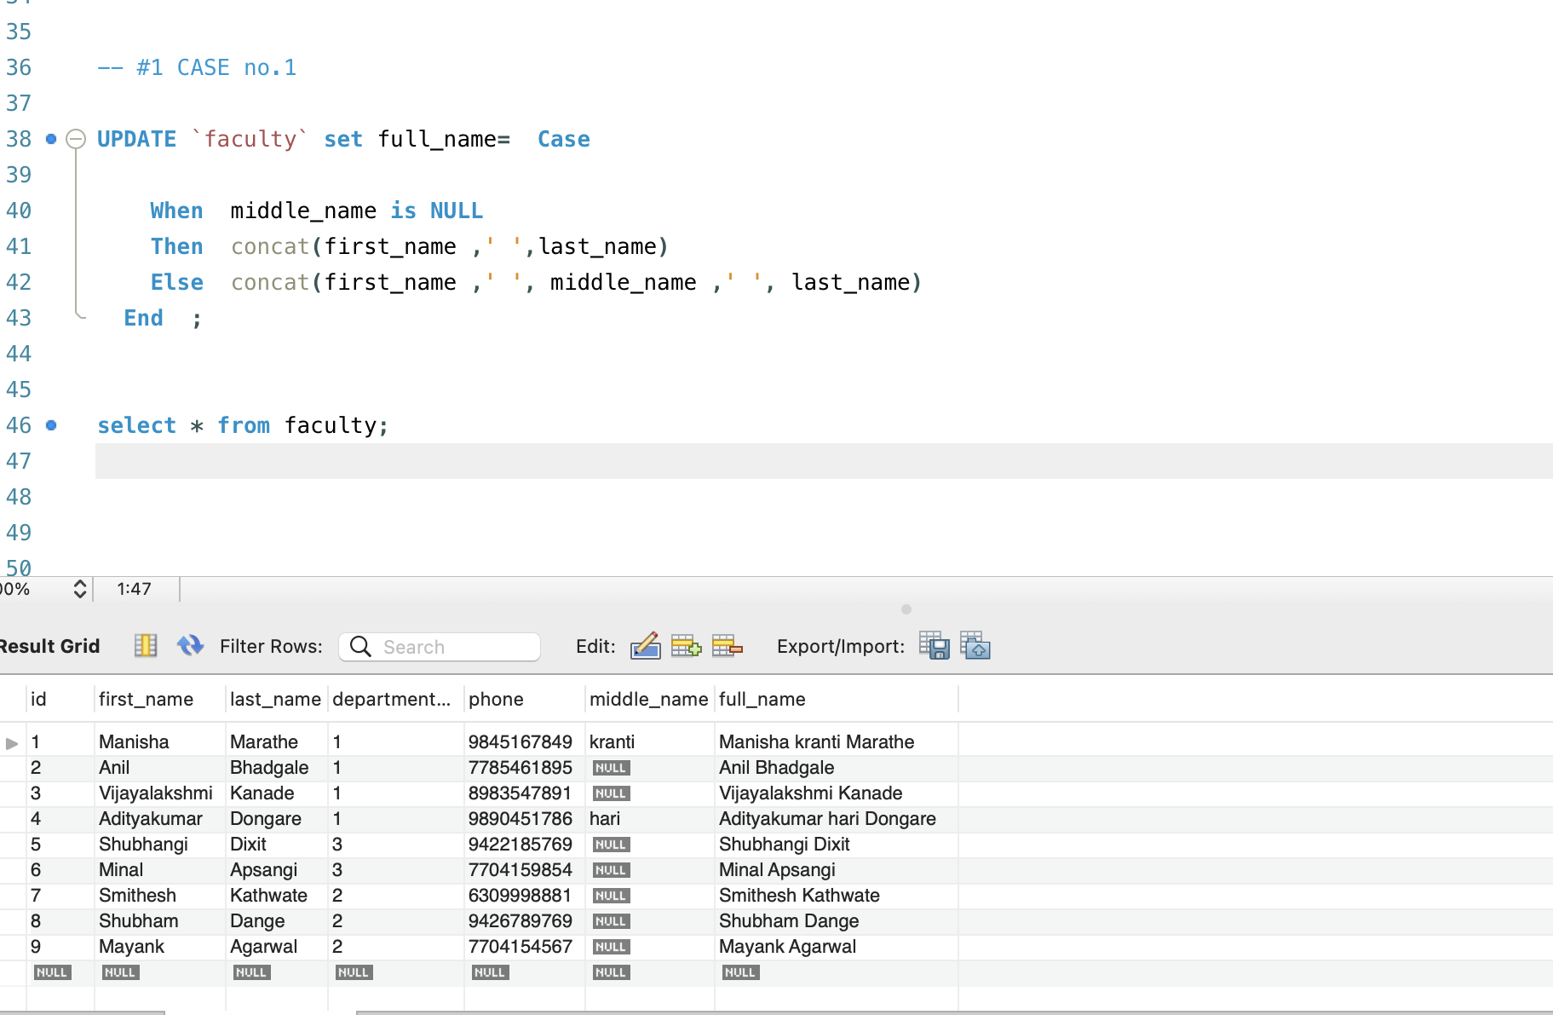

Slide 17
STORED PROCEDURES
A stored procedure or simple subroutine or a proc or a subprogram is a named PL/SQL block that performs one or more specific tasks.
The stored procedures are written in advance and compiled before their use. This improves the speed of execution.
This is like a procedure or function in other programming languages.
A procedure has a header and a body.
The header consists of the name of the procedure and the parameters or variables passed to the procedure.
The body consists of a declaration section, execution section, and exception section like a general PL/SQL Block.
A procedure is like an anonymous PL/SQL Block, but it is named for repeated usage.
An exception is an error that disrupts the normal flow of program instructions.
PL/SQL provides us the exception block which raises the exception thus helping the programmer to find out the fault and resolve it.

Slide 18
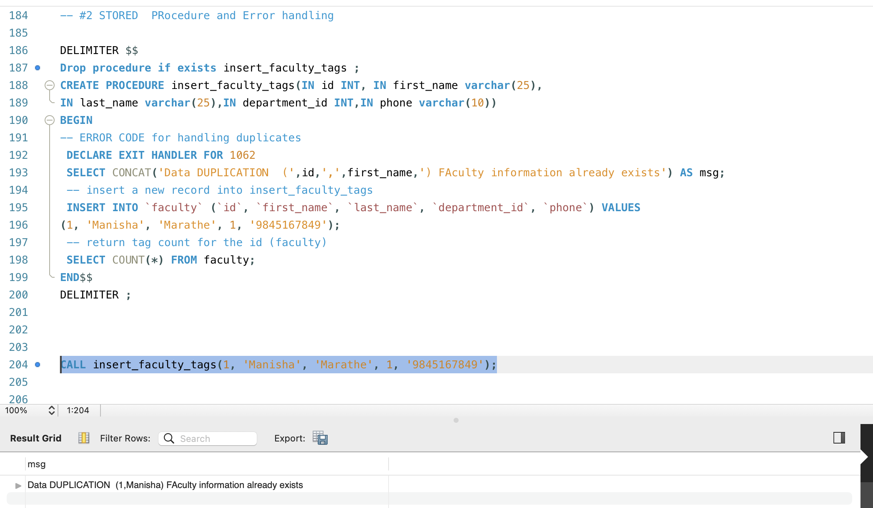

Slide 19
Thank You

