Slide 1
Credit Risk Assessment
Saikrishna B. A

Slide 2
Credit Risk Assessment:
Credit risk assessment involves estimating the probability of loss resulting from a borrower’s failure to repay a loan or debt. Traditionally, it refers to the risk that the lender may not be able to receive the principal and interest.
Credit risk assessments are carried out on the borrower’s overall ability to repay a loan according to its original terms. To assess credit risk, lenders often look at the
5 Cs:
Credit history,
Capacity to repay,
Capital,
The loan’s conditions and
Associated collateral.

Slide 3
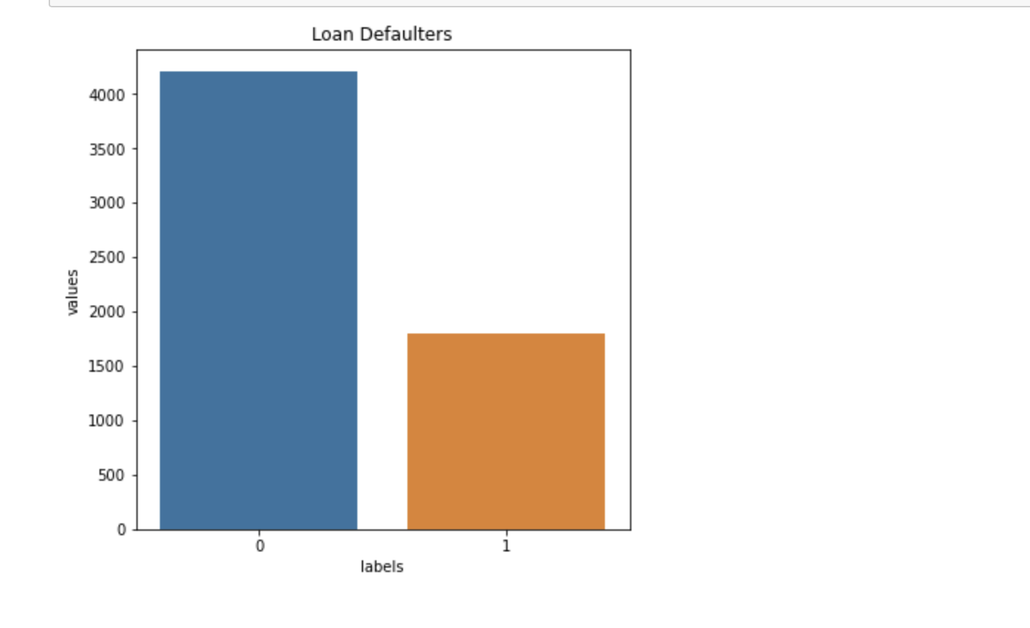
EDA:
The barplot here displays the count of customers who have defaulted on their loan repayments in past.
Label 0- depicts non defaulters
Label 1- depicts defaulters

Slide 4
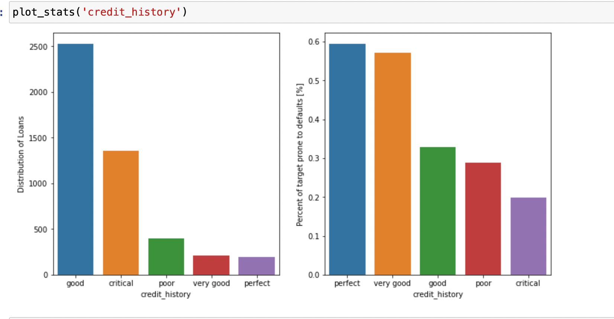
The bar plots 1 here represents the Distribution of loans amongst customers having different types of credit history.
The bar plots 2 here represents the Percentage of target prone to default amongst customers having different types of credit history.(the data represented here is in the descending order)

Slide 5
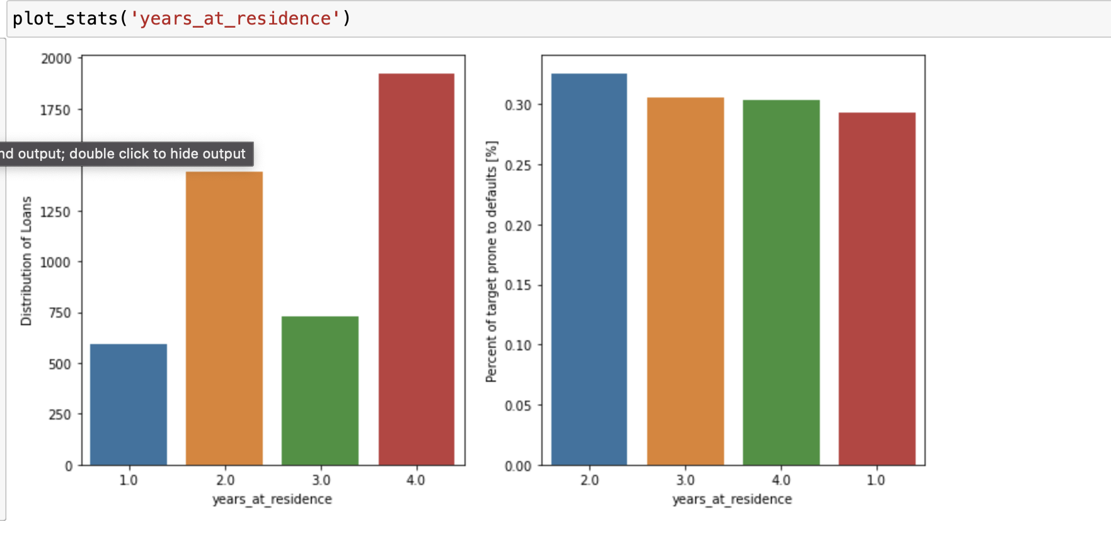
The bar plots 1 here represents the Distribution of loans amongst customers with different duration of their residence in years.
The bar plots 2 here represents the Percentage of target prone to default amongst customers having different. duration of their residence in years.(the data represented here is in the descending order)

Slide 6
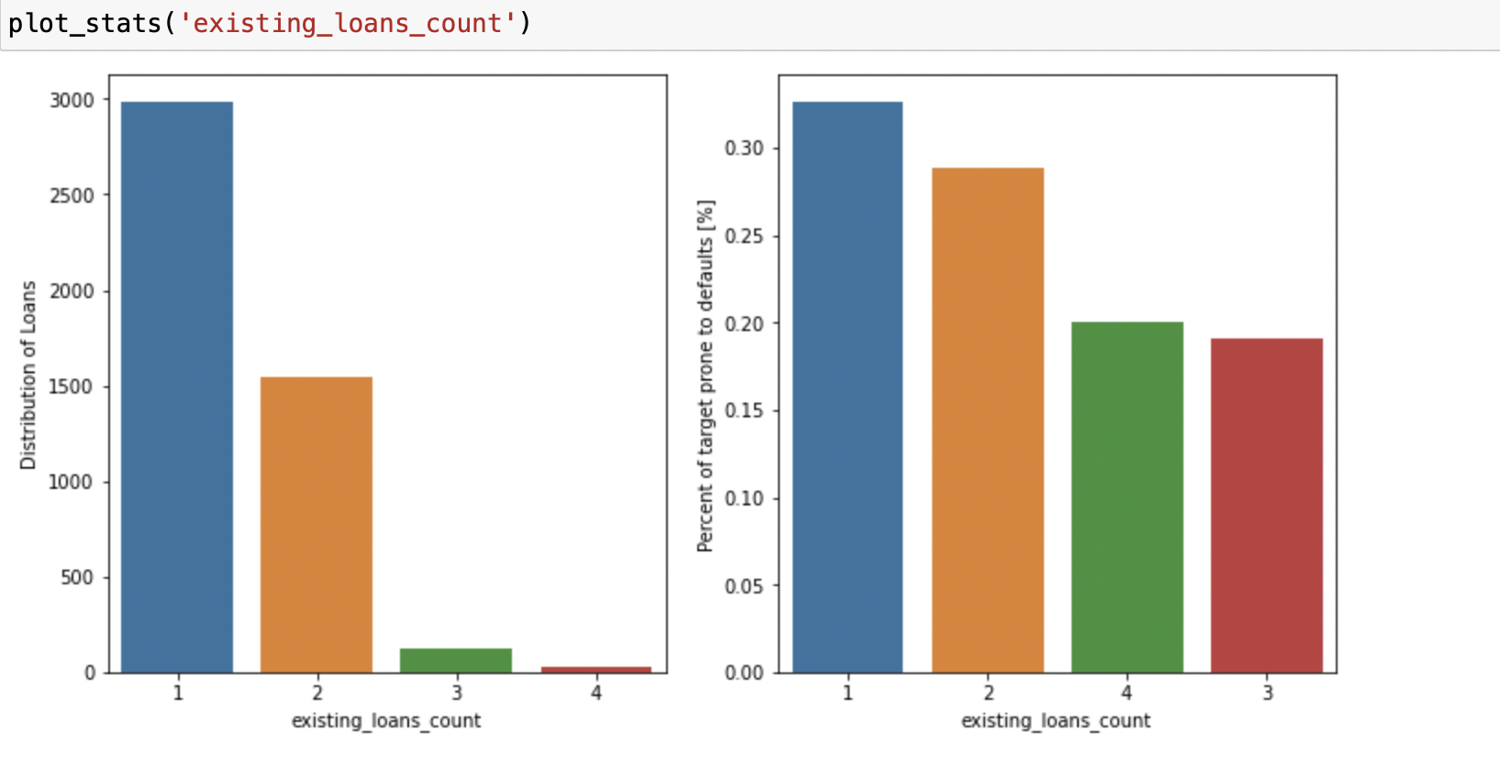
The bar plots 1 here represents the Distribution of loans amongst customers with existing loan counts.
The bar plots 2 here represents the Percentage of target prone to default amongst customers with their existing loan counts.(the data represented here is in the descending order)

Slide 7
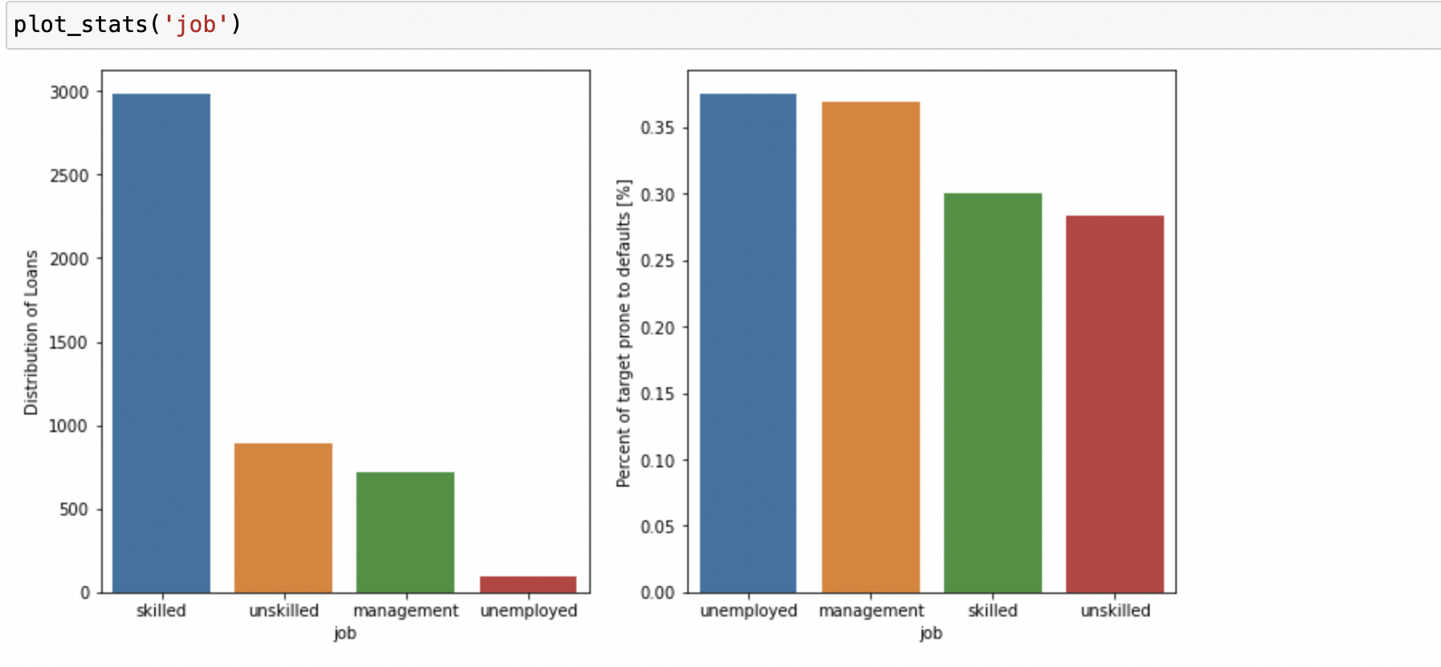
The bar plots 1 here represents the Distribution of loans amongst customers showing their job status or job type
The bar plots 2 here represents the Percentage of target prone to default amongst customers with different job types. (the data represented here is in the descending order)

Slide 8
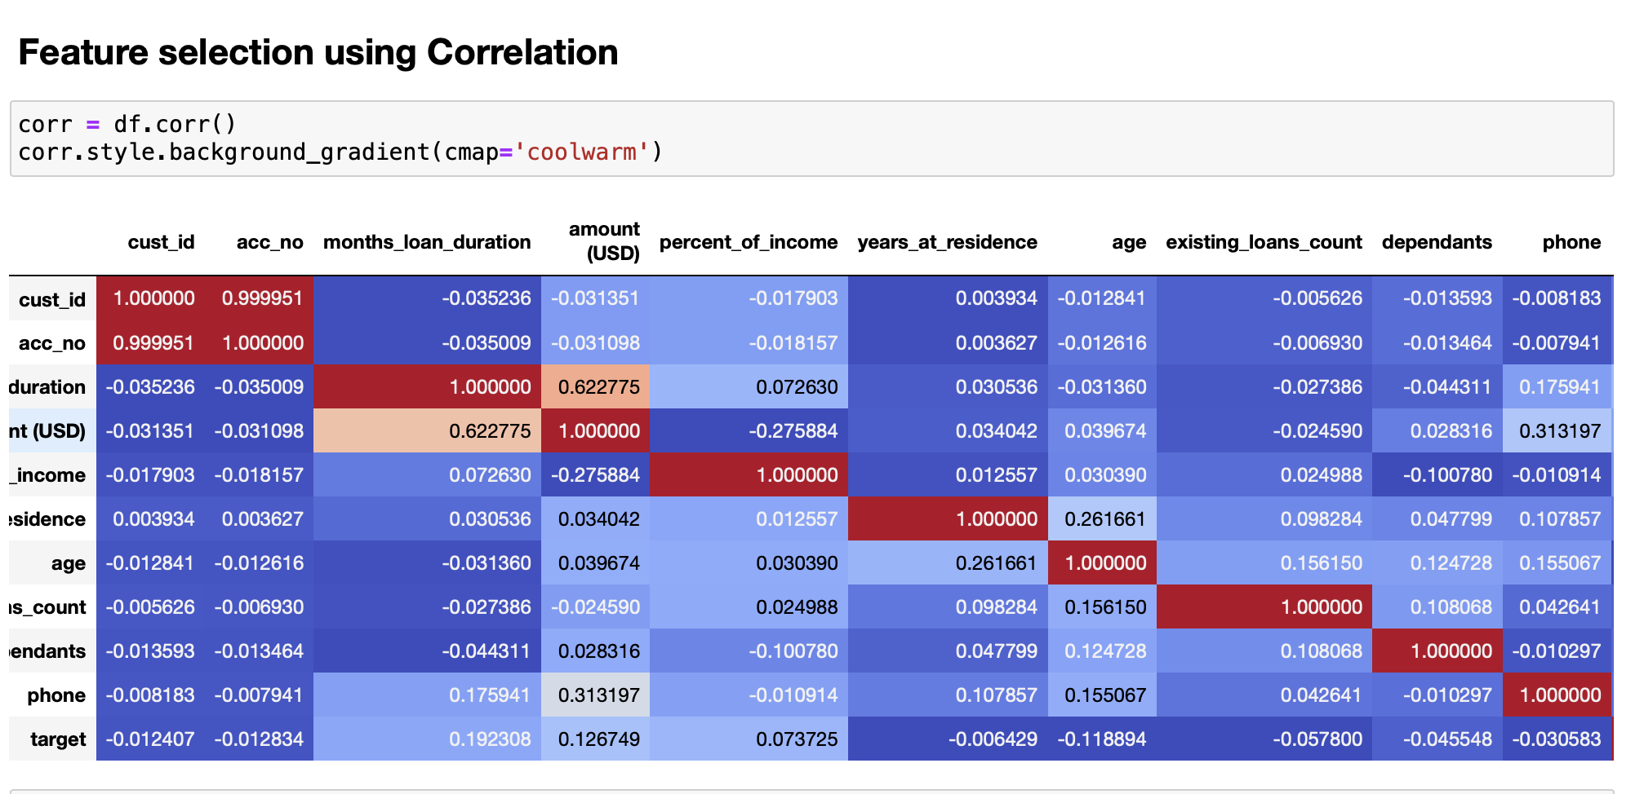

Slide 9
# Correlation is a measure of the linear relationship of 2 or more variables. Through correlation, we can predict one variable from the other. The logic behind using correlation for feature selection is that the good variables are highly correlated with the target.
# Furthermore, variables should be correlated with the target but should be uncorrelated among themselves.
# If two variables are correlated, we can predict one from the other.
#Therefore, if two features are correlated, the model only really needs one of them, as the second one does not add additional information.
# We have used the Correlation here and displayed it with through a heatmap which helps us in finding and selecting the right features for the model .

Slide 10
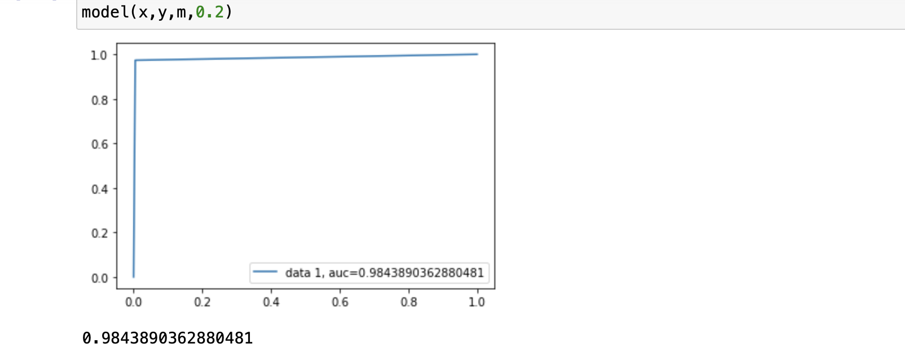
AUC - ROC curve is a performance measurement for the classification problems at various threshold settings. ROC is a probability curve and AUC represents the degree or measure of separability. It tells how much the model is capable of distinguishing between classes.

Slide 11
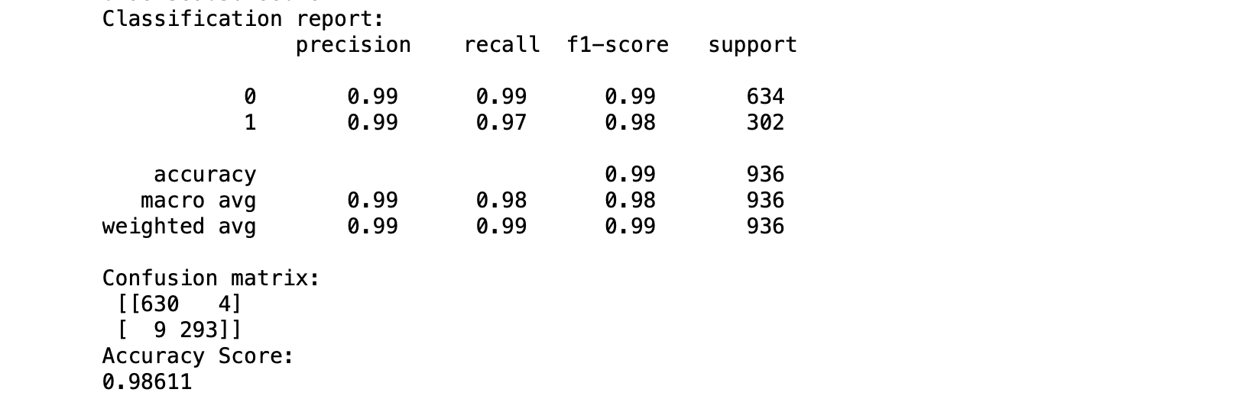
Classification report displays how the model is working on the test dataset and with the help of various parameters such as Precision ,Recall,Accuracy,F1-Score and support.
A confusion matrix is a table that is often used to describe the performance of a classification model (or "classifier") on a set of test data for which the true values are known.

Slide 12
CONCLUSION:
The dataset provided was a balanced dataset so a good Accuracy score is very much essential, along with a balance between Precision and Recall which is obtained F-Beta score i.e. (F1-Score), here the value of beta is 1 which can be varied considering the focus of the user we have considered F1 in order to have a balance between Precision and Recall with low FALSE POSITIVE and FALSE NEGATIVE, the best model we choose will be the one with lowest FALSE NEGATIVE along with high Precision and Accuracy as the utmost priority of a Financial Institute in credit risk assessment is to rightly predict all the possible defaulters and with minimum TYPE2 error i.e. FALSE NEGATIVES.

Slide 13
Thank You

