Slide 1
Behaviour: Order Management
The order management view allows to create new orders and to modify or cancel them.
User story: As a customer, I wish to modify an existing order in order to adapt to changing conditions.
XXID: Modify existing order
Test-Phase: Arrange
Click main menu "Order Management"
The value of "Due Date" in the most recently created or modified order is stored as <OldDueDate>.
Press "New" button.
Test-Phase: Act
Increase the value in field "Due Date" by "7" days.
Press "Save" button.
Test-Phase: Assert
The value of "Due Date" in the most recently created or modified order is stored as <NewDueDate>.
Do the date values of 'NewDueDate' and 'NewDueDate' differ by "7" days?

Slide 2
Feature: Managing orders
The order management view allows to create new orders and to modify or cancel them.
User story: As a customer, I wish to create an order in order to start a business process.
Scenario: Create new order
Given the page Order Management is visible
When a new order is created
Then the overview table contains a new entry
And the creation date of the new order is today.

Slide 3
@LanguageTemplate(“Enter ^^ into field ^^.“)
@LanguageTemplate(“Set ^^ into field ^^.“)
public void enterText(String fieldname, String value)
{
… // java code goes here…
addReportMessage(„Value<b>“ + value
„</b> entered into field “ “);}
@ LanguageTemplate(“Click button ^^.“)
public void clickButton(String buttonName)
{
… // java code goes here…
addReportMessage(„Button <b>“ + buttonName
„ has been clicked.“);
}
Written by Developer
@Test
public void execute()
{
…
enterText(“Age“, 30);
clickButton(“OK“);
…
}
Generazted by SysNat
Generated
by SysNat
LanguageTemplateContainer.java
Set „Bob“ into field „Name“.
Enter „30“ into field „Age“.
Click button „OK“ .
Value Bob entered into field „Name“.
Value 30 entered into field „Age“.
Button OK has been clicked.
JUnitTest.java
Run
Feels like executing natural language!
Written by SysNat User
Test.nlxx
Test.html

Slide 4
How does SysNat work?
XXID: Test1
Output „Hello World“.
Write „Hi all“.
public class LanguageTemplateContainer
{
}
public class JUnitTemplate {
private LanguageTemplateContainer container= null;
@Test
public void executeScript() throws Exception {
/* @MethodBody */
}
@Before
public void setUp() {
container = new LanguageTemplateContainer ();
}
@After
public void shutdown() {
if (container != null) testSupport = null;
}
}
@LanguageTemplate(„Write ^^.")
@LanguageTemplate(„Output ^^.")
public void output(String text)
{
}
+
System.out.print( text );
addReportMessage(“Text <b>“
+ text + “</b> “ +
„was written.“)
+
HelloWorld.nlxx
LanguageTemplateContainer.java
JUnitTemplate.java
public class HelloWorld extends ExecutableExample {
…
@Test
public void executeScript() throws Exception {
container.output("Hello World");
container.output("Hi all");
}
…
}
=
Test-Report
Run
…
Test1:
Text Hello World was written.
Text Hi all was written.
1 Fußnote / Quelle
HelloWorldTest.java
report.html

Slide 5
Wie funktioniert SysNat?
…
@LanguageTemplate(“Enter ^^ into field ^^.“)
@LanguageTemplate(“Set ^^ into field ^^.“)
public void enterText(String value, String fieldname) {
guiControl.enterTextInField(fieldName, value);
addReportMessage(„Value <b>“ + value + „</b>“ +
„entered into field “ +
„<b>“ + field + „</b>.“);
}
@ LanguageTemplate(“Click button ^^.“)
public void clickButton(String buttonName) {
guiControl.clickButton(buttonName);
addReportMessage(„Button <b>“ + buttonName
„</b> has been clicked.“);
}
…
…
@Test
public void execute()
{
…
enterText(30, “Age“);
clickButton(“OK“);
…
}
…
Implemented by Developer
Generazted by SysNat
Generated
by SysNat
…
XXID: Test 1
Set „Bob“ into field „Name“.
Enter „30“ into field „Age“.
Click button „OK“ .
Value Bob entered into field „Name“.
Value 30 entered into field „Age“.
Button OK has been clicked.
LanguageTemplateContainer.java
Test.java
Run
Feels like executing natural language!
Written by SysNat user
Test.html
Test.nlxx

Slide 6
Wie funktioniert SysNat?
…
@LanguageTemplate(“Enter ^^ into field ^^.“)
@LanguageTemplate(“Set ^^ into field ^^.“)
public void enterText(String value, String fieldname) {
guiControl.enterTextInField(fieldName, value);
addReportMessage(„Value <b>“ + value + „</b>“ +
„entered into field “ +
„<b>“ + field + „</b>.“);
}
@ LanguageTemplate(“Click button ^^.“)
public void clickButton(String buttonName) {
guiControl.clickButton(buttonName);
addReportMessage(„Button <b>“ + buttonName
„</b> has been clicked.“);
}
…
…
@Test
public void execute()
{
…
enterText(30, “Age“);
clickButton(“OK“);
…
}
…
…
XXID: Test 1
Set „Bob“ into field „Name“.
Enter „30“ into field „Age“.
Click button „OK“ .
Value Bob entered into field „Name“.
Value 30 entered into field „Age“.
Button OK has been clicked.
LanguageTemplateContainer.java
Test.java
Test.html
Test.nlxx

Slide 7
…
@LanguageTemplate(“Enter ^^ into field ^^.“)
@LanguageTemplate(“Set ^^ into field ^^.“)
public void enterText(String value, String fieldname) {
guiControl.enterTextInField(fieldName, value);
addReportMessage(„Value <b>“ + value + „</b>“ +
„entered into field “ +
„<b>“ + field + „</b>.“);
}
@ LanguageTemplate(“Click button ^^.“)
public void clickButton(String buttonName) {
guiControl.clickButton(buttonName);
addReportMessage(„Button <b>“ + buttonName
„</b> has been clicked.“);
}
…
…
@Test
public void execute()
{
…
enterText(30, “Age“);
clickButton(“OK“);
…
}
…
…
XXID: Test 1
Set „Bob“ into field „Name“.
Enter „30“ into field „Age“.
Click button „OK“ .
Value Bob entered into field „Name“.
Value 30 entered into field „Age“.
Button OK has been clicked.
LanguageTemplateContainer.java
Test.java
Test.html
Test.nlxx

Slide 8
XXID: Create new member
Click main menu „Members“.
Click button „New Member“ .
Set „Bob“ into field „Name“.
Enter „30“ into field „Age“.
Click button „OK“ .
Is the a new member displayed?
XXID: Create new member
1. Main menu item „Members“ clicked.
2. Button New Member clicked.
3. Value Bob entered into field „Name“.
4. Value 30 entered into field „Age“.
5. Button OK clicked.
6. Is a new member displayed? – Yes! ☺
Test.nlxx
Test.html
Output

Slide 9
Natural Language
eXecutable eXample
Test Report
Behaviour: Manage members
A simple example for demo purpose to illustrate the use of SysNat nlxx-files.
Precondition: Click main menu „Members“.
OneTimeCleanup: Delete member „Bob“.
XXID: Create new member
Click button „New Member“ .
Set „Bob“ into field „Name“.
Enter „30“ into field „Age“.
Click button „OK“ .
Is the a new member displayed?
XXID: Modify existing member
Select member „Bob“ in member list.
The age of the selected member is stored as <OldAge>.
Click button „Edit“ .
Enter „29“ into field „Age“.
Click button „OK“ .
The age of the selected member is stored as <NewAge>.
Do ‚OldAge‘ and ‚NewAge‘ differ?
Behaviour: Manage members
XXID: Create new member
1. Main menu item „Members“ clicked.
2. Button New Member clicked.
3. Value Bob entered into field „Name“.
4. Value 30 entered into field „Age“.
5. Button OK clicked.
6. Is a new person displayed? – Yes! ☺
XXID: Modify existing member
1. Main menu item „Members“ clicked.
2. Member Bob selected in member list..
3. Age of selected member (30) stored OldAge.
4. Button Edit clicked.
5. Value 29 entered into field „Age“.
6. Button OK has been clicked.
7. Age of selected member (29) stored OldAge.
8. Do OldAge and NewAge differ? – Yes! ☺
Member Bob deleted.
These are Behaviour Level Instructions.
This is a Dynamic Test Object.
Test.nlxx
Test.html

Slide 10
Natural
Language
Instructions
Properties
Test Data
*.nlxx
*.nls
*.dat
*.xlsx
settings.config
execution.properties
<TestApplication>.properties
<<SysNat>>
Natural
Language
Report
Screenshots
*.html
*.png

Slide 11
<<sysnat.natural.language.executable.example>>
<<SysNat>>
<<sysnat.quality.assurance>>
<<sysnat.testcase.generation>>
<<sysnat.test.execution>>
<<sysnat.test.runtime.environment>>
<<sysnat.testdata.import>>
<<sysnat.testresult.archiving>>
<<sysnat.common>>
Maven Dependency
Maven Call

Slide 12
<<sysnat.testcase.generation>>
SysNatTestCaseGenerator
CommandLibraryCreator
LanguageTemplateCollector
LanguageInstructionCollector
LanguageTemplateContainerFinder
XXGroupBuilder
PatternMergeJavaCommandGenerator
TestSeriesBuilder
JavaFileBuilder

Slide 13
<<sysnat.test.runtime.environment>>
class
ExecutableExample
class
ExecutionRuntimeInfo
Interface
GuiControl
class
LanguageTemplatesDownload
abstract class
LanguageTemplateBasics
class
LanguageTemplatesPDFValidation
class
SeleniumGuiControl
class
LanguageTemplatesCommon
class
LanguageTemplatesBasics_HelloWorldSpringBoot
class LanguageTemplatesBasics_HomePageIKS

Slide 14
<<sysnat.natural.language.executable.examples>>
class
SysNatJUnitTestCaseBuilder
class
SysNatTestingExecutor
class
SettingsConfigDialog
class
TestApplicationExImportDialog

Slide 15
<<sysnat.quality.assurance>>
class
ClassLevelTestExecutor
finds and executes
class
class
class
TestcaseGeneration_ModuleLevelTest
class
ModuleLevelTestExecutor
finds and executes
class
class
class
TestcaseGeneration_ModuleLevelTest
class
SystemLevelTestExecutor
finds and executes
class
class
class
HelloWorldSpringBootSystemLevelTest

Slide 16
XXID: Create new order
TestData: XX10
Test-Phase: Arrange
Go to order management page.
Test-Phase: Act
Create new order.
Test-Phase: Assert
The order table contains a new entry.
.
Script: Go to order management page
Click main menu item “Management“
Click submenu item “Orders“
Script: Create new order
Select in field „Customer“ value „XX10:Customer“
Click button “New“
.
Select in field “Type“ value “Standard“.
…
…
Click button “OK“.
High-Level
test formulation
Low-Level
detailed instructions

Slide 17
Scenario: Create new order
Given The order management page is displayed.
When customer „Miller“ is selected
And a new order has been created for the selected customer
Then the order table contains a new entry for the selected customer.
Then …
Script: a new order has been created for the selected customer
Click button “New“
.
Select in field “Type“ value “Standard“.
…
Click button “OK“.

Slide 18
No Divergence between
Documentation, Tests and
System behaviour
Follows
BDD
Automated
Acceptance
Tests
Single Point
of Truth
Actual System
Documentation
Executable
Examples
Domain
Test Data
Defined by
Domain Experts
Satisfies
Needs of
ATDD
Living
Documentation
Specification-by-Example
Requirements
Wording of XX represents a DSL
in terms of DDD
(Ubiquitous Language)
Documentation / Requirements
always up to date.

Slide 19
 | Declarative | Imperative
Example | User „Smith“ is logged in. | Enter „Smith“ in field „UserId“. Enter „12345“ in field „password“. Press button „Login“.
Definition | Description of a state. | List of instructions.


Properties | Short, Compact Few Details and Data Values Abstract Strongly Context Specific Hard to reuse Intransparent for Non-Developers | Wordy, Extensive Many Details and Data Values Concrete Moderate Context Specific Good to reuse Transparent for Non-Developers







Slide 20
Domain User
Developer
Natural
Language
Instructions
(nlxx, nls)
Language
Template
Implementation
SysNat
Executable
Example
required for phase 1
required for phase 2
Test Data
(nlxx, dat, xlsx)
Page Object
Natural
Language
Report

Slide 21
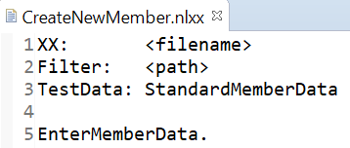
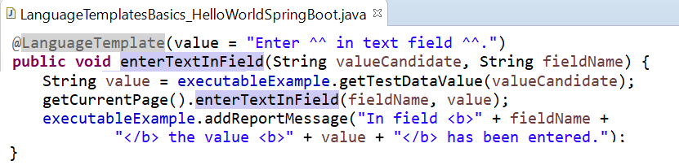
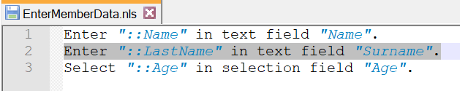
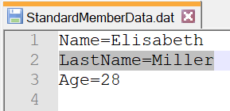
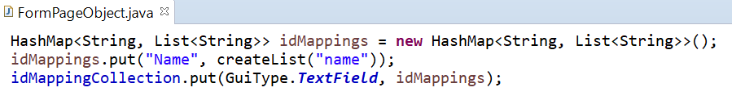
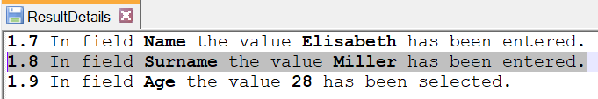
Domain User
Developer
SysNat
Executable
Example
required for phase 1
required for phase 2

Slide 22
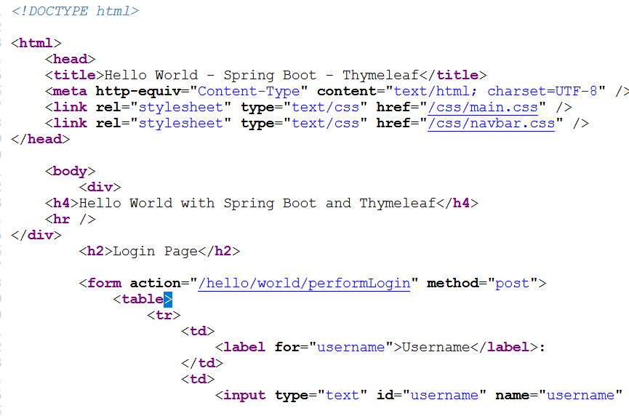
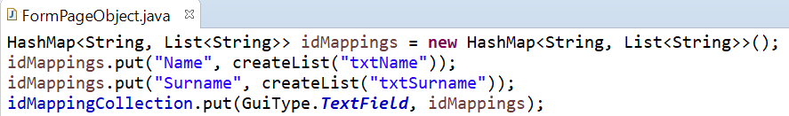
Executable
Example
1. Assure needed test data file is defined for import.
Import Data File
HTML code
Der Webseite
2. Provide new test data as key-value-pairs in data file.
Natural Language
Script
3. Tell which value key is to be used in which way with which field.
4. Give information where to find the field in the GUI.
PageObject

Slide 23
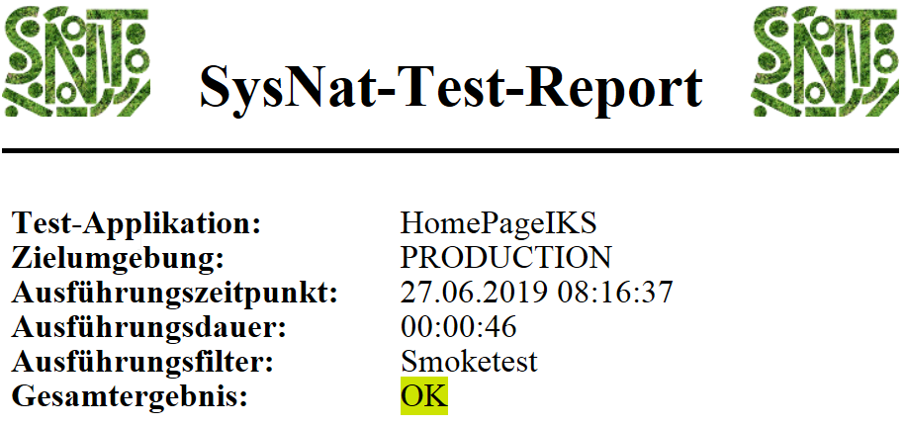

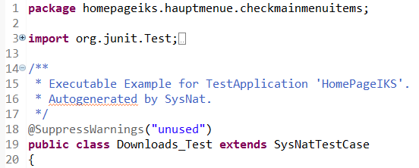
Test Results
starts
creates by being executed
generates
SysNatTestCaseGenerator
JUnit-Java-Code

Slide 24

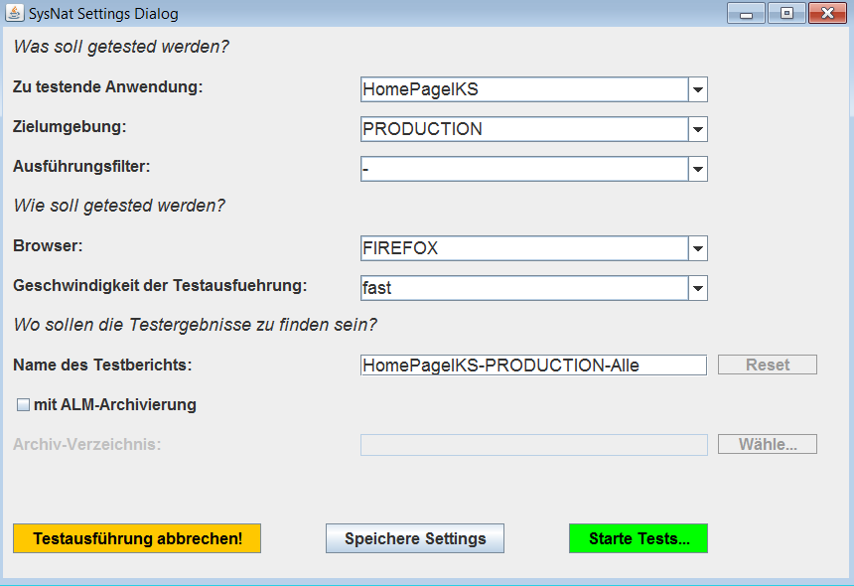



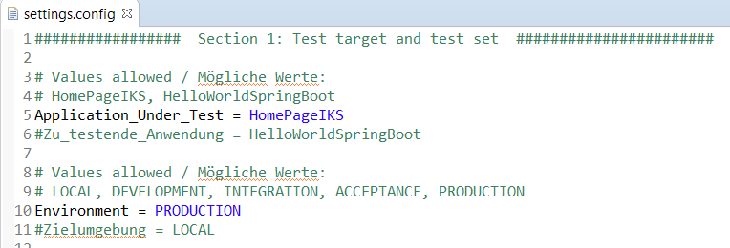
Test
Application
Used in combination with geckodriver to control web applications
opens
2.2 creates
starts
2.1 calls
b) uses
to execute
a) uses
to compile
SettingConfigDialogue
SysNatTesting
1.1 reads
1.2 generates
JUnit-Java-Code

Slide 25
System Tests
Integration Tests
Unit Tests

Slide 26
for
Development
for
Business
For QA
continuously
tested by
Automated
Tests
for
Operation
Executable
Examples
get
executed
System Documentation
illustrate progress of
implementation of
get combined and
converted to
Documentation
of Requirements
XX change
purpose between

Slide 27
XX: Create Order
Testdaten: StandardOrderData
Test-Phase: Arrange
The Standard-User is logged in.
Test-Phase: Act
A new order is created.
Test-Phase: Assert
The order overview contains the new order.
references a value from
Script: A new order is created
Click button “New Order“.
Enter in fields “Order Type“ value “::type“.
Enter…
calls
Descriptive High-Level-XX-Formulation
Contains the essential business aspect
Imperative Low-Level-Formulation
contains all necessary technical details

Slide 28
XX-Tool
Test-Application
Test Data Import
Graphical
User
Interface
Remote-Control
Natural Language
Test Execution
Webservices,
Rest, Soap….
Services
Communication
Document Validation
Database
Detailed Test Report
DB-Connection
Archiving

