Slide 1

Week 1 · Session 1
Foundations
Data pre-processing for reliable machine learning
ETRA
AI & Machine Learning Bootcamp

Slide 2
S01 · Big picture
Where Are We in the Bootcamp?
Build the end-to-end ML workflow: clean data → train → evaluate.
Week 1
Week 2
Week 3
Week 4
S1
Foundations & Preprocessing
S7
Deep Learning
S8
NLP Fundamentals
S14
Generative AI
S2
Regression Models
S9
Tokenization
S15
RAG Systems
S3
Classification Basics
S10
Text Analysis & NER
S16
MLOps
S4
Naive Bayes & Trees
S11
Language Modeling
S5
SVM & Kernels
S12
Embeddings & RNNs
S6
Clustering & PCA
S13
Seq2Seq & NMT
ETRA
02 / 62

Slide 3
Week 1 · Session 1
Foundations
Data Pre-Processing
Data Pre-Processing
Train/test splits
Feature scaling
Encoding & imputation
ETRA
03 / 62

Slide 4
S01 · Foundations
Data Pre-Processing
What we will cover in this session
–
Data Pre-Processing
–
Train/test splits
–
Feature scaling
–
Encoding & imputation
–
Data leakage
ETRA
04 / 62

Slide 5
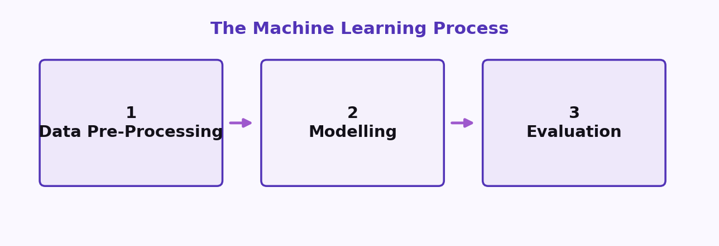
S01 · Foundations
The Machine Learning Process
The 3 main steps
Step 1 · Data Pre-Processing
Step 2 · Modelling
Step 3 · Evaluation
Load the data · Clean the data
Build the model · Train the model
Calculate performance metrics · Make a final prediction
ETRA
05 / 62

Slide 6
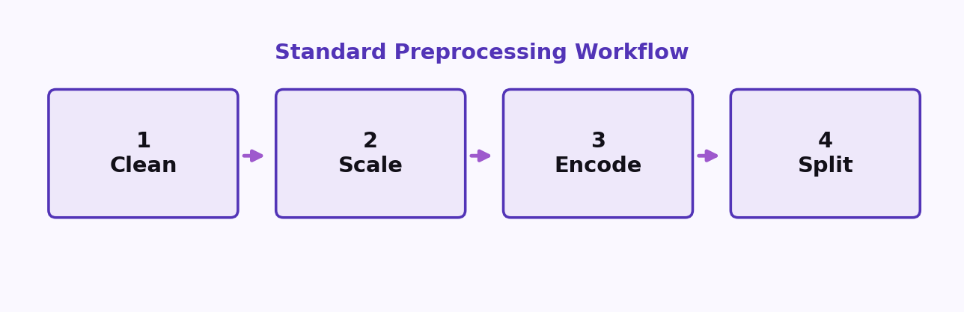
S01 · Foundations
Step 1: Data Pre-Processing
The Machine Learning Process
–
Load the data
–
Clean the data
–
Scale numeric features
–
Encode categorical features
–
Split into training and test sets
ETRA
06 / 62

Slide 7
S01 · Foundations
Step 2: Modelling
The Machine Learning Process
–
Build the model
–
Train the model
–
Make predictions
ETRA
07 / 62

Slide 8
S01 · Foundations
Step 3: Evaluation
The Machine Learning Process
–
Calculate performance metrics
–
Make a final prediction
ETRA
08 / 62

Slide 9
S01 · Foundations
Data Preprocessing Template
Standard Workflow
Clean → Scale → Encode → Split
Data preprocessing before modeling — a repeatable checklist before you train.
Start by loading the dataset, then follow the workflow in order.
ETRA
09 / 62

Slide 10
S01 · Foundations
Standard Workflow
Data Preprocessing Template
Data preprocessing before modeling
1. Clean
2. Scale
3. Encode
4. Split
Handle missing values, errors, and noise.
Normalize or standardize numeric features.
Turn categories into numeric representations.
Separate training and test data.
ETRA
10 / 62

Slide 11
S01 · Foundations
Workflow Checklist
Data Preprocessing Template
–
Load the dataset.
–
Clean — fix missing values, duplicates, and inconsistent records.
–
Scale — put numeric features on a comparable range.
–
Encode — convert categorical variables into model-ready form.
–
Split — create train/test sets before fitting the model.
ETRA
11 / 62

Slide 12
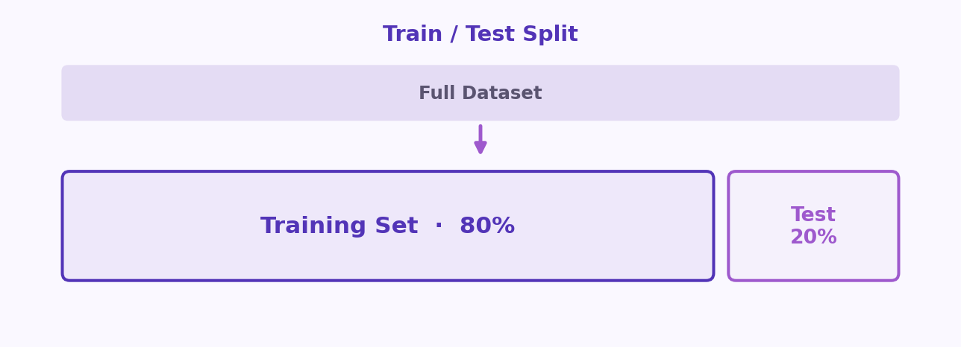
S01 · Foundations
Training Set and Test Set
Key Idea
Hold-out partition — train wide, test narrow
Typical split: 80% train · 20% test
ETRA
12 / 62

Slide 13
S01 · Foundations
Training Set and Test Set
Definitions
–
Never tune hyperparameters on the test set — it becomes part of training indirectly.
–
Stratified splits preserve class balance in classification tasks.
–
We train on one part of the data, then test on another part to make sure the model generalizes well.
ETRA
13 / 62

Slide 14
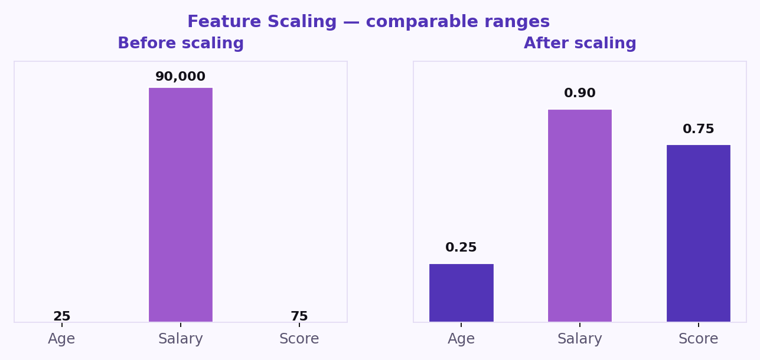
S01 · Foundations
Feature Scaling
What is Feature Scaling?
Feature scaling means adjusting feature values to a similar range using methods like standardization and normalization.
ETRA
14 / 62

Slide 15
S01 · Foundations
Feature Scaling
Why it matters
–
It prevents large-value features from dominating smaller-value features.
–
It improves performance for distance-based and gradient-based algorithms (e.g., KNN, SVM, Gradient Descent).
–
It helps training converge faster.
ETRA
15 / 62

Slide 16
S01 · Foundations
Example (Before vs After Scaling)
Worked example
Student | Height (cm) | Weight (kg) | Height (scaled) | Weight (scaled)
A | 150 | 50 | 0.25 | 0.22
B | 170 | 70 | 0.58 | 0.67
C | 185 | 85 | 0.83 | 1.00
Before scaling, height and weight have different numeric ranges. After scaling, both features are on a comparable scale and contribute more fairly.
ETRA
16 / 62

Slide 17
S01 · Foundations
Feature Scaling Methods
Feature Scaling
Comparable range
After scaling
Features brought to a comparable range.
Heights are comparable.
Normalization
Scales to [0, 1] using min–max — sensitive to outliers.
Standardization
Uses mean 0 and std 1 — preferred when features are roughly Gaussian.
Robust scaling
Uses median and IQR when outliers dominate.
ETRA
17 / 62

Slide 18
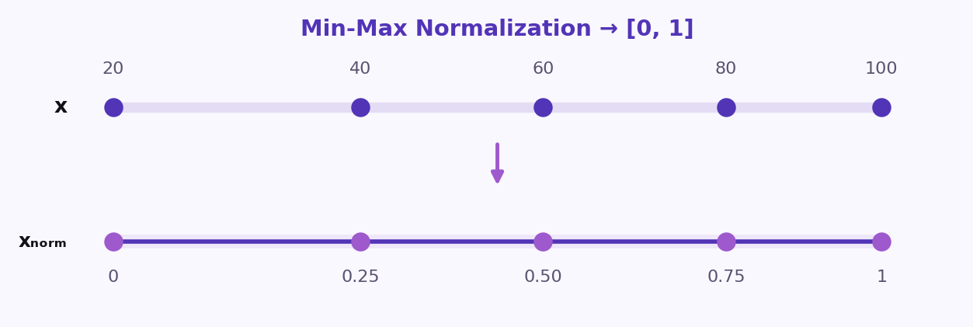
S01 · Foundations
1) Normalization (Min-Max Scaling)
Feature Scaling Methods
Normalization transforms each value to a range between 0 and 1.
Formula
x_{norm} =
x − x_{min}
x_{max} − x_{min}
–
Useful for models that depend on distances or absolute magnitudes.
–
Common choice for algorithms such as KNN and K-Means.
ETRA
18 / 62

Slide 19
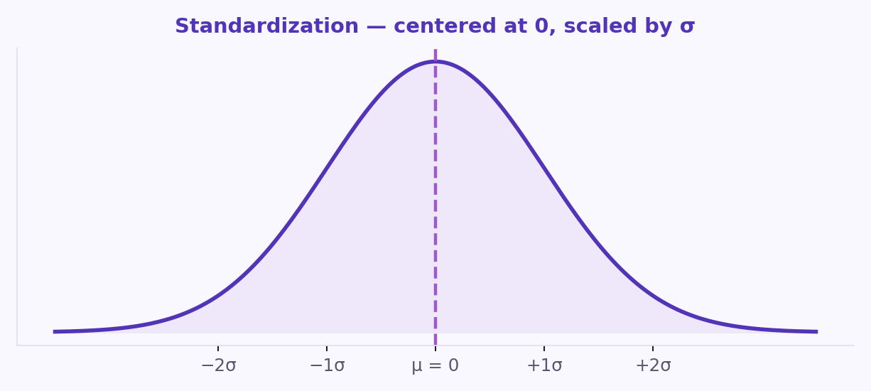
S01 · Foundations
2) Standardization (Z-score Scaling)
Feature Scaling Methods
Standardization centers data around 0 with a standard deviation of 1.
Formula
z =
x − μ
σ
–
Preferred when features are close to a Gaussian distribution.
–
Works well with Logistic Regression, SVM, and Linear Regression.
ETRA
19 / 62

Slide 20
S01 · Foundations
Choosing the Right Scaling Method
Practical guidance
–
Use standardization for SVM, logistic regression, PCA, and gradient-based training.
–
Tree-based models are scale-invariant — scaling is optional.
–
When in doubt, fit the scaler on train only, then transform train and test.
Normalization
Use Normalization when feature values have very different ranges and you want all values mapped to [0, 1].
Typical method: Min-Max Scaling.
ETRA
20 / 62

Slide 21
S01 · Foundations
Normalization vs Standardization
When to use each
Normalization
Standardization
Good for distance-based models where magnitude differences strongly affect results.
Use when features are expected to follow (or be close to) a Gaussian distribution, or when the dataset contains outliers.
Maps values to [0, 1] · typical method: Min-Max Scaling.
Keeps data centered around 0 and scales variability to 1.
–
Often preferred for linear models and optimization-based algorithms.
ETRA
21 / 62

Slide 22
S01 · Foundations
Feature Scaling Example (Normalization)
Worked example
Given feature values: [20, 40, 60, 80, 100]
Comparable range
After scaling
Features brought to a comparable range.
Heights are comparable.
x_{norm} =
x − x_{min}
x_{max} − x_{min}
x_{min} = 20 · x_{max} = 100
20
40
60
80
100
0.00
0.25
0.50
0.75
1.00
ETRA
22 / 62

Slide 23
S01 · Foundations
Before vs After Normalization
Feature Scaling Example
x_{norm} =
x − x_{min}
x_{max} − x_{min}
x_{min} = 20 · x_{max} = 100
Original value (x) | Normalized value (xₙₒᵣₘ)
20 | 0.00
40 | 0.25
60 | 0.50
80 | 0.75
100 | 1.00
This table shows how all values are scaled to the range [0, 1].
ETRA
23 / 62

Slide 24
S01 · Foundations
Feature Scaling Example (Standardization)
Worked example
Given feature values: [20, 40, 60, 80, 100]
Comparable range
After scaling
Features brought to a comparable range.
Heights are comparable.
z =
x − μ
σ
Mean: μ = 60 · Standard deviation: σ = 28.28
20
40
60
80
100
−1.41
−0.71
0.00
0.71
1.41
ETRA
24 / 62

Slide 25
S01 · Foundations
Before vs After Standardization
Feature Scaling Example
z =
x − μ
σ
Mean: μ = 60 · Standard deviation: σ = 28.28
Original value (x) | Standardized value (z)
20 | −1.41
40 | −0.71
60 | 0.00
80 | 0.71
100 | 1.41
This table shows that standardized values are centered around 0 and measured in units of standard deviation.
ETRA
25 / 62

Slide 26
S01 · Foundations
Categorical Data
What is Categorical Data?
Categorical data describes values that belong to named groups rather than continuous numbers.
ETRA
26 / 62

Slide 27
S01 · Foundations
Category Types
Ordinal vs Nominal
Type | Description | Example
Ordinal | Categories have a meaningful order. | Education Level: High School < Bachelor's < Master's < PhD
Nominal | Categories have no natural order. | Payment Method: Cash, Card, Bank Transfer
Choose encoding based on whether order matters.
ETRA
27 / 62

Slide 28
S01 · Foundations
Example 1: Label Encoding
Encoding categorical data
Raw category | Encoded value
Cash | 0
Card | 1
Bank Transfer | 2
Each category is mapped to a unique integer.
ETRA
28 / 62

Slide 29
S01 · Foundations
Example 2: One-Hot Encoding
Encoding categorical data
Raw category | Cash | Card | Bank Transfer
Cash | 1 | 0 | 0
Card | 0 | 1 | 0
Bank Transfer | 0 | 0 | 1
Most machine learning algorithms work with numerical inputs only, so categorical values must be converted into numbers.
ETRA
29 / 62

Slide 30
S01 · Foundations
How to Deal with Categorical Data (Ordinal Encoding)
What is Ordinal Encoding?
Ordinal Encoding converts ordered categories into integers that preserve their ranking.
ETRA
30 / 62

Slide 31
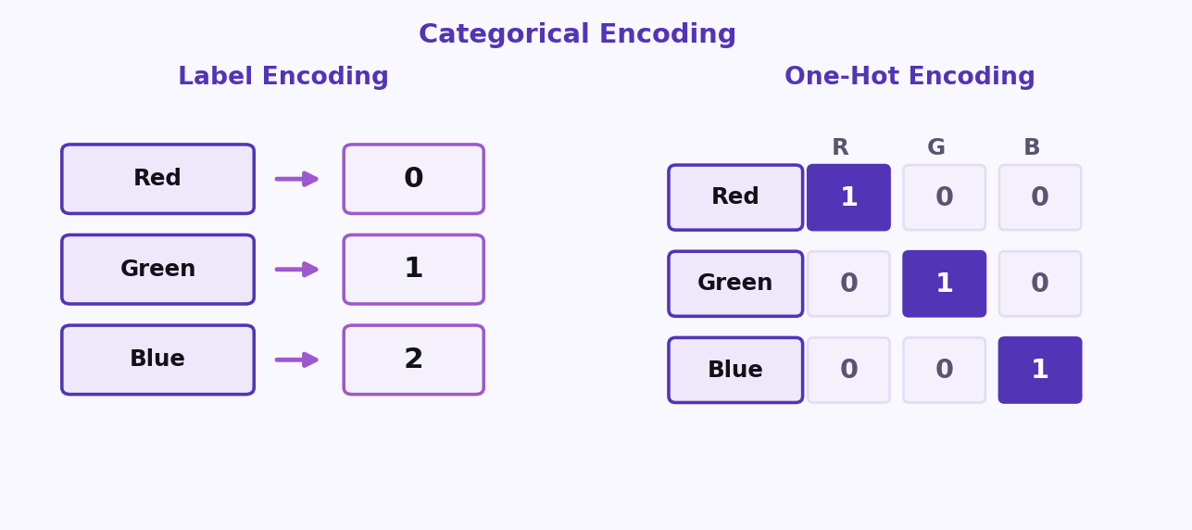
S01 · Foundations
Encoding Comparison
Choosing an encoding
Three ways to encode categorical variables
Label Encoding · One-Hot Encoding · Ordinal Encoding
ETRA
31 / 62

Slide 32
S01 · Foundations
How to Apply Ordinal Encoding
Practical steps
Use Ordinal Encoding only when categories have a true order.
–
Step 1: Identify the correct category order.
–
Step 2: Assign an integer to each level based on that order.
–
Step 3: Replace the original text values with encoded numbers.
ETRA
32 / 62

Slide 33
S01 · Foundations
Example: Ordinal Encoding
Ordinal Encoding
Satisfaction level | Encoded value
Low | 1
Medium | 2
High | 3
This method keeps the order information, which is important for many machine learning models.
ETRA
33 / 62

Slide 34
S01 · Foundations
How to Deal with Categorical Data (One-Hot Encoding)
What is One-Hot Encoding?
One-Hot Encoding converts each category into a separate binary column (0 or 1).
ETRA
34 / 62

Slide 35
S01 · Foundations
How to Apply One-Hot Encoding
Practical steps
Use One-Hot Encoding for nominal categories (no natural order).
–
Step 1: List all unique categories.
–
Step 2: Create one column for each category.
–
Step 3: Put 1 in the matching category column and 0 in all others.
ETRA
35 / 62

Slide 36
S01 · Foundations
Example: One-Hot Encoding
One-Hot Encoding
Payment method | Cash | Card | Bank Transfer
Cash | 1 | 0 | 0
Card | 0 | 1 | 0
Bank Transfer | 0 | 0 | 1
This method avoids creating a false ranking between categories.
ETRA
36 / 62

Slide 37
S01 · Foundations
Avoiding the Dummy Variable Trap
One-Hot Encoding
It helps prevent the dummy variable trap (perfect multicollinearity), especially in linear models.
–
Step 1: Start with One-Hot encoded columns.
–
Step 2: Drop one category as a reference (baseline).
–
Step 3: Keep the remaining binary columns.
Original categories: Payment Method = [Cash, Card, Bank Transfer]. · Reference category (dropped): Cash.
ETRA
37 / 62

Slide 38
S01 · Foundations
Example (Reference = Cash)
Dummy variable trap
Payment method | Card | Bank Transfer
Cash | 0 | 0
Card | 1 | 0
Bank Transfer | 0 | 1
In this setup, Cash is represented when all remaining columns are 0.
ETRA
38 / 62

Slide 39
S01 · Foundations
Encoding Methods Overview
Beyond label / one-hot / ordinal
Encoding type | Idea | Best use case
Frequency Encoding | Replace each category with how often it appears. | Large datasets with many categories
Count Encoding | Similar to frequency, but uses raw counts directly. | Tree-based models with high-cardinality features
Target Encoding | Replace category with target mean for that category. | Supervised tasks (use with care to avoid leakage)
Binary Encoding | Convert category index to binary digits across columns. | High-cardinality data with fewer columns than one-hot
Hash Encoding | Use a hash function to map categories into fixed columns. | Very large and dynamic category sets
ETRA
39 / 62

Slide 40
S01 · Foundations
1) Frequency Encoding (City)
Encoding methods
City | Frequency
Riyadh | 0.50
Jeddah | 0.33
Dammam | 0.17
ETRA
40 / 62

Slide 41
S01 · Foundations
2) Count Encoding (City)
Encoding methods
City | Count
Riyadh | 3
Jeddah | 2
Dammam | 1
ETRA
41 / 62

Slide 42
S01 · Foundations
3) Target Encoding (City)
Encoding methods
City | Mean target
Riyadh | 0.80
Jeddah | 0.40
Dammam | 0.20
ETRA
42 / 62

Slide 43
S01 · Foundations
4) Binary Encoding (City)
Encoding methods
City | Category ID | Binary code
Riyadh | 1 | 01
Jeddah | 2 | 10
Dammam | 3 | 11
ETRA
43 / 62

Slide 44
S01 · Foundations
5) Hash Encoding (4 Buckets)
Encoding methods
City | Hash bucket
Riyadh | 2
Jeddah | 0
Dammam | 3
ETRA
44 / 62

Slide 45
S01 · Foundations
Handling Missing Data
What is Missing Data?
Missing data refers to values that are absent or incomplete in one or more features of a dataset.
–
It can introduce bias into model training.
–
It may reduce prediction accuracy.
–
It can cause errors in analysis if not handled properly.
ETRA
45 / 62

Slide 46
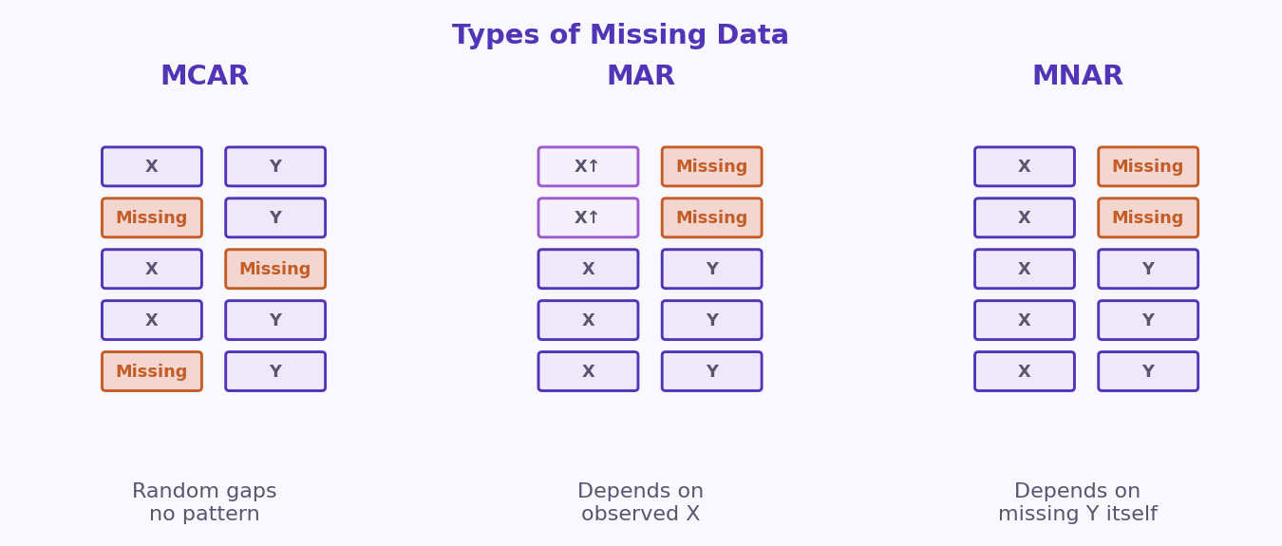
S01 · Foundations
Types of Missing Data
MCAR · MAR · MNAR
MCAR = random · MAR = explained by observed features · MNAR = tied to the missing value itself.
ETRA
46 / 62

Slide 47
S01 · Foundations
Why Do We Have Missing Data?
Handling Missing Data
Missing values can appear for many practical reasons during data collection and processing.
ETRA
47 / 62

Slide 48
S01 · Foundations
Common Causes
Why values go missing
Cause | Description | Example
Human Error | Data is skipped, entered incorrectly, or forgotten. | A user leaves the Age field empty in a form.
Device/Sensor Failure | Measurement tools fail or disconnect. | A medical sensor stops recording heart rate temporarily.
Data Integration Issues | Missing fields appear when combining data from multiple sources. | One database has salary, another does not.
Privacy or Refusal | Participants choose not to share sensitive information. | A customer does not provide income details.
System/Transmission Errors | Data is lost during storage, transfer, or export. | Network interruption causes missing rows in logs.
Conditional Missingness | Some fields are only relevant for specific groups. | Pregnancy_Status is empty for male patients.
Understanding why data is missing helps us choose the right treatment method (deletion, imputation, or advanced modeling).
ETRA
48 / 62

Slide 49
S01 · Foundations
Missing Completely at Random (MCAR)
Handling Missing Data · MCAR
MCAR means missing values occur randomly and are independent of both observed and unobserved variables.
–
MCAR has no systematic pattern.
–
In practice, MCAR is often an unrealistic assumption in real-world datasets.
–
Before assuming MCAR, review data collection workflow and consult domain experts.
–
If MCAR is reasonable, simple imputation (mean/median/mode) can work.
ETRA
49 / 62

Slide 50
S01 · Foundations
Illustrative Data Example
Handling Missing Data · MCAR
Student ID | Age | Score
101 | 20 | 85
102 | Missing | 88
103 | 21 | Missing
104 | 23 | 91
105 | Missing | 76
106 | 22 | Missing
Missing values appear across different rows and columns with no clear pattern, which is consistent with MCAR.
ETRA
50 / 62

Slide 51
S01 · Foundations
Missing at Random (MAR)
Handling Missing Data · MAR
MAR means missingness is related to observed features in the dataset, but not to the missing feature itself.
–
Missingness depends on other observed variables.
–
The missing value itself is not the direct cause of the gap.
–
More realistic than MCAR in many real-world datasets.
–
Model-based imputation that uses observed features usually works better than simple mean/median fills.
ETRA
51 / 62

Slide 52
S01 · Foundations
Imputation Techniques for MAR
Handling Missing Data · MAR
Method | Idea | Why it works for MAR
kNN Imputation | Fills missing values using the nearest similar records. | Uses observed features to find similar patterns.
MissForest | Uses random-forest models iteratively to predict missing values. | Captures non-linear relationships from observed data effectively.
Both methods leverage observed features — exactly what MAR assumes is available and informative.
ETRA
52 / 62

Slide 53
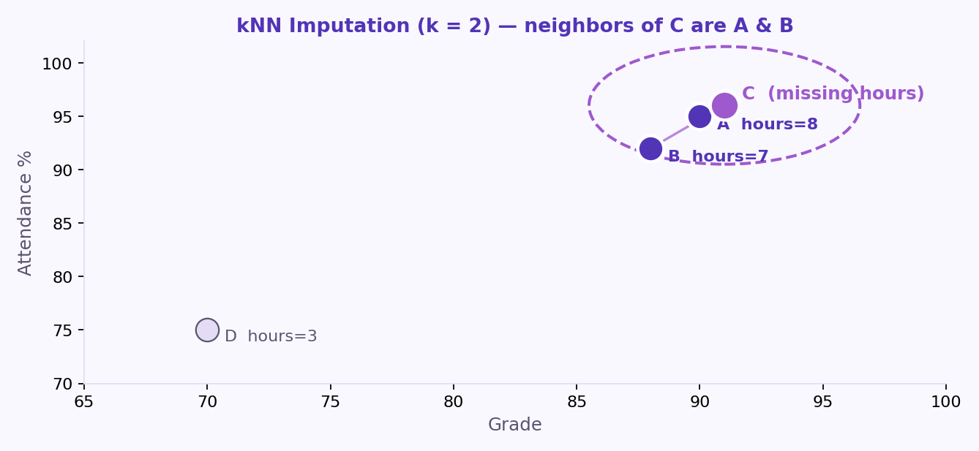
S01 · Foundations
kNN Imputation (k = 2)
Handling Missing Data · MAR
For student C, the two nearest students based on Grade and Attendance are A and B.
–
Use observed features (Grade, Attendance) to find the nearest neighbors.
–
Impute student C’s missing value from students A and B (e.g. average).
ETRA
53 / 62

Slide 54
S01 · Foundations
kNN Neighbor Table
Handling Missing Data · MAR
Student | Grade | Attendance (%) | Study Hours
A | 90 | 95 | 8
B | 88 | 92 | 7
C | 91 | 96 | Missing
D | 70 | 75 | 3
Student C is closest to A and B on Grade and Attendance — so we ignore distant student D.
ETRA
54 / 62

Slide 55
S01 · Foundations
kNN Imputed Result
Handling Missing Data · MAR
Study Hours_{C} = (8 + 7) / 2 = 7.5
Average the Study Hours of the two nearest neighbors (A and B) to fill the missing value for student C.
–
Neighbor A → Study Hours = 8
–
Neighbor B → Study Hours = 7
–
Imputed value for C → 7.5
ETRA
55 / 62

Slide 56
S01 · Foundations
Example: MissForest
Handling Missing Data · MAR
MissForest trains a Random Forest model using known rows to predict the missing value for student C.
–
Treat the incomplete column (Study Hours) as the target.
–
Train on complete rows (A, B, D) using observed features such as Grade and Attendance.
–
Predict Study Hours for student C from the learned non-linear relationships.
–
Iterate across features with missing values until predictions stabilize.
ETRA
56 / 62

Slide 57
S01 · Foundations
MissForest Result
Handling Missing Data · MAR
Study Hours_{C} ≈ 7.6
The Random Forest prediction for student C’s missing Study Hours is approximately 7.6.
–
Uses non-linear patterns learned from complete rows.
–
Often more accurate than simple neighbor averages when relationships are complex.
ETRA
57 / 62

Slide 58
S01 · Foundations
Example: MAR Grades Table
Handling Missing Data · MAR
Student | Grade (Observed) | Study Hours
1 | 95 | Missing
2 | 92 | Missing
3 | 88 | 4
4 | 75 | 6
5 | 70 | 7
MAR is common in practice because missingness can often be explained by available variables.
ETRA
58 / 62

Slide 59
S01 · Foundations
Missing Not at Random (MNAR)
Handling Missing Data · MNAR
MNAR is usually the most complex type because missingness depends on the missing value itself or unobserved variables.
–
MNAR has a systematic pattern tied to hidden information.
–
Standard imputation can be unreliable without additional data or strong domain assumptions.
–
Often needs specialized models, sensitivity analysis, or collecting the missing information directly.
–
Before treating MNAR like MAR/MCAR, validate the missingness mechanism with domain experts.
ETRA
59 / 62

Slide 60
S01 · Foundations
Example: MNAR Stress Reports
Handling Missing Data · MNAR
Participant | Reported Stress Level
1 | 2
2 | Missing
3 | 3
4 | Missing
5 | 1
Missing stress reports may be tied to the stress level itself — people with higher stress may skip the question.
ETRA
60 / 62

Slide 61
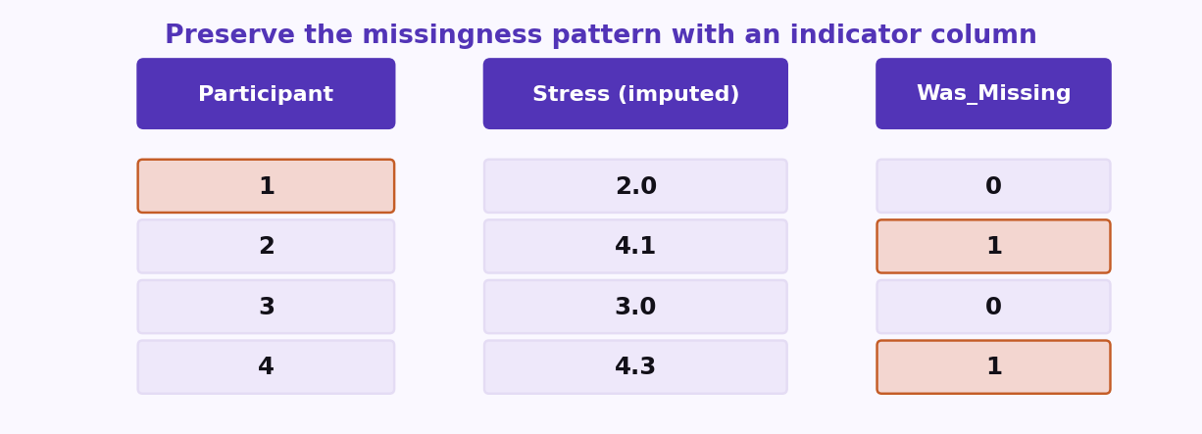
S01 · Foundations
Practical Tip: Preserve Missingness Pattern
Handling Missing Data · MNAR
Add an indicator column so the model can still learn from the fact that a value was missing.
ETRA
61 / 62

Slide 62
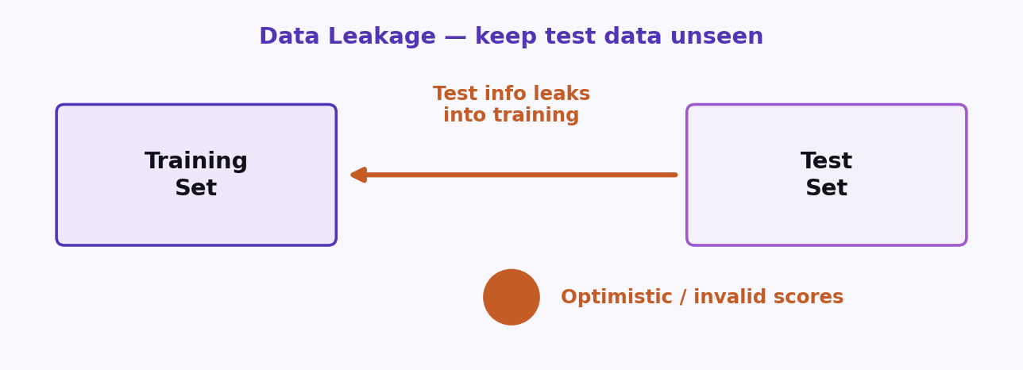
S01 · Foundations
Data Leakage
Keep the test set unseen
Data leakage happens when information from outside the training process — especially the test set — influences model fitting or decisions.
–
Never use test labels or test-only signals when choosing features, models, or hyperparameters.
–
Fit scalers and encoders on the training set only, then transform train and test.
Rule: treat the test set as future data you have not seen yet.
–
Peeking at the test set creates optimistic scores that will not hold in production.
ETRA
62 / 62

Slide 63
Week 1 · Session 2
Regression Models
From linear fits to regularized models
ETRA
AI & Machine Learning Bootcamp

Slide 64
S02 · Big picture
Where Are We in the Bootcamp?
After preprocessing — learn models that predict continuous targets.
Week 1
Week 2
Week 3
Week 4
S1
Foundations & Preprocessing
S7
Deep Learning
S8
NLP Fundamentals
S14
Generative AI
S2
Regression Models
S9
Tokenization
S15
RAG Systems
S3
Classification Basics
S10
Text Analysis & NER
S16
MLOps
S4
Naive Bayes & Trees
S11
Language Modeling
S5
SVM & Kernels
S12
Embeddings & RNNs
S6
Clustering & PCA
S13
Seq2Seq & NMT
ETRA
02 / 79

Slide 65
Week 1 · Session 2
Regression Models
Regression Models
Linear regression
OLS & R²
Residual diagnostics
Polynomial regression
ETRA
03 / 79

Slide 66
S02 · Regression Models
Regression Models
What we will cover in this session
–
Linear regression
–
OLS & R²
–
Residual diagnostics
–
Polynomial regression
–
SVR
–
Decision Tree
–
Random Forest
04 / 79

Slide 67
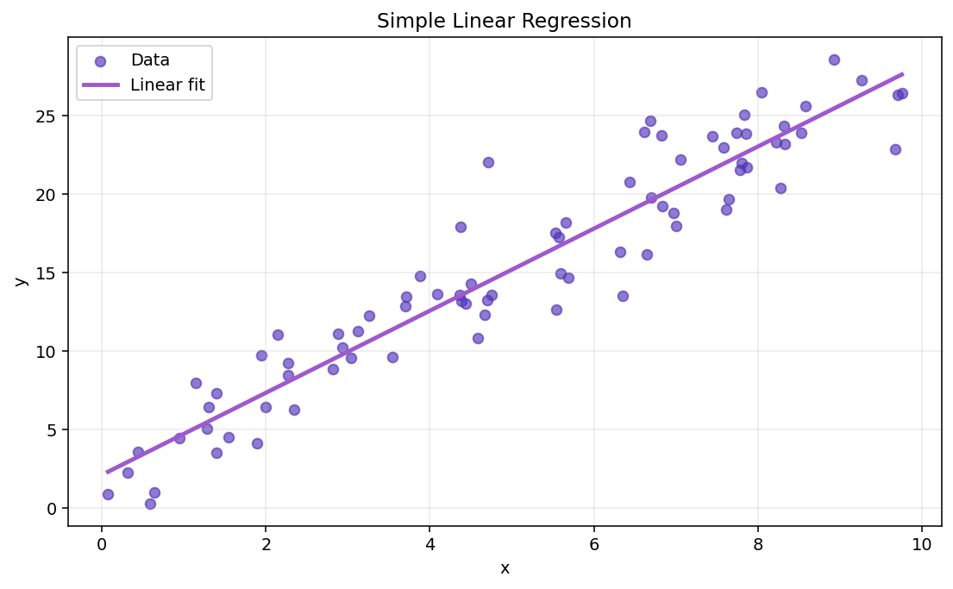
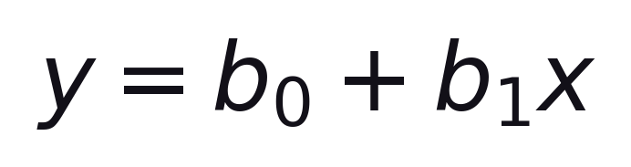
S02 · Regression Models
What is Simple Linear Regression?
Regression · Simple Linear Regression
Simple Linear Regression models the relationship between one independent variable x and one dependent variable y using a straight line.
Formula
b₀ = intercept (value of y when x = 0) · b₁ = slope (change in y per unit change in x)
–
x = input feature · y = target to predict
–
Finds the straight line that best fits the data.
One feature → one straight-line fit. Multiple features come next.
ETRA
05 / 79

Slide 68
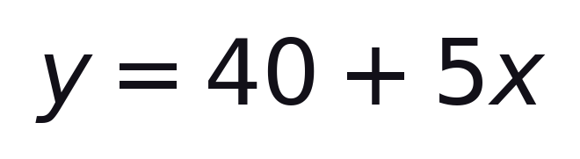
S02 · Regression Models
Practical Example
Simple Linear Regression
Suppose x = Hours of Study and y = Exam Score.
–
Slope b₁ = 5: +1 study hour → +5 score points.
–
Intercept b₀ = 40: score when hours = 0.
–
Example: 3 hours → ŷ = 40 + 5(3) = 55.
ETRA
06 / 79

Slide 69
S02 · Regression Models
Meaning of Each Symbol
Simple Linear Regression
Symbol | Meaning
y | Predicted output (dependent variable).
x | Input feature (independent variable).
b₀ | Intercept: predicted value of y when x = 0.
b₁ | Slope: expected change in y when x increases by 1 unit.
The regression line is the best-fit line that minimizes prediction errors.
ETRA
07 / 79

Slide 70
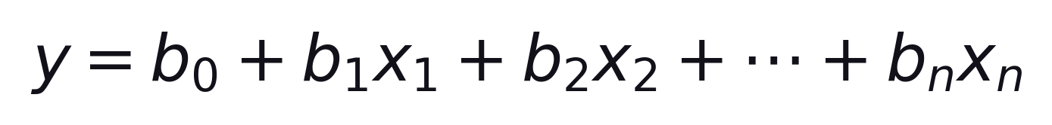
S02 · Regression Models
Multiple Linear Regression
Linear Regression · Multiple Features
Multiple Linear Regression describes the relationship between one dependent variable y and two or more independent variables.
Each bⱼ is the effect of feature xⱼ holding other features fixed.
–
Predict y from several inputs at once.
–
Still linear in the coefficients b₀ … bₙ.
OLS still minimizes the sum of squared residuals.
ETRA
08 / 79

Slide 71
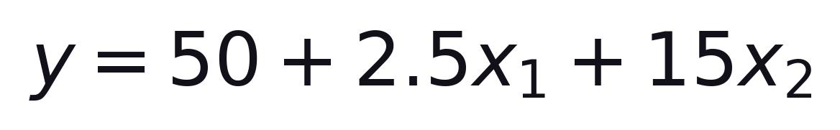
S02 · Regression Models
House Price Example
Multiple Linear Regression
Predict house price from size and bedrooms.
y = price · x₁ = size (m²) · x₂ = bedrooms
–
+1 m² → price +2.5 (other variables fixed).
–
+1 bedroom → price +15 (other variables fixed).
Interpret each coefficient holding other variables constant.
ETRA
09 / 79

Slide 72
S02 · Regression Models
House Price Calculations
Multiple Linear Regression · Example
House | Size x₁ (m²) | Bedrooms x₂ | Predicted price y ($1000)
A | 100 | 2 | 50 + 2.5(100) + 15(2) = 330
B | 120 | 3 | 50 + 2.5(120) + 15(3) = 395
C | 80 | 1 | 50 + 2.5(80) + 15(1) = 265
Same formula, different inputs → different predicted prices.
ETRA
10 / 79

Slide 73
S02 · Regression Models
What is OLS?
Ordinary Least Squares (OLS)
Ordinary Least Squares is the most common method to fit a linear regression line by minimizing prediction errors.
–
Chooses the line with the smallest total squared error.
–
Residual = actual y − predicted ŷ.
–
Simple linear case has a closed-form solution for b₀, b₁.
Smaller squared errors → better fit on the training data.
ETRA
11 / 79

Slide 74
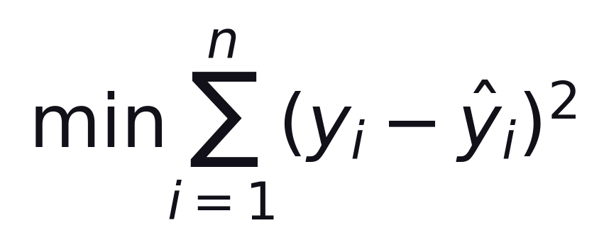
S02 · Regression Models
Sum of Squared Errors
Ordinary Least Squares (OLS)
OLS chooses parameters by minimizing the total squared difference between actual and predicted values.
Sum of squared residuals over all n training points
–
Actual value: yᵢ
–
Predicted value: ŷᵢ
–
Residual error: eᵢ = yᵢ − ŷᵢ
Squared errors make all errors positive, penalize large errors, and provide a clear optimization objective.
ETRA
12 / 79

Slide 75
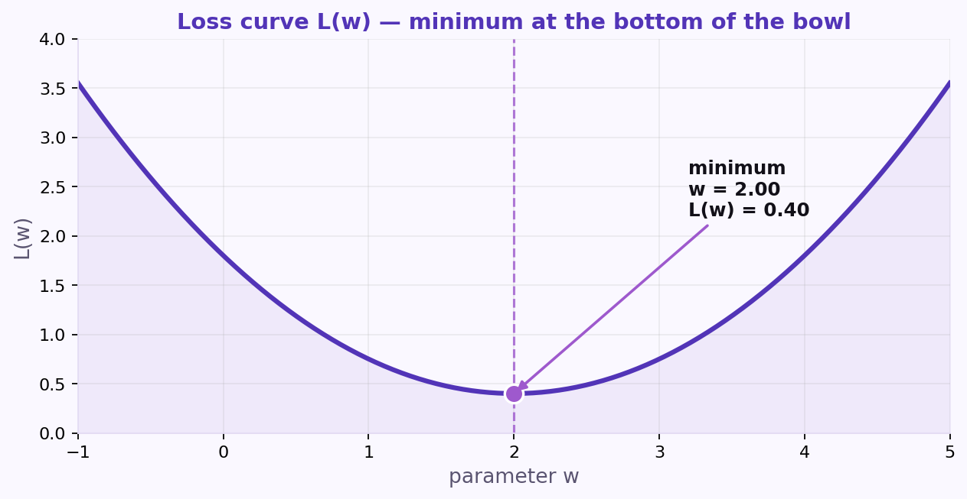
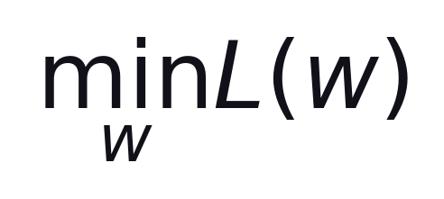
S02 · Regression Models
Gradient Descent
OLS · Optimization
Loss curve L(w) — minimum at the bottom of the bowl.
Formula
We search for the parameter w that makes the loss as small as possible.
–
Start with a guess for w, then move downhill.
–
Stop when updates become tiny (converged).
Converged: w = 2.00 · L(w) = 0.40
ETRA
13 / 79

Slide 76
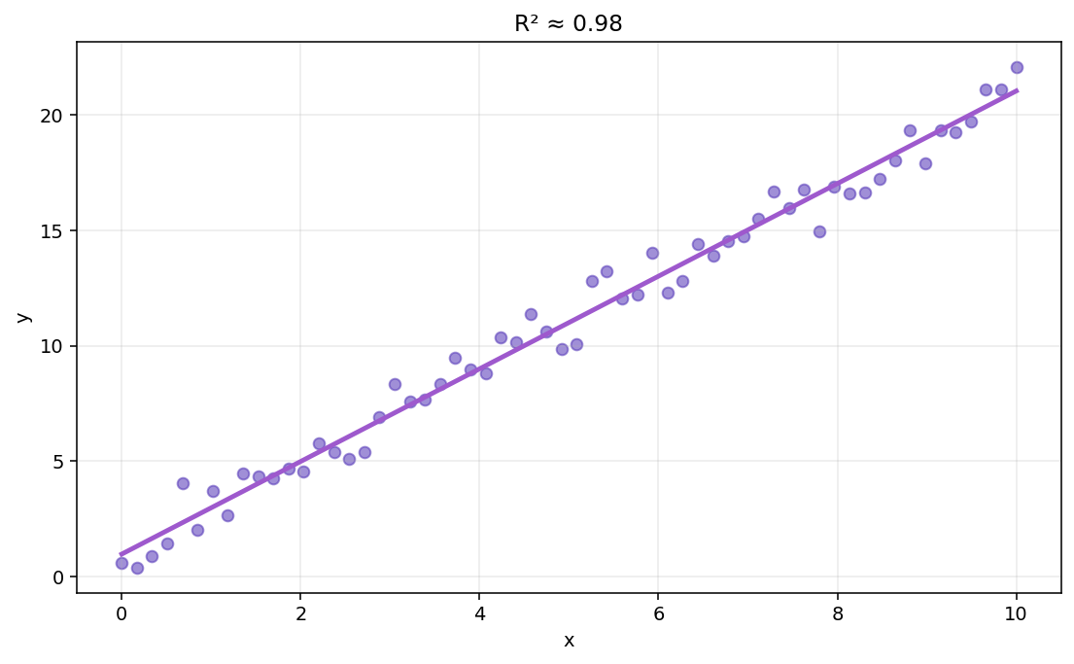
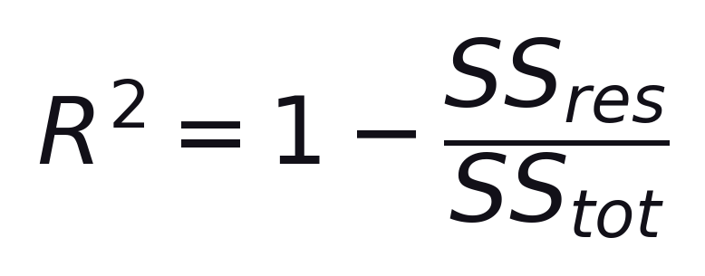
S02 · Regression Models
R-Squared (R²)
Goodness of Fit
R² measures how much variation in y is explained by the model inputs.
Formula
SS_res = residual SS · SS_tot = total SS
–
Near 1 → strong explanatory power.
–
Near 0 → little better than predicting the mean.
High R² on training data ≠ guaranteed good new-data predictions.
ETRA
14 / 79

Slide 77
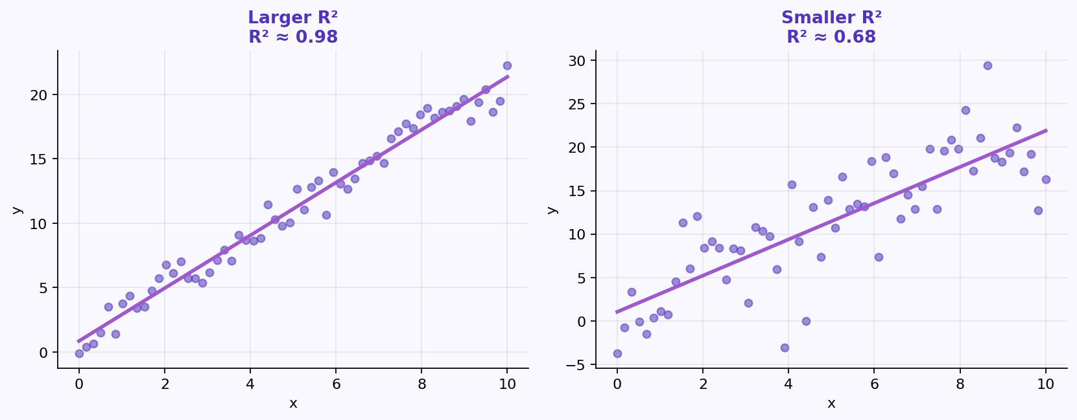
S02 · Regression Models
Interpreting R²
Goodness of Fit
Larger R² means more of the variation in y is captured by the model.
–
R² = 1 → perfect fit on that sample.
–
R² = 0 → mean-level baseline performance.
Validate generalization with hold-out metrics, not R² alone.
ETRA
15 / 79

Slide 78
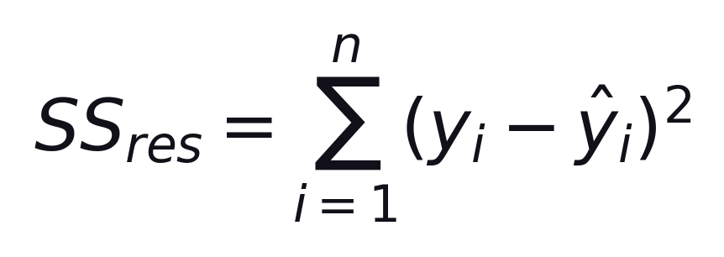
S02 · Regression Models
Residual Sum of Squares
R² · Building Blocks
SS_res measures the unexplained error — how far predictions are from the actual values.
Sum of squared residuals (prediction errors)
–
Smaller SS_res → predictions closer to the data.
–
Appears in the numerator of the R² formula.
ETRA
16 / 79

Slide 79
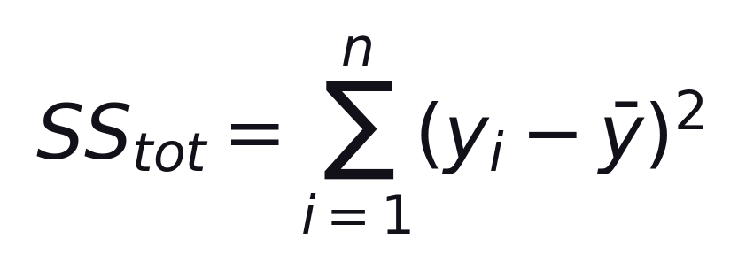
S02 · Regression Models
Total Sum of Squares
R² · Building Blocks
SS_tot measures the total variation in y around its mean — the baseline scatter to explain.
Sum of squared deviations from the mean ȳ
–
This is the variance (up to a constant factor) of the observed y values.
–
R² asks: what fraction of SS_tot is left unexplained by SS_res?
R² = 1 − SS_res / SS_tot · explained variation = SS_tot − SS_res
ETRA
17 / 79

Slide 80
S02 · Regression Models
What Do These Terms Mean?
R² · Building Blocks
Term | Description
SS_res | Residual Sum of Squares: squared distance between actual values and predictions.
SS_tot | Total Sum of Squares: squared distance between actual values and the mean of y.
R² compares unexplained error (SS_res) with total variation (SS_tot).
ETRA
18 / 79

Slide 81
S02 · Regression Models
Why R² Alone Is Not Enough
Adjusted R-Squared
In multiple regression, adding predictors often increases R² even when the new variables are not useful.
–
Ordinary R² never decreases when you add a predictor (it stays the same or goes up).
–
That can reward bloated models that fit noise instead of signal.
–
We need a metric that balances fit against model complexity.
Next: Adjusted R² applies a penalty for extra predictors.
ETRA
19 / 79

Slide 82
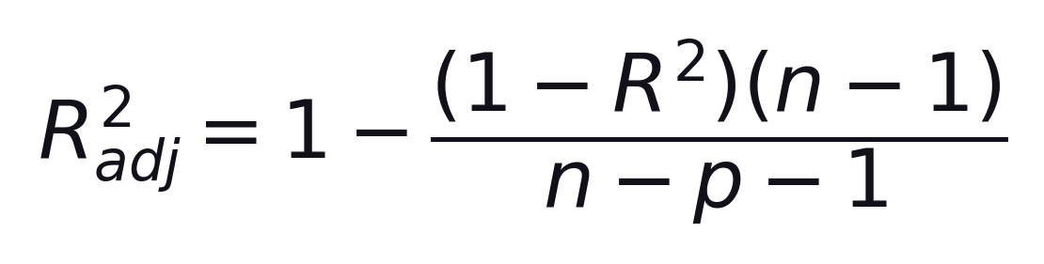
S02 · Regression Models
Adjusted R-Squared
Goodness of Fit · Model Comparison
Adjusted R² penalizes unnecessary predictors.
n = samples · p = predictors
–
Better for comparing models with different p.
–
Can fall when R² rises if the new variable is weak.
ETRA
20 / 79

Slide 83
S02 · Regression Models
Adjusted R² — Quick Example
Adjusted R-Squared
Model | Predictors | R² | Adjusted R² | Interpretation
A | x₁, x₂ | 0.82 | 0.81 | Strong and efficient model
B | x₁, x₂, x₃, x₄ | 0.83 | 0.79 | Higher R², but worse after penalty
Model B looks better by R², but Adjusted R² shows the extra variables are likely not helpful.
ETRA
21 / 79

Slide 84
S02 · Regression Models
Assumptions of Linear Regression
Overview
Assumption | Meaning | If Violated
Linearity | y vs each x is roughly linear | Biased predictions
Homoscedasticity | Error variance roughly constant | Unstable SEs
Normal Errors | Residuals ≈ normal | Weaker inference
Independence | Errors are independent | Biased tests
Low Multicollinearity | Predictors not highly redundant | Unstable coeffs
Limited Outliers | Extremes do not dominate fit | Distorted line
Next slides: practical checks and residual plots.
ETRA
22 / 79

Slide 85
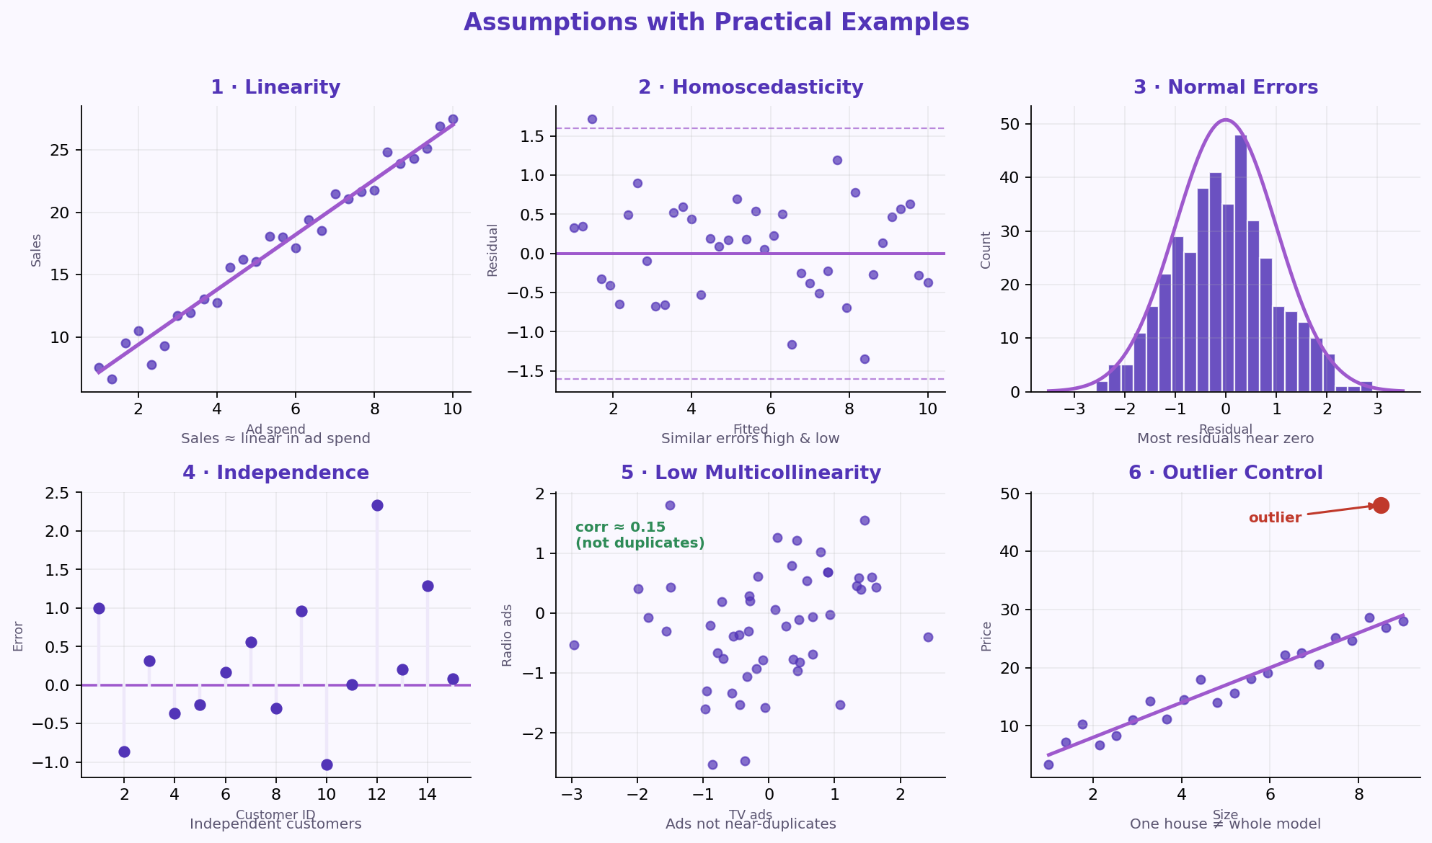
S02 · Regression Models
Assumptions with Practical Examples
Residual Diagnostics
Each panel shows a practical picture of one assumption — and what “good” looks like.
Checks: scatter/residuals · residuals vs fitted · histogram/Q-Q · design/DW · corr/VIF · Cook/leverage.
ETRA
23 / 79

Slide 86
S02 · Regression Models
Assumptions — Quick Reference
Practical Examples
Assumption | Example | Check
Linearity | Sales ≈ linear in ad spend | Scatter / residual plot
Homoscedasticity | Similar errors high & low | Residuals vs fitted
Normal Errors | Most residuals near zero | Histogram / Q-Q
Independence | Independent customers | Design / Durbin-Watson
Low Multicollinearity | Ads not near-duplicates | Corr / VIF
Outlier Control | One house ≠ whole model | Cook / leverage
If violated: transforms, robust methods, or another model.
ETRA
24 / 79

Slide 87
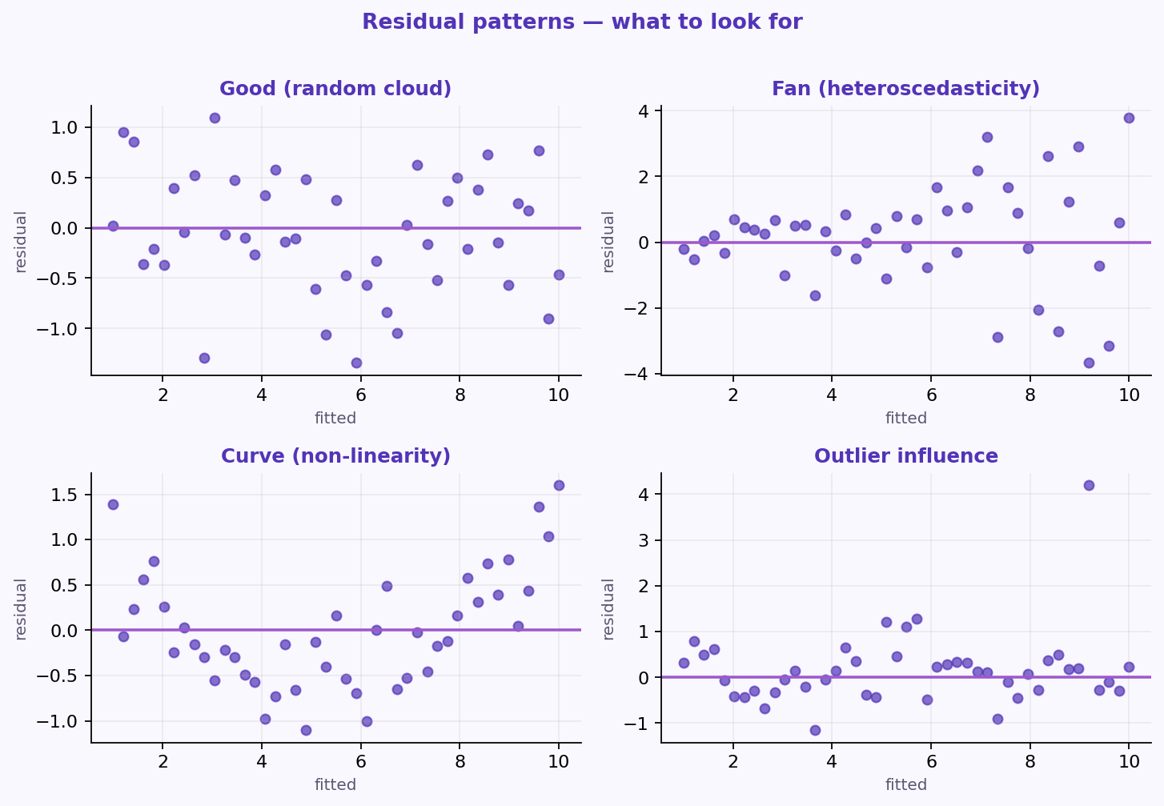
S02 · Regression Models
Residual Patterns to Spot
Assumption Checks
Common residual-plot signatures for assumption problems.
–
Good: random cloud around zero.
–
Fan / curve / outlier → investigate.
ETRA
25 / 79

Slide 88
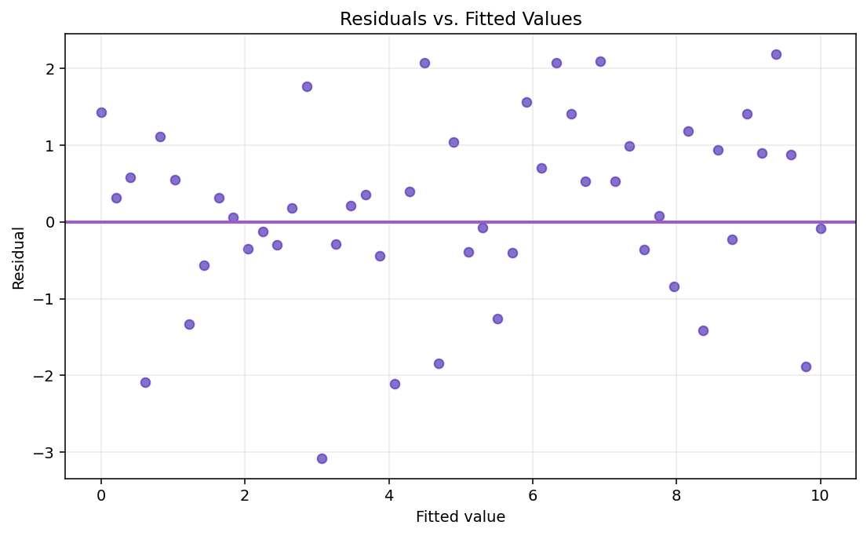
S02 · Regression Models
Residuals vs Fitted Values
Practical Check · Homoscedasticity
Look for random scatter around zero with roughly constant spread.
–
No curve → linearity looks OK.
–
Fan shape → possible heteroscedasticity.
ETRA
26 / 79

Slide 89
S02 · Regression Models
Building a Regression Model
Goal
Method | Core Idea | Best Use Case
All-in | Use all predictors | Strong prior knowledge
Backward | Start full, remove weakest | Many candidates
Forward | Start empty, add strongest | Compact model
Stepwise | Add and remove dynamically | Flexible search
Match the method to candidate count and prior knowledge.
ETRA
27 / 79

Slide 90
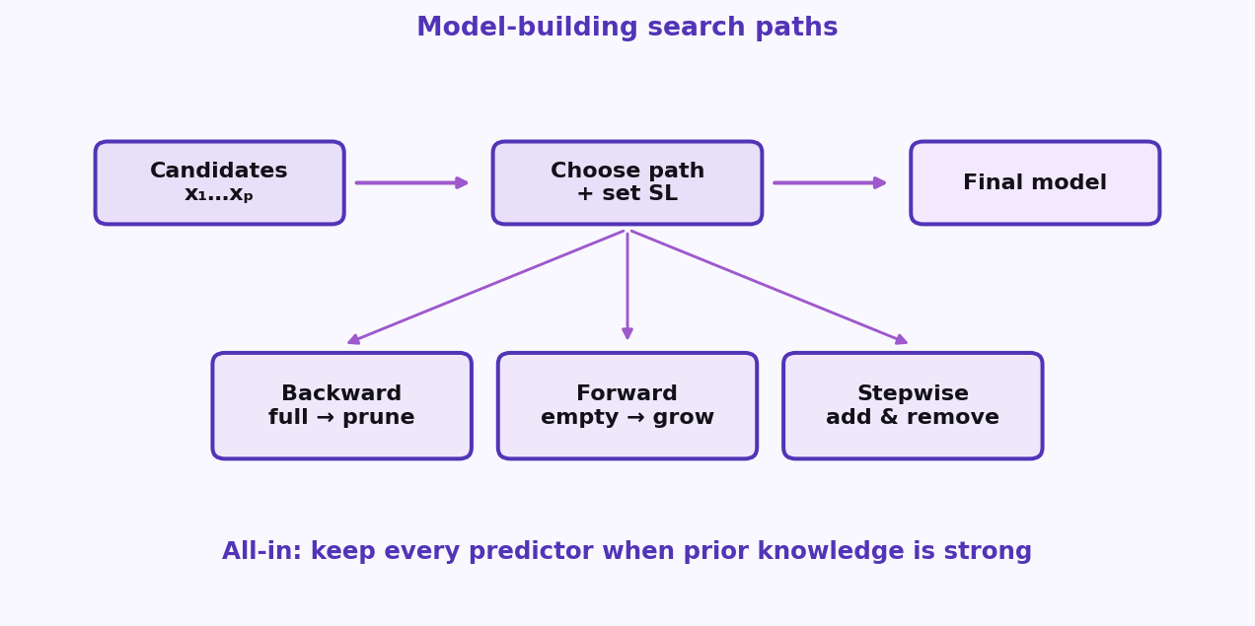
S02 · Regression Models
Model-Building Flow
All-in · Backward · Forward · Stepwise
Different search paths for choosing predictors under a significance level.
–
Backward: prune a full model.
–
Forward: grow from empty.
–
Stepwise: add and remove as you go.
ETRA
28 / 79

Slide 91
S02 · Regression Models
Backward Elimination
Model-Building Methods · Steps
Start full, then drop the least useful predictors one at a time.
–
Set SL (e.g. 0.05) and fit all predictors.
–
Remove highest p if p > SL; refit and repeat.
Best with many candidate predictors.
ETRA
29 / 79

Slide 92
S02 · Regression Models
Forward Selection
Model-Building Methods · Steps
Grow the model from scratch by adding the strongest predictors.
–
Start empty; add lowest p below SL.
–
Stop when no remaining variable qualifies.
Best when you want a compact model from the start.
ETRA
30 / 79

Slide 93
S02 · Regression Models
Bidirectional (Stepwise)
Model-Building Methods · Steps
Add and remove predictors dynamically each iteration.
–
Forward step: add significant variables.
–
Backward step: drop non-significant ones.
More adaptive than pure forward or backward alone.
ETRA
31 / 79

Slide 94
S02 · Regression Models
Mini Example — Backward Elimination
Model-Building Methods
Iteration | Candidate Predictors | Selected Action
Start | x₁, x₂, x₃, x₄ | Full model
1 | highest p-value: x₄ = 0.42 | Remove x₄
2 | highest p-value: x₃ = 0.11 | Remove x₃
Final | x₁, x₂ with p < 0.05 | Keep final model
With SL = 0.05, variables with p > SL are removed until only significant predictors remain.
ETRA
32 / 79

Slide 95
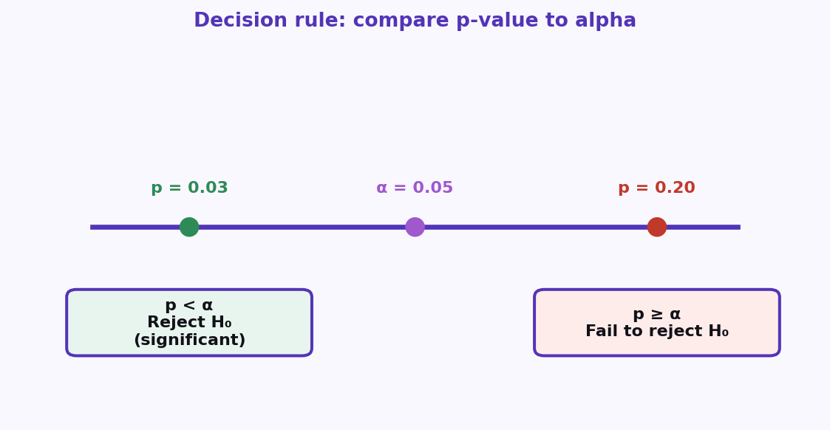
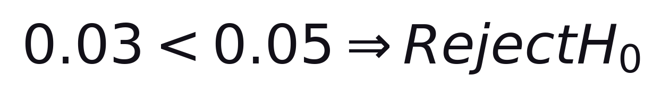
S02 · Regression Models
Significance Level and p-value
Model Selection · Decision Rule
Compare p to alpha to decide if a predictor is statistically significant.
Formula
Example: p = 0.03 · alpha = 0.05
–
p < alpha → reject H₀ (significant).
–
p ≥ alpha → fail to reject H₀.
Predictor is significant at the 5% level in this example.
ETRA
33 / 79

Slide 96
S02 · Regression Models
Key Concepts: H₀, p-value, Alpha
Significance Level and p-value
Concept | Meaning
Null Hypothesis (H₀) | No effect / no relationship
p-value | Probability of observing current result (or more extreme) if H₀ is true
Significance Level (alpha) | Maximum tolerated Type I error probability
In model building, predictors with p < alpha are kept as statistically significant.
ETRA
34 / 79

Slide 97

S02 · Regression Models
Why Is SL = 0.05 Common?
Standard Choice
SL = 0.05 balances sensitivity and false-positive risk.
95% confidence → SL = 0.05
–
Convention, not a law — adjust for domain risk.
–
Report effect size and CIs with p-values.
ETRA
35 / 79

Slide 98
S02 · Regression Models
SL vs Confidence Level
Why Is SL = 0.05 Common?
SL | Confidence Level | Strictness
0.10 | 90% | Less strict
0.05 | 95% | Standard
0.01 | 99% | More strict
Lower SL → higher confidence requirement → stricter evidence to keep a predictor.
ETRA
36 / 79

Slide 99
S02 · Regression Models
How to Choose in Practice
Significance Level
Scenario | Suggested SL
High-stakes decisions (medicine, safety, finance) | 0.01
General modeling and reporting | 0.05
Exploratory analysis | 0.10
Start with SL = 0.05, then adjust based on domain risk, dataset size, and model purpose.
ETRA
37 / 79

Slide 100
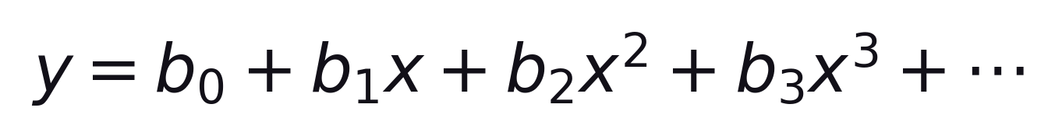
S02 · Regression Models
Polynomial Regression
Definition
Polynomial Regression extends linear regression to model non-linear relationships by adding polynomial terms.
Still linear in the coefficients
–
Adds polynomial terms to capture curves.
–
Still linear in parameters b₀, b₁, …
Transform x → x², x³, … then fit linear regression.
ETRA
38 / 79

Slide 101
S02 · Regression Models
Why Polynomial Regression?
Motivation
Many real-world relationships are curved — a straight line underfits them.
–
Population growth · disease progression
–
Sales trends · rainfall vs crop yield
ETRA
39 / 79

Slide 102
S02 · Regression Models
How Polynomial Regression Works
Polynomial Regression
Step | Description
1 | Start with input feature x
2 | Create transformed terms: x², x³, …
3 | Fit linear regression on transformed features
4 | Estimate coefficients (b₀, b₁, b₂, …)
5 | Use the fitted equation to predict y
d is the polynomial degree.
ETRA
40 / 79

Slide 103
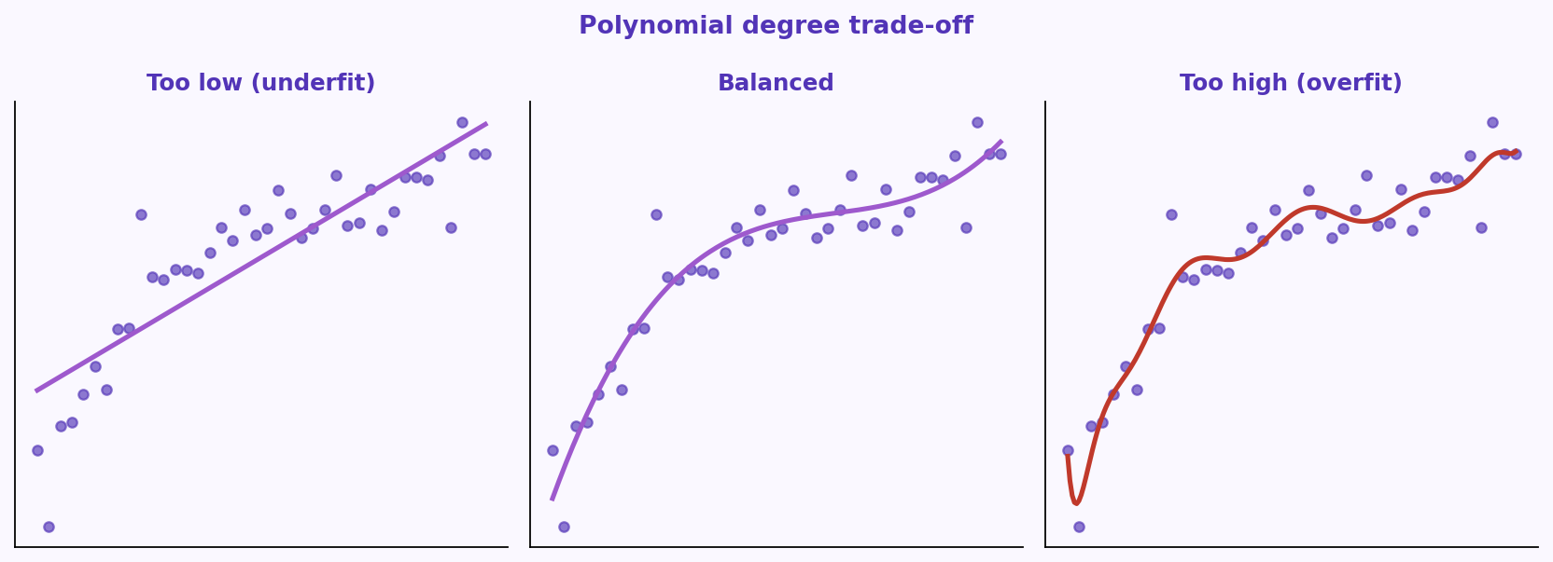
S02 · Regression Models
Choosing the Polynomial Degree
Model Complexity
Degree controls complexity — too low underfits, too high overfits.
–
Pick degree with CV / validation error.
–
Also compare adjusted R².
Balanced degree → better bias-variance trade-off.
ETRA
41 / 79

Slide 104
S02 · Regression Models
When to Use Polynomial Regression
Good Use Cases
Data shows clear curved trends · more flexibility than a straight line · you still want interpretable behavior.
Application | Example
Forecasting | Demand and sales trends
Environment | Rainfall vs crop yield
Medicine | Disease / progression patterns
Engineering | Stress-strain and similar curves
Choose polynomial regression when curves matter, but full black-box models are not required yet.
ETRA
42 / 79

Slide 105
S02 · Regression Models
Limitations of Polynomial Regression
Trade-offs
Limitation | Explanation
Overfitting risk | High-degree models may memorize noise
Outlier sensitivity | Extreme points can shift the curve strongly
Extrapolation weakness | Predictions outside training range can be unreliable
Limited flexibility for very complex patterns | Some tasks are better handled by tree-based or neural models
Use polynomial regression as a baseline, then compare with alternatives as complexity grows.
ETRA
43 / 79

Slide 106
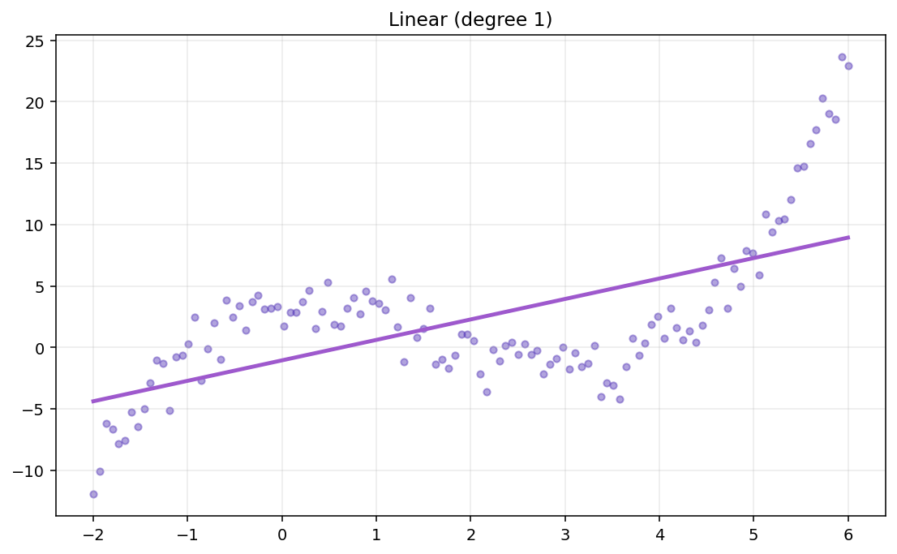
S02 · Regression Models
Polynomial Regression Visual Explanation
Linear vs Polynomial Fits
Compare linear vs polynomial fits as degree changes.
–
Too low degree → high bias (underfit).
–
Too high degree → high variance (overfit).
ETRA
44 / 79

Slide 107
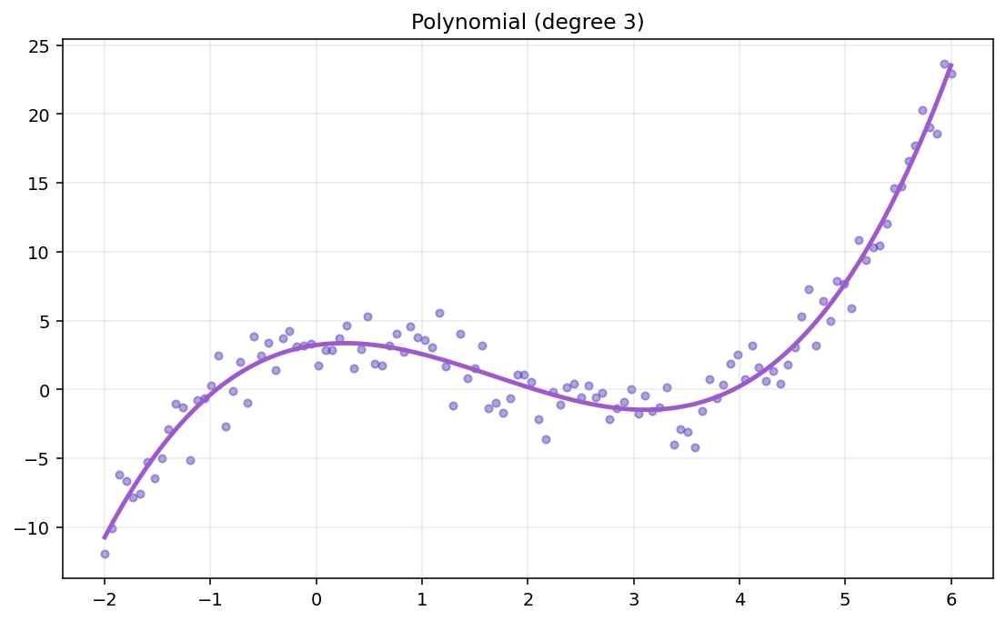
S02 · Regression Models
Effect of Polynomial Degree
Visual Explanation
Higher degree = more flexible curve — useful, then noisy.
–
Pick degree with validation curves.
–
Do not trust training error alone.
ETRA
45 / 79

Slide 108
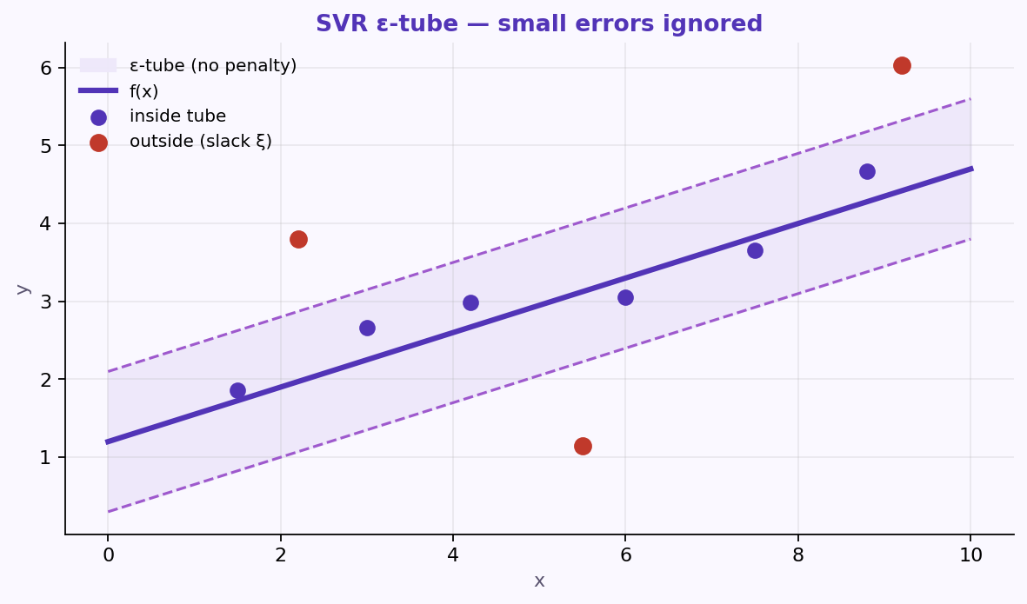
S02 · Regression Models
Support Vector Machine (SVM) and SVR
What is SVR?
SVR is the regression version of SVM: a flat function with a tolerance margin (ε-tube).
–
SVM: widest margin; support vectors define it.
–
SVR ignores small errors inside the ε-tube.
–
Used in forecasting, engineering curves, disease progression.
SVM separates classes; SVR predicts continuous y with an ε-insensitive zone.
ETRA
46 / 79

Slide 109
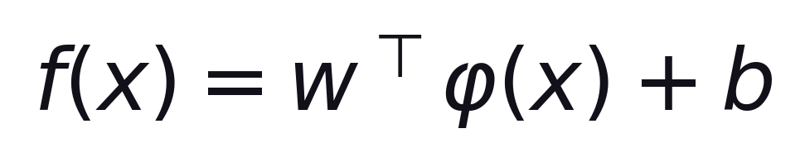
S02 · Regression Models
SVR Formulation and Equations
Model Form
SVR predicts with a (possibly kernelized) linear function in a feature space.
φ(x) maps input to a (possibly) higher-dimensional space
–
φ(x) maps input to a (possibly) higher-dimensional space.
–
With kernels, we avoid computing φ(x) explicitly.
ETRA
47 / 79

Slide 110
S02 · Regression Models
Soft-Margin SVR Objective
Optimization Objective
Keep the function flat while penalizing points outside the ε-tube.
min ½∥w∥² + C Σ (ξᵢ + ξᵢ*)
C trades flatness vs errors outside the tube
–
½∥w∥² → flatter function.
–
Larger C → tighter fit; smaller C → smoother.
ETRA
48 / 79

Slide 111
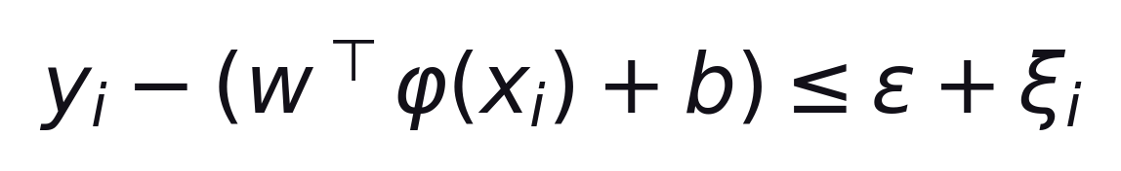
S02 · Regression Models
SVR Constraints
Soft-Margin SVR
Stay within ε of yᵢ, or pay with a slack variable.
Formula
Also: (wᵀφ(xᵢ)+b) − yᵢ ≤ ε + ξᵢ* · ξᵢ, ξᵢ* ≥ 0
–
Inside tube → no penalty.
–
Outside tube → slack cost.
ETRA
49 / 79

Slide 112
S02 · Regression Models
SVR Hyperparameters
Tuning Knobs
Hyperparameter | Role
epsilon (ε) | Width of the no-penalty tube around prediction
C | Penalty strength for points outside the tube
Kernel | Controls curve shape (linear, RBF, polynomial)
Tune ε, C, and the kernel together — changing one often changes how the others behave.
ETRA
50 / 79

Slide 113
S02 · Regression Models
Why SVR?
Compared with Traditional Regression
Aspect | Traditional | SVR
Errors | Minimize all residuals | Ignore inside ε-tube
Outliers | Can be sensitive | More robust if tuned
Non-linear | Hand-built features | Kernels directly
Large data | Usually faster | Can get expensive
Scale features · start with RBF · tune C, ε, kernel params.
ETRA
51 / 79

Slide 114
S02 · Regression Models
SVR Visual Intuition
Why SVR?
ε-tube ignores small residuals; larger deviations pull the fit.
–
Inside tube → no loss.
–
Kernels capture curves without hand features.
ETRA
52 / 79

Slide 115
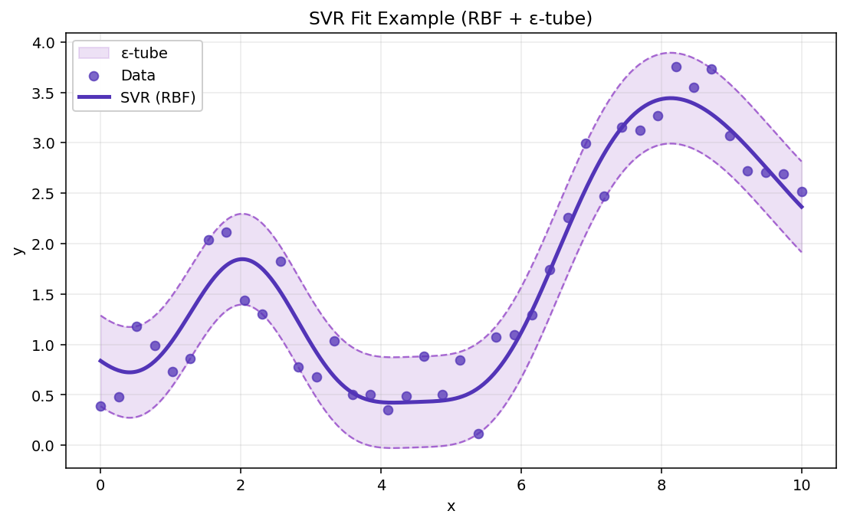
S02 · Regression Models
SVR Fit Example
Why SVR?
Tuned tube + kernel follows curves while resisting small noise.
–
Scale features first.
–
Tune C, ε, kernel with CV.
ETRA
53 / 79

Slide 116
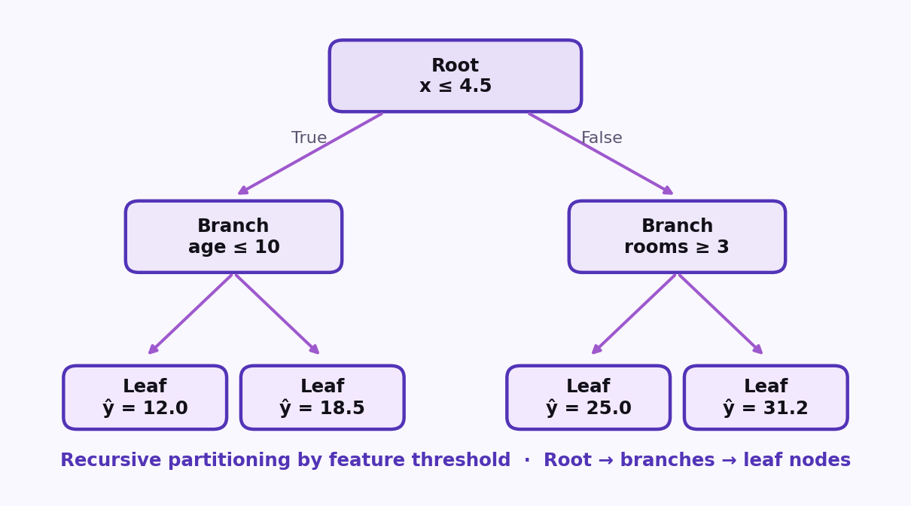
S02 · Regression Models
Decision Tree Regression (CART)
What is Decision Tree Regressor?
Decision Tree Regressor predicts continuous values by splitting feature space into rule-based regions and assigning a constant value in each region.
–
Captures non-linear relationships.
–
Easy to interpret if tree depth is controlled.
–
Handles complex feature interactions.
Decision Tree Split: recursive partitioning by feature threshold · Root → branches → leaf nodes.
ETRA
54 / 79

Slide 117
S02 · Regression Models
Core Concept of Regression Trees
Tree Structure
A regression tree is built from decision rules that partition the input space into regions with constant predictions.
–
Internal node: decision rule (e.g., x ≤ 4.5).
–
Branch: outcome of the rule.
–
Leaf node: predicted value (usually region mean).
ETRA
55 / 79

Slide 118
S02 · Regression Models
CART Perspective
Classification and Regression Trees
Tree Type | Target Type | Typical Criterion
Classification Tree | Categorical target | Gini / Entropy
Regression Tree | Continuous target | MSE (or MAE)
This section focuses on the Regression Tree part of CART.
ETRA
56 / 79

Slide 119
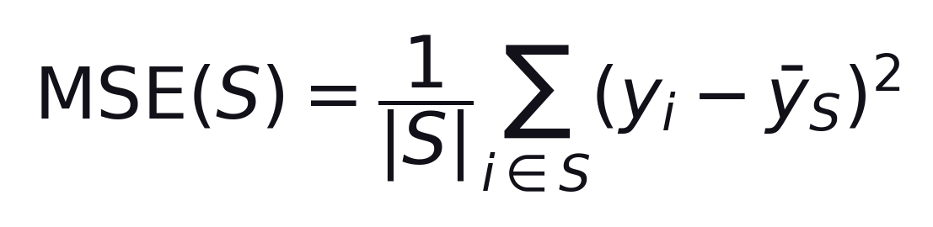
S02 · Regression Models
How Splitting Happens (MSE Criterion)
Node MSE
CART picks the split that maximally reduces MSE (regression) or Gini/entropy (classification).
Average squared distance from the node mean ȳ_S
–
Greedy splits are fast but not globally optimal.
–
Depth and min-samples-leaf control overfitting on small datasets.
ETRA
57 / 79

Slide 120
S02 · Regression Models
Split Score
MSE Criterion
A candidate split is scored by the size-weighted average MSE of the left and right child nodes.
S_L / S_R = left and right subsets after the candidate split
–
Choose the split with the minimum weighted MSE.
–
Larger child nodes influence the score more (weighted by |S_L| and |S_R|).
ETRA
58 / 79

Slide 121
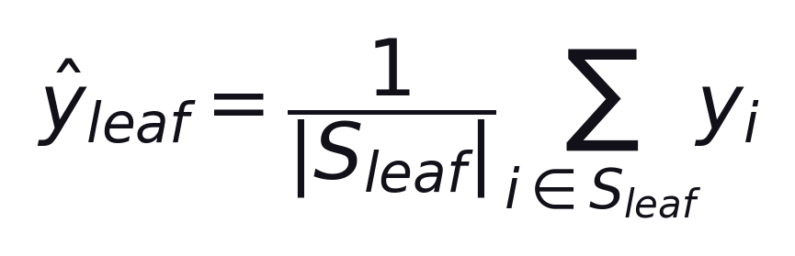
S02 · Regression Models
Prediction at Leaf
Regression Tree
Once a region is pure enough to stop splitting, the leaf predicts a constant value for every point that lands there.
Usually the mean of the training targets in that leaf region
–
Same prediction for all samples that reach the same leaf.
–
Deeper trees create smaller regions and more varied leaf values.
ETRA
59 / 79

Slide 122
S02 · Regression Models
Decision Tree Regression Algorithm
Simple Steps
Step | Action
1 | Start with all data at the root node.
2 | Evaluate candidate splits across features.
3 | Compute weighted MSE for each split.
4 | Select the split with minimum error.
5 | Repeat recursively on child nodes.
6 | Stop based on rules (max depth, min samples).
7 | Predict using leaf mean value.
Decision Tree Split: greedy recursive partitioning until a stopping rule fires.
ETRA
60 / 79

Slide 123
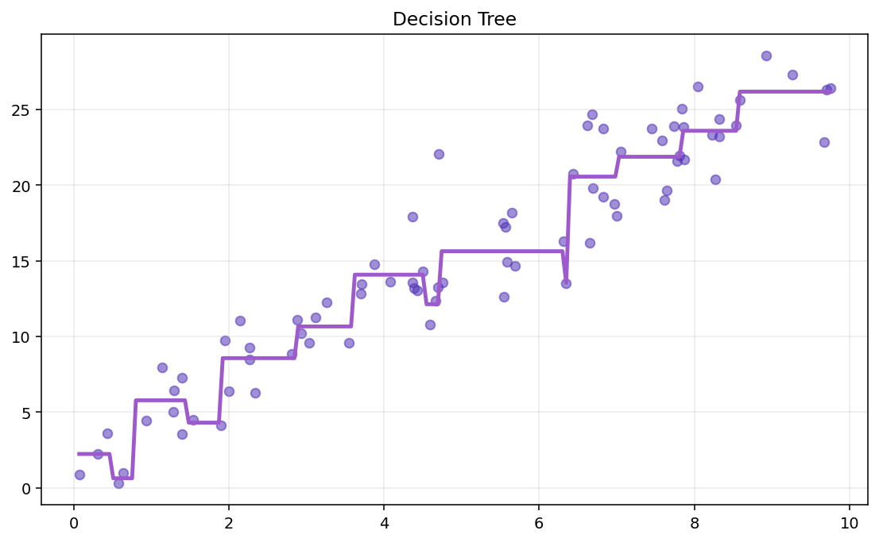
S02 · Regression Models
Decision Tree Fit (Visual)
Algorithm · Static Plot
A fitted regression tree partitions x into intervals and predicts a constant in each leaf region.
–
Piecewise-constant prediction surface.
–
More depth → more steps and finer partitions.
ETRA
61 / 79

Slide 124
S02 · Regression Models
Important Hyperparameters
Decision Tree Regression
Hyperparameter | Effect
max_depth | Controls model complexity
min_samples_split | Minimum samples required to split a node
min_samples_leaf | Minimum samples in each leaf
max_leaf_nodes | Limits number of terminal regions
These settings reduce overfitting and improve generalization.
ETRA
62 / 79

Slide 125
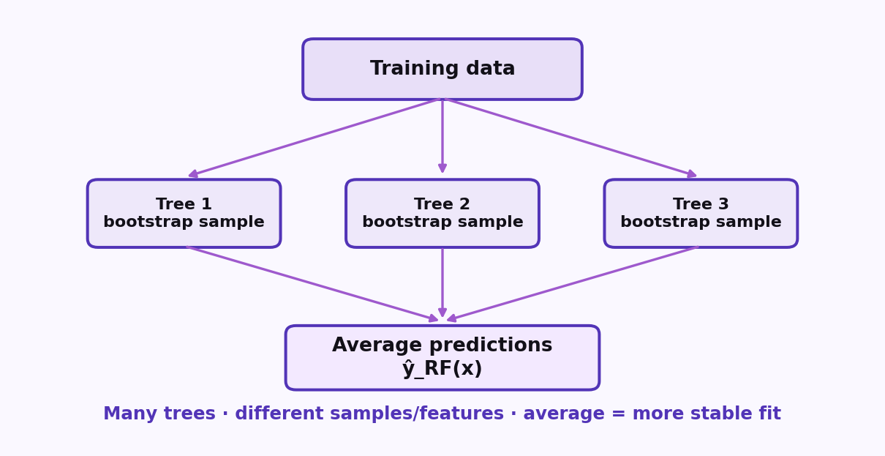
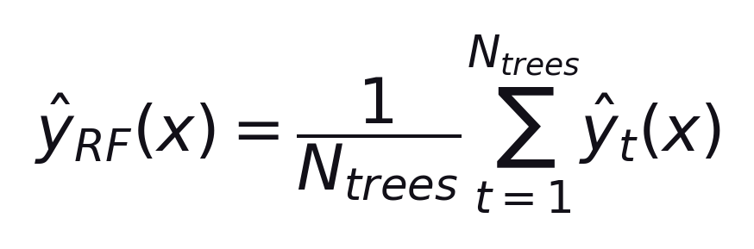
S02 · Regression Models
Random Forest Regression
What is Random Forest Regressor?
Ensemble of many trees — average their predictions.
Formula
Average of individual tree predictions
–
Bootstrap samples → many trees.
–
Averaging reduces variance vs one deep tree.
Also see fitted RF curve: slide-46-3.
ETRA
63 / 79

Slide 126
S02 · Regression Models
Decision Tree vs Random Forest
Regression Comparison
Aspect | Decision Tree | Random Forest
Model | Single tree | Many trees averaged
Split | MSE per split | MSE trees, then average
Overfit risk | Higher | Lower
Stability | Sensitive | More stable
Prediction | One tree output | Mean of trees
Interpretability | High | Medium
Tree for interpretability · Forest for stronger performance.
ETRA
64 / 79

Slide 127
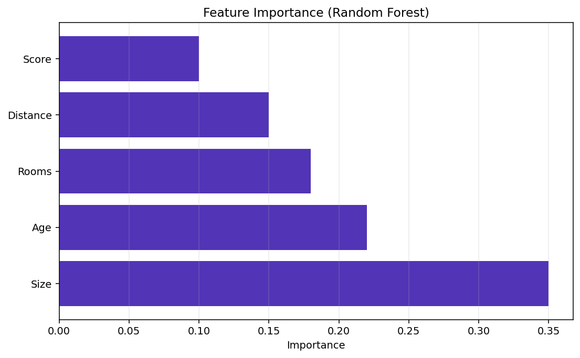
S02 · Regression Models
Feature Importance (Random Forest)
Decision Tree vs Random Forest
Importance scores show how much each feature helped reduce error.
–
Higher bar → more contribution.
–
Guide for insight — not causal proof.
ETRA
65 / 79

Slide 128
S02 · Regression Models
Evaluating Regression Models
Key Performance Metrics
Metric | Formula | Tells Us
MAE | (1/n) Σ |yᵢ − ŷᵢ| | Average error size
MSE | (1/n) Σ (yᵢ − ŷᵢ)² | Penalizes large errors
RMSE | √MSE | Error on y scale
R² | 1 − SS_res/SS_tot | Variance explained
Use more than one metric (e.g. RMSE + R²).
ETRA
66 / 79

Slide 129
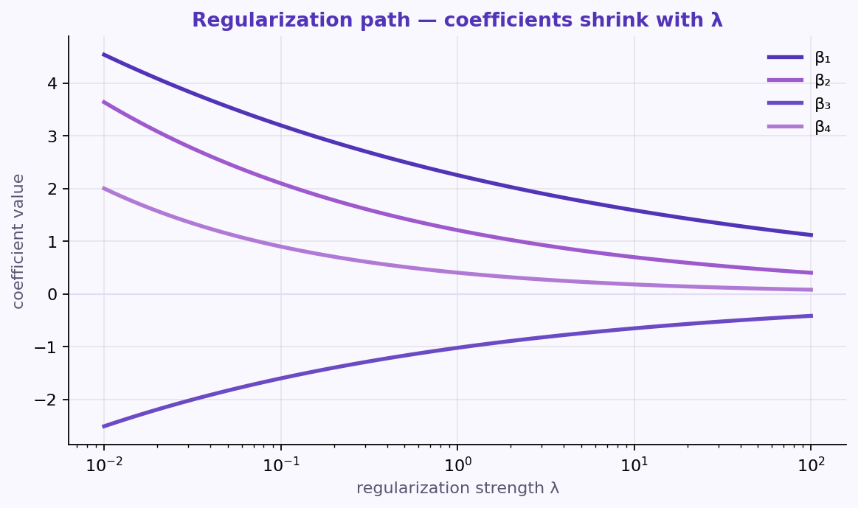
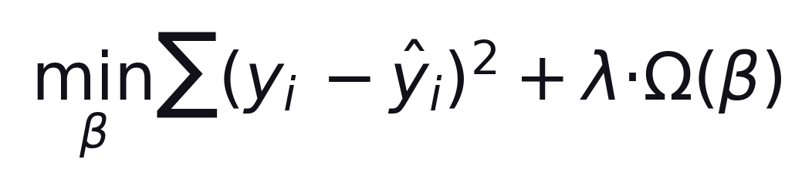
S02 · Regression Models
Regularization Methods (Why Needed?)
Overfitting Problem
Too flexible → fits noise instead of true patterns.
Formula
data loss + λ × penalty
–
Low train error, weak test performance.
–
High variance / unstable predictions.
Penalize large coefficients to control complexity.
ETRA
67 / 79

Slide 130
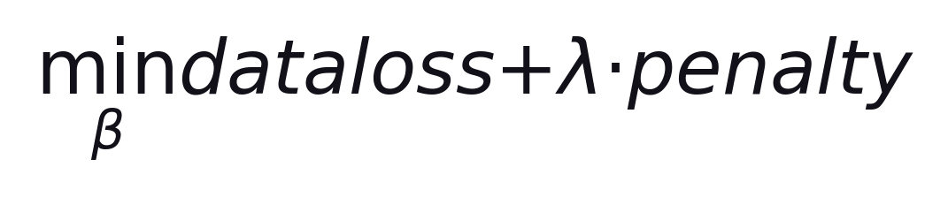
S02 · Regression Models
Regularization Objective
Data Loss + Penalty
Trade off fit vs small coefficients.
loss = Σ(yᵢ − ŷᵢ)² · penalty = Ω(β)
–
λ = 0 → ordinary least squares.
–
Larger λ → stronger shrinkage · tune with CV.
ETRA
68 / 79

Slide 131
S02 · Regression Models
Ridge, Lasso, and Elastic Net
Regularization Families
Different penalties shrink coefficients differently as λ grows.
–
Ridge (L2): shrink all — good with correlated features.
–
Lasso (L1): can zero coeffs — feature selection.
Elastic Net blends L1 + L2 for correlated sparse settings.
ETRA
69 / 79

Slide 132
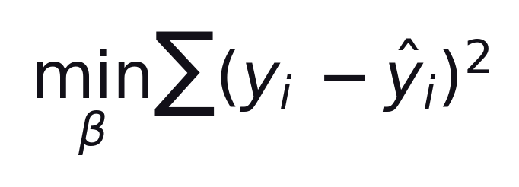
S02 · Regression Models
Without Regularization
Ordinary Least Squares
Minimize squared error only — no coefficient penalty.
Same as λ = 0
–
No shrinkage.
–
Can overfit with many / correlated features.
ETRA
70 / 79

Slide 133

S02 · Regression Models
Ridge Regression (L2)
Penalty: sum of squared coefficients
L2 penalty shrinks coefficients; rarely zeros them.
λ ≥ 0 controls shrinkage
–
Smooth shrinkage of all coefficients.
–
Good when many features correlate.
ETRA
71 / 79

Slide 134

S02 · Regression Models
Lasso Regression (L1)
Penalty: sum of absolute coefficients
L1 penalty can set some coefficients exactly to zero.
Larger λ → sparser model
–
Built-in feature selection.
–
Best when few predictors truly matter.
ETRA
72 / 79

Slide 135

S02 · Regression Models
Elastic Net (L1 + L2)
Blend of Lasso and Ridge
Combine L1 + L2 for sparsity with more stable correlation behavior.
λ₁ → sparsity · λ₂ → ridge shrinkage
–
Good for correlated feature groups.
–
Tune λ₁, λ₂ (or mix ratio) with CV.
ETRA
73 / 79

Slide 136
S02 · Regression Models
When to Use Each Method
Ridge · Lasso · Elastic Net
Match the penalty to the feature structure you expect.
–
Ridge: many small/medium useful features.
–
Lasso: few important features expected.
–
Elastic Net: correlated features + need sparsity.
ETRA
74 / 79

Slide 137
S02 · Regression Models
Regularization Comparison Table
Ridge vs Lasso vs Elastic Net
Method | Penalty Type | Main Behavior | Feature Selection
Ridge | L2 (sum βⱼ²) | Shrinks coefficients smoothly | No
Lasso | L1 (sum |βⱼ|) | Shrinks and can set some coefficients to zero | Yes
Elastic Net | L1 + L2 | Combines shrinkage + selection | Yes
Scale features before Ridge/Lasso/Elastic Net — penalties depend on coefficient magnitude.
ETRA
75 / 79

Slide 138
S02 · Regression Models
Regression Models — Pros & Cons
Session Summary
Model | Advantages | Disadvantages
Linear | Simple, fast, interpretable | Linear only; outlier-sensitive
Polynomial | Captures curves | Degree sensitive; can overfit
SVR | Kernels; robust if tuned | Needs scaling; slow on big data
Decision Tree | Interpretable; no scaling | Overfits; unstable
Random Forest | Accurate; lower variance | Less interpretable; heavier
Interpretability → Linear/Tree · Performance → Random Forest.
ETRA
76 / 79

Slide 139
S02 · Regression Models
Model Summary (Name + Equation)
Session Summary
Model | Core Equation
Linear Regression | ŷ = b₀ + b₁x
Polynomial Regression | ŷ = b₀ + b₁x + b₂x² + ⋯ + b_d x^d
SVR | f(x) = wᵀ φ(x) + b
Decision Tree Regression | ŷ_leaf = mean(y in S_leaf)
Random Forest Regression | ŷ_RF(x) = (1/N_trees) Σ ŷ_t(x)
If interpretability is priority: Linear Regression or Decision Tree. If predictive performance is priority: Random Forest.
ETRA
77 / 79

Slide 140

S02 · Regression Models
Visual Comparison of Regression Models
Same Dataset · Different Fits
Same data · five model families side by side.
–
Linear/Ridge: fast · watch curves.
–
Tree/RF: flexible · weak extrapolation.
Visual output from Python code.
ETRA
78 / 79

Slide 141
S02 · Regression Models
Model Families at a Glance
Session Closing
Model | Strength | Watch Out
Linear / Ridge | Interpretable, fast | Nonlinear patterns
SVR | Margin-based, kernels | Slow on huge data
Tree / RF | Nonlinear, little scaling | Extrapolation
Visual output from Python code is shown on the previous slide.
ETRA
79 / 79

Slide 142
Week 1 · Session 3
Classical ML
Classification basics — from labels to decision boundaries
ETRA
AI & Machine Learning Bootcamp

Slide 143
S03 · Big picture
Where Are We in the Bootcamp?
After regression — learn models that predict class labels.
Week 1
Week 2
Week 3
Week 4
S1
Foundations & Preprocessing
S7
Deep Learning
S8
NLP Fundamentals
S14
Generative AI
S2
Regression Models
S9
Tokenization
S15
RAG Systems
S3
Classification Basics
S10
Text Analysis & NER
S16
MLOps
S4
Naive Bayes & Trees
S11
Language Modeling
S5
SVM & Kernels
S12
Embeddings & RNNs
S6
Clustering & PCA
S13
Seq2Seq & NMT
ETRA
02 / 17

Slide 144
Week 1 · Session 3
Classical ML
Classification Basics
Classification Basics
Logistic regression
K-NN
Decision boundaries
Threshold tuning
ETRA
03 / 17

Slide 145
S03 · Classical ML
Classification Basics
What we will cover in this session
–
Classification Basics
–
Logistic regression
–
K-NN
–
Decision boundaries
–
Threshold tuning
ETRA
04 / 17

Slide 146

S03 · Classical ML
Classification Overview
Classification Basics
Classification is a supervised learning task used to assign a new observation to a predefined category based on learned patterns from labeled data.
–
Output is a class label (e.g., 0/1, Yes/No).
–
Used in spam, diagnosis, fraud, and churn prediction.
Features in → class label out. Probability models come next.
ETRA
05 / 17

Slide 147

S03 · Classical ML
Logistic Regression: Definition
Binary Classification
Supervised binary classifier that estimates P(y=1|x) from features.
–
Outputs probabilities in [0, 1].
–
Class label comes from applying a threshold later.
–
Models features → log-odds of the positive class.
Maps a linear score to a probability via the sigmoid.
ETRA
06 / 17

Slide 148

S03 · Classical ML
Why Not Linear Regression for Classification?
Motivation for Logistic Regression
Linear regression predicts continuous values rather than discrete classes.
–
Predictions can fall outside [0, 1] — invalid as probabilities.
–
No natural, stable class boundary for labels.
Sigmoid keeps outputs in [0, 1] and supports a clear cutoff.
ETRA
07 / 17

Slide 149

S03 · Classical ML
Sigmoid Mapping and Decision Threshold
Sigmoid & Threshold
Sigmoid turns the linear score z into a probability.
Formula
–
Default cutoff: P ≥ 0.5 → class 1, else class 0.
–
τ is tunable for cost of false positives vs false negatives.
Tune τ to business/clinical risk — covered in Threshold tuning.
ETRA
08 / 17

Slide 150

S03 · Classical ML
Key Assumptions for Logistic Regression
Model Assumptions
Works on log-odds — check independence, collinearity, and linearity in logit space.
–
Observations should be independent.
–
Avoid severe multicollinearity among predictors.
–
Relationship ≈ linear in the log-odds space.
ETRA
09 / 17

Slide 151

S03 · Classical ML
Maximum Likelihood Estimation (MLE)
How Logistic Regression Learns
Parameters β are chosen to maximize the likelihood of the observed labels.
–
Each curve is a different β (different likelihood).
–
Best fit: highest likelihood / lowest log-loss.
Pick β that makes the observed labels most probable.
ETRA
10 / 17

Slide 152

S03 · Classical ML
Logistic Regression: Strengths and Limits
When to Use It
Strong baseline when classes are roughly linearly separable; weaker on complex shapes.
–
Strengths: interpretable odds, fast training, calibrated probabilities.
–
Limits: linear boundary; struggles with overlap / non-linear shapes.
For wiggly boundaries → polynomials, K-NN, or kernels.
ETRA
11 / 17

Slide 153

S03 · Classical ML
Multiclass Extension of Logistic Regression
Beyond Binary
Extend binary logistic regression to 3+ classes with Softmax or One-vs-All.
–
Softmax: one multinomial model for all classes.
–
One-vs-All: one binary classifier per class; pick max P.
Final label = argmax_k P(y=k|x).
ETRA
12 / 17

Slide 154

S03 · Classical ML
K-Nearest Neighbors (K-NN): Core Idea
Instance-Based Learning
Non-parametric classifier: label by majority vote among the K nearest training points.
–
Choose K and a distance metric.
–
Find K nearest neighbors; majority vote wins.
Lazy learner — the training set is the model.
ETRA
13 / 17

Slide 155

S03 · Classical ML
K-NN: Choosing K and Distance Metric
Hyperparameters
K and distance control how smooth the decision boundary is.
–
Small K: flexible, noise-sensitive.
–
Large K: smoother; may miss local structure.
Pick K with CV · scale features before distance modeling.
ETRA
14 / 17

Slide 156
S03 · Classical ML
K-NN: Strengths and Limitations
When to Use It
Strengths | Limitations
Simple and intuitive | Slow prediction on large datasets
Works well on small, separated data | Sensitive to irrelevant features / imbalance
Native multiclass support | Curse of dimensionality
No training phase (lazy baseline) | Needs feature scaling
Great baseline; watch cost at inference and high dimensions.
ETRA
15 / 17

Slide 157

S03 · Classical ML
Decision Boundaries Across Models
Geometry of Classification
A decision boundary is the surface where the predicted class flips — its shape depends on the model family.
–
Logistic: linear boundary in feature space (unless you add features).
–
K-NN: local, piecewise boundary that follows nearest neighbors.
–
Kernel / RBF-like models: smooth curved boundaries.
Match model flexibility to how classes are separated in the data.
ETRA
16 / 17

Slide 158

S03 · Classical ML
Threshold Tuning: Trading FP vs FN
Operating Point
The sigmoid gives P(y=1|x); τ turns that probability into a hard class label.
–
Lower τ → more positives (↑ recall, ↑ false positives).
–
Higher τ → fewer positives (↑ precision, ↑ false negatives).
–
Default τ = 0.5 is a starting point, not a law.
Set τ from costs: missed fraud ≠ false spam alarm.
ETRA
17 / 17

Slide 159
Week 1 · Session 4
Classical ML
Naive Bayes, trees, and evaluation metrics
ETRA
AI & Machine Learning Bootcamp

Slide 160
S04 · Big picture
Where Are We in the Bootcamp?
After classification basics — probabilistic models, trees, and metrics.
Week 1
Week 2
Week 3
Week 4
S1
Foundations & Preprocessing
S7
Deep Learning
S8
NLP Fundamentals
S14
Generative AI
S2
Regression Models
S9
Tokenization
S15
RAG Systems
S3
Classification Basics
S10
Text Analysis & NER
S16
MLOps
S4
Naive Bayes & Trees
S11
Language Modeling
S5
SVM & Kernels
S12
Embeddings & RNNs
S6
Clustering & PCA
S13
Seq2Seq & NMT
ETRA
02 / 18

Slide 161
Week 1 · Session 4
Classical ML
Naive Bayes, Trees, Evaluation
Naive Bayes
Decision trees
Random Forest
Precision / recall / F1
ETRA
03 / 18

Slide 162
S04 · Classical ML
Naive Bayes, Trees, Evaluation
What we will cover in this session
–
Naive Bayes
–
Decision trees
–
Random Forest
–
Precision / recall / F1
ETRA
04 / 18

Slide 163

S04 · Classical ML
Naive Bayes: Bayes' Theorem
Core Probability Rule
Bayes’ theorem updates our belief about A after observing evidence B.
Posterior ∝ Likelihood × Prior
–
P(A|B): posterior probability after observing evidence B.
–
P(A): prior belief before seeing evidence.
–
P(B|A): likelihood of evidence if class A is true.
P(B): evidence probability (normalization term). This theorem updates beliefs when new evidence appears.
ETRA
05 / 18

Slide 164

S04 · Classical ML
Bayes’ Theorem — Visual Map
Core Probability Rule
Prior × Likelihood → Posterior (normalized by evidence).
Same rule as the formula slide — different view of the update.
ETRA
06 / 18

Slide 165

S04 · Classical ML
Why Is It Called 'Naive'?
Conditional Independence Assumption
Naive Bayes assumes features are conditionally independent given the class label.
–
Simplifies parameter estimation and speeds up training.
–
Works well in text classification and high-dimensional sparse data.
–
Can still perform well even when independence is not fully true.
When comparing classes for the same X, P(X) is constant and can be ignored.
ETRA
07 / 18

Slide 166
S04 · Classical ML
Naive Bayes: Practical Notes
Variants & Implementation
Variant | Typical Data | Key Idea
Gaussian NB | Continuous | Each feature ~ Gaussian given the class
Multinomial NB | Count-based | Common for document word counts
Bernoulli NB | Binary | Presence/absence features
Handle zero-frequency with smoothing (e.g., Laplace). Scale/preprocess by feature type and variant.
ETRA
08 / 18

Slide 167
S04 · Classical ML
Decision Tree Classification (CART)
Recursive Partitioning
Decision Tree Classification predicts class labels by recursively splitting feature space into purer class regions.
–
Internal nodes represent feature-based decisions.
–
Branches represent decision outcomes.
–
Leaf nodes output final class prediction.
Decision Tree Split · Root → branches → leaf nodes · split by feature threshold.
ETRA
09 / 18

Slide 168

S04 · Classical ML
How Splits Are Chosen in Classification Trees
Gini · Entropy · Information Gain
Splits are chosen greedily to maximize information gain.
Gini / Entropy measure impurity — lower is better
–
Choose the split that best separates classes at each node.
–
Stop splitting using rules like max depth or minimum samples.
–
Gini impurity and entropy measure node purity — lower is better.
Better splits reduce impurity and increase class purity in child nodes.
ETRA
10 / 18

Slide 169
S04 · Classical ML
Decision Tree: Classification vs Regression
Same Structure · Different Objectives
Aspect | Classification Tree | Regression Tree
Target | Categorical class | Continuous value
Split criterion | Gini / Entropy | MSE / MAE
Leaf output | Class label or class probability | Numeric mean/median
Both use recursive partitioning (Root → branches → leaves) but optimize different objectives.
ETRA
11 / 18

Slide 170

S04 · Classical ML
Gini Impurity and Entropy
Node Purity Measures
Gini (CART default) and entropy both measure node impurity — lower is better.
Better splits reduce impurity and increase class purity in child nodes.
ETRA
12 / 18

Slide 171

S04 · Classical ML
Random Forest Classification
Ensemble Learning by Bagging
Train many trees on bootstrap samples, then combine predictions by majority vote.
Formula
Majority vote across T trees
–
Sample bootstrap data and train many trees.
–
Each tree predicts a class for the new sample.
Final class = majority vote (mode). Regression RF uses the mean instead.
ETRA
13 / 18

Slide 172
S04 · Classical ML
Why Random Forest Often Outperforms a Single Tree
Bias–Variance Tradeoff
Property | Single Decision Tree | Random Forest
Variance | High | Lower (averaging effect)
Overfitting risk | Higher | Lower
Interpretability | High | Moderate
Predictive robustness | Sensitive to data noise | More stable
Bagging + feature randomness → less variance without much extra bias.
ETRA
14 / 18

Slide 173

S04 · Classical ML
Classification Errors: FP and FN
Error Types
Not all mistakes are equal — False Positives and False Negatives carry different costs.
–
False Positive (Type I): predict positive, actual is negative.
–
False Negative (Type II): predict negative, actual is positive.
–
Error impact depends on domain costs (healthcare vs spam).
Model evaluation should consider error trade-offs, not accuracy alone.
ETRA
15 / 18

Slide 174


S04 · Classical ML
Confusion Matrix and Accuracy
Actual vs Predicted Counts
Confusion matrix counts TP, FP, FN, TN — Accuracy is overall correctness.
Formula
Correct predictions ÷ all predictions
–
TP / TN: correct positives / negatives.
–
FP / FN: false alarms / missed detections.
High accuracy can hide poor minority-class performance when data is imbalanced.
ETRA
16 / 18

Slide 175
S04 · Classical ML
Confusion Matrix Cells
Metric Meanings
Metric | Meaning
TP | Correctly predicted positives
TN | Correctly predicted negatives
FP | Incorrectly predicted positives
FN | Incorrectly predicted negatives
These four counts are the building blocks of precision, recall, and F1.
ETRA
17 / 18

Slide 176

S04 · Classical ML
Precision, Recall, and F1-Score
Beyond Accuracy
Precision and recall trade off · F1 balances both when classes are imbalanced.
Use F1 especially when class distribution is imbalanced.
ETRA
18 / 18

Slide 177
Week 1 · Session 5
Classical ML
SVM and kernel methods for classification
ETRA
AI & Machine Learning Bootcamp

Slide 178
S05 · Big picture
Where Are We in the Bootcamp?
After trees and metrics — maximum-margin classifiers and kernels.
Week 1
Week 2
Week 3
Week 4
S1
Foundations & Preprocessing
S7
Deep Learning
S8
NLP Fundamentals
S14
Generative AI
S2
Regression Models
S9
Tokenization
S15
RAG Systems
S3
Classification Basics
S10
Text Analysis & NER
S16
MLOps
S4
Naive Bayes & Trees
S11
Language Modeling
S5
SVM & Kernels
S12
Embeddings & RNNs
S6
Clustering & PCA
S13
Seq2Seq & NMT
ETRA
02 / 16

Slide 179
Week 1 · Session 5
Classical ML
SVM · Kernel Methods
Margin maximization
Kernel trick
Support vectors
Linear vs RBF
ETRA
03 / 16

Slide 180
S05 · Classical ML
SVM · Kernel Methods
What we will cover in this session
–
Margin maximization
–
Kernel trick
–
Support vectors
–
Linear vs RBF
ETRA
04 / 16

Slide 181

S05 · Classical ML
Support Vector Machine (SVM): Core Idea
Maximum Margin Classifier
SVM is a supervised method that finds the best separating boundary (hyperplane) between classes.
–
It maximizes the margin between classes.
–
Only support vectors (closest points) determine the boundary.
–
A larger margin usually improves generalization.
SVM Maximum Margin · widest gap between classes · support vectors define the margin.
ETRA
05 / 16

Slide 182

S05 · Classical ML
How SVM Classification Works
Decision Function
New points are classified by the side of the hyperplane they fall on.
f(x)>0 → class +1 · f(x)<0 → class −1
–
Hard margin: no misclassification allowed (strict separation).
–
Soft margin: allows violations for better robustness with overlap/noise.
Soft-margin SVM adds penalty C to control the margin–violation tradeoff.
ETRA
06 / 16

Slide 183
S05 · Classical ML
Why SVM Is Powerful
When SVM Shines
Capability | Why It Matters
Maximum-margin principle | Better robustness to small perturbations
Kernel support | Handles non-linear class boundaries
High-dimensional performance | Works well in text and sparse feature spaces
Common in text/image features · often effective on small-to-medium datasets. Support vectors define the margin.
ETRA
07 / 16

Slide 184

S05 · Classical ML
Kernel Trick: From Non-Linear to Linear Separation
Feature Mapping Without Explicit φ(x)
When data is not linearly separable in original space, SVM uses kernel functions to separate it in a transformed feature space.
–
Avoids explicit high-dimensional mapping in many cases.
–
Computes similarity using kernel function K(xᵢ, xⱼ).
Work with K(xᵢ, xⱼ) = ⟨φ(xᵢ), φ(xⱼ)⟩ instead of building φ(x) by hand.
ETRA
08 / 16

Slide 185

S05 · Classical ML
Kernel Similarity K(xᵢ, xⱼ)
Kernel Trick
Avoids explicit high-dimensional mapping · computes similarity with K(xᵢ, xⱼ).
SVM decision depends on kernel similarities to support vectors — not on building φ(x).
ETRA
09 / 16

Slide 186

S05 · Classical ML
RBF Kernel in SVM
Gaussian Similarity
RBF measures how close x is to a landmark lᵢ — a common default for non-linear SVM.
Close to lᵢ → K≈1 · far → K≈0
–
If x is close to landmark lᵢ, similarity is near 1.
–
If x is far, similarity approaches 0.
–
RBF is a common default for non-linear SVM.
Effect of σ: large → smoother, wider boundary (higher bias) · small → tighter, complex boundary (higher variance).
ETRA
10 / 16

Slide 187

S05 · Classical ML
Effect of Sigma (σ) in RBF
Bias–Variance of the Kernel Width
σ controls how far a landmark’s influence reaches.
–
Large sigma: smoother, wider decision boundary (higher bias).
–
Small sigma: tighter, complex boundary (higher variance / overfitting risk).
Tune σ (or gamma) with cross-validation together with C.
ETRA
11 / 16

Slide 188
S05 · Classical ML
Common SVM Kernels
Choosing K(xᵢ, xⱼ)
Kernel | Typical Use | Notes
Linear | High-dimensional sparse data | Fast and interpretable margin
RBF (Gaussian) | General non-linear patterns | Strong baseline in many tasks
Polynomial | Polynomial-like interactions | Degree controls complexity
Sigmoid | Neural-style boundary behavior | Less common in practice
Start with Linear (text/sparse) or RBF (general). Support vectors still define the margin.
ETRA
12 / 16

Slide 189
S05 · Classical ML
When to Use SVM / When Not
Practical Guidance
Use SVM When | Avoid SVM When
Data is high-dimensional or moderately sized | Dataset is very large (training can be expensive)
Classes are reasonably separable | Data is extremely noisy with weak class structure
You need non-linear boundaries via kernels | Kernel matrix becomes too costly (features × samples)
Use: medium data, clear margin, high-dim text · Avoid: massive data, heavy noise without tuning.
ETRA
13 / 16

Slide 190
S05 · Classical ML
Support Vectors — Why They Matter
Sparse Decision Boundary
Only the points on (or inside) the margin shape the SVM — the rest can be removed without changing the boundary.
–
Support vectors define the margin edges.
–
Decision depends on a sparse subset of training points.
–
Removing non-support points usually leaves the model unchanged.
Wider margin · fewer influential points · often better generalization.
ETRA
14 / 16

Slide 191
S05 · Classical ML
SVM vs Logistic Regression vs K-NN
Model Comparison
Aspect | SVM | Logistic Regression | K-NN
Primary task | Classification (and SVR) | Classification | Classification
Non-linearity | Yes, with kernels | Limited in linear form | Yes (distance-based)
Compute profile | Can be heavy on large data | Usually efficient | Heavy at prediction
Best for | Complex margins, high-dim spaces | Fast interpretable baseline | Local neighborhood patterns
LogReg: probabilities + τ=0.5 · SVM: max-margin · K-NN: local votes.
ETRA
15 / 16

Slide 192
S05 · Classical ML
SVM Practical Hyperparameters
What to Tune
Parameter | Role | Typical Tuning Direction
C | Penalty for margin violations | Higher C → stricter fit · lower C → smoother margin
Kernel | Similarity function | Start with RBF · compare linear/polynomial
gamma (RBF) | Locality of influence | Higher gamma → tighter boundary
degree (poly) | Polynomial complexity | Increase only when needed
Scale features first · tune with CV · support vectors define the margin.
ETRA
16 / 16

Slide 193
Week 2 · Session 1
Deep Learning
Neural networks, backpropagation, CNNs, and RNNs
ETRA
AI & Machine Learning Bootcamp

Slide 194
S07 · Big picture
Where Are We in the Bootcamp?
Week 1 classical ML is done — now stacked nonlinear models.
Week 1
Week 2
Week 3
Week 4
S1
Foundations & Preprocessing
S7
Deep Learning
S8
NLP Fundamentals
S14
Generative AI
S2
Regression Models
S9
Tokenization
S15
RAG Systems
S3
Classification Basics
S10
Text Analysis & NER
S16
MLOps
S4
Naive Bayes & Trees
S11
Language Modeling
S5
SVM & Kernels
S12
Embeddings & RNNs
S6
Clustering & PCA
S13
Seq2Seq & NMT
ETRA
02 / 106

Slide 195
Week 2 · Session 1
Deep Learning
Neural Networks · CNNs · RNNs
Deep Learning
Neural Networks
Perceptron & MLP
Backpropagation
CNNs
RNNs & regularization
ETRA
03 / 106

Slide 196
S07 · Deep Learning
Neural Networks · CNNs · RNNs
What we will cover in this session
–
Deep Learning
–
Neural Networks
–
Perceptron & MLP
–
Backpropagation
–
CNNs
–
RNNs & regularization
ETRA
04 / 106

Slide 197

S07 · Deep Learning
Deep Learning: Introduction
Foundations → Optimization → Architectures → Autoencoders
Each phase answers a different question.
–
Four phases: foundations → optimization → architectures → autoencoders.
–
Each phase has a lab-style checkpoint — pause at phase boundaries.
–
Focus on deep learning basics — phase breaks are intentional.
Phase 1 focus: understand the “why” and the mathematical mechanics of a single neuron before scaling to layers and data.
ETRA
05 / 106

Slide 198

S07 · Deep Learning
Deep Learning: Introduction
Four phases, four questions
Foundations → optimization → architectures → autoencoders. Pause at each boundary.
Phase 1 focus: understand the “why” and the mathematical mechanics of a single neuron before scaling to layers and data.
ETRA
06 / 106

Slide 199

S07 · Deep Learning
Phase 1: Foundations & Neural Core
Why depth, neurons, and forward pass
Goal: understand what a neuron computes and why stacking layers enables hierarchical features.
Exit check: explain this — and why nonlinearity is required between layers.
–
Topics: perceptron, activations, MLP, forward propagation, and loss functions.
–
Stacking layers builds hierarchical features only if a nonlinearity sits between them.
ETRA
07 / 106

Slide 200
S07 · Deep Learning
Phase 1 Roadmap
Why depth, neurons, and forward pass
Block | Question it answers
Perceptron & MLP | What does one layer compute?
Forward pass | How does inference flow through the graph?
Loss & gradients | What are we optimizing?
Exit check: explain z = w·x + b and why nonlinearity is required between layers.
ETRA
08 / 106

Slide 201
S07 · Deep Learning
What Is Deep Learning?
Definition in One Sentence — Then the Details
Deep learning learns a parameterized mapping from inputs to outputs by stacking nonlinear transformations (layers).
–
“Deep” means multiple such transformations — hierarchical features, not one giant linear rule.
Layers rewrite features step by step. Depth is composition, not one giant linear rule.
ETRA
09 / 106

Slide 202
S07 · Deep Learning
What Is Deep Learning?
Definition in One Sentence — Then the Details
–
Training = pick a loss that measures mistakes, then adjust weights with gradients so average loss drops on data (generalization to unseen data is the real goal).
–
Unlike fixed pipelines of hand-crafted features, the network learns representations that are tuned to the task (edges → textures → parts → objects in vision, etc.).
Generalization to unseen data is the real goal — not memorizing the training set.
ETRA
10 / 106

Slide 203
S07 · Deep Learning
Three Ingredients You Always Have
Architecture · Loss · Optimizer + data
Ingredient | What it means
Architecture | How signals flow (MLP, CNN, RNN, Transformer, …)
Loss / objective | What “better” means for your task (MSE, cross-entropy, …)
Optimizer + data | How you search parameters and what examples you show
You always have these three. Change one, and the model’s behavior changes with it.
ETRA
11 / 106

Slide 204

S07 · Deep Learning
Three Ingredients You Always Have
Architecture · Loss · Optimizer + data
A strong architecture with the wrong loss still learns the wrong thing.
ETRA
12 / 106

Slide 205
S07 · Deep Learning
AI, Machine Learning, and Deep Learning
Subset Relationships — Not Interchangeable Labels
–
Artificial intelligence (AI): the broad field—rules, search, optimization, learning, planning—anything that aims at intelligent behavior.
–
Machine learning (ML): a subfield of AI where behavior improves from data via a learning algorithm (not only hand-written rules).
–
Deep learning (DL): a subfield of ML using deep neural networks—multiple learned nonlinear layers; representation learning is central.
ETRA
13 / 106

Slide 206

S07 · Deep Learning
AI, Machine Learning, and Deep Learning
Subset Relationships — Not Interchangeable Labels
DL ⊂ ML ⊂ AI
ETRA
14 / 106

Slide 207
S07 · Deep Learning
Containment (conceptual)
Subset Relationships — Not Interchangeable Labels
Set | Contains
AI | Rule systems, classical search, ML, knowledge bases, …
ML | Linear models, trees, kernel SVMs, shallow nets, deep nets
DL | CNNs, RNNs/GRU/LSTM, Transformers, GANs, VAEs, …
Saying “we used AI” is vague; “we used supervised DL with a CNN” is precise.
ETRA
15 / 106

Slide 208
S07 · Deep Learning
Use-Case Fit: When Deep Learning Shines — and When to Skip It
Match Method to Data, Risk, and Budget
–
DL is strongest when: large data (or strong pre-training), high-dimensional raw inputs (images, text, speech), and compositionality you want learned end-to-end.
–
Think twice when: tiny tabular datasets, strict interpretability requirements, tight latency on CPU without optimization, or simple baselines already solve the problem.
–
Always compare against strong baselines (logistic regression, gradient boosting, k-NN on engineered features)—DL must earn its complexity on validation metrics you care about.
ETRA
16 / 106

Slide 209

S07 · Deep Learning
Use-Case Fit: When Deep Learning Shines — and When to Skip It
Match Method to Data, Risk, and Budget
ETRA
17 / 106

Slide 210
S07 · Deep Learning
Use-Case Fit: When Deep Learning Shines — and When to Skip It
Match Method to Data, Risk, and Budget
Situation | Typical first choice | Why
Large labeled images / audio / text | Pre-trained DL + fine-tune | Raw inputs; hierarchical features
Small tabular (< few k rows) | Trees / linear + regularization | Lower variance, fast iteration, interpretability
Need causal or legal explanation | Simpler model or hybrid | Auditability and stability
Plenty of GPUs + big data | Larger nets + careful tuning | Capacity + regularization can scale
Edge device, millisecond latency | Small distilled / quantized models | Memory and power limits
ETRA
18 / 106

Slide 211

S07 · Deep Learning
Why Depth Works
Hierarchical Representation Learning
Each layer rewrites the previous layer’s features into a more useful space.
–
Early layers detect simple patterns (edges, local tokens).
–
Middle layers compose those into textures, parts, phrases.
–
Late layers assemble task semantics (objects, intent, class scores).
Depth is composition. Width is how many features you keep at each level.
ETRA
19 / 106

Slide 212
S07 · Deep Learning
Session Roadmap
What we build today
Block | Question it answers
Perceptron & MLP | What does one layer compute?
Backpropagation | How do we update the weights?
CNNs | How do we exploit spatial structure?
RNNs & regularization | How do we model sequences and generalize?
Exit check: explain z = w·x + b and why nonlinearity is required between layers.
ETRA
20 / 106

Slide 213


S07 · Deep Learning
Single Neuron (Perceptron): Math, Weights, and Bias
One Affine Map + One Nonlinearity
One weighted sum plus bias, then an activation. The output can be used as-is or passed onward.
Formula
ŷ = a (or further processing)
ETRA
21 / 106

Slide 214
S07 · Deep Learning
Single Neuron (Perceptron): Math, Weights, and Bias
One Affine Map + One Nonlinearity
–
Affine part (see formula above): z is the weighted sum of inputs plus b—each xᵢ is multiplied by wᵢ.
–
The bias b shifts the decision boundary (same orientation, normal w); it does not rotate the separating hyperplane.
–
Weights encode which patterns excite the neuron; training adjusts w and b so that on labeled data the loss decreases.
–
With no hidden layer and a monotonic activation, the decision boundary in input space is linear (a hyperplane)—powerful but limited.
ETRA
22 / 106

Slide 215
S07 · Deep Learning
Symbols at a Glance
One Affine Map + One Nonlinearity
Symbol | Shape intuition | Role
x | Feature vector (length d) | One training example’s inputs
w | Same length as x | Direction + strength of sensitivity to each feature
b | Scalar | Offset / threshold in logit space
f | Maps ℝ → ℝ (per neuron) | Introduces nonlinearity (or identity)
Bias shifts the hyperplane; it does not rotate it. Rotation comes from w.
ETRA
23 / 106

Slide 216
S07 · Deep Learning
Weight Initialization: Why Zeros Break Training
Symmetry Must Be Broken
–
If all weights in a layer start equal (especially zero), every hidden unit receives the same gradient and stays identical forever—symmetry never breaks.
–
Random initialization makes each unit walk a different path in parameter space so they can specialize as feature detectors.
–
Frameworks use He (Kaiming) for ReLU and Xavier (Glorot) for Tanh to keep activation scale stable.
ETRA
24 / 106

Slide 217

S07 · Deep Learning
Weight Initialization: Why Zeros Break Training
Symmetry Must Be Broken
ETRA
25 / 106

Slide 218

S07 · Deep Learning
Weight Initialization: Why Zeros Break Training
Symmetry Must Be Broken
He (Kaiming) for ReLU: variance = 2 / n_in. Xavier (Glorot) for Tanh: variance = 2 / (n_in + n_out).
Keep activation scale stable across layers
–
He matches ReLU, which zeros out about half the signals.
–
Xavier matches Sigmoid / Tanh, which are symmetric around zero.
ETRA
26 / 106

Slide 219
S07 · Deep Learning
Weight Initialization: Why Zeros Break Training
Symmetry Must Be Broken
Init scheme | Problem it avoids | Best suited for
All zeros | Hidden units stay identical; no representation diversity | None (always avoid for weights)
Xavier (Glorot) | Vanishing or exploding variance across layers | Sigmoid / Tanh activations
He (Kaiming) | Variance drop due to ReLU zeroing out half the signals | ReLU / Leaky ReLU activations
ETRA
27 / 106

Slide 220

S07 · Deep Learning
Activation Functions: Sigmoid, Tanh, and ReLU
Nonlinearity is the Key to Network Depth
Stacked linear layers collapse to one linear map. Activations prevent that collapse.
ETRA
28 / 106

Slide 221

S07 · Deep Learning
Activation Functions: Sigmoid, Tanh, and ReLU
Nonlinearity is the Key to Network Depth
f(x)=1/(1+e^{−5x}) vs g(x)=1/(1+e^{−10x}) · tanh(x) is zero-centered, range (−1, 1)
ETRA
29 / 106

Slide 222
S07 · Deep Learning
Activation Functions: Sigmoid, Tanh, and ReLU
Nonlinearity is the Key to Network Depth
–
Sigmoid: maps inputs to (0, 1)—useful for probabilities, but suffers from vanishing gradients when z is very large or very small (saturation).
–
Tanh: zero-centered, maps inputs to (-1, 1)—often nicer than sigmoid for hidden layers but still saturates.
–
ReLU: modern default for deep stacks—cheap to compute, avoids vanishing gradient on positive domain; leaky ReLU / ELU are variants.
ETRA
30 / 106

Slide 223
S07 · Deep Learning
Activation Functions: Sigmoid, Tanh, and ReLU
Nonlinearity is the Key to Network Depth
Function | Range | Primary use-case
Sigmoid | (0, 1) | Binary classification output layer, gating networks
Tanh | (-1, 1) | Hidden layers (recurrent networks)
ReLU | [0, ∞) | Default choice for hidden layers in MLPs and CNNs
ETRA
31 / 106

Slide 224


S07 · Deep Learning
Sigmoid & Threshold
Probability cutoff for classification
Decision threshold τ = 0.5 splits class 0 from class 1 on the sigmoid probability.
Formula
Predict class 1 when σ(z) ≥ τ
ETRA
32 / 106

Slide 225

S07 · Deep Learning
Activation Curves
Nonlinearity is the Key to Network Depth
Flat tails (sigmoid / tanh) → tiny gradients. ReLU is linear on the positive side.
ETRA
33 / 106

Slide 226
S07 · Deep Learning
The XOR Problem: Why Hidden Layers Are Logically Necessary
Why a single line cannot solve XOR
–
XOR is not linearly separable in the 2D input plane: no single line separates class 1 from class 0 on the four corners.
–
A single perceptron computes a half-space; XOR requires nonlinear mixing of inputs—exactly what a hidden layer provides.
–
Hidden units reparameterize inputs into a space where the task becomes linearly separable—this is the core intuition for representation learning.
ETRA
34 / 106

Slide 227

S07 · Deep Learning
The XOR Problem: Why Hidden Layers Are Logically Necessary
Why a single line cannot solve XOR
A hidden layer remaps the inputs so the output layer can cut with a line.
ETRA
35 / 106

Slide 228
S07 · Deep Learning
XOR Truth Table
Four Points, One Nonlinear Rule
x₁ | x₂ | XOR
0 | 0 | 0
0 | 1 | 1
1 | 0 | 1
1 | 1 | 0
Hidden units reparameterize the inputs so XOR becomes linearly separable.
ETRA
36 / 106

Slide 229


S07 · Deep Learning
From Perceptron to MLP (Multi-Layer Perceptron)
Depth = Composed Nonlinear Features
Hidden layer: affine map + nonlinearity → features h. Output: another affine map + τ.
Formula
φ = hidden activation · τ = output activation
ETRA
37 / 106

Slide 230
S07 · Deep Learning
From Perceptron to MLP (Multi-Layer Perceptron)
Depth = Composed Nonlinear Features
–
Each hidden layer applies an affine map followed by a nonlinearity, producing new features h as functions of the original inputs.
–
Width (units per layer) and depth (number of layers) trade off capacity, data needs, compute, and optimization difficulty.
–
Universal approximation (broad strokes): one sufficiently wide hidden layer can approximate many continuous functions on compact domains—in practice depth + inductive bias wins.
ETRA
38 / 106

Slide 231
S07 · Deep Learning
From Perceptron to MLP (Multi-Layer Perceptron)
Depth = Composed Nonlinear Features
Hyperparameter | What it controls
Hidden width | How many independent nonlinear features per layer
Depth | How many levels of composition (edges→textures→…)
Skip / residual | Ease of optimization in very deep nets
ETRA
39 / 106

Slide 232

S07 · Deep Learning
Forward Propagation: The Engine of Inference
Neural Network
Edge thickness reflects weight magnitude.
ETRA
40 / 106

Slide 233
S07 · Deep Learning
Forward Propagation: The Engine of Inference
The Engine of Inference
–
Forward pass: feed input x through each layer in order—compute logits or scores at the end (then softmax for class probabilities if needed).
–
Implementation-wise this is a computational graph: each op (matmul, ReLU, …) knows how to propagate values forward.
–
Training repeats forward passes on mini-batches for efficiency and gradient noise that can help generalization.
ETRA
41 / 106

Slide 234
S07 · Deep Learning
Forward Propagation: The Engine of Inference
The Engine of Inference
Step | Operation | Output carries…
1 | Linear: z = Wx + b | Weighted sum at each unit
2 | Activation: a = f(z) | Nonlinear feature for next layer
3 | Repeat / head | Class logits or regression value
ETRA
42 / 106

Slide 235

S07 · Deep Learning
Forward Propagation: The Engine of Inference
Linear → Activation → Head
Training repeats this on mini-batches. The graph also knows how to send gradients backward.
ETRA
43 / 106

Slide 236

S07 · Deep Learning
Loss Functions: MSE vs Cross-Entropy
Match the Loss to the Output and Task
Regression — Mean Squared Error (MSE)
–
Penalizes large errors heavily (quadratic); differentiable everywhere—classic for continuous targets.
–
Assumes Gaussian-like noise in a probabilistic story; outliers can dominate—Huber loss is a robust alternative.
ETRA
44 / 106

Slide 237

S07 · Deep Learning
Loss Functions: MSE vs Cross-Entropy
Match the Loss to the Output and Task
Classification — Cross-entropy
Often with logits + log-softmax for stability
–
Compares predicted probabilities p̂ to the true distribution (one-hot or soft labels).
–
Pairs naturally with softmax at the output; gradients are well-behaved when implemented in log-space.
ETRA
45 / 106

Slide 238

S07 · Deep Learning
Loss Functions: MSE vs Cross-Entropy
Match the Loss to the Output and Task
ETRA
46 / 106

Slide 239
S07 · Deep Learning
Loss Functions: MSE vs Cross-Entropy
Match the Loss to the Output and Task
Task | Common head + loss
Regression | Linear output + MSE / Huber
Binary classification | Sigmoid + binary cross-entropy
Multi-class | Softmax + cross-entropy
Often with logits + log-softmax for numerical stability.
ETRA
47 / 106

Slide 240

S07 · Deep Learning
Backpropagation: Chain Rule on the Computational Graph
Chain along paths
Chain along paths
–
Backprop applies the chain rule systematically: compute adjoints ∂L/∂ each intermediate tensor from outputs backward.
ETRA
48 / 106

Slide 241

S07 · Deep Learning
Backpropagation: Chain Rule on the Computational Graph
Chain along paths
Forward computes predictions. Backward carries ∂L/∂w along every path.
ETRA
49 / 106

Slide 242
S07 · Deep Learning
Backpropagation: Chain Rule on the Computational Graph
Chain along paths
–
Reverse-mode autodiff (backprop) is efficient when many parameters feed one scalar loss—exactly the neural net case.
–
Modern frameworks (PyTorch, JAX, TensorFlow) build the graph (explicit or traced) and implement this reliably—you still debug shapes, numerical stability, and vanishing gradients.
Understanding backprop = understanding which paths carry gradient and which activations saturate.
ETRA
50 / 106

Slide 243
S07 · Deep Learning
Backpropagation: Chain Rule on the Computational Graph
Chain along paths
Idea | Meaning
Shared subexpressions | Same forward values reused; backward visits each edge once
Topological order | Visit nodes after their successors—dynamic programming on the graph
Understanding backprop = understanding which paths carry gradient and which activations saturate.
ETRA
51 / 106

Slide 244
S07 · Deep Learning
Phase 2: Optimization & Training Strategy
Stable Optimization + Generalization
–
Phase 2 is about the art of training: diagnosing fit, controlling gradients, picking optimizers, normalizing, and regularizing.
–
Good models are not only “big”—they match capacity to data, monitor validation faithfully, and fail visibly when something is wrong.
ETRA
52 / 106

Slide 245
S07 · Deep Learning
Phase 2: Optimization & Training Strategy
Stable Optimization + Generalization
ETRA
53 / 106

Slide 246
S07 · Deep Learning
Phase 2: Optimization & Training Strategy
What you will control in practice
Layer | Examples
Optimization | SGD, Adam, gradient clipping
Stabilization | Batch Norm, residual paths, initialization
Generalization | Dropout, weight decay, early stopping
ETRA
54 / 106

Slide 247
S07 · Deep Learning
Training Diagnostics: Underfitting, Good Fit, and Overfitting
Read Train vs Validation Behavior
–
Underfitting: both train and validation error stay high—the model is too simple, features are insufficient, or optimization is stuck (LR too low, wrong loss).
–
Good fit: train and validation errors are both low and track each other; small gap is normal if train is slightly better.
–
Overfitting: train error keeps dropping while validation worsens or plateaus badly—the model memorizes idiosyncrasies (noise, augment leakage).
ETRA
55 / 106

Slide 248

S07 · Deep Learning
Training Diagnostics: Underfitting, Good Fit, and Overfitting
Read Train vs Validation Behavior
A small train–val gap is normal. A widening gap is overfitting.
ETRA
56 / 106

Slide 249
S07 · Deep Learning
Training Diagnostics: Underfitting, Good Fit, and Overfitting
Read Train vs Validation Behavior
Regime | Train loss | Val loss / metric | Typical response
Underfitting | High | High | More capacity, better features, longer train, higher LR (carefully)
Good fit | Low | Low, close to train | Keep regularization; ship or iterate on data
Overfitting | Very low | Worse / diverging gap | More data, dropout, wd, simpler model, early stop
ETRA
57 / 106

Slide 250
S07 · Deep Learning
Vanishing and Exploding Gradients
Depth Multiplies Jacobians Layer by Layer
–
Vanishing: backprop multiplies many factors < 1 (saturated sigmoid/tanh, poor init)—early layers get tiny updates and learn slowly.
–
Exploding: repeated factors > 1 or large weights produce huge parameter updates—loss spikes, NaNs.
–
Fixes are layered: architecture (residual paths), activations (ReLU), initialization (He/Xavier), normalization (BN/LN), and optimization (clipping).
ETRA
58 / 106

Slide 251

S07 · Deep Learning
Vanishing and Exploding Gradients
Depth Multiplies Jacobians Layer by Layer
ETRA
59 / 106

Slide 252
S07 · Deep Learning
Vanishing and Exploding Gradients
Depth Multiplies Jacobians Layer by Layer
Symptom | Likely cause | Mitigation
Early layers barely move | Vanishing chain through saturated units | ReLU, He init, residuals, norm
Loss → NaN quickly | Exploding activations or LR too high | Clip grads, lower LR, check loss scaling
Stable then sudden blow-up | Rare but real—mixed precision, bad data batch | Finite checks, gradient clipping
ETRA
60 / 106

Slide 253
S07 · Deep Learning
Optimizers: SGD and Adam
Learning rate, Momentum, and Adaptive Steps
–
SGD + momentum: accumulates updates in a velocity vector to dampen oscillations in ravines and accelerate along consistent directions.
–
Adam: tracks both first-moment (momentum) and second-moment (recent squared gradients) of gradients to adapt learning rates per parameter.
–
SGD is often preferred in computer vision for generalization, while Adam is the default starting point for Transformers and general MLPs.
Learning rate (LR) is the single most important hyperparameter to tune (typically searched on a log grid, e.g., 1e-4, 1e-3, 1e-2).
ETRA
61 / 106

Slide 254

S07 · Deep Learning
Optimizers: SGD and Adam
Learning rate, Momentum, and Adaptive Steps
ETRA
62 / 106

Slide 255

S07 · Deep Learning
Optimizers: SGD and Adam
Learning rate, Momentum, and Adaptive Steps
η = learning rate · typical log grid: 1e-4, 1e-3, 1e-2
ETRA
63 / 106

Slide 256
S07 · Deep Learning
Optimizers: SGD and Adam
Learning rate, Momentum, and Adaptive Steps
Optimizer | Core mechanism | When to use
Vanilla SGD | Step in negative gradient direction | Rarely used alone today
SGD + Momentum | Adds fraction of previous step direction | Standard for CV models
Adam | Adapts learning rate per parameter based on gradients | Robust default for text/tabular/MLPs
Learning rate (LR) is the single most important hyperparameter to tune (typically searched on a log grid, e.g., 1e-4, 1e-3, 1e-2).
ETRA
64 / 106

Slide 257

S07 · Deep Learning
Normalization: Batch Normalization
Stabilize Activations and Speed Up Deep Training
Feature scaling: features brought to a comparable range.
ETRA
65 / 106

Slide 258

S07 · Deep Learning
Normalization: Batch Normalization
Stabilize Activations and Speed Up Deep Training
Batch Norm (BN): normalizes activations across the mini-batch for each channel, then learns scale γ and shift β.
–
It stabilizes internal activations, allowing higher learning rates and reducing dependency on precise initialization.
–
Alternative is Layer Norm (LN) which normalizes across features per example—standard in Transformers and sequence models.
ETRA
66 / 106

Slide 259

S07 · Deep Learning
Normalization: Batch Normalization
Stabilize Activations and Speed Up Deep Training
ETRA
67 / 106

Slide 260
S07 · Deep Learning
Normalization: Batch Normalization
Stabilize Activations and Speed Up Deep Training
Method | Normalization dimension | Typical use-case
Batch Norm | Across batch and spatial dimensions | CNN classifiers, ResNets
Layer Norm | Across features for a single token/example | Transformers, RNNs
ETRA
68 / 106

Slide 261

S07 · Deep Learning
Regularization: Dropout, Weight Decay, and Early Stopping
Constrain Capacity to Prevent Overfitting
–
Randomly zero out hidden units during training with probability p (e.g., 0.2-0.5) so neurons cannot co-adapt.
ETRA
69 / 106

Slide 262
S07 · Deep Learning
Regularization: Dropout, Weight Decay, and Early Stopping
Constrain Capacity to Prevent Overfitting
–
Dropout acts as a powerful implicit ensemble method; disabled during inference (evaluation mode).
–
Weight Decay (L2 regularization): adds a penalty to the loss proportional to the squared sum of weights to keep weights small and smooth.
–
Early stopping: monitor validation loss during training and stop when it ceases to improve for a certain number of epochs (patience).
ETRA
70 / 106

Slide 263

S07 · Deep Learning
Regularization: Dropout, Weight Decay, and Early Stopping
Constrain Capacity to Prevent Overfitting
ETRA
71 / 106

Slide 264
S07 · Deep Learning
Regularization: Dropout, Weight Decay, and Early Stopping
Constrain Capacity to Prevent Overfitting
Technique | Primary action | Inference behavior
Dropout | Randomly drops connections | Turned OFF (weights scaled)
L2 Weight Decay | Shrinks weights toward zero | Turned ON (weights are static)
Early Stopping | Halts training at lowest val loss | N/A (model is checkpointed)
ETRA
72 / 106

Slide 265
S07 · Deep Learning
Phase 3: Specialized Architectures (Vision & Sequences)
Images vs Ordered Sequences
–
Images have 2D locality and translation symmetry—convolutions exploit shared weights across space.
–
Sequences have order—recurrence, causal convolutions, or attention carry context across time or position.
–
Choosing the right inductive bias beats blindly scaling the wrong architecture.
ETRA
73 / 106

Slide 266

S07 · Deep Learning
Phase 3: Specialized Architectures (Vision & Sequences)
Images vs Ordered Sequences
ETRA
74 / 106

Slide 267
S07 · Deep Learning
Phase 3: Specialized Architectures (Vision & Sequences)
Images vs Ordered Sequences
Modality | Core structure | Representative layers
Image / video frames | Spatial grids | Conv2D, pooling, residual blocks
Text / speech / sensors | Ordered tokens or time steps | RNN/GRU/LSTM, causal conv, self-attention
ETRA
75 / 106

Slide 268
S07 · Deep Learning
Image Data: How Computers “See” Pixels
Tensors, Channels, and Local Structure
–
A color image is usually a tensor of shape H×W×3 (RGB); each entry is an intensity discretized into 8 bits (0–255) before normalization.
–
Meaning lives in local neighborhoods: small patches reveal edges; larger contexts reveal objects—hierarchical composition.
–
Augmentation (crop, flip, color jitter) teaches invariance; normalization (e.g., ImageNet mean/std) stabilizes optimization.
ETRA
76 / 106

Slide 269

S07 · Deep Learning
Image Data: How Computers “See” Pixels
Tensors, Channels, and Local Structure
ETRA
77 / 106

Slide 270

S07 · Deep Learning
Image Data: How Computers “See” Pixels
Tensors, Channels, and Local Structure
ETRA
78 / 106

Slide 271
S07 · Deep Learning
Image Data: How Computers “See” Pixels
Tensors, Channels, and Local Structure
Stage | What happens
Raw sensor | Quantized intensities per channel per pixel
Preprocess | Resize, crop, normalize, augment
Model input | Batch × C × H × W tensor fed to stem convolutions
ETRA
79 / 106

Slide 272
S07 · Deep Learning
Convolution: Kernels, Edge Filters, and Feature Maps
Sliding Linear Filters + Nonlinearity
–
A kernel is a small learnable matrix (e.g., 3×3) that responds to local patterns; multiple kernels produce a stack of feature maps.
–
Classical edge detectors (Sobel, shown) are fixed kernels; CNNs learn task-specific filters from data.
–
Deep stacks widen the receptive field: early layers ≈ edges/textures; late layers ≈ object parts and semantics.
ETRA
80 / 106

Slide 273

S07 · Deep Learning
Convolution: Kernels, Edge Filters, and Feature Maps
Sliding Linear Filters + Nonlinearity
ETRA
81 / 106

Slide 274

S07 · Deep Learning
Convolution: Kernels, Edge Filters, and Feature Maps
Sliding Linear Filters + Nonlinearity
ETRA
82 / 106

Slide 275

S07 · Deep Learning
Convolution: Kernels, Edge Filters, and Feature Maps
Sliding Linear Filters + Nonlinearity
ETRA
83 / 106

Slide 276
S07 · Deep Learning
Convolution: Kernels, Edge Filters, and Feature Maps
Sliding Linear Filters + Nonlinearity
Hyperparameter | Effect
Kernel size | Immediate neighborhood size (3×3 common)
Stride | Downsample spatially when >1
Padding | Keep spatial size (same padding) or control border
ETRA
84 / 106

Slide 277

S07 · Deep Learning
CNN Blocks: From Conv-Pool to ResNet
Depth, Regularization, and Residual Learning
(residual block learns F, identity carries gradient)
ETRA
85 / 106

Slide 278

S07 · Deep Learning
CNN Blocks: From Conv-Pool to ResNet
Depth, Regularization, and Residual Learning
ETRA
86 / 106

Slide 279

S07 · Deep Learning
CNN Blocks: From Conv-Pool to ResNet
Depth, Regularization, and Residual Learning
ETRA
87 / 106

Slide 280
S07 · Deep Learning
CNN Blocks: From Conv-Pool to ResNet
Depth, Regularization, and Residual Learning
–
Standard CNN: Alternates Conv2D, Activation (ReLU), and Pooling (Max Pool) layers to extract spatial features and downsample.
–
AlexNet (2012): First large-scale CNN to win ImageNet; used ReLU, dropout, and multi-GPU training.
–
ResNet (2015): Introduced skip (shortcut) connections, allowing gradients to flow back easily through identity mappings. Enables training networks with 100+ layers.
ETRA
88 / 106

Slide 281
S07 · Deep Learning
CNN Blocks: From Conv-Pool to ResNet
Landmark ideas (simplified)
Model / block | Idea you should remember
Conv + MaxPool | Feature extraction + spatial downsampling
AlexNet | Scale + ReLU + data aug on GPUs
ResNet | Residual mapping F(x)+x; skip paths help gradients
ETRA
89 / 106

Slide 282
S07 · Deep Learning
Transfer Learning with Pretrained Models
Reuse Features, Adapt the Head
–
Pretraining on millions of labeled images (e.g. ImageNet) learns general low/mid-level filters (edges, textures) transferable to new domains.
–
Typical recipe: replace the final classifier head; freeze the pretrained backbone for small datasets, or fine-tune with a very small learning rate for larger datasets.
–
Transfer learning dramatically reduces training time and required labeled samples for a new vision task.
ETRA
90 / 106

Slide 283

S07 · Deep Learning
Transfer Learning with Pretrained Models
Reuse Features, Adapt the Head
ETRA
91 / 106

Slide 284
S07 · Deep Learning
Transfer Learning with Pretrained Models
Reuse Features, Adapt the Head
Target Dataset Size | Strategy
Small target dataset | Freeze backbone, train head only
Medium dataset | Fine-tune top blocks with a smaller learning rate
Large target dataset | Full fine-tune of all layers with a small learning rate
ETRA
92 / 106

Slide 285

S07 · Deep Learning
Sequential Data & Vanilla RNNs
One Transition, Unfolded Through Time
ETRA
93 / 106

Slide 286

S07 · Deep Learning
Sequential Data & Vanilla RNNs
One Transition, Unfolded Through Time
ETRA
94 / 106

Slide 287
S07 · Deep Learning
Sequential Data & Vanilla RNNs
One Transition, Unfolded Through Time
–
Sequence modeling: text, audio, and sensor streams have order; shuffling them breaks their semantic meaning.
–
Recurrent Neural Networks (RNN): maintain a recurrent state vector hₜ that acts as a memory summary of the past.
–
The same weights W_hh and W_xh are reused across all timesteps (parameter efficiency), but long-range dependencies suffer from vanishing/exploding gradients.
ETRA
95 / 106

Slide 288
S07 · Deep Learning
Sequential Data & Vanilla RNNs
One Transition, Unfolded Through Time
Feature | Limitation
Reuses parameters | Sequential execution (cannot parallelize steps)
Tracks state hₜ | Cannot hold long-term memories in practice
ETRA
96 / 106

Slide 289

S07 · Deep Learning
LSTM: Gates for Long-Term Memory
Forget, Input, Output — Cell State Flows Linearly
ETRA
97 / 106

Slide 290
S07 · Deep Learning
LSTM: Gates for Long-Term Memory
Forget, Input, Output — Cell State Flows Linearly
–
Cell state cₜ can accumulate information with an additive path—mitigates vanishing signal compared with plain tanh RNNs.
–
Forget gate fₜ decides how much past cell content to erase; input gate iₜ and candidate g̃ control new information written.
–
Output gate oₜ filters what becomes hidden state hₜ exposed to the next layer or timestep.
ETRA
98 / 106

Slide 291
S07 · Deep Learning
LSTM: Gates for Long-Term Memory
Forget, Input, Output — Cell State Flows Linearly
Gate | Role (intuition)
fₜ | Erase irrelevant history from the cell
iₜ | Allow new candidate information in
oₜ | Expose part of the cell as hₜ
ETRA
99 / 106

Slide 292
S07 · Deep Learning
Phase 4: Generative Models & Reconstruction
Generative Models and Representation Learning
–
Phase 4 explores unsupervised representation learning and basic generative frameworks.
–
Autoencoders are the foundation here: they learn to compress inputs to a low-dimensional bottleneck (latent space) and reconstruct them.
ETRA
100 / 106

Slide 293
S07 · Deep Learning
Phase 4: Generative Models & Reconstruction
Generative Models and Representation Learning
Concept | Input | Goal
Autoencoder | Unlabeled data x | Compress and reconstruct x̂ ≈ x
ETRA
101 / 106

Slide 294

S07 · Deep Learning
Autoencoders (AE): Compression and Reconstruction
Encoder → Bottleneck → Decoder
ETRA
102 / 106

Slide 295
S07 · Deep Learning
Autoencoders (AE): Compression and Reconstruction
Encoder → Bottleneck → Decoder
–
Encoder f maps input x to a low-dimensional code z = f(x); decoder g maps z back to x̂ ≈ x.
–
The bottleneck forces a compressed representation—useful for denoising (train on noisy→clean), anomaly detection (high recon error = abnormal).
–
Linear AE with MSE relates to PCA when constraints align—nonlinear AE learns curved manifolds.
ETRA
103 / 106

Slide 296
S07 · Deep Learning
Autoencoders (AE): Compression and Reconstruction
Encoder → Bottleneck → Decoder
Variant | Idea
Denoising AE | Corrupt input, reconstruct clean—robust features
Sparse AE | Penalty on activations—encourages informative sparse codes
Contractive AE | Penalize sensitivity of code to small input changes—smoother latent map
ETRA
104 / 106

Slide 297
S07 · Takeaways
3 Ideas to Keep
Leave with these
1
A neuron is z = wᵀx + b then a = f(z). Depth needs nonlinearity between layers.
2
Backprop is the chain rule on a graph. Watch vanishing gradients, LR, and train vs val.
3
CNNs share filters across space; RNNs share weights across time; regularize so they generalize.
ETRA
105 / 106

Slide 298
Thank you
Labs: code/15- Deep Learning
ETRA
ETRA
106 / 106

Slide 299
Week 3 · Session 1
NLP
NLP Workshop: Foundations to Seq2Seq
ETRA
AI & Machine Learning Bootcamp

Slide 300
S08 · Big picture
Where Are We in the Bootcamp?
Week 3 Session 1 — NLP from raw text to Seq2Seq.
Week 1
Week 2
Week 3
Week 4
S1
Foundations & Preprocessing
S7
Deep Learning
S8
NLP Fundamentals
S14
Generative AI
S2
Regression Models
S9
Tokenization
S15
RAG Systems
S3
Classification Basics
S10
Text Analysis & NER
S16
MLOps
S4
Naive Bayes & Trees
S11
Language Modeling
S5
SVM & Kernels
S12
Embeddings & RNNs
S6
Clustering & PCA
S13
Seq2Seq & NMT
ETRA
02 / 66

Slide 301
Week 3 · Session 1
NLP
Foundations · Tokenization · Seq2Seq
NLP Fundamentals
Regex & Cleaning
Tokenization
POS & NER
Language Modeling
Embeddings & RNNs
Seq2Seq & Attention
ETRA
03 / 66

Slide 302
S08 · NLP
Foundations · Tokenization · Seq2Seq
What we will cover in this session
–
NLP Fundamentals
–
Regex & Cleaning
–
Tokenization
–
POS & NER
–
Language Modeling
–
Embeddings & RNNs
–
Seq2Seq & Attention
ETRA
04 / 66

Slide 303

S08 · NLP
NLP Fundamentals and Challenges
Why Natural Language Is Difficult for Machines
ETRA
05 / 66

Slide 304
S08 · NLP
NLP Fundamentals and Challenges
Why Natural Language Is Difficult for Machines
–
Natural language is ambiguous, context-dependent, and full of idioms.
–
Meaning often depends on pragmatics, domain, and cultural background.
–
The same sentence can map to multiple valid interpretations.
NLP systems must model form, meaning, and context simultaneously.
ETRA
06 / 66

Slide 305

S08 · NLP
Ambiguity in Language: Practical Examples
ETRA
07 / 66

Slide 306
S08 · NLP
Ambiguity in Language: Practical Examples
Expression | Possible Interpretation A | Possible Interpretation B
The bank is closed | Financial institution is closed | River bank area is inaccessible
It's cold | Low temperature | Emotionally distant behavior
The chicken is ready to eat | Food is ready to be eaten | Animal is ready to eat food
Robust NLP requires disambiguation using surrounding textual and situational context.
ETRA
08 / 66

Slide 307

S08 · NLP
Regular Expressions (Regex): Core Idea
ETRA
09 / 66

Slide 308
S08 · NLP
Regular Expressions (Regex): Core Idea
–
Regex is a compact pattern language for matching and transforming text.
–
Typical uses include validation, extraction, and rule-based cleanup.
–
Useful for emails, phone numbers, logs, and normalization pipelines.
ETRA
10 / 66

Slide 309
S08 · NLP
Regular Expressions (Regex): Core Idea
Pattern | Meaning | Example Match
\d+ | one or more digits | 2026
\w+ | one or more word chars | nlp_model1
^[A-Z] | starts with uppercase letter | Hello
\S+ | one or more non-space chars | token123
ETRA
11 / 66

Slide 310

S08 · NLP
Text Cleaning — Conceptual Steps & Python Code
Conceptual stages matched with Python regex implementations
ETRA
12 / 66

Slide 311
S08 · NLP
Text Cleaning — Conceptual Steps & Python Code
Conceptual stages matched with Python regex implementations
Stage | Python Implementation | Goal
1. Decode & Clean HTML | html.unescape(text) & re.sub(r'<[^>]+>', '', text) | Keep readable text only
2. Remove Contacts/URLs | re.sub(r'https?://\S+|www\.\S+', '', text) | Drop URL metadata
3. Remove Mentions/Socials | re.sub(r'@\w+|#\w+', '', text) | Remove handles & hashtags
4. Drop Non-ASCII & Emoji | text.encode('ascii', 'ignore').decode('ascii') | Drop emoji/special symbols
5. Normalize Whitespace | re.sub(r'\s+', ' ', text).strip() | Normalize extra spaces
A regex-based cleaning function is usually the first stage in an NLP preprocessing pipeline.
ETRA
13 / 66

Slide 312
S08 · NLP
Text Cleaning — Worked Example
Trace of raw input transitioning to clean text
Stage | Operation performed | Text snapshot
0. Raw Input | Original raw string | <p>John: "AI is amazing!!!! 🤖🔥" Visit: https://ai.com @john #AI</p>
1. Clean HTML | Decode entities & remove tags | John: "AI is amazing!!!! 🤖🔥" Visit: https://ai.com @john #AI
2. Remove URLs | Remove web addresses | John: "AI is amazing!!!! 🤖🔥" Visit: @john #AI
3. Remove Socials | Remove @mentions and #hashtags | John: "AI is amazing!!!! 🤖🔥" Visit:
4. Drop Emoji/Symbols | ASCII-only encoding & cleanup | John AI is amazing!!!! Visit
Text cleaning produces standard, noise-free input for tokenizer components.
ETRA
14 / 66

Slide 313
S08 · NLP
Tokenization Granularities (Word, Char, Subword)
Granularity | Strength | Tradeoff | Example output (for 'running')
Word / Space-based | Human-readable tokens | Weak on rare/compound words (OOV) | ['running']
Character-based | No unknown words (no OOV) | Very long sequences, loss of meaning | ['r', 'u', 'n', 'n', 'i', 'n', 'g']
Subword-based | Handles rare words, compact vocab | Requires tokenizer training/tuning | ['run', '##ning']
Subword tokenization is the industry standard for modern LLMs and neural NLP models.
ETRA
15 / 66

Slide 314
S08 · NLP
Tokenization Views (Code Examples)
Same sentence, word / char / subword splits side by side
Tokenizer Type | Python Implementation | Result on "I'm running to the store!"
Word | word_tokenize(text) | ['I', "'m", 'running', 'to', 'the', 'store', '!']
Character | list(text) | ['I', "'", 'm', ' ', 'r', 'u', 'n', 'n', 'i', 'n', 'g', ...]
Subword | model_tokenizer.tokenize(text) | ['I', "'m", 'run', '##ning', 'to', 'the', 'store', '!']
Sentence | sent_tokenize(text) | ["I'm running to the store!"]
ETRA
16 / 66

Slide 315
S08 · NLP
Subword Tokenization (LLMs) — Why It Wins
How subwords solve core vocabulary challenges
Word Tokenizer Issue | Subword Solution | Example Worked Out
Huge vocabulary size | Reuse frequent morphemes/pieces | unbelievably → un + ##believe + ##ably
Out-of-Vocabulary (OOV) words | Break unknown forms into known units | ChatGPT → ['Chat', 'G', 'PT']
Morphological variants | Shared roots reduce feature sparsity | running/runs/runner share 'run'
ETRA
17 / 66

Slide 316

S08 · NLP
BPE Walkthrough & Inference Example
How Byte Pair Encoding learns merges and splits unseen words
ETRA
18 / 66

Slide 317
S08 · NLP
BPE Walkthrough & Inference Example
How Byte Pair Encoding learns merges and splits unseen words
–
Walkthrough: start with chars (l, o, w, e, s, t, r) -> merge l+o (lo) -> merge lo+w (low) -> compact vocabulary.
–
Inference on 'lowered the lowest curtain': splits rare words to ['low', 'er', 'ed'] and ['low', 'est'] while keeping 'the' and 'curtain' whole.
ETRA
19 / 66

Slide 318
S08 · NLP
BPE Walkthrough & Inference Example
How Byte Pair Encoding learns merges and splits unseen words
Word | Subword Output | Explanation
lowered | ['low', 'er', 'ed'] | Decomposes into learned root and suffix subwords
lowest | ['low', 'est'] | Decomposes into base 'low' and suffix 'est'
BPE repeatedly merges frequent adjacent units until target vocabulary size is reached.
ETRA
20 / 66

Slide 319
S08 · NLP
Stop Words: Purpose & Tradeoffs
Filtering low-information tokens from texts
–
Function words (the, is, and) dominate word counts but carry minimal topic signal.
–
Removing stop words reduces dimensionality for TF-IDF & Bag-of-Words.
–
Critical Rule: NEVER remove stop words for language models (GPT/BERT), translation, or sentiment analysis where negation ('not') and syntax carry the core meaning.
ETRA
21 / 66

Slide 320
S08 · NLP
Stop Words: Purpose & Tradeoffs
Filtering low-information tokens from texts
Task Category | Stop Word Policy | Reasoning
Search & Topic Modeling | Remove | Improves speed and focus on key words
Large Language Models | Keep | Syntactic and semantic flow is vital
Sentiment Analysis | Keep | Negations like 'not' reverse polarity
ETRA
22 / 66

Slide 321

S08 · NLP
Stemming vs Lemmatization
Normalizing words to their base forms
ETRA
23 / 66

Slide 322
S08 · NLP
Stemming vs Lemmatization
Normalizing words to their base forms
Aspect | Stemming | Lemmatization
Mechanism | Rule-based suffix chopping (heuristic) | Dictionary lookup + morphological analysis
Speed | Very fast, computationally cheap | Slower, requires resource lookup
Output | Can be non-words (e.g., study -> studi) | Always dictionary words (e.g., study -> study)
POS Awareness | No | Yes (e.g., saw -> see or saw depending on POS)
Lemmatization preserves semantics better than aggressive stemming.
ETRA
24 / 66

Slide 323

S08 · NLP
Part-of-Speech (POS) Tagging
Grammar Labels per Token
ETRA
25 / 66

Slide 324
S08 · NLP
Part-of-Speech (POS) Tagging
Grammar Labels per Token
–
Universal categories include NOUN, VERB, ADJ, ADV, DET, ADP, PROPN, NUM, …
–
POS feeds lemmatization quality and downstream relation extraction.
–
SpaCy exposes coarse pos_ and fine-grained tag_ plus dependency dep_.
ETRA
26 / 66

Slide 325
S08 · NLP
Part-of-Speech (POS) Tagging
Grammar Labels per Token
POS | Role | Quick examples
NOUN / PROPN | Things and names | city, Tesla
VERB / AUX | Actions and helpers | run, is
ADJ / ADV | Modifiers | quick, quickly
DET / ADP | Structure words | the, in
ETRA
27 / 66

Slide 326

S08 · NLP
Named Entity Recognition (NER)
Typed Spans over Text
ETRA
28 / 66

Slide 327
S08 · NLP
Named Entity Recognition (NER)
Typed Spans over Text
–
Labels include PERSON, ORG, GPE, DATE, MONEY, PERCENT, PRODUCT, EVENT, …
–
Useful for indexing, compliance redaction, financial news graphs, and search facets.
–
Small models err on edge cases — always spot-check domain text.
ETRA
29 / 66

Slide 328
S08 · NLP
Named Entity Recognition (NER)
Typed Spans over Text
Label | Examples
PERSON | Tim Cook, Jensen Huang
ORG / GPE | Apple, Texas
MONEY / PERCENT | $430 billion, 3.5%
ETRA
30 / 66

Slide 329

S08 · NLP
Full SpaCy Pipeline Functionally
ETRA
31 / 66

Slide 330
S08 · NLP
Full SpaCy Pipeline Functionally
–
One doc object: tokens, lemmas, POS, entities, noun_chunks, sents.
–
Typical export: clean token list, lemma bag, entity list, POS histogram.
–
Use length-based heuristics (e.g. longest sentence) only as weak importance cues.
ETRA
32 / 66

Slide 331

S08 · NLP
NLP Language Modeling with N-grams
From Count-Based Prediction to Evaluation
ETRA
33 / 66

Slide 332
S08 · NLP
NLP Language Modeling with N-grams
From Count-Based Prediction to Evaluation
–
Language models estimate probabilities over word sequences.
–
N-gram models predict the next token from a limited context window.
–
This module connects N-gram intuition to modern LLM generation.
ETRA
34 / 66

Slide 333

S08 · NLP
Formal Language Modeling Objective
ETRA
35 / 66

Slide 334

S08 · NLP
Formal Language Modeling Objective
–
A language model can score full sentences or predict the next word.
–
Exact estimation over full histories is intractable for real corpora.
–
Approximation strategies include N-grams, smoothing, and neural LMs.
ETRA
36 / 66

Slide 335

S08 · NLP
Worked Bigram Example
Given counts: C("want to") = 608, C("want") = 927
–
Interpretation: in this corpus, "to" follows "want" about 65.6% of the time.
–
Count quality depends strongly on corpus domain and size.
ETRA
37 / 66

Slide 336

S08 · NLP
Why Use Log Probabilities
ETRA
38 / 66

Slide 337
S08 · NLP
Why Use Log Probabilities
–
Multiplying many small probabilities causes numerical underflow.
–
Log transform converts multiplication into stable addition.
–
Sequence scoring becomes computationally robust and efficient.
ETRA
39 / 66

Slide 338
S08 · NLP
Why Use Log Probabilities
Original Space | Log Space
P = p1 * p2 * ... * pk | log P = log p1 + log p2 + ... + log pk
Very small numbers | Numerically stable sums
ETRA
40 / 66

Slide 339

S08 · NLP
Perplexity (PP): Interpretation
–
Perplexity is the average branching uncertainty of the model.
–
Lower PP means better predictive confidence on unseen text.
–
Use identical test sets when comparing models.
Raw sentence probabilities are length-sensitive; perplexity normalizes by token count.
ETRA
41 / 66

Slide 340

S08 · NLP
Static vs Contextualized Word Representations
ETRA
42 / 66

Slide 341
S08 · NLP
Static vs Contextualized Word Representations
Property | Static Embeddings (Word2Vec/GloVe) | Contextualized Embeddings (ELMo/BERT/GPT)
Vector per word | One fixed vector | Different vectors per context
Polysemy handling | Weak | Strong
Context direction | Usually local/global corpus only | Bidirectional or autoregressive sequence context
Task transfer | Moderate | High with pretraining + fine-tuning
Contextualization is a core enabler for modern LLM quality.
ETRA
43 / 66

Slide 342

S08 · NLP
How Contextualized Embeddings Work
Words as vectors in embedding space
ETRA
44 / 66

Slide 343
S08 · NLP
How Contextualized Embeddings Work
Words as vectors in embedding space
–
Static embeddings: one vector per word type.
–
Contextual: vector depends on surrounding tokens (ELMo, BERT-style).
ETRA
45 / 66

Slide 344
S08 · NLP
How Contextualized Embeddings Work
Architecture Layers
–
Token/base embedding layer maps input ids to dense vectors.
–
Context encoder layers (often Transformer blocks) enrich each token with sequence context.
–
Task head uses contextual features for prediction.
ETRA
46 / 66

Slide 345
S08 · NLP
How Contextualized Embeddings Work
Layer Semantics
–
Lower layers capture local syntax/patterns.
–
Middle layers improve sense disambiguation.
ETRA
47 / 66

Slide 346

S08 · NLP
RNN Mechanism and Weight Sharing
ETRA
48 / 66

Slide 347

S08 · NLP
RNN Mechanism and Weight Sharing
ETRA
49 / 66

Slide 348

S08 · NLP
Common RNN Input/Output Patterns
ETRA
50 / 66

Slide 349
S08 · NLP
Common RNN Input/Output Patterns
Pattern | Mapping | Example Task
One-to-One | single input -> single output | basic regression/classification
One-to-Many | single input -> sequence output | image captioning
Many-to-One | sequence input -> single output | sentiment classification
Many-to-Many | sequence input -> sequence output | machine translation
Sequence-aware patterns are where recurrent models provide clear value.
ETRA
51 / 66

Slide 350

S08 · NLP
RNN Family: Vanilla, GRU, BiRNN, LSTM
ETRA
52 / 66

Slide 351
S08 · NLP
RNN Family: Vanilla, GRU, BiRNN, LSTM
Model | Vanishing Gradient Risk | Key Strength | Typical Limitation
Vanilla RNN | High | Simple architecture | Poor long-range memory
GRU | Lower | Efficient gating with fewer parameters | Can still degrade on very long contexts
BiRNN | Medium | Uses past and future context | Higher compute and memory
LSTM | Low (relative) | Strong long-term dependency handling | Heavier than GRU
ETRA
53 / 66

Slide 352

S08 · NLP
NLP Seq2Seq for Neural Machine Translation
Encoder-Decoder Modeling, Decoding Strategies, and Evaluation
ETRA
54 / 66

Slide 353
S08 · NLP
NLP Seq2Seq for Neural Machine Translation
Encoder-Decoder Modeling, Decoding Strategies, and Evaluation
–
Seq2Seq maps variable-length input sequences to variable-length outputs.
–
Encoder-decoder models were foundational for neural machine translation.
–
This module covers training, decoding, bottlenecks, attention, and metrics.
ETRA
55 / 66

Slide 354

S08 · NLP
Inference: Greedy Decoding vs Beam Search
ETRA
56 / 66

Slide 355
S08 · NLP
Inference: Greedy Decoding vs Beam Search
Method | Decision Rule | Strength | Risk
Greedy | Pick top token each step | Fast and simple | May miss globally better sequence
Beam Search | Track top-k hypotheses each step | Better global sequence quality | Higher compute; can become generic/bland
Typical beam sizes are moderate (e.g., 4-10) to balance quality and cost.
ETRA
57 / 66

Slide 356

S08 · NLP
Information Bottleneck in Basic Seq2Seq
ETRA
58 / 66

Slide 357
S08 · NLP
Information Bottleneck in Basic Seq2Seq
–
Compressing a full source sentence into one fixed vector can lose detail.
–
Longer/complex inputs worsen the bottleneck effect.
–
Decoder needs different source details at different output steps.
This motivates attention over all encoder hidden states.
ETRA
59 / 66

Slide 358

S08 · NLP
Attention as the Bottleneck Solution
ETRA
60 / 66

Slide 359
S08 · NLP
Attention as the Bottleneck Solution
–
Decoder attends to relevant encoder positions at each generation step.
–
Dynamic alignment improves translation adequacy and fluency.
–
Attention laid the foundation for transformer-dominant NMT systems.
ETRA
61 / 66

Slide 360
S08 · NLP
NMT Evaluation Metrics: BLEU and ROUGE
Metric | Orientation | What It Measures | Common Limitation
BLEU | Precision-oriented | n-gram overlap from candidate to reference | Weak semantic/syntactic sensitivity
ROUGE-N | Recall-oriented | n-gram overlap from reference to candidate | Can reward lexical overlap over meaning
F1 (with overlap metrics) | Balance precision/recall | Harmonic tradeoff view | Still limited on deep semantics
ETRA
62 / 66

Slide 361

S08 · NLP
Transformer Encoder-Decoder Overview
Bridge to Week 4 GenAI — encoder-decoder intuition before BERT/GPT
ETRA
63 / 66

Slide 362
S08 · NLP
Transformer Encoder-Decoder Overview
Bridge to Week 4 GenAI — encoder-decoder intuition before BERT/GPT
–
Encoder builds contextual token representations from source text.
–
Decoder generates target tokens autoregressively with attention to encoder states.
–
Foundation architecture for translation, summarization, and many LLM pipelines.
Attention mechanisms reduce reliance on recurrence for sequence modeling.
ETRA
64 / 66

Slide 363
S08 · Takeaways
3 Ideas to Keep
Leave with these
1
Language is ambiguous — cleaning and tokenization choices persist through the pipeline.
2
N-grams and RNNs model sequences; attention removes the seq2seq bottleneck.
3
Subword tokenizers and encoder–decoder attention are the bridge to Transformers.
ETRA
65 / 66

Slide 364
Thank you
Labs: code/16- NLP
ETRA
ETRA
66 / 66

Slide 365
Week 4 · Session 1
GenAI
GenAI: BERT, T5, GPT, Attention
ETRA
AI & Machine Learning Bootcamp

Slide 366
S14 · Big picture
Where Are We in the Bootcamp?
Week 4 Session 1 — GenAI: BERT, T5, GPT, Attention.
Week 1
Week 2
Week 3
Week 4
S1
Foundations & Preprocessing
S7
Deep Learning
S8
NLP Fundamentals
S14
Generative AI
S2
Regression Models
S9
Tokenization
S15
RAG Systems
S3
Classification Basics
S10
Text Analysis & NER
S16
MLOps
S4
Naive Bayes & Trees
S11
Language Modeling
S5
SVM & Kernels
S12
Embeddings & RNNs
S6
Clustering & PCA
S13
Seq2Seq & NMT
ETRA
02 / 42

Slide 367
Week 4 · Session 1
GenAI
BERT · T5 · GPT · Attention
Core Concepts
Transfer Learning
BERT
T5
GPT
Attention
Scaling & Practice
ETRA
03 / 42

Slide 368
S14 · GenAI
BERT · T5 · GPT · Attention
What we will cover in this session
–
Core Concepts
–
Transfer Learning
–
BERT
–
T5
–
GPT
–
Attention
–
Scaling & Practice
ETRA
04 / 42

Slide 369

S14 · GenAI
Generative AI: Core Concepts
BERT, T5, GPT, LLMs, and Attention (Focused Edition)
ETRA
05 / 42

Slide 370
S14 · GenAI
Generative AI: Core Concepts
BERT, T5, GPT, LLMs, and Attention (Focused Edition)
–
This section extracts the most important ideas into a compact teaching flow.
–
Focus areas: transfer learning, model families, attention mechanics, scaling, and practical deployment.
–
Designed for bootcamp delivery within roughly 20 slides.
ETRA
06 / 42

Slide 371

S14 · GenAI
Transfer Learning in Generative AI
ETRA
07 / 42

Slide 372
S14 · GenAI
Transfer Learning in Generative AI
Stage | Data Type | Goal
Pretraining | Large mostly unlabeled corpora | Learn general language representations
Fine-tuning | Task-labeled dataset | Adapt model to specific downstream objective
Inference | User prompt/context | Generate or classify outputs for real tasks
Transfer learning reduces labeled data needs and accelerates convergence.
ETRA
08 / 42

Slide 373

S14 · GenAI
Feature-Based Transfer vs Fine-Tuning
ETRA
09 / 42

Slide 374
S14 · GenAI
Feature-Based Transfer vs Fine-Tuning
Strategy | What Changes | Pros | Tradeoff
Feature-based | Freeze pretrained backbone; use embeddings as input features | Fast and lightweight | Less task adaptation
Fine-tuning | Update model weights (often with a task head) | Higher task performance | More compute and tuning effort
ETRA
10 / 42

Slide 375

S14 · GenAI
BERT: Encoder-Only Bidirectional Understanding
ETRA
11 / 42

Slide 376
S14 · GenAI
BERT: Encoder-Only Bidirectional Understanding
–
BERT learns contextual token representations using both left and right context.
–
Strong for understanding tasks: classification, NER, QA, and retrieval-oriented use cases.
–
Pretrained at scale (Wikipedia + BooksCorpus), then adapted to downstream tasks.
ETRA
12 / 42

Slide 377
S14 · GenAI
BERT Pretraining Objectives
Objective | How It Works | What It Teaches
MLM (Masked Language Modeling) | Mask subset of tokens and predict originals | Bidirectional contextual semantics
NSP (Next Sentence Prediction) | Predict whether sentence B follows sentence A | Inter-sentence coherence signals
MLM and NSP were jointly used in original BERT training setup.
ETRA
13 / 42

Slide 378

S14 · GenAI
BERT Special Tokens: [CLS] and [SEP]
ETRA
14 / 42

Slide 379
S14 · GenAI
BERT Special Tokens: [CLS] and [SEP]
–
[CLS] is prepended and its final embedding is used as a sequence-level summary.
–
[SEP] separates sentence segments and marks boundaries.
–
In classification tasks, [CLS] passes through a lightweight prediction head.
Token design helps unify single- and pair-sentence tasks.
ETRA
15 / 42

Slide 380
S14 · GenAI
Arabic Adaptation Example: AraBERT
–
AraBERT follows BERT-base style architecture with Arabic-specific preprocessing.
–
Segmentation and Arabic-tailored tokenization improve vocabulary coverage.
–
Domain/language adaptation quality can matter more than raw parameter count.
ETRA
16 / 42

Slide 381
S14 · GenAI
Arabic Adaptation Example: AraBERT
Component | Adaptation Benefit
Farasa-style segmentation | Better handling of prefixes/suffixes and morphology
Arabic-focused vocabulary | Lower fragmentation and stronger lexical coverage
Arabic corpus curation | Improved contextual understanding in target language
ETRA
17 / 42

Slide 382

S14 · GenAI
T5: Unified Text-to-Text Framework
ETRA
18 / 42

Slide 383
S14 · GenAI
T5: Unified Text-to-Text Framework
–
T5 reframes every NLP task as text input -> text output.
–
Task instruction is included as a prefix (e.g., "summarize:", "translate:").
–
One shared architecture/training recipe serves multiple tasks.
This design strongly influenced modern prompt-based LLM usage.
ETRA
19 / 42

Slide 384

S14 · GenAI
T5 Pretraining Objective: Span Corruption
ETRA
20 / 42

Slide 385
S14 · GenAI
T5 Pretraining Objective: Span Corruption
–
Remove contiguous text spans from input and replace with sentinel tokens.
–
Train model to reconstruct missing spans autoregressively.
–
Encourages stronger generative behavior than token-only masking.
ETRA
21 / 42

Slide 386
S14 · GenAI
T5 Pretraining Objective: Span Corruption
Model | Corruption Style | Typical Strength
BERT | Random masked individual tokens | Language understanding tasks
T5 | Contiguous span corruption | Generation + multitask transfer
ETRA
22 / 42

Slide 387

S14 · GenAI
T5 Attention Strategies (Encoder/Decoder)
ETRA
23 / 42

Slide 388
S14 · GenAI
T5 Attention Strategies (Encoder/Decoder)
Attention Type | Visibility | Used In
Fully visible | All tokens attend to all tokens | Encoder representations
Causal | Token attends to past only | Autoregressive generation
Prefix-causal hybrid | Full source access + causal target decoding | Seq2Seq decoding in T5
ETRA
24 / 42

Slide 389

S14 · GenAI
GPT: Decoder-Only Autoregressive Generation
ETRA
25 / 42

Slide 390
S14 · GenAI
GPT: Decoder-Only Autoregressive Generation
–
GPT predicts next token from left context only (causal modeling).
–
Uses masked self-attention in decoder stack for no-lookahead generation.
–
Excellent for open-ended completion, instruction following, and synthesis.
ETRA
26 / 42

Slide 391
S14 · GenAI
GPT Evolution and Foundation Model Scale
Generation | Approx. Parameters | Key Theme
GPT-1 | 117M | Proof of transfer-learning viability
GPT-2 | 1.5B | Large-scale web pretraining for generation
GPT-3 | 175B | Few-shot in-context capabilities at scale
Model utility scales with data, architecture, and training compute quality.
ETRA
27 / 42

Slide 392
S14 · GenAI
Attention: Why It Was a Breakthrough
ETRA
28 / 42

Slide 393
S14 · GenAI
Attention: Why It Was a Breakthrough
–
Attention solves fixed-vector bottlenecks in sequence transduction.
–
At each step, model dynamically focuses on most relevant source positions.
–
Entire mechanism is differentiable and learned end-to-end.
ETRA
29 / 42

Slide 394

S14 · GenAI
Attention Computation Pipeline
–
Compute relevance scores between query state and source states.
–
Apply softmax to obtain attention weights (probability distribution).
–
Return weighted sum of value/source states as contextual output.
ETRA
30 / 42

Slide 395
S14 · GenAI
Bahdanau vs Luong Attention (Classic RNN Era)
Variant | Scoring Function | Typical Placement
Luong | Bilinear/dot-style | Attention after decoder state update
Bahdanau | MLP/additive score | Attention integrated before decoder update
Both approximate alignment; design choice affects speed and accuracy tradeoffs.
ETRA
31 / 42

Slide 396

S14 · GenAI
Self-Attention, Q/K/V, and Multi-Head
ETRA
32 / 42

Slide 397
S14 · GenAI
Self-Attention, Q/K/V, and Multi-Head
–
Query asks for relevant context; Key indexes available context; Value carries content.
–
Self-attention lets each token aggregate information from other tokens in sequence.
–
Multi-head attention captures different linguistic relations in parallel.
Different heads can specialize in syntax, agreement, locality, or semantics.
ETRA
33 / 42

Slide 398

S14 · GenAI
Masked Self-Attention in Decoders
ETRA
34 / 42

Slide 399
S14 · GenAI
Masked Self-Attention in Decoders
–
Decoder cannot access future tokens during generation.
–
Causal mask enforces left-to-right consistency and prevents information leakage.
–
Enables parallel training over full target sequence while preserving autoregressive objective.
ETRA
35 / 42

Slide 400

S14 · GenAI
Long-Sequence Challenge in Transformers
ETRA
36 / 42

Slide 401
S14 · GenAI
Long-Sequence Challenge in Transformers
Bottleneck | Complexity | Practical Impact
Attention map computation | O(L²) | Time/memory explode as context grows
Activation storage (training) | O(N*L*d_model) | High VRAM demand for deep long-context models
Long-context efficiency is now a central LLM engineering topic.
ETRA
37 / 42

Slide 402
S14 · GenAI
Scaling Laws and Compute-Optimal Training
–
Performance improves with data, model size, and compute, but with diminishing returns.
–
Compute-optimal training balances parameter count and token budget.
–
Chinchilla-style insight: many large models are under-trained relative to their size.
ETRA
38 / 42

Slide 403
S14 · GenAI
Scaling Laws and Compute-Optimal Training
Principle | Implication
Fixed compute budget | Tune model size and data volume jointly
Data-quality filtering | Small fraction of tokens may dominate useful learning
Chinchilla ratio (rule of thumb) | Roughly ~20 training tokens per parameter
ETRA
39 / 42

Slide 404
S14 · GenAI
Generative AI Practical Takeaways
–
Choose architecture by task type: encoder-only, encoder-decoder, or decoder-only.
–
Prefer transfer learning and fine-tuning over training from scratch when possible.
–
Use attention-aware designs and decoding strategy (greedy/beam) based on product constraints.
–
Plan for memory/compute early: quantization, context limits, and deployment targets.
–
For domain-heavy use cases, adapt with specialized corpora and evaluation protocols.
Strong GenAI systems come from balanced choices across data, architecture, compute, and evaluation.
ETRA
40 / 42

Slide 405
S14 · Takeaways
3 Ideas to Keep
Leave with these
1
Choose architecture by task: encoder-only (BERT), encoder-decoder (T5), or decoder-only (GPT).
2
Prefer transfer learning and fine-tuning over training from scratch.
3
Attention, decoding strategy, and compute limits shape what you can ship.
ETRA
41 / 42

Slide 406
Thank you
Labs: code/17- GenAI
ETRA
ETRA
42 / 42

