Slide 1

Week 1 · Session 1
Foundations
Data pre-processing for reliable machine learning
ETRA
AI & Machine Learning Bootcamp

Slide 2
S01 · Big picture
Where Are We in the Bootcamp?
Build the end-to-end ML workflow: clean data → train → evaluate.
Week 1
Week 2
Week 3
Week 4
S1
Foundations & Preprocessing
S7
Deep Learning
S8
NLP Fundamentals
S14
Generative AI
S2
Regression Models
S9
Tokenization
S15
RAG Systems
S3
Classification Basics
S10
Text Analysis & NER
S16
MLOps
S4
Naive Bayes & Trees
S11
Language Modeling
S5
SVM & Kernels
S12
Embeddings & RNNs
S6
Clustering & PCA
S13
Seq2Seq & NMT
ETRA
02 / 62

Slide 3
Week 1 · Session 1
Foundations
Data Pre-Processing
Data Pre-Processing
Train/test splits
Feature scaling
Encoding & imputation
ETRA
03 / 62

Slide 4
S01 · Foundations
Data Pre-Processing
What we will cover in this session
–
Data Pre-Processing
–
Train/test splits
–
Feature scaling
–
Encoding & imputation
–
Data leakage
ETRA
04 / 62

Slide 5
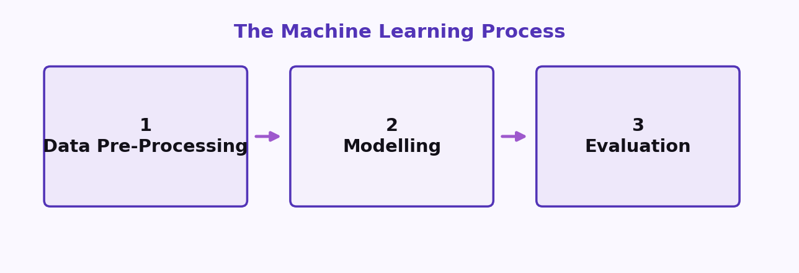
S01 · Foundations
The Machine Learning Process
The 3 main steps
Step 1 · Data Pre-Processing
Step 2 · Modelling
Step 3 · Evaluation
Load the data · Clean the data
Build the model · Train the model
Calculate performance metrics · Make a final prediction
ETRA
05 / 62

Slide 6
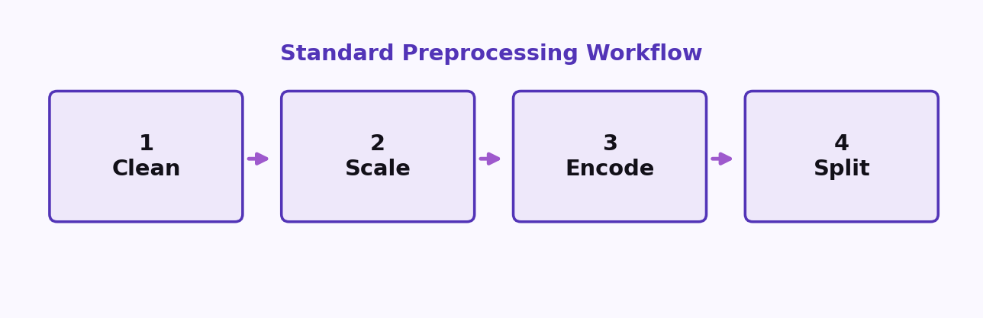
S01 · Foundations
Step 1: Data Pre-Processing
The Machine Learning Process
–
Load the data
–
Clean the data
–
Scale numeric features
–
Encode categorical features
–
Split into training and test sets
ETRA
06 / 62

Slide 7
S01 · Foundations
Step 2: Modelling
The Machine Learning Process
–
Build the model
–
Train the model
–
Make predictions
ETRA
07 / 62

Slide 8
S01 · Foundations
Step 3: Evaluation
The Machine Learning Process
–
Calculate performance metrics
–
Make a final prediction
ETRA
08 / 62

Slide 9
S01 · Foundations
Data Preprocessing Template
Standard Workflow
Clean → Scale → Encode → Split
Data preprocessing before modeling — a repeatable checklist before you train.
Start by loading the dataset, then follow the workflow in order.
ETRA
09 / 62

Slide 10
S01 · Foundations
Standard Workflow
Data Preprocessing Template
Data preprocessing before modeling
1. Clean
2. Scale
3. Encode
4. Split
Handle missing values, errors, and noise.
Normalize or standardize numeric features.
Turn categories into numeric representations.
Separate training and test data.
ETRA
10 / 62

Slide 11
S01 · Foundations
Workflow Checklist
Data Preprocessing Template
–
Load the dataset.
–
Clean — fix missing values, duplicates, and inconsistent records.
–
Scale — put numeric features on a comparable range.
–
Encode — convert categorical variables into model-ready form.
–
Split — create train/test sets before fitting the model.
ETRA
11 / 62

Slide 12
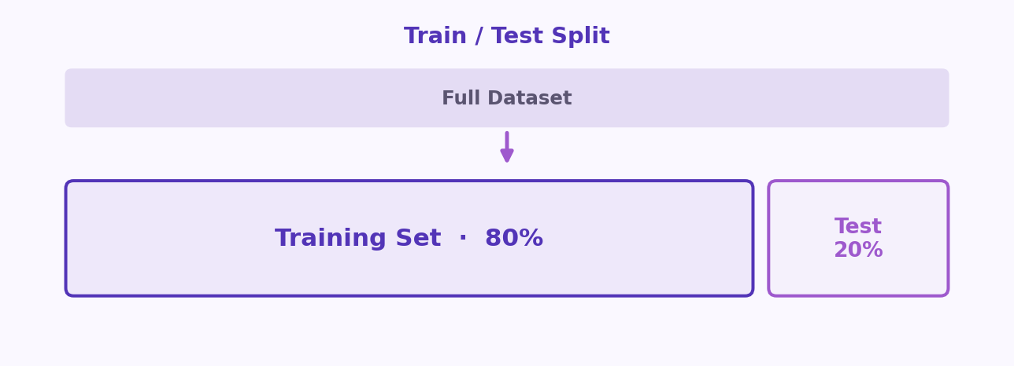
S01 · Foundations
Training Set and Test Set
Key Idea
Hold-out partition — train wide, test narrow
Typical split: 80% train · 20% test
ETRA
12 / 62

Slide 13
S01 · Foundations
Training Set and Test Set
Definitions
–
Never tune hyperparameters on the test set — it becomes part of training indirectly.
–
Stratified splits preserve class balance in classification tasks.
–
We train on one part of the data, then test on another part to make sure the model generalizes well.
ETRA
13 / 62

Slide 14
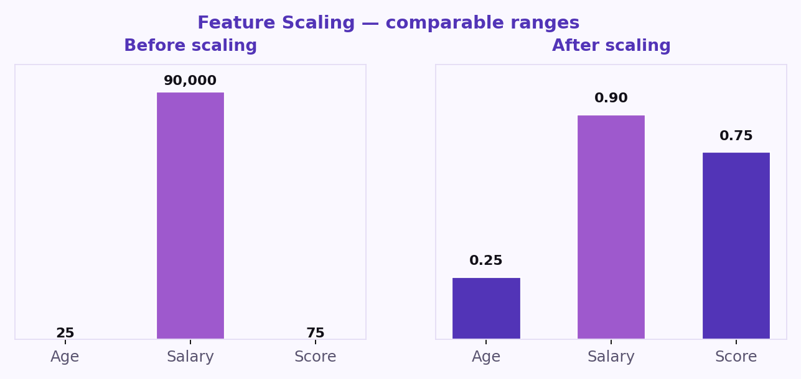
S01 · Foundations
Feature Scaling
What is Feature Scaling?
Feature scaling means adjusting feature values to a similar range using methods like standardization and normalization.
ETRA
14 / 62

Slide 15
S01 · Foundations
Feature Scaling
Why it matters
–
It prevents large-value features from dominating smaller-value features.
–
It improves performance for distance-based and gradient-based algorithms (e.g., KNN, SVM, Gradient Descent).
–
It helps training converge faster.
ETRA
15 / 62

Slide 16
S01 · Foundations
Example (Before vs After Scaling)
Worked example
Student | Height (cm) | Weight (kg) | Height (scaled) | Weight (scaled)
A | 150 | 50 | 0.25 | 0.22
B | 170 | 70 | 0.58 | 0.67
C | 185 | 85 | 0.83 | 1.00
Before scaling, height and weight have different numeric ranges. After scaling, both features are on a comparable scale and contribute more fairly.
ETRA
16 / 62

Slide 17
S01 · Foundations
Feature Scaling Methods
Feature Scaling
Comparable range
After scaling
Features brought to a comparable range.
Heights are comparable.
Normalization
Scales to [0, 1] using min–max — sensitive to outliers.
Standardization
Uses mean 0 and std 1 — preferred when features are roughly Gaussian.
Robust scaling
Uses median and IQR when outliers dominate.
ETRA
17 / 62

Slide 18
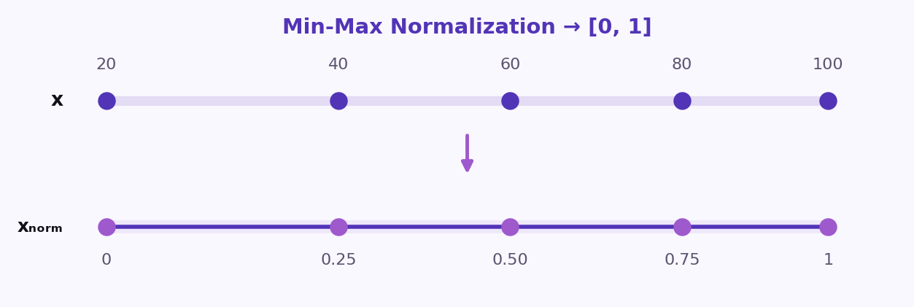
S01 · Foundations
1) Normalization (Min-Max Scaling)
Feature Scaling Methods
Normalization transforms each value to a range between 0 and 1.
Formula
x_{norm} =
x − x_{min}
x_{max} − x_{min}
–
Useful for models that depend on distances or absolute magnitudes.
–
Common choice for algorithms such as KNN and K-Means.
ETRA
18 / 62

Slide 19
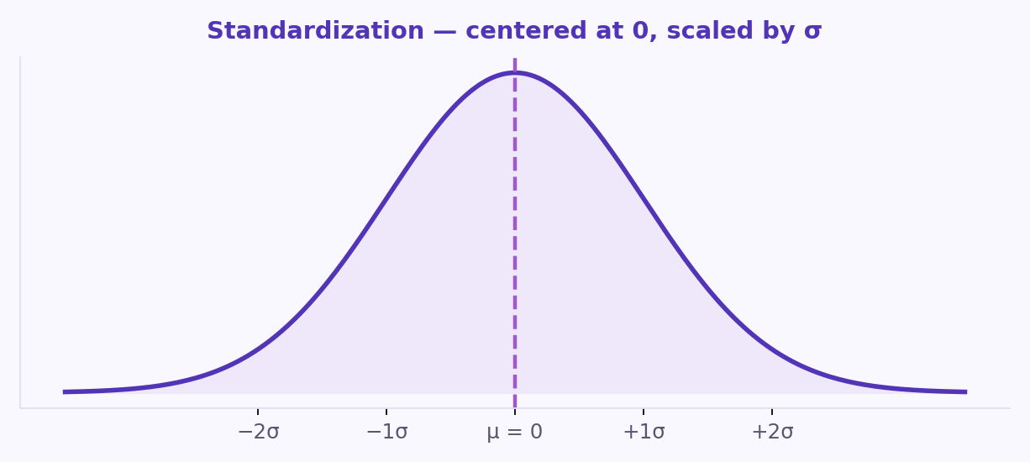
S01 · Foundations
2) Standardization (Z-score Scaling)
Feature Scaling Methods
Standardization centers data around 0 with a standard deviation of 1.
Formula
z =
x − μ
σ
–
Preferred when features are close to a Gaussian distribution.
–
Works well with Logistic Regression, SVM, and Linear Regression.
ETRA
19 / 62

Slide 20
S01 · Foundations
Choosing the Right Scaling Method
Practical guidance
–
Use standardization for SVM, logistic regression, PCA, and gradient-based training.
–
Tree-based models are scale-invariant — scaling is optional.
–
When in doubt, fit the scaler on train only, then transform train and test.
Normalization
Use Normalization when feature values have very different ranges and you want all values mapped to [0, 1].
Typical method: Min-Max Scaling.
ETRA
20 / 62

Slide 21
S01 · Foundations
Normalization vs Standardization
When to use each
Normalization
Standardization
Good for distance-based models where magnitude differences strongly affect results.
Use when features are expected to follow (or be close to) a Gaussian distribution, or when the dataset contains outliers.
Maps values to [0, 1] · typical method: Min-Max Scaling.
Keeps data centered around 0 and scales variability to 1.
–
Often preferred for linear models and optimization-based algorithms.
ETRA
21 / 62

Slide 22
S01 · Foundations
Feature Scaling Example (Normalization)
Worked example
Given feature values: [20, 40, 60, 80, 100]
Comparable range
After scaling
Features brought to a comparable range.
Heights are comparable.
x_{norm} =
x − x_{min}
x_{max} − x_{min}
x_{min} = 20 · x_{max} = 100
20
40
60
80
100
0.00
0.25
0.50
0.75
1.00
ETRA
22 / 62

Slide 23
S01 · Foundations
Before vs After Normalization
Feature Scaling Example
x_{norm} =
x − x_{min}
x_{max} − x_{min}
x_{min} = 20 · x_{max} = 100
Original value (x) | Normalized value (xₙₒᵣₘ)
20 | 0.00
40 | 0.25
60 | 0.50
80 | 0.75
100 | 1.00
This table shows how all values are scaled to the range [0, 1].
ETRA
23 / 62

Slide 24
S01 · Foundations
Feature Scaling Example (Standardization)
Worked example
Given feature values: [20, 40, 60, 80, 100]
Comparable range
After scaling
Features brought to a comparable range.
Heights are comparable.
z =
x − μ
σ
Mean: μ = 60 · Standard deviation: σ = 28.28
20
40
60
80
100
−1.41
−0.71
0.00
0.71
1.41
ETRA
24 / 62

Slide 25
S01 · Foundations
Before vs After Standardization
Feature Scaling Example
z =
x − μ
σ
Mean: μ = 60 · Standard deviation: σ = 28.28
Original value (x) | Standardized value (z)
20 | −1.41
40 | −0.71
60 | 0.00
80 | 0.71
100 | 1.41
This table shows that standardized values are centered around 0 and measured in units of standard deviation.
ETRA
25 / 62

Slide 26
S01 · Foundations
Categorical Data
What is Categorical Data?
Categorical data describes values that belong to named groups rather than continuous numbers.
ETRA
26 / 62

Slide 27
S01 · Foundations
Category Types
Ordinal vs Nominal
Type | Description | Example
Ordinal | Categories have a meaningful order. | Education Level: High School < Bachelor's < Master's < PhD
Nominal | Categories have no natural order. | Payment Method: Cash, Card, Bank Transfer
Choose encoding based on whether order matters.
ETRA
27 / 62

Slide 28
S01 · Foundations
Example 1: Label Encoding
Encoding categorical data
Raw category | Encoded value
Cash | 0
Card | 1
Bank Transfer | 2
Each category is mapped to a unique integer.
ETRA
28 / 62

Slide 29
S01 · Foundations
Example 2: One-Hot Encoding
Encoding categorical data
Raw category | Cash | Card | Bank Transfer
Cash | 1 | 0 | 0
Card | 0 | 1 | 0
Bank Transfer | 0 | 0 | 1
Most machine learning algorithms work with numerical inputs only, so categorical values must be converted into numbers.
ETRA
29 / 62

Slide 30
S01 · Foundations
How to Deal with Categorical Data (Ordinal Encoding)
What is Ordinal Encoding?
Ordinal Encoding converts ordered categories into integers that preserve their ranking.
ETRA
30 / 62

Slide 31
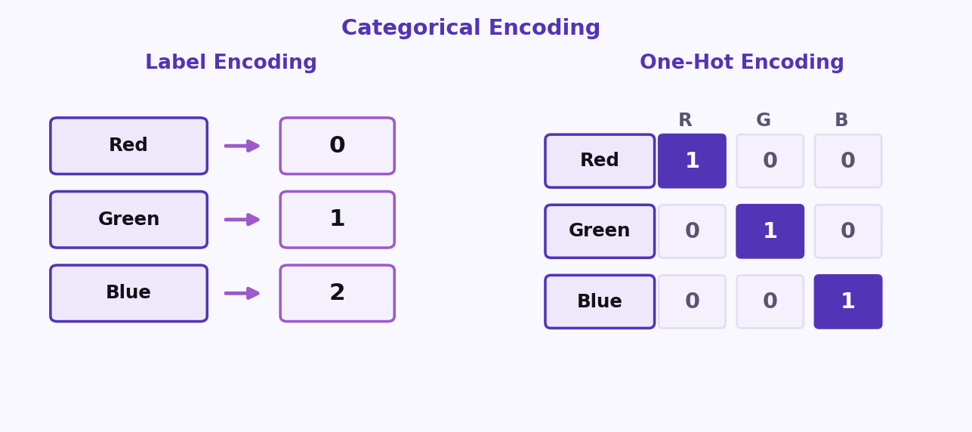
S01 · Foundations
Encoding Comparison
Choosing an encoding
Three ways to encode categorical variables
Label Encoding · One-Hot Encoding · Ordinal Encoding
ETRA
31 / 62

Slide 32
S01 · Foundations
How to Apply Ordinal Encoding
Practical steps
Use Ordinal Encoding only when categories have a true order.
–
Step 1: Identify the correct category order.
–
Step 2: Assign an integer to each level based on that order.
–
Step 3: Replace the original text values with encoded numbers.
ETRA
32 / 62

Slide 33
S01 · Foundations
Example: Ordinal Encoding
Ordinal Encoding
Satisfaction level | Encoded value
Low | 1
Medium | 2
High | 3
This method keeps the order information, which is important for many machine learning models.
ETRA
33 / 62

Slide 34
S01 · Foundations
How to Deal with Categorical Data (One-Hot Encoding)
What is One-Hot Encoding?
One-Hot Encoding converts each category into a separate binary column (0 or 1).
ETRA
34 / 62

Slide 35
S01 · Foundations
How to Apply One-Hot Encoding
Practical steps
Use One-Hot Encoding for nominal categories (no natural order).
–
Step 1: List all unique categories.
–
Step 2: Create one column for each category.
–
Step 3: Put 1 in the matching category column and 0 in all others.
ETRA
35 / 62

Slide 36
S01 · Foundations
Example: One-Hot Encoding
One-Hot Encoding
Payment method | Cash | Card | Bank Transfer
Cash | 1 | 0 | 0
Card | 0 | 1 | 0
Bank Transfer | 0 | 0 | 1
This method avoids creating a false ranking between categories.
ETRA
36 / 62

Slide 37
S01 · Foundations
Avoiding the Dummy Variable Trap
One-Hot Encoding
It helps prevent the dummy variable trap (perfect multicollinearity), especially in linear models.
–
Step 1: Start with One-Hot encoded columns.
–
Step 2: Drop one category as a reference (baseline).
–
Step 3: Keep the remaining binary columns.
Original categories: Payment Method = [Cash, Card, Bank Transfer]. · Reference category (dropped): Cash.
ETRA
37 / 62

Slide 38
S01 · Foundations
Example (Reference = Cash)
Dummy variable trap
Payment method | Card | Bank Transfer
Cash | 0 | 0
Card | 1 | 0
Bank Transfer | 0 | 1
In this setup, Cash is represented when all remaining columns are 0.
ETRA
38 / 62

Slide 39
S01 · Foundations
Encoding Methods Overview
Beyond label / one-hot / ordinal
Encoding type | Idea | Best use case
Frequency Encoding | Replace each category with how often it appears. | Large datasets with many categories
Count Encoding | Similar to frequency, but uses raw counts directly. | Tree-based models with high-cardinality features
Target Encoding | Replace category with target mean for that category. | Supervised tasks (use with care to avoid leakage)
Binary Encoding | Convert category index to binary digits across columns. | High-cardinality data with fewer columns than one-hot
Hash Encoding | Use a hash function to map categories into fixed columns. | Very large and dynamic category sets
ETRA
39 / 62

Slide 40
S01 · Foundations
1) Frequency Encoding (City)
Encoding methods
City | Frequency
Riyadh | 0.50
Jeddah | 0.33
Dammam | 0.17
ETRA
40 / 62

Slide 41
S01 · Foundations
2) Count Encoding (City)
Encoding methods
City | Count
Riyadh | 3
Jeddah | 2
Dammam | 1
ETRA
41 / 62

Slide 42
S01 · Foundations
3) Target Encoding (City)
Encoding methods
City | Mean target
Riyadh | 0.80
Jeddah | 0.40
Dammam | 0.20
ETRA
42 / 62

Slide 43
S01 · Foundations
4) Binary Encoding (City)
Encoding methods
City | Category ID | Binary code
Riyadh | 1 | 01
Jeddah | 2 | 10
Dammam | 3 | 11
ETRA
43 / 62

Slide 44
S01 · Foundations
5) Hash Encoding (4 Buckets)
Encoding methods
City | Hash bucket
Riyadh | 2
Jeddah | 0
Dammam | 3
ETRA
44 / 62

Slide 45
S01 · Foundations
Handling Missing Data
What is Missing Data?
Missing data refers to values that are absent or incomplete in one or more features of a dataset.
–
It can introduce bias into model training.
–
It may reduce prediction accuracy.
–
It can cause errors in analysis if not handled properly.
ETRA
45 / 62

Slide 46
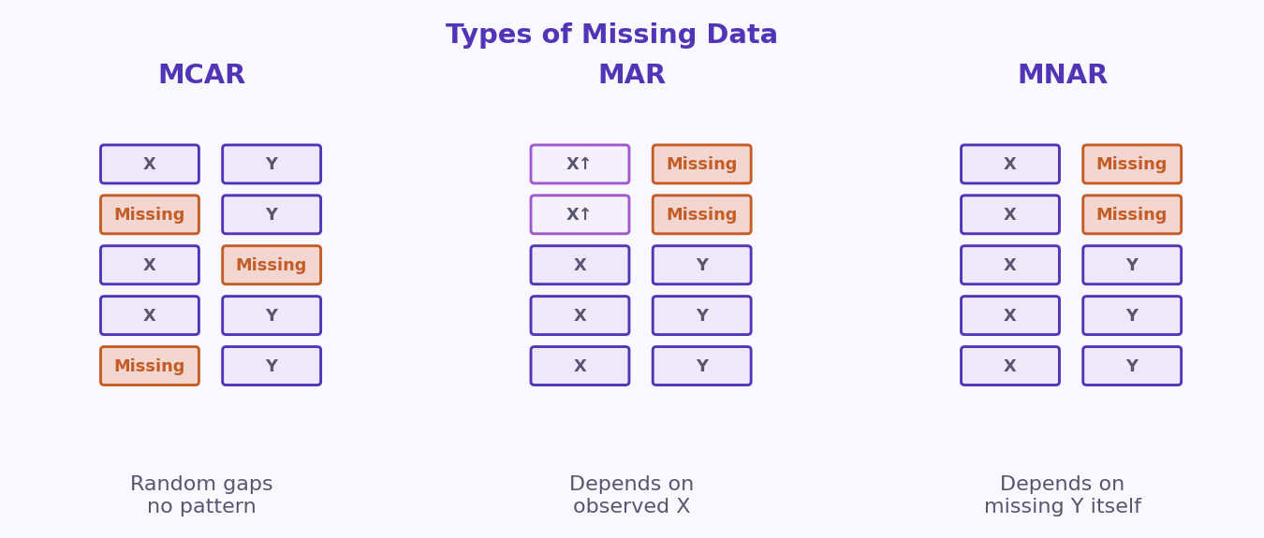
S01 · Foundations
Types of Missing Data
MCAR · MAR · MNAR
MCAR = random · MAR = explained by observed features · MNAR = tied to the missing value itself.
ETRA
46 / 62

Slide 47
S01 · Foundations
Why Do We Have Missing Data?
Handling Missing Data
Missing values can appear for many practical reasons during data collection and processing.
ETRA
47 / 62

Slide 48
S01 · Foundations
Common Causes
Why values go missing
Cause | Description | Example
Human Error | Data is skipped, entered incorrectly, or forgotten. | A user leaves the Age field empty in a form.
Device/Sensor Failure | Measurement tools fail or disconnect. | A medical sensor stops recording heart rate temporarily.
Data Integration Issues | Missing fields appear when combining data from multiple sources. | One database has salary, another does not.
Privacy or Refusal | Participants choose not to share sensitive information. | A customer does not provide income details.
System/Transmission Errors | Data is lost during storage, transfer, or export. | Network interruption causes missing rows in logs.
Conditional Missingness | Some fields are only relevant for specific groups. | Pregnancy_Status is empty for male patients.
Understanding why data is missing helps us choose the right treatment method (deletion, imputation, or advanced modeling).
ETRA
48 / 62

Slide 49
S01 · Foundations
Missing Completely at Random (MCAR)
Handling Missing Data · MCAR
MCAR means missing values occur randomly and are independent of both observed and unobserved variables.
–
MCAR has no systematic pattern.
–
In practice, MCAR is often an unrealistic assumption in real-world datasets.
–
Before assuming MCAR, review data collection workflow and consult domain experts.
–
If MCAR is reasonable, simple imputation (mean/median/mode) can work.
ETRA
49 / 62

Slide 50
S01 · Foundations
Illustrative Data Example
Handling Missing Data · MCAR
Student ID | Age | Score
101 | 20 | 85
102 | Missing | 88
103 | 21 | Missing
104 | 23 | 91
105 | Missing | 76
106 | 22 | Missing
Missing values appear across different rows and columns with no clear pattern, which is consistent with MCAR.
ETRA
50 / 62

Slide 51
S01 · Foundations
Missing at Random (MAR)
Handling Missing Data · MAR
MAR means missingness is related to observed features in the dataset, but not to the missing feature itself.
–
Missingness depends on other observed variables.
–
The missing value itself is not the direct cause of the gap.
–
More realistic than MCAR in many real-world datasets.
–
Model-based imputation that uses observed features usually works better than simple mean/median fills.
ETRA
51 / 62

Slide 52
S01 · Foundations
Imputation Techniques for MAR
Handling Missing Data · MAR
Method | Idea | Why it works for MAR
kNN Imputation | Fills missing values using the nearest similar records. | Uses observed features to find similar patterns.
MissForest | Uses random-forest models iteratively to predict missing values. | Captures non-linear relationships from observed data effectively.
Both methods leverage observed features — exactly what MAR assumes is available and informative.
ETRA
52 / 62

Slide 53
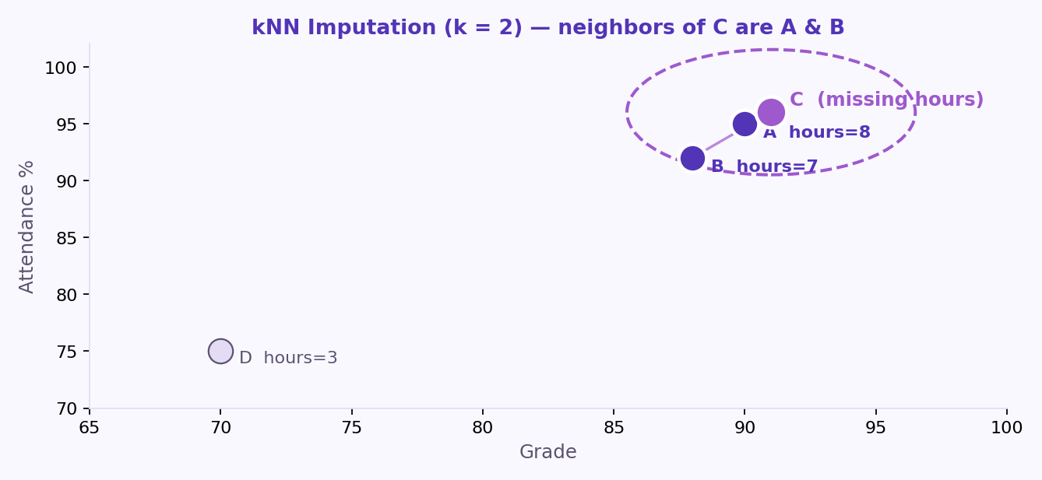
S01 · Foundations
kNN Imputation (k = 2)
Handling Missing Data · MAR
For student C, the two nearest students based on Grade and Attendance are A and B.
–
Use observed features (Grade, Attendance) to find the nearest neighbors.
–
Impute student C’s missing value from students A and B (e.g. average).
ETRA
53 / 62

Slide 54
S01 · Foundations
kNN Neighbor Table
Handling Missing Data · MAR
Student | Grade | Attendance (%) | Study Hours
A | 90 | 95 | 8
B | 88 | 92 | 7
C | 91 | 96 | Missing
D | 70 | 75 | 3
Student C is closest to A and B on Grade and Attendance — so we ignore distant student D.
ETRA
54 / 62

Slide 55
S01 · Foundations
kNN Imputed Result
Handling Missing Data · MAR
Study Hours_{C} = (8 + 7) / 2 = 7.5
Average the Study Hours of the two nearest neighbors (A and B) to fill the missing value for student C.
–
Neighbor A → Study Hours = 8
–
Neighbor B → Study Hours = 7
–
Imputed value for C → 7.5
ETRA
55 / 62

Slide 56
S01 · Foundations
Example: MissForest
Handling Missing Data · MAR
MissForest trains a Random Forest model using known rows to predict the missing value for student C.
–
Treat the incomplete column (Study Hours) as the target.
–
Train on complete rows (A, B, D) using observed features such as Grade and Attendance.
–
Predict Study Hours for student C from the learned non-linear relationships.
–
Iterate across features with missing values until predictions stabilize.
ETRA
56 / 62

Slide 57
S01 · Foundations
MissForest Result
Handling Missing Data · MAR
Study Hours_{C} ≈ 7.6
The Random Forest prediction for student C’s missing Study Hours is approximately 7.6.
–
Uses non-linear patterns learned from complete rows.
–
Often more accurate than simple neighbor averages when relationships are complex.
ETRA
57 / 62

Slide 58
S01 · Foundations
Example: MAR Grades Table
Handling Missing Data · MAR
Student | Grade (Observed) | Study Hours
1 | 95 | Missing
2 | 92 | Missing
3 | 88 | 4
4 | 75 | 6
5 | 70 | 7
MAR is common in practice because missingness can often be explained by available variables.
ETRA
58 / 62

Slide 59
S01 · Foundations
Missing Not at Random (MNAR)
Handling Missing Data · MNAR
MNAR is usually the most complex type because missingness depends on the missing value itself or unobserved variables.
–
MNAR has a systematic pattern tied to hidden information.
–
Standard imputation can be unreliable without additional data or strong domain assumptions.
–
Often needs specialized models, sensitivity analysis, or collecting the missing information directly.
–
Before treating MNAR like MAR/MCAR, validate the missingness mechanism with domain experts.
ETRA
59 / 62

Slide 60
S01 · Foundations
Example: MNAR Stress Reports
Handling Missing Data · MNAR
Participant | Reported Stress Level
1 | 2
2 | Missing
3 | 3
4 | Missing
5 | 1
Missing stress reports may be tied to the stress level itself — people with higher stress may skip the question.
ETRA
60 / 62

Slide 61
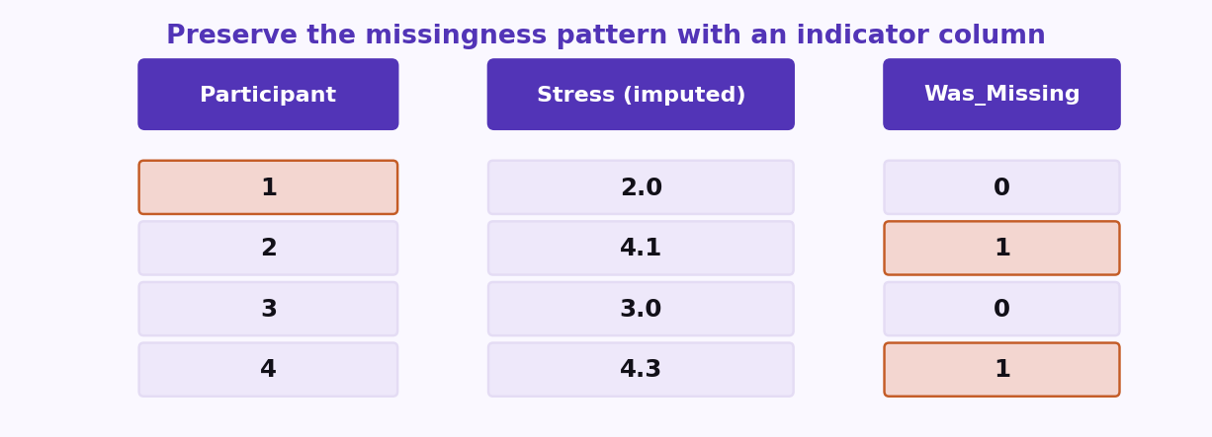
S01 · Foundations
Practical Tip: Preserve Missingness Pattern
Handling Missing Data · MNAR
Add an indicator column so the model can still learn from the fact that a value was missing.
ETRA
61 / 62

Slide 62
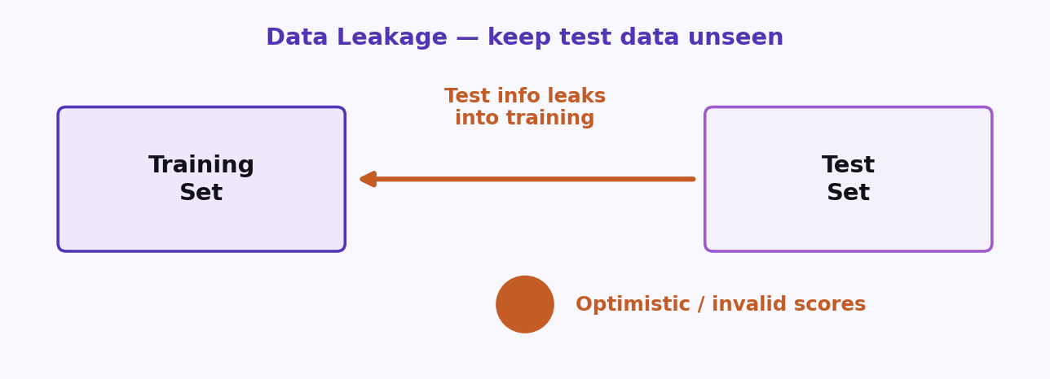
S01 · Foundations
Data Leakage
Keep the test set unseen
Data leakage happens when information from outside the training process — especially the test set — influences model fitting or decisions.
–
Never use test labels or test-only signals when choosing features, models, or hyperparameters.
–
Fit scalers and encoders on the training set only, then transform train and test.
Rule: treat the test set as future data you have not seen yet.
–
Peeking at the test set creates optimistic scores that will not hold in production.
ETRA
62 / 62

