Slide 1
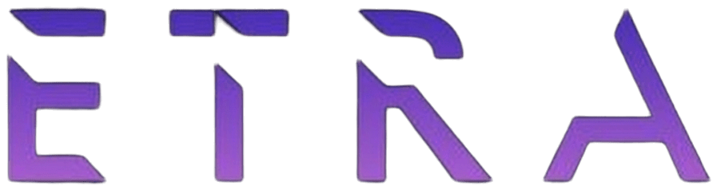
Week 4 · Session 1
GenAI
GenAI: BERT, T5, GPT, Attention
ETRA
AI & Machine Learning Bootcamp

Slide 2
S14 · Big picture
Where Are We in the Bootcamp?
Week 4 Session 1 — GenAI: BERT, T5, GPT, Attention.
Week 1
Week 2
Week 3
Week 4
S1
Foundations & Preprocessing
S7
Deep Learning
S8
NLP Fundamentals
S14
Generative AI
S2
Regression Models
S9
Tokenization
S15
RAG Systems
S3
Classification Basics
S10
Text Analysis & NER
S16
MLOps
S4
Naive Bayes & Trees
S11
Language Modeling
S5
SVM & Kernels
S12
Embeddings & RNNs
S6
Clustering & PCA
S13
Seq2Seq & NMT
ETRA
02 / 42

Slide 3
Week 4 · Session 1
GenAI
BERT · T5 · GPT · Attention
Core Concepts
Transfer Learning
BERT
T5
GPT
Attention
Scaling & Practice
ETRA
03 / 42

Slide 4
S14 · GenAI
BERT · T5 · GPT · Attention
What we will cover in this session
–
Core Concepts
–
Transfer Learning
–
BERT
–
T5
–
GPT
–
Attention
–
Scaling & Practice
ETRA
04 / 42

Slide 5
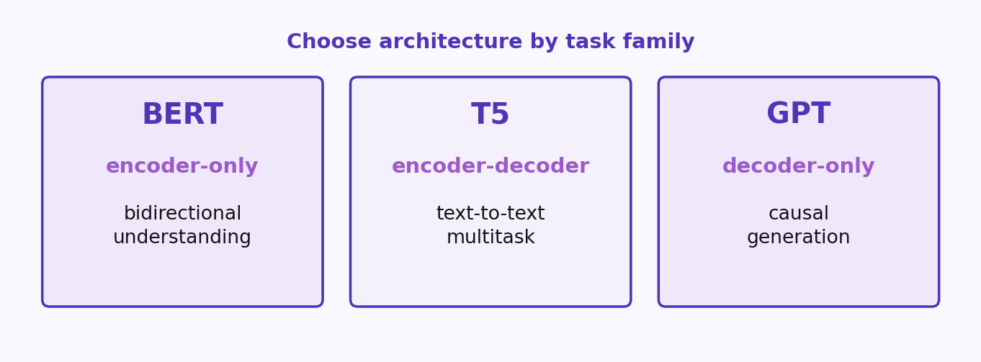
S14 · GenAI
Generative AI: Core Concepts
BERT, T5, GPT, LLMs, and Attention (Focused Edition)
ETRA
05 / 42

Slide 6
S14 · GenAI
Generative AI: Core Concepts
BERT, T5, GPT, LLMs, and Attention (Focused Edition)
–
This section extracts the most important ideas into a compact teaching flow.
–
Focus areas: transfer learning, model families, attention mechanics, scaling, and practical deployment.
–
Designed for bootcamp delivery within roughly 20 slides.
ETRA
06 / 42

Slide 7
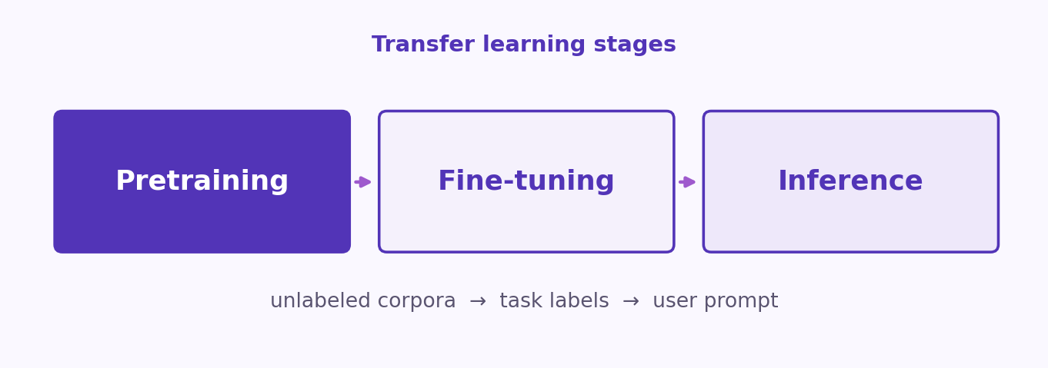
S14 · GenAI
Transfer Learning in Generative AI
ETRA
07 / 42

Slide 8
S14 · GenAI
Transfer Learning in Generative AI
Stage | Data Type | Goal
Pretraining | Large mostly unlabeled corpora | Learn general language representations
Fine-tuning | Task-labeled dataset | Adapt model to specific downstream objective
Inference | User prompt/context | Generate or classify outputs for real tasks
Transfer learning reduces labeled data needs and accelerates convergence.
ETRA
08 / 42

Slide 9
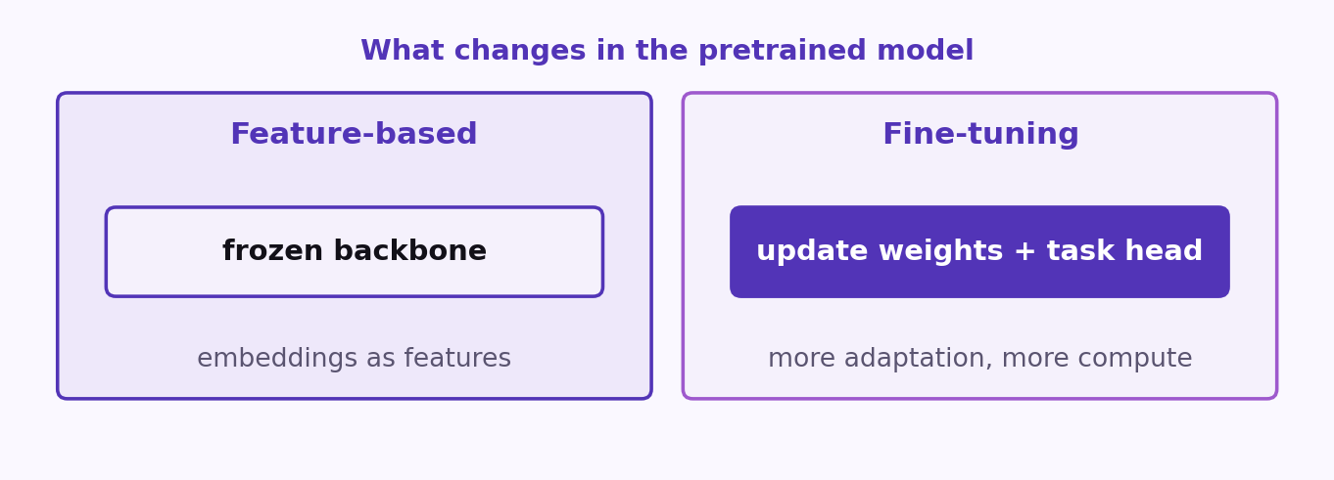
S14 · GenAI
Feature-Based Transfer vs Fine-Tuning
ETRA
09 / 42

Slide 10
S14 · GenAI
Feature-Based Transfer vs Fine-Tuning
Strategy | What Changes | Pros | Tradeoff
Feature-based | Freeze pretrained backbone; use embeddings as input features | Fast and lightweight | Less task adaptation
Fine-tuning | Update model weights (often with a task head) | Higher task performance | More compute and tuning effort
ETRA
10 / 42

Slide 11
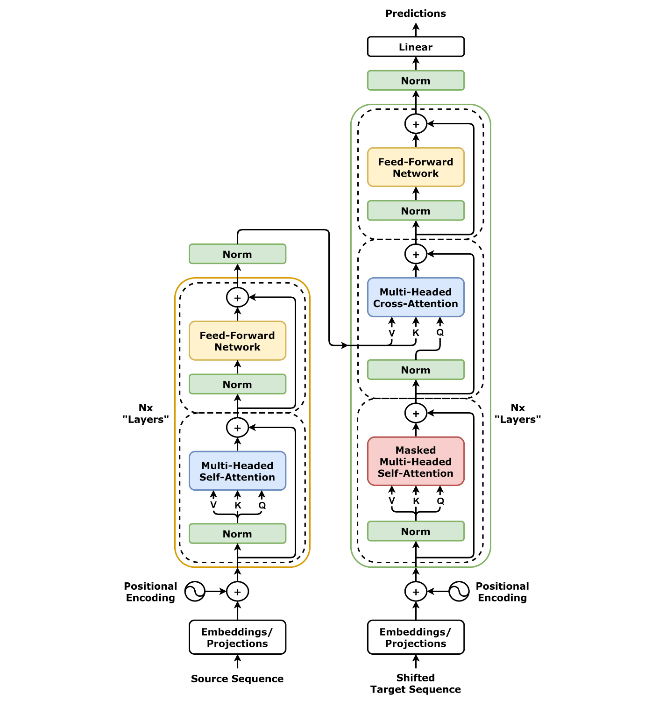
S14 · GenAI
BERT: Encoder-Only Bidirectional Understanding
ETRA
11 / 42

Slide 12
S14 · GenAI
BERT: Encoder-Only Bidirectional Understanding
–
BERT learns contextual token representations using both left and right context.
–
Strong for understanding tasks: classification, NER, QA, and retrieval-oriented use cases.
–
Pretrained at scale (Wikipedia + BooksCorpus), then adapted to downstream tasks.
ETRA
12 / 42

Slide 13
S14 · GenAI
BERT Pretraining Objectives
Objective | How It Works | What It Teaches
MLM (Masked Language Modeling) | Mask subset of tokens and predict originals | Bidirectional contextual semantics
NSP (Next Sentence Prediction) | Predict whether sentence B follows sentence A | Inter-sentence coherence signals
MLM and NSP were jointly used in original BERT training setup.
ETRA
13 / 42

Slide 14
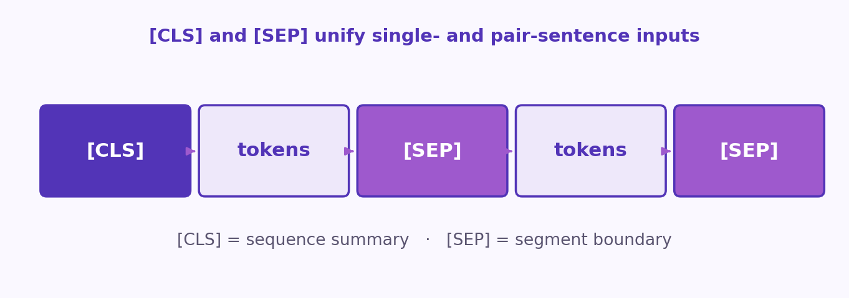
S14 · GenAI
BERT Special Tokens: [CLS] and [SEP]
ETRA
14 / 42

Slide 15
S14 · GenAI
BERT Special Tokens: [CLS] and [SEP]
–
[CLS] is prepended and its final embedding is used as a sequence-level summary.
–
[SEP] separates sentence segments and marks boundaries.
–
In classification tasks, [CLS] passes through a lightweight prediction head.
Token design helps unify single- and pair-sentence tasks.
ETRA
15 / 42

Slide 16
S14 · GenAI
Arabic Adaptation Example: AraBERT
–
AraBERT follows BERT-base style architecture with Arabic-specific preprocessing.
–
Segmentation and Arabic-tailored tokenization improve vocabulary coverage.
–
Domain/language adaptation quality can matter more than raw parameter count.
ETRA
16 / 42

Slide 17
S14 · GenAI
Arabic Adaptation Example: AraBERT
Component | Adaptation Benefit
Farasa-style segmentation | Better handling of prefixes/suffixes and morphology
Arabic-focused vocabulary | Lower fragmentation and stronger lexical coverage
Arabic corpus curation | Improved contextual understanding in target language
ETRA
17 / 42

Slide 18
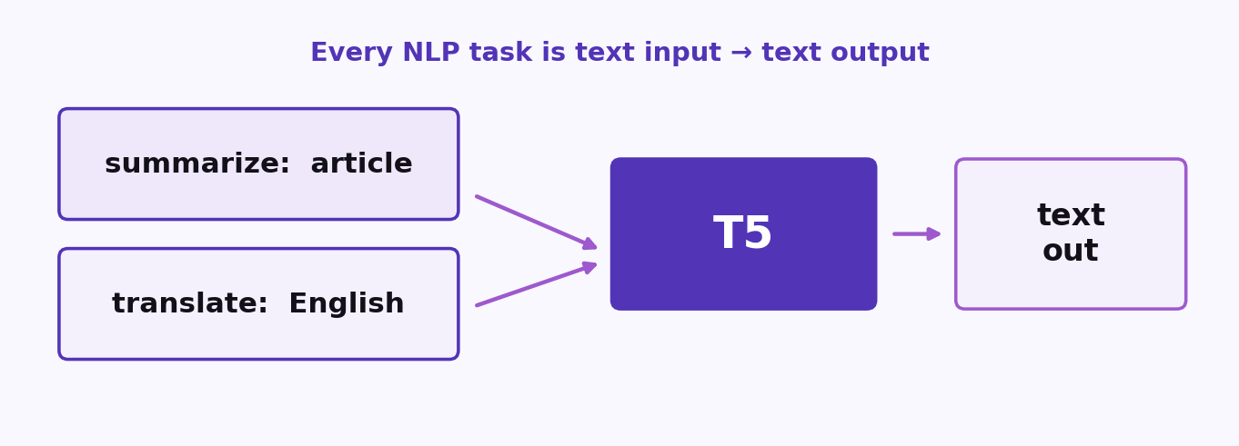
S14 · GenAI
T5: Unified Text-to-Text Framework
ETRA
18 / 42

Slide 19
S14 · GenAI
T5: Unified Text-to-Text Framework
–
T5 reframes every NLP task as text input -> text output.
–
Task instruction is included as a prefix (e.g., "summarize:", "translate:").
–
One shared architecture/training recipe serves multiple tasks.
This design strongly influenced modern prompt-based LLM usage.
ETRA
19 / 42

Slide 20
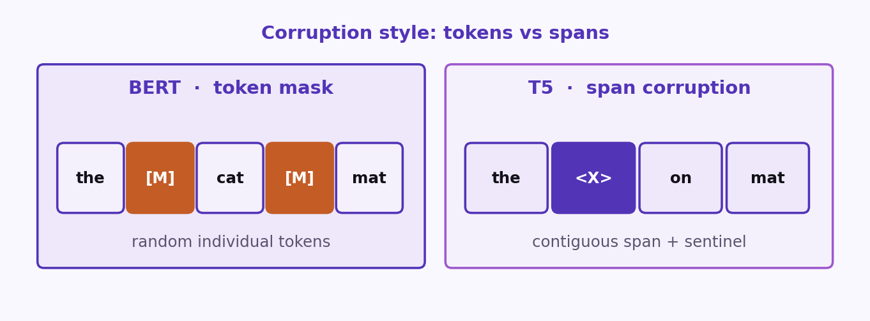
S14 · GenAI
T5 Pretraining Objective: Span Corruption
ETRA
20 / 42

Slide 21
S14 · GenAI
T5 Pretraining Objective: Span Corruption
–
Remove contiguous text spans from input and replace with sentinel tokens.
–
Train model to reconstruct missing spans autoregressively.
–
Encourages stronger generative behavior than token-only masking.
ETRA
21 / 42

Slide 22
S14 · GenAI
T5 Pretraining Objective: Span Corruption
Model | Corruption Style | Typical Strength
BERT | Random masked individual tokens | Language understanding tasks
T5 | Contiguous span corruption | Generation + multitask transfer
ETRA
22 / 42

Slide 23
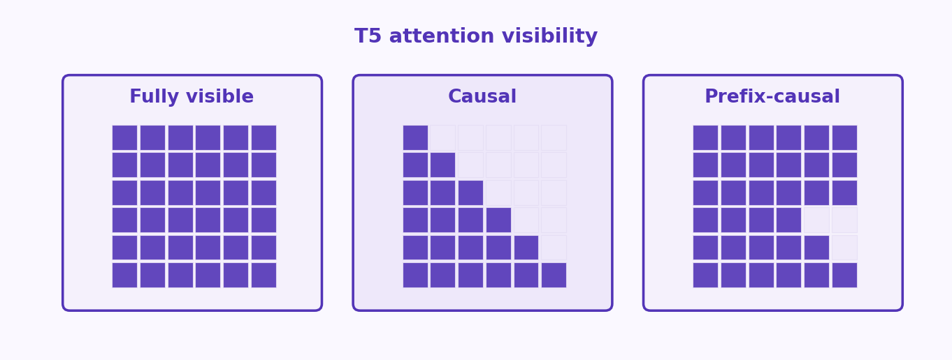
S14 · GenAI
T5 Attention Strategies (Encoder/Decoder)
ETRA
23 / 42

Slide 24
S14 · GenAI
T5 Attention Strategies (Encoder/Decoder)
Attention Type | Visibility | Used In
Fully visible | All tokens attend to all tokens | Encoder representations
Causal | Token attends to past only | Autoregressive generation
Prefix-causal hybrid | Full source access + causal target decoding | Seq2Seq decoding in T5
ETRA
24 / 42

Slide 25
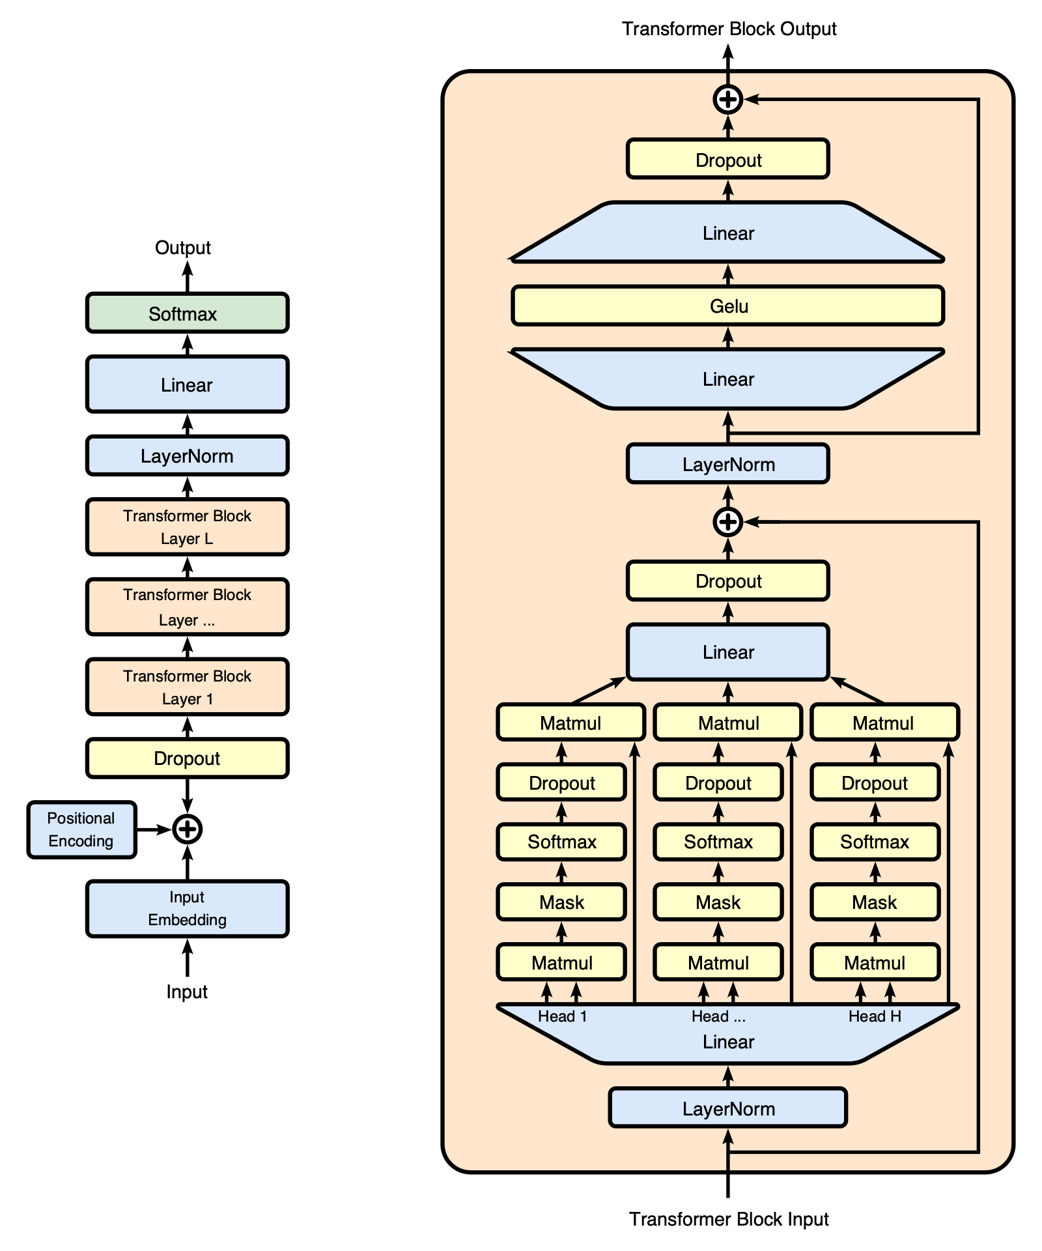
S14 · GenAI
GPT: Decoder-Only Autoregressive Generation
ETRA
25 / 42

Slide 26
S14 · GenAI
GPT: Decoder-Only Autoregressive Generation
–
GPT predicts next token from left context only (causal modeling).
–
Uses masked self-attention in decoder stack for no-lookahead generation.
–
Excellent for open-ended completion, instruction following, and synthesis.
ETRA
26 / 42

Slide 27
S14 · GenAI
GPT Evolution and Foundation Model Scale
Generation | Approx. Parameters | Key Theme
GPT-1 | 117M | Proof of transfer-learning viability
GPT-2 | 1.5B | Large-scale web pretraining for generation
GPT-3 | 175B | Few-shot in-context capabilities at scale
Model utility scales with data, architecture, and training compute quality.
ETRA
27 / 42

Slide 28
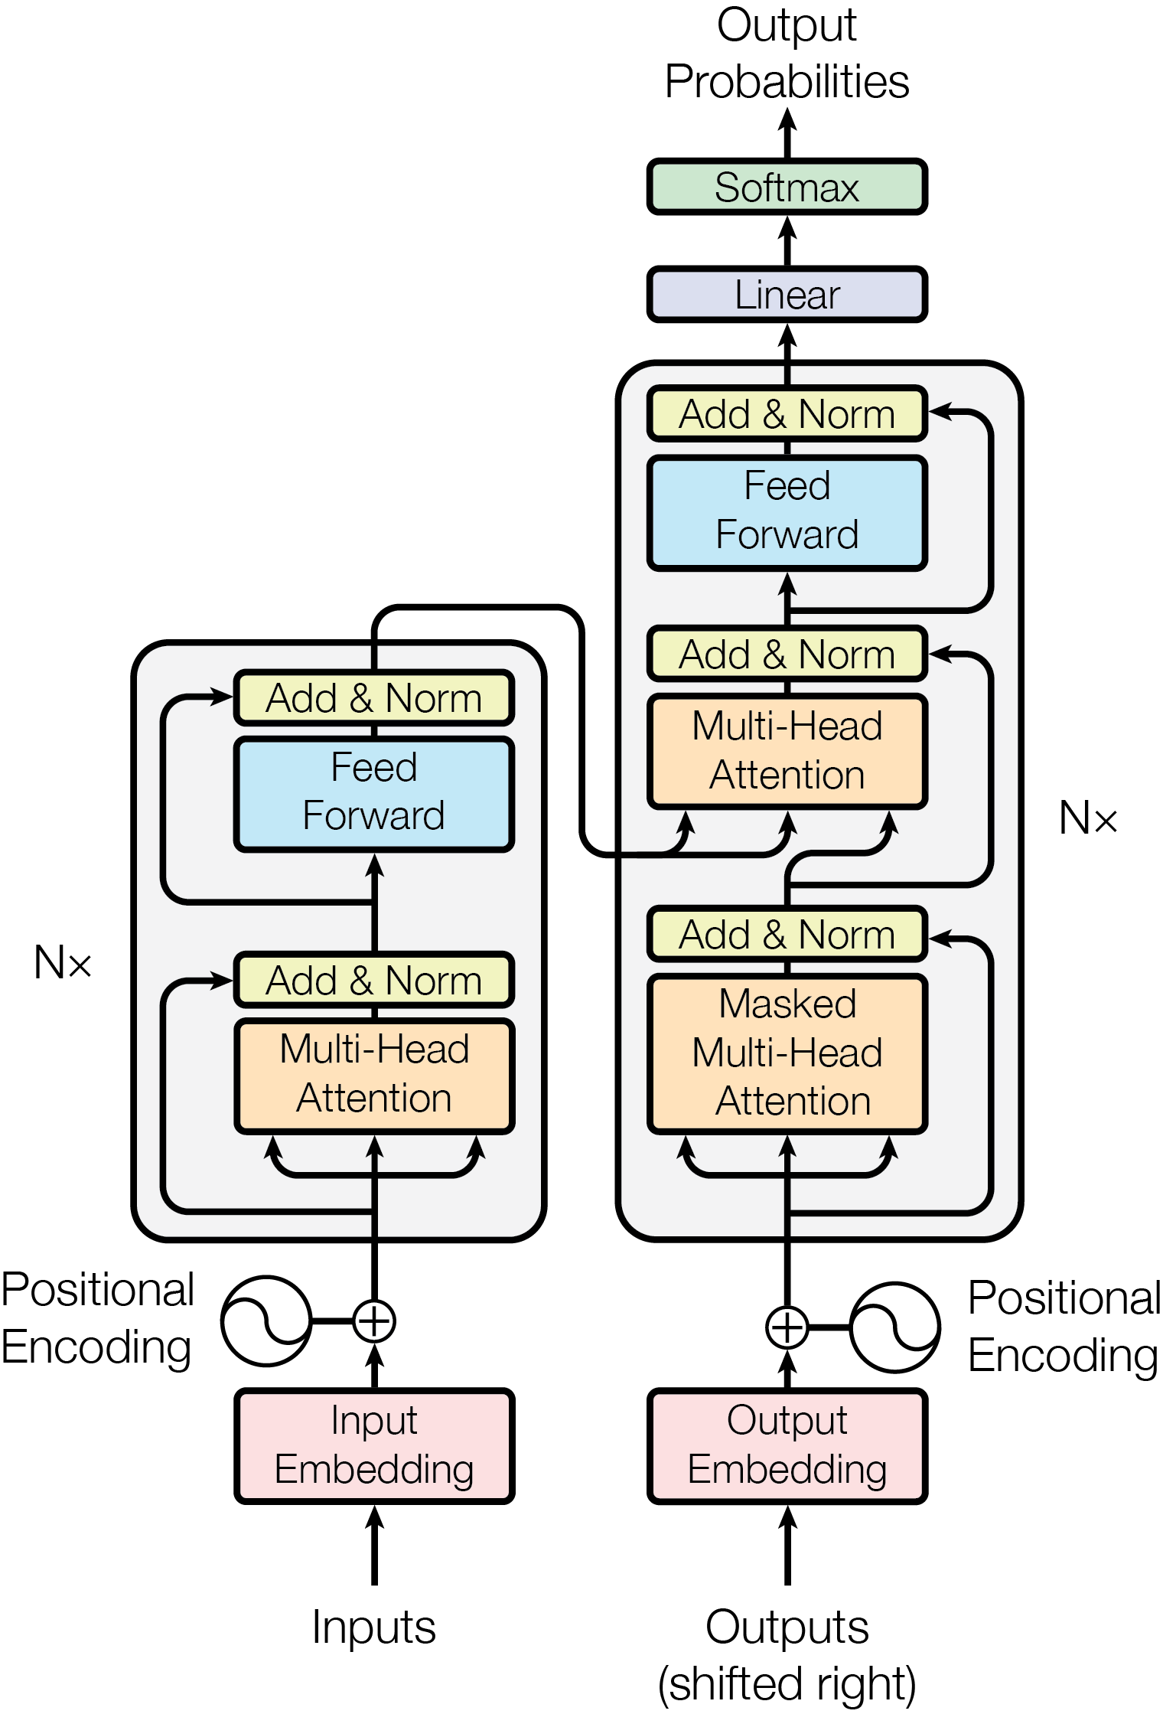
S14 · GenAI
Attention: Why It Was a Breakthrough
ETRA
28 / 42

Slide 29
S14 · GenAI
Attention: Why It Was a Breakthrough
–
Attention solves fixed-vector bottlenecks in sequence transduction.
–
At each step, model dynamically focuses on most relevant source positions.
–
Entire mechanism is differentiable and learned end-to-end.
ETRA
29 / 42

Slide 30
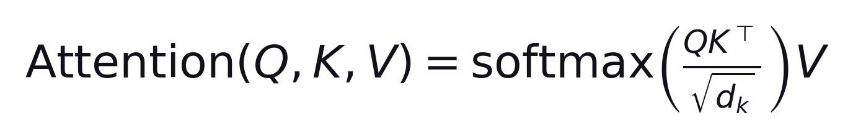
S14 · GenAI
Attention Computation Pipeline
–
Compute relevance scores between query state and source states.
–
Apply softmax to obtain attention weights (probability distribution).
–
Return weighted sum of value/source states as contextual output.
ETRA
30 / 42

Slide 31
S14 · GenAI
Bahdanau vs Luong Attention (Classic RNN Era)
Variant | Scoring Function | Typical Placement
Luong | Bilinear/dot-style | Attention after decoder state update
Bahdanau | MLP/additive score | Attention integrated before decoder update
Both approximate alignment; design choice affects speed and accuracy tradeoffs.
ETRA
31 / 42

Slide 32
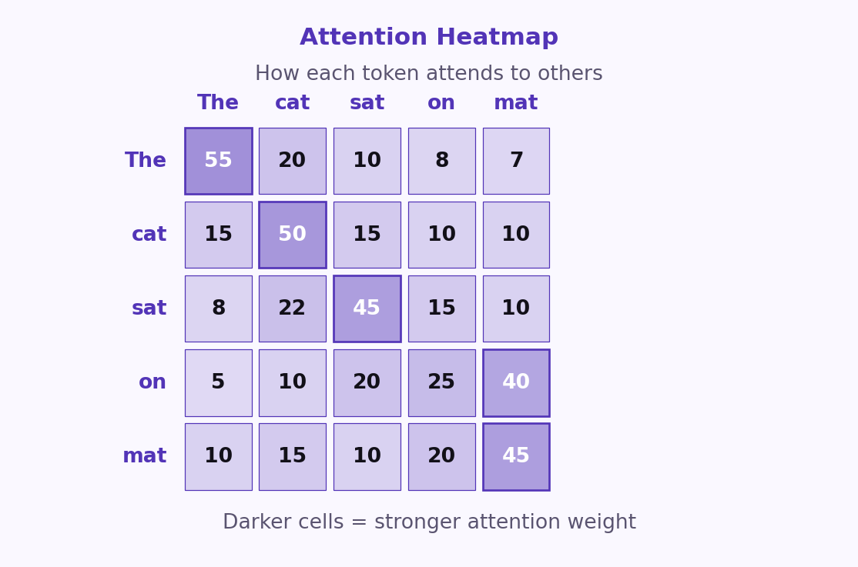
S14 · GenAI
Self-Attention, Q/K/V, and Multi-Head
ETRA
32 / 42

Slide 33
S14 · GenAI
Self-Attention, Q/K/V, and Multi-Head
–
Query asks for relevant context; Key indexes available context; Value carries content.
–
Self-attention lets each token aggregate information from other tokens in sequence.
–
Multi-head attention captures different linguistic relations in parallel.
Different heads can specialize in syntax, agreement, locality, or semantics.
ETRA
33 / 42

Slide 34
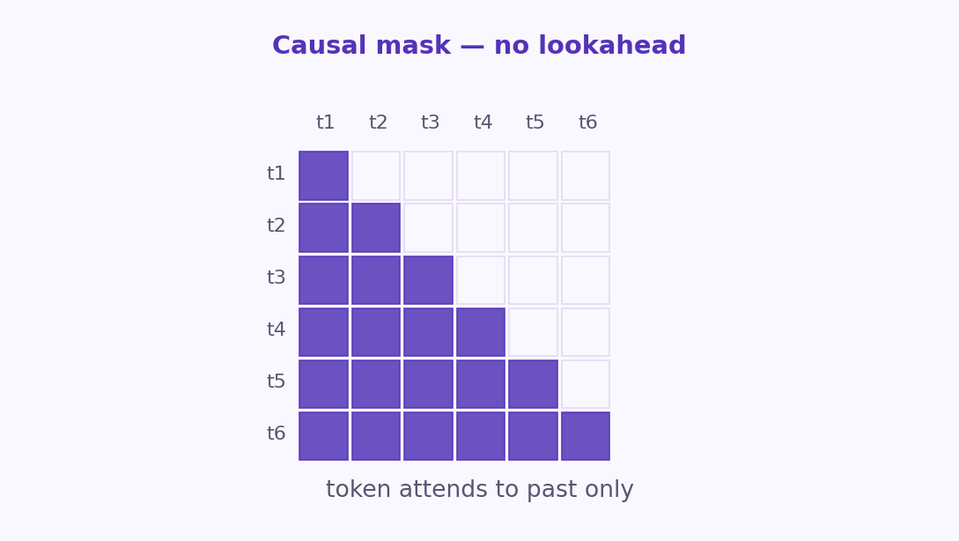
S14 · GenAI
Masked Self-Attention in Decoders
ETRA
34 / 42

Slide 35
S14 · GenAI
Masked Self-Attention in Decoders
–
Decoder cannot access future tokens during generation.
–
Causal mask enforces left-to-right consistency and prevents information leakage.
–
Enables parallel training over full target sequence while preserving autoregressive objective.
ETRA
35 / 42

Slide 36
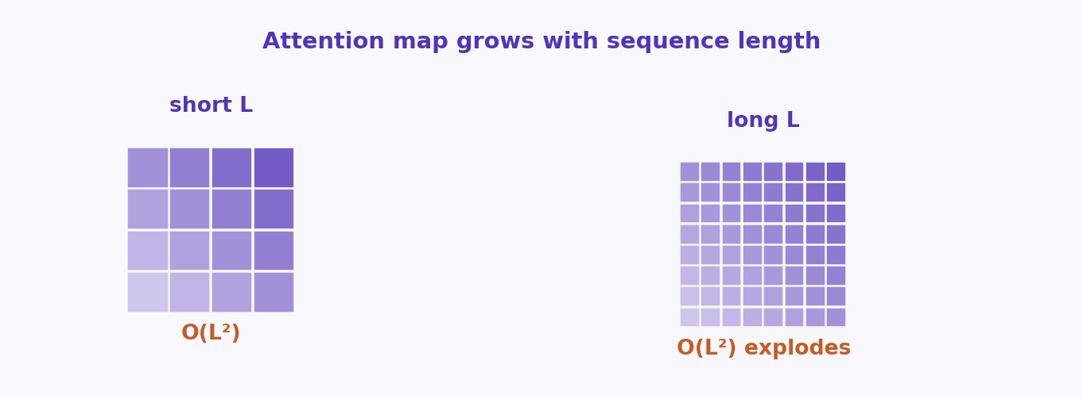
S14 · GenAI
Long-Sequence Challenge in Transformers
ETRA
36 / 42

Slide 37
S14 · GenAI
Long-Sequence Challenge in Transformers
Bottleneck | Complexity | Practical Impact
Attention map computation | O(L²) | Time/memory explode as context grows
Activation storage (training) | O(N*L*d_model) | High VRAM demand for deep long-context models
Long-context efficiency is now a central LLM engineering topic.
ETRA
37 / 42

Slide 38
S14 · GenAI
Scaling Laws and Compute-Optimal Training
–
Performance improves with data, model size, and compute, but with diminishing returns.
–
Compute-optimal training balances parameter count and token budget.
–
Chinchilla-style insight: many large models are under-trained relative to their size.
ETRA
38 / 42

Slide 39
S14 · GenAI
Scaling Laws and Compute-Optimal Training
Principle | Implication
Fixed compute budget | Tune model size and data volume jointly
Data-quality filtering | Small fraction of tokens may dominate useful learning
Chinchilla ratio (rule of thumb) | Roughly ~20 training tokens per parameter
ETRA
39 / 42

Slide 40
S14 · GenAI
Generative AI Practical Takeaways
–
Choose architecture by task type: encoder-only, encoder-decoder, or decoder-only.
–
Prefer transfer learning and fine-tuning over training from scratch when possible.
–
Use attention-aware designs and decoding strategy (greedy/beam) based on product constraints.
–
Plan for memory/compute early: quantization, context limits, and deployment targets.
–
For domain-heavy use cases, adapt with specialized corpora and evaluation protocols.
Strong GenAI systems come from balanced choices across data, architecture, compute, and evaluation.
ETRA
40 / 42

Slide 41
S14 · Takeaways
3 Ideas to Keep
Leave with these
1
Choose architecture by task: encoder-only (BERT), encoder-decoder (T5), or decoder-only (GPT).
2
Prefer transfer learning and fine-tuning over training from scratch.
3
Attention, decoding strategy, and compute limits shape what you can ship.
ETRA
41 / 42

Slide 42
Thank you
Labs: code/17- GenAI
ETRA
ETRA
42 / 42

