Slide 1

Week 3 · Session 1
NLP
NLP Workshop: Foundations to Seq2Seq
ETRA
AI & Machine Learning Bootcamp

Slide 2
S08 · Big picture
Where Are We in the Bootcamp?
Week 3 Session 1 — NLP from raw text to Seq2Seq.
Week 1
Week 2
Week 3
Week 4
S1
Foundations & Preprocessing
S7
Deep Learning
S8
NLP Fundamentals
S14
Generative AI
S2
Regression Models
S9
Tokenization
S15
RAG Systems
S3
Classification Basics
S10
Text Analysis & NER
S16
MLOps
S4
Naive Bayes & Trees
S11
Language Modeling
S5
SVM & Kernels
S12
Embeddings & RNNs
S6
Clustering & PCA
S13
Seq2Seq & NMT
ETRA
02 / 66

Slide 3
Week 3 · Session 1
NLP
Foundations · Tokenization · Seq2Seq
NLP Fundamentals
Regex & Cleaning
Tokenization
POS & NER
Language Modeling
Embeddings & RNNs
Seq2Seq & Attention
ETRA
03 / 66

Slide 4
S08 · NLP
Foundations · Tokenization · Seq2Seq
What we will cover in this session
–
NLP Fundamentals
–
Regex & Cleaning
–
Tokenization
–
POS & NER
–
Language Modeling
–
Embeddings & RNNs
–
Seq2Seq & Attention
ETRA
04 / 66

Slide 5
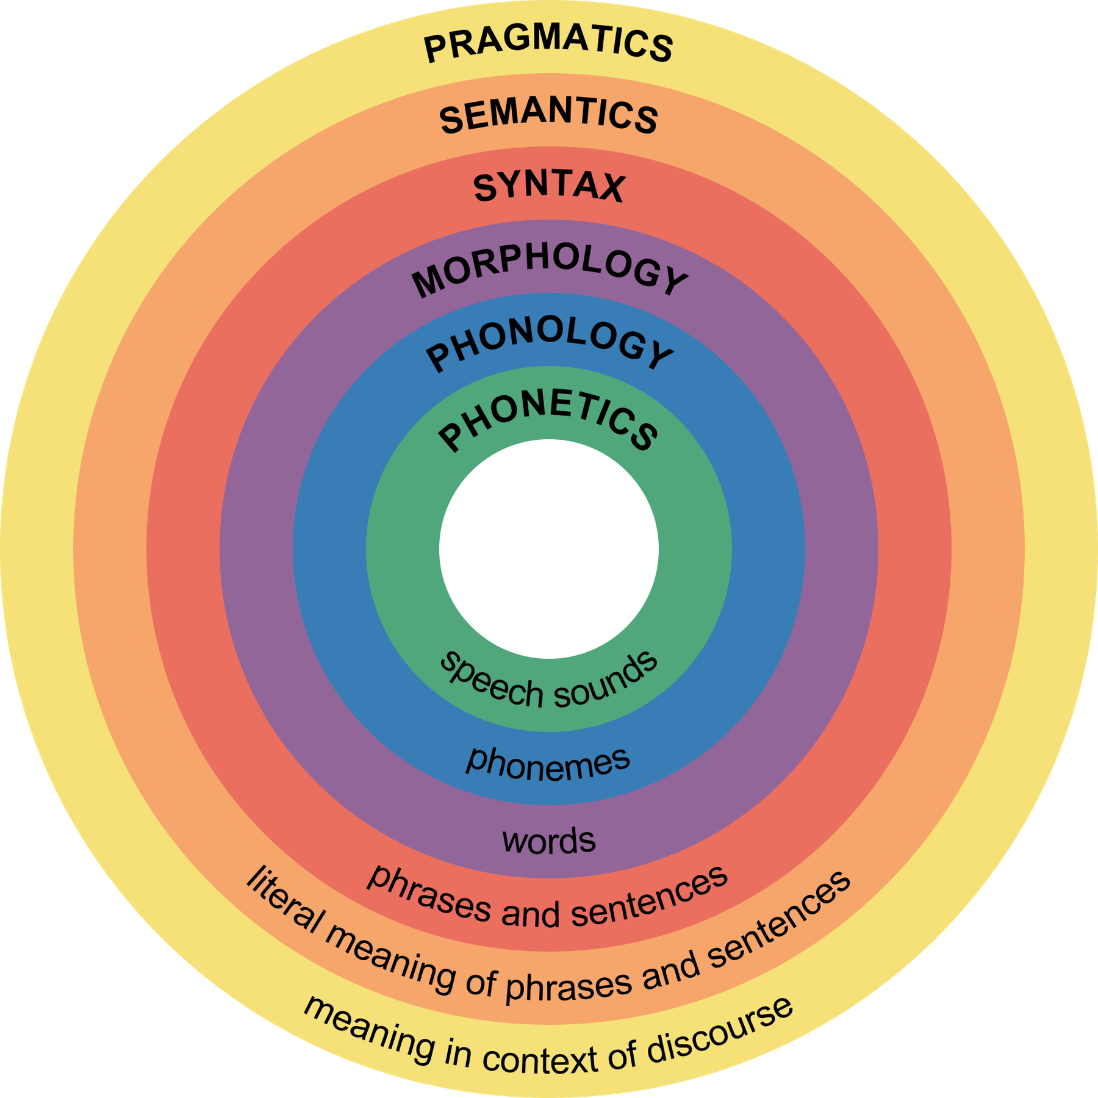
S08 · NLP
NLP Fundamentals and Challenges
Why Natural Language Is Difficult for Machines
ETRA
05 / 66

Slide 6
S08 · NLP
NLP Fundamentals and Challenges
Why Natural Language Is Difficult for Machines
–
Natural language is ambiguous, context-dependent, and full of idioms.
–
Meaning often depends on pragmatics, domain, and cultural background.
–
The same sentence can map to multiple valid interpretations.
NLP systems must model form, meaning, and context simultaneously.
ETRA
06 / 66

Slide 7
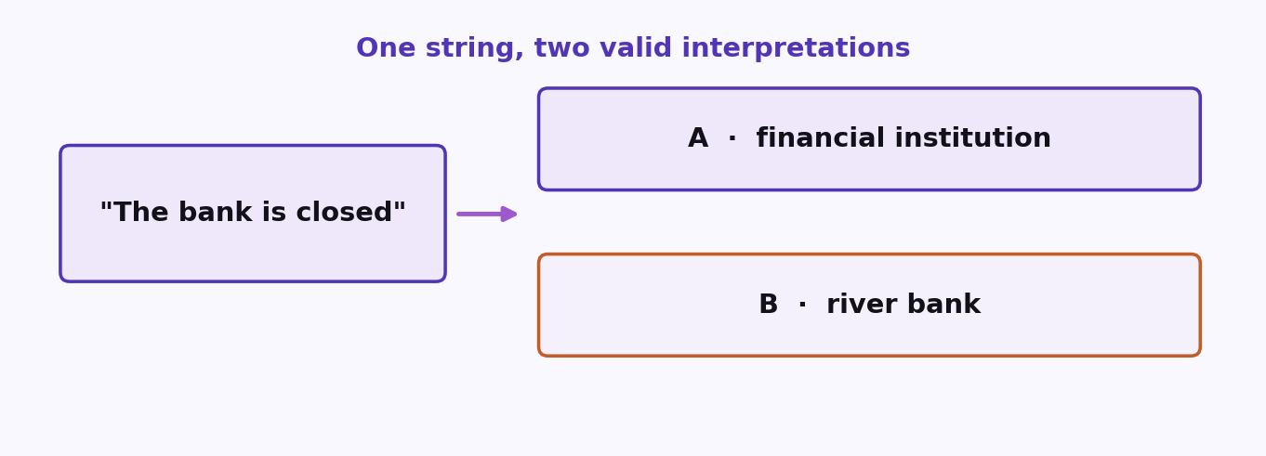
S08 · NLP
Ambiguity in Language: Practical Examples
ETRA
07 / 66

Slide 8
S08 · NLP
Ambiguity in Language: Practical Examples
Expression | Possible Interpretation A | Possible Interpretation B
The bank is closed | Financial institution is closed | River bank area is inaccessible
It's cold | Low temperature | Emotionally distant behavior
The chicken is ready to eat | Food is ready to be eaten | Animal is ready to eat food
Robust NLP requires disambiguation using surrounding textual and situational context.
ETRA
08 / 66

Slide 9
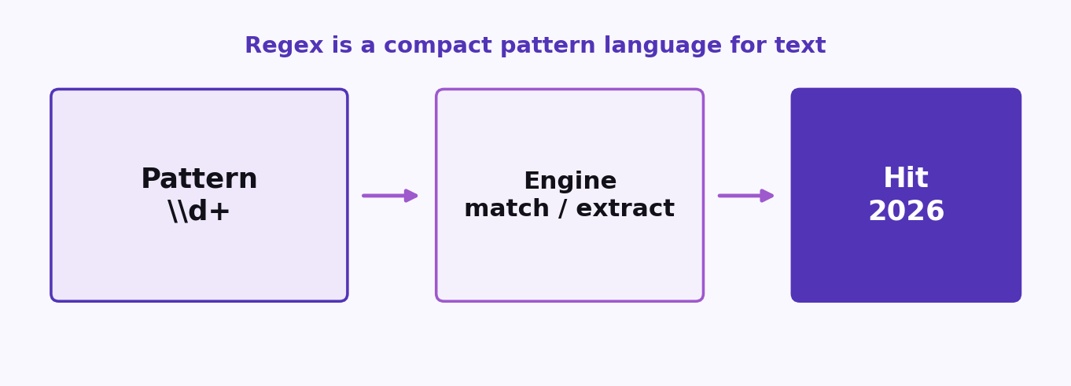
S08 · NLP
Regular Expressions (Regex): Core Idea
ETRA
09 / 66

Slide 10
S08 · NLP
Regular Expressions (Regex): Core Idea
–
Regex is a compact pattern language for matching and transforming text.
–
Typical uses include validation, extraction, and rule-based cleanup.
–
Useful for emails, phone numbers, logs, and normalization pipelines.
ETRA
10 / 66

Slide 11
S08 · NLP
Regular Expressions (Regex): Core Idea
Pattern | Meaning | Example Match
\d+ | one or more digits | 2026
\w+ | one or more word chars | nlp_model1
^[A-Z] | starts with uppercase letter | Hello
\S+ | one or more non-space chars | token123
ETRA
11 / 66

Slide 12
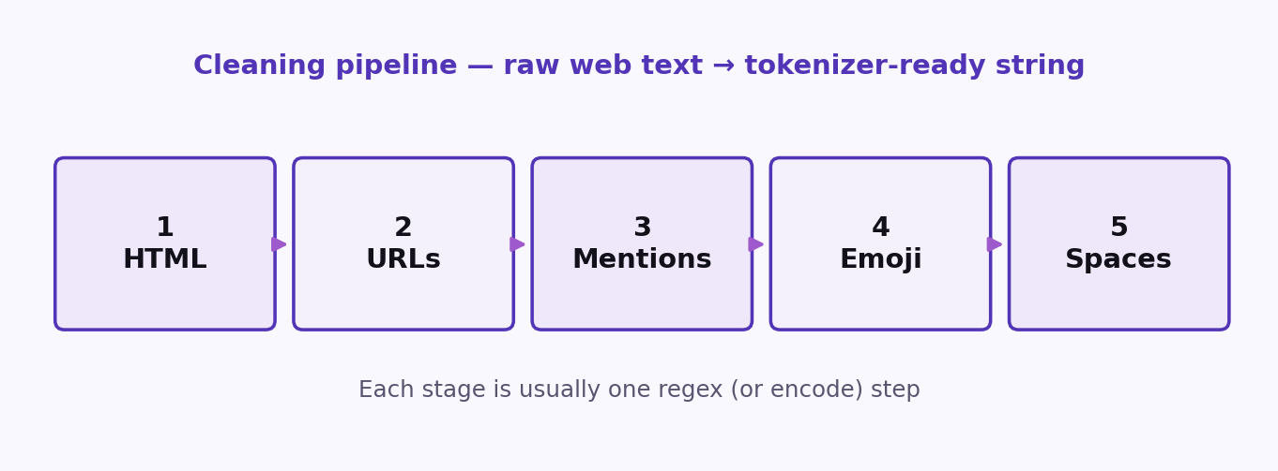
S08 · NLP
Text Cleaning — Conceptual Steps & Python Code
Conceptual stages matched with Python regex implementations
ETRA
12 / 66

Slide 13
S08 · NLP
Text Cleaning — Conceptual Steps & Python Code
Conceptual stages matched with Python regex implementations
Stage | Python Implementation | Goal
1. Decode & Clean HTML | html.unescape(text) & re.sub(r'<[^>]+>', '', text) | Keep readable text only
2. Remove Contacts/URLs | re.sub(r'https?://\S+|www\.\S+', '', text) | Drop URL metadata
3. Remove Mentions/Socials | re.sub(r'@\w+|#\w+', '', text) | Remove handles & hashtags
4. Drop Non-ASCII & Emoji | text.encode('ascii', 'ignore').decode('ascii') | Drop emoji/special symbols
5. Normalize Whitespace | re.sub(r'\s+', ' ', text).strip() | Normalize extra spaces
A regex-based cleaning function is usually the first stage in an NLP preprocessing pipeline.
ETRA
13 / 66

Slide 14
S08 · NLP
Text Cleaning — Worked Example
Trace of raw input transitioning to clean text
Stage | Operation performed | Text snapshot
0. Raw Input | Original raw string | <p>John: "AI is amazing!!!! 🤖🔥" Visit: https://ai.com @john #AI</p>
1. Clean HTML | Decode entities & remove tags | John: "AI is amazing!!!! 🤖🔥" Visit: https://ai.com @john #AI
2. Remove URLs | Remove web addresses | John: "AI is amazing!!!! 🤖🔥" Visit: @john #AI
3. Remove Socials | Remove @mentions and #hashtags | John: "AI is amazing!!!! 🤖🔥" Visit:
4. Drop Emoji/Symbols | ASCII-only encoding & cleanup | John AI is amazing!!!! Visit
Text cleaning produces standard, noise-free input for tokenizer components.
ETRA
14 / 66

Slide 15
S08 · NLP
Tokenization Granularities (Word, Char, Subword)
Granularity | Strength | Tradeoff | Example output (for 'running')
Word / Space-based | Human-readable tokens | Weak on rare/compound words (OOV) | ['running']
Character-based | No unknown words (no OOV) | Very long sequences, loss of meaning | ['r', 'u', 'n', 'n', 'i', 'n', 'g']
Subword-based | Handles rare words, compact vocab | Requires tokenizer training/tuning | ['run', '##ning']
Subword tokenization is the industry standard for modern LLMs and neural NLP models.
ETRA
15 / 66

Slide 16
S08 · NLP
Tokenization Views (Code Examples)
Same sentence, word / char / subword splits side by side
Tokenizer Type | Python Implementation | Result on "I'm running to the store!"
Word | word_tokenize(text) | ['I', "'m", 'running', 'to', 'the', 'store', '!']
Character | list(text) | ['I', "'", 'm', ' ', 'r', 'u', 'n', 'n', 'i', 'n', 'g', ...]
Subword | model_tokenizer.tokenize(text) | ['I', "'m", 'run', '##ning', 'to', 'the', 'store', '!']
Sentence | sent_tokenize(text) | ["I'm running to the store!"]
ETRA
16 / 66

Slide 17
S08 · NLP
Subword Tokenization (LLMs) — Why It Wins
How subwords solve core vocabulary challenges
Word Tokenizer Issue | Subword Solution | Example Worked Out
Huge vocabulary size | Reuse frequent morphemes/pieces | unbelievably → un + ##believe + ##ably
Out-of-Vocabulary (OOV) words | Break unknown forms into known units | ChatGPT → ['Chat', 'G', 'PT']
Morphological variants | Shared roots reduce feature sparsity | running/runs/runner share 'run'
ETRA
17 / 66

Slide 18
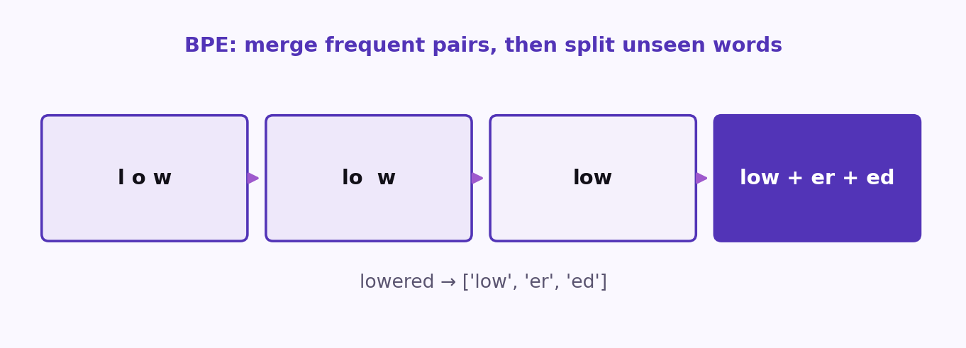
S08 · NLP
BPE Walkthrough & Inference Example
How Byte Pair Encoding learns merges and splits unseen words
ETRA
18 / 66

Slide 19
S08 · NLP
BPE Walkthrough & Inference Example
How Byte Pair Encoding learns merges and splits unseen words
–
Walkthrough: start with chars (l, o, w, e, s, t, r) -> merge l+o (lo) -> merge lo+w (low) -> compact vocabulary.
–
Inference on 'lowered the lowest curtain': splits rare words to ['low', 'er', 'ed'] and ['low', 'est'] while keeping 'the' and 'curtain' whole.
ETRA
19 / 66

Slide 20
S08 · NLP
BPE Walkthrough & Inference Example
How Byte Pair Encoding learns merges and splits unseen words
Word | Subword Output | Explanation
lowered | ['low', 'er', 'ed'] | Decomposes into learned root and suffix subwords
lowest | ['low', 'est'] | Decomposes into base 'low' and suffix 'est'
BPE repeatedly merges frequent adjacent units until target vocabulary size is reached.
ETRA
20 / 66

Slide 21
S08 · NLP
Stop Words: Purpose & Tradeoffs
Filtering low-information tokens from texts
–
Function words (the, is, and) dominate word counts but carry minimal topic signal.
–
Removing stop words reduces dimensionality for TF-IDF & Bag-of-Words.
–
Critical Rule: NEVER remove stop words for language models (GPT/BERT), translation, or sentiment analysis where negation ('not') and syntax carry the core meaning.
ETRA
21 / 66

Slide 22
S08 · NLP
Stop Words: Purpose & Tradeoffs
Filtering low-information tokens from texts
Task Category | Stop Word Policy | Reasoning
Search & Topic Modeling | Remove | Improves speed and focus on key words
Large Language Models | Keep | Syntactic and semantic flow is vital
Sentiment Analysis | Keep | Negations like 'not' reverse polarity
ETRA
22 / 66

Slide 23
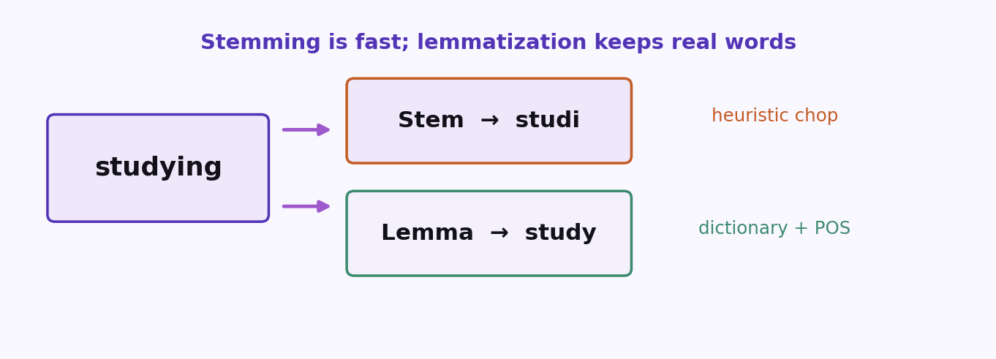
S08 · NLP
Stemming vs Lemmatization
Normalizing words to their base forms
ETRA
23 / 66

Slide 24
S08 · NLP
Stemming vs Lemmatization
Normalizing words to their base forms
Aspect | Stemming | Lemmatization
Mechanism | Rule-based suffix chopping (heuristic) | Dictionary lookup + morphological analysis
Speed | Very fast, computationally cheap | Slower, requires resource lookup
Output | Can be non-words (e.g., study -> studi) | Always dictionary words (e.g., study -> study)
POS Awareness | No | Yes (e.g., saw -> see or saw depending on POS)
Lemmatization preserves semantics better than aggressive stemming.
ETRA
24 / 66

Slide 25
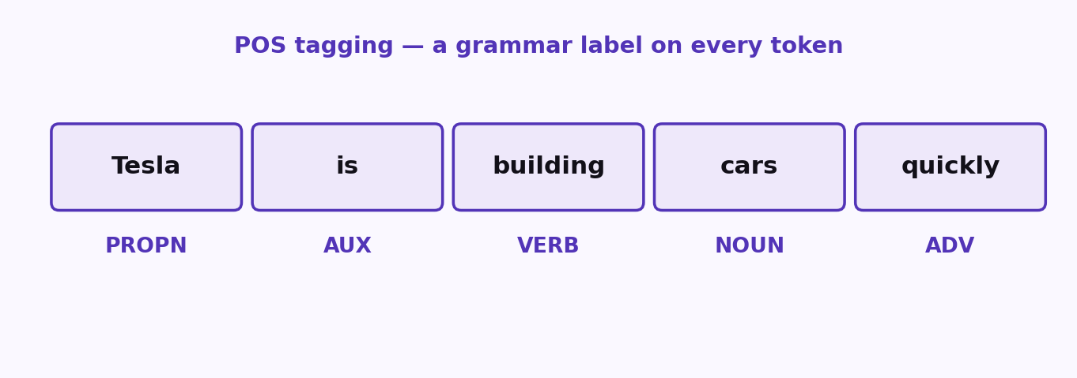
S08 · NLP
Part-of-Speech (POS) Tagging
Grammar Labels per Token
ETRA
25 / 66

Slide 26
S08 · NLP
Part-of-Speech (POS) Tagging
Grammar Labels per Token
–
Universal categories include NOUN, VERB, ADJ, ADV, DET, ADP, PROPN, NUM, …
–
POS feeds lemmatization quality and downstream relation extraction.
–
SpaCy exposes coarse pos_ and fine-grained tag_ plus dependency dep_.
ETRA
26 / 66

Slide 27
S08 · NLP
Part-of-Speech (POS) Tagging
Grammar Labels per Token
POS | Role | Quick examples
NOUN / PROPN | Things and names | city, Tesla
VERB / AUX | Actions and helpers | run, is
ADJ / ADV | Modifiers | quick, quickly
DET / ADP | Structure words | the, in
ETRA
27 / 66

Slide 28
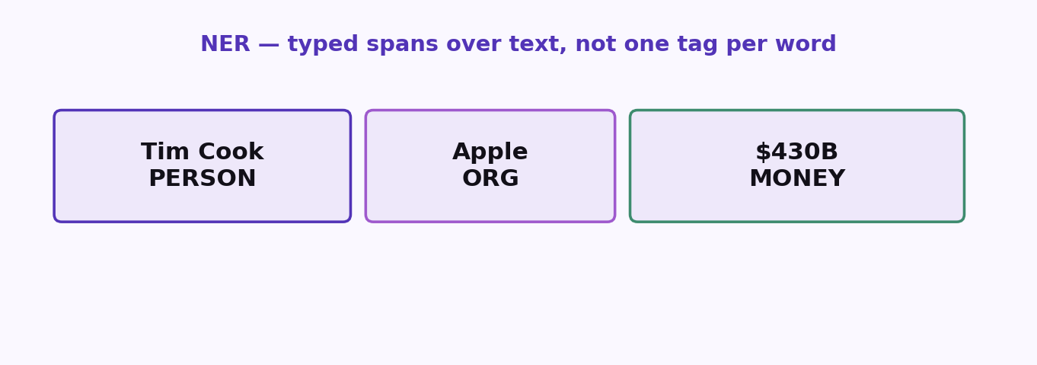
S08 · NLP
Named Entity Recognition (NER)
Typed Spans over Text
ETRA
28 / 66

Slide 29
S08 · NLP
Named Entity Recognition (NER)
Typed Spans over Text
–
Labels include PERSON, ORG, GPE, DATE, MONEY, PERCENT, PRODUCT, EVENT, …
–
Useful for indexing, compliance redaction, financial news graphs, and search facets.
–
Small models err on edge cases — always spot-check domain text.
ETRA
29 / 66

Slide 30
S08 · NLP
Named Entity Recognition (NER)
Typed Spans over Text
Label | Examples
PERSON | Tim Cook, Jensen Huang
ORG / GPE | Apple, Texas
MONEY / PERCENT | $430 billion, 3.5%
ETRA
30 / 66

Slide 31
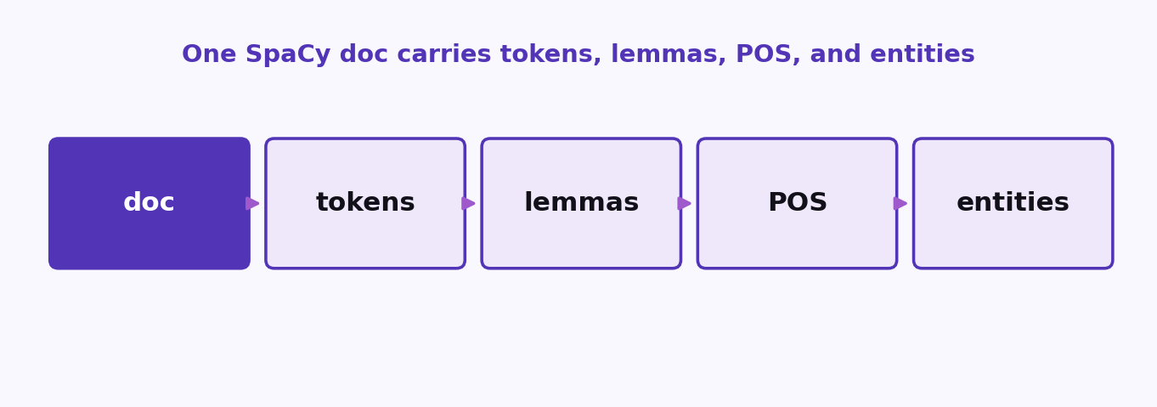
S08 · NLP
Full SpaCy Pipeline Functionally
ETRA
31 / 66

Slide 32
S08 · NLP
Full SpaCy Pipeline Functionally
–
One doc object: tokens, lemmas, POS, entities, noun_chunks, sents.
–
Typical export: clean token list, lemma bag, entity list, POS histogram.
–
Use length-based heuristics (e.g. longest sentence) only as weak importance cues.
ETRA
32 / 66

Slide 33
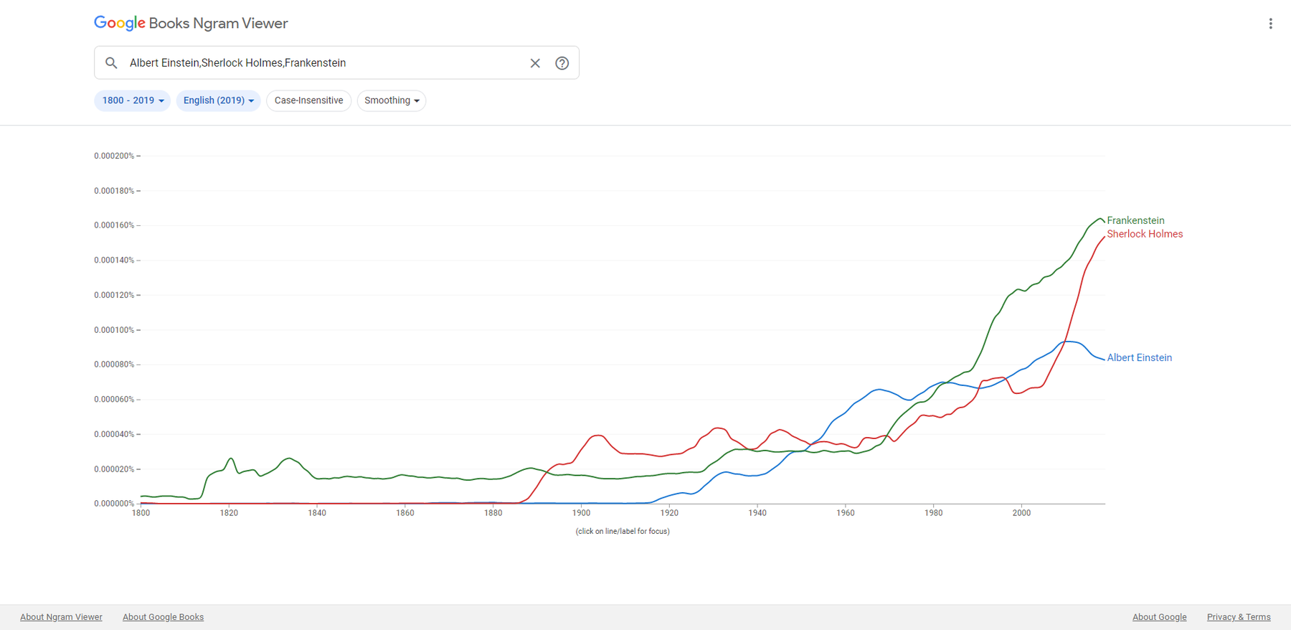
S08 · NLP
NLP Language Modeling with N-grams
From Count-Based Prediction to Evaluation
ETRA
33 / 66

Slide 34
S08 · NLP
NLP Language Modeling with N-grams
From Count-Based Prediction to Evaluation
–
Language models estimate probabilities over word sequences.
–
N-gram models predict the next token from a limited context window.
–
This module connects N-gram intuition to modern LLM generation.
ETRA
34 / 66

Slide 35
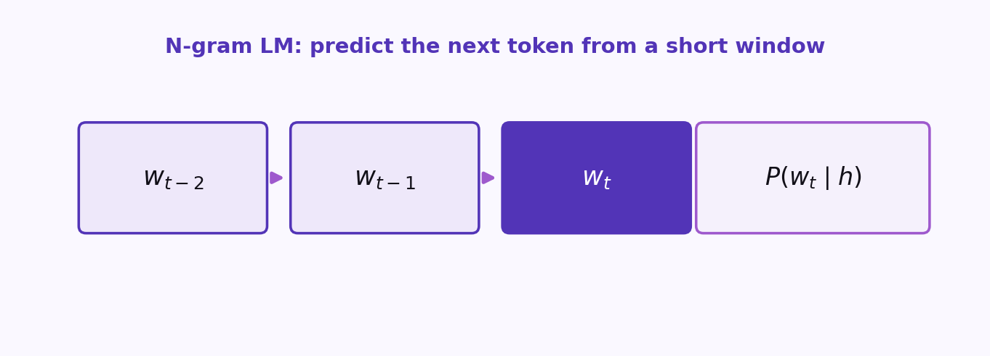
S08 · NLP
Formal Language Modeling Objective
ETRA
35 / 66

Slide 36
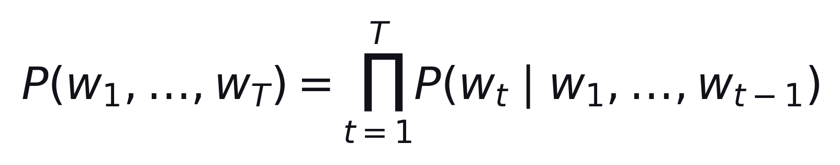
S08 · NLP
Formal Language Modeling Objective
–
A language model can score full sentences or predict the next word.
–
Exact estimation over full histories is intractable for real corpora.
–
Approximation strategies include N-grams, smoothing, and neural LMs.
ETRA
36 / 66

Slide 37
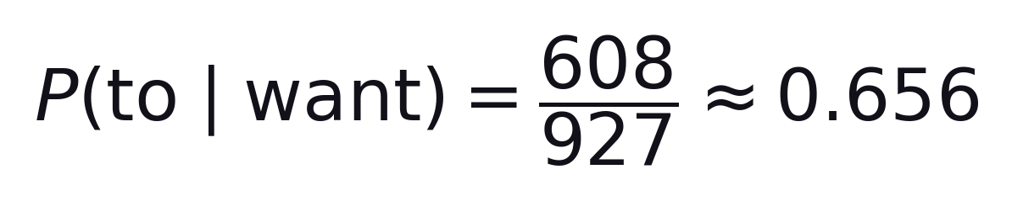
S08 · NLP
Worked Bigram Example
Given counts: C("want to") = 608, C("want") = 927
–
Interpretation: in this corpus, "to" follows "want" about 65.6% of the time.
–
Count quality depends strongly on corpus domain and size.
ETRA
37 / 66

Slide 38
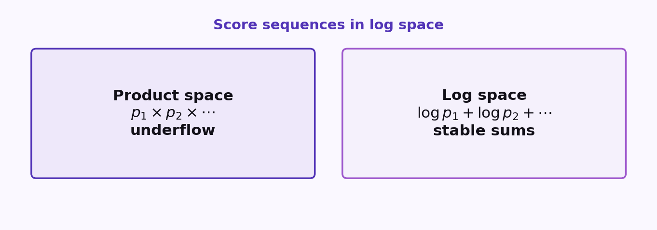
S08 · NLP
Why Use Log Probabilities
ETRA
38 / 66

Slide 39
S08 · NLP
Why Use Log Probabilities
–
Multiplying many small probabilities causes numerical underflow.
–
Log transform converts multiplication into stable addition.
–
Sequence scoring becomes computationally robust and efficient.
ETRA
39 / 66

Slide 40
S08 · NLP
Why Use Log Probabilities
Original Space | Log Space
P = p1 * p2 * ... * pk | log P = log p1 + log p2 + ... + log pk
Very small numbers | Numerically stable sums
ETRA
40 / 66

Slide 41
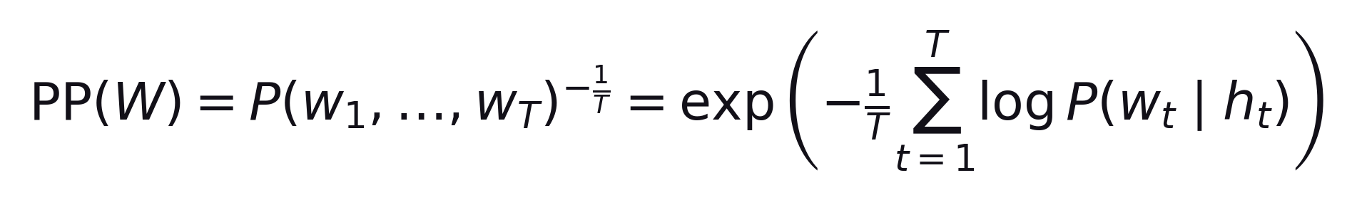
S08 · NLP
Perplexity (PP): Interpretation
–
Perplexity is the average branching uncertainty of the model.
–
Lower PP means better predictive confidence on unseen text.
–
Use identical test sets when comparing models.
Raw sentence probabilities are length-sensitive; perplexity normalizes by token count.
ETRA
41 / 66

Slide 42
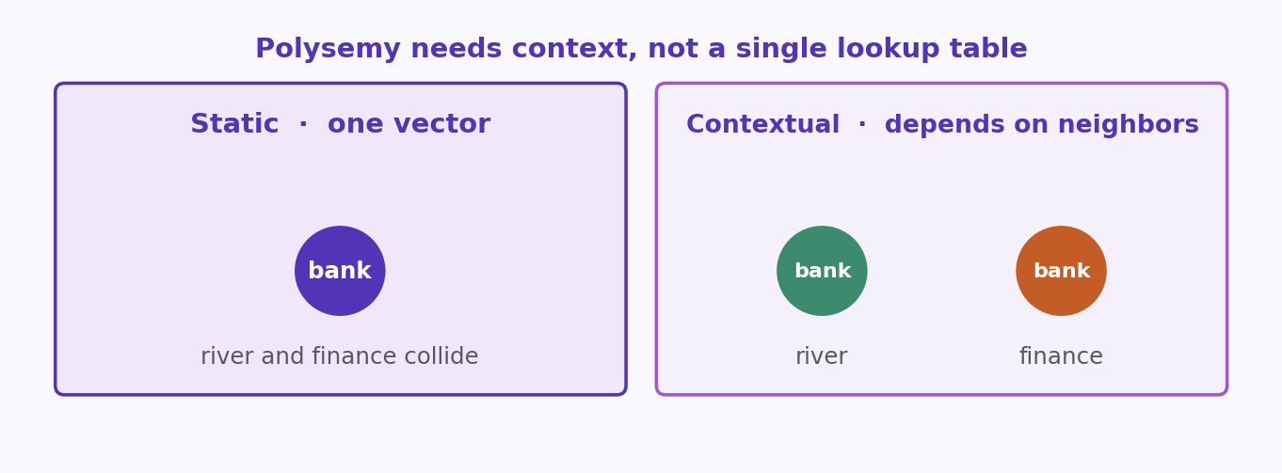
S08 · NLP
Static vs Contextualized Word Representations
ETRA
42 / 66

Slide 43
S08 · NLP
Static vs Contextualized Word Representations
Property | Static Embeddings (Word2Vec/GloVe) | Contextualized Embeddings (ELMo/BERT/GPT)
Vector per word | One fixed vector | Different vectors per context
Polysemy handling | Weak | Strong
Context direction | Usually local/global corpus only | Bidirectional or autoregressive sequence context
Task transfer | Moderate | High with pretraining + fine-tuning
Contextualization is a core enabler for modern LLM quality.
ETRA
43 / 66

Slide 44
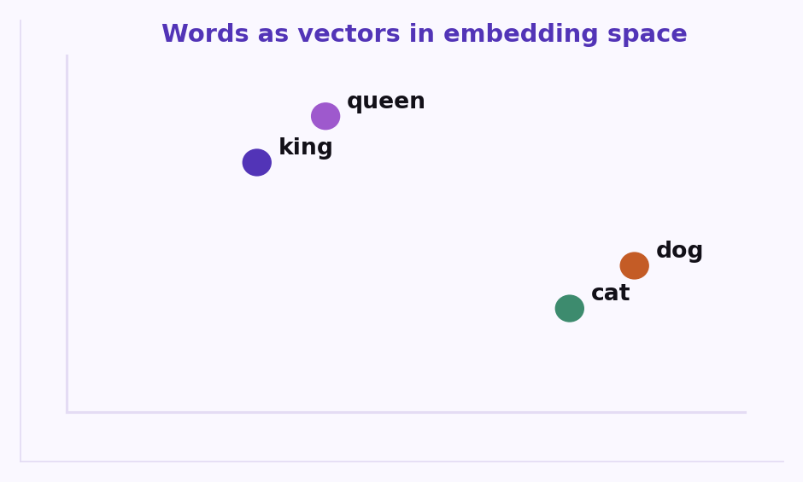
S08 · NLP
How Contextualized Embeddings Work
Words as vectors in embedding space
ETRA
44 / 66

Slide 45
S08 · NLP
How Contextualized Embeddings Work
Words as vectors in embedding space
–
Static embeddings: one vector per word type.
–
Contextual: vector depends on surrounding tokens (ELMo, BERT-style).
ETRA
45 / 66

Slide 46
S08 · NLP
How Contextualized Embeddings Work
Architecture Layers
–
Token/base embedding layer maps input ids to dense vectors.
–
Context encoder layers (often Transformer blocks) enrich each token with sequence context.
–
Task head uses contextual features for prediction.
ETRA
46 / 66

Slide 47
S08 · NLP
How Contextualized Embeddings Work
Layer Semantics
–
Lower layers capture local syntax/patterns.
–
Middle layers improve sense disambiguation.
ETRA
47 / 66

Slide 48
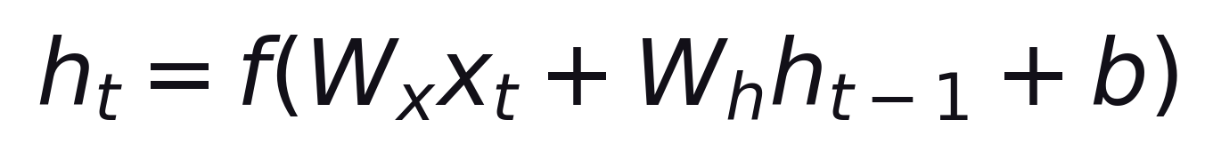
S08 · NLP
RNN Mechanism and Weight Sharing
ETRA
48 / 66

Slide 49
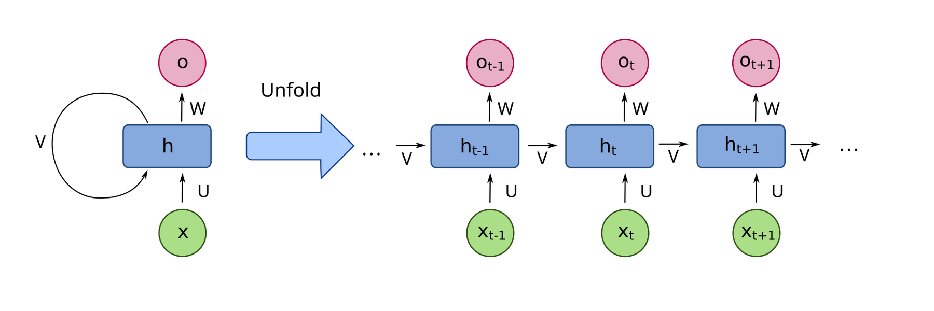
S08 · NLP
RNN Mechanism and Weight Sharing
ETRA
49 / 66

Slide 50
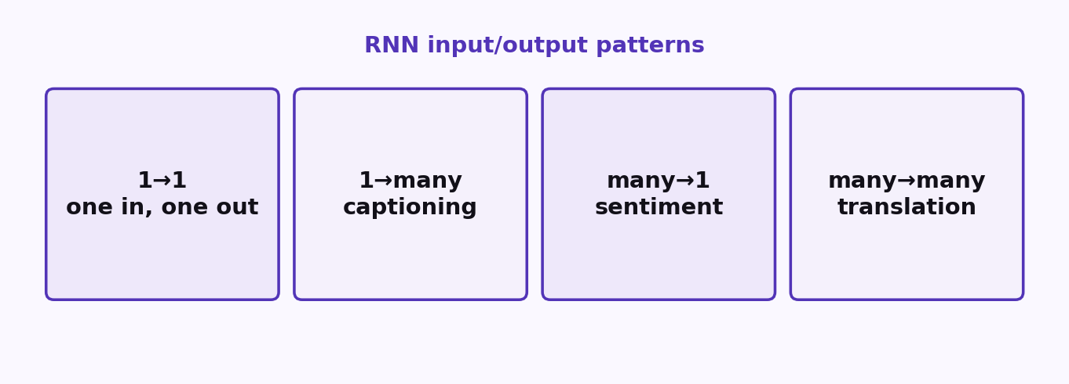
S08 · NLP
Common RNN Input/Output Patterns
ETRA
50 / 66

Slide 51
S08 · NLP
Common RNN Input/Output Patterns
Pattern | Mapping | Example Task
One-to-One | single input -> single output | basic regression/classification
One-to-Many | single input -> sequence output | image captioning
Many-to-One | sequence input -> single output | sentiment classification
Many-to-Many | sequence input -> sequence output | machine translation
Sequence-aware patterns are where recurrent models provide clear value.
ETRA
51 / 66

Slide 52
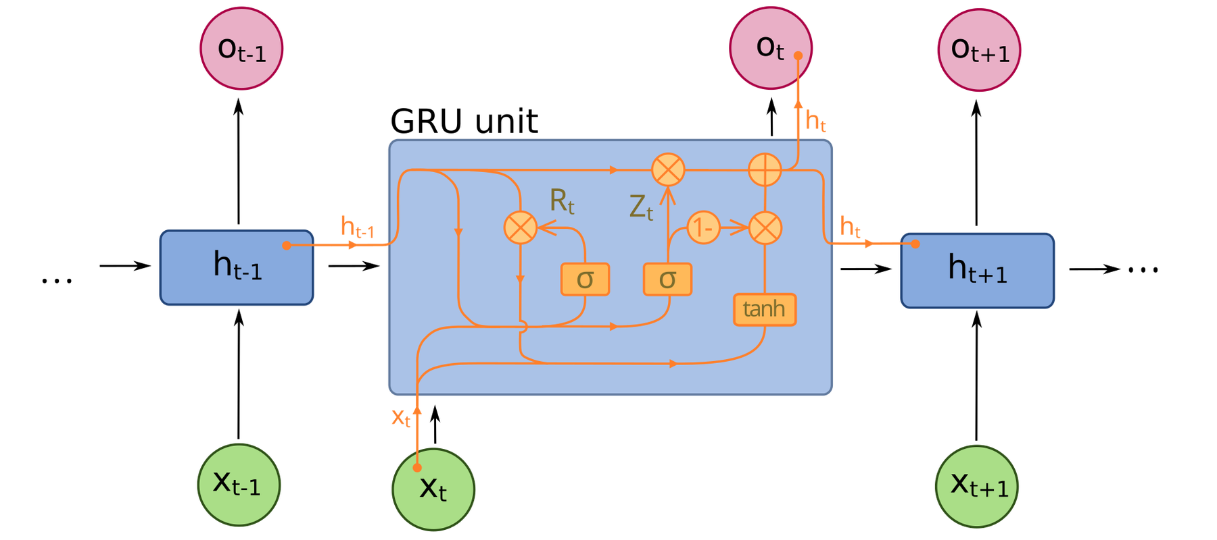
S08 · NLP
RNN Family: Vanilla, GRU, BiRNN, LSTM
ETRA
52 / 66

Slide 53
S08 · NLP
RNN Family: Vanilla, GRU, BiRNN, LSTM
Model | Vanishing Gradient Risk | Key Strength | Typical Limitation
Vanilla RNN | High | Simple architecture | Poor long-range memory
GRU | Lower | Efficient gating with fewer parameters | Can still degrade on very long contexts
BiRNN | Medium | Uses past and future context | Higher compute and memory
LSTM | Low (relative) | Strong long-term dependency handling | Heavier than GRU
ETRA
53 / 66

Slide 54
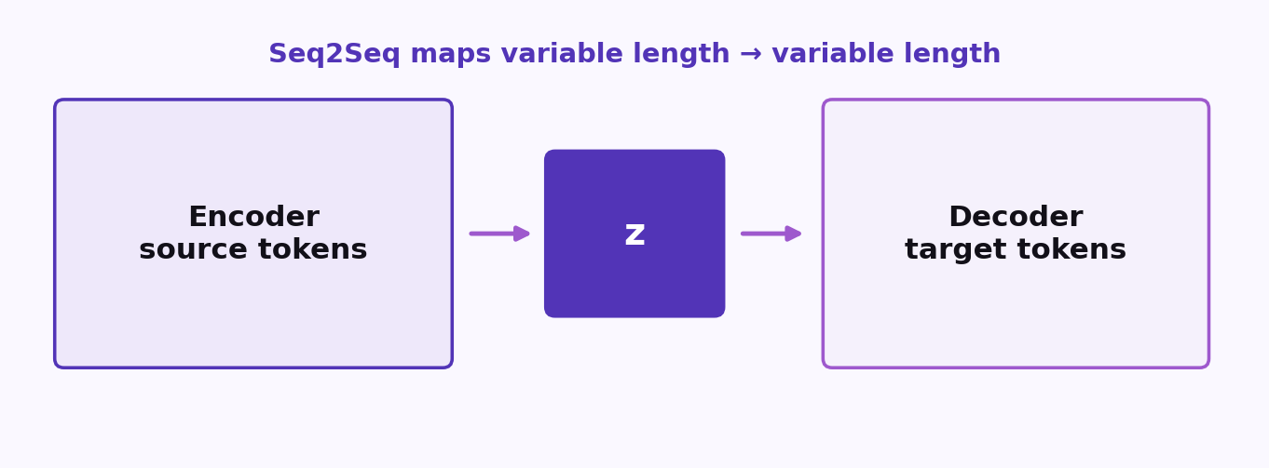
S08 · NLP
NLP Seq2Seq for Neural Machine Translation
Encoder-Decoder Modeling, Decoding Strategies, and Evaluation
ETRA
54 / 66

Slide 55
S08 · NLP
NLP Seq2Seq for Neural Machine Translation
Encoder-Decoder Modeling, Decoding Strategies, and Evaluation
–
Seq2Seq maps variable-length input sequences to variable-length outputs.
–
Encoder-decoder models were foundational for neural machine translation.
–
This module covers training, decoding, bottlenecks, attention, and metrics.
ETRA
55 / 66

Slide 56
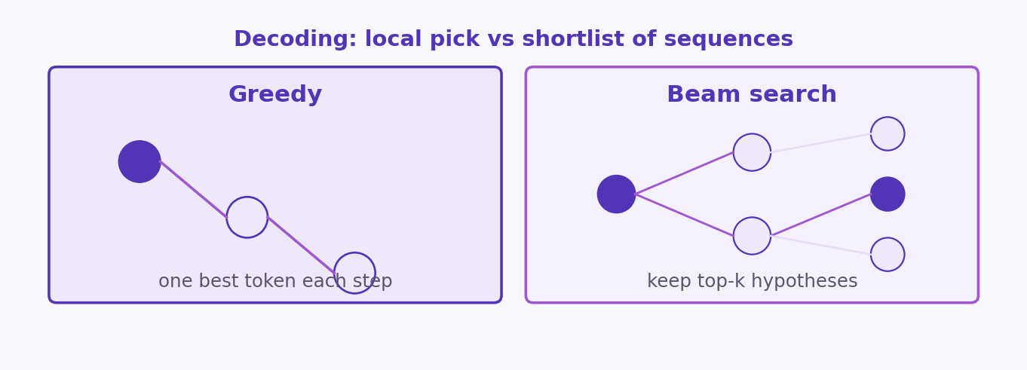
S08 · NLP
Inference: Greedy Decoding vs Beam Search
ETRA
56 / 66

Slide 57
S08 · NLP
Inference: Greedy Decoding vs Beam Search
Method | Decision Rule | Strength | Risk
Greedy | Pick top token each step | Fast and simple | May miss globally better sequence
Beam Search | Track top-k hypotheses each step | Better global sequence quality | Higher compute; can become generic/bland
Typical beam sizes are moderate (e.g., 4-10) to balance quality and cost.
ETRA
57 / 66

Slide 58
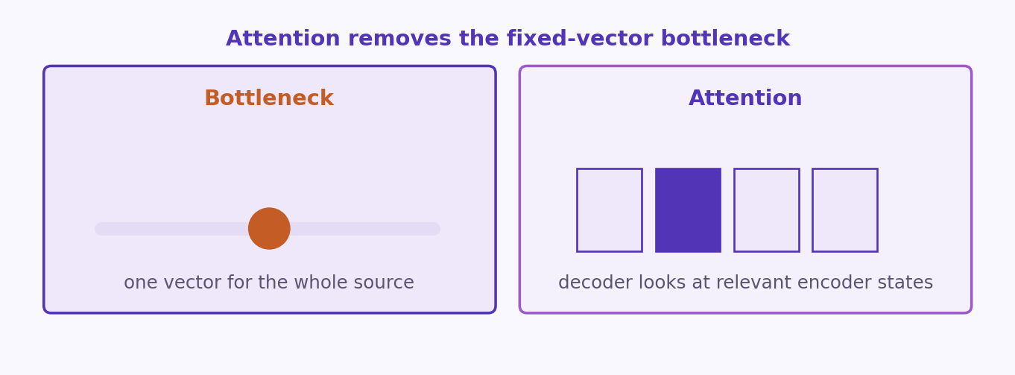
S08 · NLP
Information Bottleneck in Basic Seq2Seq
ETRA
58 / 66

Slide 59
S08 · NLP
Information Bottleneck in Basic Seq2Seq
–
Compressing a full source sentence into one fixed vector can lose detail.
–
Longer/complex inputs worsen the bottleneck effect.
–
Decoder needs different source details at different output steps.
This motivates attention over all encoder hidden states.
ETRA
59 / 66

Slide 60
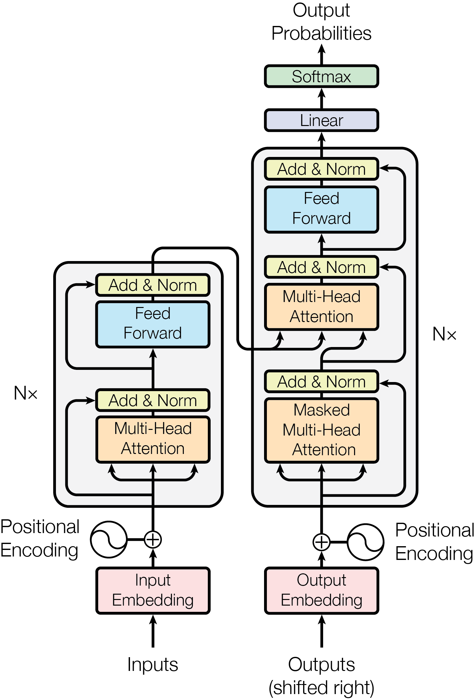
S08 · NLP
Attention as the Bottleneck Solution
ETRA
60 / 66

Slide 61
S08 · NLP
Attention as the Bottleneck Solution
–
Decoder attends to relevant encoder positions at each generation step.
–
Dynamic alignment improves translation adequacy and fluency.
–
Attention laid the foundation for transformer-dominant NMT systems.
ETRA
61 / 66

Slide 62
S08 · NLP
NMT Evaluation Metrics: BLEU and ROUGE
Metric | Orientation | What It Measures | Common Limitation
BLEU | Precision-oriented | n-gram overlap from candidate to reference | Weak semantic/syntactic sensitivity
ROUGE-N | Recall-oriented | n-gram overlap from reference to candidate | Can reward lexical overlap over meaning
F1 (with overlap metrics) | Balance precision/recall | Harmonic tradeoff view | Still limited on deep semantics
ETRA
62 / 66

Slide 63
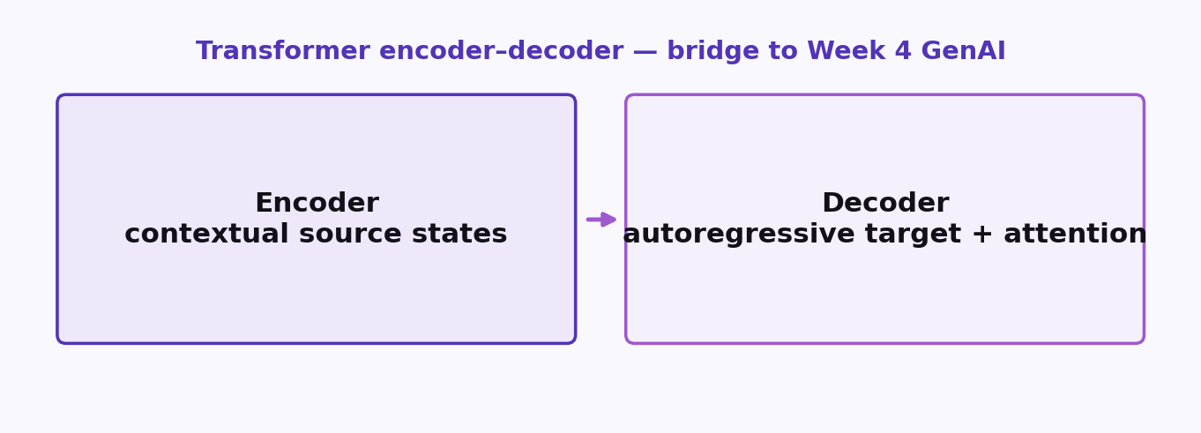
S08 · NLP
Transformer Encoder-Decoder Overview
Bridge to Week 4 GenAI — encoder-decoder intuition before BERT/GPT
ETRA
63 / 66

Slide 64
S08 · NLP
Transformer Encoder-Decoder Overview
Bridge to Week 4 GenAI — encoder-decoder intuition before BERT/GPT
–
Encoder builds contextual token representations from source text.
–
Decoder generates target tokens autoregressively with attention to encoder states.
–
Foundation architecture for translation, summarization, and many LLM pipelines.
Attention mechanisms reduce reliance on recurrence for sequence modeling.
ETRA
64 / 66

Slide 65
S08 · Takeaways
3 Ideas to Keep
Leave with these
1
Language is ambiguous — cleaning and tokenization choices persist through the pipeline.
2
N-grams and RNNs model sequences; attention removes the seq2seq bottleneck.
3
Subword tokenizers and encoder–decoder attention are the bridge to Transformers.
ETRA
65 / 66

Slide 66
Thank you
Labs: code/16- NLP
ETRA
ETRA
66 / 66

