Slide 1

Week 1 · Session 2
Regression Models
From linear fits to regularized models
ETRA
AI & Machine Learning Bootcamp

Slide 2
S02 · Big picture
Where Are We in the Bootcamp?
After preprocessing — learn models that predict continuous targets.
Week 1
Week 2
Week 3
Week 4
S1
Foundations & Preprocessing
S7
Deep Learning
S8
NLP Fundamentals
S14
Generative AI
S2
Regression Models
S9
Tokenization
S15
RAG Systems
S3
Classification Basics
S10
Text Analysis & NER
S16
MLOps
S4
Naive Bayes & Trees
S11
Language Modeling
S5
SVM & Kernels
S12
Embeddings & RNNs
S6
Clustering & PCA
S13
Seq2Seq & NMT
ETRA
02 / 79

Slide 3
Week 1 · Session 2
Regression Models
Regression Models
Linear regression
OLS & R²
Residual diagnostics
Polynomial regression
ETRA
03 / 79

Slide 4
S02 · Regression Models
Regression Models
What we will cover in this session
–
Linear regression
–
OLS & R²
–
Residual diagnostics
–
Polynomial regression
–
SVR
–
Decision Tree
–
Random Forest
04 / 79

Slide 5
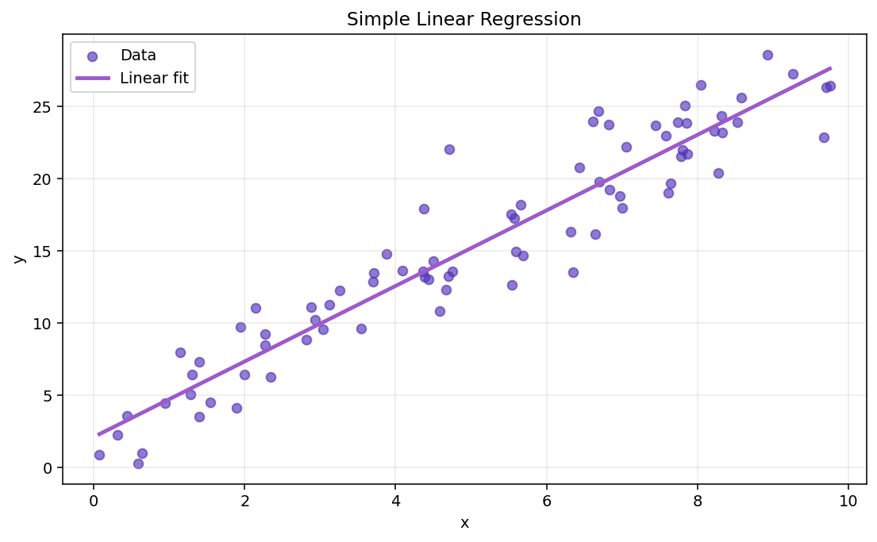
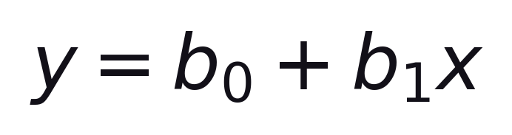
S02 · Regression Models
What is Simple Linear Regression?
Regression · Simple Linear Regression
Simple Linear Regression models the relationship between one independent variable x and one dependent variable y using a straight line.
Formula
b₀ = intercept (value of y when x = 0) · b₁ = slope (change in y per unit change in x)
–
x = input feature · y = target to predict
–
Finds the straight line that best fits the data.
One feature → one straight-line fit. Multiple features come next.
ETRA
05 / 79

Slide 6
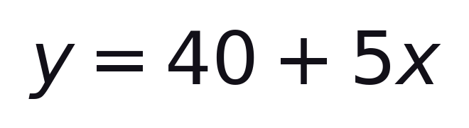
S02 · Regression Models
Practical Example
Simple Linear Regression
Suppose x = Hours of Study and y = Exam Score.
–
Slope b₁ = 5: +1 study hour → +5 score points.
–
Intercept b₀ = 40: score when hours = 0.
–
Example: 3 hours → ŷ = 40 + 5(3) = 55.
ETRA
06 / 79

Slide 7
S02 · Regression Models
Meaning of Each Symbol
Simple Linear Regression
Symbol | Meaning
y | Predicted output (dependent variable).
x | Input feature (independent variable).
b₀ | Intercept: predicted value of y when x = 0.
b₁ | Slope: expected change in y when x increases by 1 unit.
The regression line is the best-fit line that minimizes prediction errors.
ETRA
07 / 79

Slide 8
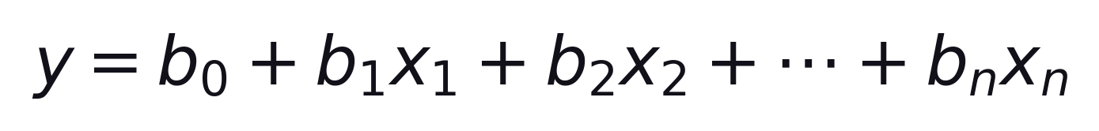
S02 · Regression Models
Multiple Linear Regression
Linear Regression · Multiple Features
Multiple Linear Regression describes the relationship between one dependent variable y and two or more independent variables.
Each bⱼ is the effect of feature xⱼ holding other features fixed.
–
Predict y from several inputs at once.
–
Still linear in the coefficients b₀ … bₙ.
OLS still minimizes the sum of squared residuals.
ETRA
08 / 79

Slide 9
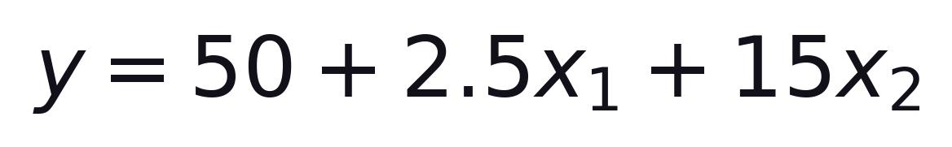
S02 · Regression Models
House Price Example
Multiple Linear Regression
Predict house price from size and bedrooms.
y = price · x₁ = size (m²) · x₂ = bedrooms
–
+1 m² → price +2.5 (other variables fixed).
–
+1 bedroom → price +15 (other variables fixed).
Interpret each coefficient holding other variables constant.
ETRA
09 / 79

Slide 10
S02 · Regression Models
House Price Calculations
Multiple Linear Regression · Example
House | Size x₁ (m²) | Bedrooms x₂ | Predicted price y ($1000)
A | 100 | 2 | 50 + 2.5(100) + 15(2) = 330
B | 120 | 3 | 50 + 2.5(120) + 15(3) = 395
C | 80 | 1 | 50 + 2.5(80) + 15(1) = 265
Same formula, different inputs → different predicted prices.
ETRA
10 / 79

Slide 11
S02 · Regression Models
What is OLS?
Ordinary Least Squares (OLS)
Ordinary Least Squares is the most common method to fit a linear regression line by minimizing prediction errors.
–
Chooses the line with the smallest total squared error.
–
Residual = actual y − predicted ŷ.
–
Simple linear case has a closed-form solution for b₀, b₁.
Smaller squared errors → better fit on the training data.
ETRA
11 / 79

Slide 12
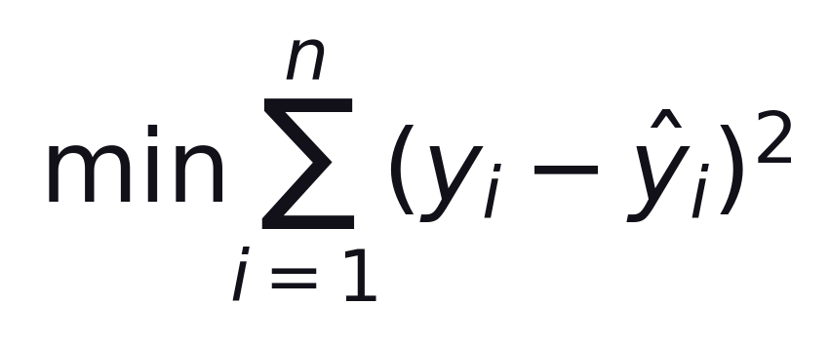
S02 · Regression Models
Sum of Squared Errors
Ordinary Least Squares (OLS)
OLS chooses parameters by minimizing the total squared difference between actual and predicted values.
Sum of squared residuals over all n training points
–
Actual value: yᵢ
–
Predicted value: ŷᵢ
–
Residual error: eᵢ = yᵢ − ŷᵢ
Squared errors make all errors positive, penalize large errors, and provide a clear optimization objective.
ETRA
12 / 79

Slide 13
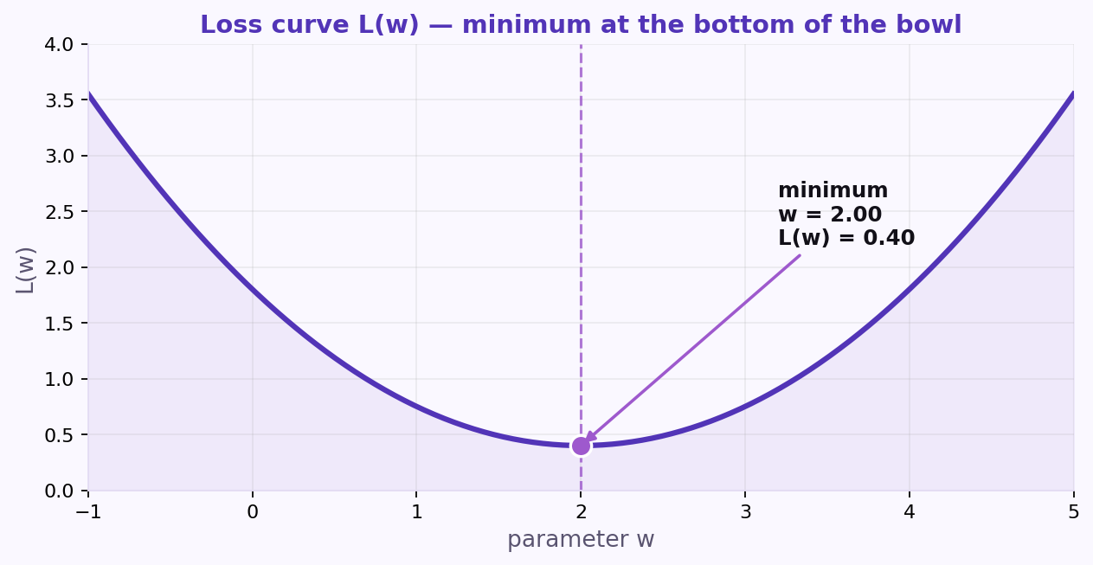
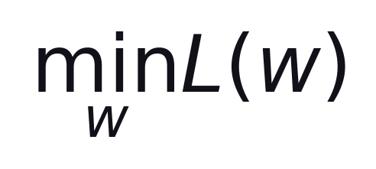
S02 · Regression Models
Gradient Descent
OLS · Optimization
Loss curve L(w) — minimum at the bottom of the bowl.
Formula
We search for the parameter w that makes the loss as small as possible.
–
Start with a guess for w, then move downhill.
–
Stop when updates become tiny (converged).
Converged: w = 2.00 · L(w) = 0.40
ETRA
13 / 79

Slide 14
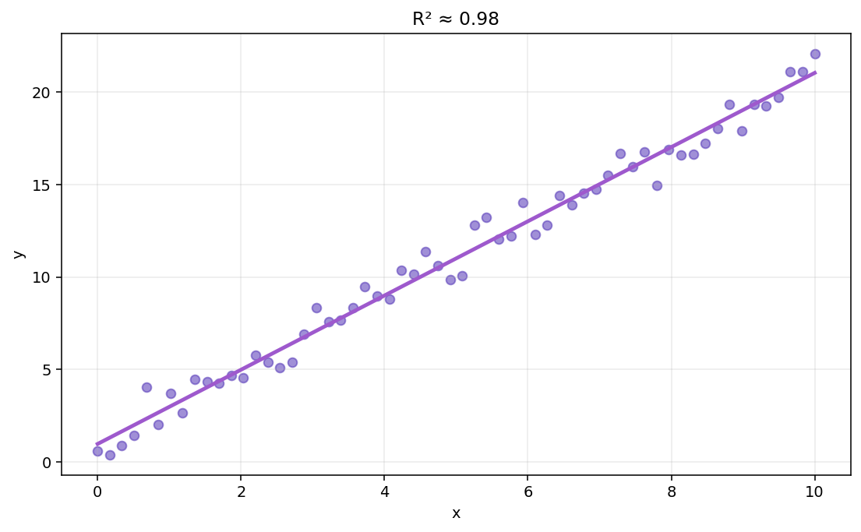
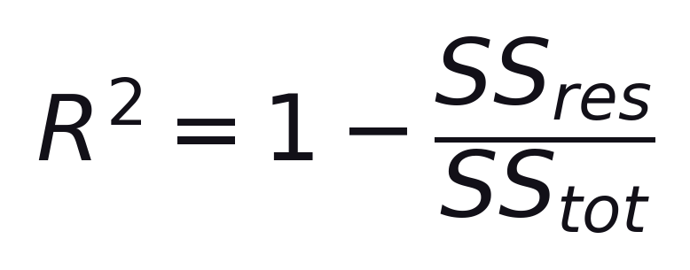
S02 · Regression Models
R-Squared (R²)
Goodness of Fit
R² measures how much variation in y is explained by the model inputs.
Formula
SS_res = residual SS · SS_tot = total SS
–
Near 1 → strong explanatory power.
–
Near 0 → little better than predicting the mean.
High R² on training data ≠ guaranteed good new-data predictions.
ETRA
14 / 79

Slide 15
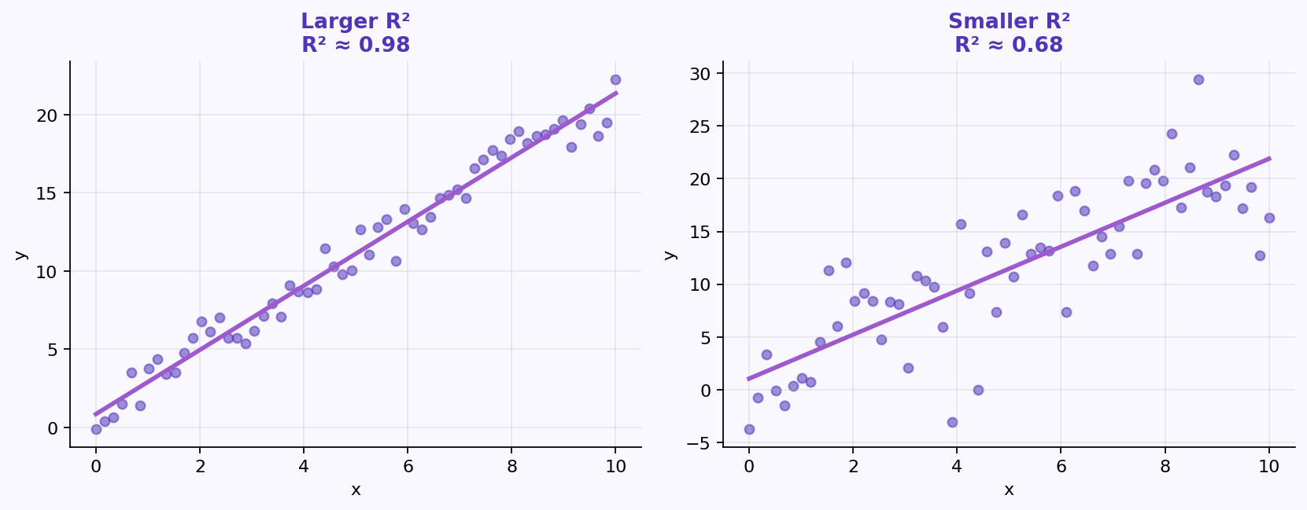
S02 · Regression Models
Interpreting R²
Goodness of Fit
Larger R² means more of the variation in y is captured by the model.
–
R² = 1 → perfect fit on that sample.
–
R² = 0 → mean-level baseline performance.
Validate generalization with hold-out metrics, not R² alone.
ETRA
15 / 79

Slide 16
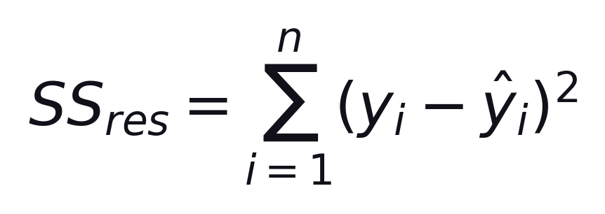
S02 · Regression Models
Residual Sum of Squares
R² · Building Blocks
SS_res measures the unexplained error — how far predictions are from the actual values.
Sum of squared residuals (prediction errors)
–
Smaller SS_res → predictions closer to the data.
–
Appears in the numerator of the R² formula.
ETRA
16 / 79

Slide 17
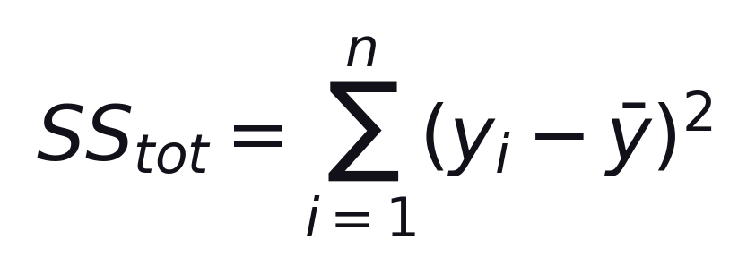
S02 · Regression Models
Total Sum of Squares
R² · Building Blocks
SS_tot measures the total variation in y around its mean — the baseline scatter to explain.
Sum of squared deviations from the mean ȳ
–
This is the variance (up to a constant factor) of the observed y values.
–
R² asks: what fraction of SS_tot is left unexplained by SS_res?
R² = 1 − SS_res / SS_tot · explained variation = SS_tot − SS_res
ETRA
17 / 79

Slide 18
S02 · Regression Models
What Do These Terms Mean?
R² · Building Blocks
Term | Description
SS_res | Residual Sum of Squares: squared distance between actual values and predictions.
SS_tot | Total Sum of Squares: squared distance between actual values and the mean of y.
R² compares unexplained error (SS_res) with total variation (SS_tot).
ETRA
18 / 79

Slide 19
S02 · Regression Models
Why R² Alone Is Not Enough
Adjusted R-Squared
In multiple regression, adding predictors often increases R² even when the new variables are not useful.
–
Ordinary R² never decreases when you add a predictor (it stays the same or goes up).
–
That can reward bloated models that fit noise instead of signal.
–
We need a metric that balances fit against model complexity.
Next: Adjusted R² applies a penalty for extra predictors.
ETRA
19 / 79

Slide 20
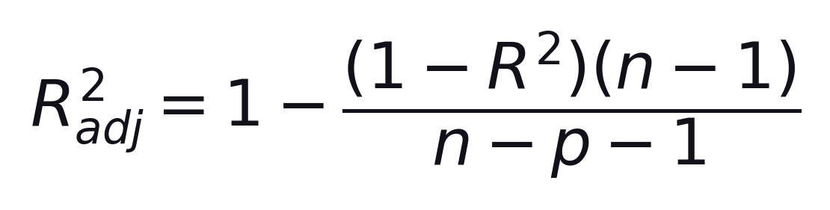
S02 · Regression Models
Adjusted R-Squared
Goodness of Fit · Model Comparison
Adjusted R² penalizes unnecessary predictors.
n = samples · p = predictors
–
Better for comparing models with different p.
–
Can fall when R² rises if the new variable is weak.
ETRA
20 / 79

Slide 21
S02 · Regression Models
Adjusted R² — Quick Example
Adjusted R-Squared
Model | Predictors | R² | Adjusted R² | Interpretation
A | x₁, x₂ | 0.82 | 0.81 | Strong and efficient model
B | x₁, x₂, x₃, x₄ | 0.83 | 0.79 | Higher R², but worse after penalty
Model B looks better by R², but Adjusted R² shows the extra variables are likely not helpful.
ETRA
21 / 79

Slide 22
S02 · Regression Models
Assumptions of Linear Regression
Overview
Assumption | Meaning | If Violated
Linearity | y vs each x is roughly linear | Biased predictions
Homoscedasticity | Error variance roughly constant | Unstable SEs
Normal Errors | Residuals ≈ normal | Weaker inference
Independence | Errors are independent | Biased tests
Low Multicollinearity | Predictors not highly redundant | Unstable coeffs
Limited Outliers | Extremes do not dominate fit | Distorted line
Next slides: practical checks and residual plots.
ETRA
22 / 79

Slide 23
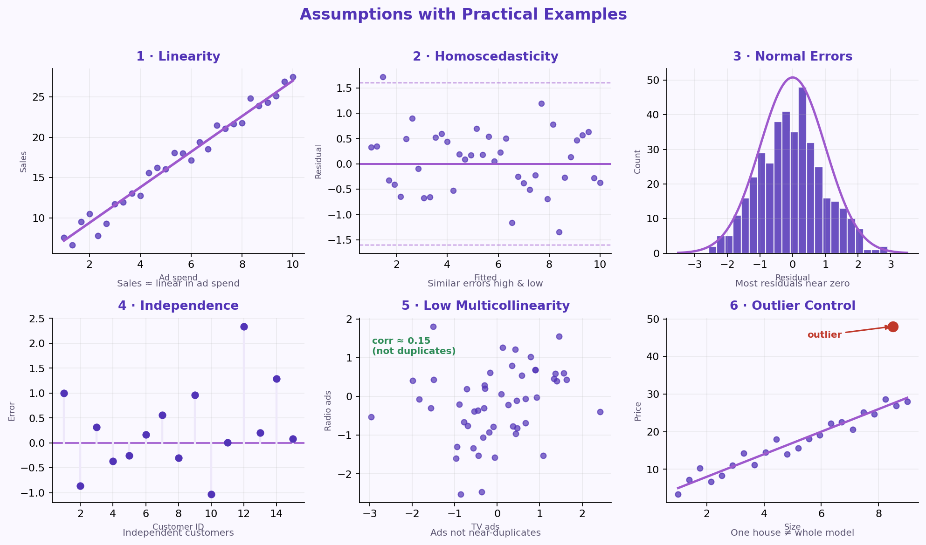
S02 · Regression Models
Assumptions with Practical Examples
Residual Diagnostics
Each panel shows a practical picture of one assumption — and what “good” looks like.
Checks: scatter/residuals · residuals vs fitted · histogram/Q-Q · design/DW · corr/VIF · Cook/leverage.
ETRA
23 / 79

Slide 24
S02 · Regression Models
Assumptions — Quick Reference
Practical Examples
Assumption | Example | Check
Linearity | Sales ≈ linear in ad spend | Scatter / residual plot
Homoscedasticity | Similar errors high & low | Residuals vs fitted
Normal Errors | Most residuals near zero | Histogram / Q-Q
Independence | Independent customers | Design / Durbin-Watson
Low Multicollinearity | Ads not near-duplicates | Corr / VIF
Outlier Control | One house ≠ whole model | Cook / leverage
If violated: transforms, robust methods, or another model.
ETRA
24 / 79

Slide 25
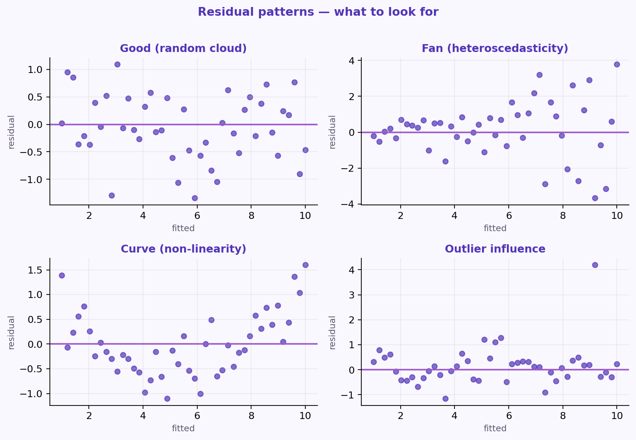
S02 · Regression Models
Residual Patterns to Spot
Assumption Checks
Common residual-plot signatures for assumption problems.
–
Good: random cloud around zero.
–
Fan / curve / outlier → investigate.
ETRA
25 / 79

Slide 26
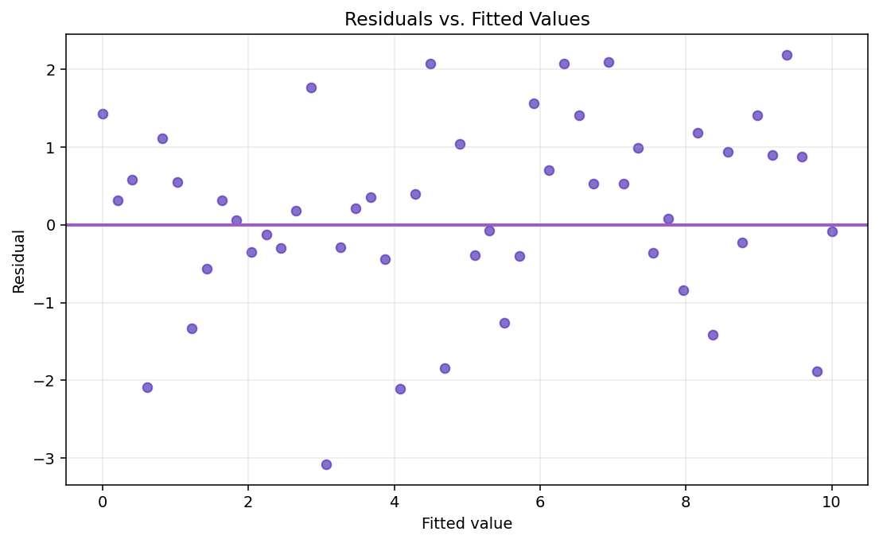
S02 · Regression Models
Residuals vs Fitted Values
Practical Check · Homoscedasticity
Look for random scatter around zero with roughly constant spread.
–
No curve → linearity looks OK.
–
Fan shape → possible heteroscedasticity.
ETRA
26 / 79

Slide 27
S02 · Regression Models
Building a Regression Model
Goal
Method | Core Idea | Best Use Case
All-in | Use all predictors | Strong prior knowledge
Backward | Start full, remove weakest | Many candidates
Forward | Start empty, add strongest | Compact model
Stepwise | Add and remove dynamically | Flexible search
Match the method to candidate count and prior knowledge.
ETRA
27 / 79

Slide 28
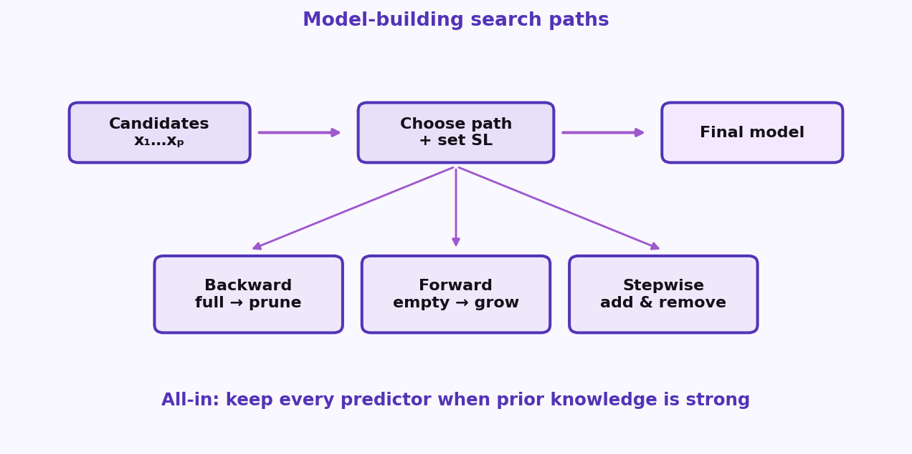
S02 · Regression Models
Model-Building Flow
All-in · Backward · Forward · Stepwise
Different search paths for choosing predictors under a significance level.
–
Backward: prune a full model.
–
Forward: grow from empty.
–
Stepwise: add and remove as you go.
ETRA
28 / 79

Slide 29
S02 · Regression Models
Backward Elimination
Model-Building Methods · Steps
Start full, then drop the least useful predictors one at a time.
–
Set SL (e.g. 0.05) and fit all predictors.
–
Remove highest p if p > SL; refit and repeat.
Best with many candidate predictors.
ETRA
29 / 79

Slide 30
S02 · Regression Models
Forward Selection
Model-Building Methods · Steps
Grow the model from scratch by adding the strongest predictors.
–
Start empty; add lowest p below SL.
–
Stop when no remaining variable qualifies.
Best when you want a compact model from the start.
ETRA
30 / 79

Slide 31
S02 · Regression Models
Bidirectional (Stepwise)
Model-Building Methods · Steps
Add and remove predictors dynamically each iteration.
–
Forward step: add significant variables.
–
Backward step: drop non-significant ones.
More adaptive than pure forward or backward alone.
ETRA
31 / 79

Slide 32
S02 · Regression Models
Mini Example — Backward Elimination
Model-Building Methods
Iteration | Candidate Predictors | Selected Action
Start | x₁, x₂, x₃, x₄ | Full model
1 | highest p-value: x₄ = 0.42 | Remove x₄
2 | highest p-value: x₃ = 0.11 | Remove x₃
Final | x₁, x₂ with p < 0.05 | Keep final model
With SL = 0.05, variables with p > SL are removed until only significant predictors remain.
ETRA
32 / 79

Slide 33
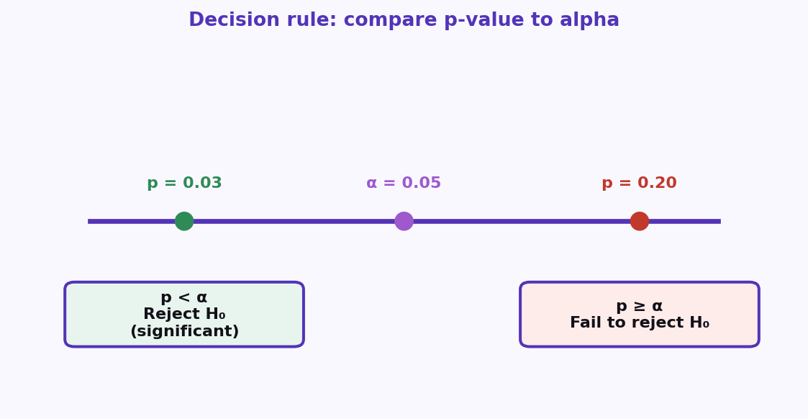
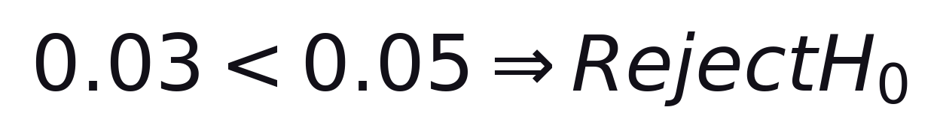
S02 · Regression Models
Significance Level and p-value
Model Selection · Decision Rule
Compare p to alpha to decide if a predictor is statistically significant.
Formula
Example: p = 0.03 · alpha = 0.05
–
p < alpha → reject H₀ (significant).
–
p ≥ alpha → fail to reject H₀.
Predictor is significant at the 5% level in this example.
ETRA
33 / 79

Slide 34
S02 · Regression Models
Key Concepts: H₀, p-value, Alpha
Significance Level and p-value
Concept | Meaning
Null Hypothesis (H₀) | No effect / no relationship
p-value | Probability of observing current result (or more extreme) if H₀ is true
Significance Level (alpha) | Maximum tolerated Type I error probability
In model building, predictors with p < alpha are kept as statistically significant.
ETRA
34 / 79

Slide 35

S02 · Regression Models
Why Is SL = 0.05 Common?
Standard Choice
SL = 0.05 balances sensitivity and false-positive risk.
95% confidence → SL = 0.05
–
Convention, not a law — adjust for domain risk.
–
Report effect size and CIs with p-values.
ETRA
35 / 79

Slide 36
S02 · Regression Models
SL vs Confidence Level
Why Is SL = 0.05 Common?
SL | Confidence Level | Strictness
0.10 | 90% | Less strict
0.05 | 95% | Standard
0.01 | 99% | More strict
Lower SL → higher confidence requirement → stricter evidence to keep a predictor.
ETRA
36 / 79

Slide 37
S02 · Regression Models
How to Choose in Practice
Significance Level
Scenario | Suggested SL
High-stakes decisions (medicine, safety, finance) | 0.01
General modeling and reporting | 0.05
Exploratory analysis | 0.10
Start with SL = 0.05, then adjust based on domain risk, dataset size, and model purpose.
ETRA
37 / 79

Slide 38
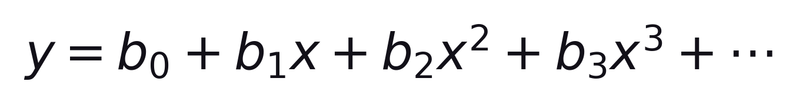
S02 · Regression Models
Polynomial Regression
Definition
Polynomial Regression extends linear regression to model non-linear relationships by adding polynomial terms.
Still linear in the coefficients
–
Adds polynomial terms to capture curves.
–
Still linear in parameters b₀, b₁, …
Transform x → x², x³, … then fit linear regression.
ETRA
38 / 79

Slide 39
S02 · Regression Models
Why Polynomial Regression?
Motivation
Many real-world relationships are curved — a straight line underfits them.
–
Population growth · disease progression
–
Sales trends · rainfall vs crop yield
ETRA
39 / 79

Slide 40
S02 · Regression Models
How Polynomial Regression Works
Polynomial Regression
Step | Description
1 | Start with input feature x
2 | Create transformed terms: x², x³, …
3 | Fit linear regression on transformed features
4 | Estimate coefficients (b₀, b₁, b₂, …)
5 | Use the fitted equation to predict y
d is the polynomial degree.
ETRA
40 / 79

Slide 41
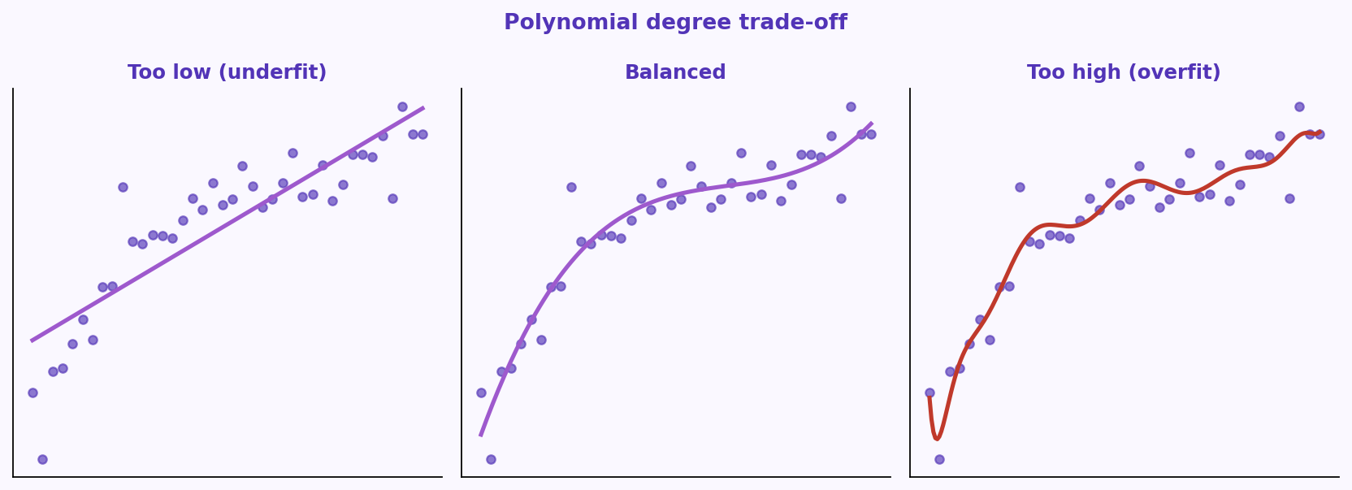
S02 · Regression Models
Choosing the Polynomial Degree
Model Complexity
Degree controls complexity — too low underfits, too high overfits.
–
Pick degree with CV / validation error.
–
Also compare adjusted R².
Balanced degree → better bias-variance trade-off.
ETRA
41 / 79

Slide 42
S02 · Regression Models
When to Use Polynomial Regression
Good Use Cases
Data shows clear curved trends · more flexibility than a straight line · you still want interpretable behavior.
Application | Example
Forecasting | Demand and sales trends
Environment | Rainfall vs crop yield
Medicine | Disease / progression patterns
Engineering | Stress-strain and similar curves
Choose polynomial regression when curves matter, but full black-box models are not required yet.
ETRA
42 / 79

Slide 43
S02 · Regression Models
Limitations of Polynomial Regression
Trade-offs
Limitation | Explanation
Overfitting risk | High-degree models may memorize noise
Outlier sensitivity | Extreme points can shift the curve strongly
Extrapolation weakness | Predictions outside training range can be unreliable
Limited flexibility for very complex patterns | Some tasks are better handled by tree-based or neural models
Use polynomial regression as a baseline, then compare with alternatives as complexity grows.
ETRA
43 / 79

Slide 44
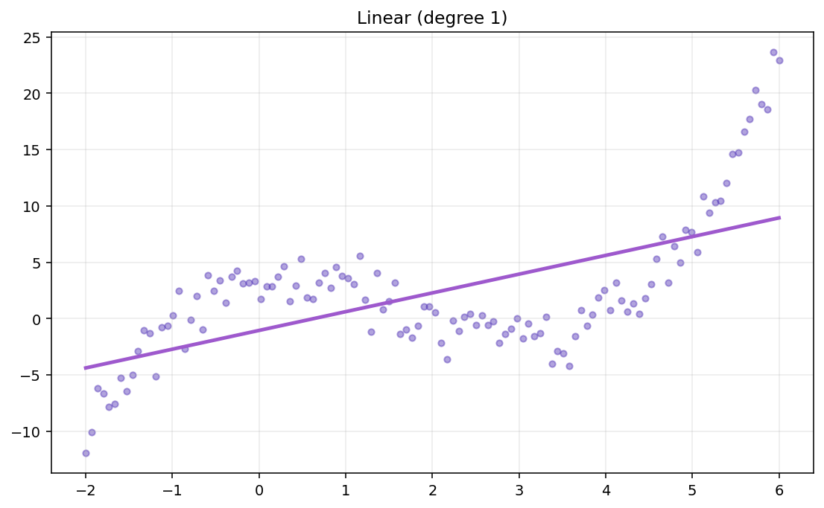
S02 · Regression Models
Polynomial Regression Visual Explanation
Linear vs Polynomial Fits
Compare linear vs polynomial fits as degree changes.
–
Too low degree → high bias (underfit).
–
Too high degree → high variance (overfit).
ETRA
44 / 79

Slide 45
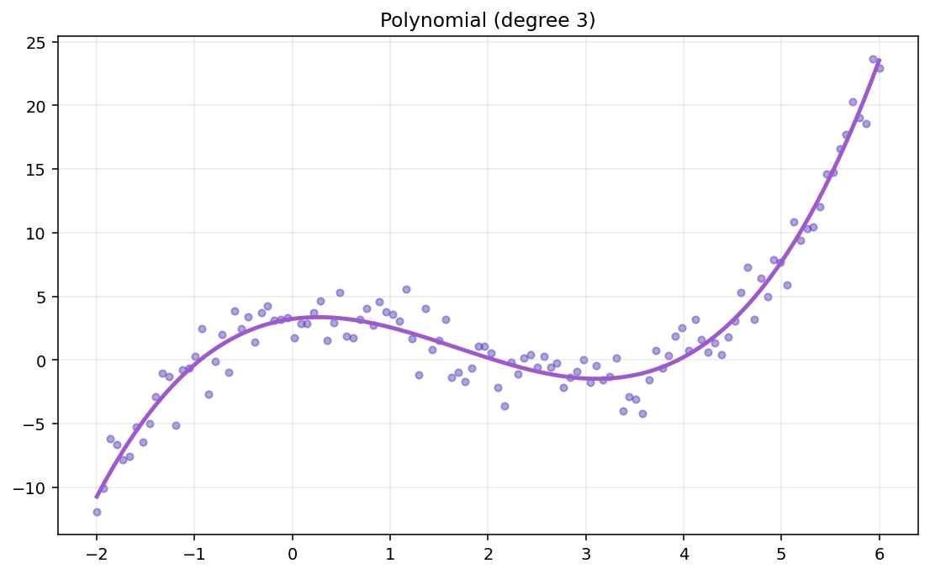
S02 · Regression Models
Effect of Polynomial Degree
Visual Explanation
Higher degree = more flexible curve — useful, then noisy.
–
Pick degree with validation curves.
–
Do not trust training error alone.
ETRA
45 / 79

Slide 46
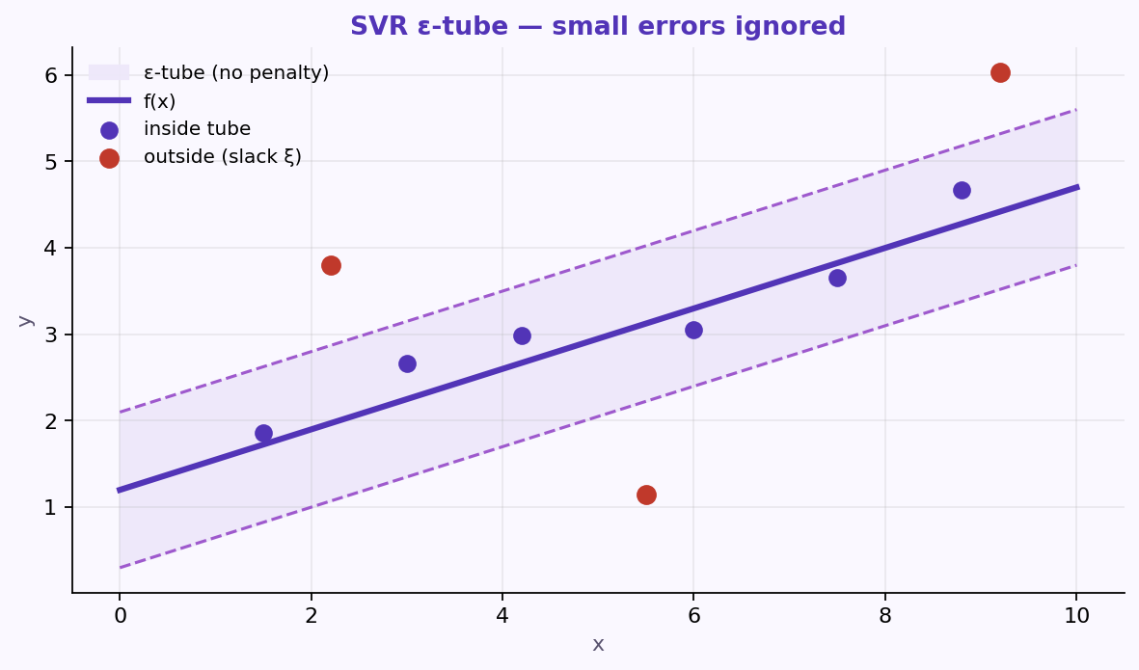
S02 · Regression Models
Support Vector Machine (SVM) and SVR
What is SVR?
SVR is the regression version of SVM: a flat function with a tolerance margin (ε-tube).
–
SVM: widest margin; support vectors define it.
–
SVR ignores small errors inside the ε-tube.
–
Used in forecasting, engineering curves, disease progression.
SVM separates classes; SVR predicts continuous y with an ε-insensitive zone.
ETRA
46 / 79

Slide 47
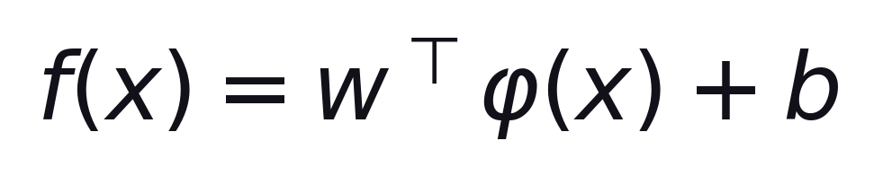
S02 · Regression Models
SVR Formulation and Equations
Model Form
SVR predicts with a (possibly kernelized) linear function in a feature space.
φ(x) maps input to a (possibly) higher-dimensional space
–
φ(x) maps input to a (possibly) higher-dimensional space.
–
With kernels, we avoid computing φ(x) explicitly.
ETRA
47 / 79

Slide 48
S02 · Regression Models
Soft-Margin SVR Objective
Optimization Objective
Keep the function flat while penalizing points outside the ε-tube.
min ½∥w∥² + C Σ (ξᵢ + ξᵢ*)
C trades flatness vs errors outside the tube
–
½∥w∥² → flatter function.
–
Larger C → tighter fit; smaller C → smoother.
ETRA
48 / 79

Slide 49
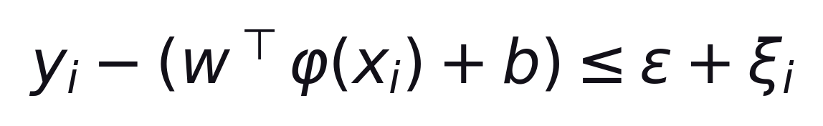
S02 · Regression Models
SVR Constraints
Soft-Margin SVR
Stay within ε of yᵢ, or pay with a slack variable.
Formula
Also: (wᵀφ(xᵢ)+b) − yᵢ ≤ ε + ξᵢ* · ξᵢ, ξᵢ* ≥ 0
–
Inside tube → no penalty.
–
Outside tube → slack cost.
ETRA
49 / 79

Slide 50
S02 · Regression Models
SVR Hyperparameters
Tuning Knobs
Hyperparameter | Role
epsilon (ε) | Width of the no-penalty tube around prediction
C | Penalty strength for points outside the tube
Kernel | Controls curve shape (linear, RBF, polynomial)
Tune ε, C, and the kernel together — changing one often changes how the others behave.
ETRA
50 / 79

Slide 51
S02 · Regression Models
Why SVR?
Compared with Traditional Regression
Aspect | Traditional | SVR
Errors | Minimize all residuals | Ignore inside ε-tube
Outliers | Can be sensitive | More robust if tuned
Non-linear | Hand-built features | Kernels directly
Large data | Usually faster | Can get expensive
Scale features · start with RBF · tune C, ε, kernel params.
ETRA
51 / 79

Slide 52
S02 · Regression Models
SVR Visual Intuition
Why SVR?
ε-tube ignores small residuals; larger deviations pull the fit.
–
Inside tube → no loss.
–
Kernels capture curves without hand features.
ETRA
52 / 79

Slide 53
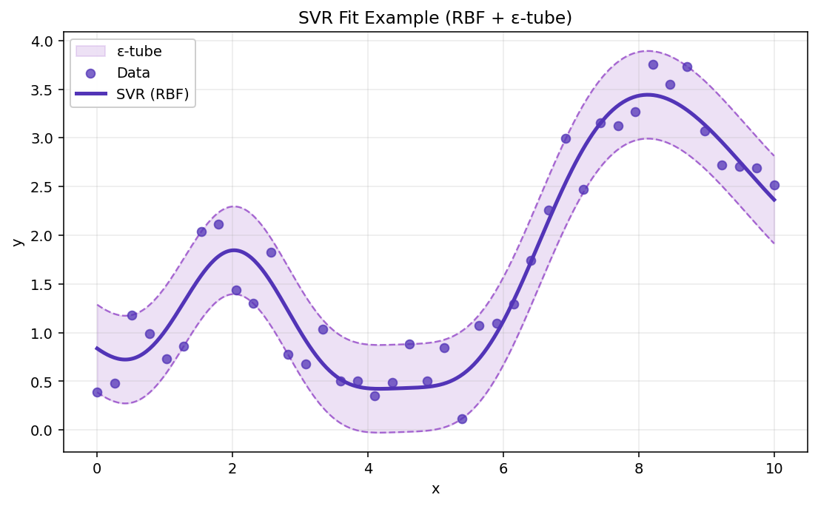
S02 · Regression Models
SVR Fit Example
Why SVR?
Tuned tube + kernel follows curves while resisting small noise.
–
Scale features first.
–
Tune C, ε, kernel with CV.
ETRA
53 / 79

Slide 54
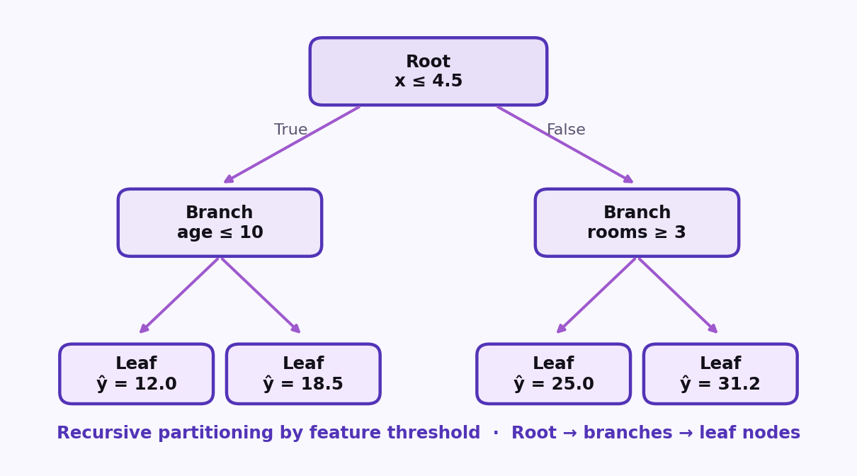
S02 · Regression Models
Decision Tree Regression (CART)
What is Decision Tree Regressor?
Decision Tree Regressor predicts continuous values by splitting feature space into rule-based regions and assigning a constant value in each region.
–
Captures non-linear relationships.
–
Easy to interpret if tree depth is controlled.
–
Handles complex feature interactions.
Decision Tree Split: recursive partitioning by feature threshold · Root → branches → leaf nodes.
ETRA
54 / 79

Slide 55
S02 · Regression Models
Core Concept of Regression Trees
Tree Structure
A regression tree is built from decision rules that partition the input space into regions with constant predictions.
–
Internal node: decision rule (e.g., x ≤ 4.5).
–
Branch: outcome of the rule.
–
Leaf node: predicted value (usually region mean).
ETRA
55 / 79

Slide 56
S02 · Regression Models
CART Perspective
Classification and Regression Trees
Tree Type | Target Type | Typical Criterion
Classification Tree | Categorical target | Gini / Entropy
Regression Tree | Continuous target | MSE (or MAE)
This section focuses on the Regression Tree part of CART.
ETRA
56 / 79

Slide 57
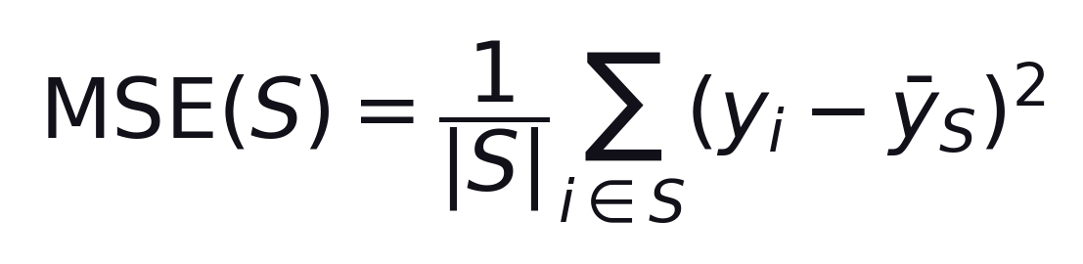
S02 · Regression Models
How Splitting Happens (MSE Criterion)
Node MSE
CART picks the split that maximally reduces MSE (regression) or Gini/entropy (classification).
Average squared distance from the node mean ȳ_S
–
Greedy splits are fast but not globally optimal.
–
Depth and min-samples-leaf control overfitting on small datasets.
ETRA
57 / 79

Slide 58
S02 · Regression Models
Split Score
MSE Criterion
A candidate split is scored by the size-weighted average MSE of the left and right child nodes.
S_L / S_R = left and right subsets after the candidate split
–
Choose the split with the minimum weighted MSE.
–
Larger child nodes influence the score more (weighted by |S_L| and |S_R|).
ETRA
58 / 79

Slide 59
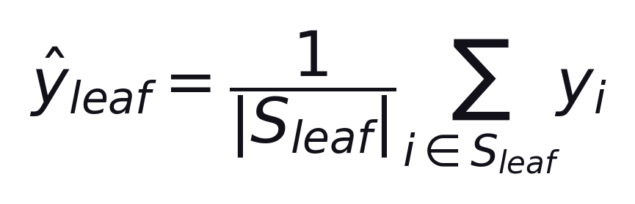
S02 · Regression Models
Prediction at Leaf
Regression Tree
Once a region is pure enough to stop splitting, the leaf predicts a constant value for every point that lands there.
Usually the mean of the training targets in that leaf region
–
Same prediction for all samples that reach the same leaf.
–
Deeper trees create smaller regions and more varied leaf values.
ETRA
59 / 79

Slide 60
S02 · Regression Models
Decision Tree Regression Algorithm
Simple Steps
Step | Action
1 | Start with all data at the root node.
2 | Evaluate candidate splits across features.
3 | Compute weighted MSE for each split.
4 | Select the split with minimum error.
5 | Repeat recursively on child nodes.
6 | Stop based on rules (max depth, min samples).
7 | Predict using leaf mean value.
Decision Tree Split: greedy recursive partitioning until a stopping rule fires.
ETRA
60 / 79

Slide 61
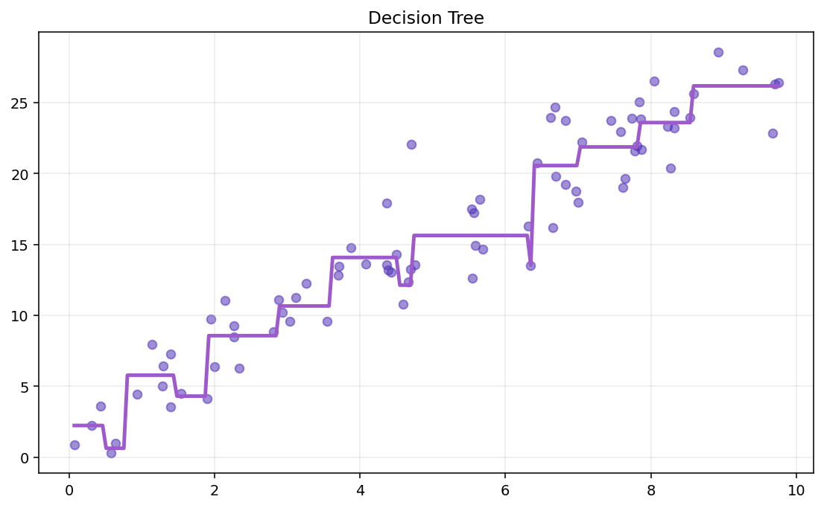
S02 · Regression Models
Decision Tree Fit (Visual)
Algorithm · Static Plot
A fitted regression tree partitions x into intervals and predicts a constant in each leaf region.
–
Piecewise-constant prediction surface.
–
More depth → more steps and finer partitions.
ETRA
61 / 79

Slide 62
S02 · Regression Models
Important Hyperparameters
Decision Tree Regression
Hyperparameter | Effect
max_depth | Controls model complexity
min_samples_split | Minimum samples required to split a node
min_samples_leaf | Minimum samples in each leaf
max_leaf_nodes | Limits number of terminal regions
These settings reduce overfitting and improve generalization.
ETRA
62 / 79

Slide 63
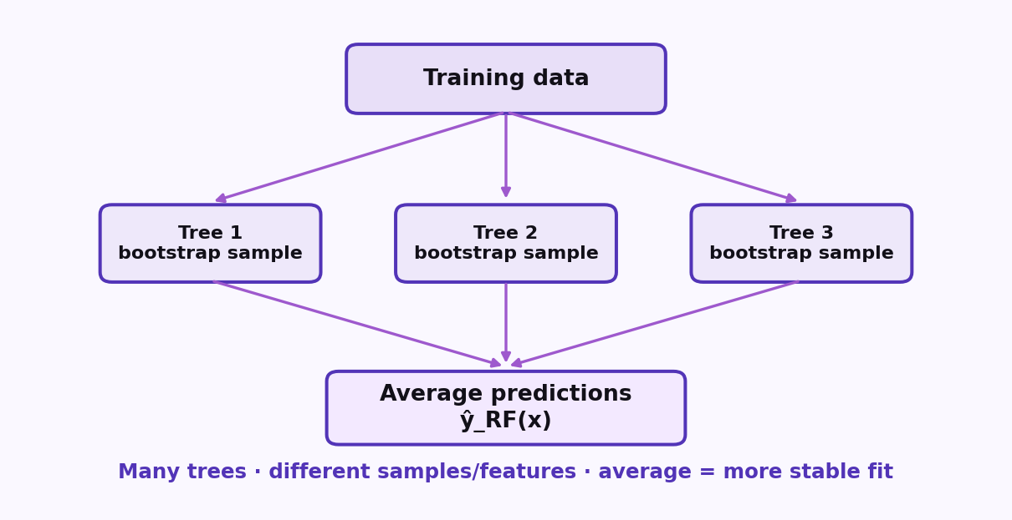
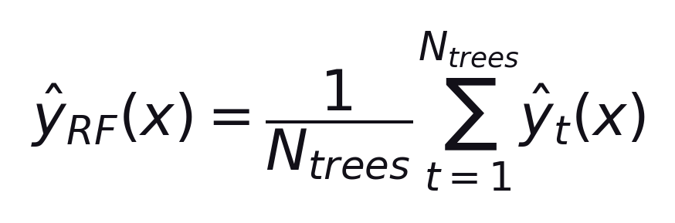
S02 · Regression Models
Random Forest Regression
What is Random Forest Regressor?
Ensemble of many trees — average their predictions.
Formula
Average of individual tree predictions
–
Bootstrap samples → many trees.
–
Averaging reduces variance vs one deep tree.
Also see fitted RF curve: slide-46-3.
ETRA
63 / 79

Slide 64
S02 · Regression Models
Decision Tree vs Random Forest
Regression Comparison
Aspect | Decision Tree | Random Forest
Model | Single tree | Many trees averaged
Split | MSE per split | MSE trees, then average
Overfit risk | Higher | Lower
Stability | Sensitive | More stable
Prediction | One tree output | Mean of trees
Interpretability | High | Medium
Tree for interpretability · Forest for stronger performance.
ETRA
64 / 79

Slide 65
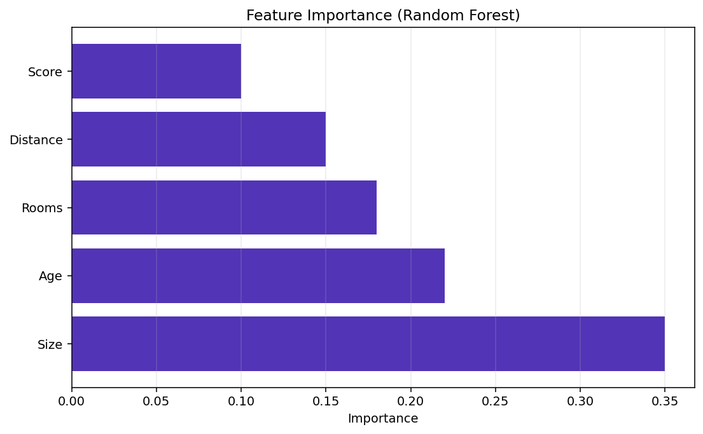
S02 · Regression Models
Feature Importance (Random Forest)
Decision Tree vs Random Forest
Importance scores show how much each feature helped reduce error.
–
Higher bar → more contribution.
–
Guide for insight — not causal proof.
ETRA
65 / 79

Slide 66
S02 · Regression Models
Evaluating Regression Models
Key Performance Metrics
Metric | Formula | Tells Us
MAE | (1/n) Σ |yᵢ − ŷᵢ| | Average error size
MSE | (1/n) Σ (yᵢ − ŷᵢ)² | Penalizes large errors
RMSE | √MSE | Error on y scale
R² | 1 − SS_res/SS_tot | Variance explained
Use more than one metric (e.g. RMSE + R²).
ETRA
66 / 79

Slide 67
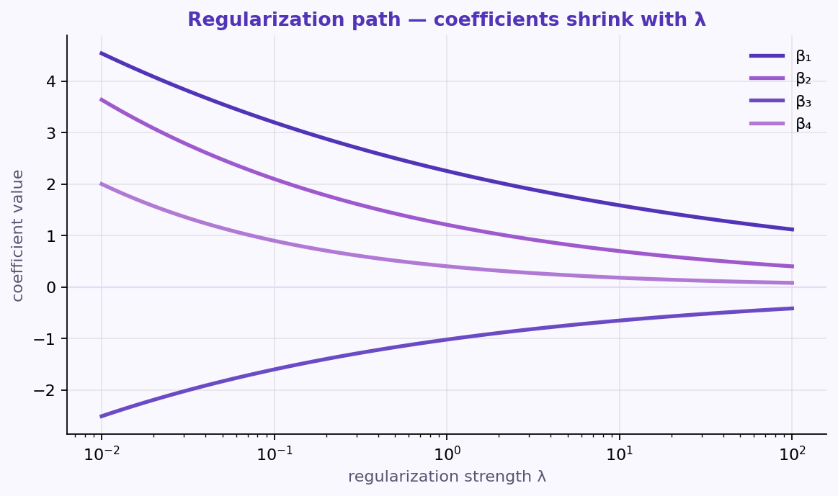
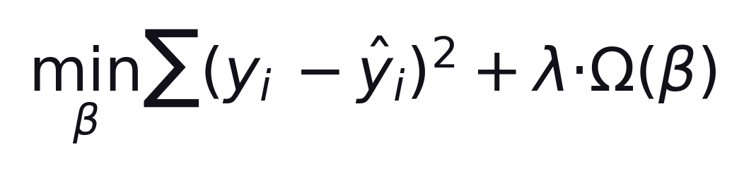
S02 · Regression Models
Regularization Methods (Why Needed?)
Overfitting Problem
Too flexible → fits noise instead of true patterns.
Formula
data loss + λ × penalty
–
Low train error, weak test performance.
–
High variance / unstable predictions.
Penalize large coefficients to control complexity.
ETRA
67 / 79

Slide 68
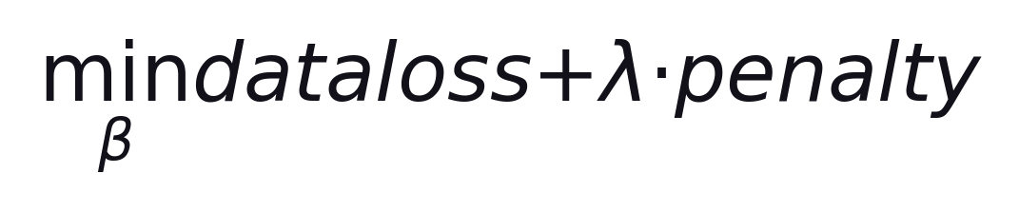
S02 · Regression Models
Regularization Objective
Data Loss + Penalty
Trade off fit vs small coefficients.
loss = Σ(yᵢ − ŷᵢ)² · penalty = Ω(β)
–
λ = 0 → ordinary least squares.
–
Larger λ → stronger shrinkage · tune with CV.
ETRA
68 / 79

Slide 69
S02 · Regression Models
Ridge, Lasso, and Elastic Net
Regularization Families
Different penalties shrink coefficients differently as λ grows.
–
Ridge (L2): shrink all — good with correlated features.
–
Lasso (L1): can zero coeffs — feature selection.
Elastic Net blends L1 + L2 for correlated sparse settings.
ETRA
69 / 79

Slide 70
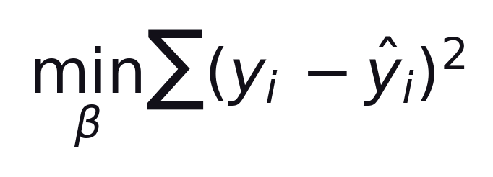
S02 · Regression Models
Without Regularization
Ordinary Least Squares
Minimize squared error only — no coefficient penalty.
Same as λ = 0
–
No shrinkage.
–
Can overfit with many / correlated features.
ETRA
70 / 79

Slide 71
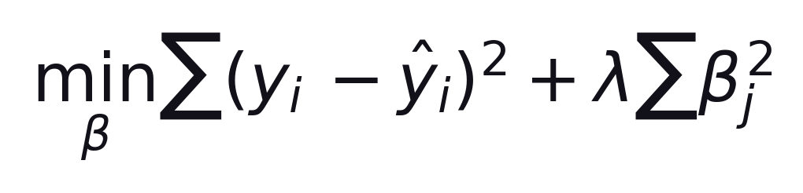
S02 · Regression Models
Ridge Regression (L2)
Penalty: sum of squared coefficients
L2 penalty shrinks coefficients; rarely zeros them.
λ ≥ 0 controls shrinkage
–
Smooth shrinkage of all coefficients.
–
Good when many features correlate.
ETRA
71 / 79

Slide 72
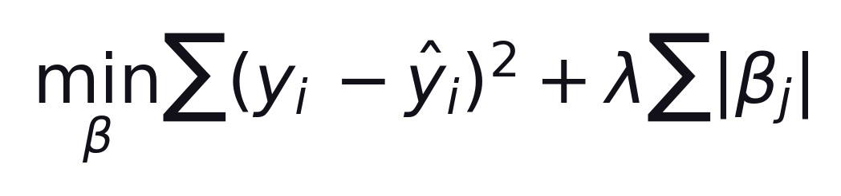
S02 · Regression Models
Lasso Regression (L1)
Penalty: sum of absolute coefficients
L1 penalty can set some coefficients exactly to zero.
Larger λ → sparser model
–
Built-in feature selection.
–
Best when few predictors truly matter.
ETRA
72 / 79

Slide 73
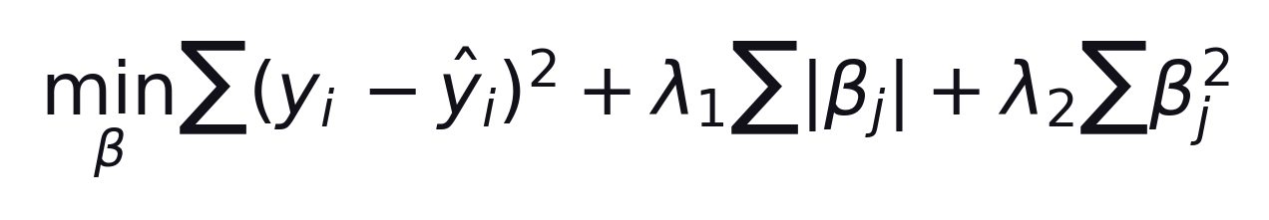
S02 · Regression Models
Elastic Net (L1 + L2)
Blend of Lasso and Ridge
Combine L1 + L2 for sparsity with more stable correlation behavior.
λ₁ → sparsity · λ₂ → ridge shrinkage
–
Good for correlated feature groups.
–
Tune λ₁, λ₂ (or mix ratio) with CV.
ETRA
73 / 79

Slide 74
S02 · Regression Models
When to Use Each Method
Ridge · Lasso · Elastic Net
Match the penalty to the feature structure you expect.
–
Ridge: many small/medium useful features.
–
Lasso: few important features expected.
–
Elastic Net: correlated features + need sparsity.
ETRA
74 / 79

Slide 75
S02 · Regression Models
Regularization Comparison Table
Ridge vs Lasso vs Elastic Net
Method | Penalty Type | Main Behavior | Feature Selection
Ridge | L2 (sum βⱼ²) | Shrinks coefficients smoothly | No
Lasso | L1 (sum |βⱼ|) | Shrinks and can set some coefficients to zero | Yes
Elastic Net | L1 + L2 | Combines shrinkage + selection | Yes
Scale features before Ridge/Lasso/Elastic Net — penalties depend on coefficient magnitude.
ETRA
75 / 79

Slide 76
S02 · Regression Models
Regression Models — Pros & Cons
Session Summary
Model | Advantages | Disadvantages
Linear | Simple, fast, interpretable | Linear only; outlier-sensitive
Polynomial | Captures curves | Degree sensitive; can overfit
SVR | Kernels; robust if tuned | Needs scaling; slow on big data
Decision Tree | Interpretable; no scaling | Overfits; unstable
Random Forest | Accurate; lower variance | Less interpretable; heavier
Interpretability → Linear/Tree · Performance → Random Forest.
ETRA
76 / 79

Slide 77
S02 · Regression Models
Model Summary (Name + Equation)
Session Summary
Model | Core Equation
Linear Regression | ŷ = b₀ + b₁x
Polynomial Regression | ŷ = b₀ + b₁x + b₂x² + ⋯ + b_d x^d
SVR | f(x) = wᵀ φ(x) + b
Decision Tree Regression | ŷ_leaf = mean(y in S_leaf)
Random Forest Regression | ŷ_RF(x) = (1/N_trees) Σ ŷ_t(x)
If interpretability is priority: Linear Regression or Decision Tree. If predictive performance is priority: Random Forest.
ETRA
77 / 79

Slide 78
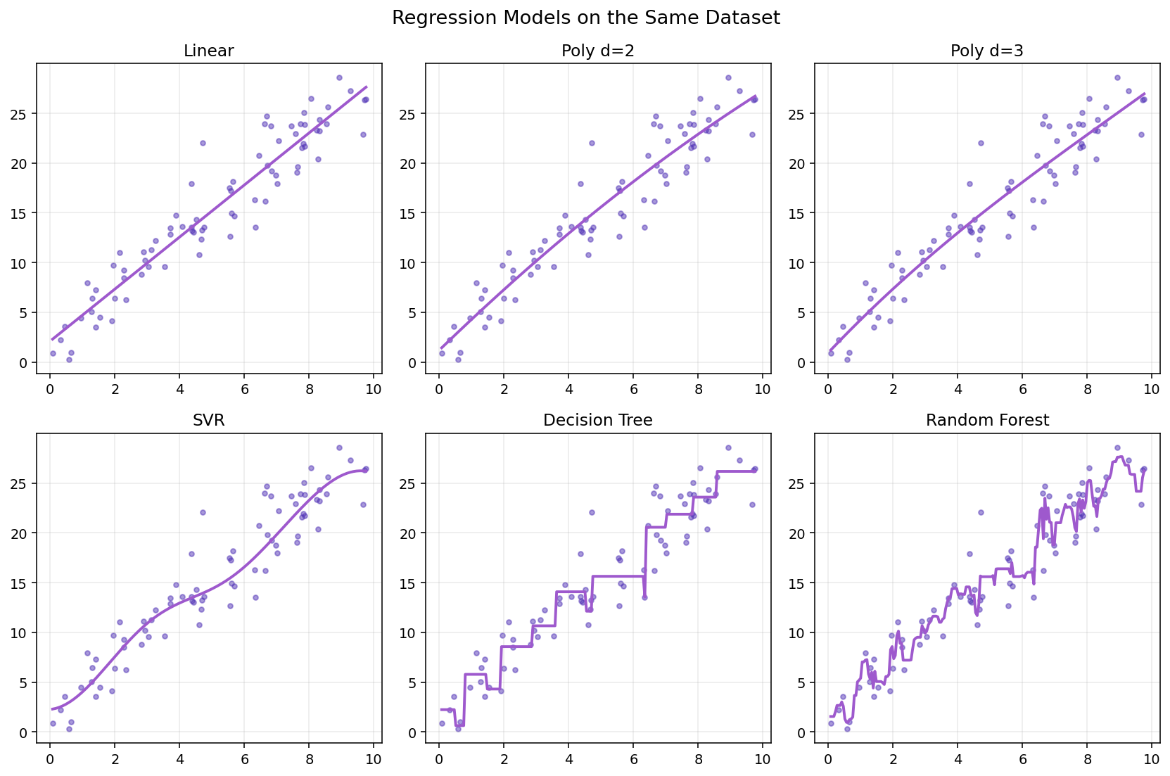
S02 · Regression Models
Visual Comparison of Regression Models
Same Dataset · Different Fits
Same data · five model families side by side.
–
Linear/Ridge: fast · watch curves.
–
Tree/RF: flexible · weak extrapolation.
Visual output from Python code.
ETRA
78 / 79

Slide 79
S02 · Regression Models
Model Families at a Glance
Session Closing
Model | Strength | Watch Out
Linear / Ridge | Interpretable, fast | Nonlinear patterns
SVR | Margin-based, kernels | Slow on huge data
Tree / RF | Nonlinear, little scaling | Extrapolation
Visual output from Python code is shown on the previous slide.
ETRA
79 / 79

