Slide 1

Week 1 · Session 3
Classical ML
Classification basics — from labels to decision boundaries
ETRA
AI & Machine Learning Bootcamp

Slide 2
S03 · Big picture
Where Are We in the Bootcamp?
After regression — learn models that predict class labels.
Week 1
Week 2
Week 3
Week 4
S1
Foundations & Preprocessing
S7
Deep Learning
S8
NLP Fundamentals
S14
Generative AI
S2
Regression Models
S9
Tokenization
S15
RAG Systems
S3
Classification Basics
S10
Text Analysis & NER
S16
MLOps
S4
Naive Bayes & Trees
S11
Language Modeling
S5
SVM & Kernels
S12
Embeddings & RNNs
S6
Clustering & PCA
S13
Seq2Seq & NMT
ETRA
02 / 17

Slide 3
Week 1 · Session 3
Classical ML
Classification Basics
Classification Basics
Logistic regression
K-NN
Decision boundaries
Threshold tuning
ETRA
03 / 17

Slide 4
S03 · Classical ML
Classification Basics
What we will cover in this session
–
Classification Basics
–
Logistic regression
–
K-NN
–
Decision boundaries
–
Threshold tuning
ETRA
04 / 17

Slide 5
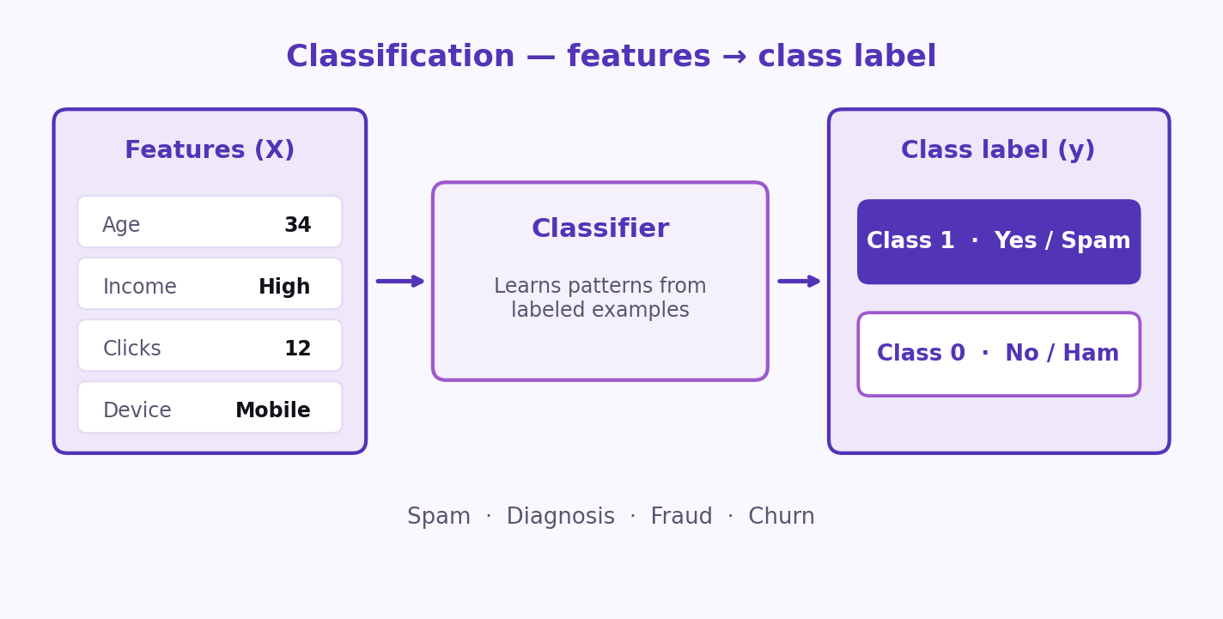
S03 · Classical ML
Classification Overview
Classification Basics
Classification is a supervised learning task used to assign a new observation to a predefined category based on learned patterns from labeled data.
–
Output is a class label (e.g., 0/1, Yes/No).
–
Used in spam, diagnosis, fraud, and churn prediction.
Features in → class label out. Probability models come next.
ETRA
05 / 17

Slide 6
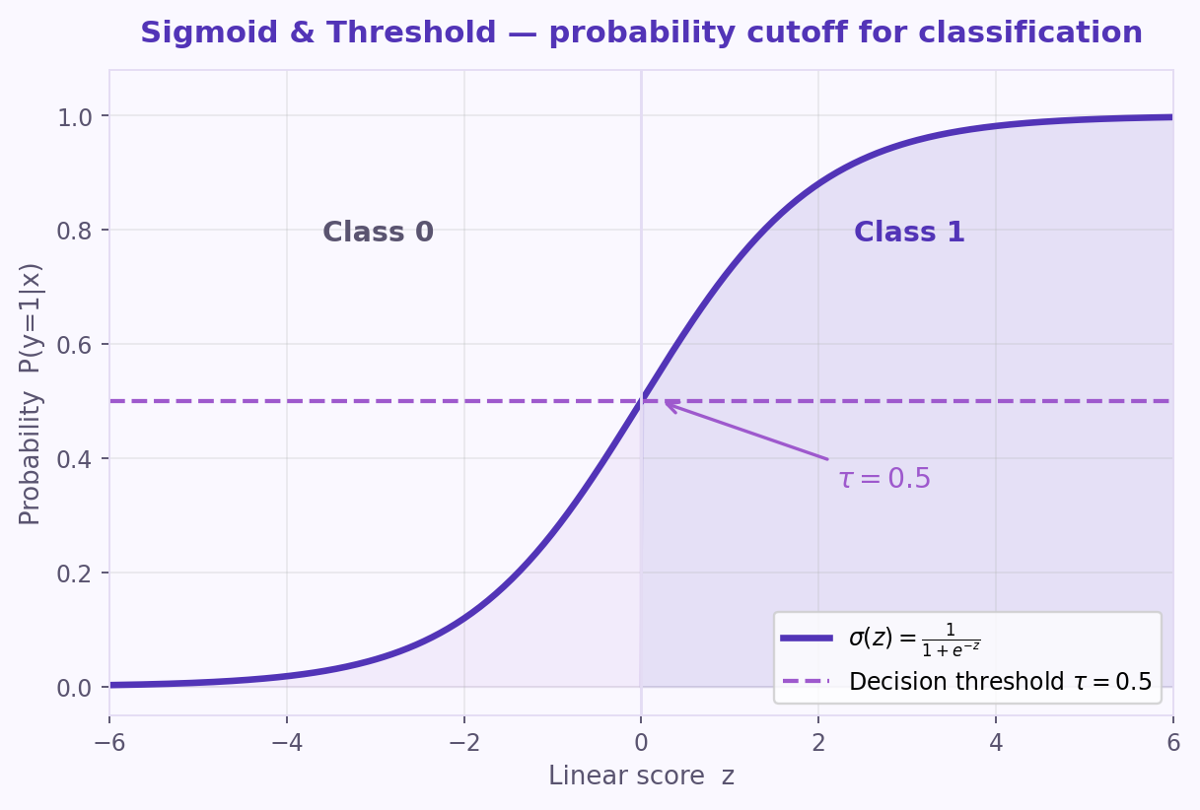
S03 · Classical ML
Logistic Regression: Definition
Binary Classification
Supervised binary classifier that estimates P(y=1|x) from features.
–
Outputs probabilities in [0, 1].
–
Class label comes from applying a threshold later.
–
Models features → log-odds of the positive class.
Maps a linear score to a probability via the sigmoid.
ETRA
06 / 17

Slide 7
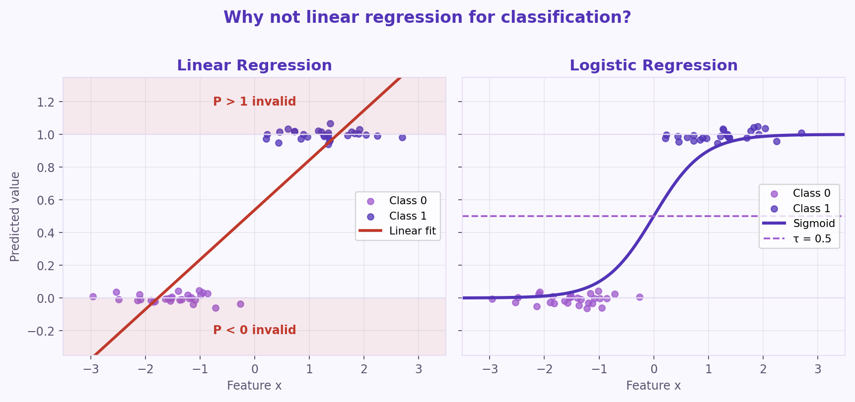
S03 · Classical ML
Why Not Linear Regression for Classification?
Motivation for Logistic Regression
Linear regression predicts continuous values rather than discrete classes.
–
Predictions can fall outside [0, 1] — invalid as probabilities.
–
No natural, stable class boundary for labels.
Sigmoid keeps outputs in [0, 1] and supports a clear cutoff.
ETRA
07 / 17

Slide 8
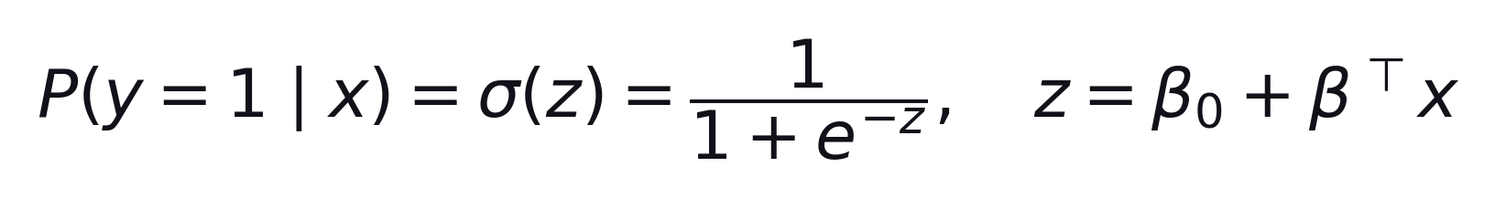
S03 · Classical ML
Sigmoid Mapping and Decision Threshold
Sigmoid & Threshold
Sigmoid turns the linear score z into a probability.
Formula
–
Default cutoff: P ≥ 0.5 → class 1, else class 0.
–
τ is tunable for cost of false positives vs false negatives.
Tune τ to business/clinical risk — covered in Threshold tuning.
ETRA
08 / 17

Slide 9
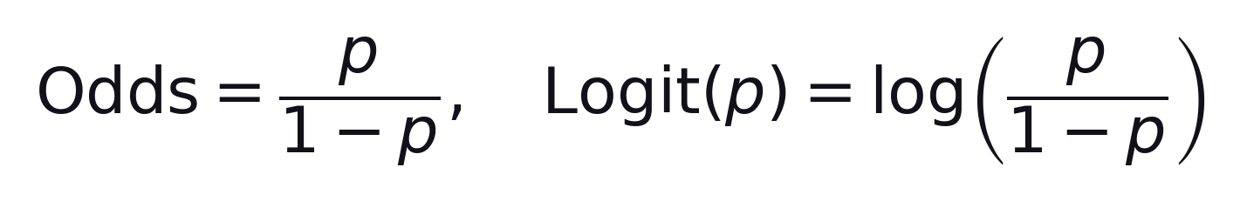
S03 · Classical ML
Key Assumptions for Logistic Regression
Model Assumptions
Works on log-odds — check independence, collinearity, and linearity in logit space.
–
Observations should be independent.
–
Avoid severe multicollinearity among predictors.
–
Relationship ≈ linear in the log-odds space.
ETRA
09 / 17

Slide 10
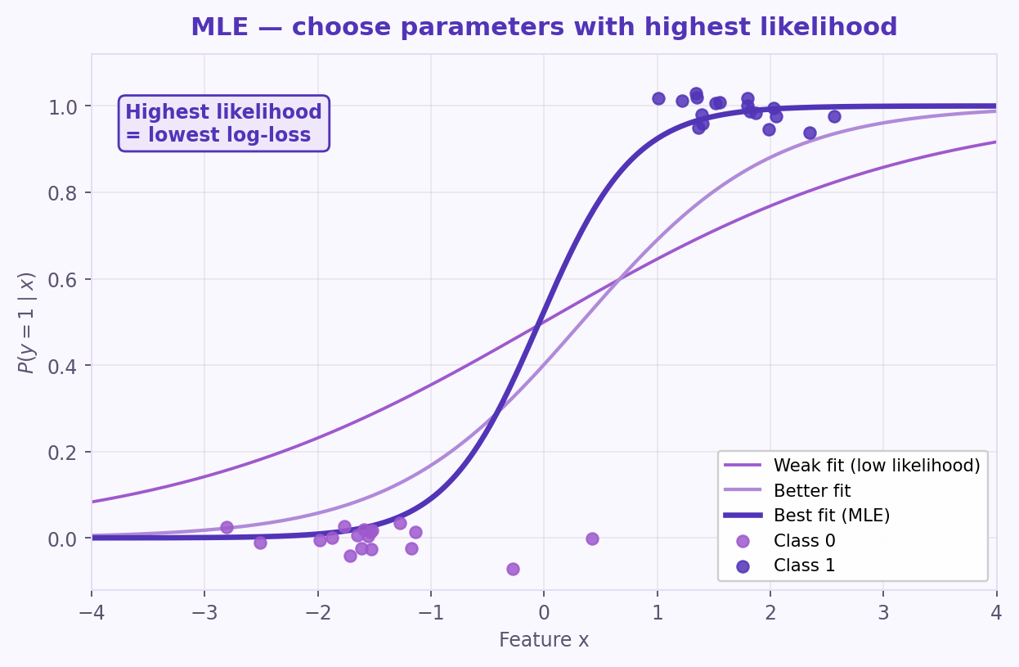
S03 · Classical ML
Maximum Likelihood Estimation (MLE)
How Logistic Regression Learns
Parameters β are chosen to maximize the likelihood of the observed labels.
–
Each curve is a different β (different likelihood).
–
Best fit: highest likelihood / lowest log-loss.
Pick β that makes the observed labels most probable.
ETRA
10 / 17

Slide 11
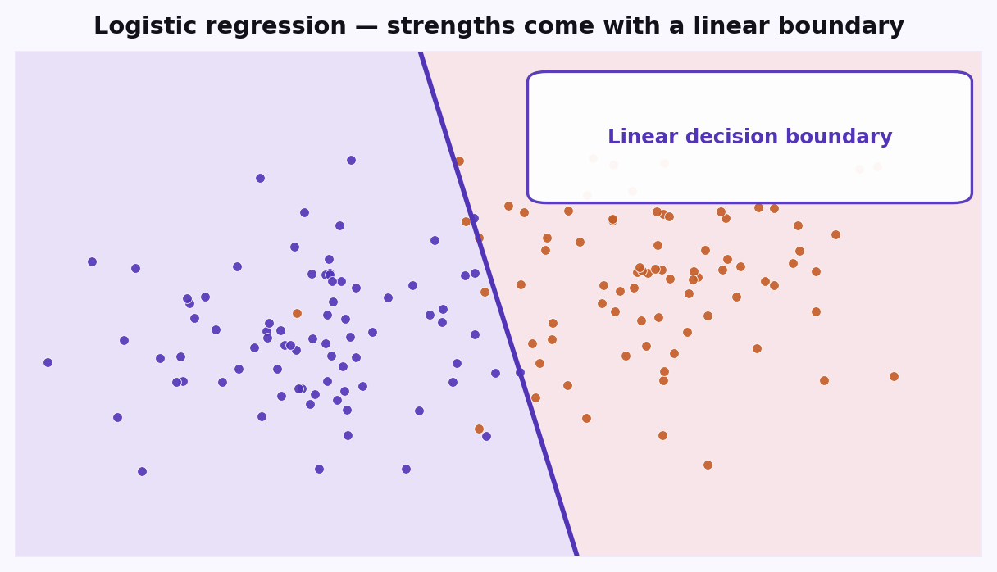
S03 · Classical ML
Logistic Regression: Strengths and Limits
When to Use It
Strong baseline when classes are roughly linearly separable; weaker on complex shapes.
–
Strengths: interpretable odds, fast training, calibrated probabilities.
–
Limits: linear boundary; struggles with overlap / non-linear shapes.
For wiggly boundaries → polynomials, K-NN, or kernels.
ETRA
11 / 17

Slide 12
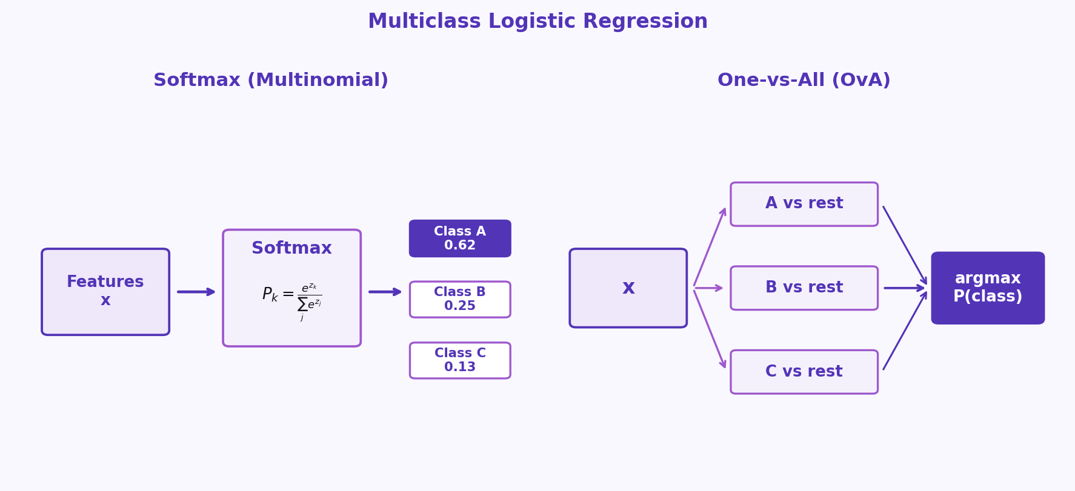
S03 · Classical ML
Multiclass Extension of Logistic Regression
Beyond Binary
Extend binary logistic regression to 3+ classes with Softmax or One-vs-All.
–
Softmax: one multinomial model for all classes.
–
One-vs-All: one binary classifier per class; pick max P.
Final label = argmax_k P(y=k|x).
ETRA
12 / 17

Slide 13
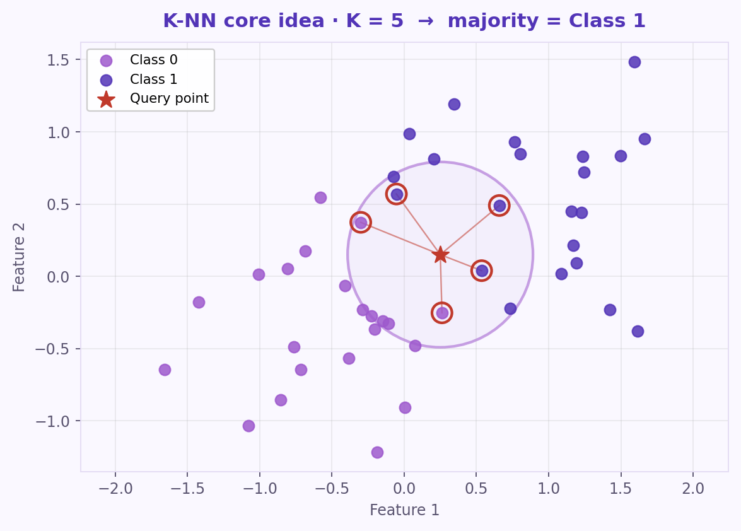
S03 · Classical ML
K-Nearest Neighbors (K-NN): Core Idea
Instance-Based Learning
Non-parametric classifier: label by majority vote among the K nearest training points.
–
Choose K and a distance metric.
–
Find K nearest neighbors; majority vote wins.
Lazy learner — the training set is the model.
ETRA
13 / 17

Slide 14
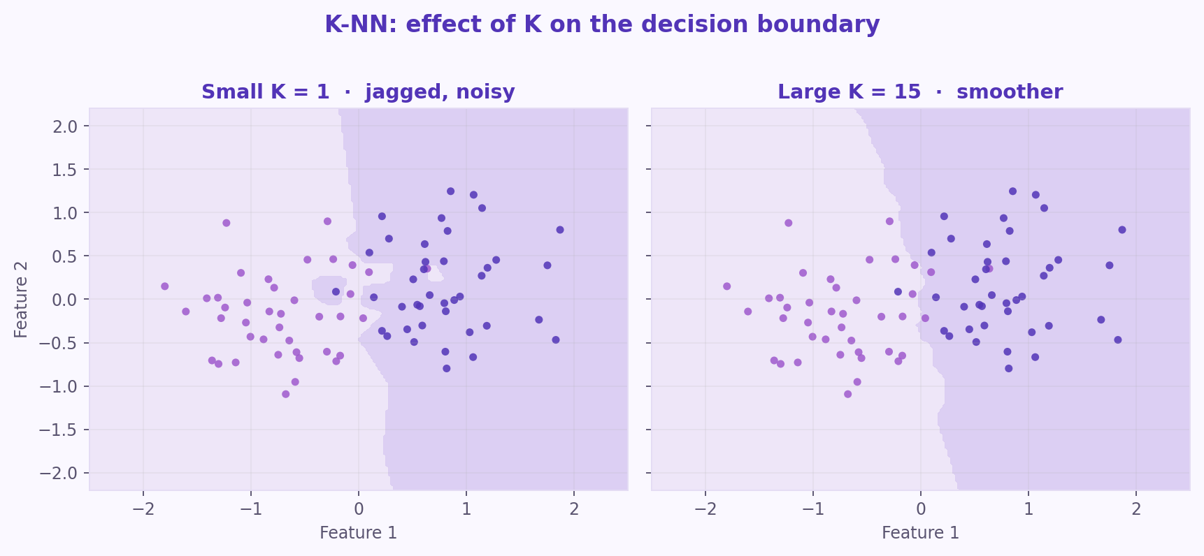
S03 · Classical ML
K-NN: Choosing K and Distance Metric
Hyperparameters
K and distance control how smooth the decision boundary is.
–
Small K: flexible, noise-sensitive.
–
Large K: smoother; may miss local structure.
Pick K with CV · scale features before distance modeling.
ETRA
14 / 17

Slide 15
S03 · Classical ML
K-NN: Strengths and Limitations
When to Use It
Strengths | Limitations
Simple and intuitive | Slow prediction on large datasets
Works well on small, separated data | Sensitive to irrelevant features / imbalance
Native multiclass support | Curse of dimensionality
No training phase (lazy baseline) | Needs feature scaling
Great baseline; watch cost at inference and high dimensions.
ETRA
15 / 17

Slide 16
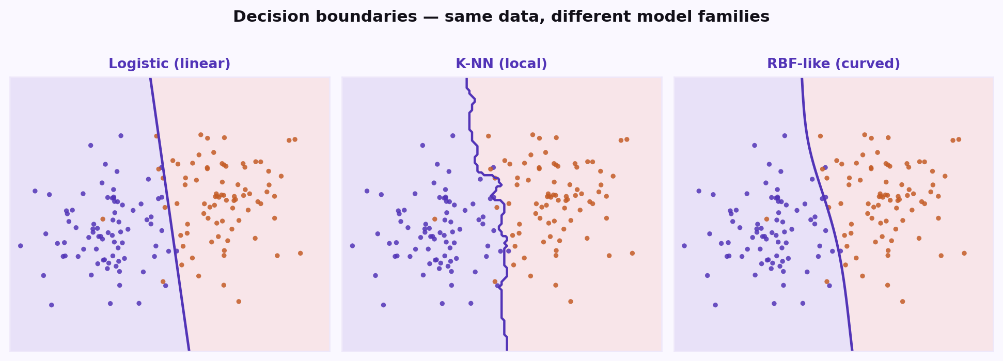
S03 · Classical ML
Decision Boundaries Across Models
Geometry of Classification
A decision boundary is the surface where the predicted class flips — its shape depends on the model family.
–
Logistic: linear boundary in feature space (unless you add features).
–
K-NN: local, piecewise boundary that follows nearest neighbors.
–
Kernel / RBF-like models: smooth curved boundaries.
Match model flexibility to how classes are separated in the data.
ETRA
16 / 17

Slide 17
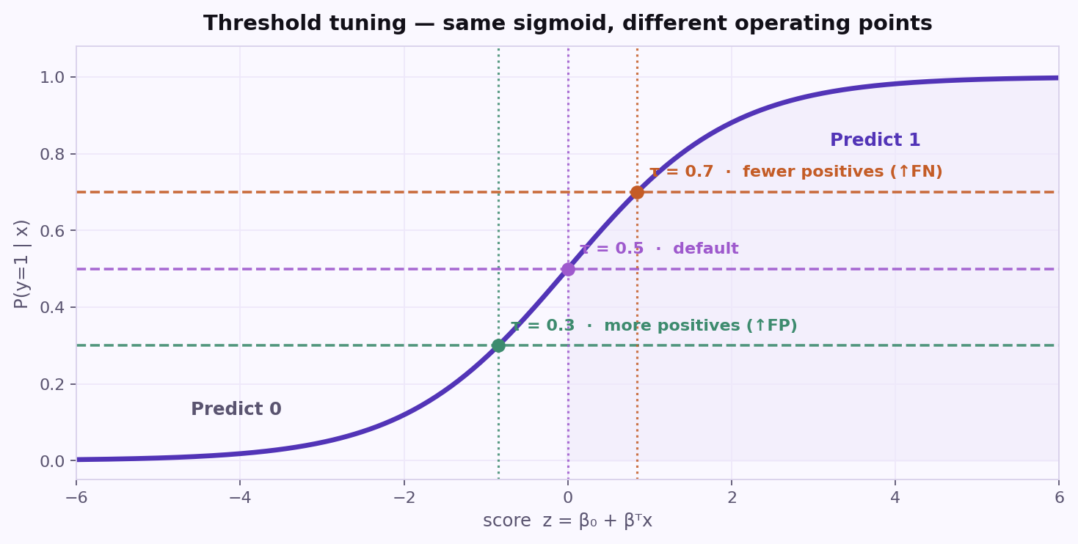
S03 · Classical ML
Threshold Tuning: Trading FP vs FN
Operating Point
The sigmoid gives P(y=1|x); τ turns that probability into a hard class label.
–
Lower τ → more positives (↑ recall, ↑ false positives).
–
Higher τ → fewer positives (↑ precision, ↑ false negatives).
–
Default τ = 0.5 is a starting point, not a law.
Set τ from costs: missed fraud ≠ false spam alarm.
ETRA
17 / 17

