Slide 1

Week 1 · Session 4
Classical ML
Naive Bayes, trees, and evaluation metrics
ETRA
AI & Machine Learning Bootcamp

Slide 2
S04 · Big picture
Where Are We in the Bootcamp?
After classification basics — probabilistic models, trees, and metrics.
Week 1
Week 2
Week 3
Week 4
S1
Foundations & Preprocessing
S7
Deep Learning
S8
NLP Fundamentals
S14
Generative AI
S2
Regression Models
S9
Tokenization
S15
RAG Systems
S3
Classification Basics
S10
Text Analysis & NER
S16
MLOps
S4
Naive Bayes & Trees
S11
Language Modeling
S5
SVM & Kernels
S12
Embeddings & RNNs
S6
Clustering & PCA
S13
Seq2Seq & NMT
ETRA
02 / 18

Slide 3
Week 1 · Session 4
Classical ML
Naive Bayes, Trees, Evaluation
Naive Bayes
Decision trees
Random Forest
Precision / recall / F1
ETRA
03 / 18

Slide 4
S04 · Classical ML
Naive Bayes, Trees, Evaluation
What we will cover in this session
–
Naive Bayes
–
Decision trees
–
Random Forest
–
Precision / recall / F1
ETRA
04 / 18

Slide 5
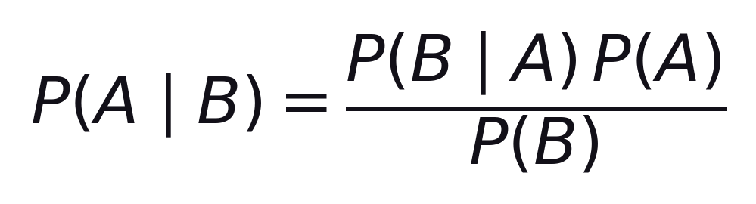
S04 · Classical ML
Naive Bayes: Bayes' Theorem
Core Probability Rule
Bayes’ theorem updates our belief about A after observing evidence B.
Posterior ∝ Likelihood × Prior
–
P(A|B): posterior probability after observing evidence B.
–
P(A): prior belief before seeing evidence.
–
P(B|A): likelihood of evidence if class A is true.
P(B): evidence probability (normalization term). This theorem updates beliefs when new evidence appears.
ETRA
05 / 18

Slide 6
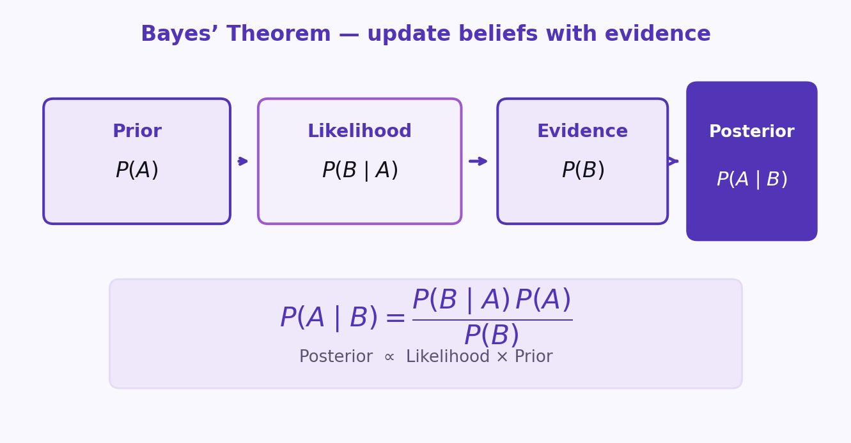
S04 · Classical ML
Bayes’ Theorem — Visual Map
Core Probability Rule
Prior × Likelihood → Posterior (normalized by evidence).
Same rule as the formula slide — different view of the update.
ETRA
06 / 18

Slide 7
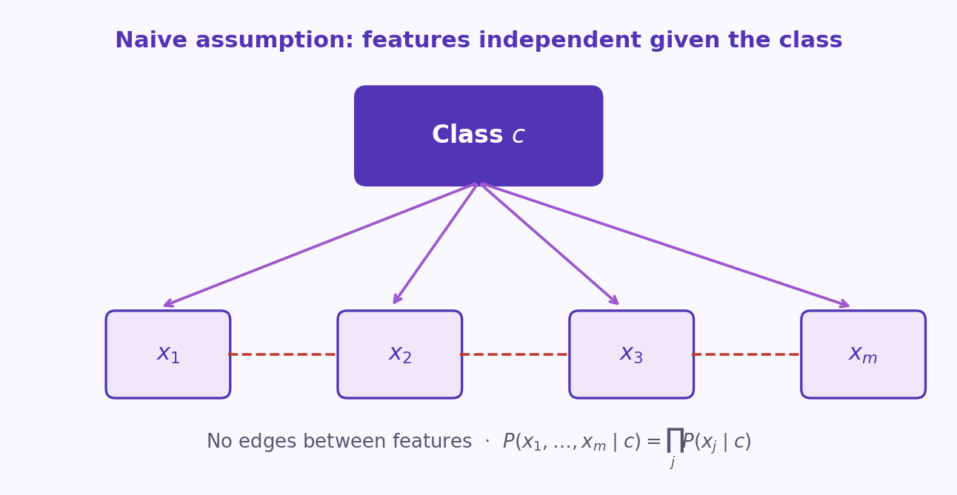
S04 · Classical ML
Why Is It Called 'Naive'?
Conditional Independence Assumption
Naive Bayes assumes features are conditionally independent given the class label.
–
Simplifies parameter estimation and speeds up training.
–
Works well in text classification and high-dimensional sparse data.
–
Can still perform well even when independence is not fully true.
When comparing classes for the same X, P(X) is constant and can be ignored.
ETRA
07 / 18

Slide 8
S04 · Classical ML
Naive Bayes: Practical Notes
Variants & Implementation
Variant | Typical Data | Key Idea
Gaussian NB | Continuous | Each feature ~ Gaussian given the class
Multinomial NB | Count-based | Common for document word counts
Bernoulli NB | Binary | Presence/absence features
Handle zero-frequency with smoothing (e.g., Laplace). Scale/preprocess by feature type and variant.
ETRA
08 / 18

Slide 9
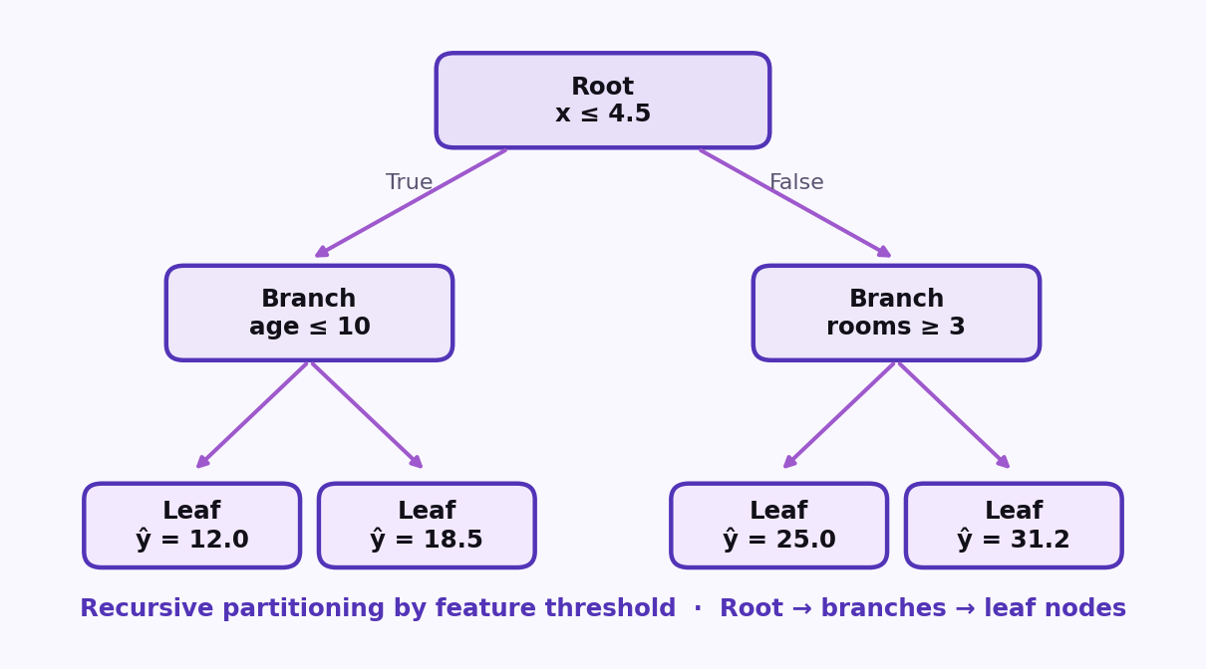
S04 · Classical ML
Decision Tree Classification (CART)
Recursive Partitioning
Decision Tree Classification predicts class labels by recursively splitting feature space into purer class regions.
–
Internal nodes represent feature-based decisions.
–
Branches represent decision outcomes.
–
Leaf nodes output final class prediction.
Decision Tree Split · Root → branches → leaf nodes · split by feature threshold.
ETRA
09 / 18

Slide 10
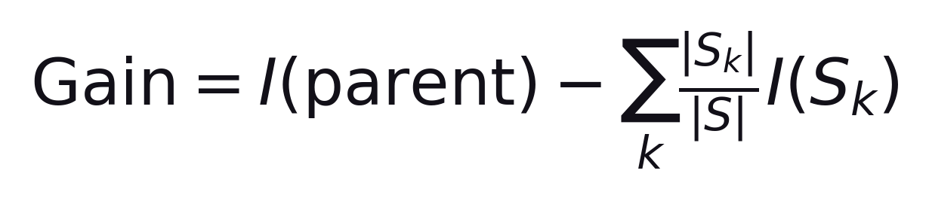
S04 · Classical ML
How Splits Are Chosen in Classification Trees
Gini · Entropy · Information Gain
Splits are chosen greedily to maximize information gain.
Gini / Entropy measure impurity — lower is better
–
Choose the split that best separates classes at each node.
–
Stop splitting using rules like max depth or minimum samples.
–
Gini impurity and entropy measure node purity — lower is better.
Better splits reduce impurity and increase class purity in child nodes.
ETRA
10 / 18

Slide 11
S04 · Classical ML
Decision Tree: Classification vs Regression
Same Structure · Different Objectives
Aspect | Classification Tree | Regression Tree
Target | Categorical class | Continuous value
Split criterion | Gini / Entropy | MSE / MAE
Leaf output | Class label or class probability | Numeric mean/median
Both use recursive partitioning (Root → branches → leaves) but optimize different objectives.
ETRA
11 / 18

Slide 12
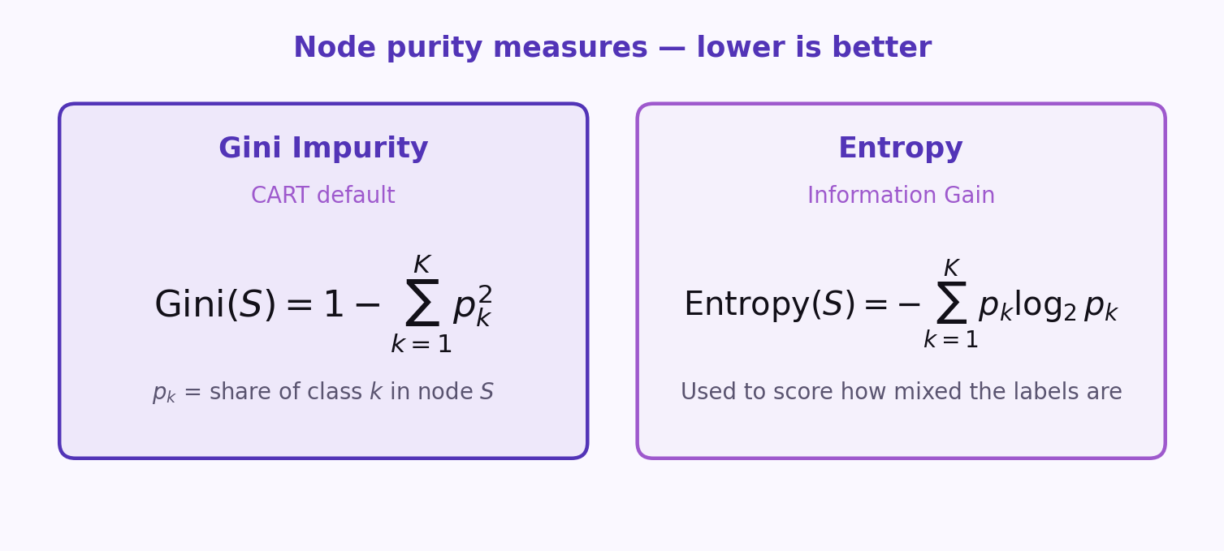
S04 · Classical ML
Gini Impurity and Entropy
Node Purity Measures
Gini (CART default) and entropy both measure node impurity — lower is better.
Better splits reduce impurity and increase class purity in child nodes.
ETRA
12 / 18

Slide 13
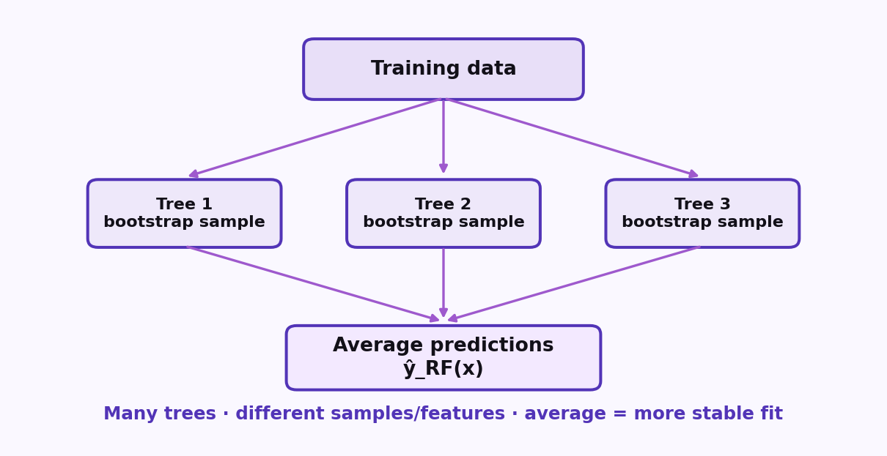
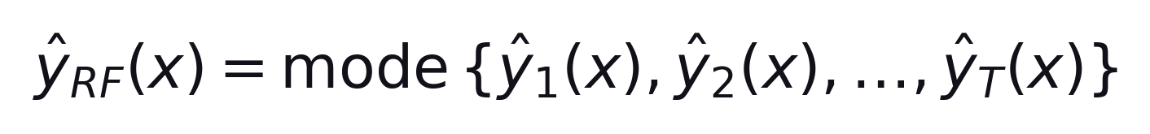
S04 · Classical ML
Random Forest Classification
Ensemble Learning by Bagging
Train many trees on bootstrap samples, then combine predictions by majority vote.
Formula
Majority vote across T trees
–
Sample bootstrap data and train many trees.
–
Each tree predicts a class for the new sample.
Final class = majority vote (mode). Regression RF uses the mean instead.
ETRA
13 / 18

Slide 14
S04 · Classical ML
Why Random Forest Often Outperforms a Single Tree
Bias–Variance Tradeoff
Property | Single Decision Tree | Random Forest
Variance | High | Lower (averaging effect)
Overfitting risk | Higher | Lower
Interpretability | High | Moderate
Predictive robustness | Sensitive to data noise | More stable
Bagging + feature randomness → less variance without much extra bias.
ETRA
14 / 18

Slide 15
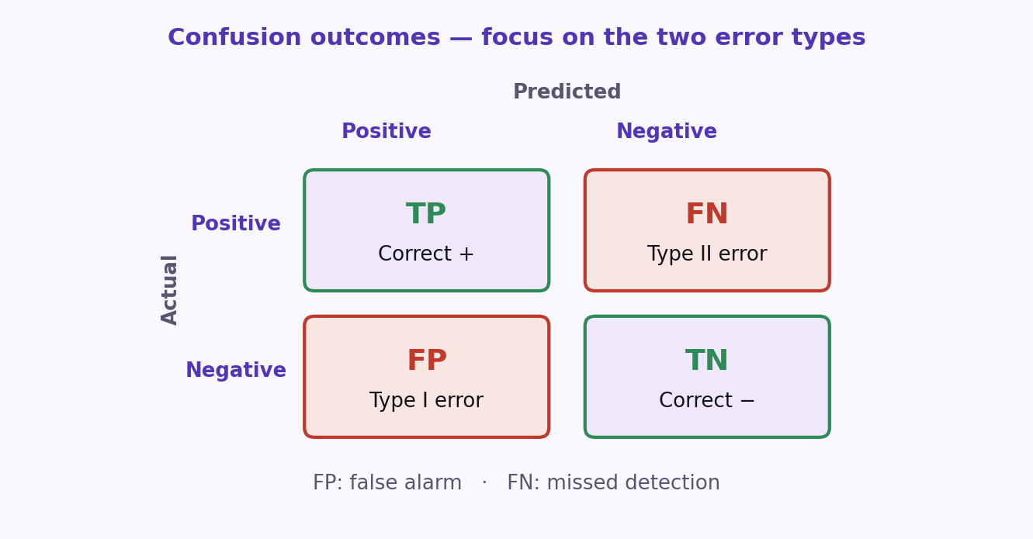
S04 · Classical ML
Classification Errors: FP and FN
Error Types
Not all mistakes are equal — False Positives and False Negatives carry different costs.
–
False Positive (Type I): predict positive, actual is negative.
–
False Negative (Type II): predict negative, actual is positive.
–
Error impact depends on domain costs (healthcare vs spam).
Model evaluation should consider error trade-offs, not accuracy alone.
ETRA
15 / 18

Slide 16
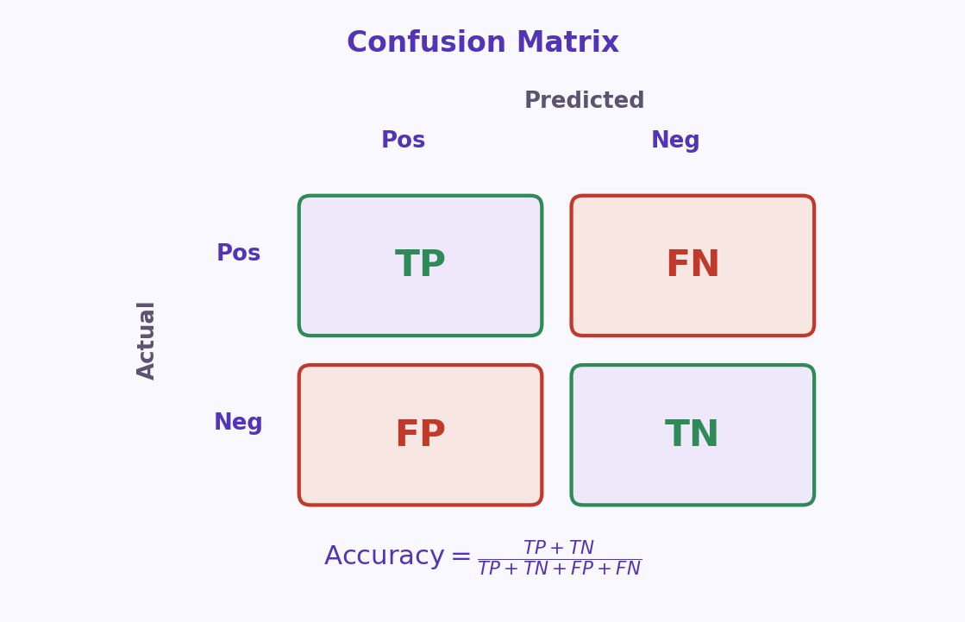
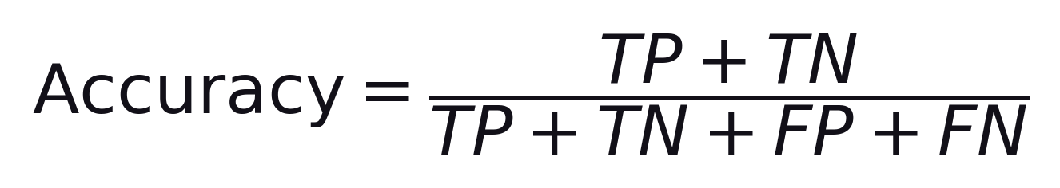
S04 · Classical ML
Confusion Matrix and Accuracy
Actual vs Predicted Counts
Confusion matrix counts TP, FP, FN, TN — Accuracy is overall correctness.
Formula
Correct predictions ÷ all predictions
–
TP / TN: correct positives / negatives.
–
FP / FN: false alarms / missed detections.
High accuracy can hide poor minority-class performance when data is imbalanced.
ETRA
16 / 18

Slide 17
S04 · Classical ML
Confusion Matrix Cells
Metric Meanings
Metric | Meaning
TP | Correctly predicted positives
TN | Correctly predicted negatives
FP | Incorrectly predicted positives
FN | Incorrectly predicted negatives
These four counts are the building blocks of precision, recall, and F1.
ETRA
17 / 18

Slide 18
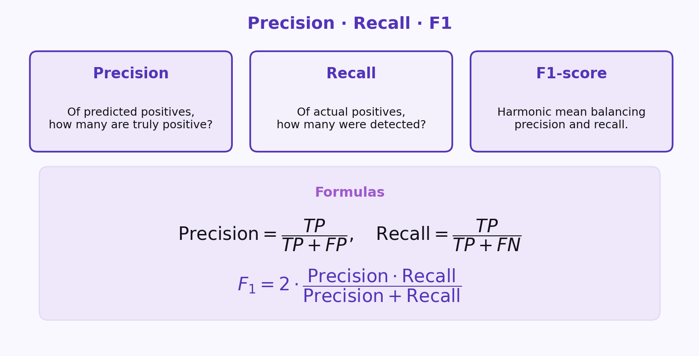
S04 · Classical ML
Precision, Recall, and F1-Score
Beyond Accuracy
Precision and recall trade off · F1 balances both when classes are imbalanced.
Use F1 especially when class distribution is imbalanced.
ETRA
18 / 18

