Slide 1
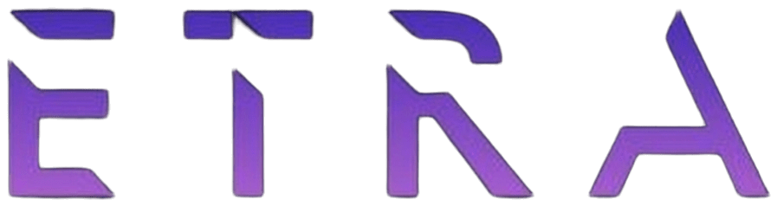
Week 2 · Session 1
Deep Learning
Neural networks, backpropagation, CNNs, and RNNs
ETRA
AI & Machine Learning Bootcamp

Slide 2
S07 · Big picture
Where Are We in the Bootcamp?
Week 1 classical ML is done — now stacked nonlinear models.
Week 1
Week 2
Week 3
Week 4
S1
Foundations & Preprocessing
S7
Deep Learning
S8
NLP Fundamentals
S14
Generative AI
S2
Regression Models
S9
Tokenization
S15
RAG Systems
S3
Classification Basics
S10
Text Analysis & NER
S16
MLOps
S4
Naive Bayes & Trees
S11
Language Modeling
S5
SVM & Kernels
S12
Embeddings & RNNs
S6
Clustering & PCA
S13
Seq2Seq & NMT
ETRA
02 / 106

Slide 3
Week 2 · Session 1
Deep Learning
Neural Networks · CNNs · RNNs
Deep Learning
Neural Networks
Perceptron & MLP
Backpropagation
CNNs
RNNs & regularization
ETRA
03 / 106

Slide 4
S07 · Deep Learning
Neural Networks · CNNs · RNNs
What we will cover in this session
–
Deep Learning
–
Neural Networks
–
Perceptron & MLP
–
Backpropagation
–
CNNs
–
RNNs & regularization
ETRA
04 / 106

Slide 5
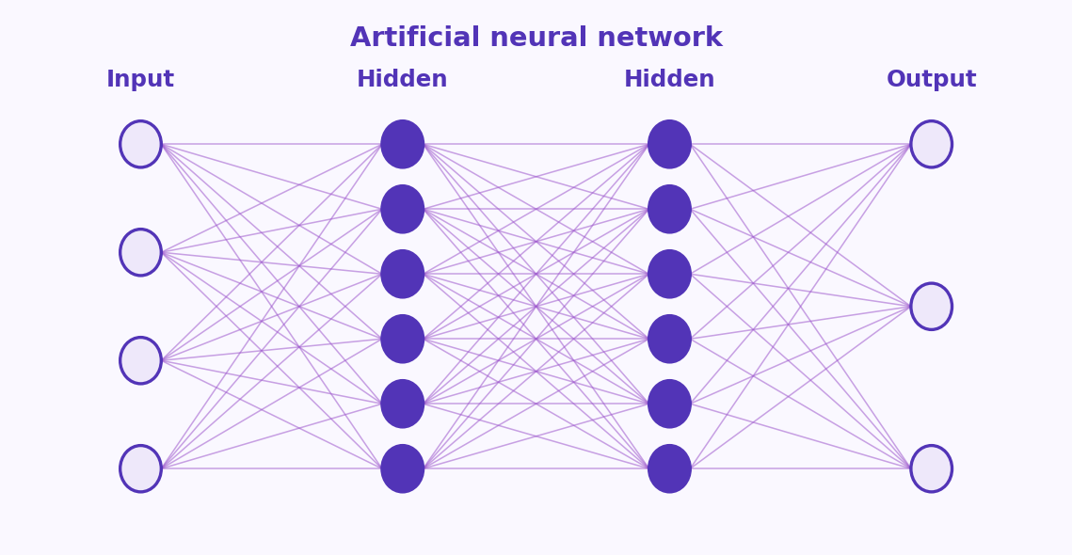
S07 · Deep Learning
Deep Learning: Introduction
Foundations → Optimization → Architectures → Autoencoders
Each phase answers a different question.
–
Four phases: foundations → optimization → architectures → autoencoders.
–
Each phase has a lab-style checkpoint — pause at phase boundaries.
–
Focus on deep learning basics — phase breaks are intentional.
Phase 1 focus: understand the “why” and the mathematical mechanics of a single neuron before scaling to layers and data.
ETRA
05 / 106

Slide 6
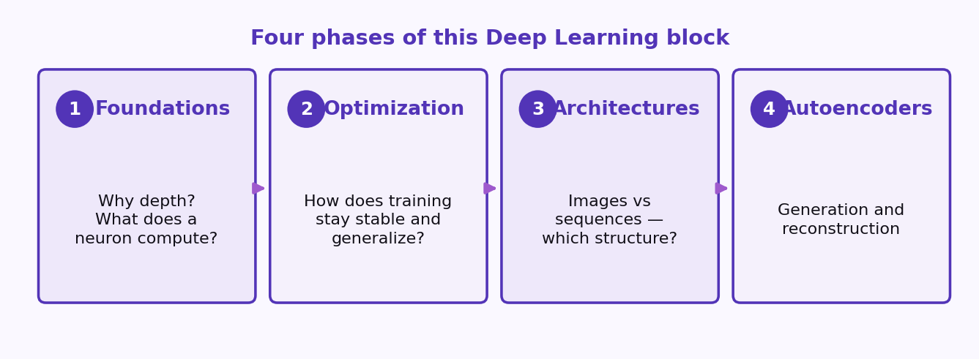
S07 · Deep Learning
Deep Learning: Introduction
Four phases, four questions
Foundations → optimization → architectures → autoencoders. Pause at each boundary.
Phase 1 focus: understand the “why” and the mathematical mechanics of a single neuron before scaling to layers and data.
ETRA
06 / 106

Slide 7
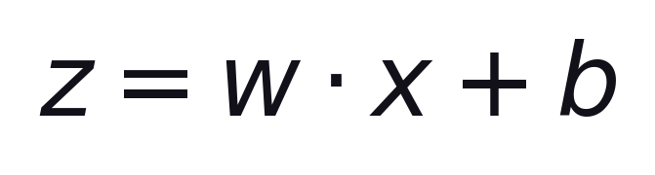
S07 · Deep Learning
Phase 1: Foundations & Neural Core
Why depth, neurons, and forward pass
Goal: understand what a neuron computes and why stacking layers enables hierarchical features.
Exit check: explain this — and why nonlinearity is required between layers.
–
Topics: perceptron, activations, MLP, forward propagation, and loss functions.
–
Stacking layers builds hierarchical features only if a nonlinearity sits between them.
ETRA
07 / 106

Slide 8
S07 · Deep Learning
Phase 1 Roadmap
Why depth, neurons, and forward pass
Block | Question it answers
Perceptron & MLP | What does one layer compute?
Forward pass | How does inference flow through the graph?
Loss & gradients | What are we optimizing?
Exit check: explain z = w·x + b and why nonlinearity is required between layers.
ETRA
08 / 106

Slide 9
S07 · Deep Learning
What Is Deep Learning?
Definition in One Sentence — Then the Details
Deep learning learns a parameterized mapping from inputs to outputs by stacking nonlinear transformations (layers).
–
“Deep” means multiple such transformations — hierarchical features, not one giant linear rule.
Layers rewrite features step by step. Depth is composition, not one giant linear rule.
ETRA
09 / 106

Slide 10
S07 · Deep Learning
What Is Deep Learning?
Definition in One Sentence — Then the Details
–
Training = pick a loss that measures mistakes, then adjust weights with gradients so average loss drops on data (generalization to unseen data is the real goal).
–
Unlike fixed pipelines of hand-crafted features, the network learns representations that are tuned to the task (edges → textures → parts → objects in vision, etc.).
Generalization to unseen data is the real goal — not memorizing the training set.
ETRA
10 / 106

Slide 11
S07 · Deep Learning
Three Ingredients You Always Have
Architecture · Loss · Optimizer + data
Ingredient | What it means
Architecture | How signals flow (MLP, CNN, RNN, Transformer, …)
Loss / objective | What “better” means for your task (MSE, cross-entropy, …)
Optimizer + data | How you search parameters and what examples you show
You always have these three. Change one, and the model’s behavior changes with it.
ETRA
11 / 106

Slide 12
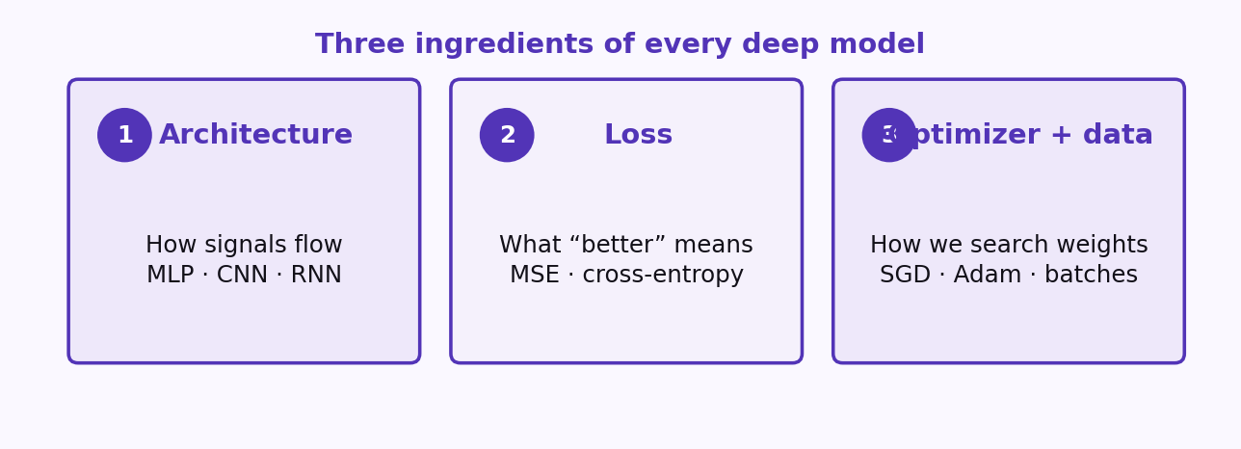
S07 · Deep Learning
Three Ingredients You Always Have
Architecture · Loss · Optimizer + data
A strong architecture with the wrong loss still learns the wrong thing.
ETRA
12 / 106

Slide 13
S07 · Deep Learning
AI, Machine Learning, and Deep Learning
Subset Relationships — Not Interchangeable Labels
–
Artificial intelligence (AI): the broad field—rules, search, optimization, learning, planning—anything that aims at intelligent behavior.
–
Machine learning (ML): a subfield of AI where behavior improves from data via a learning algorithm (not only hand-written rules).
–
Deep learning (DL): a subfield of ML using deep neural networks—multiple learned nonlinear layers; representation learning is central.
ETRA
13 / 106

Slide 14
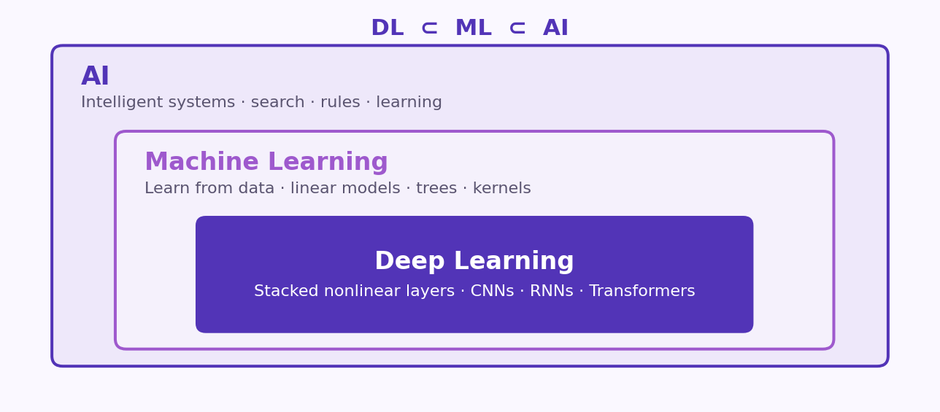
S07 · Deep Learning
AI, Machine Learning, and Deep Learning
Subset Relationships — Not Interchangeable Labels
DL ⊂ ML ⊂ AI
ETRA
14 / 106

Slide 15
S07 · Deep Learning
Containment (conceptual)
Subset Relationships — Not Interchangeable Labels
Set | Contains
AI | Rule systems, classical search, ML, knowledge bases, …
ML | Linear models, trees, kernel SVMs, shallow nets, deep nets
DL | CNNs, RNNs/GRU/LSTM, Transformers, GANs, VAEs, …
Saying “we used AI” is vague; “we used supervised DL with a CNN” is precise.
ETRA
15 / 106

Slide 16
S07 · Deep Learning
Use-Case Fit: When Deep Learning Shines — and When to Skip It
Match Method to Data, Risk, and Budget
–
DL is strongest when: large data (or strong pre-training), high-dimensional raw inputs (images, text, speech), and compositionality you want learned end-to-end.
–
Think twice when: tiny tabular datasets, strict interpretability requirements, tight latency on CPU without optimization, or simple baselines already solve the problem.
–
Always compare against strong baselines (logistic regression, gradient boosting, k-NN on engineered features)—DL must earn its complexity on validation metrics you care about.
ETRA
16 / 106

Slide 17
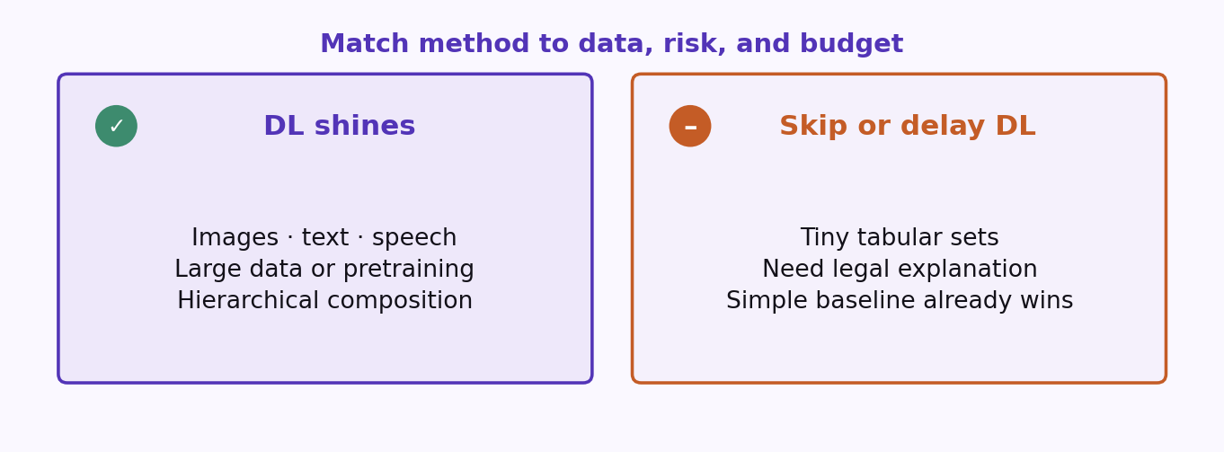
S07 · Deep Learning
Use-Case Fit: When Deep Learning Shines — and When to Skip It
Match Method to Data, Risk, and Budget
ETRA
17 / 106

Slide 18
S07 · Deep Learning
Use-Case Fit: When Deep Learning Shines — and When to Skip It
Match Method to Data, Risk, and Budget
Situation | Typical first choice | Why
Large labeled images / audio / text | Pre-trained DL + fine-tune | Raw inputs; hierarchical features
Small tabular (< few k rows) | Trees / linear + regularization | Lower variance, fast iteration, interpretability
Need causal or legal explanation | Simpler model or hybrid | Auditability and stability
Plenty of GPUs + big data | Larger nets + careful tuning | Capacity + regularization can scale
Edge device, millisecond latency | Small distilled / quantized models | Memory and power limits
ETRA
18 / 106

Slide 19
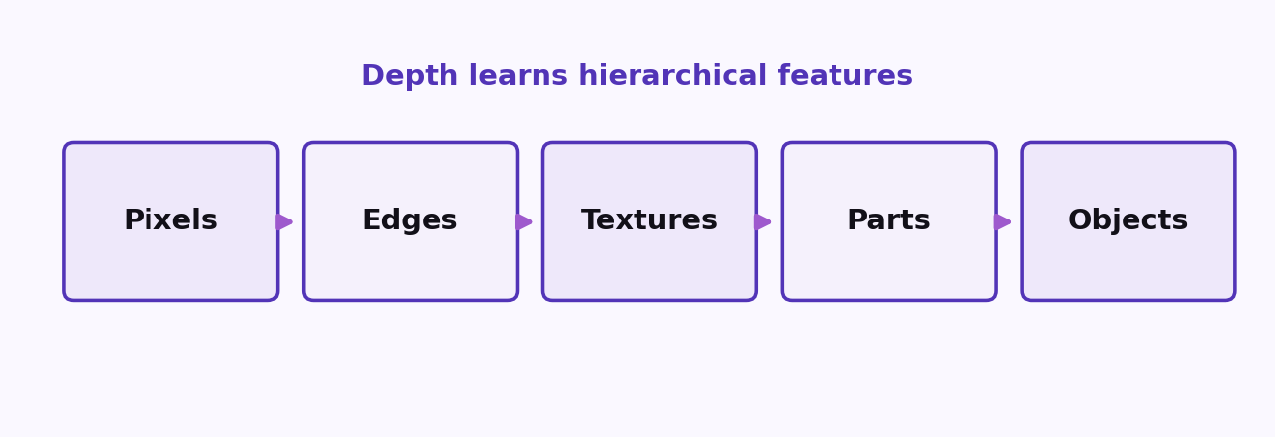
S07 · Deep Learning
Why Depth Works
Hierarchical Representation Learning
Each layer rewrites the previous layer’s features into a more useful space.
–
Early layers detect simple patterns (edges, local tokens).
–
Middle layers compose those into textures, parts, phrases.
–
Late layers assemble task semantics (objects, intent, class scores).
Depth is composition. Width is how many features you keep at each level.
ETRA
19 / 106

Slide 20
S07 · Deep Learning
Session Roadmap
What we build today
Block | Question it answers
Perceptron & MLP | What does one layer compute?
Backpropagation | How do we update the weights?
CNNs | How do we exploit spatial structure?
RNNs & regularization | How do we model sequences and generalize?
Exit check: explain z = w·x + b and why nonlinearity is required between layers.
ETRA
20 / 106

Slide 21
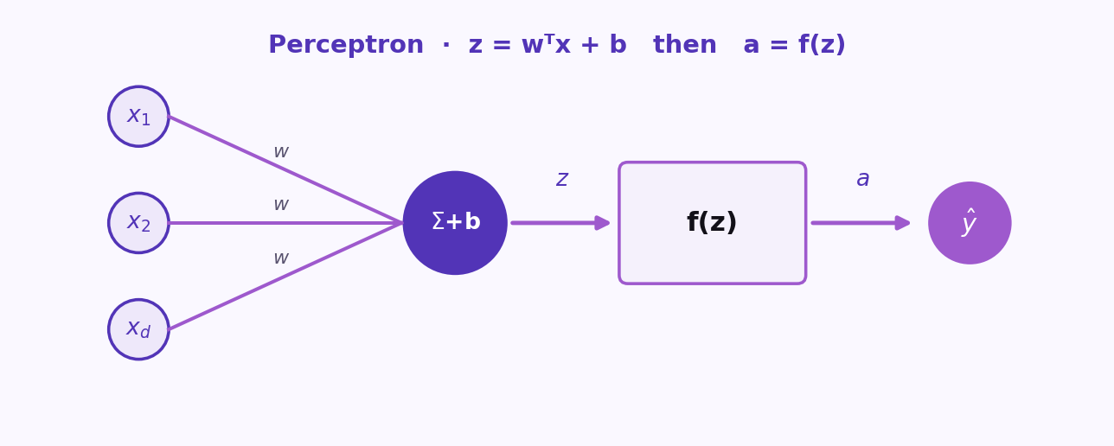
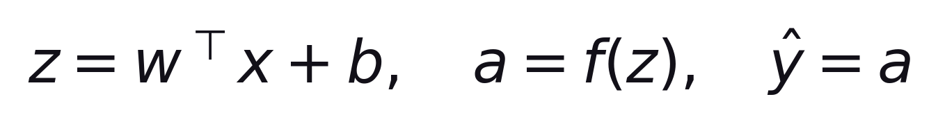
S07 · Deep Learning
Single Neuron (Perceptron): Math, Weights, and Bias
One Affine Map + One Nonlinearity
One weighted sum plus bias, then an activation. The output can be used as-is or passed onward.
Formula
ŷ = a (or further processing)
ETRA
21 / 106

Slide 22
S07 · Deep Learning
Single Neuron (Perceptron): Math, Weights, and Bias
One Affine Map + One Nonlinearity
–
Affine part (see formula above): z is the weighted sum of inputs plus b—each xᵢ is multiplied by wᵢ.
–
The bias b shifts the decision boundary (same orientation, normal w); it does not rotate the separating hyperplane.
–
Weights encode which patterns excite the neuron; training adjusts w and b so that on labeled data the loss decreases.
–
With no hidden layer and a monotonic activation, the decision boundary in input space is linear (a hyperplane)—powerful but limited.
ETRA
22 / 106

Slide 23
S07 · Deep Learning
Symbols at a Glance
One Affine Map + One Nonlinearity
Symbol | Shape intuition | Role
x | Feature vector (length d) | One training example’s inputs
w | Same length as x | Direction + strength of sensitivity to each feature
b | Scalar | Offset / threshold in logit space
f | Maps ℝ → ℝ (per neuron) | Introduces nonlinearity (or identity)
Bias shifts the hyperplane; it does not rotate it. Rotation comes from w.
ETRA
23 / 106

Slide 24
S07 · Deep Learning
Weight Initialization: Why Zeros Break Training
Symmetry Must Be Broken
–
If all weights in a layer start equal (especially zero), every hidden unit receives the same gradient and stays identical forever—symmetry never breaks.
–
Random initialization makes each unit walk a different path in parameter space so they can specialize as feature detectors.
–
Frameworks use He (Kaiming) for ReLU and Xavier (Glorot) for Tanh to keep activation scale stable.
ETRA
24 / 106

Slide 25
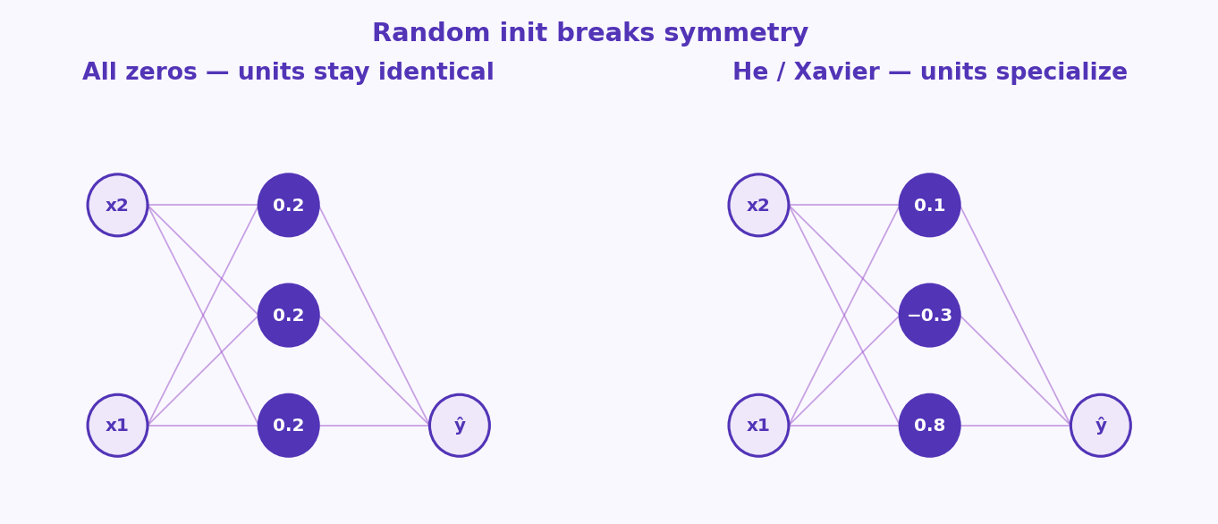
S07 · Deep Learning
Weight Initialization: Why Zeros Break Training
Symmetry Must Be Broken
ETRA
25 / 106

Slide 26
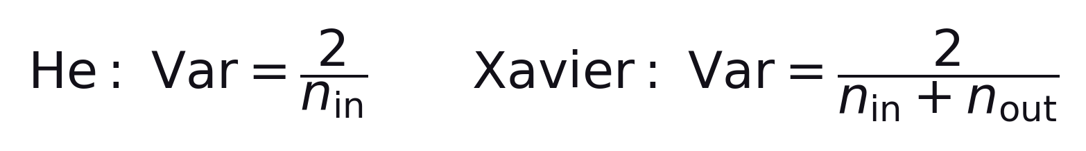
S07 · Deep Learning
Weight Initialization: Why Zeros Break Training
Symmetry Must Be Broken
He (Kaiming) for ReLU: variance = 2 / n_in. Xavier (Glorot) for Tanh: variance = 2 / (n_in + n_out).
Keep activation scale stable across layers
–
He matches ReLU, which zeros out about half the signals.
–
Xavier matches Sigmoid / Tanh, which are symmetric around zero.
ETRA
26 / 106

Slide 27
S07 · Deep Learning
Weight Initialization: Why Zeros Break Training
Symmetry Must Be Broken
Init scheme | Problem it avoids | Best suited for
All zeros | Hidden units stay identical; no representation diversity | None (always avoid for weights)
Xavier (Glorot) | Vanishing or exploding variance across layers | Sigmoid / Tanh activations
He (Kaiming) | Variance drop due to ReLU zeroing out half the signals | ReLU / Leaky ReLU activations
ETRA
27 / 106

Slide 28
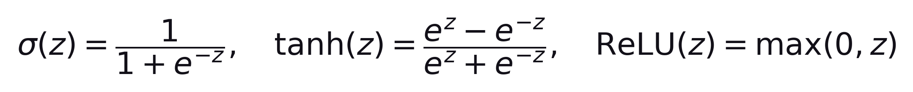
S07 · Deep Learning
Activation Functions: Sigmoid, Tanh, and ReLU
Nonlinearity is the Key to Network Depth
Stacked linear layers collapse to one linear map. Activations prevent that collapse.
ETRA
28 / 106

Slide 29
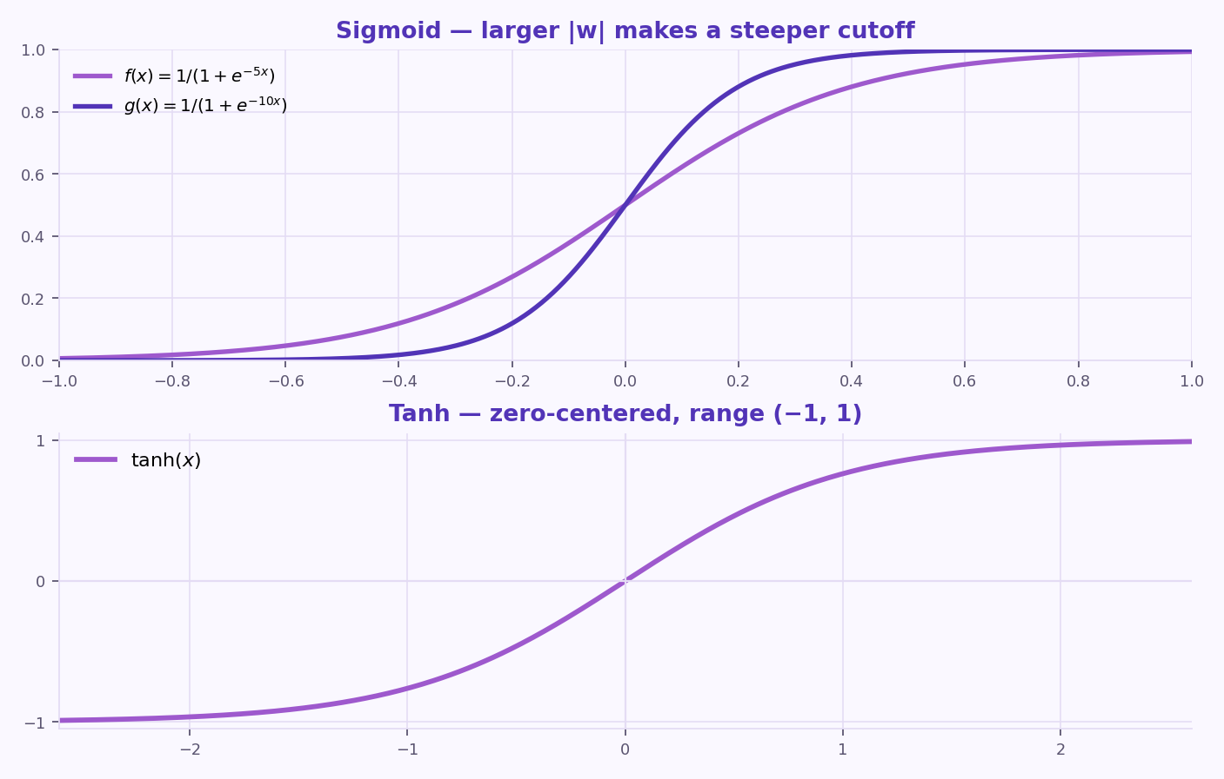
S07 · Deep Learning
Activation Functions: Sigmoid, Tanh, and ReLU
Nonlinearity is the Key to Network Depth
f(x)=1/(1+e^{−5x}) vs g(x)=1/(1+e^{−10x}) · tanh(x) is zero-centered, range (−1, 1)
ETRA
29 / 106

Slide 30
S07 · Deep Learning
Activation Functions: Sigmoid, Tanh, and ReLU
Nonlinearity is the Key to Network Depth
–
Sigmoid: maps inputs to (0, 1)—useful for probabilities, but suffers from vanishing gradients when z is very large or very small (saturation).
–
Tanh: zero-centered, maps inputs to (-1, 1)—often nicer than sigmoid for hidden layers but still saturates.
–
ReLU: modern default for deep stacks—cheap to compute, avoids vanishing gradient on positive domain; leaky ReLU / ELU are variants.
ETRA
30 / 106

Slide 31
S07 · Deep Learning
Activation Functions: Sigmoid, Tanh, and ReLU
Nonlinearity is the Key to Network Depth
Function | Range | Primary use-case
Sigmoid | (0, 1) | Binary classification output layer, gating networks
Tanh | (-1, 1) | Hidden layers (recurrent networks)
ReLU | [0, ∞) | Default choice for hidden layers in MLPs and CNNs
ETRA
31 / 106

Slide 32
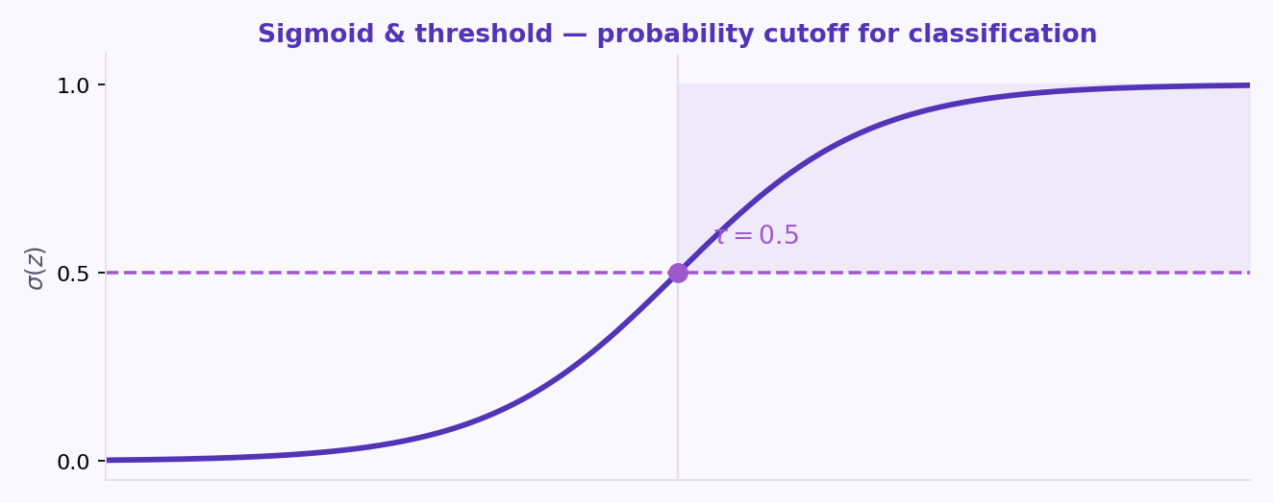
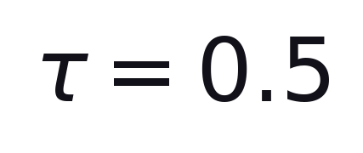
S07 · Deep Learning
Sigmoid & Threshold
Probability cutoff for classification
Decision threshold τ = 0.5 splits class 0 from class 1 on the sigmoid probability.
Formula
Predict class 1 when σ(z) ≥ τ
ETRA
32 / 106

Slide 33
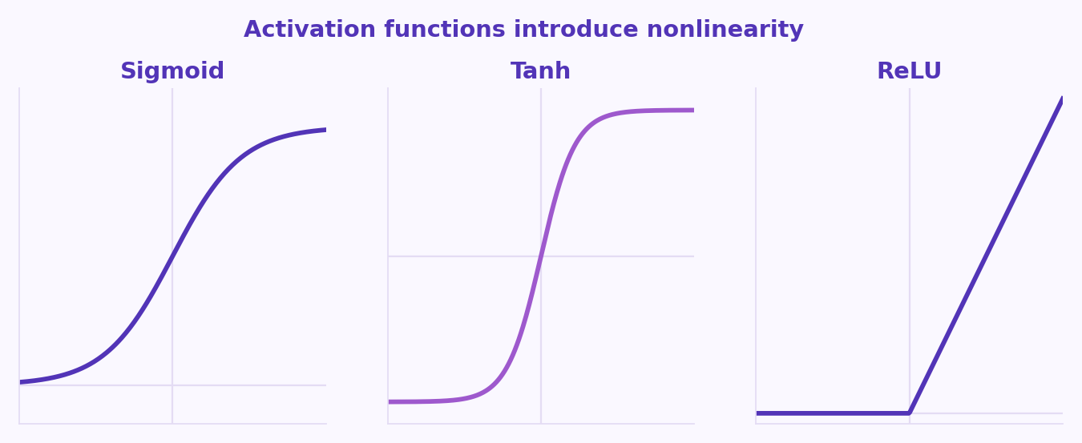
S07 · Deep Learning
Activation Curves
Nonlinearity is the Key to Network Depth
Flat tails (sigmoid / tanh) → tiny gradients. ReLU is linear on the positive side.
ETRA
33 / 106

Slide 34
S07 · Deep Learning
The XOR Problem: Why Hidden Layers Are Logically Necessary
Why a single line cannot solve XOR
–
XOR is not linearly separable in the 2D input plane: no single line separates class 1 from class 0 on the four corners.
–
A single perceptron computes a half-space; XOR requires nonlinear mixing of inputs—exactly what a hidden layer provides.
–
Hidden units reparameterize inputs into a space where the task becomes linearly separable—this is the core intuition for representation learning.
ETRA
34 / 106

Slide 35
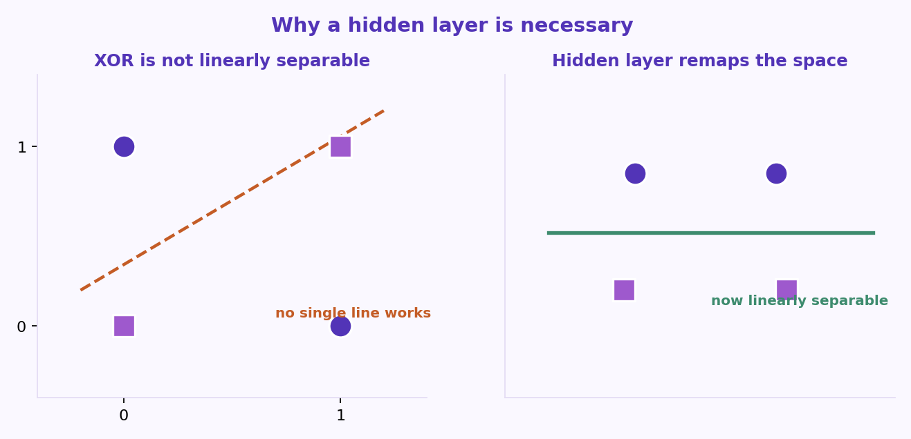
S07 · Deep Learning
The XOR Problem: Why Hidden Layers Are Logically Necessary
Why a single line cannot solve XOR
A hidden layer remaps the inputs so the output layer can cut with a line.
ETRA
35 / 106

Slide 36
S07 · Deep Learning
XOR Truth Table
Four Points, One Nonlinear Rule
x₁ | x₂ | XOR
0 | 0 | 0
0 | 1 | 1
1 | 0 | 1
1 | 1 | 0
Hidden units reparameterize the inputs so XOR becomes linearly separable.
ETRA
36 / 106

Slide 37
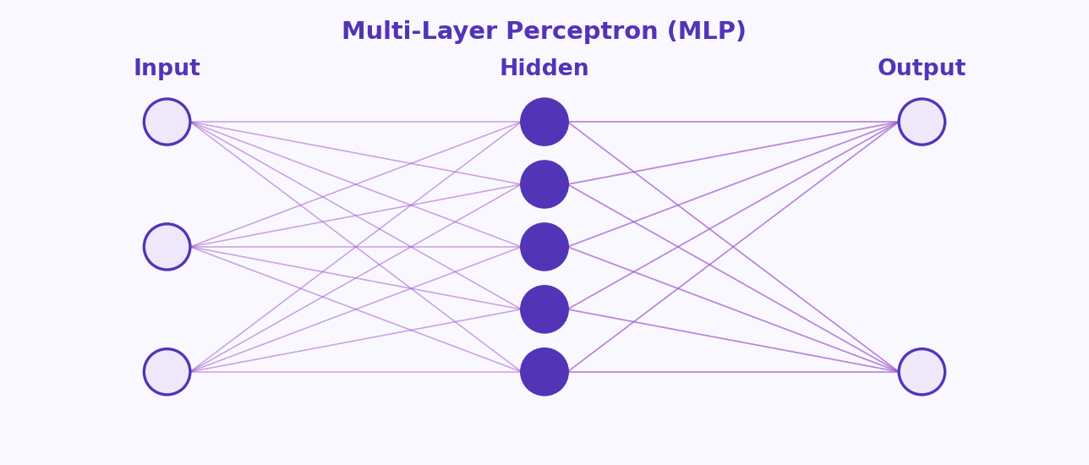
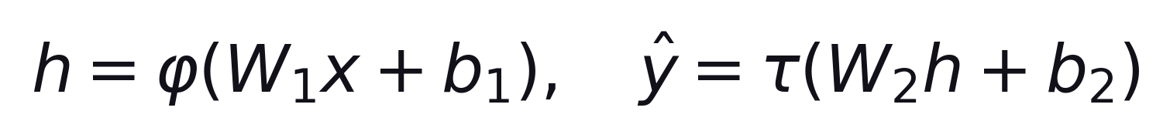
S07 · Deep Learning
From Perceptron to MLP (Multi-Layer Perceptron)
Depth = Composed Nonlinear Features
Hidden layer: affine map + nonlinearity → features h. Output: another affine map + τ.
Formula
φ = hidden activation · τ = output activation
ETRA
37 / 106

Slide 38
S07 · Deep Learning
From Perceptron to MLP (Multi-Layer Perceptron)
Depth = Composed Nonlinear Features
–
Each hidden layer applies an affine map followed by a nonlinearity, producing new features h as functions of the original inputs.
–
Width (units per layer) and depth (number of layers) trade off capacity, data needs, compute, and optimization difficulty.
–
Universal approximation (broad strokes): one sufficiently wide hidden layer can approximate many continuous functions on compact domains—in practice depth + inductive bias wins.
ETRA
38 / 106

Slide 39
S07 · Deep Learning
From Perceptron to MLP (Multi-Layer Perceptron)
Depth = Composed Nonlinear Features
Hyperparameter | What it controls
Hidden width | How many independent nonlinear features per layer
Depth | How many levels of composition (edges→textures→…)
Skip / residual | Ease of optimization in very deep nets
ETRA
39 / 106

Slide 40
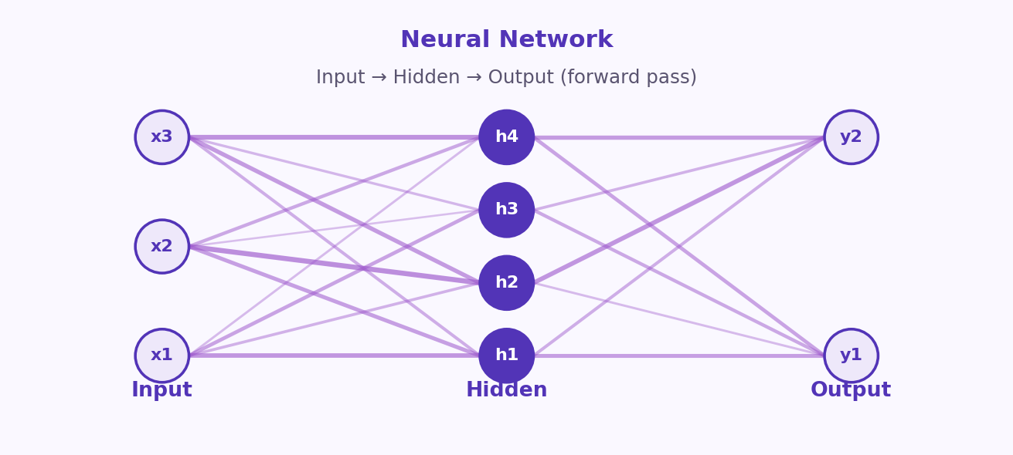
S07 · Deep Learning
Forward Propagation: The Engine of Inference
Neural Network
Edge thickness reflects weight magnitude.
ETRA
40 / 106

Slide 41
S07 · Deep Learning
Forward Propagation: The Engine of Inference
The Engine of Inference
–
Forward pass: feed input x through each layer in order—compute logits or scores at the end (then softmax for class probabilities if needed).
–
Implementation-wise this is a computational graph: each op (matmul, ReLU, …) knows how to propagate values forward.
–
Training repeats forward passes on mini-batches for efficiency and gradient noise that can help generalization.
ETRA
41 / 106

Slide 42
S07 · Deep Learning
Forward Propagation: The Engine of Inference
The Engine of Inference
Step | Operation | Output carries…
1 | Linear: z = Wx + b | Weighted sum at each unit
2 | Activation: a = f(z) | Nonlinear feature for next layer
3 | Repeat / head | Class logits or regression value
ETRA
42 / 106

Slide 43
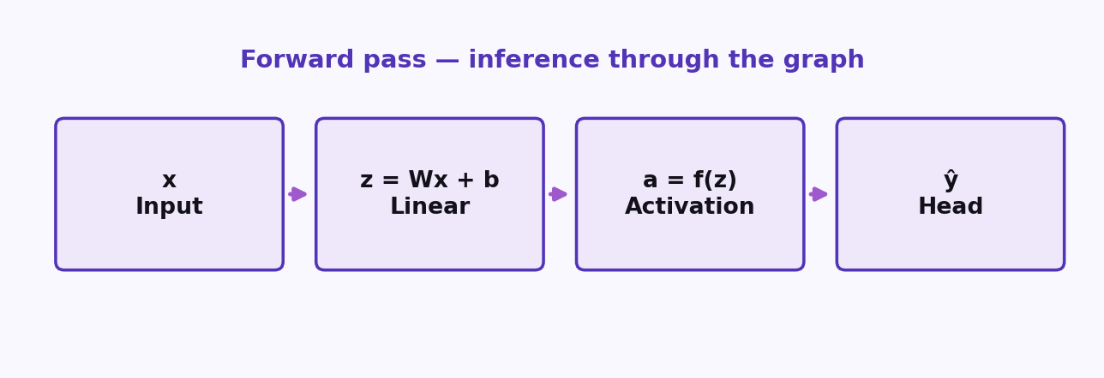
S07 · Deep Learning
Forward Propagation: The Engine of Inference
Linear → Activation → Head
Training repeats this on mini-batches. The graph also knows how to send gradients backward.
ETRA
43 / 106

Slide 44
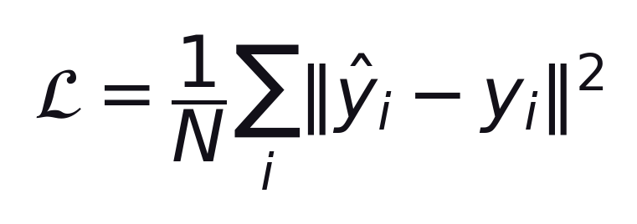
S07 · Deep Learning
Loss Functions: MSE vs Cross-Entropy
Match the Loss to the Output and Task
Regression — Mean Squared Error (MSE)
–
Penalizes large errors heavily (quadratic); differentiable everywhere—classic for continuous targets.
–
Assumes Gaussian-like noise in a probabilistic story; outliers can dominate—Huber loss is a robust alternative.
ETRA
44 / 106

Slide 45
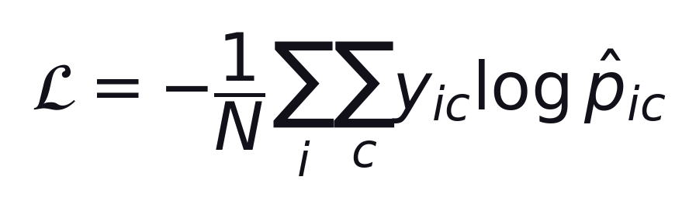
S07 · Deep Learning
Loss Functions: MSE vs Cross-Entropy
Match the Loss to the Output and Task
Classification — Cross-entropy
Often with logits + log-softmax for stability
–
Compares predicted probabilities p̂ to the true distribution (one-hot or soft labels).
–
Pairs naturally with softmax at the output; gradients are well-behaved when implemented in log-space.
ETRA
45 / 106

Slide 46
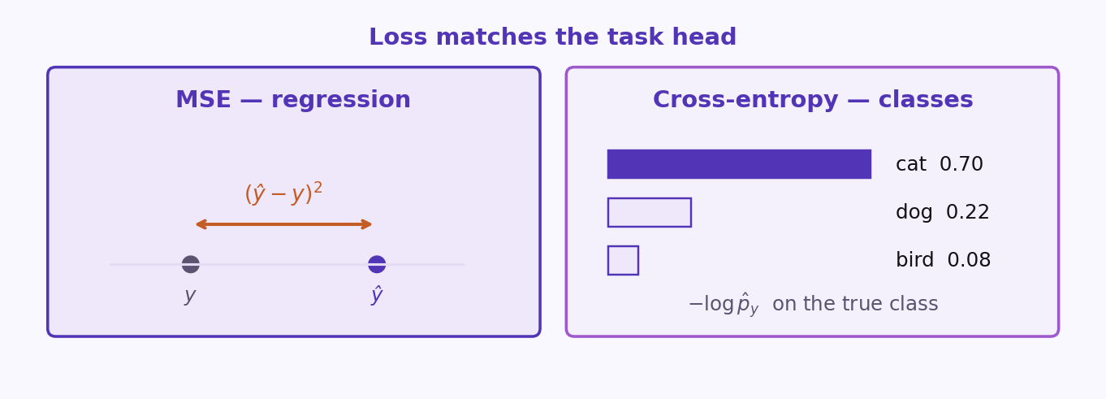
S07 · Deep Learning
Loss Functions: MSE vs Cross-Entropy
Match the Loss to the Output and Task
ETRA
46 / 106

Slide 47
S07 · Deep Learning
Loss Functions: MSE vs Cross-Entropy
Match the Loss to the Output and Task
Task | Common head + loss
Regression | Linear output + MSE / Huber
Binary classification | Sigmoid + binary cross-entropy
Multi-class | Softmax + cross-entropy
Often with logits + log-softmax for numerical stability.
ETRA
47 / 106

Slide 48
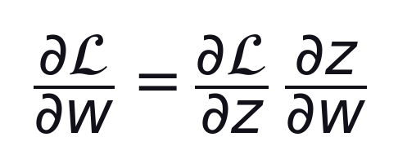
S07 · Deep Learning
Backpropagation: Chain Rule on the Computational Graph
Chain along paths
Chain along paths
–
Backprop applies the chain rule systematically: compute adjoints ∂L/∂ each intermediate tensor from outputs backward.
ETRA
48 / 106

Slide 49
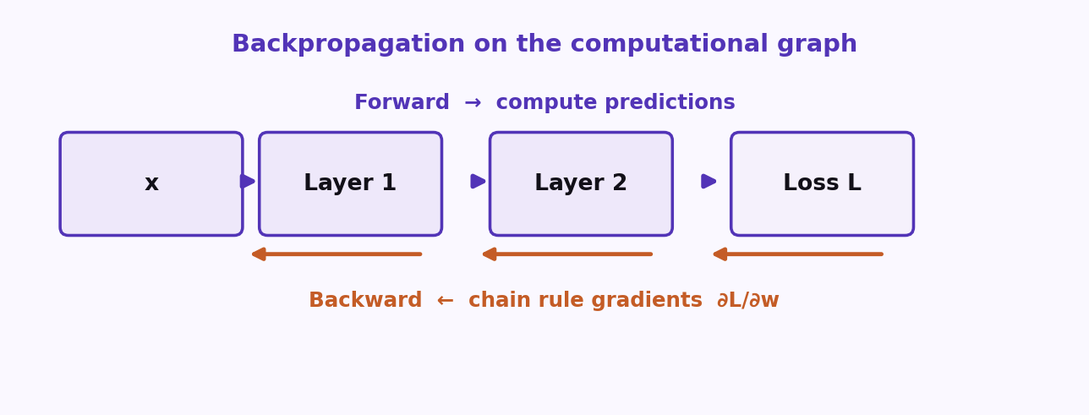
S07 · Deep Learning
Backpropagation: Chain Rule on the Computational Graph
Chain along paths
Forward computes predictions. Backward carries ∂L/∂w along every path.
ETRA
49 / 106

Slide 50
S07 · Deep Learning
Backpropagation: Chain Rule on the Computational Graph
Chain along paths
–
Reverse-mode autodiff (backprop) is efficient when many parameters feed one scalar loss—exactly the neural net case.
–
Modern frameworks (PyTorch, JAX, TensorFlow) build the graph (explicit or traced) and implement this reliably—you still debug shapes, numerical stability, and vanishing gradients.
Understanding backprop = understanding which paths carry gradient and which activations saturate.
ETRA
50 / 106

Slide 51
S07 · Deep Learning
Backpropagation: Chain Rule on the Computational Graph
Chain along paths
Idea | Meaning
Shared subexpressions | Same forward values reused; backward visits each edge once
Topological order | Visit nodes after their successors—dynamic programming on the graph
Understanding backprop = understanding which paths carry gradient and which activations saturate.
ETRA
51 / 106

Slide 52
S07 · Deep Learning
Phase 2: Optimization & Training Strategy
Stable Optimization + Generalization
–
Phase 2 is about the art of training: diagnosing fit, controlling gradients, picking optimizers, normalizing, and regularizing.
–
Good models are not only “big”—they match capacity to data, monitor validation faithfully, and fail visibly when something is wrong.
ETRA
52 / 106

Slide 53
S07 · Deep Learning
Phase 2: Optimization & Training Strategy
Stable Optimization + Generalization
ETRA
53 / 106

Slide 54
S07 · Deep Learning
Phase 2: Optimization & Training Strategy
What you will control in practice
Layer | Examples
Optimization | SGD, Adam, gradient clipping
Stabilization | Batch Norm, residual paths, initialization
Generalization | Dropout, weight decay, early stopping
ETRA
54 / 106

Slide 55
S07 · Deep Learning
Training Diagnostics: Underfitting, Good Fit, and Overfitting
Read Train vs Validation Behavior
–
Underfitting: both train and validation error stay high—the model is too simple, features are insufficient, or optimization is stuck (LR too low, wrong loss).
–
Good fit: train and validation errors are both low and track each other; small gap is normal if train is slightly better.
–
Overfitting: train error keeps dropping while validation worsens or plateaus badly—the model memorizes idiosyncrasies (noise, augment leakage).
ETRA
55 / 106

Slide 56
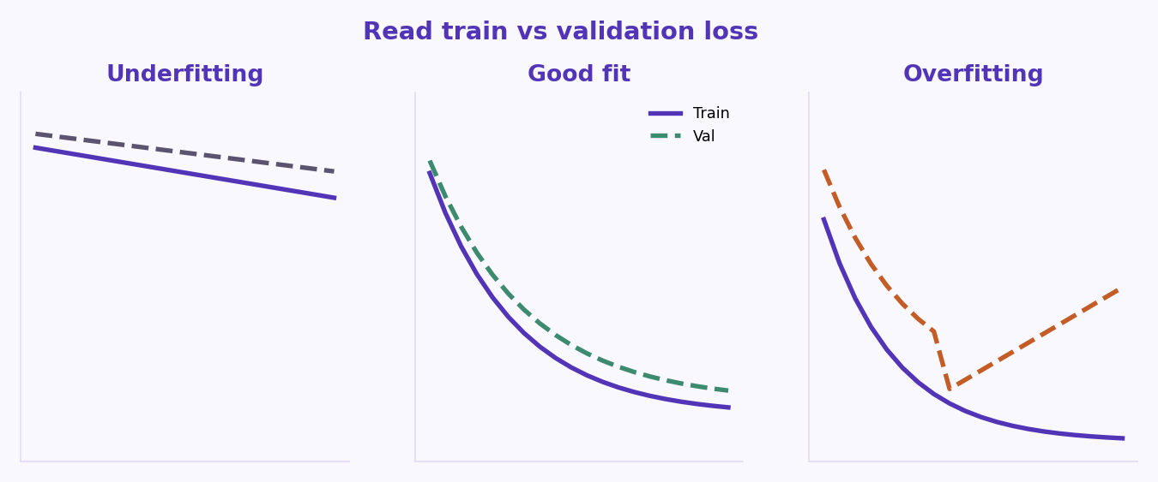
S07 · Deep Learning
Training Diagnostics: Underfitting, Good Fit, and Overfitting
Read Train vs Validation Behavior
A small train–val gap is normal. A widening gap is overfitting.
ETRA
56 / 106

Slide 57
S07 · Deep Learning
Training Diagnostics: Underfitting, Good Fit, and Overfitting
Read Train vs Validation Behavior
Regime | Train loss | Val loss / metric | Typical response
Underfitting | High | High | More capacity, better features, longer train, higher LR (carefully)
Good fit | Low | Low, close to train | Keep regularization; ship or iterate on data
Overfitting | Very low | Worse / diverging gap | More data, dropout, wd, simpler model, early stop
ETRA
57 / 106

Slide 58
S07 · Deep Learning
Vanishing and Exploding Gradients
Depth Multiplies Jacobians Layer by Layer
–
Vanishing: backprop multiplies many factors < 1 (saturated sigmoid/tanh, poor init)—early layers get tiny updates and learn slowly.
–
Exploding: repeated factors > 1 or large weights produce huge parameter updates—loss spikes, NaNs.
–
Fixes are layered: architecture (residual paths), activations (ReLU), initialization (He/Xavier), normalization (BN/LN), and optimization (clipping).
ETRA
58 / 106

Slide 59
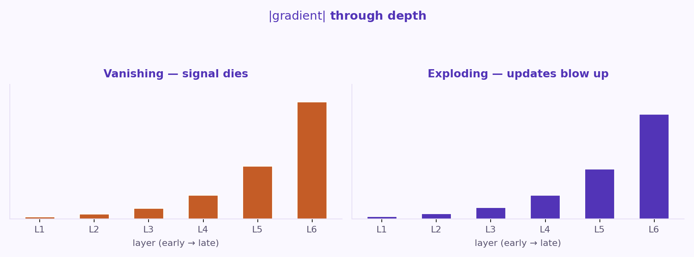
S07 · Deep Learning
Vanishing and Exploding Gradients
Depth Multiplies Jacobians Layer by Layer
ETRA
59 / 106

Slide 60
S07 · Deep Learning
Vanishing and Exploding Gradients
Depth Multiplies Jacobians Layer by Layer
Symptom | Likely cause | Mitigation
Early layers barely move | Vanishing chain through saturated units | ReLU, He init, residuals, norm
Loss → NaN quickly | Exploding activations or LR too high | Clip grads, lower LR, check loss scaling
Stable then sudden blow-up | Rare but real—mixed precision, bad data batch | Finite checks, gradient clipping
ETRA
60 / 106

Slide 61
S07 · Deep Learning
Optimizers: SGD and Adam
Learning rate, Momentum, and Adaptive Steps
–
SGD + momentum: accumulates updates in a velocity vector to dampen oscillations in ravines and accelerate along consistent directions.
–
Adam: tracks both first-moment (momentum) and second-moment (recent squared gradients) of gradients to adapt learning rates per parameter.
–
SGD is often preferred in computer vision for generalization, while Adam is the default starting point for Transformers and general MLPs.
Learning rate (LR) is the single most important hyperparameter to tune (typically searched on a log grid, e.g., 1e-4, 1e-3, 1e-2).
ETRA
61 / 106

Slide 62
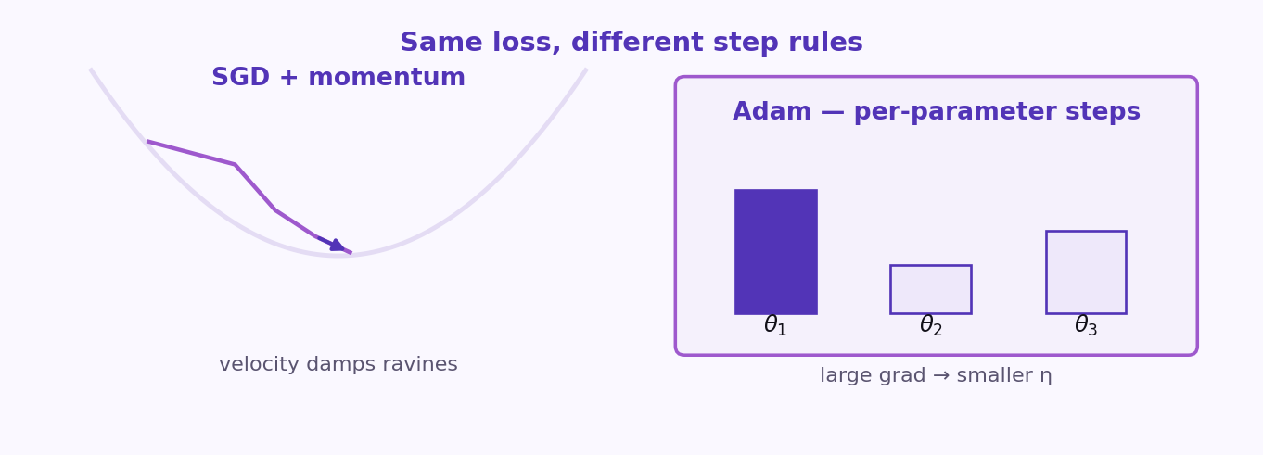
S07 · Deep Learning
Optimizers: SGD and Adam
Learning rate, Momentum, and Adaptive Steps
ETRA
62 / 106

Slide 63
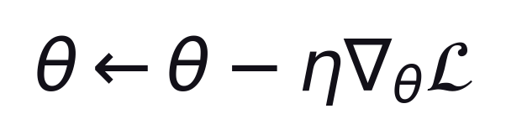
S07 · Deep Learning
Optimizers: SGD and Adam
Learning rate, Momentum, and Adaptive Steps
η = learning rate · typical log grid: 1e-4, 1e-3, 1e-2
ETRA
63 / 106

Slide 64
S07 · Deep Learning
Optimizers: SGD and Adam
Learning rate, Momentum, and Adaptive Steps
Optimizer | Core mechanism | When to use
Vanilla SGD | Step in negative gradient direction | Rarely used alone today
SGD + Momentum | Adds fraction of previous step direction | Standard for CV models
Adam | Adapts learning rate per parameter based on gradients | Robust default for text/tabular/MLPs
Learning rate (LR) is the single most important hyperparameter to tune (typically searched on a log grid, e.g., 1e-4, 1e-3, 1e-2).
ETRA
64 / 106

Slide 65
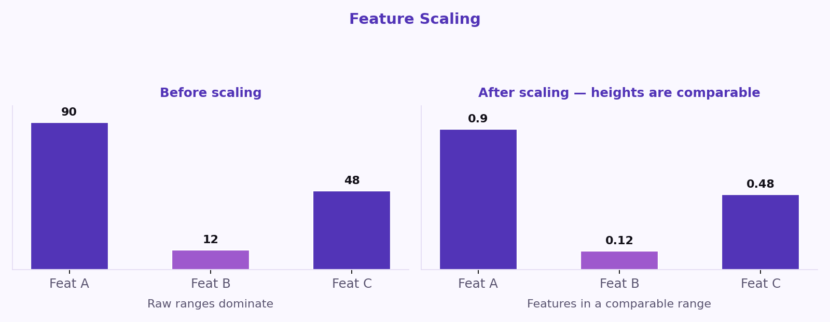
S07 · Deep Learning
Normalization: Batch Normalization
Stabilize Activations and Speed Up Deep Training
Feature scaling: features brought to a comparable range.
ETRA
65 / 106

Slide 66
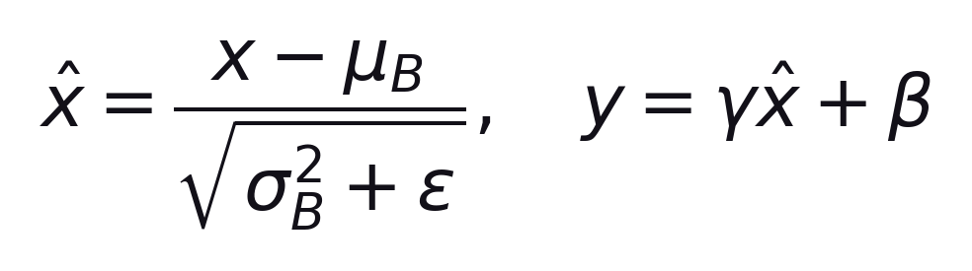
S07 · Deep Learning
Normalization: Batch Normalization
Stabilize Activations and Speed Up Deep Training
Batch Norm (BN): normalizes activations across the mini-batch for each channel, then learns scale γ and shift β.
–
It stabilizes internal activations, allowing higher learning rates and reducing dependency on precise initialization.
–
Alternative is Layer Norm (LN) which normalizes across features per example—standard in Transformers and sequence models.
ETRA
66 / 106

Slide 67
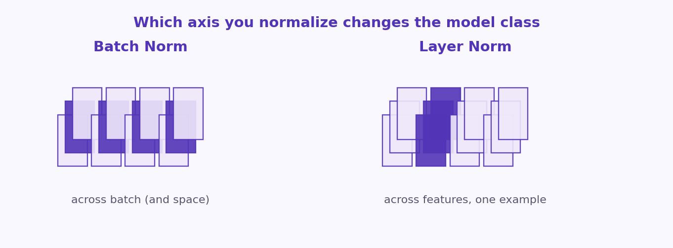
S07 · Deep Learning
Normalization: Batch Normalization
Stabilize Activations and Speed Up Deep Training
ETRA
67 / 106

Slide 68
S07 · Deep Learning
Normalization: Batch Normalization
Stabilize Activations and Speed Up Deep Training
Method | Normalization dimension | Typical use-case
Batch Norm | Across batch and spatial dimensions | CNN classifiers, ResNets
Layer Norm | Across features for a single token/example | Transformers, RNNs
ETRA
68 / 106

Slide 69
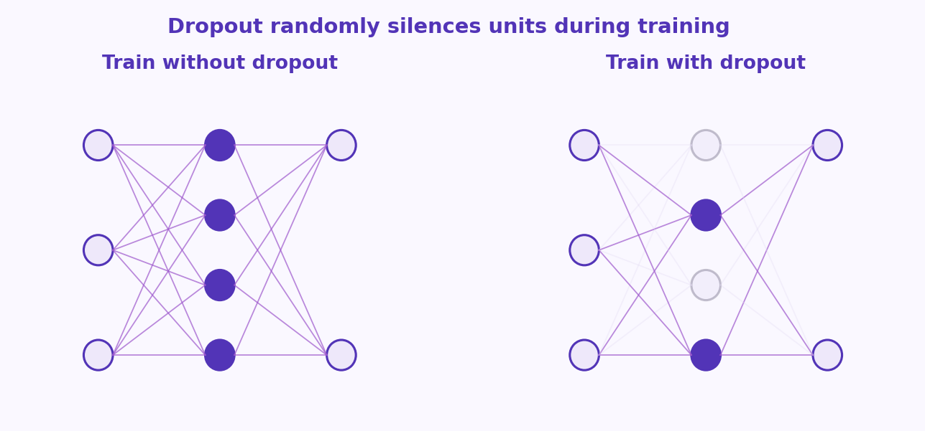
S07 · Deep Learning
Regularization: Dropout, Weight Decay, and Early Stopping
Constrain Capacity to Prevent Overfitting
–
Randomly zero out hidden units during training with probability p (e.g., 0.2-0.5) so neurons cannot co-adapt.
ETRA
69 / 106

Slide 70
S07 · Deep Learning
Regularization: Dropout, Weight Decay, and Early Stopping
Constrain Capacity to Prevent Overfitting
–
Dropout acts as a powerful implicit ensemble method; disabled during inference (evaluation mode).
–
Weight Decay (L2 regularization): adds a penalty to the loss proportional to the squared sum of weights to keep weights small and smooth.
–
Early stopping: monitor validation loss during training and stop when it ceases to improve for a certain number of epochs (patience).
ETRA
70 / 106

Slide 71
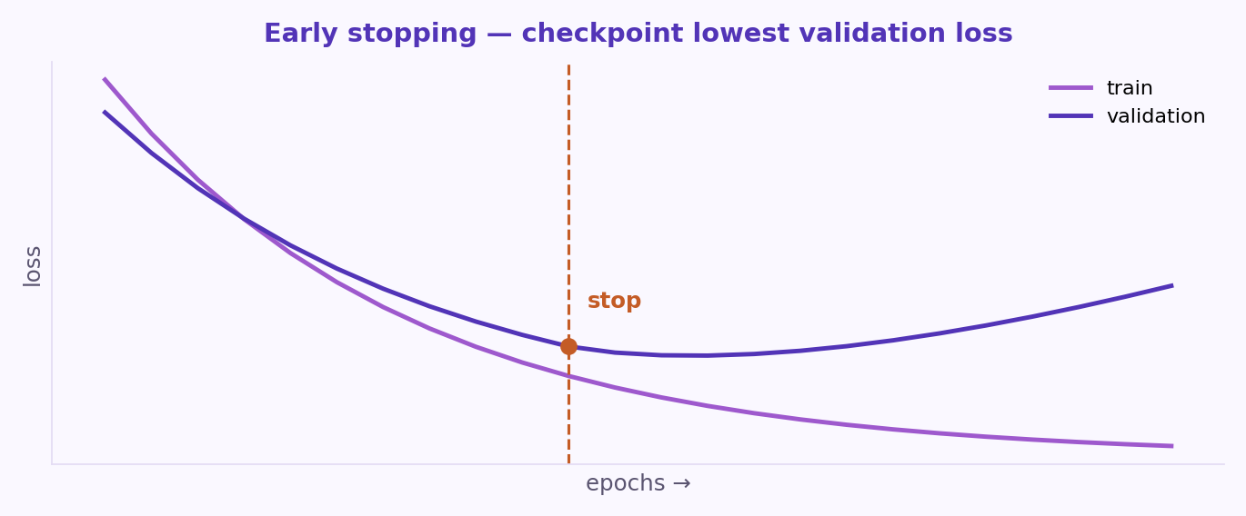
S07 · Deep Learning
Regularization: Dropout, Weight Decay, and Early Stopping
Constrain Capacity to Prevent Overfitting
ETRA
71 / 106

Slide 72
S07 · Deep Learning
Regularization: Dropout, Weight Decay, and Early Stopping
Constrain Capacity to Prevent Overfitting
Technique | Primary action | Inference behavior
Dropout | Randomly drops connections | Turned OFF (weights scaled)
L2 Weight Decay | Shrinks weights toward zero | Turned ON (weights are static)
Early Stopping | Halts training at lowest val loss | N/A (model is checkpointed)
ETRA
72 / 106

Slide 73
S07 · Deep Learning
Phase 3: Specialized Architectures (Vision & Sequences)
Images vs Ordered Sequences
–
Images have 2D locality and translation symmetry—convolutions exploit shared weights across space.
–
Sequences have order—recurrence, causal convolutions, or attention carry context across time or position.
–
Choosing the right inductive bias beats blindly scaling the wrong architecture.
ETRA
73 / 106

Slide 74
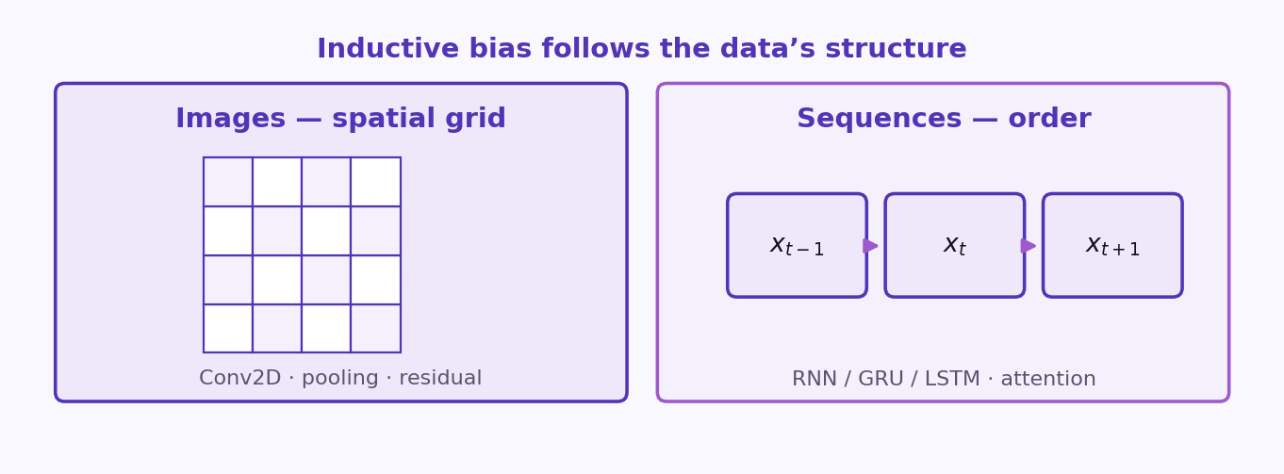
S07 · Deep Learning
Phase 3: Specialized Architectures (Vision & Sequences)
Images vs Ordered Sequences
ETRA
74 / 106

Slide 75
S07 · Deep Learning
Phase 3: Specialized Architectures (Vision & Sequences)
Images vs Ordered Sequences
Modality | Core structure | Representative layers
Image / video frames | Spatial grids | Conv2D, pooling, residual blocks
Text / speech / sensors | Ordered tokens or time steps | RNN/GRU/LSTM, causal conv, self-attention
ETRA
75 / 106

Slide 76
S07 · Deep Learning
Image Data: How Computers “See” Pixels
Tensors, Channels, and Local Structure
–
A color image is usually a tensor of shape H×W×3 (RGB); each entry is an intensity discretized into 8 bits (0–255) before normalization.
–
Meaning lives in local neighborhoods: small patches reveal edges; larger contexts reveal objects—hierarchical composition.
–
Augmentation (crop, flip, color jitter) teaches invariance; normalization (e.g., ImageNet mean/std) stabilizes optimization.
ETRA
76 / 106

Slide 77
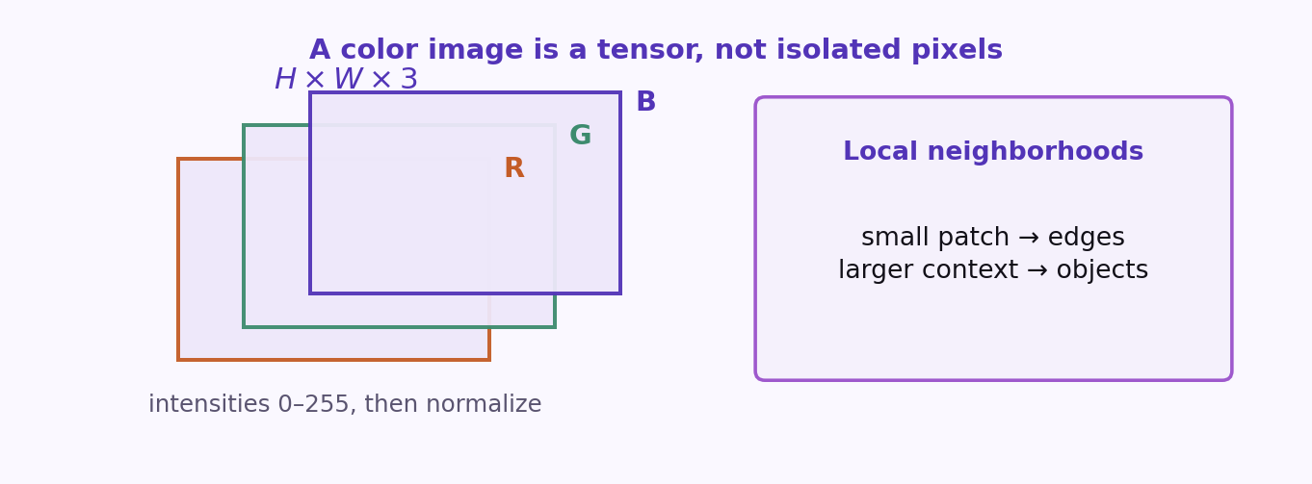
S07 · Deep Learning
Image Data: How Computers “See” Pixels
Tensors, Channels, and Local Structure
ETRA
77 / 106

Slide 78
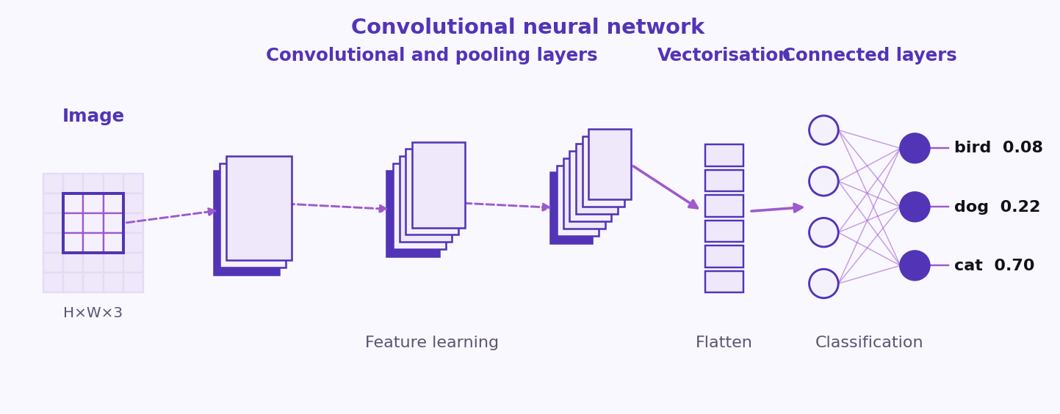
S07 · Deep Learning
Image Data: How Computers “See” Pixels
Tensors, Channels, and Local Structure
ETRA
78 / 106

Slide 79
S07 · Deep Learning
Image Data: How Computers “See” Pixels
Tensors, Channels, and Local Structure
Stage | What happens
Raw sensor | Quantized intensities per channel per pixel
Preprocess | Resize, crop, normalize, augment
Model input | Batch × C × H × W tensor fed to stem convolutions
ETRA
79 / 106

Slide 80
S07 · Deep Learning
Convolution: Kernels, Edge Filters, and Feature Maps
Sliding Linear Filters + Nonlinearity
–
A kernel is a small learnable matrix (e.g., 3×3) that responds to local patterns; multiple kernels produce a stack of feature maps.
–
Classical edge detectors (Sobel, shown) are fixed kernels; CNNs learn task-specific filters from data.
–
Deep stacks widen the receptive field: early layers ≈ edges/textures; late layers ≈ object parts and semantics.
ETRA
80 / 106

Slide 81
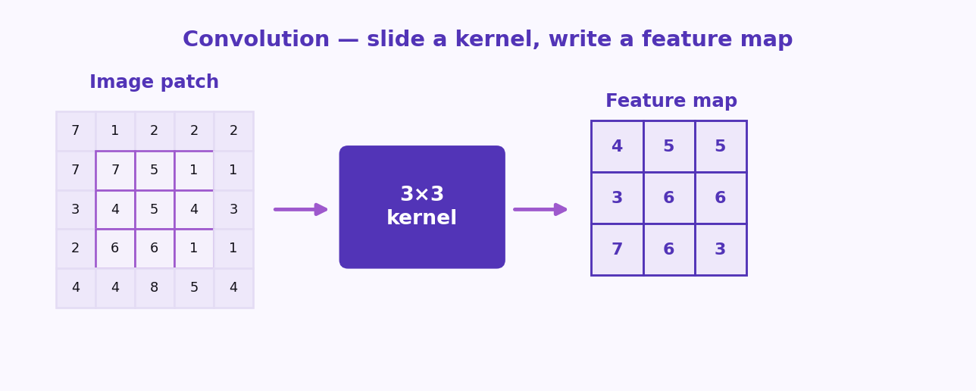
S07 · Deep Learning
Convolution: Kernels, Edge Filters, and Feature Maps
Sliding Linear Filters + Nonlinearity
ETRA
81 / 106

Slide 82
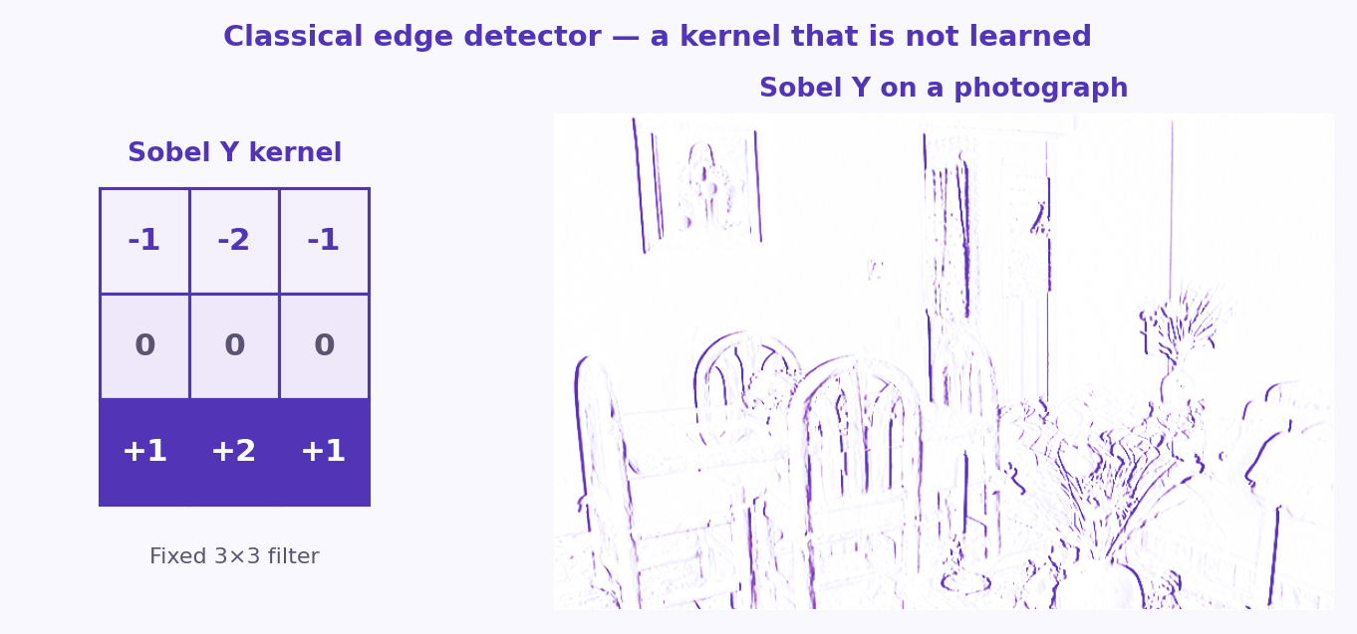
S07 · Deep Learning
Convolution: Kernels, Edge Filters, and Feature Maps
Sliding Linear Filters + Nonlinearity
ETRA
82 / 106

Slide 83
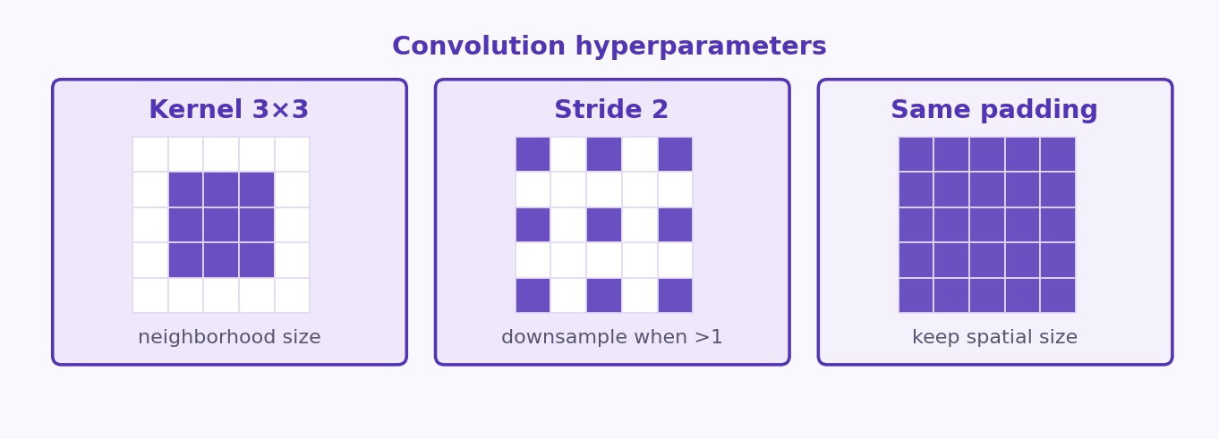
S07 · Deep Learning
Convolution: Kernels, Edge Filters, and Feature Maps
Sliding Linear Filters + Nonlinearity
ETRA
83 / 106

Slide 84
S07 · Deep Learning
Convolution: Kernels, Edge Filters, and Feature Maps
Sliding Linear Filters + Nonlinearity
Hyperparameter | Effect
Kernel size | Immediate neighborhood size (3×3 common)
Stride | Downsample spatially when >1
Padding | Keep spatial size (same padding) or control border
ETRA
84 / 106

Slide 85
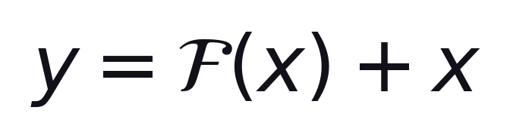
S07 · Deep Learning
CNN Blocks: From Conv-Pool to ResNet
Depth, Regularization, and Residual Learning
(residual block learns F, identity carries gradient)
ETRA
85 / 106

Slide 86
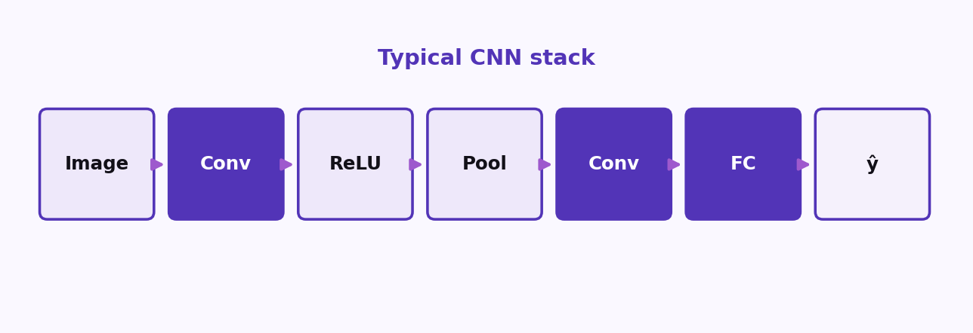
S07 · Deep Learning
CNN Blocks: From Conv-Pool to ResNet
Depth, Regularization, and Residual Learning
ETRA
86 / 106

Slide 87
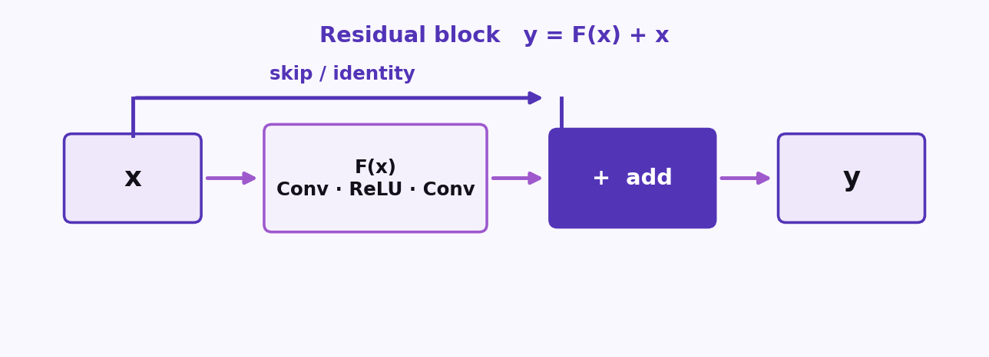
S07 · Deep Learning
CNN Blocks: From Conv-Pool to ResNet
Depth, Regularization, and Residual Learning
ETRA
87 / 106

Slide 88
S07 · Deep Learning
CNN Blocks: From Conv-Pool to ResNet
Depth, Regularization, and Residual Learning
–
Standard CNN: Alternates Conv2D, Activation (ReLU), and Pooling (Max Pool) layers to extract spatial features and downsample.
–
AlexNet (2012): First large-scale CNN to win ImageNet; used ReLU, dropout, and multi-GPU training.
–
ResNet (2015): Introduced skip (shortcut) connections, allowing gradients to flow back easily through identity mappings. Enables training networks with 100+ layers.
ETRA
88 / 106

Slide 89
S07 · Deep Learning
CNN Blocks: From Conv-Pool to ResNet
Landmark ideas (simplified)
Model / block | Idea you should remember
Conv + MaxPool | Feature extraction + spatial downsampling
AlexNet | Scale + ReLU + data aug on GPUs
ResNet | Residual mapping F(x)+x; skip paths help gradients
ETRA
89 / 106

Slide 90
S07 · Deep Learning
Transfer Learning with Pretrained Models
Reuse Features, Adapt the Head
–
Pretraining on millions of labeled images (e.g. ImageNet) learns general low/mid-level filters (edges, textures) transferable to new domains.
–
Typical recipe: replace the final classifier head; freeze the pretrained backbone for small datasets, or fine-tune with a very small learning rate for larger datasets.
–
Transfer learning dramatically reduces training time and required labeled samples for a new vision task.
ETRA
90 / 106

Slide 91
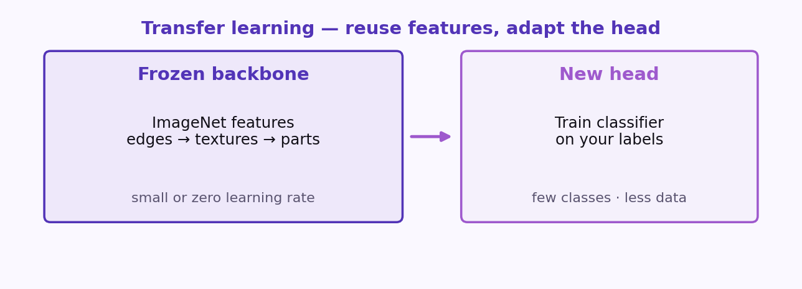
S07 · Deep Learning
Transfer Learning with Pretrained Models
Reuse Features, Adapt the Head
ETRA
91 / 106

Slide 92
S07 · Deep Learning
Transfer Learning with Pretrained Models
Reuse Features, Adapt the Head
Target Dataset Size | Strategy
Small target dataset | Freeze backbone, train head only
Medium dataset | Fine-tune top blocks with a smaller learning rate
Large target dataset | Full fine-tune of all layers with a small learning rate
ETRA
92 / 106

Slide 93
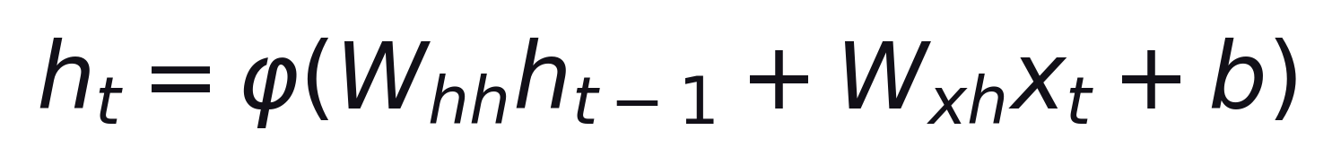
S07 · Deep Learning
Sequential Data & Vanilla RNNs
One Transition, Unfolded Through Time
ETRA
93 / 106

Slide 94
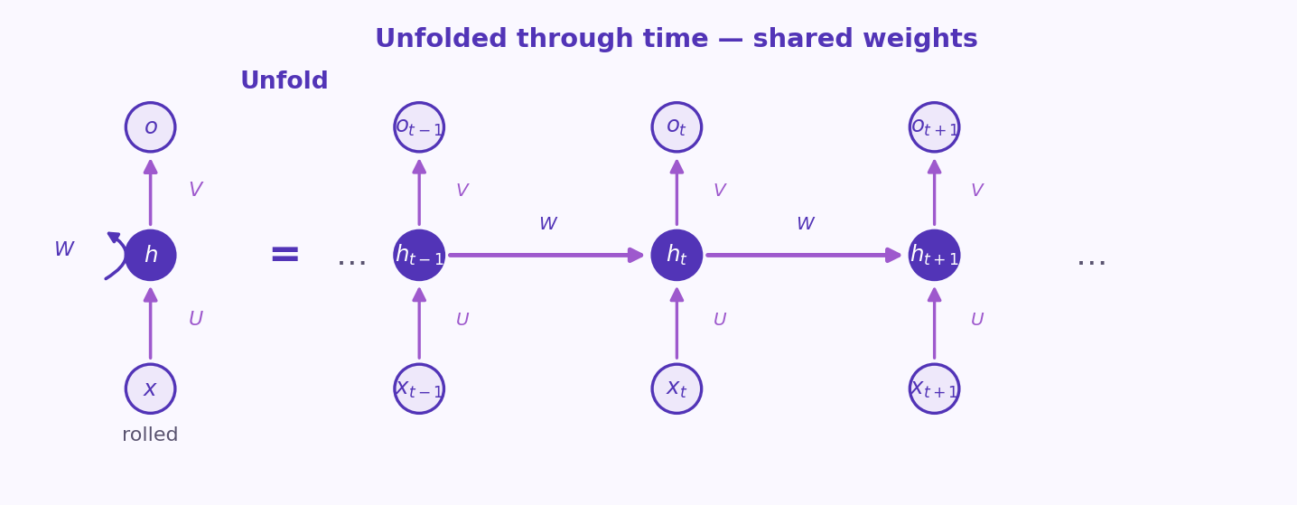
S07 · Deep Learning
Sequential Data & Vanilla RNNs
One Transition, Unfolded Through Time
ETRA
94 / 106

Slide 95
S07 · Deep Learning
Sequential Data & Vanilla RNNs
One Transition, Unfolded Through Time
–
Sequence modeling: text, audio, and sensor streams have order; shuffling them breaks their semantic meaning.
–
Recurrent Neural Networks (RNN): maintain a recurrent state vector hₜ that acts as a memory summary of the past.
–
The same weights W_hh and W_xh are reused across all timesteps (parameter efficiency), but long-range dependencies suffer from vanishing/exploding gradients.
ETRA
95 / 106

Slide 96
S07 · Deep Learning
Sequential Data & Vanilla RNNs
One Transition, Unfolded Through Time
Feature | Limitation
Reuses parameters | Sequential execution (cannot parallelize steps)
Tracks state hₜ | Cannot hold long-term memories in practice
ETRA
96 / 106

Slide 97
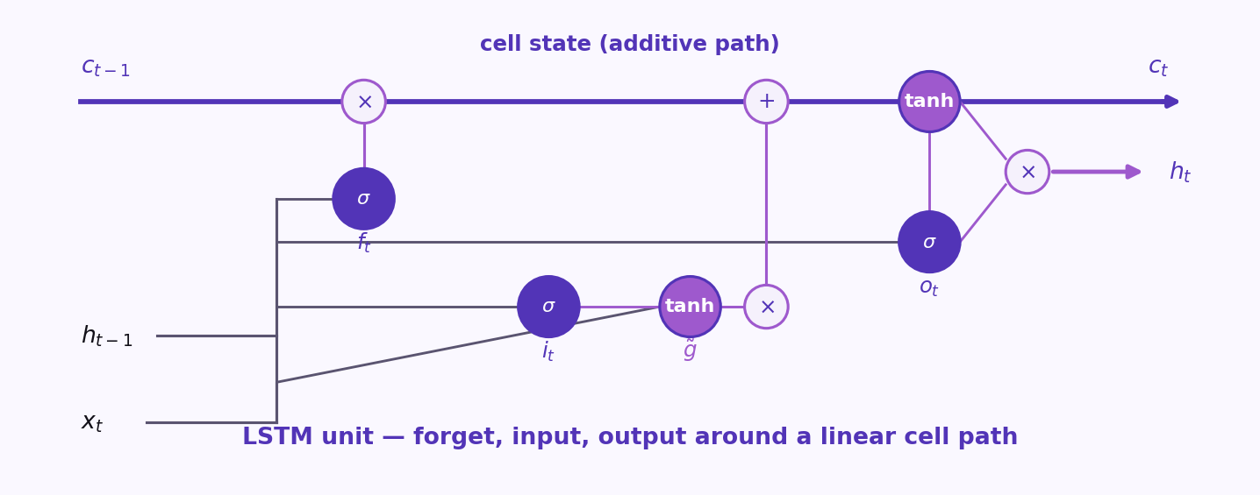
S07 · Deep Learning
LSTM: Gates for Long-Term Memory
Forget, Input, Output — Cell State Flows Linearly
ETRA
97 / 106

Slide 98
S07 · Deep Learning
LSTM: Gates for Long-Term Memory
Forget, Input, Output — Cell State Flows Linearly
–
Cell state cₜ can accumulate information with an additive path—mitigates vanishing signal compared with plain tanh RNNs.
–
Forget gate fₜ decides how much past cell content to erase; input gate iₜ and candidate g̃ control new information written.
–
Output gate oₜ filters what becomes hidden state hₜ exposed to the next layer or timestep.
ETRA
98 / 106

Slide 99
S07 · Deep Learning
LSTM: Gates for Long-Term Memory
Forget, Input, Output — Cell State Flows Linearly
Gate | Role (intuition)
fₜ | Erase irrelevant history from the cell
iₜ | Allow new candidate information in
oₜ | Expose part of the cell as hₜ
ETRA
99 / 106

Slide 100
S07 · Deep Learning
Phase 4: Generative Models & Reconstruction
Generative Models and Representation Learning
–
Phase 4 explores unsupervised representation learning and basic generative frameworks.
–
Autoencoders are the foundation here: they learn to compress inputs to a low-dimensional bottleneck (latent space) and reconstruct them.
ETRA
100 / 106

Slide 101
S07 · Deep Learning
Phase 4: Generative Models & Reconstruction
Generative Models and Representation Learning
Concept | Input | Goal
Autoencoder | Unlabeled data x | Compress and reconstruct x̂ ≈ x
ETRA
101 / 106

Slide 102
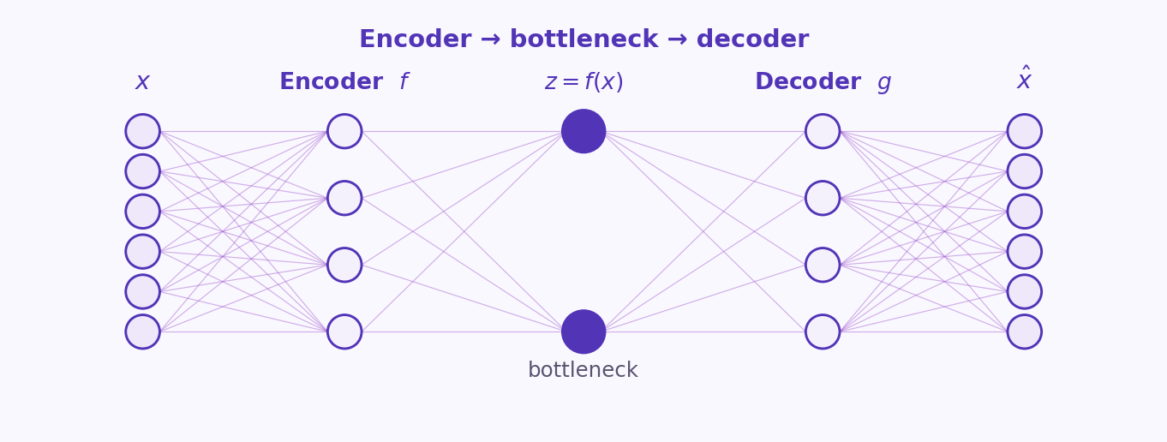
S07 · Deep Learning
Autoencoders (AE): Compression and Reconstruction
Encoder → Bottleneck → Decoder
ETRA
102 / 106

Slide 103
S07 · Deep Learning
Autoencoders (AE): Compression and Reconstruction
Encoder → Bottleneck → Decoder
–
Encoder f maps input x to a low-dimensional code z = f(x); decoder g maps z back to x̂ ≈ x.
–
The bottleneck forces a compressed representation—useful for denoising (train on noisy→clean), anomaly detection (high recon error = abnormal).
–
Linear AE with MSE relates to PCA when constraints align—nonlinear AE learns curved manifolds.
ETRA
103 / 106

Slide 104
S07 · Deep Learning
Autoencoders (AE): Compression and Reconstruction
Encoder → Bottleneck → Decoder
Variant | Idea
Denoising AE | Corrupt input, reconstruct clean—robust features
Sparse AE | Penalty on activations—encourages informative sparse codes
Contractive AE | Penalize sensitivity of code to small input changes—smoother latent map
ETRA
104 / 106

Slide 105
S07 · Takeaways
3 Ideas to Keep
Leave with these
1
A neuron is z = wᵀx + b then a = f(z). Depth needs nonlinearity between layers.
2
Backprop is the chain rule on a graph. Watch vanishing gradients, LR, and train vs val.
3
CNNs share filters across space; RNNs share weights across time; regularize so they generalize.
ETRA
105 / 106

Slide 106
Thank you
Labs: code/15- Deep Learning
ETRA
ETRA
106 / 106

