Slide 1
Automated SMS & Email Notification System For Attendance from Dynamic Data source
Created By :- Karan Sheth (21316SBECE30015)
Guide Name : - Mr. Tejasvee Gupta

Slide 2
Abstract
Automated applications are the latest and a rapid growing technology. This project focuses an Student’s weekly Attendance which provide the functionality to notify parents/Guardian about absence of their junior on weekly bases.
In this project system will generate reports on weekly bases, also Sends SMS to the Student’s parents whose attendance will be less then required percentage.
Faculty/Teacher can also view the weekly report based different type of sorting function availability.

Slide 3
Purpose
This system acts as an totally automated system, to provide accurate and quick solutions.
Attendance Of student for each lecture is maintained in the respective class sheet, which is uploaded by the subject teacher after completion of the lecture.
This systems alerts the student weekly as reports generates. Alerts like these can improve Student’s attendance issues and students can manage their leaves accordingly.
Online Attendance maintenance system reduces the manual troublesome of analysis and generation of reports and also the attendance is available any time from any where.

Slide 4
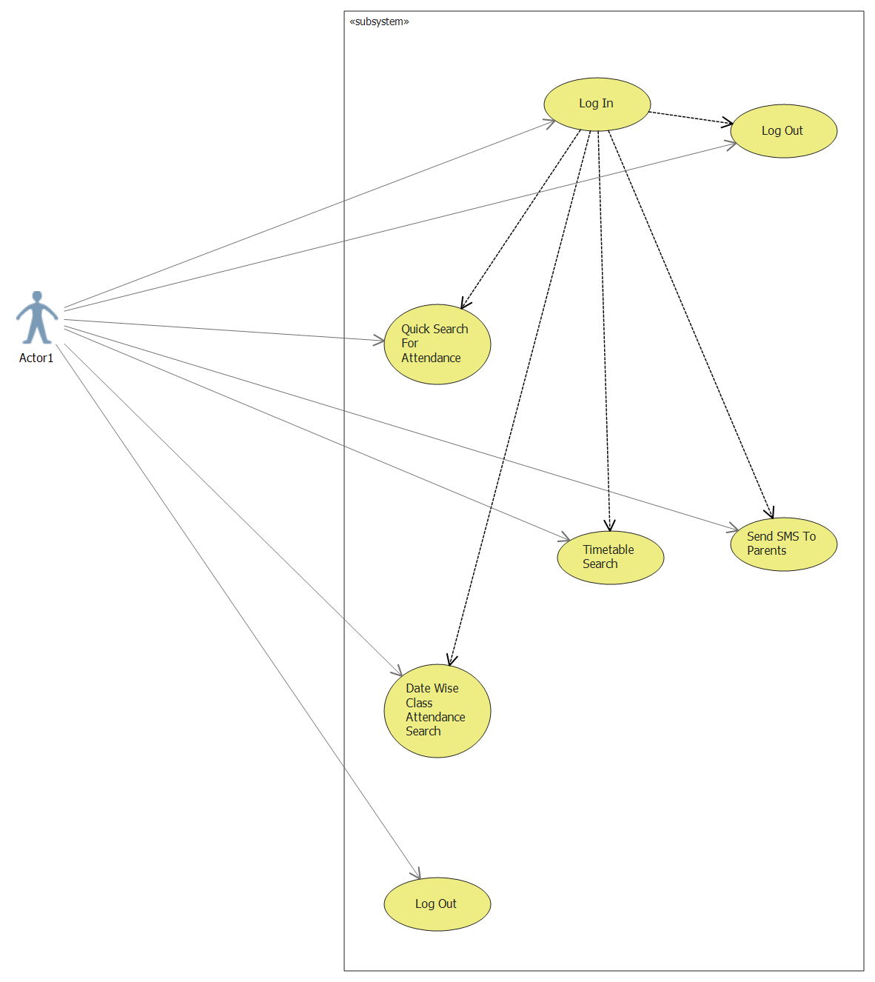
Use-Case
Diagram For
Faculty
(Indirect User)

Slide 5
Class Diagram :-

Slide 6
Activity
Diagram

Slide 7
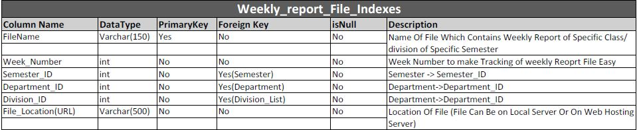
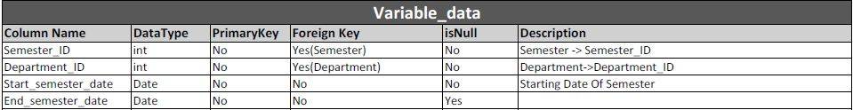
Data Dictionary

Slide 8
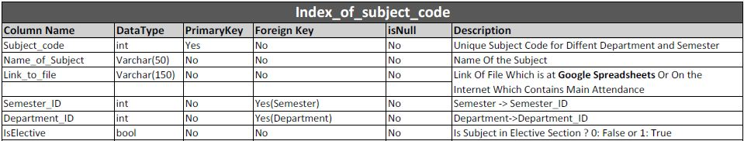
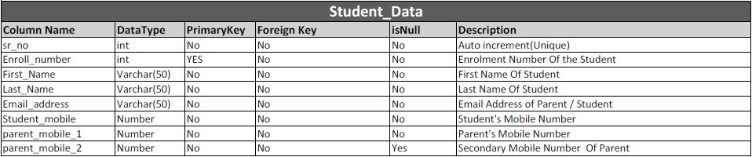
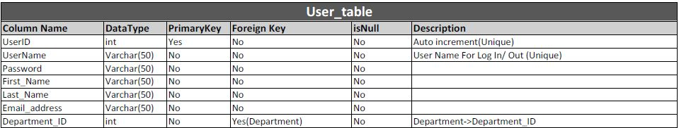

Slide 9
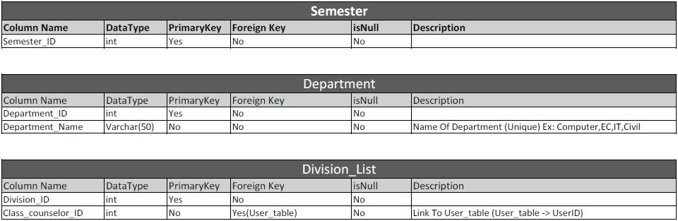
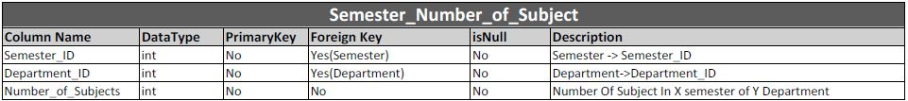

Slide 10
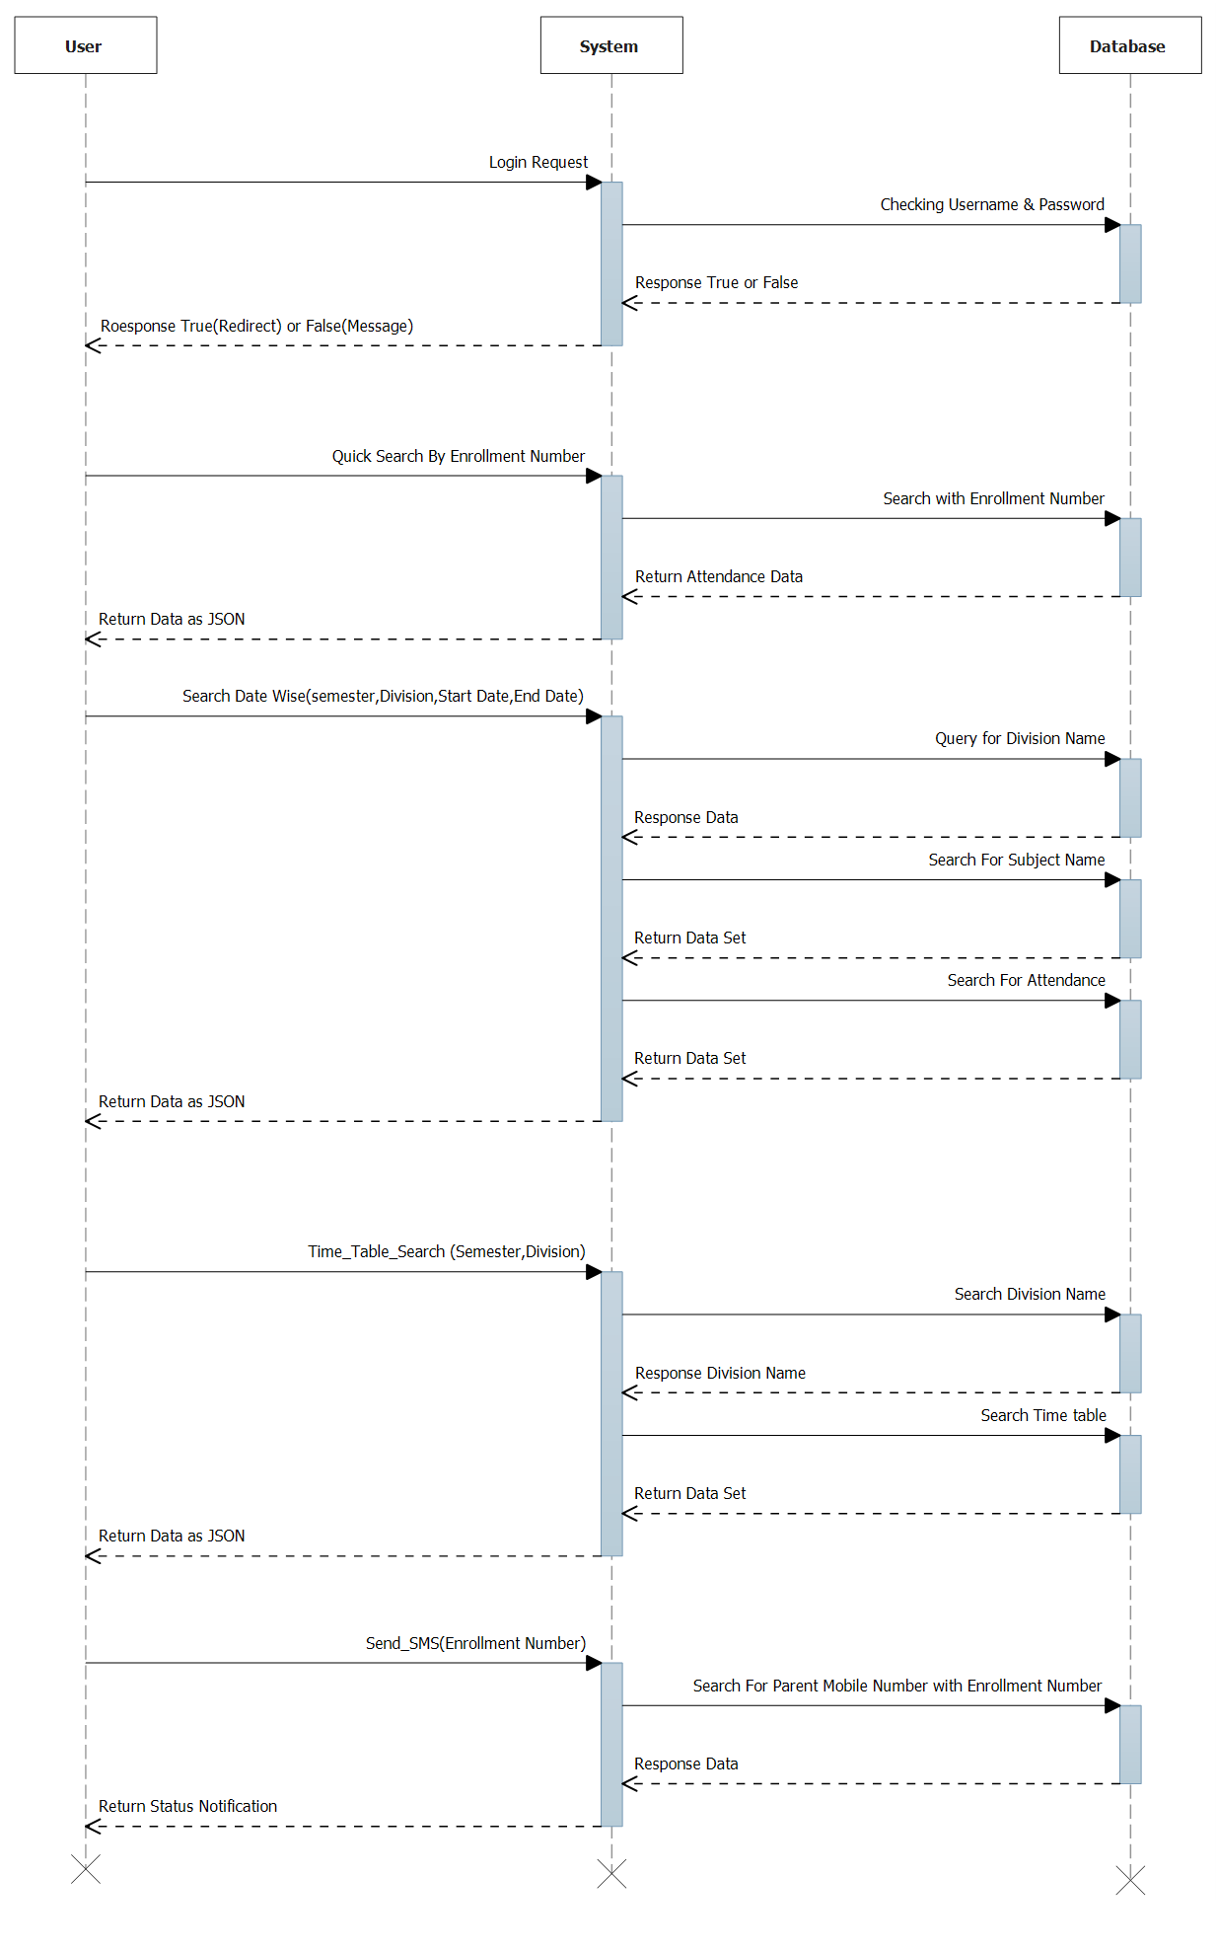
Sequence
Diagram to
User Login

Slide 11
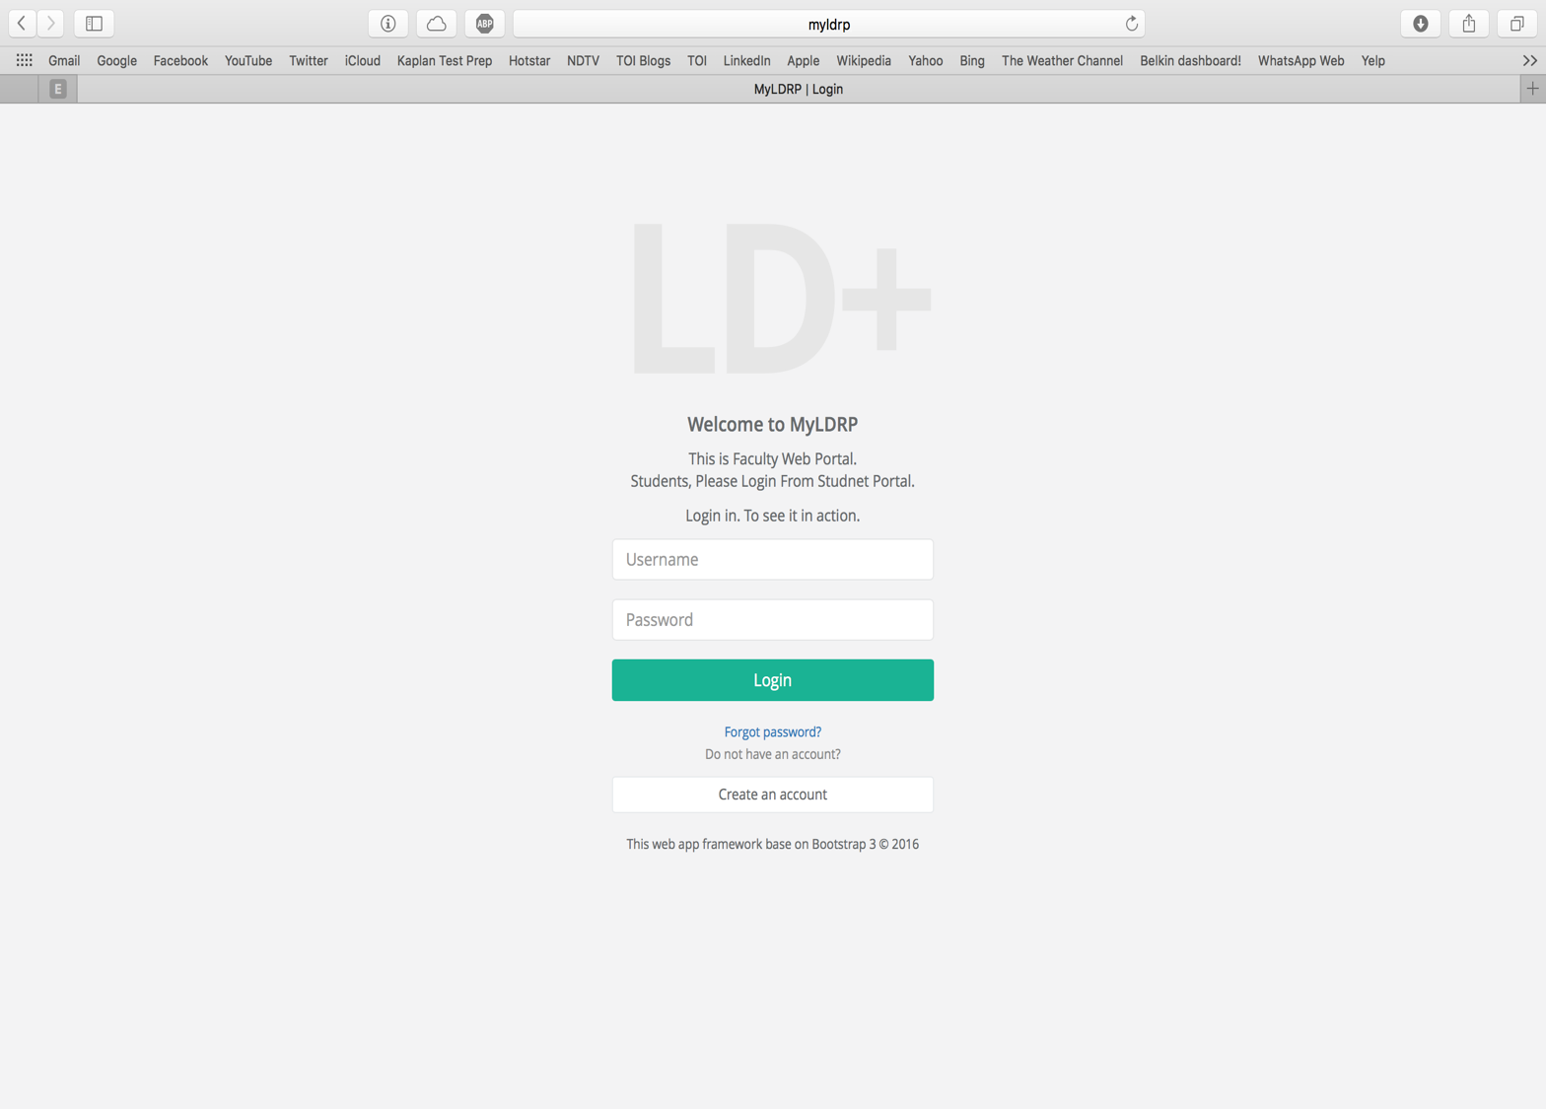

Slide 12
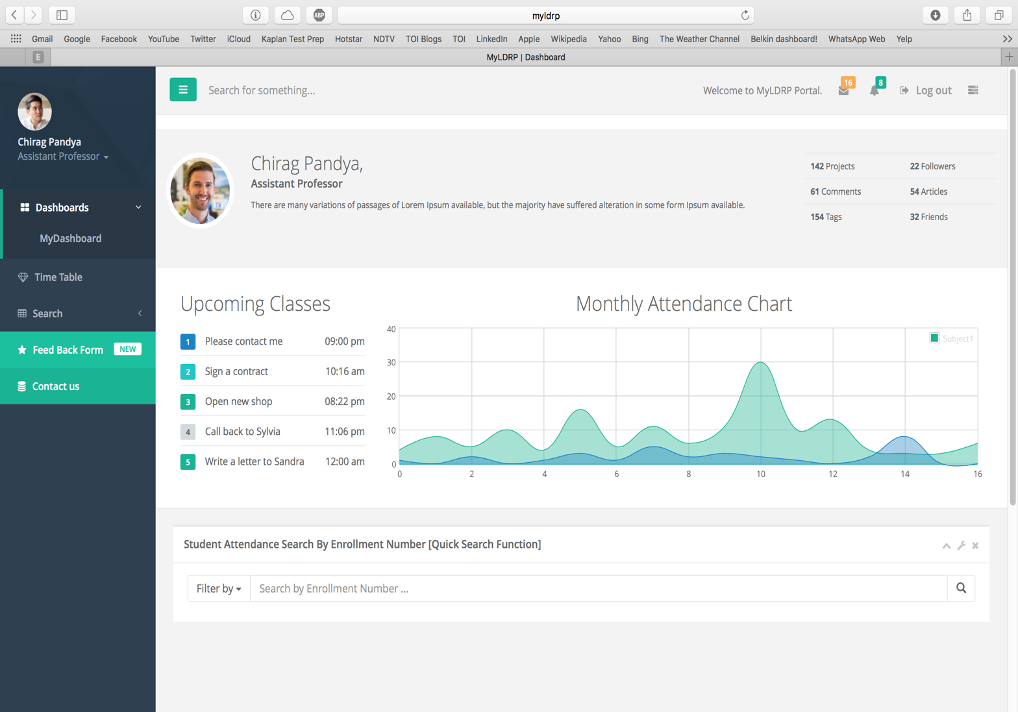

Slide 13
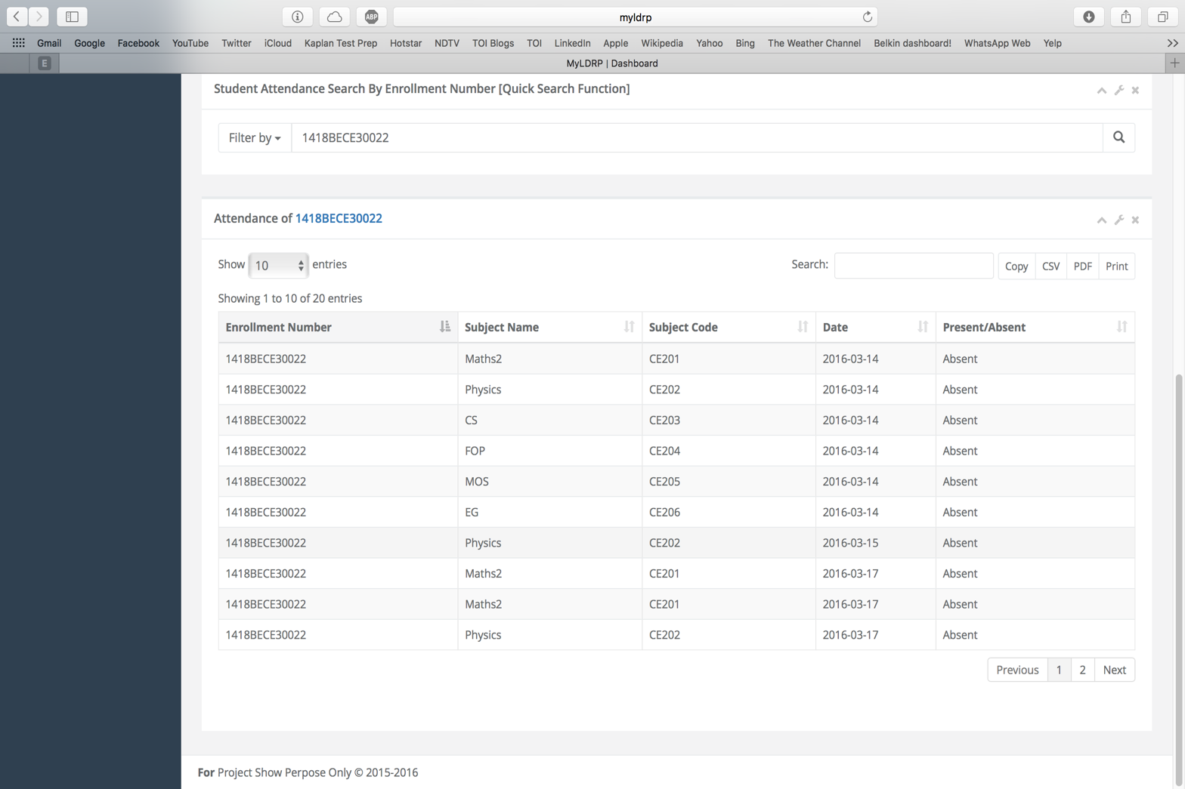

Slide 14
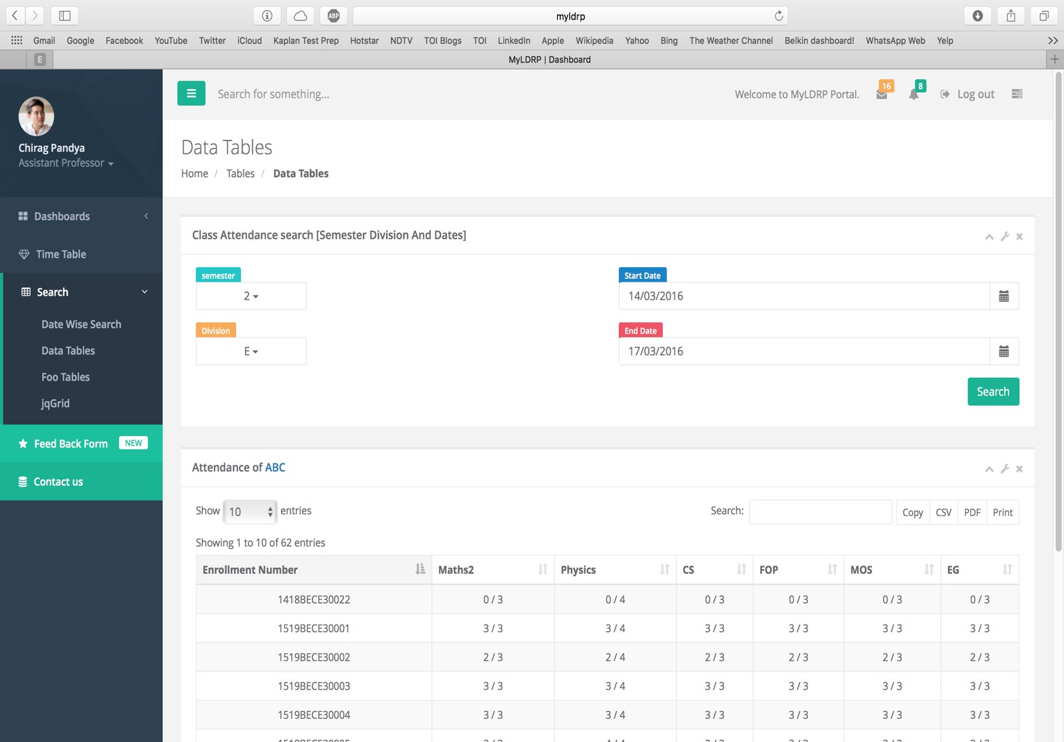

Slide 15
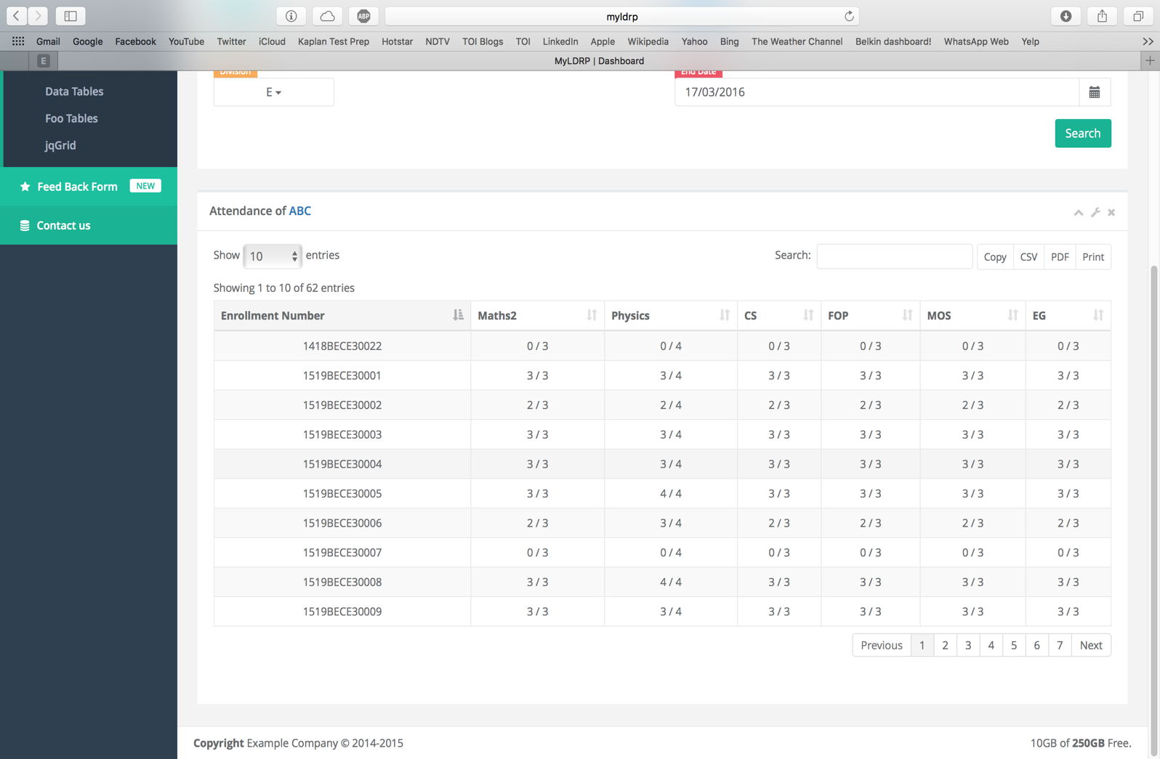

Slide 16
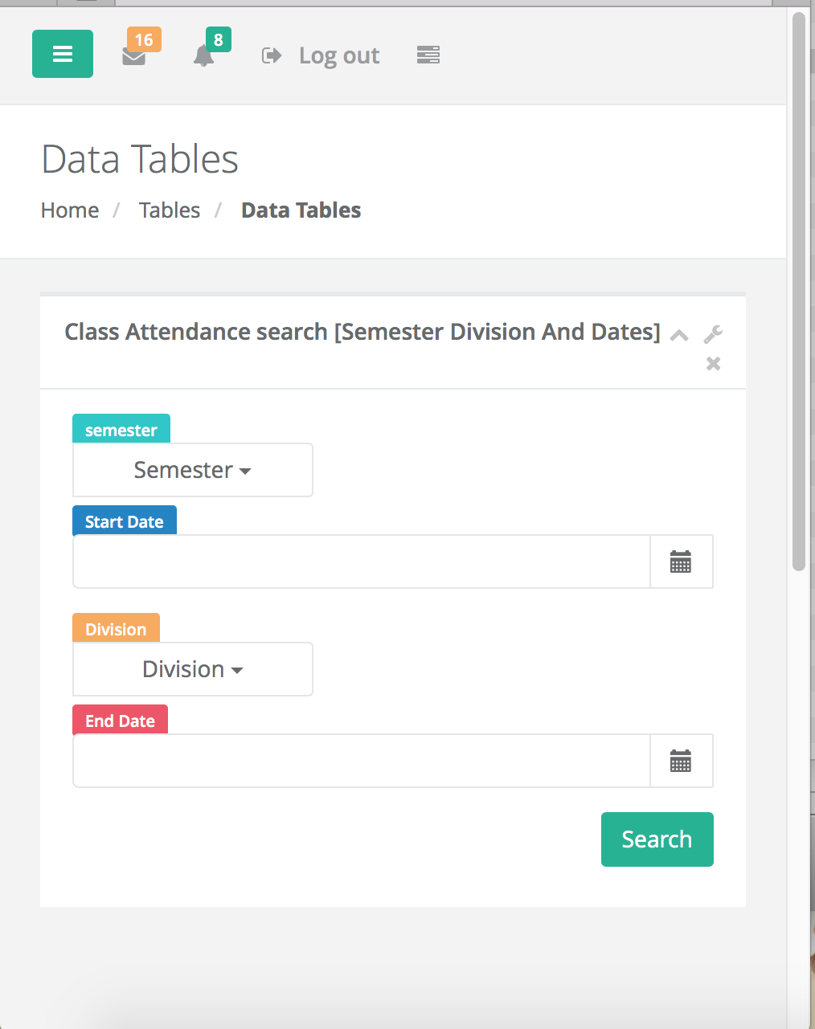

Slide 17
Thank you !

