Slide 1
ICSI 518 Software Engineering
Fall 2017

Slide 2
Instructor
Mei-Hwa Chen: mchen@albany.edu
TAs
Ming Ying: mying2@albany.edu
Vishal Mudi: vmudi@albany.edu
Labs
MW: 12:00 – 1255pm
HU025

Slide 3
Evaluation
Midterm Exam: 15%
Class participation and quizzes: 25%
Assignments (Term project): 40%
Team project: 20%

Slide 4
Cheating Policy
Every exam, quiz, and lab assignment should be done individually.
50% or more identical to others will receive 100% penalty.
More than one violation will receive an ‘E’ course grade.
The university’s policies on academic integrity http://www.albany.edu/undergraduate_bulletin/regulations.html

Slide 5
Week | Topic | Team project | Lab Assignments
Week 1: 8/28 | Software Process Modeling | Project Proposal
Week 2 : 9/5 | Agile Workshop
Week 3 : 9/12 | Agile/Software Requirements | Sprint 0 | Lab1 (3%)
Week 4 : 9/19 | Software Requirement
Week 5 : 9/26 | Software Design |  | Lab2 (4%)
Week 6 : 10/3 |  | Sprint 1
Week 7: 10/10 | Software Design |  | Lab3 (8%)
Week 8: 10/17
Week 9: 10/24 | Midterm Exam
Week 10: 10/31 |  | Sprint 2
Week 11: 11/7 | Design Patterns |  | Lab4 (10%)
Week 12: 11/14 | Design Patterns
Week 13: 11/21 |  | Sprint 3
Week 14: 11/28 | Software Testing
Week 15: 12/5 |  | Final Presentation | Lab5 (15%)

Slide 6
MEAN Stack v.s. Java Based
MEAN Stack
MongoDB, a NoSQL database
Express.js, a web application framework that runs on Node.js
Angular.js or Angular, JavaScript MVC frameworks that run in browser JavaScript engines
Node.js, an execution environment for event-driven server-side and networking applications
Java Based
JSP
Java
MySQL

Slide 7
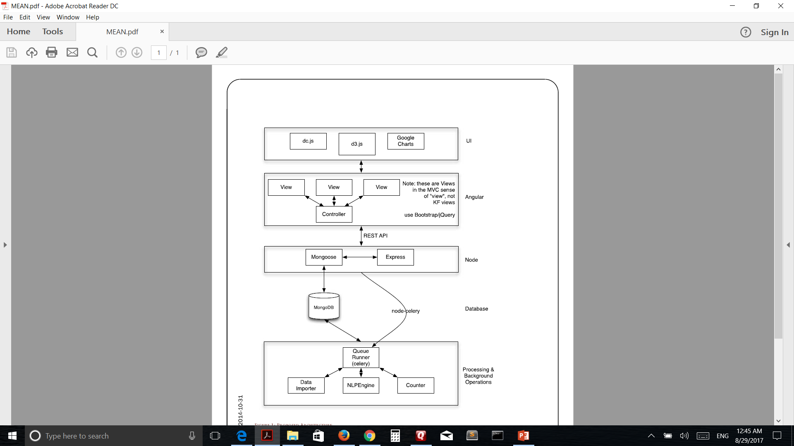

Slide 8
Team 1
Abbu,Saiteja
Annamalai,Sockalingam
Chaudhari,Abhishek
Fang,Bill
Gangrade,Nikhil
Guerrero,David
Hariharan,Lakshmi Priya

Slide 9
Team 2
Jayakumar,Harshini
Jiang,Yunwei
Khoja,Ellisa
Korat,Nilay Nileshkumar
Manishankar,Vignesh
Misal,Sanket Misal
Patel,Anand
Patel,Ketul

Slide 10
Team 3
Patel,Ravi Mukeshbhai
Patel,Vaikunth
Patel,Viral
Priya,Sonali
Ruikar,Rashmi
Shah,Rushabh
Srivastava,Mrigank Shekhar
Vithalani,Monali

Slide 11
Team 4
Bhatia,Astha
Chaudhari,Ninad
Chhabra,Sumit
Doddabadigere Prasad,Namratha
Doshi,Pranav
Doshi,Shrey
Kamath,Saurabh
Koneru,Vamsi

Slide 12
Team 5
Kshirsagar,Apoorva
Kulkarni,Rohan
Parikh,Preet
Patel,Kush
Patel,Riddhi
Raval,Tanmay
Sarkar,Rahul
Shah,Harnish

Slide 13
Team 6
Sharma,Manisha
Sheth,Karan
Shiekh Zeeshan
Singh,Divyarth
Srivastava,Lakshya
Tanna,Jay
Valgotar,Jasmin
Vats,Kalika

