Slide 1
PyUnit Framework
Ikuru K

Slide 2
index
unittest how to with python
Generic Unit test loader & Runner
Coverage.py

Slide 3
Import unittest module
No external dependencies: its packaged by default.

Slide 4
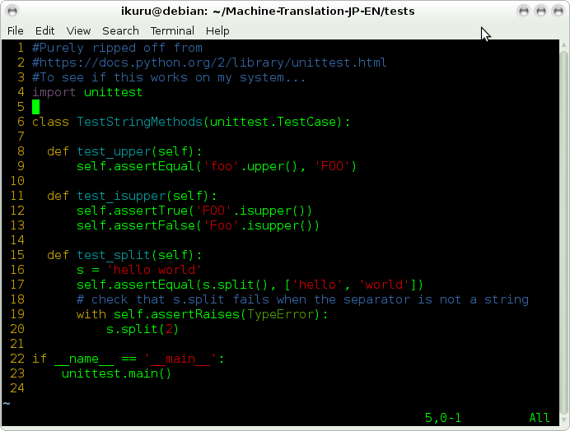
Creating a unit test

Slide 5
Points
Test case is a class that inherits from TestCase class.

Slide 6
Parameters
Need to have self as parameter all the time; same as defining any new class in python. (Is this the case?)

Slide 7
Class Name
Class name needs to start with “Test”
  Self awareness begins from a class named a test in unittest realm.

Slide 8
Method (=unit test case) name needs to start with “test”
  If not, the method will not be part of the test report.

Slide 9
Number of test methods
Can have multiple test methods.

Slide 10
File name
File containing the test can be named anything, but for making detection/loading/running easier it is a good idea to give it a consistent naming (i.e. name it as *test.py)

Slide 11
__name__?
The last if __name__ part enables the Test case class to be inferred as a test case when running it from command line
  However, does not get executed when running from a test runner which will be described later.

Slide 12
Output looks like:
usr:~/Machine-Translation-JP-EN/tests$ python random_splitter_test.py
...
----------------------------------------------------------------------
Ran 3 tests in 0.001s
OK

Slide 13
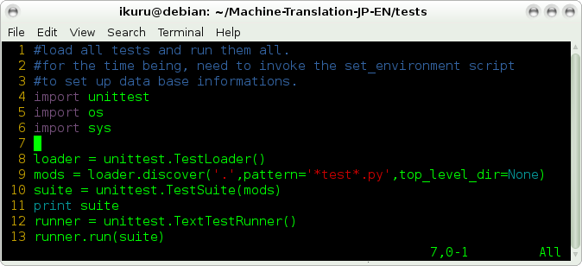
Loading and running test cases
Short answer: Place all test case files in a single directory and run this script to show an aggregated result of all rests being run:

Slide 14
Anatomy
Loader identifies unittests by file name pattern
Test runner runs all of the identified test methods and test classes to run them in bulk.
Please ignore irrelevant imports and comment; that was my own setup.

Slide 15
Bonus: coverage package
Use coverage package to get a concise report (text and html) of how well your code is tested.
Very easy to use
Can handle C1 coverage
pip install coverage

Slide 16
Thank you!

