Slide 1
Setting up my Japanese environment in Debian Jessie/w Mate
Ikuru K

Slide 2
Prerequisites
Installed debian 8 jessie
Set up as US/English
Mate desktop environment selected

Slide 3
Japanese input
Mozc is Japanese input software maintained by Google. However, not listed in default package so needs to explicitly be stated.
  echo "deb http://backports.debian.org/debian-backports squeeze-backports main" >> /etc/apt/sources.list
  apt-get install mozc-utils-gui
  apt-get install mozc-server
  apt-get install ibus-mozc
  apt-get install uim-mozc

Slide 4
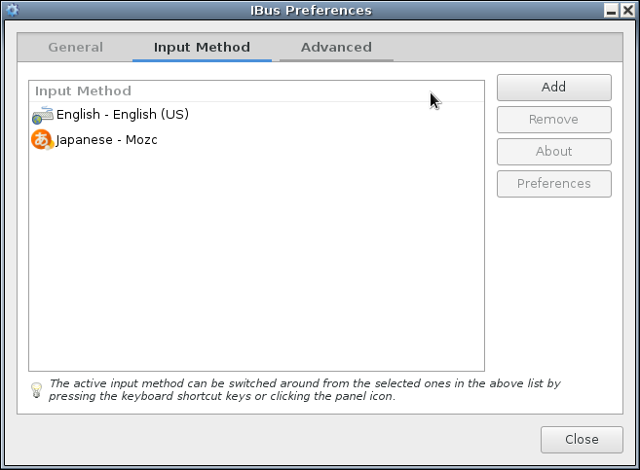
ibus configuration
Add mozc to input mehtods
System->Ibus Preference->Input Methods
Result should look like below.
Test in arbitrary editor

Slide 5
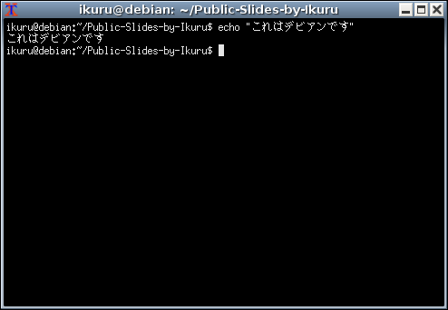
Uxterm just works fine

Slide 6
Thank you!

