Slide 1
Some cool vim tricks
Ikuru K

Slide 2
References
Web
Rtfm – read the fine manual

Slide 3
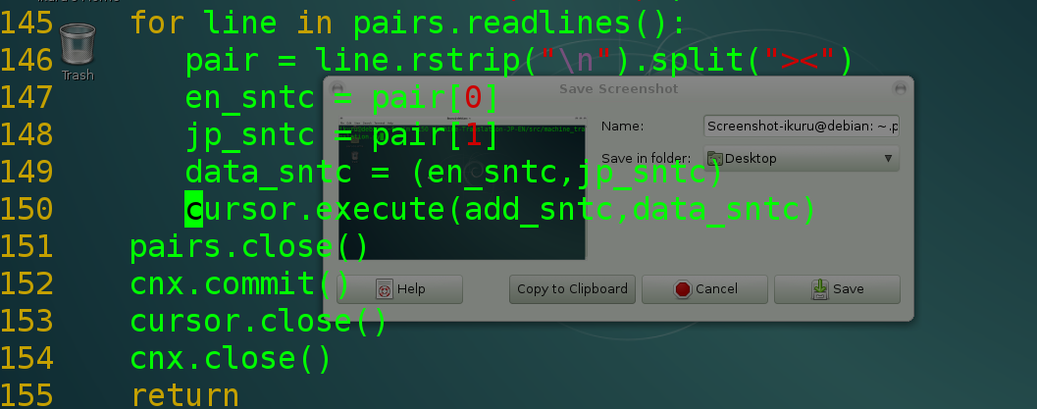
vim +<line #> <filename>
Invoke this from the command line to open a file at the provided line number.

Slide 4
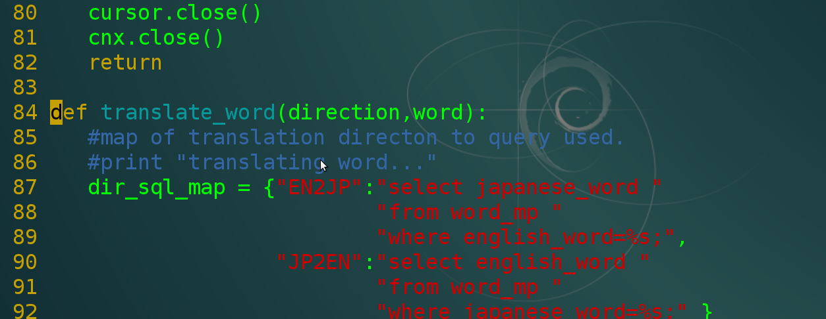
Vim +/<pattern> <file name>
Open a file at the first occurrence of the provided pattern.

Slide 5
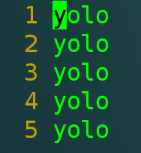
Multi line insert - 1
Starting with a file with multiple rows like this

Slide 6
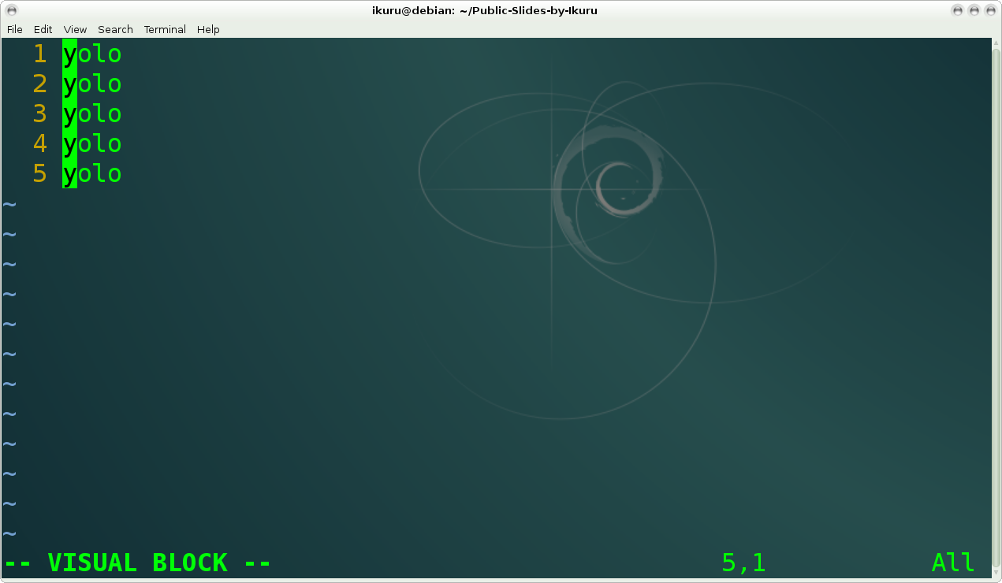
Multi line insert - 2
Highlight selections with visual block mode (Ctrl + v)

Slide 7
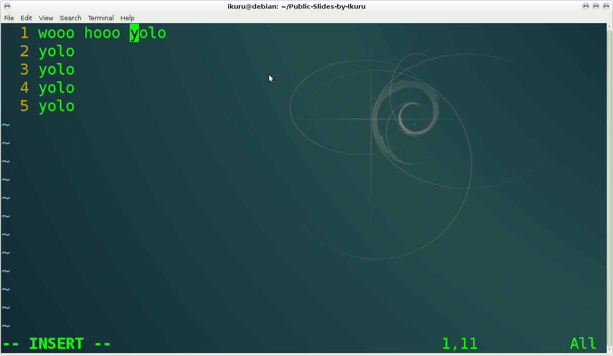
Multiple line insert - 3
Once desired lines are selected, (Shift + i ) to insert desired characters. Note that 'i' alone will not do.

Slide 8
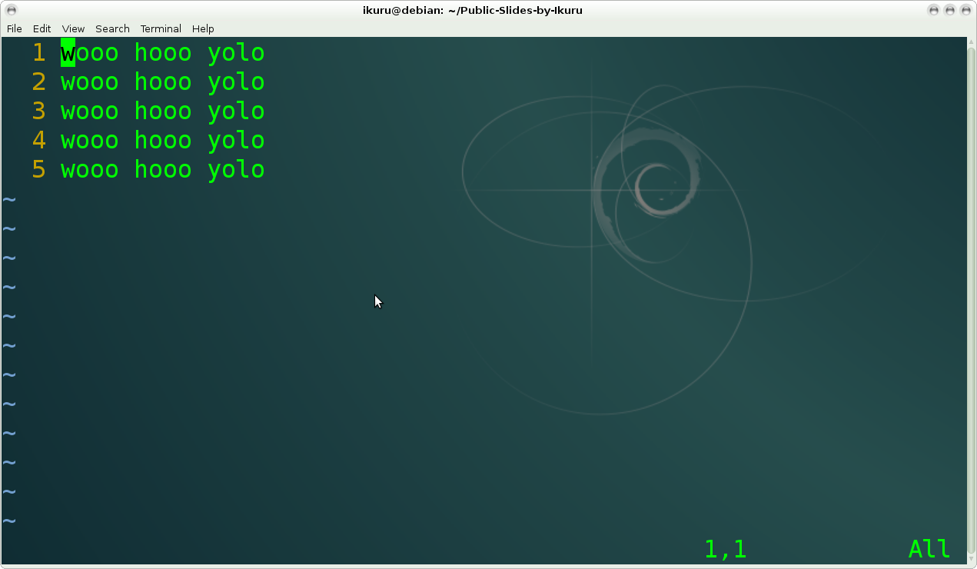
Multiple line edit - 4
Hit Esc, and typed characters will be inserted across multiple rows.

Slide 9
Nice things to have in .vimrc
:set nu
  Shows line numbers to the left.
syntax on
  Will highlight lexical elements intelligently, if vim can make sense of the language.

Slide 10
Thank you

